Slide 1
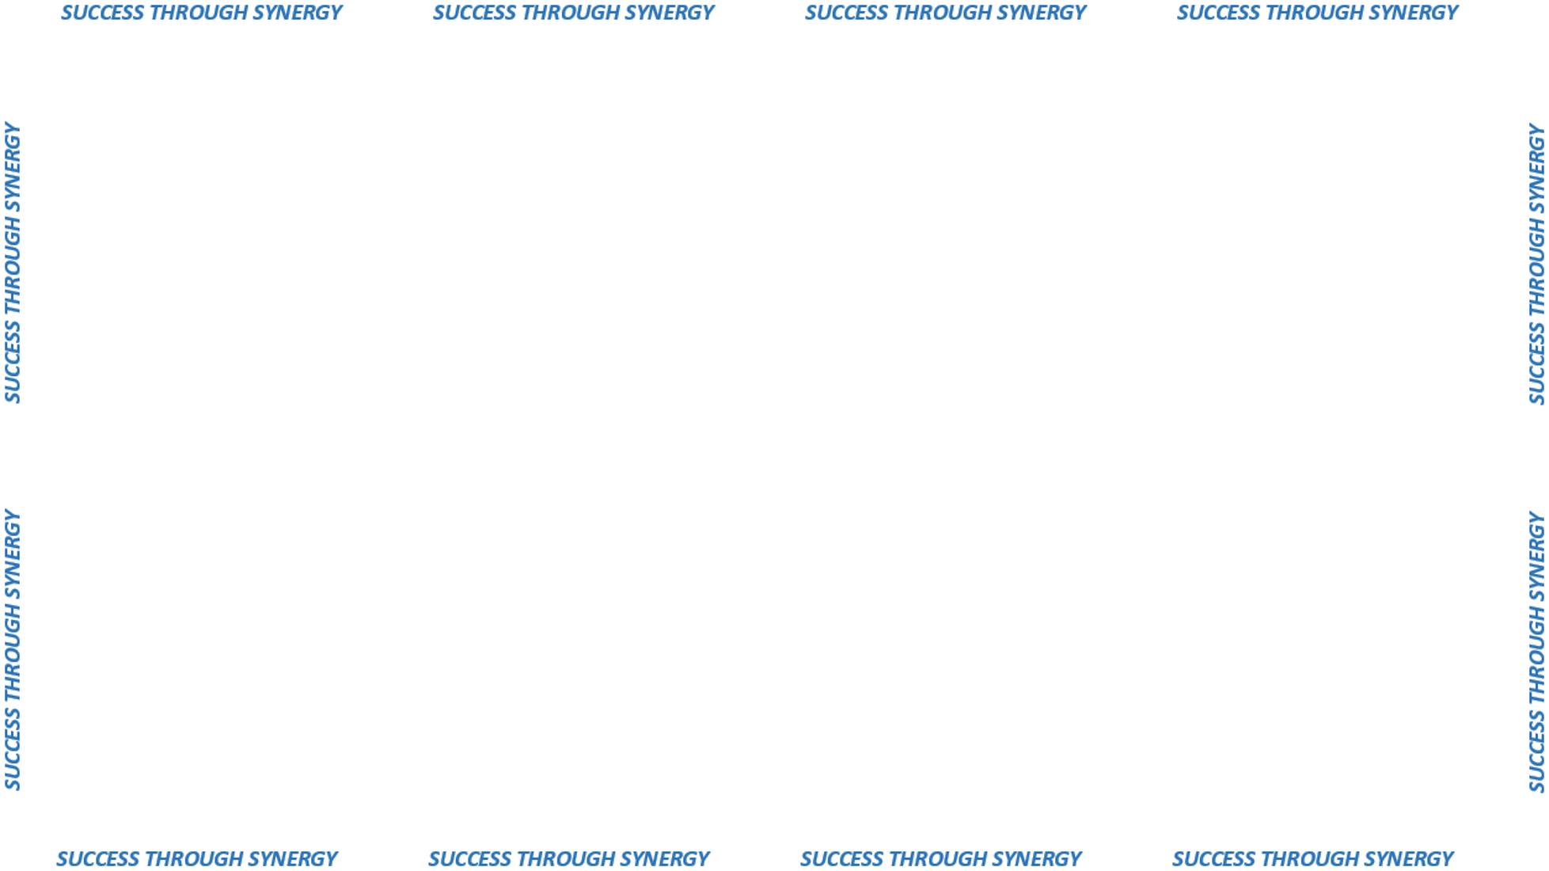
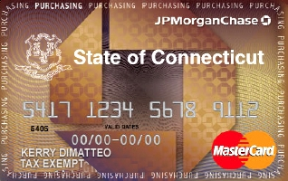
SYNERGIZING WITH CORE-CT
P-CARD PROGRAM

Slide 2
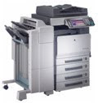

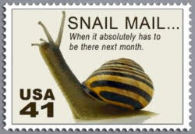
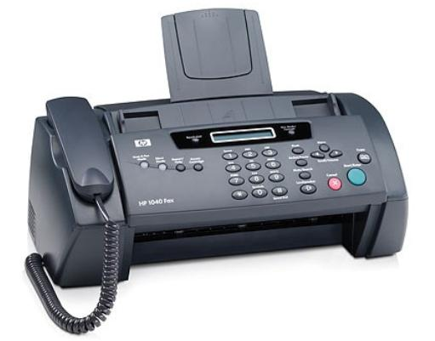

Paper Application Process

Slide 3


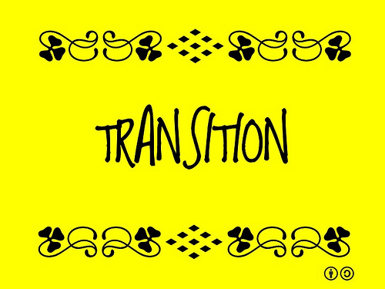

Electronic Transition

Slide 4
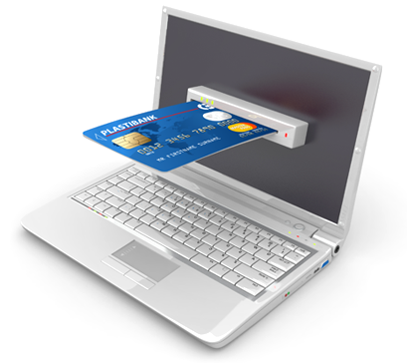


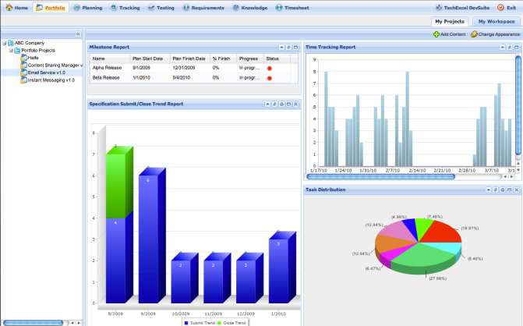
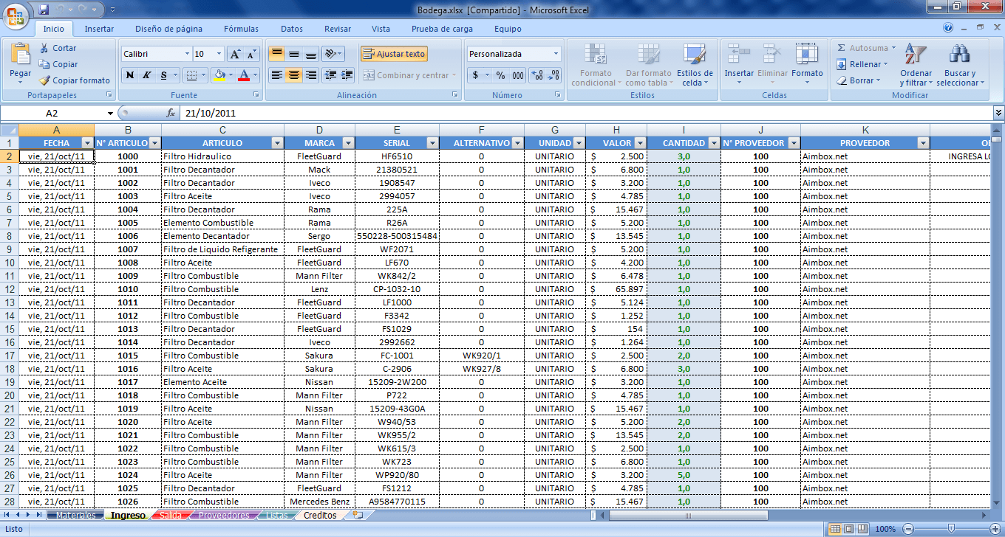
Capturing Transaction Information
Capturing DATA
Reconciling Purchase Transactions in CORE-CT
Consolidation of Reports in CORE-CT

Slide 5
What’s New in P-Card Technology
S.U.A – Single Use Accounts
Phone Apps
Completely paperless process
(purchase to pay)

