Slide 1

Considerations when purchasing Microsoft Cloud Services
Mark Raymond - DAS BEST, Chief Information Officer
Aimee Cunningham - DAS Procurement Contract Specialist

Slide 2





Now that we’ve got Cloud, what are we gonna do….with it??

Slide 3
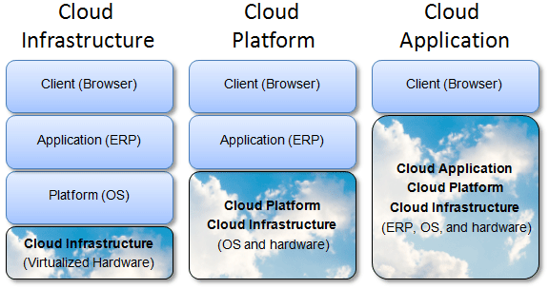
Refresher:
The Cloud can be many things-
Public/Community/Private/Hybrid
IAAS/PAAS/SAAS
Storage/Security/Monitoring/NAAS
Instant Gratification (no infrastructure work, broad usability

Slide 4
Yes, we have a new agreement in place.
Yes, the floodgates require a password
**All purchases for Microsoft online/cloud services require pre-approval**
You must be able to clearly articulate the following:
A complete description of desired products inclusive of quantity/options/components
How the cloud option incorporates your Agency’s fundamental business plan
An Agency supported Project Management Plan (from Req. Definition through Go-Live)
Category of intended data
Data recovery plan/method
Plan to address integration challenges that potentially impact existing systems
If a Legacy system is suitable in the cloud/estimated percentage of re-architecture
*please refer to the DAS/BEST Microsoft online/cloud services guidelines

Slide 5
Cost Considerations
Maintaining the current EA without Software Assurance may be a better financial option until on-line/cloud plans are comprehensive and resolute
Cost may not scale down on lower usage; payment in arrears can mean uncertain future expenditures
Be wary of upfront License fees; should not pay for a license at implementation phase
Hidden costs may be found outside scope; analytical work to filter superfluous data and then higher costs to store the data

