Slide 1


NASPO VALUEPOINT
COOPERATIVE
15PSX0133
Telephone
Translation
SAVINGS
$243,000
Interpretation
Services

Slide 2
NASPO VALUEPOINT
COOPERATIVE
Information Technology
Vendor Managed Services
(VMS)
LEAD
STATE
Contract #14PSX0338
Consolidated Billing
Best Candidates
Optional interviews
SAVINGS
$2,532,000

Slide 3

NASPO VALUEPOINT
COOPERATIVE
Tires, Tubes & Tire Related Services
Contract #12PSX0109
Contract directly with manufacturers
Pricing is lower than what
distributors can buy tires for
SAVINGS
$4,500,000

Slide 4


NASPO VALUEPOINT
COOPERATIVE
KPMG
Benchmark
survey
Aftermarket Auto Parts
Additional 30% discount over
prior contract
(20% to 50%)
Contract #16psx0030
Additional
2% Rebate
Program
Min 5 deliveries/day
Inventory reduction
YEESSSS!
SAVINGS = $3 MILLION

Slide 5

NASPO VALUEPOINT
COOPERATIVE
Vehicle Lifts & Associated Garage Equipment
Contract #17PSX0074
SAVINGS
Additional 10% discount over prior contract

Slide 6


NASPO VALUEPOINT
COOPERATIVE
ELECTRONIC MONITORING OF OFFENDER SERVICES
Contract #12PSX0139
SAVINGS
$40,000

Slide 7
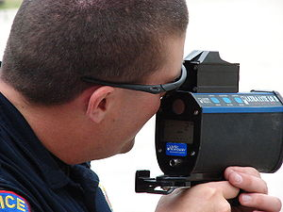

NASPO VALUEPOINT
COOPERATIVE
Police Radar, Lidar,
Parts & Equipment
Contract # 15PSX0161
SAVINGS
$10,000

Slide 8
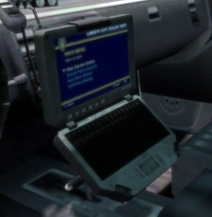
NASPO VALUEPOINT
COOPERATIVE
Mobile video recorder
And
toughbooks
Contract # 15PSX0221
Savings = $10,000

Slide 9






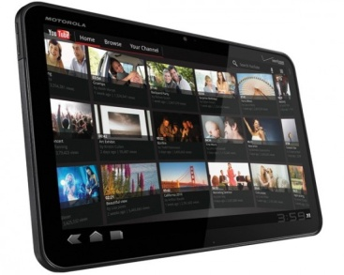

NASPO VALUEPOINT
COOPERATIVE
Contract #13PSX0280
Laptops
Desktop computers
Workstations
Savings = $1,200,000
Related
Services
Servers
Tablets
Monitors

Slide 10

NASPO VALUEPOINT
COOPERATIVE
Commercial
Contract # 15PSX0247
Contract # 17PSX0129
Off
Consolidation of multiple
separate contracts
The
Software licenses
Maintenance & Support
Related Services
Shelf
SOFTWARE
SAVINGS = $500,000

Slide 11

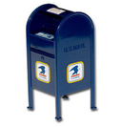

NASPO VALUEPOINT
COOPERATIVE
Contract #11PSX0037
POSTAGE & MAIL ROOM
EQUIPMENT, SERVICE & SUPPORT
SAVINGS = $37,000

Slide 12


NASPO VALUEPOINT
COOPERATIVE
SAVINGS
$37,000
CONTRACT #15PSX0246
DATA BREACH
CREDIT MONITORING

Slide 13



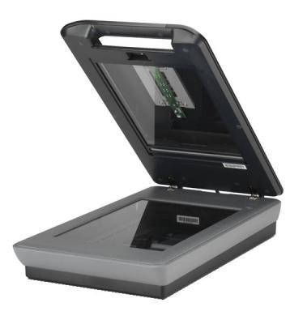
NASPO VALUEPOINT
COOPERATIVE
COPIERS, PRINTERS
& RELATED DEVICES
CONTRACT #14PSX0125
SAVINGS
$37,000

Slide 14


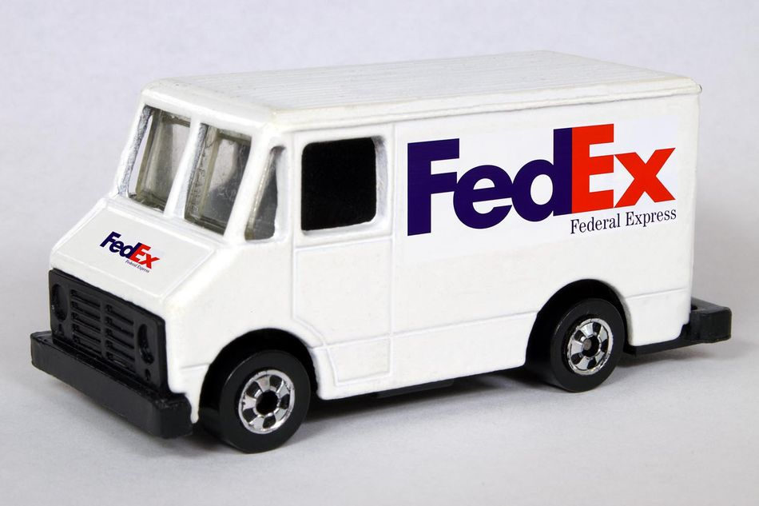
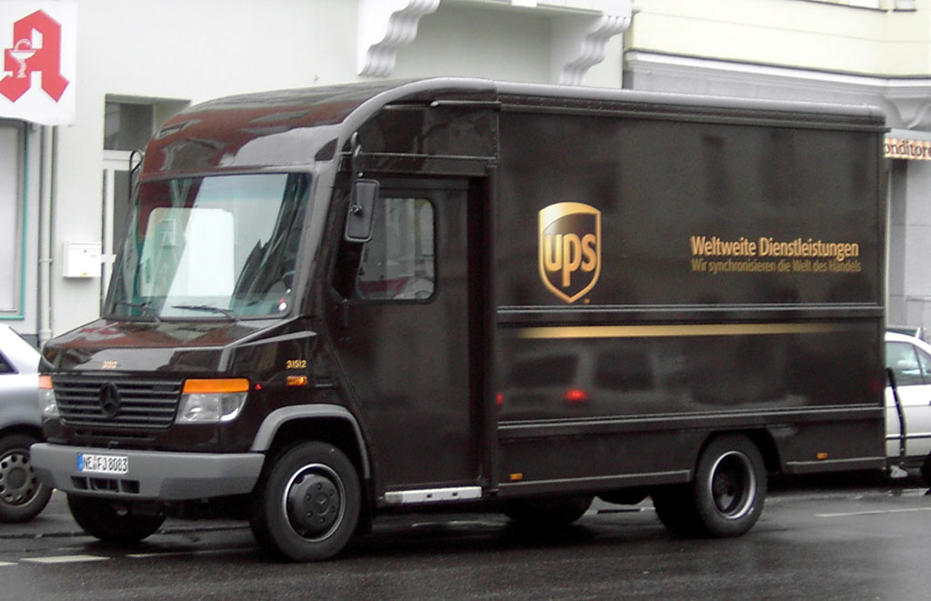
NASPO VALUEPOINT
COOPERATIVE
SMALL PACKAGE DELIVERY SERVICE
Contract # 16PSX0106
SAVINGS = $200,000

Slide 15

NASPO VALUEPOINT
Cooperative
Wireless Equipment & Services
12PSX0409
Verizon Wireless
13PSX0339
AT&T Mobility
15PSX0339
T-Mobil Wireless
Can you hear me now?
SAVINGS
$10,000

Slide 16

NASPO VALUEPOINT
COOPERATIVE
Data Communication Products & Services
Contract #14PSX0266
SAVINGS
$225,000

Slide 17




NASPO VALUEPOINT
COOPERATIVE
MAINTENANCE, REPAIR & OPERATIONS
“MRO”
Contract #10PSX0204
TOTAL SAVINGS $1.5 MILLION
Negotiated
Additional 2%
Rebate Program

