Slide 1
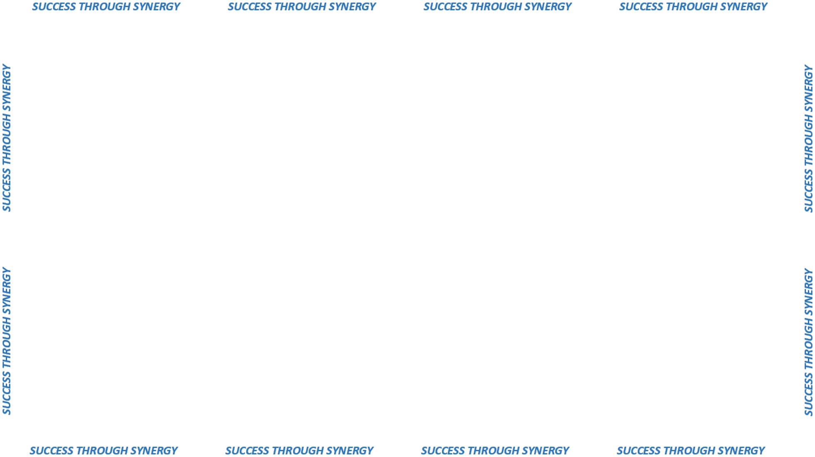

PROCUREMENT AUTHORITY
&
PURCHASING REGULATIONS

Slide 2
Establishes the powers, duties and
responsibilities of the designated
procurement staff by defining how
goods and services must be solicited,
evaluated and awarded.
Require that we contract for goods and
services in a fair and competitive manner,
providing an equal opportunity to all
vendors who can meet the state’s need.
C.G.S 4A-57
Creates a system of checks, balances and transparency to assure that procurement
professionals meet the requirements for competition and ethical conduct
by all parties involved.

Slide 3
PROCUREMENT AUTHORITY
DAS Procurement Services is charged with the purchase, lease or contract
for all supplies, materials, equipment and contractual services
required by any state agency
Currently about 1000 active contracts
Average contract term is 3 – 5 years
Estimated contract value of $2.4 billion
24/7
INTERACTIVE WEBSITE:
http://portal.ct.gov/en/DAS/Services/For-Agencies-and-Municipalities
WEALTH OF POLICY, PROCEDURAL AND GENERAL PROCUREMENT
INFORMATION FOR YOUR STAFF
SOLICITATION AND CONTRACT INFORMATION

Slide 4
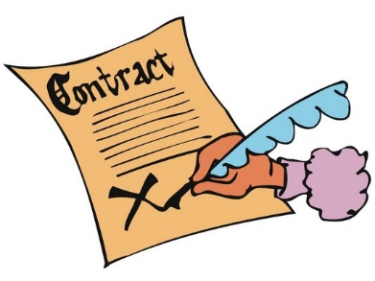
DAS CONTRACT ADMINISTRATION
SOLICITATION PROCESSES

Slide 5

Specification driven
Advertised
Sealed bid & public opening
No ability to negotiate
Awarded to lowest, qualified,
responsible bidder

Slide 6

Request For Proposal
a.k.a. Competitive Negotiation

Slide 7

Evaluation Team & Consensus Scoring
Problem Statement
Permits other criteria for award besides lowest price
Seeking best overall solution
Negotiation Permitted
Advertised, sealed response
No public opening

Slide 8

How do agencies use State Contracts
and make purchases?

Slide 9

Find the Contract on the State Contracting Portal
Read the Contract!
Contact the Contracting Staff listed on the Contract with any questions
Order in accordance with Contract

Slide 10
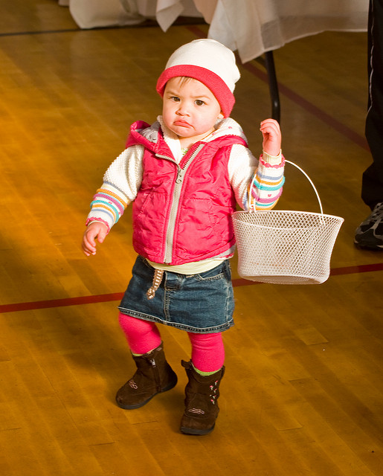
How do I make a purchase when there is no State Contract?

Slide 11

LET’S TALK
GENERAL LETTER 71
“GL-71”

