Slide 1
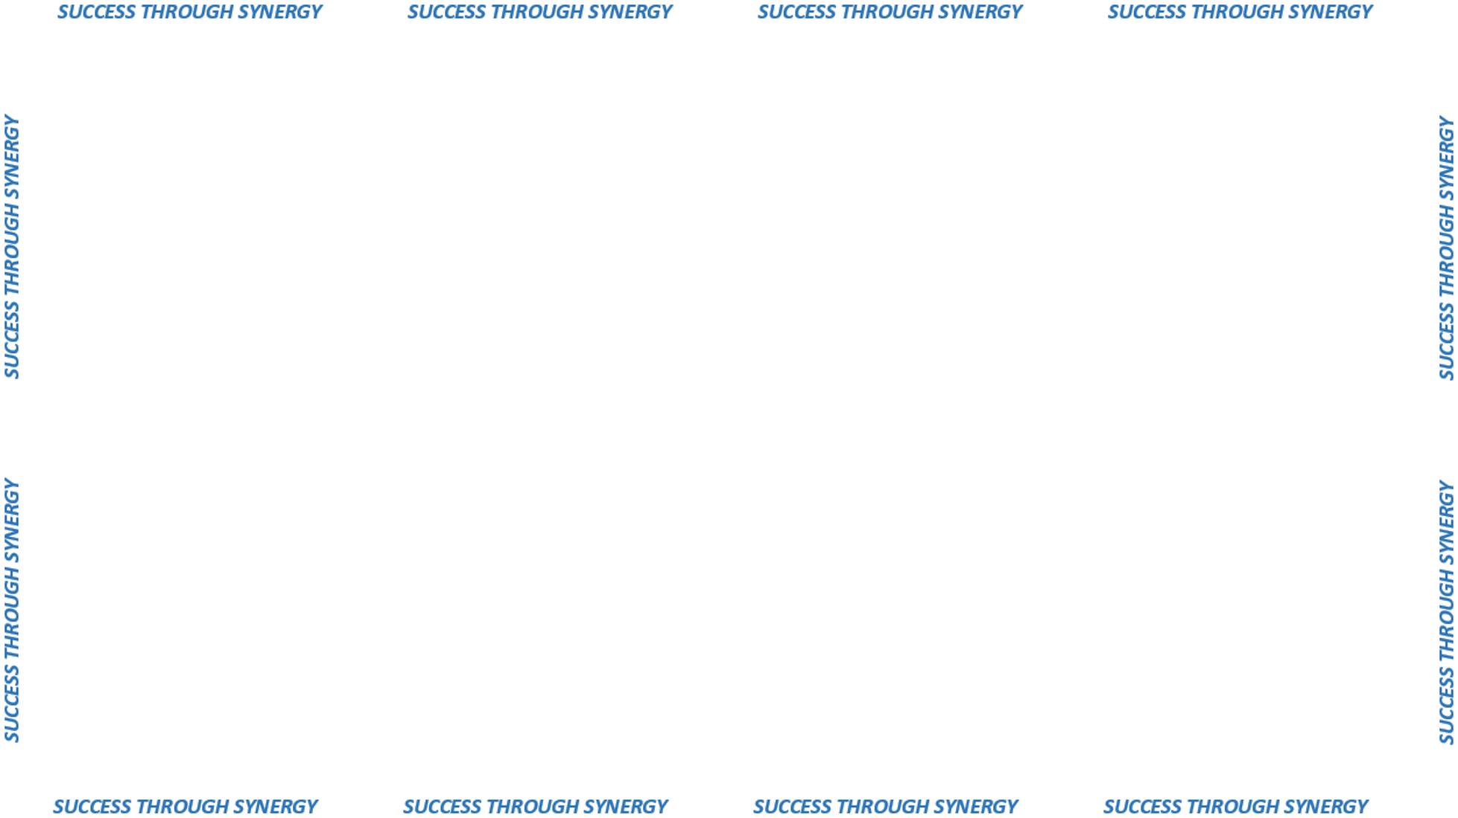

USE OF FEDERAL GSA CONTRACTS
“Government Services Administration”

Slide 2
Agencies MAY be able to utilize GSA Contracts
ONLY
when NO DAS contract exists for the goods/services being requested.
Need approval from the DAS Director of Procurement
Purchasing authority falls under 4a-66b

Slide 3
NO deviations allowed on terms, conditions, specifications,
product and/or service as offered on the GSA contract.
GSA pricing is negotiable
Schedules 70 (Information Technology “Consolidated Schedule”)
and 84 (“Law Enforcement & Security) are extended to all states
and local governments
Information on the GSA Cooperative Purchasing Program
www.gsa.gov/portal/GetMediaData?mediaID=181943

