Slide 1
“GL-71”
What if I misuse it?
Who can use it?
When do I use it?
What is it?
How do I use it?

Slide 2
General Letter 71
What is it?
Direct purchasing authority
granted to agencies
by the Director
of DAS Procurement
May be amended
from time to time
Granted in Title
4a Chapter 58
Subject to limitations

Slide 3
Who can use it?
When do I use it?
DAS CONTRACT DOES NOT EXIST
Minor non-recurring purchases
Cost is less than $50,000
IT/Telecom must have technical
review/approval by DAS/Bureau
of Enterprise Systems and Technology
(BEST) prior to DAS Procurement acting
Staff holding
Fiscal/Administrative
series job classifications

Slide 4
How do I use it?
Agency need
DAS State Contract?
Agency must purchase against DAS State Contract
Over
$50,000?
Requisition to DAS for public solicitation/contract
No State Contract
REVIEW GL-71

Slide 5
GL-71a
Direct purchases (open market purchases)
under $2,500
May be made without obtaining quotes or bids
No annual limits or restrictions
GL-71b
Over $2,500 but less than $10,000 (annually)
3 written quotes or bids (when possible)
Responsible and qualified sources of supply

Slide 6
GL-71c
Over $10,000 but less than $50,000 (annually)
3 written quotes or bids (when possible)
Responsible and qualified sources of supply
Agencies must publish their request for quote or bid
on the State Contracting Portal per CGS 4e-13
“Non-competitive purchases”
May be made without obtaining quotes or bids
Specific items only (refer to GL-71)
No annual limits or restrictions
GL-71d

Slide 7
GL-71e
Emergency repairs and Emergency services
Where the normal operation of an agency
(or portions thereof); the health or safety of any
person; or the preservation of property would be
seriously impaired, threatened, or jeopardized if
immediate action were not taken to correct the
situation
Up to $50,000
Excludes “real property”

Slide 8
GL-71f
Between or among state agencies
Do not require quotes or bids
Not subject to annual limits or restrictions
Other government entities
Do not require quotes or bids
No annual limits or restrictions
Requires written approval from DAS
GL-71g
GL-71h
Equipment and Appliances
Meet or exceed the Federal Energy Star
standards consistent with CGS 4a-67c

Slide 9
Checks
Balances
GL-71 AUDITS
Process in place for GL-71 quarterly audits by DAS staff
Ensures agencies use DAS Contracts
and their GL-71 purchasing authority appropriately
Identifies repetitive purchases and potential contract opportunities

Slide 10
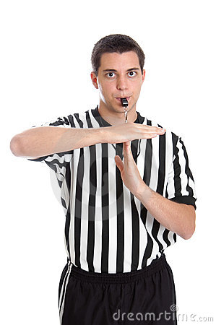
What if I misuse it?
Questions/justifications addressed with agency Commissioner/CFO
DAS may rescind the agency’s authority to purchase
under GL-71 until such time as DAS is satisfied that the
failure is not likely to recur.

Slide 11
REMEMBER….
YOU JUST CAN’T GO OUT AND BUY SOMETHING!

