Slide 1
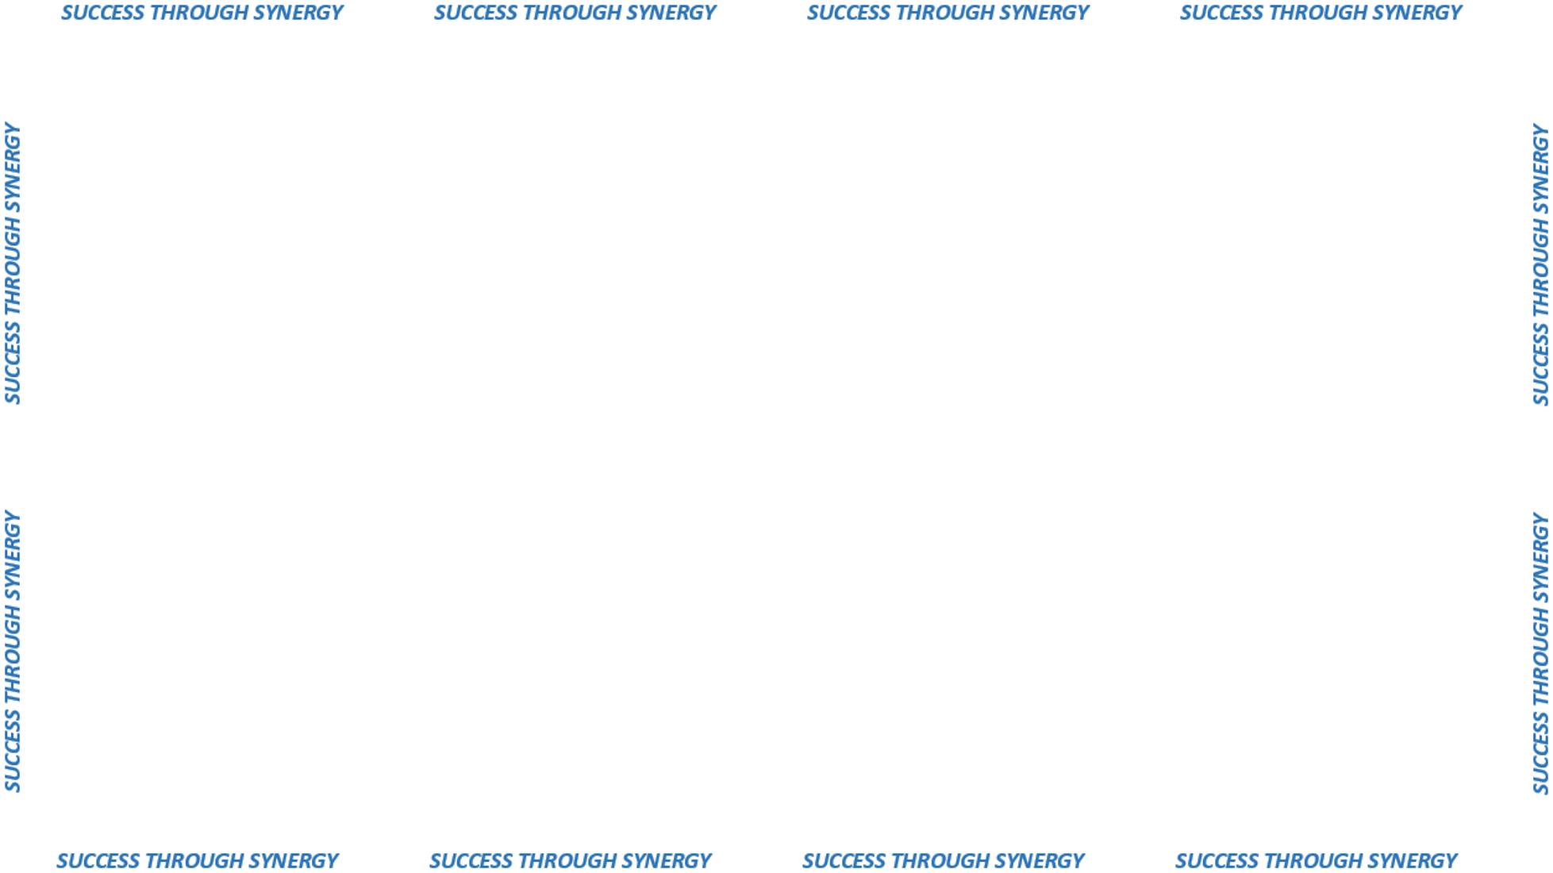
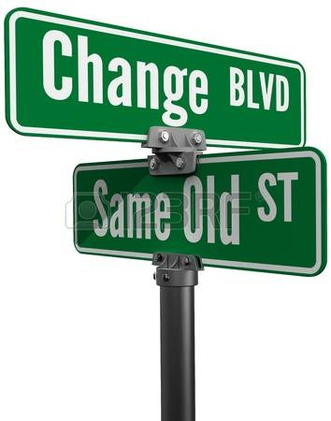
Wage Increase Affidavit
In the Past
Contractors sent a generic letter requesting an wage increase.
Contractors provided vague information.
Agencies would review the information and approve the increase.
Contract Specialist would issue a supplement.
There was not a way to verify the details.

Slide 2
Wage Increase Affidavit
1. The wage earning: This section collects each employees' name, current earnings, how many hours a month they work and shows the mathematics for each employee.
2. The benefit increases: This section lists each employees name, the benefit detail by category and shows the mathematics for each employee.
Totals from sections 1 and 2; the old monthly cost and the new monthly cost.
Notary section; the Contractor signs and swears the information provided in the wage increase request is correct.

Slide 3

Wage Increase Affidavit
Cost Avoidance = SAVINGS!!
Some employees were making over the wage rates.
Contractors were including wage increases for union workers onto the State. (Union rates exceeded the standard wage increase.)

