Slide 1
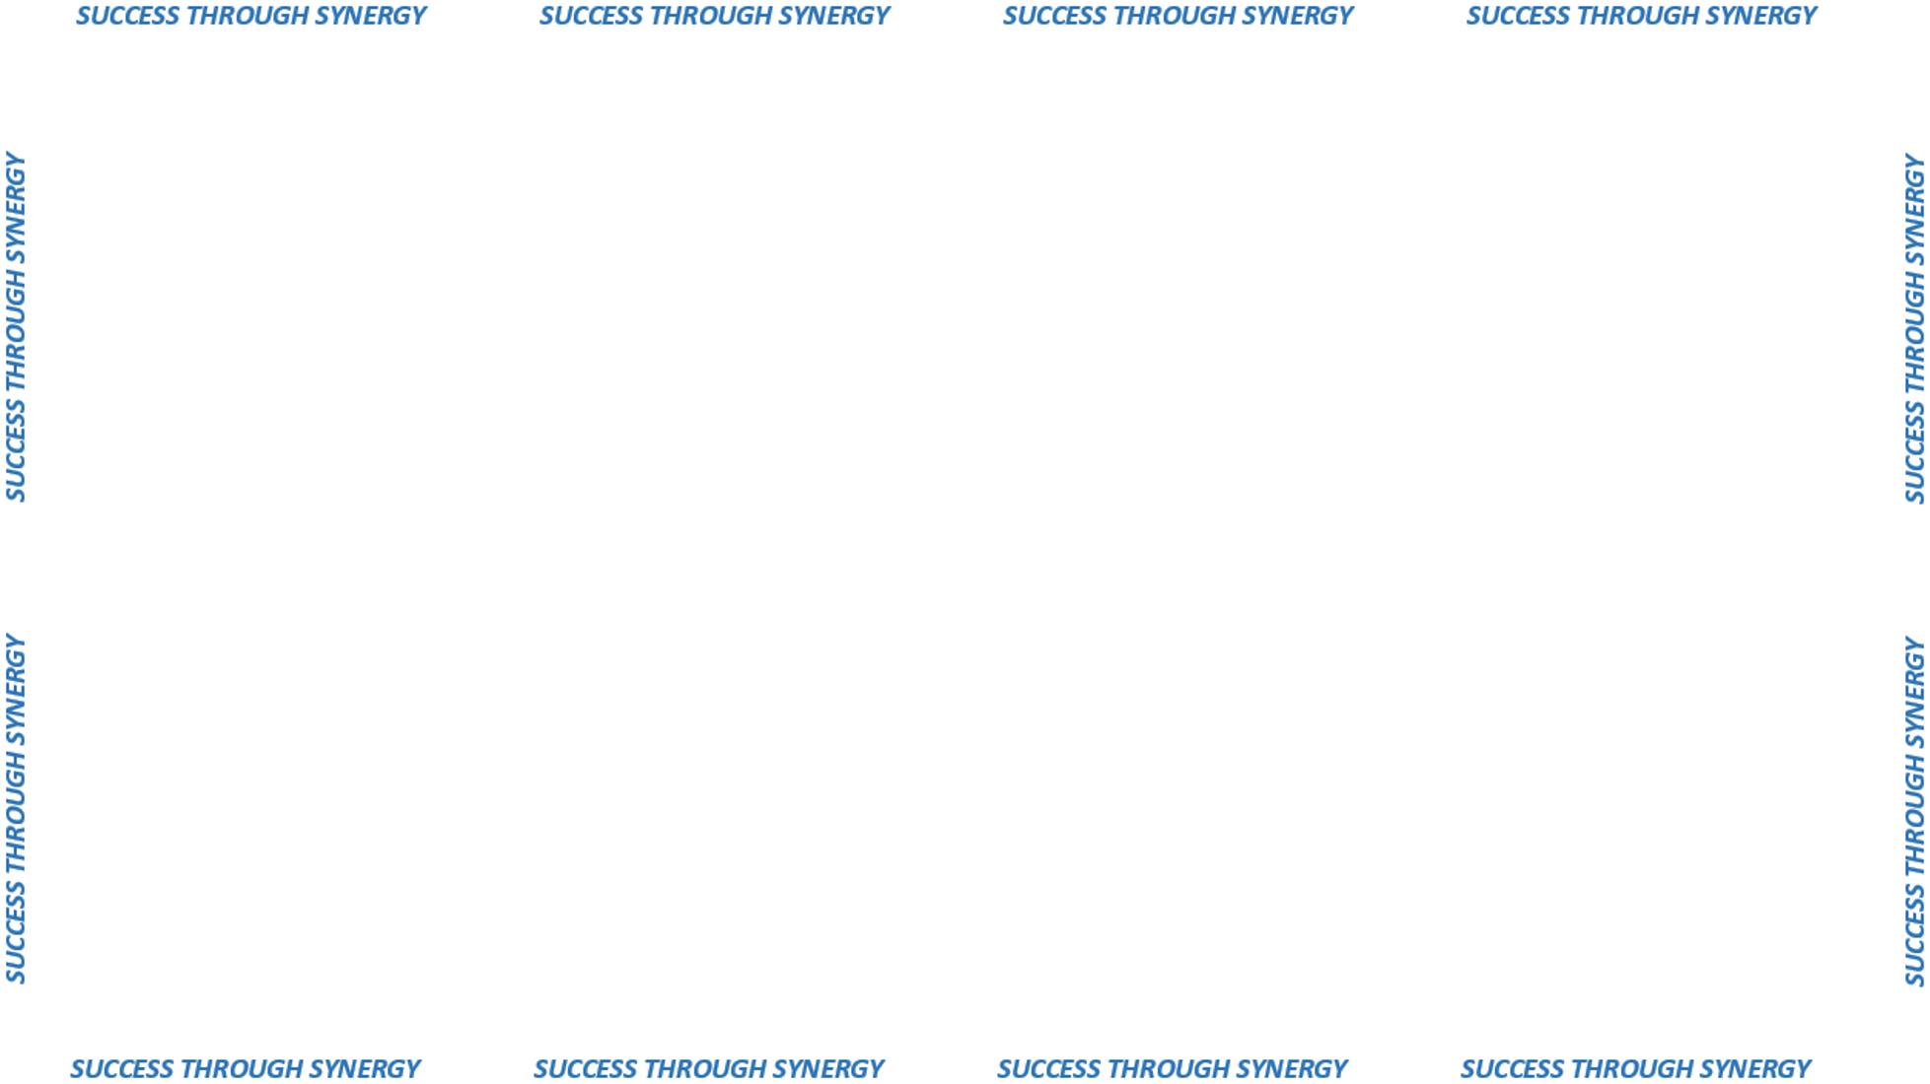
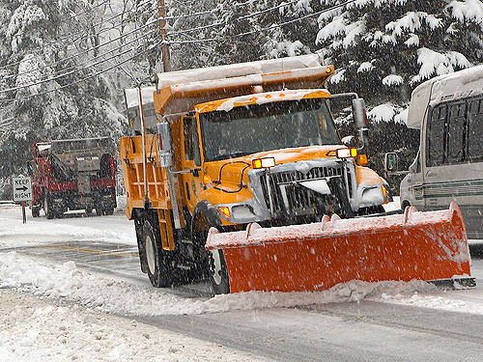


Contract #14psx0239
Snow & Ice Plow Trucks
41,000 GVWR
62,000 GVWR
72,000 GVWR
Consolidated 7 individual contracts into 1
Consolidated to one manufacturerr
DAS & DOT
Reduction of inventory parts
SAVINGS: $8 MILLION

Slide 2
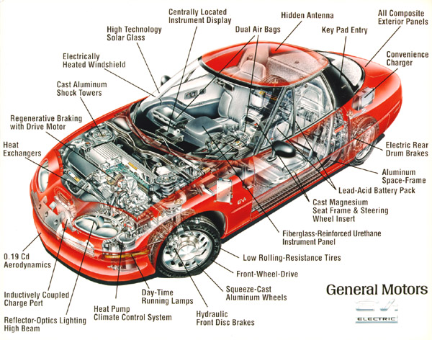

Contract #16PSX0030
Automotive Parts
Pre planning and developing requirements with customer
Service requirements built into contract language
Benchmarking initiative identifies pricing as lowest ever
DAS & DOT
Negotiated 2% rebate program
SAVINGS: $3 MILLION !

