Slide 1
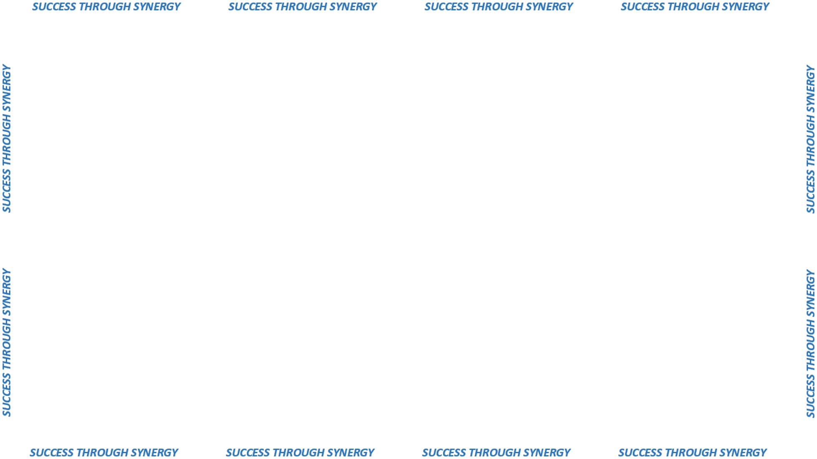
Road Salt 2017-2018
Historically, how we did it
DAS received documents from DOT.
ITB created.
Award made to the lowest, qualified, responsible bidder(s) for each Store Are.
No price reduction allowed in ITB – to verify the details.

Slide 2

Road Salt 2017-2018
Survey conducted with States of Rhode Island and Pennsylvania
Process for Road Salt – Reverse Auction
Benefits of Reverse Auction
Reverse Auction opening via EASi, Inc.

