Slide 1
CTsource Training 4 Document Library
State of Connecticut DAS – Procurement Services
April 7, 2021
Notes:
Welcome to CTsource Training 4: Document Library. This is the fourth training provided to you by the State of Connecticut – DAS Procurement Services CTsource Training Team.

Slide 2
CTsource Training 4
Section | Page
Enterprise Administrator Role | 3
Document Library | 7
CTsource Training 4
Enterprise Admin Role
Document Library
Notes:
During this training, we will recap the Enterprise Administrator role/responsibilities and will demonstrate the Document Library functionality available to you as an agency.
You may follow along with the PowerPoint slides. Each of the sections is hyperlinked, simply press Ctrl key on your keyboard and click your mouse to follow link. The page numbers (slide numbers) are listed as well. At the bottom of the screen you will find “breadcrumb” tabs in the ribbon: Enterprise Admin Role and Document Library. When a new section begins, the color of the tab will change and will indicate which section you are in.

Slide 3
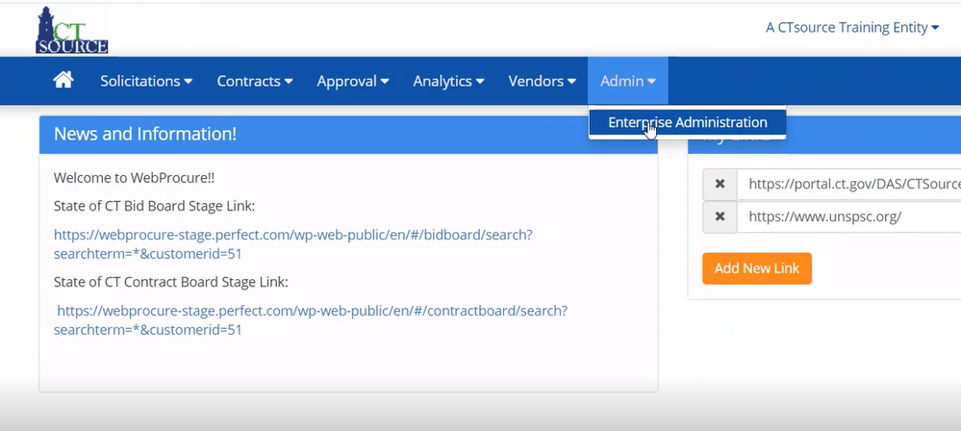
Enterprise Administrator Role
CTsource Training 4
Enterprise Admin Role
Document Library
Notes:
We will be demonstrating the information logged into “A CTsource Training Entity” in the Stage Environment.
As an administrator, the way to access any of the user information, document libraries, etc., you will need to go first to the Admin dropdown menu. From the Admin dropdown menu, click on Enterprise Administration.
[DEMO]

Slide 4
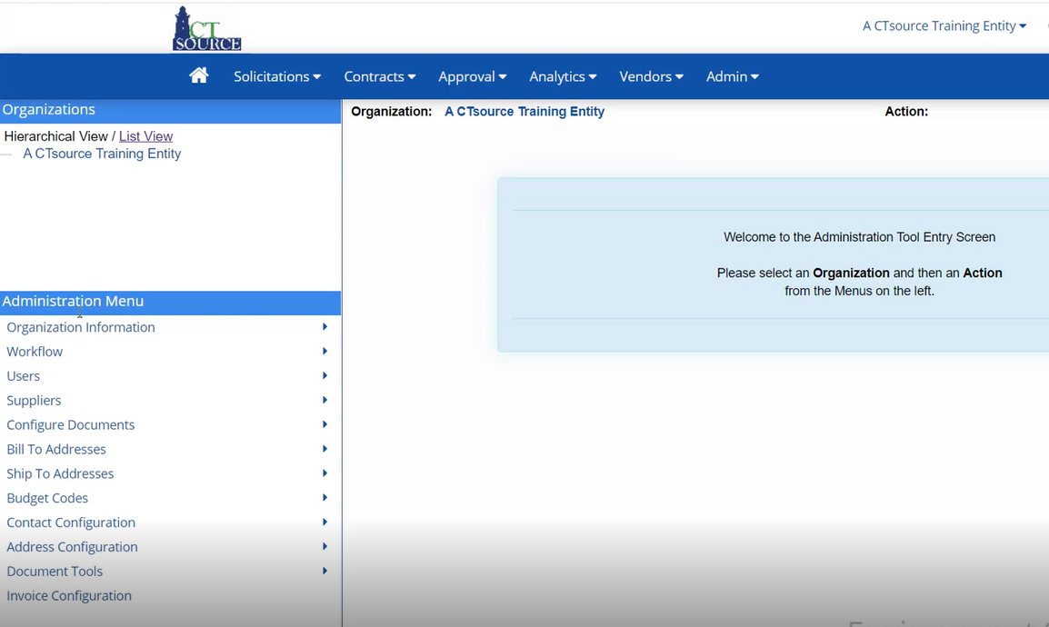
Enterprise Administrator Role
CTsource Training 4
Enterprise Admin Role
Document Library
Notes:
On the left side, Organizations appear. Click on your organization, so it populates on the right hand side; the menu options are then activated below in the Administration Menu.
[DEMO]

Slide 5
Enterprise Administrator Role
CTsource Training 4
Enterprise Admin Role
Document Library
Notes:
The sub-org admin role, provides you access to various options under the Administration Menu. Depending upon your permissions, the admin role will allow you to perform functions under the first five menu options:
1. Organization Information - The information in each one of these options is only for your organization and you can only affect your sub-org
2. Workflow – This can be set up if your org decides to bring workflow into solicitations and contracts
3. Users – To edit users, create new users, change password information
4. Suppliers – To add, edit or approve supplier information
5. Configuration Documents – There are several sub-menu functions that allow you to affect configurations in the solicitation and/or contract documents
[DEMO]

Slide 6
Enterprise Administrator Role
CTsource Training 4
Enterprise Admin Role
Document Library
Notes:
Under Configure Documents, you will find options to: Manage Document Libraries, Manage Document Types, Manage Field Library, Document Field Mapping and Manage Questionnaire Library. Many of these options should be explored in the Stage environment prior to implementing in Production.
[DEMO]

Slide 7
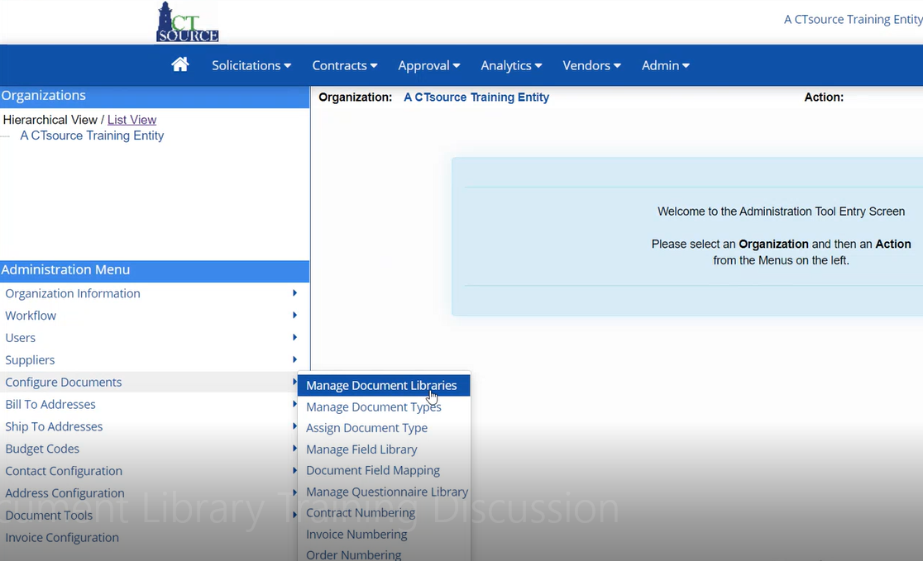
Document Library
CTsource Training 4
Enterprise Admin Role
Document Library
Notes:
This training session we will demonstrate how to manage the document libraries for both solicitations and contracts. Click on Configure Documents. Select Manage Document Libraries.
[DEMO]

Slide 8
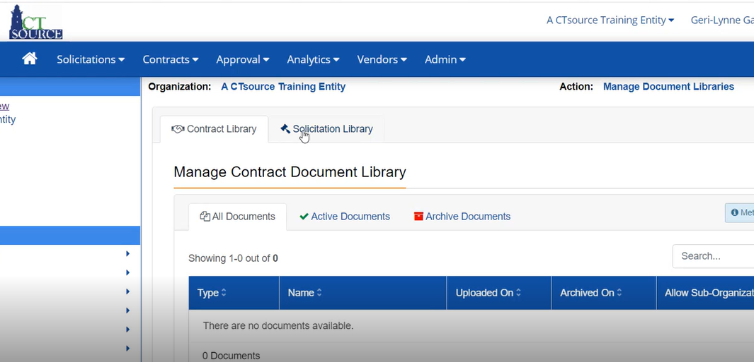
Document Library
CTsource Training 4
Enterprise Admin Role
Document Library
Notes:
For your staff to have continuous access to your organization’s templates, this is where documents are housed. Keep in mind that there are two document libraries involved: Contracts Library and Solicitation Library.
[DEMO]

Slide 9
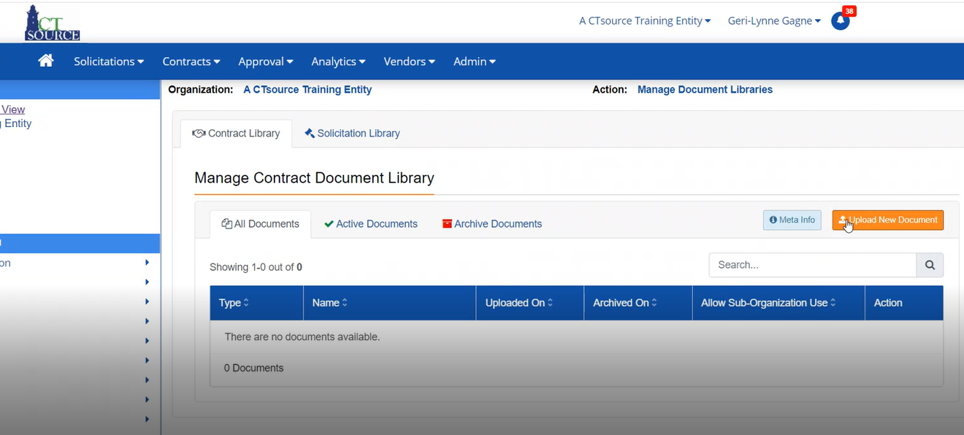
Document Library
CTsource Training 4
Enterprise Admin Role
Document Library
Notes:
To upload templates into the Contract Document Library, click on the Upload New Document button. Uploading new documents is the same process in every function in WebProcure. By clicking on the Upload New Document button, you will be taken to your desktop where you may select a document to upload by either “double-clicking” on the file or selecting the file and clicking Open.
[DEMO]

Slide 10
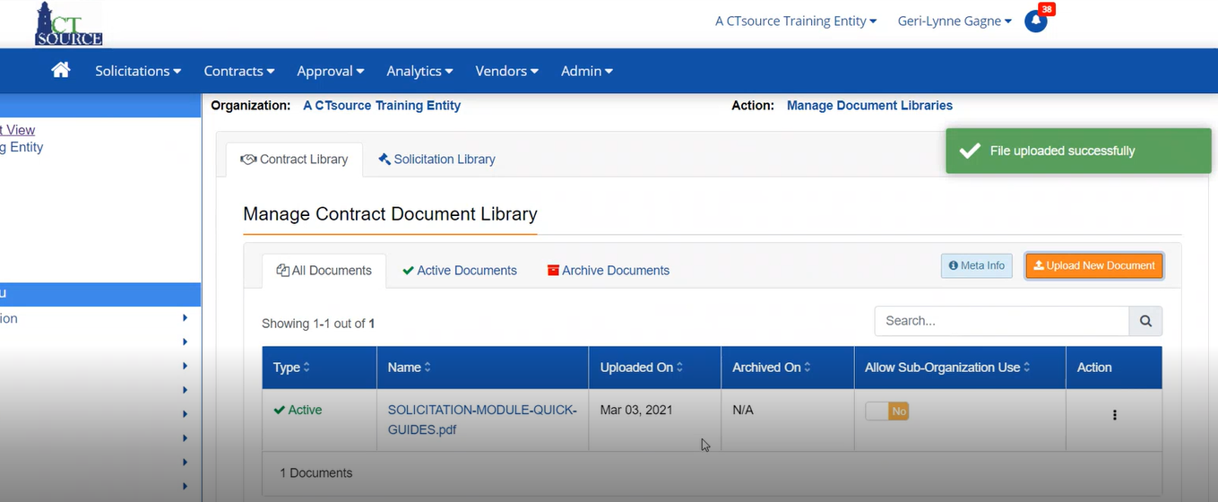
Document Library
CTsource Training 4
Enterprise Admin Role
Document Library
Notes:
WebProcure will alert you when you have successfully uploaded a document.
[DEMO]

Slide 11
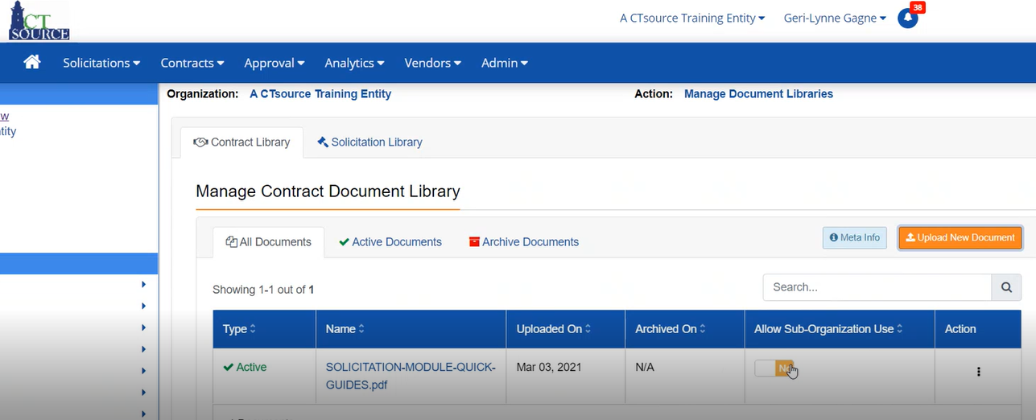
Document Library
CTsource Training 4
Enterprise Admin Role
Document Library
Notes:
You will be able to see on the left, that the document is Active. You will also be able to see the name of the document and the date the document was uploaded. Typically, there would be no sub-organizations nested under your organization, and the Allow Sub-Organization Use defaults to No. However if you are a sub-org with additional sub-orgs that fall below you may allow access to your documents to them if applicable.
[DEMO]

Slide 12
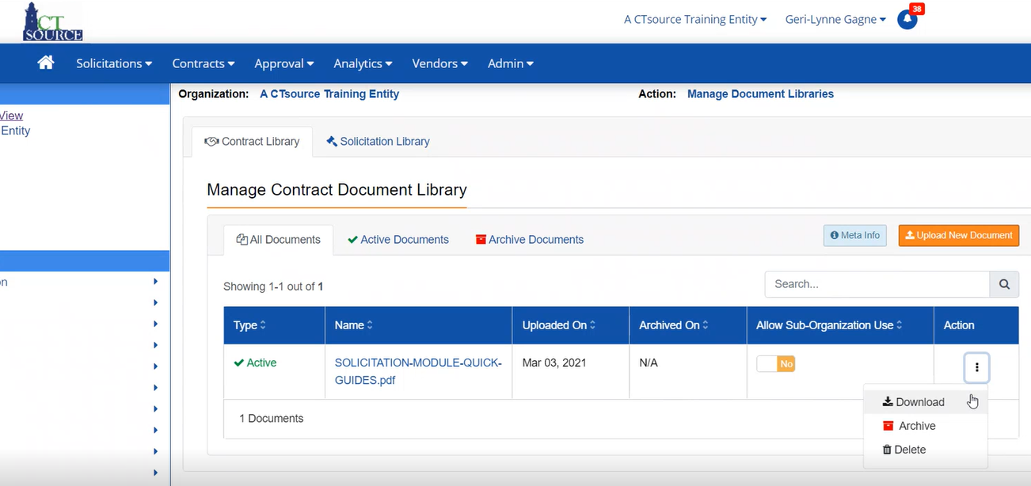
Document Library
CTsource Training 4
Enterprise Admin Role
Document Library
Notes:
From the Actions menu, you have three options: Download, Archive, and Delete. If you would like to the download the document, select Download (this is the same as click the document name hyperlink). The document will download to your desktop and you may save it from there.
You may also choose to archive the document, should you want to have the version of the document for future reference or you may choose to Delete the document. There is no option to “undo” a deleted document.
[DEMO]

Slide 13
Document Library
CTsource Training 4
Enterprise Admin Role
Document Library
Notes:
You may have noticed the three tabs: All Documents, Active Documents, and Archive Documents. Once you click on one of the tabs, the listing on documents will populate for each status, and you will be able to download, archive or delete as needed.
NOTE: All document types are able to be uploaded; however, templates requiring buyers to track changes should be uploaded as Word Documents. This will allow buyers to download the template from CTsource to their computer, make necessary edits, and upload into the solicitation or contract as necessary.
[DEMO]

Slide 14
CTsource Training 4
This concludes Training 4.
Please be sure to go to https://portal.ct.gov/DAS/CTSource/CTSource
to find recordings of all trainings.
For any questions after the webinar contact DAS Procurement Services by emailing: das.ctsource@ct.govYou w
Thank you!
CTsource Training 4

