Slide 1
CTsource Training 3 Contracts/Master Agreements
State of Connecticut DAS – Procurement Services
January 27, 2021
Notes:
Welcome to CTsource Training 3: Contracts/Master Agreements. This is the third training provided to you by the State of Connecticut – DAS Procurement Services CTsource Training Team.

Slide 2
CTsource Training 3
Section | Page
Utilizing Contract Management functionality Create Contract Contract Notifications/Reminders Attach Documents Amendments | 3
Utilizing Master Agreements Generate Solicitation from Master Agreement | 43
CTsource Training 3
Contract Management
Master Agreements
Notes:
During this training, we will cover creating a contract, contract management functionality and utilizing contract notifications/reminders, and attaching documents. This training will also cover functionality for Utilizing Master Agreements which includes creating solicitations from Master Agreements, evaluating and awarding.
You may follow along with the PowerPoint slides. Each of the sections is hyperlinked, simply press Ctrl key on your keyboard and click your mouse to follow link. The page numbers (slide numbers) are listed as well. At the bottom of the screen you will find “breadcrumb” tabs in the ribbon: Contract Management and Master Agreements. When a new section begins, the color of the tab will change and will indicate which section you are in.

Slide 3
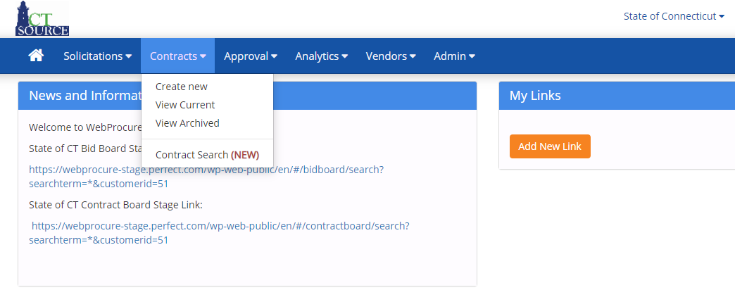
Contract Management
CTsource Training 3
Contract Management
Master Agreements
Notes:
From the Contracts dropdown menu, you may Create New, View Current, View Archived, and perform a Contract Search to review and manage a contract.
[DEMO]

Slide 4
Contract Management
CTsource Training 3
Contract Management
Master Agreements
Notes:
To search for a contract, start from the Home screen. Select View Current Contracts from the Contracts dropdown menu OR select Contract Search.

Slide 5
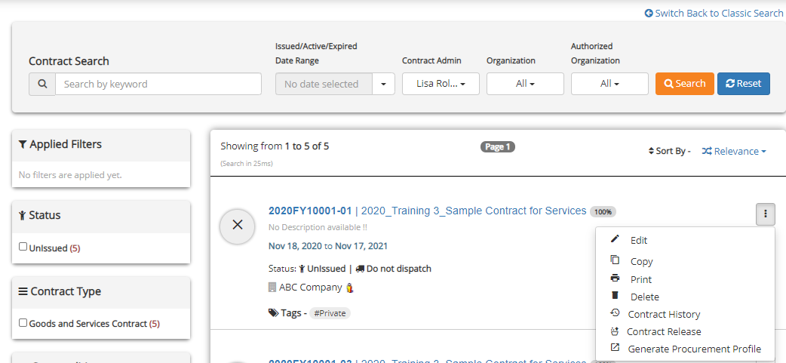
Contract Management
CTsource Training 3
Contract Management
Master Agreements
Notes:
To search for and find a contract to Edit, Copy, Print, or Delete, use the Contract Search fields to enter search criteria or applying filters. Hover over icons or symbols to view their meaning.
Once you locate the contract, click the three vertical dots and choose an action from the pop-out window.
[DEMO]

Slide 6
Contract Management
CTsource Training 3
Contract Management
Master Agreements
Notes:
To create a contract directly in the Contract Module (that is not a result of a solicitation), start from the Home screen, select Create new from the Contracts dropdown menu. [DEMO]

Slide 7
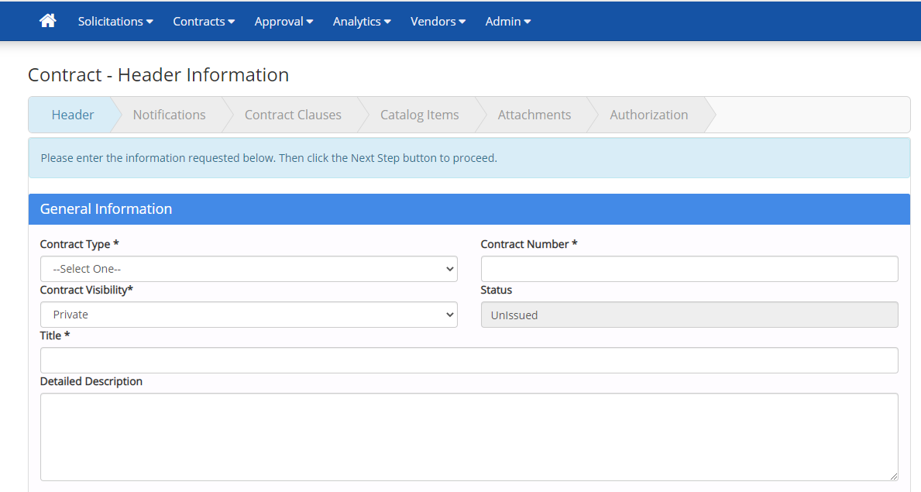
Contract Management
CTsource Training 3
Contract Management
Master Agreements
Notes:
The Contract – Header Information page opens. The system requires you to step through each section within the contract navigation bar. All fields with an * (asterisk) are required.
[DEMO]

Slide 8
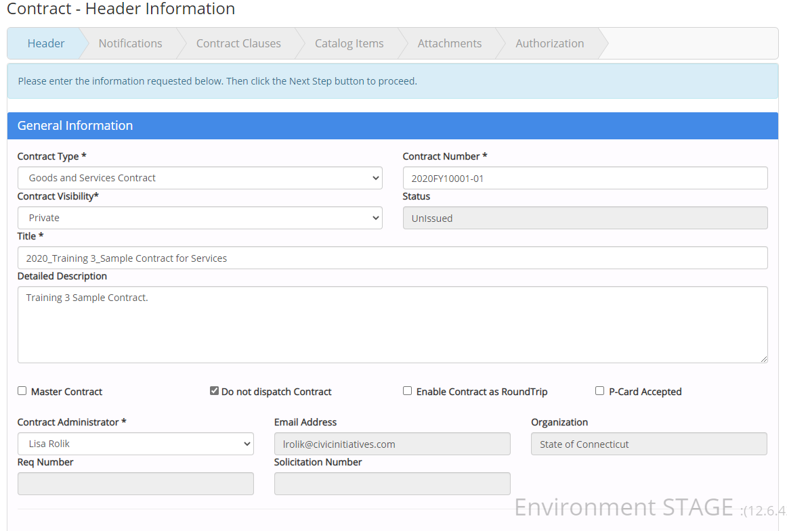
Contract Management
CTsource Training 3
Contract Management
Master Agreements
Notes:
Select Contract Type; enter Contract Number.
WebProcure defaults to Contract Visibility*: Private; if the contract should be displayed on the Contract Board change to Public.
Notice the Status is Unissued. This contract will remain in the Unissued status until it is submitted and approved (and based on approval workflow).
Enter the title of the contract in the Title field and a description for the contract in the Detailed Description field.
Select appropriate identifiers, for example if P-Card is accepted as payment for this contract. NOTE: Dispatch Contract refers to emailing the contract to the supplier’s contact identified in their profile.
WebProcure defaults to your name as Contract Administrator, but you may select another name within your organization using the dropdown menu.
[DEMO]

Slide 9
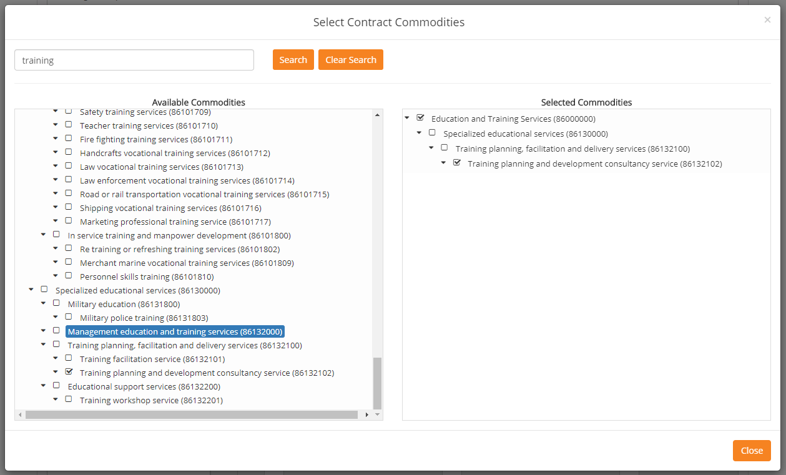
Contract Management
CTsource Training 3
Contract Management
Master Agreements
Notes:
Click on Commodities and the Select Contract Commodities window opens.
Type in keyword. Click Search. Find and select appropriate description/code. Include any and all header category codes to aid with any future contract search.
Click Close. The Selected Categories will populate in the Commodities window.

Slide 10
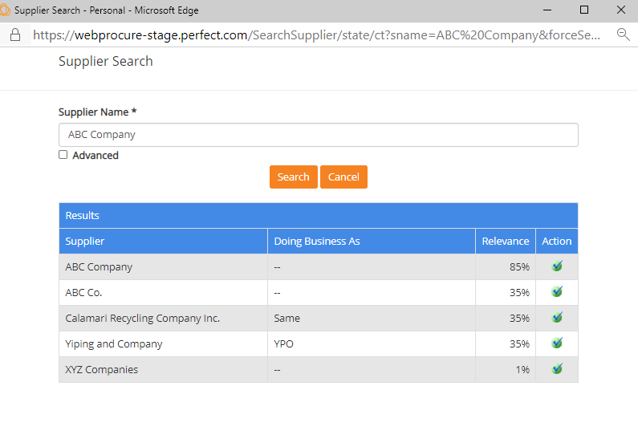
Contract Management
CTsource Training 3
Contract Management
Master Agreements
Notes:
Click Search Contractors and search for contractor/supplier. Contractor must be registered in CTsource and approved.
Type in the Supplier Name field. Click Search. From the results, select the supplier by clicking on the green checkmark.
[DEMO]

Slide 11
Contract Management
CTsource Training 3
Contract Management
Master Agreements
Notes:
The main and contract contacts from the Supplier portal will automatically fill, if available. Only the supplier can modify this information on their portal.
You may enter any additional contact information by completing the fields: Contact Type, Contact Name, Email Address, and Phone. Click Add Contacts.
Add or delete as necessary and additional contact information you have added. (You may delete a contact by clicking the red “x” at the right.)
[DEMO]

Slide 12
Contract Management
CTsource Training 3
Contract Management
Master Agreements
Notes:
Insurance related to the contract is added and managed only at the contract level. This information is not required to complete; however, if you enter values in one of the fields, you must complete all fields in the row.
To identify an Insurance Category, select from the dropdown: General Liability, Automotive Liability, Professional Services Liability, or Other. Click on the dropdown menu and make your selection.
Enter the Policy Number and Carrier name if you feel it is necessary for your organization to track this information. NOTE: DAS Procurement Contract Specialists only enter an * in the fields to satisfy the system requirement for entry.
Enter the Effective Date and Expiration Date in the appropriate fields. NOTE: Email notifications are sent to the buyer and supplier regarding expiration date information.
Click Add Insurance when finished with a row to add all appropriate insurance policies.
[DEMO]

Slide 13
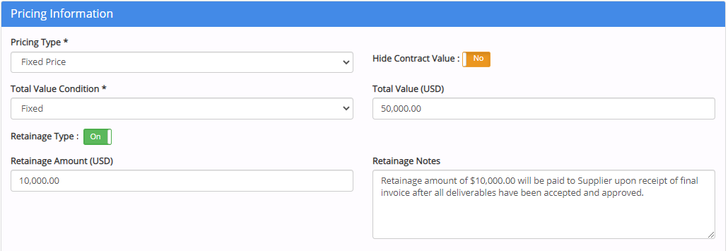
Contract Management
CTsource Training 3
Contract Management
Master Agreements
Notes:
Pricing Information:
Select Pricing Type and Total Value Condition from the dropdown menus.
Select Yes/No to Hide Contract Value – this determines whether or not it is displayed on the Contract Board
Enter Total Value (USD) – if using approval workflow based upon Total Contract Value Workflow, a value must be entered in this field.
Determine Retainage Type [Off/On] represent amount versus percentage, enter Retainage Amount or Percent as applicable and Retainage Notes. You may enter data in these fields for information purposes only. The State of Connecticut does not use the payment module to enforce this information.
[DEMO]

Slide 14
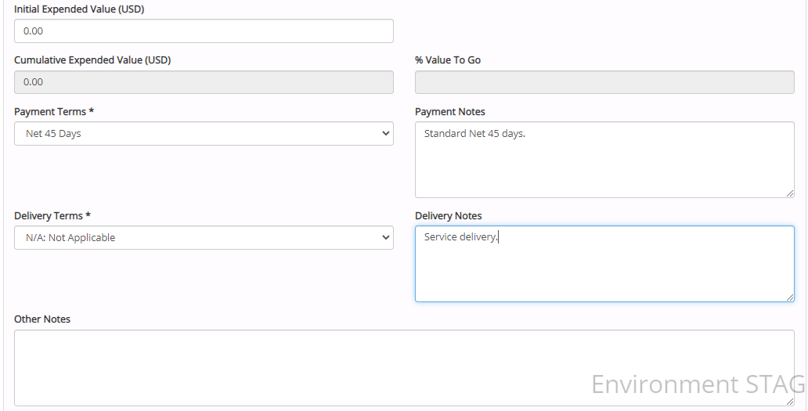
Contract Management
CTsource Training 3
Contract Management
Master Agreements
Notes:
Pricing Information (continued):
The Initial Expended Value (USD) does not apply for the State of Connecticut it is related to the Purchase Order module.
Select payment and delivery terms from the Payment Terms and Delivery Terms dropdown menus. Please note: Additional delivery and payment terms cannot be added to the dropdown options. Select the field option: “See Delivery Notes” or “See Payment Notes” and enter the pertinent data that applies in the text box. Enter appropriate notes in the Payment Notes and Delivery Notes fields.
“Other Notes” field is for any additional information pertaining to the contract for INTERNAL purposes/viewing only.
[DEMO]

Slide 15
Contract Management
CTsource Training 3
Contract Management
Master Agreements
Notes:
Set the Contract Period by entering Issue Date, Award Date, Effective Date and Expiration Date. You may use the calendar icons to navigate the calendar.
WebProcure defaults the Potential Final Expiration Date to be the Same as Expiration Date. If these are not the same dates, deselect and enter the appropriate date. This is a great feature to display multiple year contract terms.
[DEMO]

Slide 16
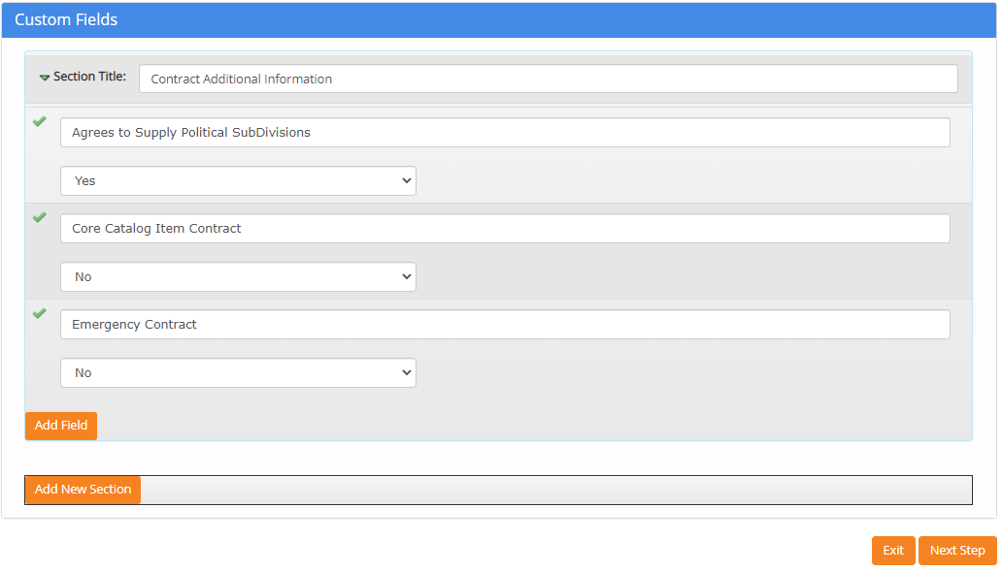
Contract Management
CTsource Training 3
Contract Management
Master Agreements
Notes:
You may bypass Custom Fields.
If desired, add new fields and or new sections. The information shown on the slide is an example for your reference and what DAS Procurement Services uses for their contracts.
Click Next Step once finished adding fields/sections.
[DEMO]

Slide 17
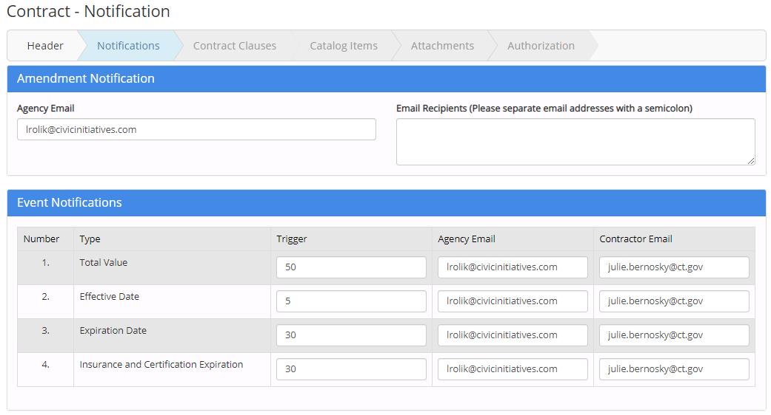
Contract Management
CTsource Training 3
Contract Management
Master Agreements
Notes:
In the Notifications section of the contract, enter email addresses for those who should receive an Amendment Notification. WebProcure defaults with your email address for Agency Email. If adding multiple email addresses in the Email Recipients text box, do not separate the email addresses with any spaces; only separate by a semicolon.
Event Notifications: Enter a Trigger for each Type of notification. The Agency Email and Contractor Email default to the email addresses per the Header section of the contract. (Total Value does not apply for the State of Connecticut.)
Add any additional notifications by clicking on Add Notification from Library button in the Custom Notifications field. This information is currently established and managed at the DAS Administrator level. Please contact DAS for more information.
Dispatch Email Content – You may override the standard email that WebProcure sends to the supplier by changing the toggle switch to Yes.
Once all entries have been entered Click Next [DEMO]

Slide 18
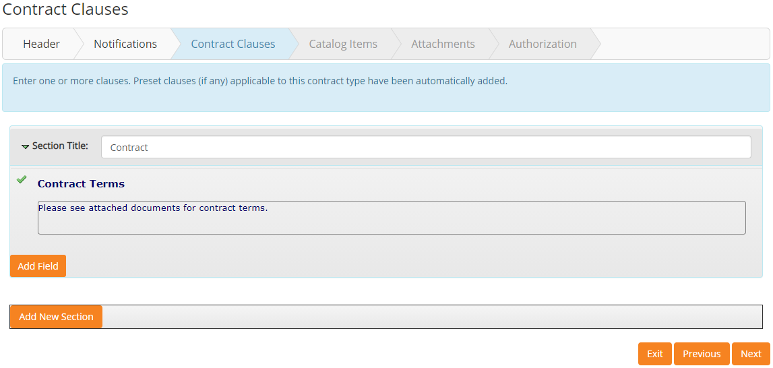
Contract Management
CTsource Training 3
Contract Management
Master Agreements
Notes:
Contract Clauses will be future functionality in terms of using Document Library clauses. Click Next.
[DEMO]

Slide 19
Contract Management
CTsource Training 3
Contract Management
Master Agreements
Notes:
However, you may include other requirements and Add Field to add more clauses.
Select Field Type. You may also delete by clicking on the trashcan icon.
[DEMO]

Slide 20
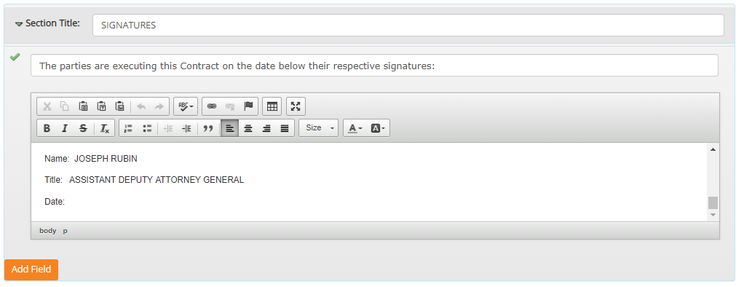
Contract Management
CTsource Training 3
Contract Management
Master Agreements
Notes:
You may also Add New Section. Or you may delete the section by clicking on the trashcan icon.
Select Next to move forward to the next section Catalog Items.
[DEMO]

Slide 21
Contract Management
CTsource Training 3
Contract Management
Master Agreements
Notes:
This feature could be available to your organization if using item spec functionality (DAS is not using this functionality). Click Next to continue to the next section Documents.
[DEMO]

Slide 22
Contract Management
CTsource Training 3
Contract Management
Master Agreements
Notes:
Though there are two functions in this section, Add Documents from Library and Upload New Documents, the document library will be determined by your organization’s administrator.
Select Upload New Documents.
[DEMO]

Slide 23
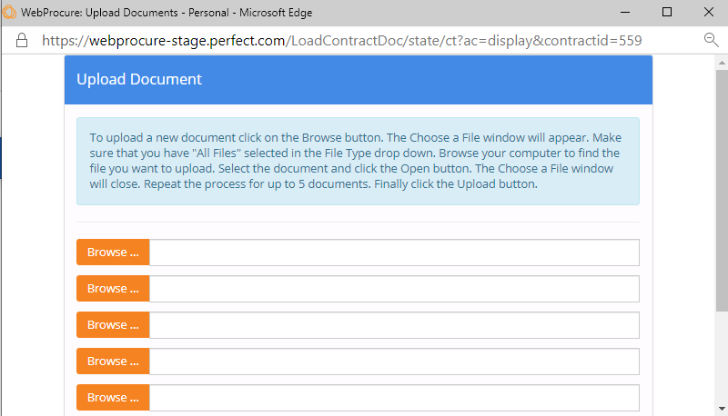
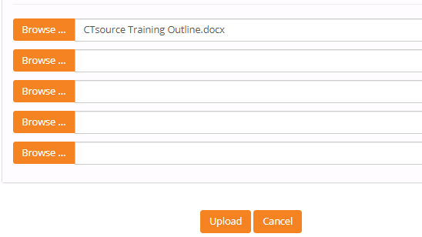
Contract Management
CTsource Training 3
Contract Management
Master Agreements
Notes:
Click Browse… button. Locate file you wish to upload. Click open. The file will populate in the Upload Document screen. Click Upload.
[DEMO]

Slide 24
Contract Management
CTsource Training 3
Contract Management
Master Agreements
Notes:
Back on the Contract Documents screen you will find the newly uploaded document. Check whether you would like to make this document is Private and/or Visible to Contractor or Public. Use the toggle switch to change the visibility to public. You also have the ability to Delete by clicking on the trashcan icon.
Click Next when ready to move forward to the Authorization section.
NOTE: When saving/naming documents, DO NOT USE special characters in the file name or the file will not display on the Public Contract Board.
[DEMO]

Slide 25
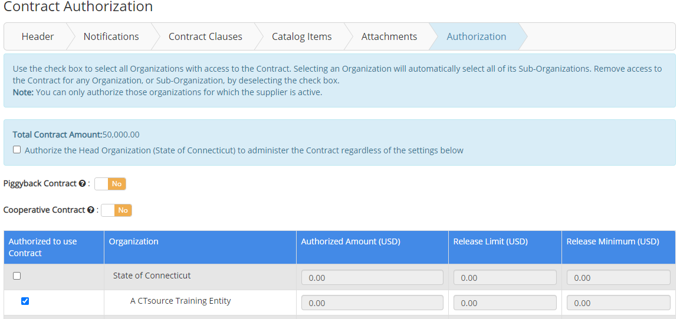
Contract Management
CTsource Training 3
Contract Management
Master Agreements
Notes:
On the Contract Authorization screen, “Total Contract Amount” displayed here is being pulled from the Pricing Information section of the Contract Header Information page. The check box is not applicable for the State of Connecticut as is relates to the Purchase Order module.
Click the toggle switch to Yes if Piggyback Contract and/or Cooperative Contract is applicable; this is for information/reporting purposes only.
Click the check box for the organization “Authorized to Use Contract”; this is also for informational purposes and will be displayed/searchable on the Contract Board or under Contract Search (New) functionality. Selecting the check box in this column will assist with reporting functionality.
Click Finished and you move to the Summary screen.
[DEMO]

Slide 26
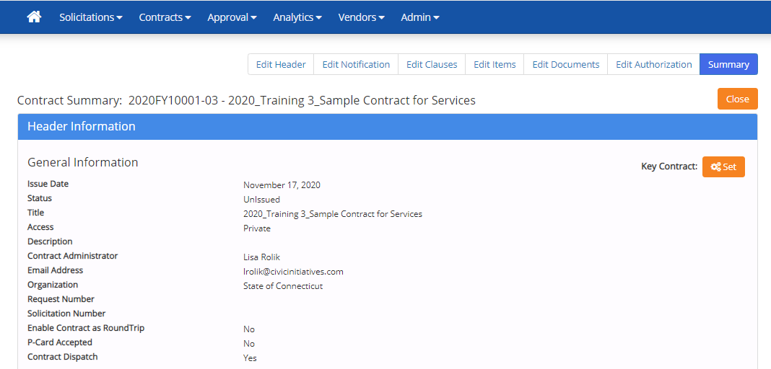
Contract Management
CTsource Training 3
Contract Management
Master Agreements
Notes:
The Summary provides the opportunity to review all the information you have entered. If the information is correct, you may select Submit to post to the Contract Board at the Effective Date entered on the header page. If your organization has established approval workflow, Submit will send the contract for review and approval.
If the information requires a revision you must use the Edit functionality within any section or the top ribbon of the page in any order. After completing your revision to a section you will select Save and must click the Summary page in the top ribbon to access that page to then select Submit.
[DEMO]

Slide 27
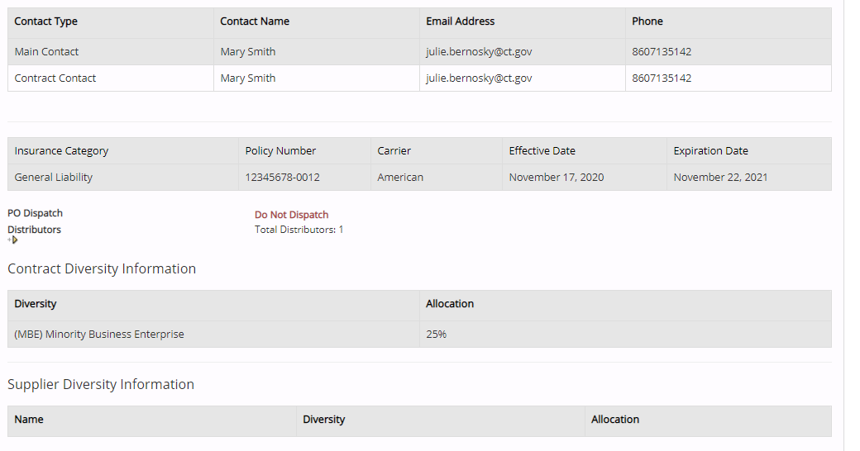
Contract Management
CTsource Training 3
Contract Management
Master Agreements
Notes:
Header Information continued.
[DEMO]

Slide 28
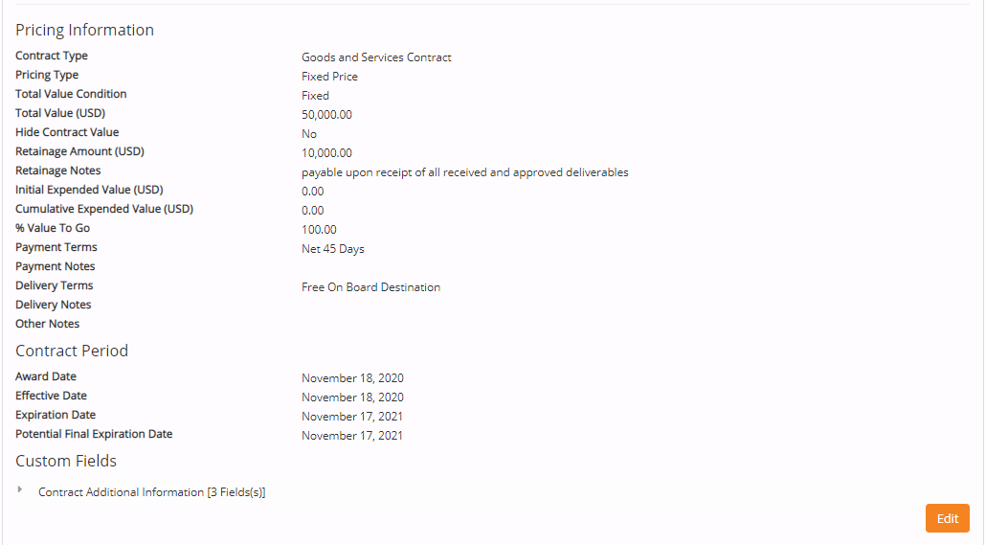
Contract Management
CTsource Training 3
Contract Management
Master Agreements
Notes:
Header Information continued.
At the end of the Header Information section, you may click on the Edit button should you wish to enter directly into the Header Information section from this point on the screen without having to return up to the contract navigation bar.
[DEMO]

Slide 29
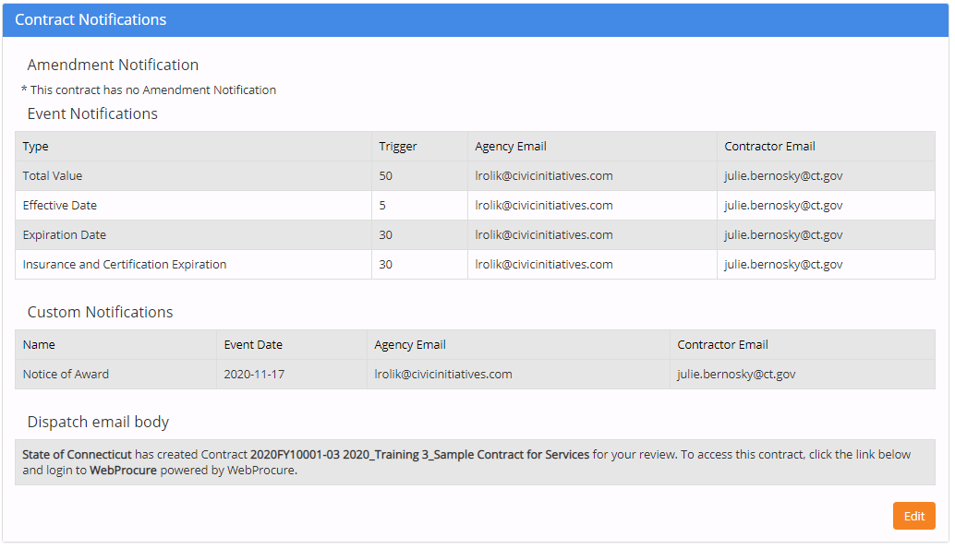
Contract Management
CTsource Training 3
Contract Management
Master Agreements
Notes:
Review Contract Notifications.
At the end of the Contract Notifications section, you may click on the Edit button should you wish to enter directly into the section from this point on the screen without having to return up to the contract navigation bar.
[DEMO]

Slide 30
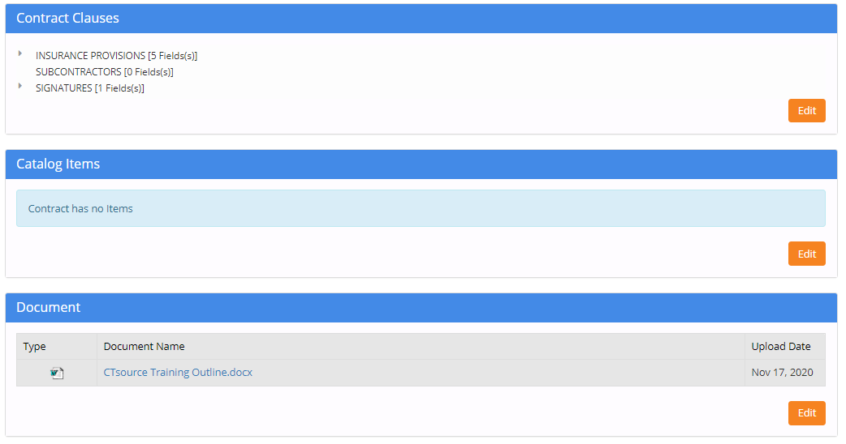
Contract Management
CTsource Training 3
Contract Management
Master Agreements
Notes:
Review Contract Clauses, Catalog Items, and Document sections.
At the end of these sections, you may click on the Edit button should you wish to enter directly into these sections from this point on the screen without having to return up to the contract navigation bar.
[DEMO]

Slide 31
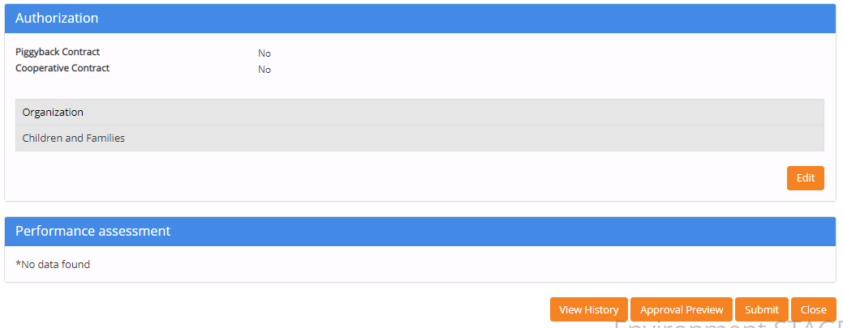
Contract Management
CTsource Training 3
Contract Management
Master Agreements
Notes:
Review Authorization.
You may click on the Edit button should you wish to enter directly into the section from this point on the screen without having to return up to the contract navigation bar.
You have options to View History, Approval Preview (if your organization elects to use approval workflow), Submit, and Close.
Click Submit to post the contract to the Public Contract Board. The contract will post on the effective date entered in the Header of the contract.
Just as in Training 2: Solicitations and verifying the solicitation posts on the Public Bid Board, do the same for contracts.
[DEMO]

Slide 32
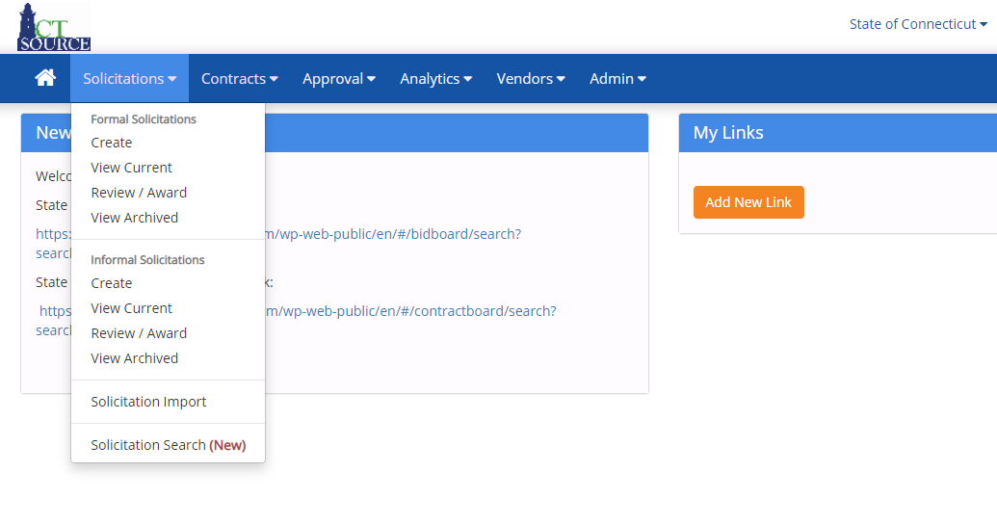
Contract Management
CTsource Training 3
Contract Management
Master Agreements
Notes:
If you choose to creater a contract from a solicitation, from the Solicitations dropdown menu, select View Archived and search for the solicitation.
[DEMO]

Slide 33
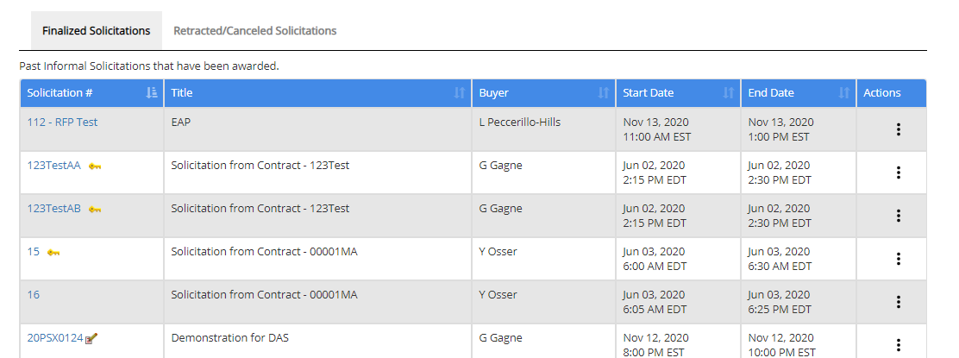
Contract Management
CTsource Training 3
Contract Management
Master Agreements
Notes:
Under Finalized Solicitations, click the solicitation # hyperlink.
[DEMO]

Slide 34
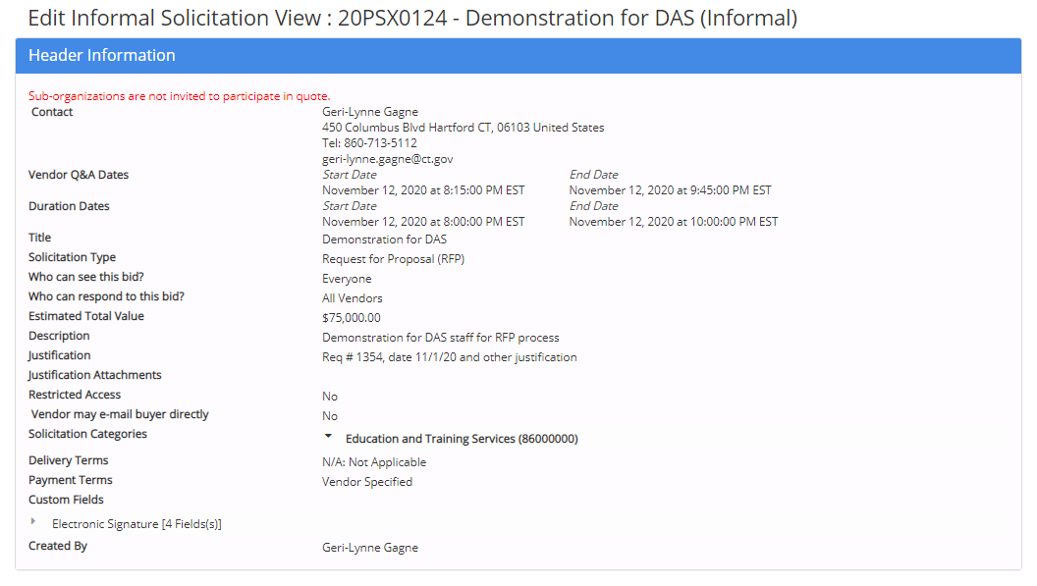
Contract Management
CTsource Training 3
Contract Management
Master Agreements
Notes:
The Edit Solicitation page opens. Scroll down to the bottom of the page and select Generate Contracts.
[DEMO]

Slide 35
Contract Management
CTsource Training 3
Contract Management
Master Agreements
Notes:
Answer the following questions: Master Contract should be No (at this time); Award Contract to Vendor select radio button for awarded supplier and click Next; lastly Catalog Contract should be No (at this time).
[DEMO]

Slide 36
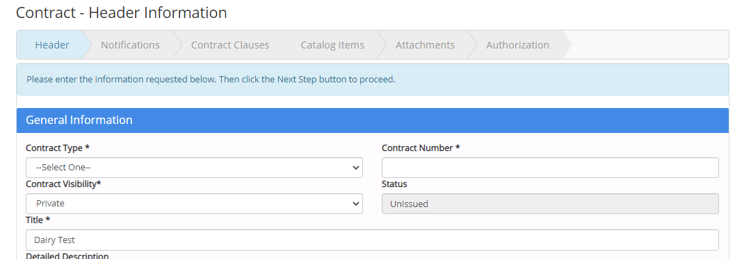
Contract Management
CTsource Training 3
Contract Management
Master Agreements
Notes:
The Contract – Header Information screen will open.
By generating a contract from a solicitation, WebProcure will transfer information from the solicitation. You may override the information if needed.
Continue to the same process steps as in creating a contract within the Contract Module.
[DEMO]

Slide 37
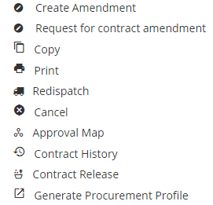
Contract Management
CTsource Training 3
Contract Management
Master Agreements
Notes:
To amend a contract after it has been approved and active, go to View Current and use the search filter to bring up the contract details. Click the ellipsis under the Actions column and select Create Amendment.
NOTE: Making any changes to any exiting contract will result in an amendment to the contract and the application will automatically notify the supplier via email upon the effective date of the amendment.
In an effort to easily track amendments, DAS uses the Custom Fields section on the Header to identify specifics for the amendment. It is up to your organization as to how you want to manage this process. On the Notifications page you are able to modify the email that is sent to the supplier to report amendment details. The system also tracks via the contract history and audit functionality changes to the contract. More information related to amendments may be found in resource documents on the DAS website.
[DEMO]

Slide 38
Contract Management
CTsource Training 3
Contract Management
Master Agreements
Notes:
If you choose to Edit a contract, once you click on Edit, you will be taken directly into the Summary of the contract. Notice the contract navigation bar. You may edit from here, saving your changes.
At the bottom of each section you choose to edit, there will be a Return button and Save button. Save your work. Click Return to return to the Summary screen and click Submit to send the amendment to the supplier and the Contract Board.
[DEMO]

Slide 39
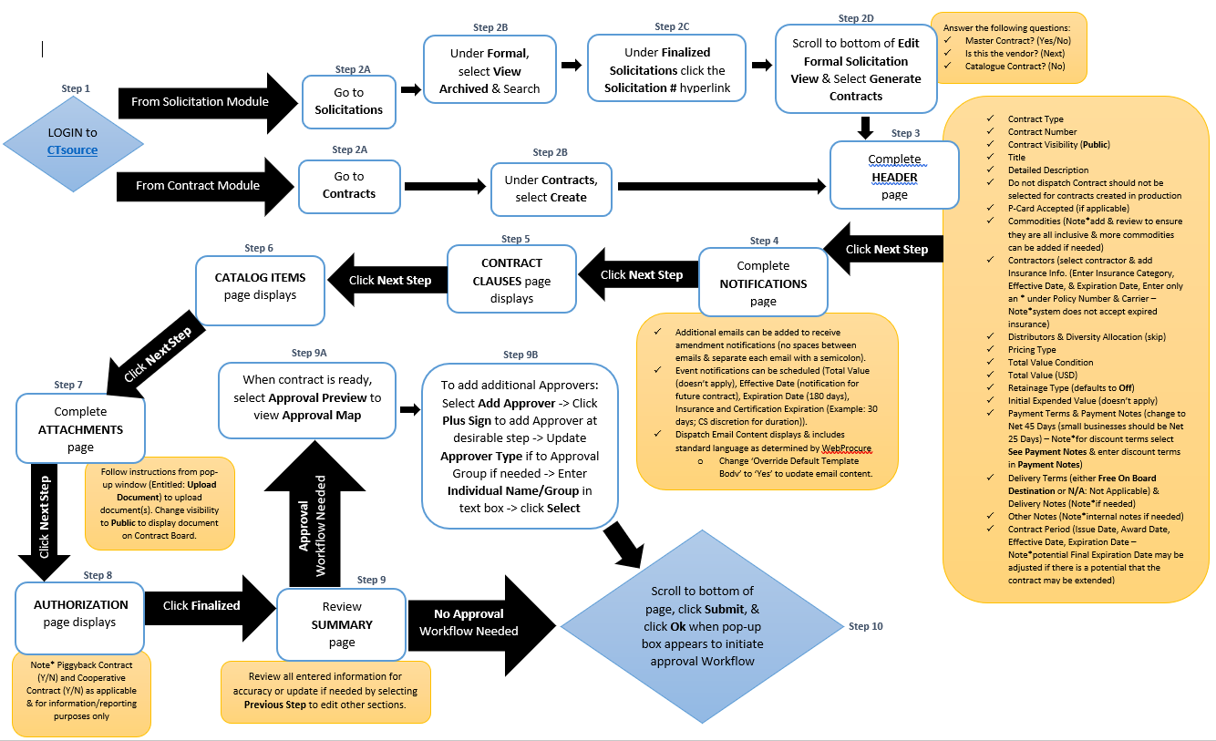
Contract Management
CTsource Training 3
Contract Management
Master Agreements
Notes:
You may create a contract either from the Solicitation module or the Contract module.
Follow the steps as identified in the process flow.
[DEMO]

Slide 40
Master Agreements
Public Solicitation
Solicitation Awarded
Master Contract Created
Solicitation Created from Master Contract (Private)
Solicitation Awarded
CTsource Training 3
Contract Management
Master Agreements
Notes:
DAS Procurement Services is the only org using the Master Contract feature in CTsource. As briefly discussed when creating a contract from a solicitation, one of the options was to select whether the contract would be a Master Contract.
Master Contracts essentially serve as a pool of qualified suppliers who are then allowed to bid on a subsequent Statement of Work (SOW) or Work Orders during a formal or informal solicitation process. This allows for expedited ordering of goods and services by working with pre-qualified, capable suppliers, ensuring the best and most competitive prices. DAS Procurement Services utilizes the Master Contract functionality for their multiple supplier awarded contracts accessible to all using State Agencies and Political Sub-Divisions.
This flow chart provides an overview of the process.

Slide 41
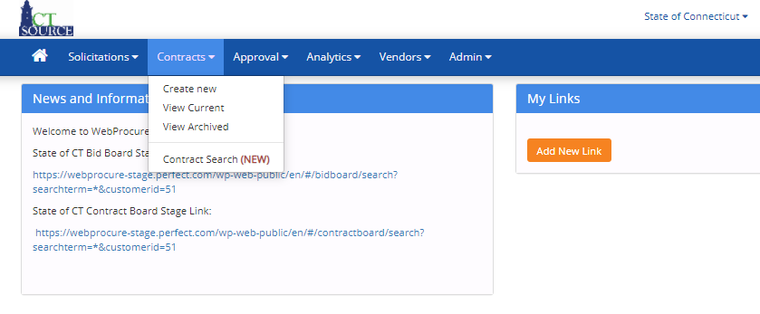
Master Agreements
CTsource Training 3
Contract Management
Master Agreements
Notes:
Please note: Users must be granted Contract Management permissions to “Create Solicitation from Contract” in order to perform this functionality. Please see your CTsource Administrator to be granted permissions.
Starting at the Home screen, select View Current from the Contracts dropdown menu.
[DEMO]

Slide 42
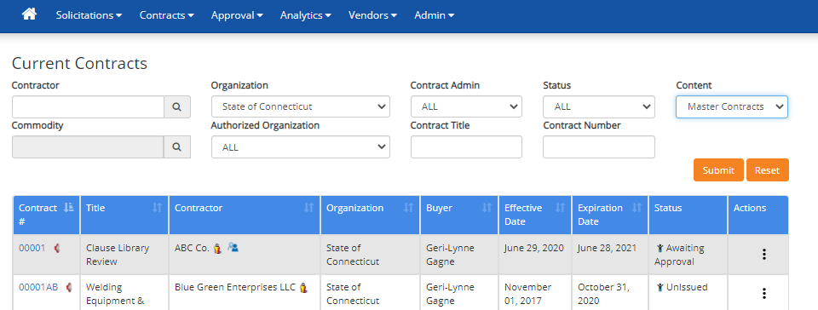
Master Agreements
CTsource Training 3
Contract Management
Master Agreements
Notes:
The Current Contracts screen opens. From the Content dropdown menu, select Master Contracts and click Submit. Use other filter options to assist with your search.
[DEMO]

Slide 43
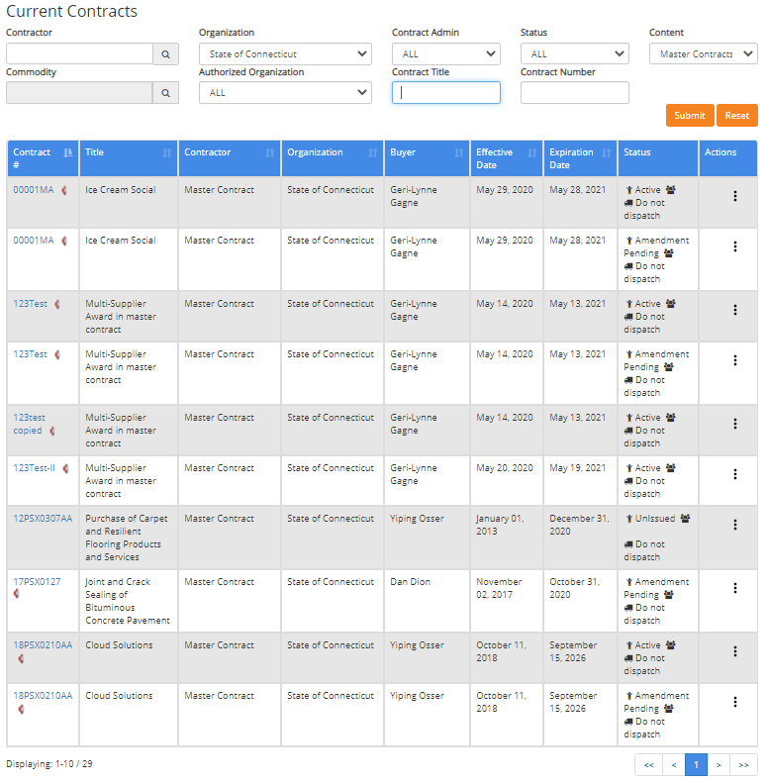
Master Agreements
CTsource Training 3
Contract Management
Master Agreements
Notes:
Only State of Connecticut Master Contracts should be populating the screen now. Search for the master contract with which you wish to create a solicitation.
As stated previously, only users with the assigned Create Solicitation from Contract permissions will be able to create a solicitation from a Master Contract. The Master Contract must be in Active status and the solicitation must contain line items.
You may do this by reviewing the list or by utilizing the search fields. Use the arrows at the bottom of the screen to move forward and to move back in the Current Contracts listing.
[DEMO]

Slide 44
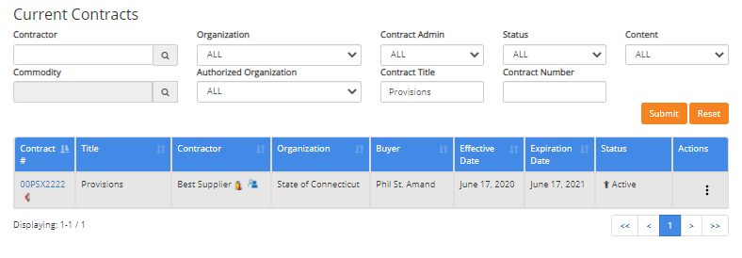
Master Agreements
CTsource Training 3
Contract Management
Master Agreements
Notes:
For this search, “Provisions” (the contract title) was entered in the Contract Title field. Notice that only that contract is now displaying. (If a new search is needed, click Reset to begin a new search.)
Click on the contract number in the Contract # column. This will open the contract summary.

Slide 45
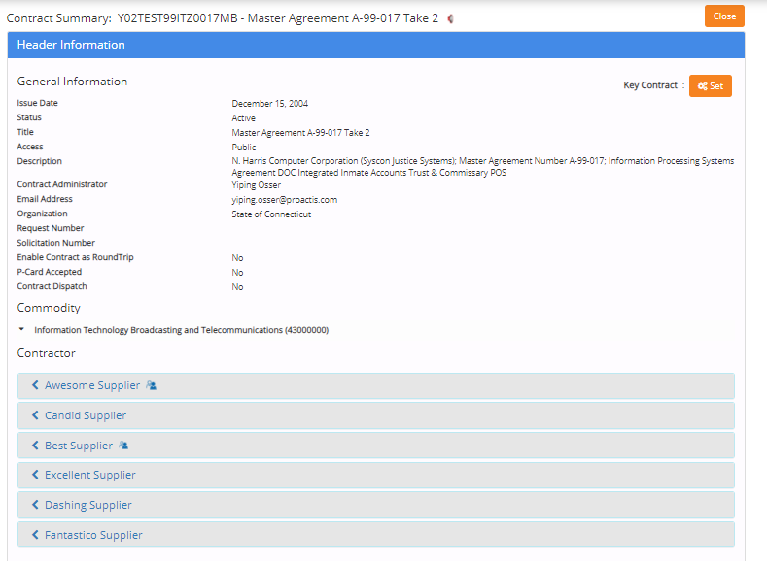
Master Agreements
CTsource Training 3
Contract Management
Master Agreements
Notes:
The Contract Summary page will open.
Scroll through the contract summary to review the Header Information.

Slide 46
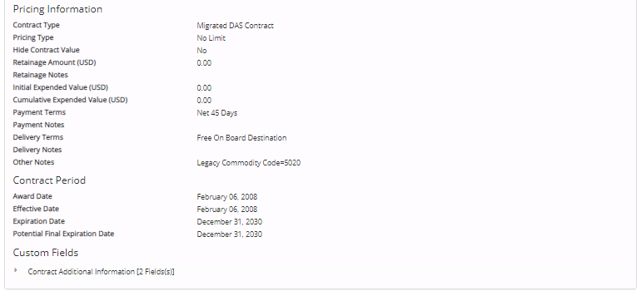
Master Agreements
CTsource Training 3
Contract Management
Master Agreements
Notes:
Review of Header Information continued…

Slide 47
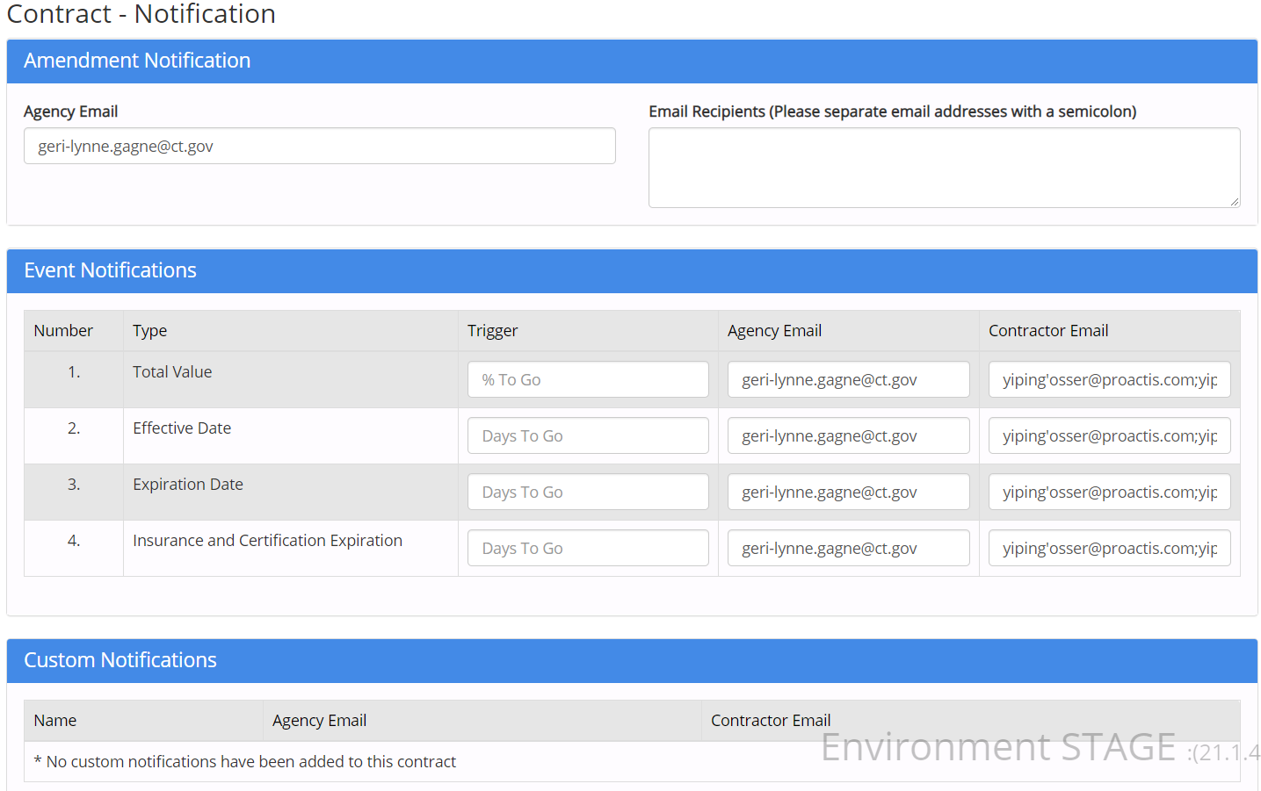
Master Agreements
CTsource Training 3
Contract Management
Master Agreements
Notes:
Review the Contract Notifications and Contract Clauses sections.

Slide 48
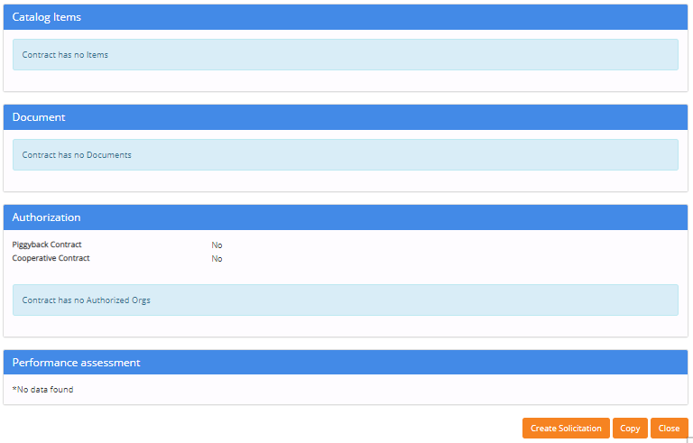
Master Agreements
CTsource Training 3
Contract Management
Master Agreements
Notes:
Review the Catalog Items, Document, Authorization, and Performance Assessment sections.
Click Create Solicitation.

Slide 49
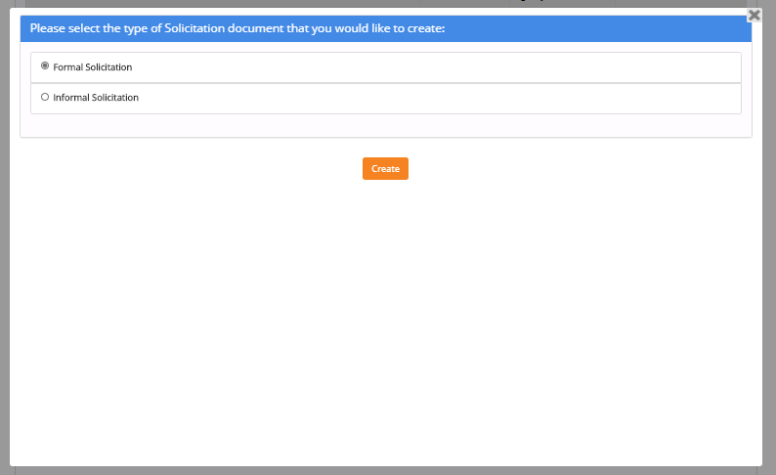
Master Agreements
CTsource Training 3
Contract Management
Master Agreements
Notes:
When you select Create Solicitation, a window appears prompting you to choose the type of solicitation: Formal Solicitation or Informal Solicitation.
Select Formal Solicitation to receive sealed bids or Informal Solicitation. Click Create.
[DEMO]

Slide 50
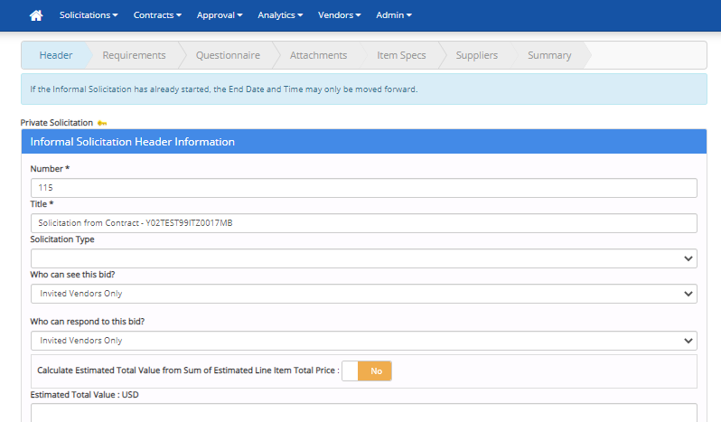
Master Agreements
CTsource Training 3
Contract Management
Master Agreements
Notes:
When you select Create, WebProcure takes you to the Solicitation Creation pages. You will be able to tell you are creating a Private Solicitation as this is identified.
Follow the instructions for creating a formal/informal solicitation from here. At least one line item is required to be entered on the Item Specs page to save this type of solicitation.
Please note: Only those suppliers from the contract will be allowed on the solicitation. Additional suppliers may not be added to the solicitation, however, you do not have to send the solicitation to all the suppliers in the pool and select only those suppliers you would like to include. Only items that are in the contract commodity category or categories may be added.
[DEMO]

Slide 51
Master Agreements
CTsource Training 3
Contract Management
Master Agreements
Notes:
This slide shows an example of a line item entry required for an informal solicitation associated with a master contract. It is up to the organization as to how to set up the line item, however, it is our suggestion to complete as follows:
Item Specification Name – Brief description of the informal solicitation
Item Specification Number – leave blank
Manufacturer Name – leave blank
Manufacturer Part Number – leave blank
Description – Enter a more detailed description (e.g. Provide lump sum for Statement of Work attached)
Commodity Category – must be same as master contract commodities
Specify Quantity – 1
Unit of Measure – Lump Sum
Remaining fields – leave blank
Click Save

Slide 52
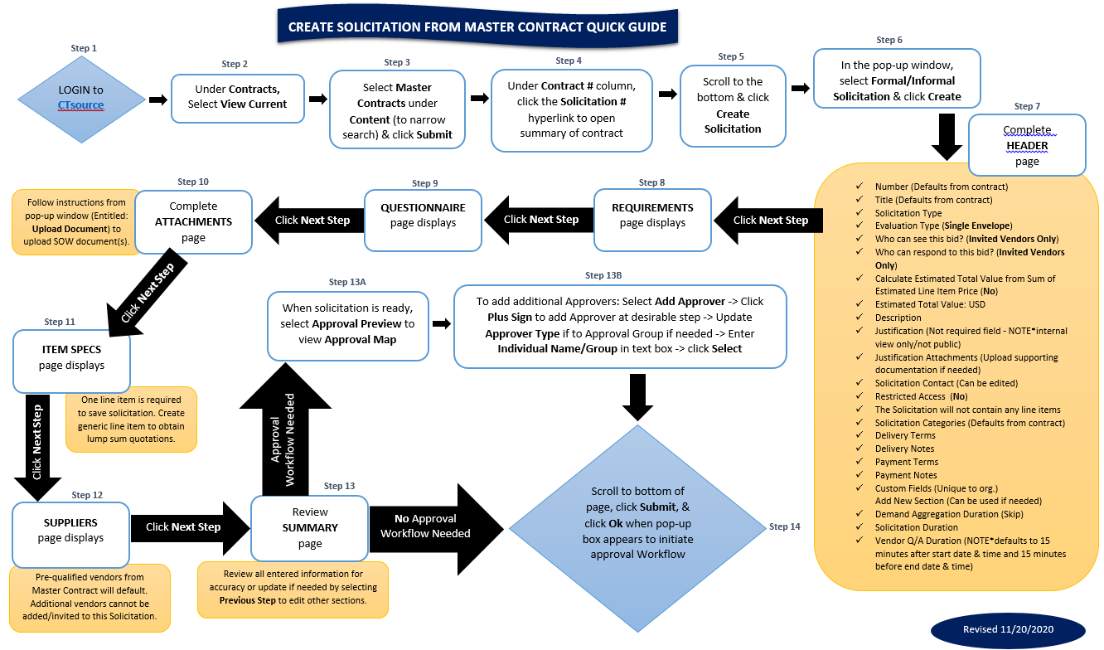
Master Agreements
CTsource Training 3
Contract Management
Master Agreements
Notes:
Follow these process steps to create a solicitation from a Master Contract.

Slide 53
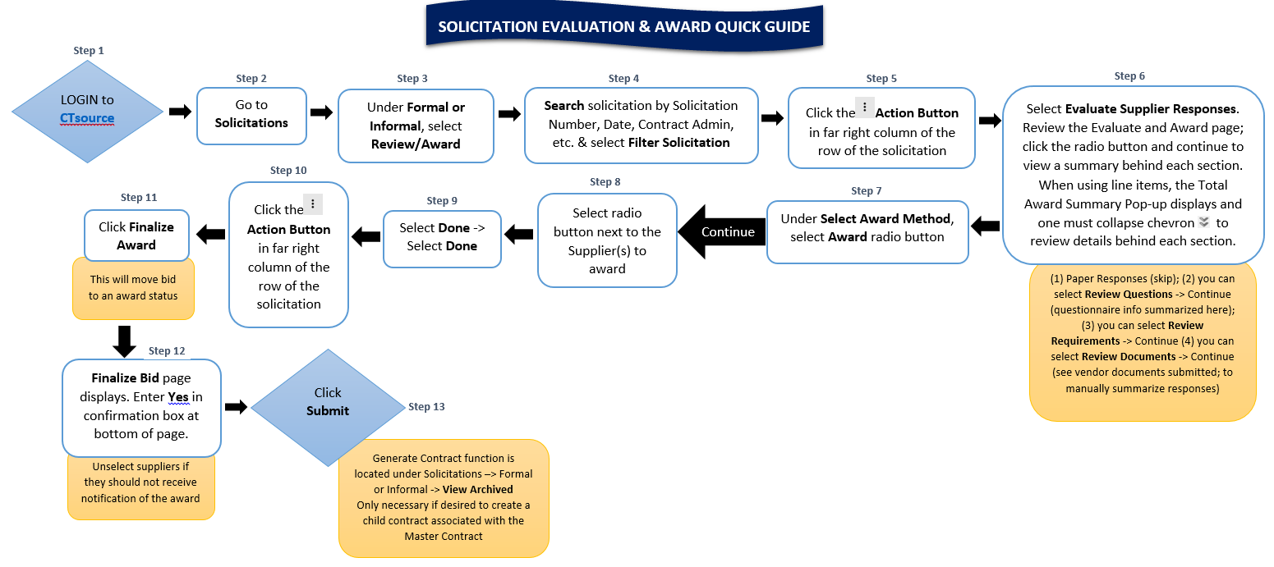
Master Agreements
CTsource Training 3
Contract Management
Master Agreements
Notes:
Follow these process steps to evaluate and award a solicitation from a Master Contract.

Slide 54
Questions & Answers
Please use the Q&A function at the bottom of the screen to ask questions during the training webinar.
We will answer as many questions as we can.
All questions and answers will be posted on our website for future reference, so please be sure to go to https://portal.ct.gov/DAS/CTSource/CTSource
CTsource Training 3

Slide 55
CTsource Training 3
This concludes Training 3.
Please be sure to go to https://portal.ct.gov/DAS/CTSource/CTSource
to find recordings of all training videos.
For any questions after the webinar or to request a username and password to the Stage Environment contact DAS Procurement Services by emailing: das.ctsource@ct.gov
You w
Thank you!
CTsource Training 3

