Slide 1
CTsource Training 2 Solicitations
State of Connecticut DAS – Procurement Services
January 20, 2021
Notes:
Welcome to CTsource Training 2: Solicitations. This is the second of three trainings provided to you by the State of Connecticut – DAS Procurement Services CTsource Training Team. This webinar is being recorded and will be available on the DAS website. The Team is live and ready to answer any questions you may have after each video demonstration. We encourage you to enter questions in the Q&A section of this webinar and we will answer as many as time allows. All questions will be answered and posted on our website along with this recorded training session.

Slide 2
CTsource Training 2
Section | Page
Formal and Informal Solicitations Building solicitations using solicitation attachments Posting Solicitations | 3
Managing Solicitations Addenda Questions and Answers | 40
Evaluate | 65
Award | 90
CTsource Training 2
Formal/Informal
Manage
Evaluate
Award
Notes:
During this training, we will cover functionality for formal and informal solicitations, building solicitations using attachments, and how posting to the Bid Board works within CTsource. We will also cover managing the solicitation which includes posting addenda and the Q&A Center. After the solicitation closes we will show you how to evaluate supplier responses and award to supplier(s). Some of the functionality discussed today is not required and it is up to your organization as to whether or not you choose to take advantage of it. For example, it is not required to use the Q&A Center or complete the award process. These processes may be performed outside of CTsource as you may currently complete them today. We will highlight this information when we discuss those sections.
You may follow along with the PowerPoint slides. Each of the sections are hyperlinked. Simply hover over the link, press the Ctrl button and click your mouse to follow the link. The page numbers or slide numbers are listed in the bottom right corner. Also at the bottom of the screen you will find “breadcrumb” tabs in the ribbon: Formal/Informal, Manage, Evaluate, and Award. When a new section begins, the color of the tab will change and will indicate which section you are in.

Slide 3
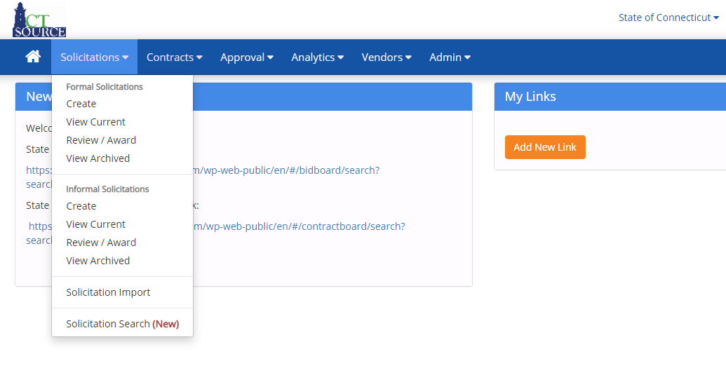
Formal/Informal Solicitations
CTsource Training 2
Formal/Informal
Manage
Evaluate
Award
Notes:
It is important to note that based on your organization’s procurement rules, your organization will determine how to use the functionality we are about to demonstrate. We will be demonstrating the buyer role; not everyone viewing this training will have access to complete these functions, however, all other roles have the ability to view the results. This will be highlighted throughout the presentation.
There are two solicitation types from which to choose: Formal and Informal. These are the same with one exception: the formal solicitation has functionality to enforce the Sealed Bid requirement. This means that a solicitation cannot be awarded and supplier responses cannot be viewed prior to the End Date and Time set up for that solicitation.

Slide 4
Formal Solicitations
CTsource Training 2
Formal/Informal
Manage
Evaluate
Award
Notes:
To create a Formal Solicitation, select Create from the Solicitations dropdown menu. [DEMO]

Slide 5
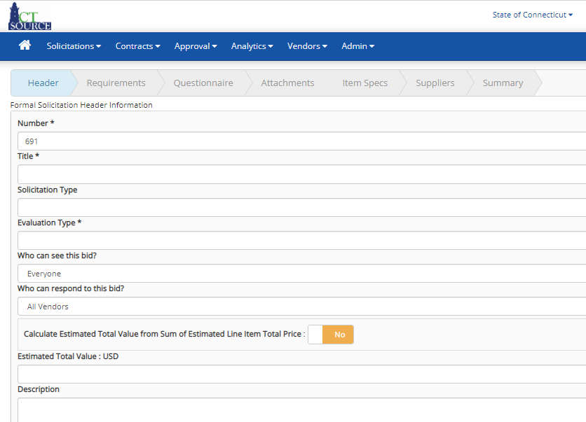
Formal Solicitations
CTsource Training 2
Formal/Informal
Manage
Evaluate
Award
Notes:
The solicitation window (WebProcure: Create Bid Form) opens. Just below the main tool bar is the solicitation navigation bar with Header highlighted. The solicitation navigation bar indicates the current step the user is in during the solicitation creation process.
The system requires you to go through each step in the solicitation navigation bar as you build the solicitation. All fields with an * (asterisk) are required.
[DEMO]

Slide 6
Formal Solicitations
CTsource Training 2
Formal/Informal
Manage
Evaluate
Award
Notes:
The solicitation number automatically populates. This may be overridden to reflect a unique solicitation number.
Enter the name of the solicitation in the Title field. Select the type of formal solicitation from the Solicitation Type dropdown menu.
Select either Single Envelope or Two Envelope in the Evaluation Type field.
A Two Envelope System separates vendor responses to Formal Solicitations into two sealed bids, or envelopes: a technical proposal and a price proposal. The envelopes are evaluated independently to ensure procurement integrity and reduce the risk of pricing criteria unfairly influencing the evaluation process. This process is typically associated with Formal Solicitations of the Request for Proposal (RFP) type.)
[DEMO]

Slide 7
Formal Solicitations
CTsource Training 2
Formal/Informal
Manage
Evaluate
Award
Notes:
For solicitations posted to the public bid board (typically formal solicitation), select “Everyone” from the dropdown menu of the Who can see this bid? and “All Vendors” from the Who can respond to this bid? [DEMO]
For solicitations not posted to the public bid board (typically informal solicitation), select “Invited Vendors Only” from the dropdown menu of the Who can see the bid? and “Invited Vendors Only” from the dropdown menu of the Who can respond to the bid?

Slide 8
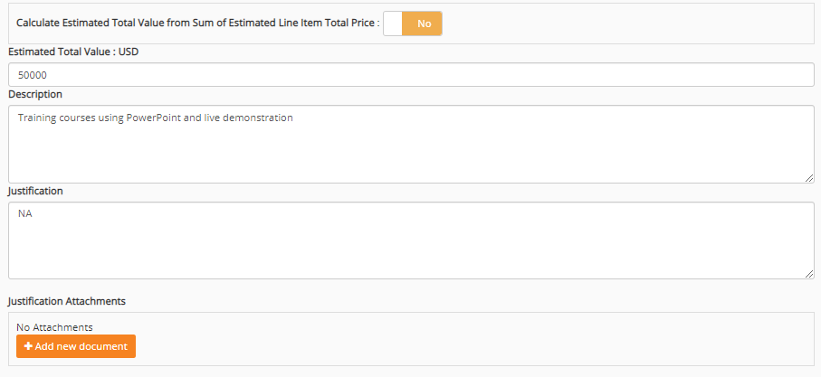
Formal Solicitations
CTsource Training 2
Formal/Informal
Manage
Evaluate
Award
Notes:
Calculate Estimated Total Value from Sum of Estimated Line Item Total Price defaults to No. This will not apply for bids without line items entered on the Item Spec page.
Enter the estimated total value of the solicitation in the Estimated Total Value field. This value will not be visible to the suppliers and is only used for Approval Workflow and Reporting.
Enter a description in the Description field. This field is used to provide an overview of the products and services requested by your organization. The description allows the suppliers to review for products and services at a quick glance so enough information should be provided so that it can capture the suppliers’ interest when viewing/participating in the solicitation. Maximum of 2,000 characters.
Enter a justification for the solicitation in the Justification field and attach any necessary documents in the Justification Attachments field. These will not be visible to the suppliers and is only used for Approval Workflow and Reporting.
[DEMO]

Slide 9
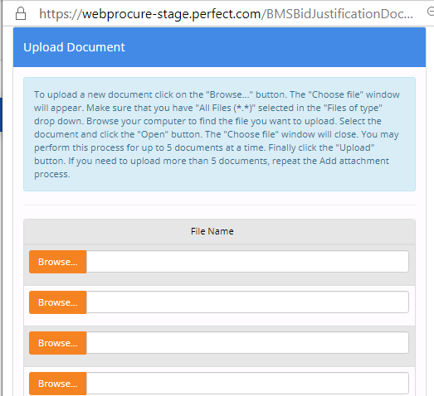
Formal Solicitations
CTsource Training 2
Formal/Informal
Manage
Evaluate
Award
Notes:
PLEASE NOTE: The Add New Document functionality is the same throughout this application. Should you click on the button, WebProcure will open the Upload Document window for you to browse through documents available to you on your computer or shared drive for uploading purposes.
[DEMO]

Slide 10
Formal Solicitations
CTsource Training 2
Formal/Informal
Manage
Evaluate
Award
Notes:
The Solicitation Contact will default to the user creating the document. You can search and update to add additional contacts or modify or delete what is there or replace with a different person. Type another CTsource user name in the Find a Contact box and select from offered choices; if not a CTsource user you must type the information in the text box provided.
The Restricted Access will default to No. Any individual with the buyer role in your organization will have the ability to edit your solicitation in your absence if needed. If you are to be the ONLY user (or small group of specific users) to have access to this solicitation, you may change this to Yes.
The check box for This Solicitation will not contain any line items is not checked by default. If a solicitation is not going to contain any line items but rather be used as a document passing vehicle between buyer and supplier, then check the box must be checked. The bid process will occur based on submitted documents by the suppliers. If this box is checked, then header level categories are required. At this time we are recommending to always check this box to post solicitations without line items to the Bid Board. Item Spec functionality may be used by your organization in the future and you may request additional training or resources at a later date.
[DEMO]

Slide 11
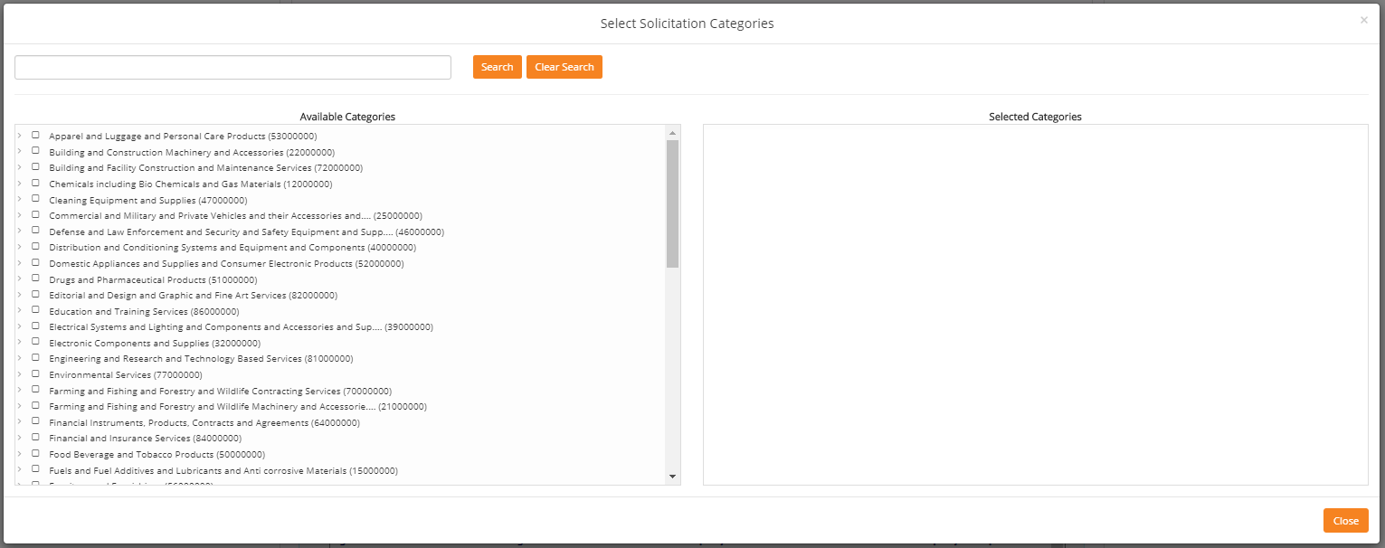
Formal Solicitations
CTsource Training 2
Formal/Informal
Manage
Evaluate
Award
Notes:
Solicitation Categories are required in order to save your solicitation and invite suppliers to view the opportunity. Suppliers that have registered with matching categories will receive an email invitation. BizNet used commodity codes that were developed in-house and are only applicable to the State and not applicable in other states. In CTsource, UNSPSC codes are used. UNSPSC stands for United Nations Standard Products and Services Codes.
To enter a category for the solicitation, click on Select Categories and the Select Solicitation Categories window opens. You can search for specific categories and clear that search. Select the highest level of the category that pertains to the solicitation. By doing so, all vendors that have selected lower-level categories in their supplier profile will be included in the solicitation invite. [DEMO]

Slide 12
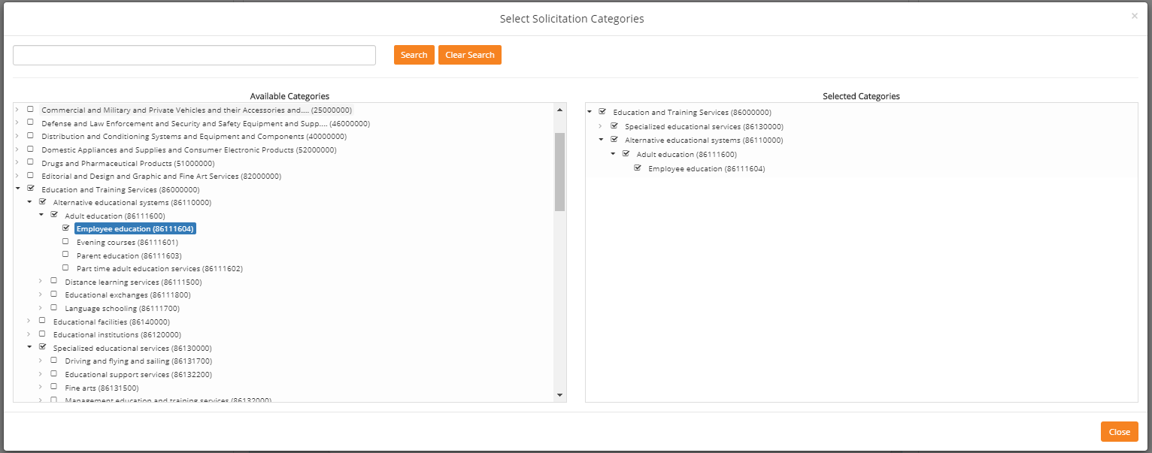
Formal Solicitations
CTsource Training 2
Formal/Informal
Manage
Evaluate
Award
Notes:
Click the arrow before the box for the highest level category and you may view the subcategories. You may continue to drilldown to view subcategories if you so desire by clicking the arrows.
Click in the box next to the highest level category or categories to select those that pertain to the solicitation, the categories populate in the right window. By doing so, all vendors that have selected lower-level categories in their supplier profile will be included in the solicitation invite. Selecting multiple header categories will include and invite as many suppliers in the solicitation as possible. [DEMO]

Slide 13
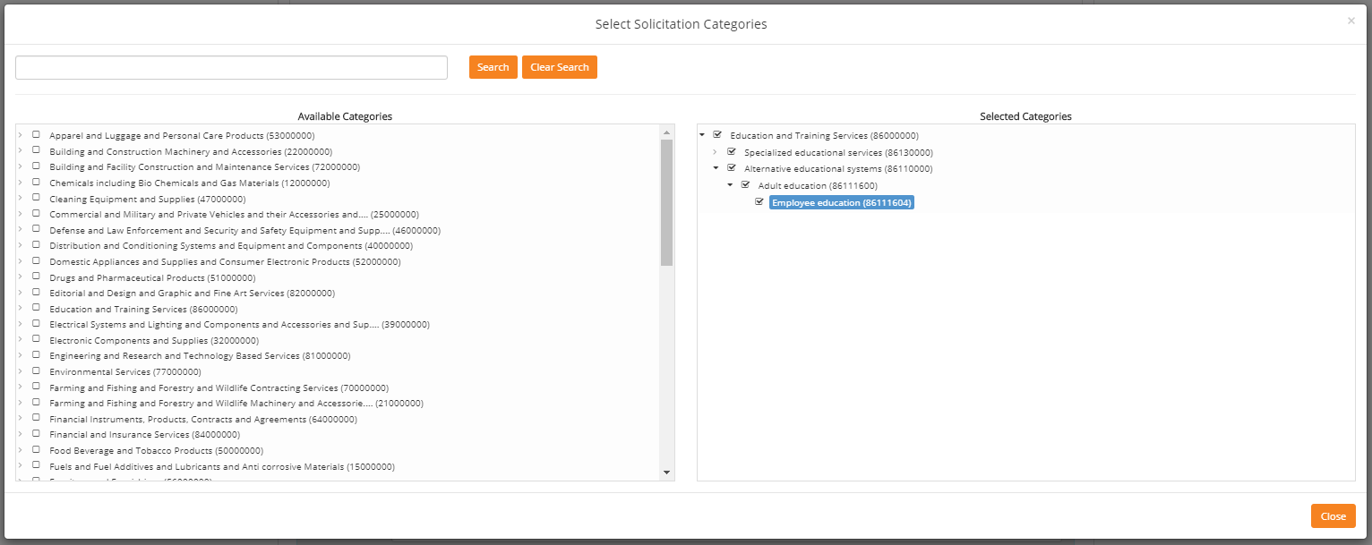
Formal Solicitations
CTsource Training 2
Formal/Informal
Manage
Evaluate
Award
Notes:
Once you have selected the appropriate category, click Close; the categories will populate and return you to the previous screen. [DEMO]
To remove a header category simply uncheck the appropriate check box under the Selected Categories column.

Slide 14
Formal Solicitations
Let’s break down the UNSPSC for 4320150114:
https://www.unspsc.org/faqs#How%20does%20UNSPSC%20work
CTsource Training 2
Formal/Informal
Manage
Evaluate
Award
Notes:
All UNSPSC entities are identified with an 8-digit structured numeric code which both indicates its location in the taxonomy and uniquely classifies it. An additional 2-digit suffix indicates the business function identifier. For more information on how the UNSPSC hierarchy is set up and how UNSPSC works, go to https://www.unspsc.org/ or the DAS Contracting Portal for a PDF reference guide.

Slide 15
Formal Solicitations
CTsource Training 2
Formal/Informal
Manage
Evaluate
Award
Notes:
In the Additional Information box, select Delivery Terms and Payment Terms from the dropdown menus. Enter any notes pertaining to each Delivery Notes and Payment Notes as necessary.
Please note: Additional delivery and payment terms cannot be added to the dropdown options. Select the field option: “See Delivery Notes” or “See Payment Notes” and enter the pertinent data that applies in the text box. [DEMO]

Slide 16
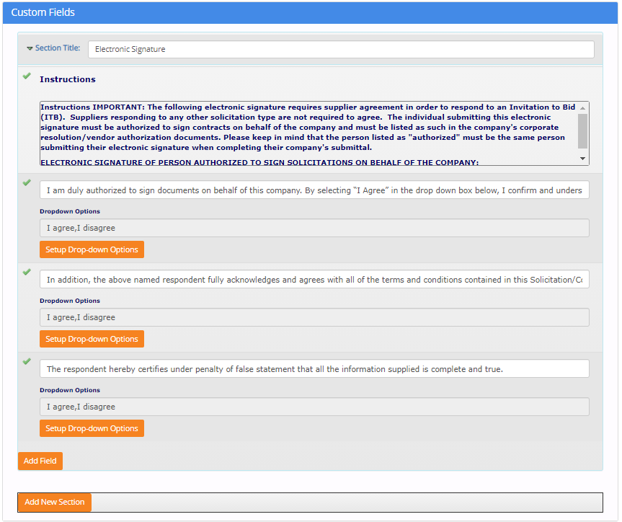
Formal Solicitations
CTsource Training 2
Formal/Informal
Manage
Evaluate
Award
Notes:
Custom Fields can be created for your organization at the Header level for your organization by your Administrator. Your organization may determine whether or not to use this functionality. [DEMO]
This is an example of a custom field DAS Procurement Services is utilizing for their solicitations.

Slide 17
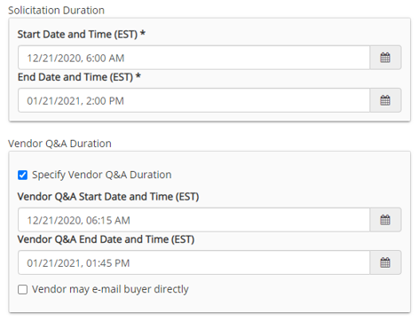
Formal Solicitations
CTsource Training 2
Formal/Informal
Manage
Evaluate
Award
Notes:
Solicitation Duration - Select the start and end dates and times from the drop-down boxes. Default times are defined but may be changed accordingly. Click Next Step to save entries on this page. [DEMO]
Vendor Q&A Duration – To enable this feature, select Specify Vendor Q&A Duration checkbox should this solicitation require a Q&A period. Select the appropriate start and end dates/times from the available drop-down boxes. The duration for the solicitation must start at least 15 minutes after the Solicitation Duration Start and end at least 15 minutes before the Solicitation End date and time, but may be shorter.
This provides two-way communication between buyers and suppliers for the solicitation. Vendors may submit questions relating to the active solicitation and buyers may respond directly or via addendum. Note this feature only works for CTsource registered suppliers, an addendum of the Q&A should be posted for transparency.

Slide 18
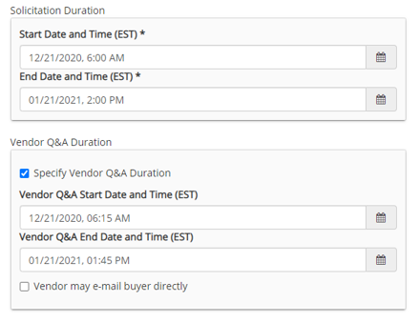
Formal Solicitations
CTsource Training 2
Formal/Informal
Manage
Evaluate
Award
Notes:
Select Exit or Next Step. If you select Exit, you may lose the information you have entered thus far. Click Next Step. [DEMO]

Slide 19
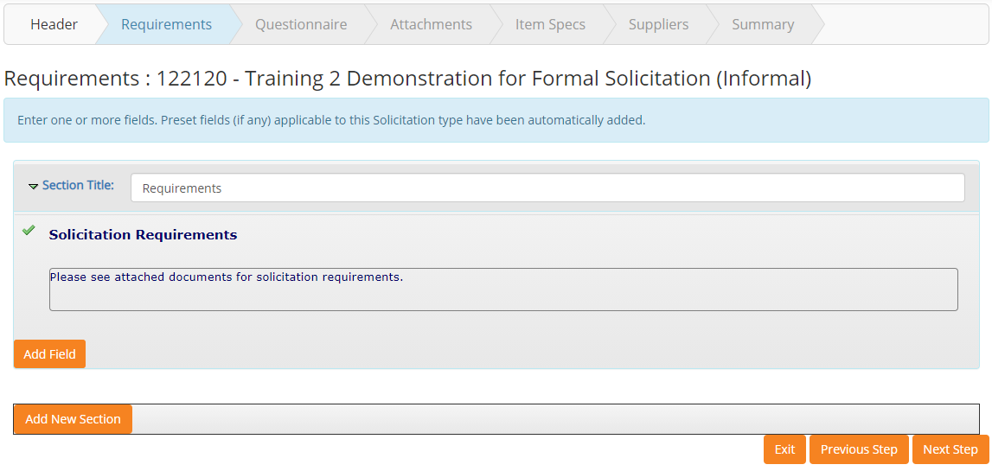
Formal Solicitations
CTsource Training 2
Formal/Informal
Manage
Evaluate
Award
Notes:
By selecting Next Step, you will move forward in the create solicitation process to the next section: Requirements. Notice that Requirements is now highlighted.
Additional Fields could be defined at the Administrative Level for use. Functionality will become available at a later date for state agencies to use.
[DEMO]

Slide 20
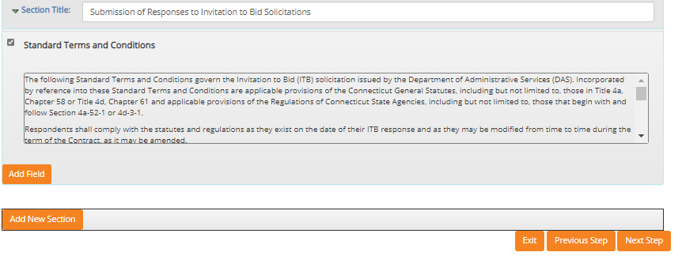
Formal Solicitations
CTsource Training 2
Formal/Informal
Manage
Evaluate
Award
Notes:
If so desired, you may establish a requirement through the Add New Section feature. [DEMO]
Choose Next Step to move forward to the Questionnaire section. (You may also go back to Previous Step and Exit.)

Slide 21
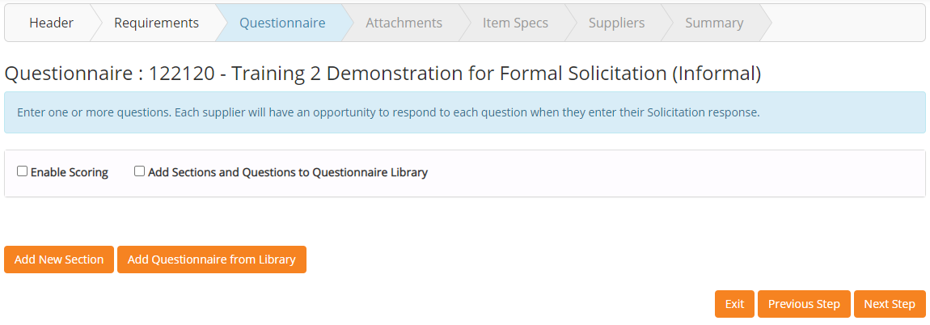
Formal Solicitations
CTsource Training 2
Formal/Informal
Manage
Evaluate
Award
Notes:
Questionnaire, when enabled, allows for you to include section containers with questions that may be scored and weighted. Effective questions can provide insight into a supplier's capabilities and combined with the supplier responses, can simplify the scoring and review process, as well as contribute greatly to the awarding decision.
Scoring allows sections to be weighted and questions within those sections to have point values. Combined, these values become a weighted score and are used in the evaluation and awarding process. Or you can build questions without scoring.
Select Next Step when ready to proceed to the Attachments section. [DEMO]

Slide 22
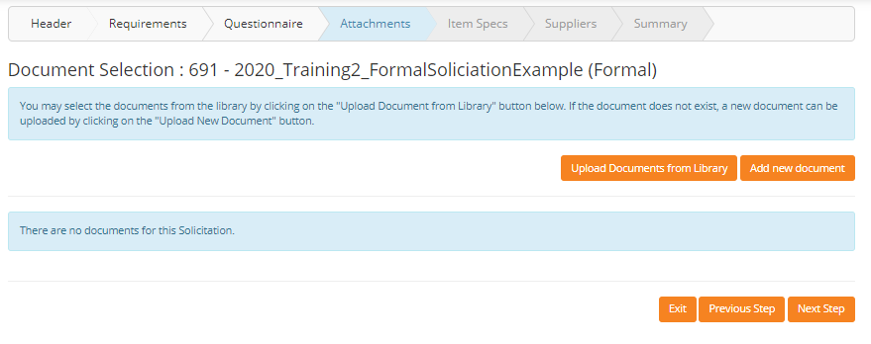
Formal Solicitations
CTsource Training 2
Formal/Informal
Manage
Evaluate
Award
Notes:
To select a document from the Library for your bid, select the Upload Documents from Library or Add new document. Document Library management - add and delete capability - is accessible to users with appropriate permissions.
[DEMO]

Slide 23
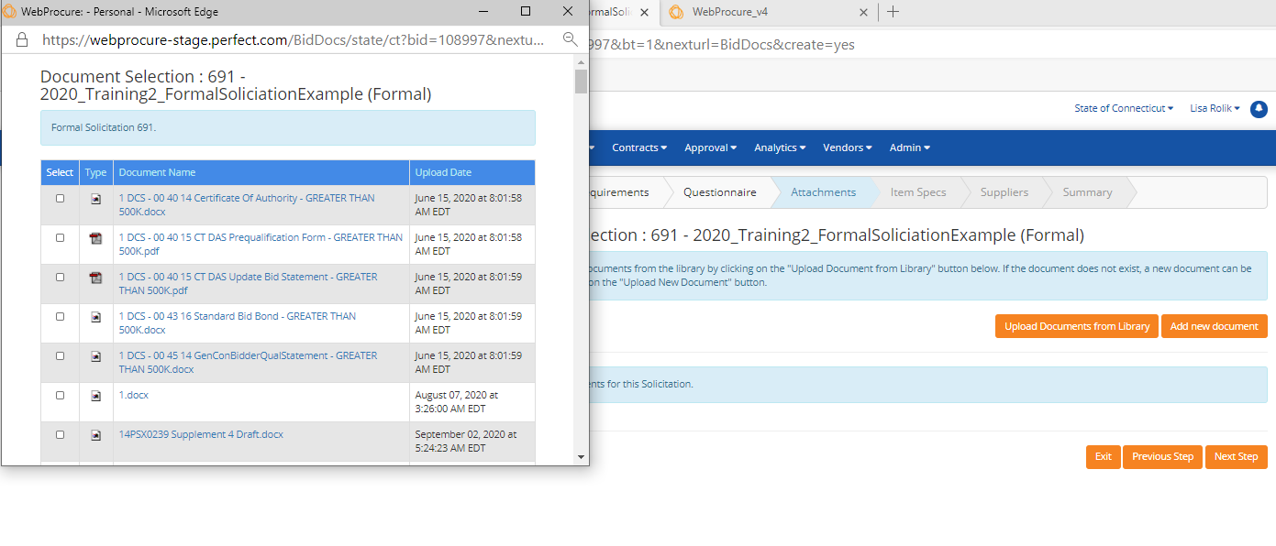
Formal Solicitations
CTsource Training 2
Formal/Informal
Manage
Evaluate
Award
Notes:
To select a document(s) from the Library for your bid, select the Upload Documents from Library button. Scroll through the list and click the check box for any document (up to five) to add to your solicitation. You may sort list by clicking on the column heading (Type, Document Name, Upload Date). At the bottom of the page select Save. [DEMO]

Slide 24
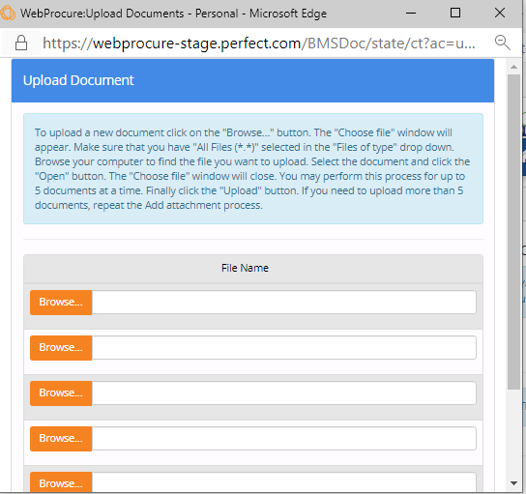
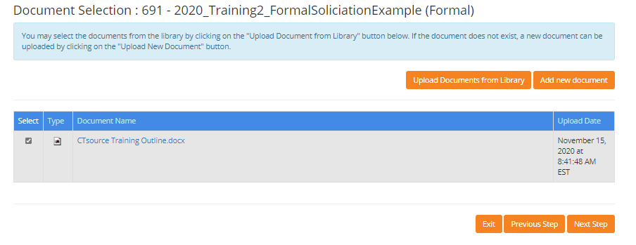
Formal Solicitations
CTsource Training 2
Formal/Informal
Manage
Evaluate
Award
Notes:
Or select Add New Document and the Upload Document window will open for you to browse and find those documents you wish to attach. After attaching all necessary documents, select Next Step to move forward to the Item Specs section.
To remove a document for an unissued solicitation, simply uncheck the box under the Select column for the document to remove.
[DEMO]

Slide 25
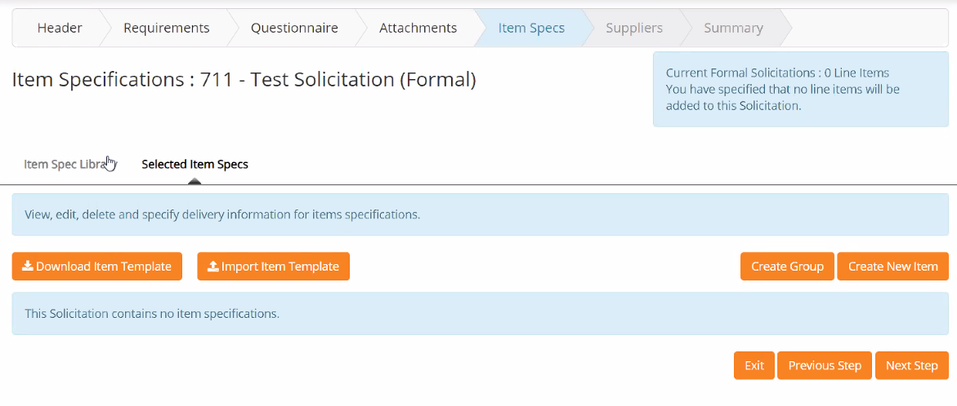
Formal Solicitations
CTsource Training 2
Formal/Informal
Manage
Evaluate
Award
Notes:
Item Specs functionality will be available at a future date. Please note that this current solicitation contains 0 line items. Item Spec Library functionality is system-wide functionality and will not be utilized until an enhancement is in place to separate organizations so that their items specs may be unique to their orgs.
Once finished, select Next Step to move to the Suppliers section. [DEMO]

Slide 26
Formal Solicitations
CTsource Training 2
Formal/Informal
Manage
Evaluate
Award
Notes:
The Suppliers section will default to Selected Suppliers. Supplier names are hyperlinks to their vendor profile, notice that some suppliers have icons next to their names; hover over the icon to see a description or menu of options.
If you do not see a supplier that you would like to include in the invitation, click on Add Suppliers, perform a search, add the supplier by clicking the check box next to name and select Save Selections.
Use the [Check All] or [Uncheck all] link to select/add all the suppliers to select suppliers or deselect them for the email invite. Suppliers not invited will still be able to respond to the solicitation.
Use the scroll bar to navigate to the bottom of the screen or use the END key. Click Next Step to move to the Summary section. [DEMO]

Slide 27
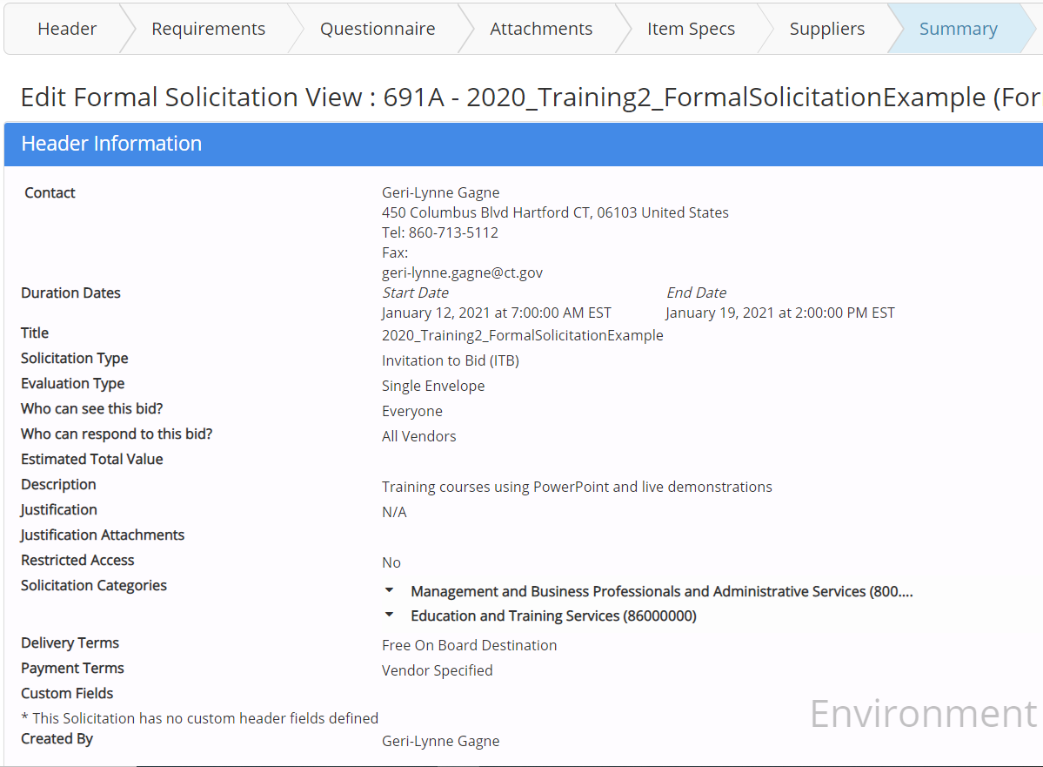
Formal Solicitations
CTsource Training 2
Formal/Informal
Manage
Evaluate
Award
Notes:
The Summary provides the opportunity to review your solicitation entries. If the information is correct, you may select Submit to post to the bid board at the start date and time you entered on the header. If your organization has established approval workflow, Submit will send the solicitation for review and approval.
If the information requires a change you must select Previous Step to move backwards through each section until you get to the page you want, you will then have to click Next Step on each page to return to the Summary page to select Submit.
It is more efficient to select the Done button when you finish your entries. This will save the solicitation and allow you more freedom through the Edit functionality to move to any section in any order. After completing your change to a section you will select Save and must click the Summary page in the top ribbon to access that page to then select Submit. [DEMO]

Slide 28
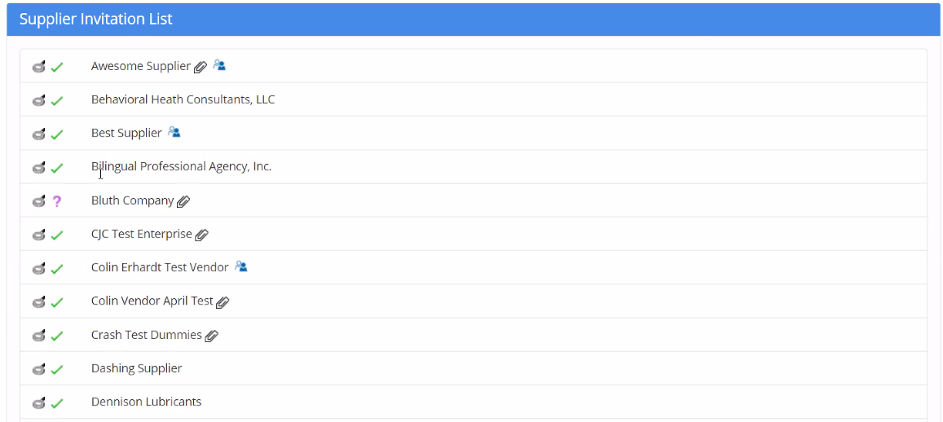
Formal Solicitations
CTsource Training 2
Formal/Informal
Manage
Evaluate
Award
Notes:
On the Summary page, the Supplier Invitation List displays the suppliers’ status. The green check mark indicates that the supplier has been vetted and approved to do business with the State of Connecticut. The purple question mark indicates the vendor has not been approved and cannot be awarded until the supplier is in approved status. It also allows for one more opportunity to view other details on the supplier’s profile. [DEMO]

Slide 29
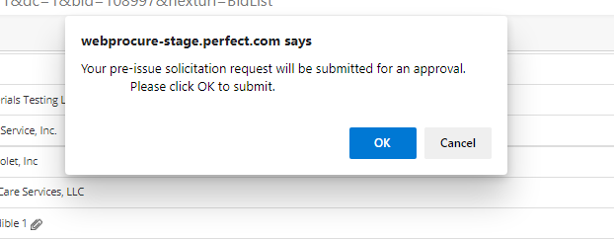
Formal Solicitations
CTsource Training 2
Formal/Informal
Manage
Evaluate
Award
Notes:
When ready to submit the solicitation, click Submit. Click OK or Cancel. The solicitation will either be sent to approval workflow or to the bid board. [DEMO]

Slide 30
Formal Solicitations
CTsource Training 2
Formal/Informal
Manage
Evaluate
Award
Notes:
Hitting Submit, changes the solicitation status to Approved. Based on the solicitation’s start date and time, the solicitation will post and email invitations will be sent to the suppliers. [DEMO]

Slide 31
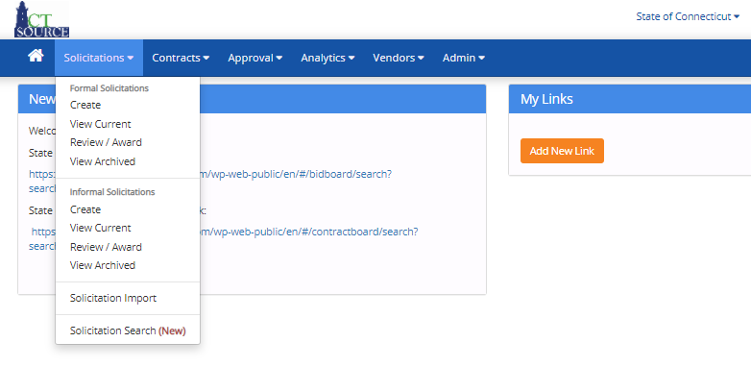
Formal Solicitations
CTsource Training 2
Formal/Informal
Manage
Evaluate
Award
Notes:
Should you have exited the solicitation (clicked Done or Save or Close) so that you can continue at a later time, locate the solicitation from the View Current Formal Solicitation screen.
From the Solicitation dropdown menu, select View Current. The Current Formal Solicitation screen will populate.
[DEMO]

Slide 32
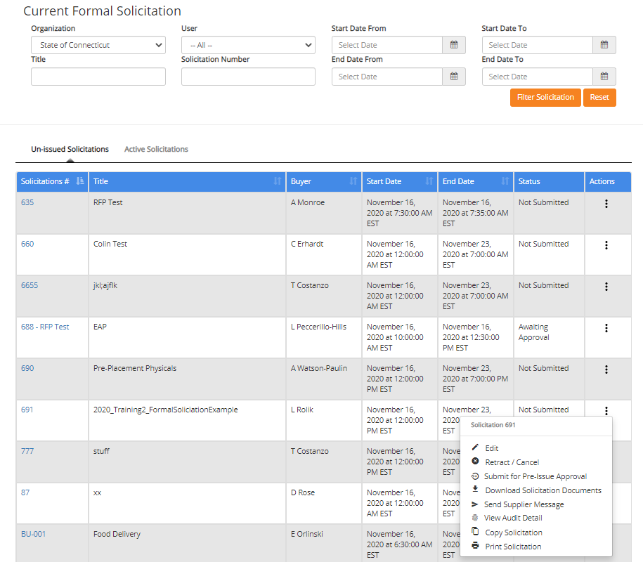
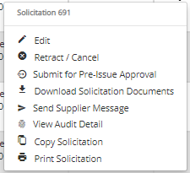
Formal Solicitations
CTsource Training 2
Formal/Informal
Manage
Evaluate
Award
Notes:
Enter search criteria and click Filter Solicitation. Under Un-Issued Solicitations, find the solicitation for which you would like to edit. Click in the Actions column (three vertical dots) at the far right of the solicitation line. Select Edit from the Actions pop-up. [DEMO]

Slide 33
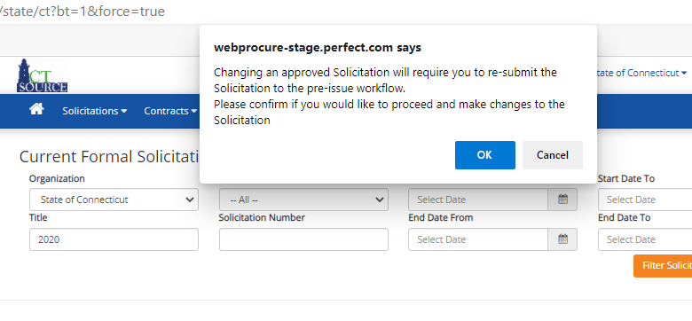
Formal Solicitations
CTsource Training 2
Formal/Informal
Manage
Evaluate
Award
Notes:
NOTE: If the solicitation has already been approved, you will be notified that changing an approved solicitation will require you to re-submit the solicitation through the pre-issue workflow. If the solicitation has already posted, any change made will result in an addendum to the solicitation. Posted solicitations will not be found under the Un-Issued Solicitation section.

Slide 34
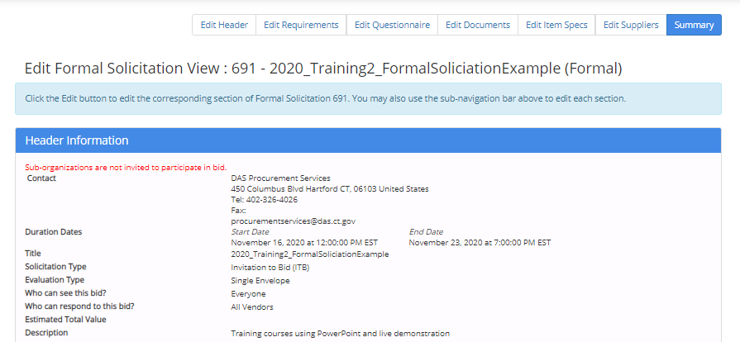
Formal Solicitations
CTsource Training 2
Formal/Informal
Manage
Evaluate
Award
Notes:
Notice how in the solicitation navigation bar, Summary is highlighted. You may return to any section within the solicitation to edit the information whether that is to Edit Header, Edit Requirements, Edit Questionnaire, Edit Documents, Edit Item Specs, or Edit Suppliers.
The Summary page options also change under Edit mode. Notice the Delete, Copy and Print buttons are now available if needed.

Slide 35
Informal Solicitations
CTsource Training 2
Formal/Informal
Manage
Evaluate
Award
Notes:
For Informal Solicitations.
We can follow the same process as when we created the Formal Solicitation. Remember, the formal solicitation has functionality to enforce the Sealed Bid requirement. This means that a solicitation cannot be awarded and supplier responses cannot be viewed prior to the End Date and Time set up for that solicitation.
From the Solicitations dropdown menu, find and select Create.
[DEMO]

Slide 36
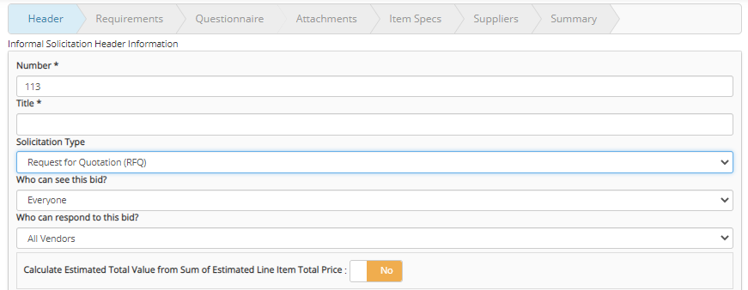
Informal Solicitations
CTsource Training 2
Formal/Informal
Manage
Evaluate
Award
Notes:
The Informal Solicitation Header Information window opens.
NOTE: If you wanted to do a quick informal solicitation Request for Quotation, you can quickly ask suppliers to respond and not “publicly” invite them. This is an invite only process. [DEMO]
This is also the process used when creating a quotation off of a master contract which will be demonstrated in Training #3.

Slide 37
Informal Solicitations
CTsource Training 2
Formal/Informal
Manage
Evaluate
Award
Notes:
Once all of information for the solicitation have been made and any edits have been completed, click Submit. WebProcure will ask you to confirm: click OK.
If there is an approval workflow, the solicitation will go through the approval process. The solicitation will automatically post and become active based on the start date/time you selected for the Solicitation Duration. [DEMO]

Slide 38
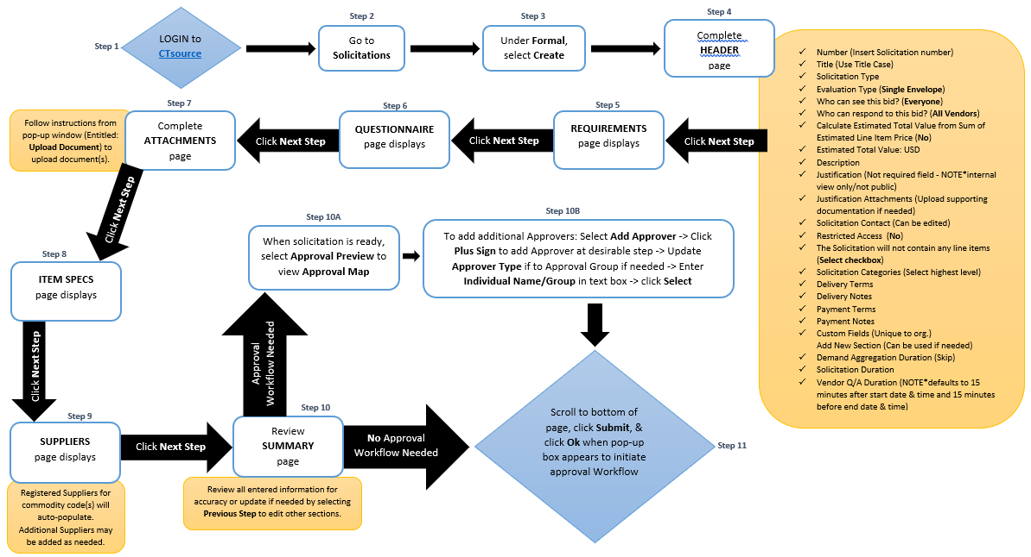
Formal/Informal Solicitations
CTsource Training 2
Formal/Informal
Manage
Evaluate
Award
Notes:
To create a solicitation, follow the process steps as captured in this process flow.

Slide 39
Questions & Answers
Please use the Q&A function at the bottom of the screen to continue asking questions.
We will answer as many questions as we can during the time we have allowed for this segment.
All questions and answers will be posted on our website for future reference, so please be sure to go to https://portal.ct.gov/DAS/CTSource/CTSource
CTsource Training 2
Formal/Informal
Manage
Evaluate
Award

Slide 40
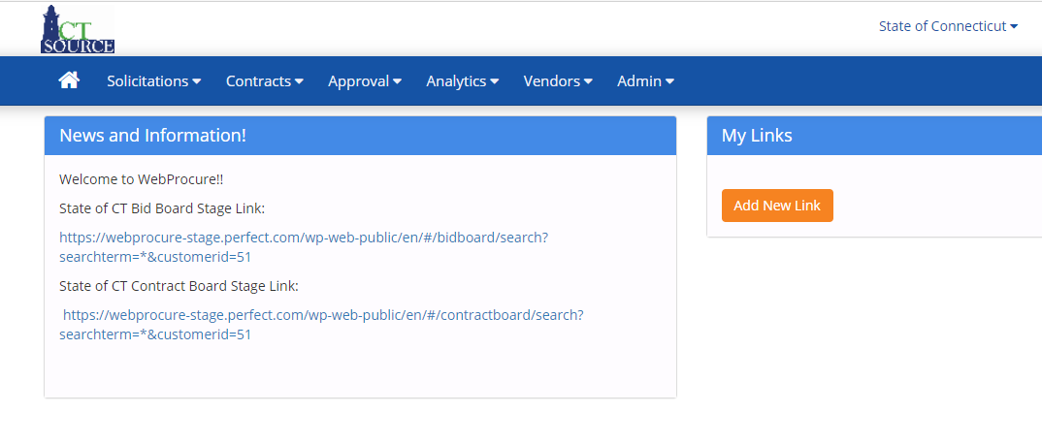
Manage Solicitations
CTsource Training 2
Formal/Informal
Manage
Evaluate
Award
Notes:
To ensure the solicitation has posted, return to the home screen, and click the link to the State of CT Bid Board Stage Link (In the production environment, this is the Solicitation Public Board). [DEMO]

Slide 41
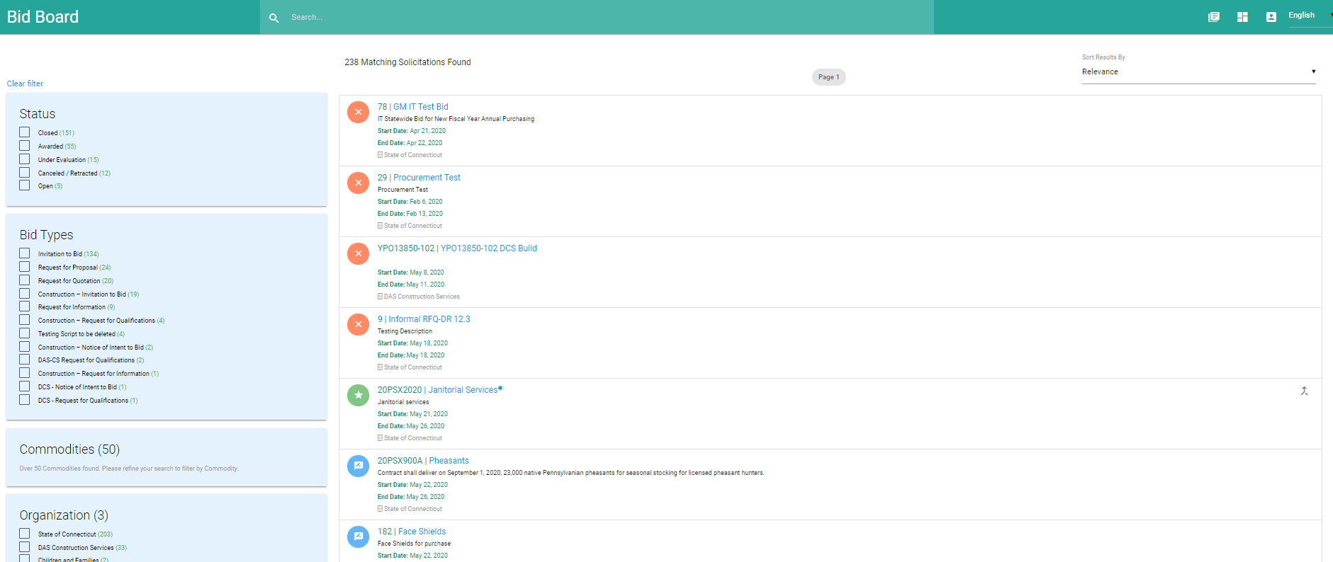
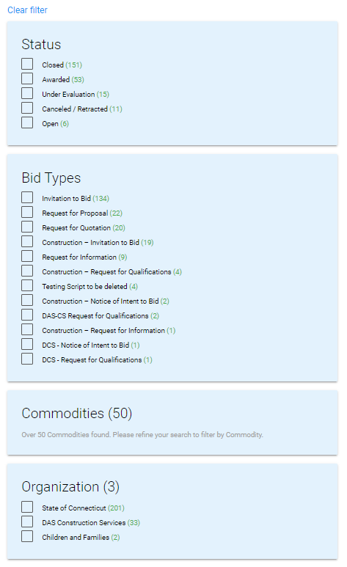
Manage Solicitations
CTsource Training 2
Formal/Informal
Manage
Evaluate
Award
Notes:
The Bid Board will open and you may search for a solicitation filtering by the following: Status, Bid Types, Organization or Commodities. Use the filters on the left panel to assist you in your search OR if you know the name of the solicitation, you may enter it in the Search field. You may also search by Relevance. You may Clear filter when you would like to start filtering anew. [DEMO]

Slide 42
Managing Solicitations
CTsource Training 2
Formal/Informal
Manage
Evaluate
42
Award
Notes:
Another way to search is by utilizing the Solicitation Search (New). This may be a more efficient way to search if you are uncertain the status of the solicitation or if you are an Inquiry Only User. [DEMO]

Slide 43
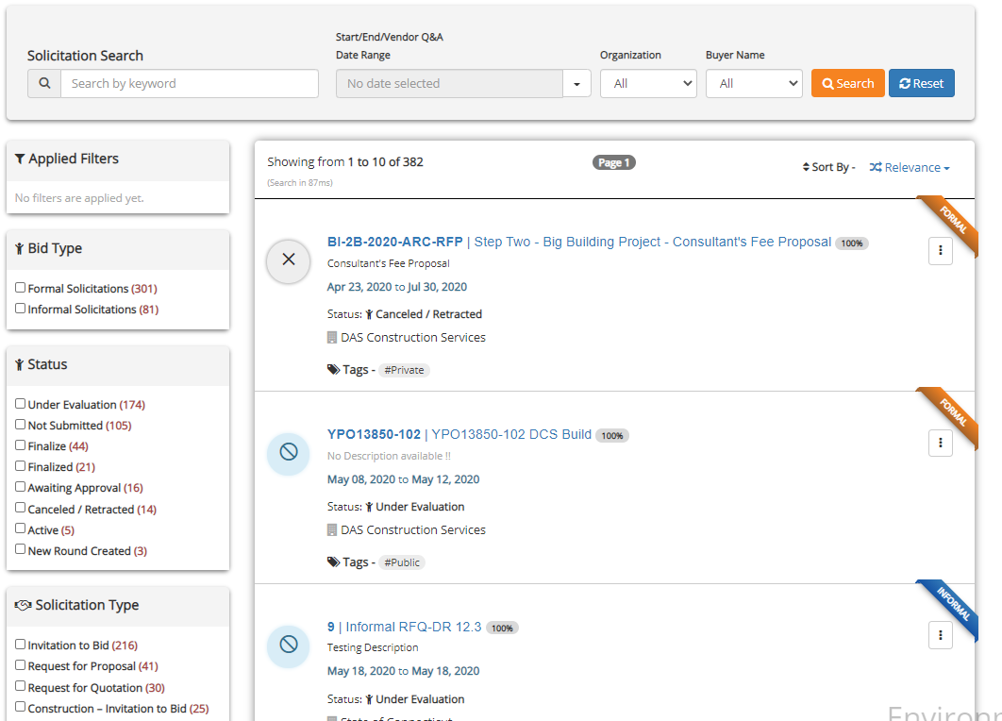
Managing Solicitations
CTsource Training 2
Formal/Informal
Manage
Evaluate
43
Award
Notes:
The Solicitation Search page will open. Apply filters in the left panel and or apply search criteria and click Search. You may start your search anew by clicking on Reset. [DEMO]
Hover over icons and symbols to identify their meaning. Click on the appropriate icon in lieu of using the action button; icons appear above the solicitation number and title when your cursor hovers the area.
The options available are subject to role permissions.

Slide 44
Manage Solicitations
CTsource Training 2
Formal/Informal
Manage
Evaluate
Award
Notes:
As mentioned, solicitations will post once they are approved and as the date/time is specified in the Solicitation Duration. At the home screen, to select View Current from the Solicitations dropdown menu.
[DEMO]

Slide 45
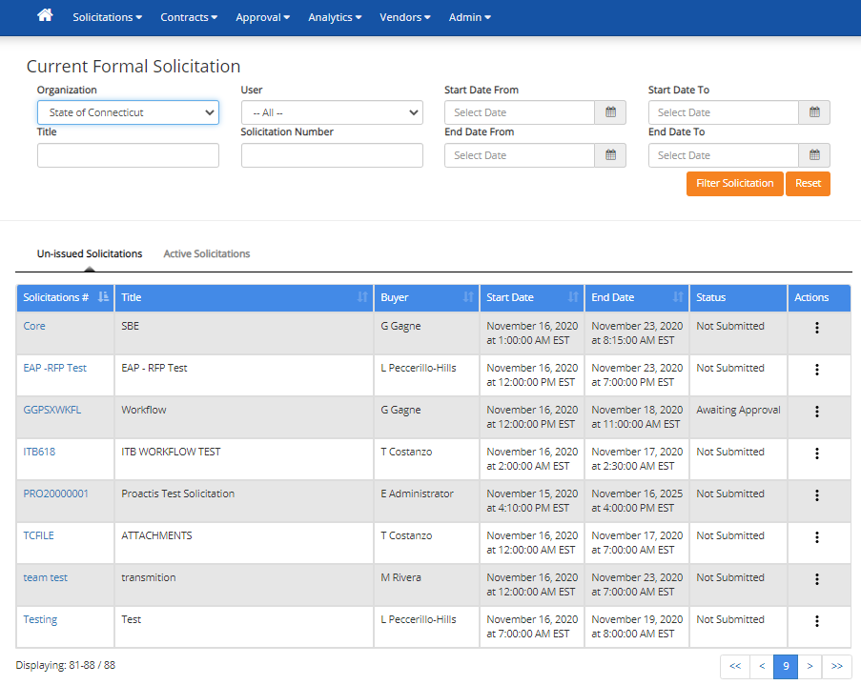
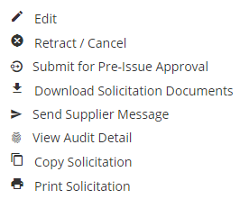
Manage Solicitations
CTsource Training 2
Formal/Informal
Manage
Evaluate
Award
Notes:
The Current Formal Solicitation screen opens. Search for a solicitation by entering the appropriate information in the search fields. You will see solicitations that are not submitted, approved or (if using approval workflow) awaiting approval, rejected. You will also see the solicitations that have posted and are active. WebProcure defaults to showing the user Un-issued Solicitations. If you wanted to search for an active solicitations, click on Active Solicitations.
Once you locate the solicitation for which you are searching, you may select certain actions by clicking in the Actions column (the three vertical dots to the far right of the solicitation), and selecting from the options that populate in the Solicitation # window.
NOTE: Copy Solicitation is a great feature to use in the event you have a very similar solicitation to issue in the future. This functionality allows for you to copy the entire solicitation, making only those revisions for your solicitation, except it will not copy any modifications made to the Requirements page.
[DEMO]

Slide 46
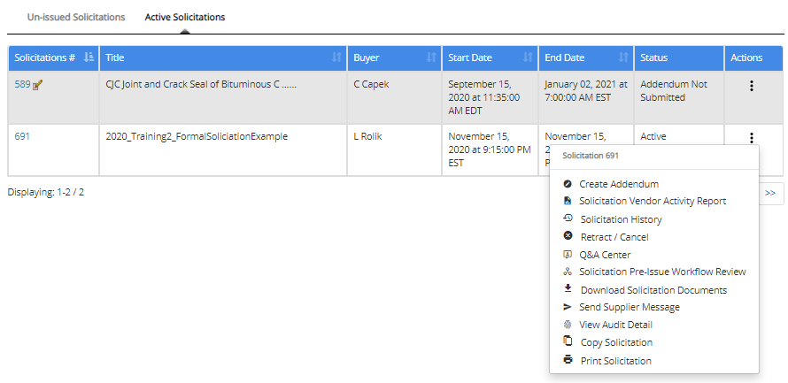
Manage Solicitations
CTsource Training 2
Formal/Informal
Manage
Evaluate
Award
Notes:
Managing solicitations may include creating addenda, managing the Questions and Answers, etc. To create an addendum, locate the solicitation and select Create Addendum from the Actions menu for the solicitation. [DEMO]

Slide 47
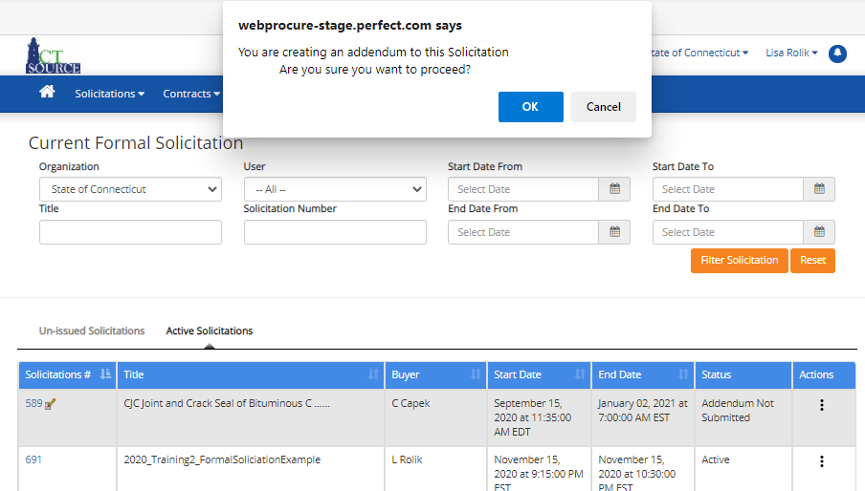
Manage Solicitations
CTsource Training 2
Formal/Informal
Manage
Evaluate
Award
Notes:
To create an addendum, locate the solicitation and select Create Addendum from the Actions for the solicitation. Click OK.

Slide 48
Manage Solicitations
CTsource Training 2
Formal/Informal
Manage
Evaluate
Award
Notes:
Navigate to the solicitation section you wish to change. Once you have made appropriate changes, click Save at the bottom of the section. Return to Summary, and click Submit.
[DEMO]

Slide 49
Manage Solicitations
CTsource Training 2
Formal/Informal
Manage
Evaluate
Award
Notes:
WebProcure will prompt you to accept or cancel the addendum. Click OK.
[DEMO]

Slide 50
Manage Solicitations
CTsource Training 2
Formal/Informal
Manage
Evaluate
Award
Notes:
If you select Cancel, WebProcure will prompt you to confirm.

Slide 51
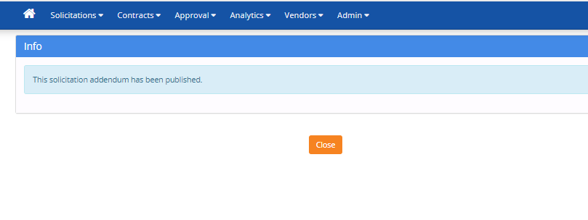
Manage Solicitations
CTsource Training 2
Formal/Informal
Manage
Evaluate
Award
Notes:
To view Questions received from suppliers, you may enter the Q&A Center.
NOTE: Based on your organization’s procurement rules, you may determine for your organization how to use the Q&A functionality.
[DEMO]

Slide 52
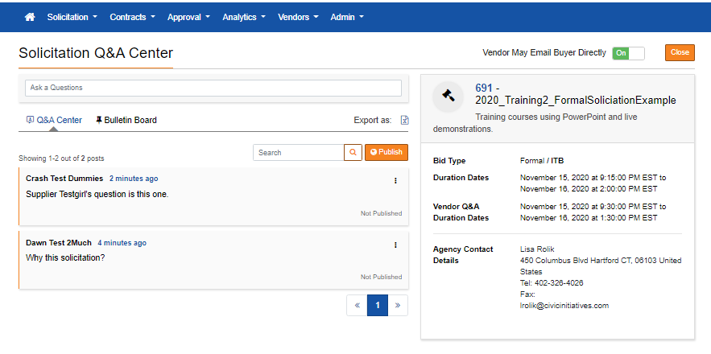
Manage Solicitations
CTsource Training 2
Formal/Informal
Manage
Evaluate
Award
Notes:
You will find the questions submitted by the suppliers. You may answer questions and answers on a rolling basis or you may save answers and publish all questions and answers at one time.
[DEMO]

Slide 53
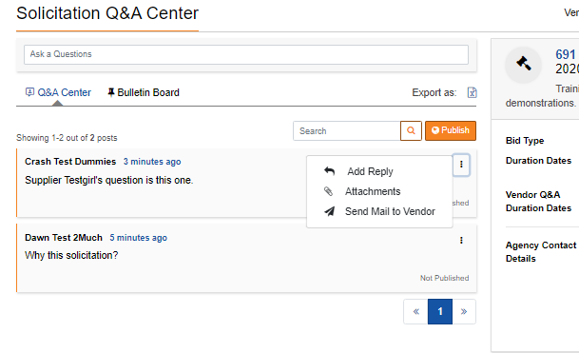
Manage Solicitations
CTsource Training 2
Formal/Informal
Manage
Evaluate
Award
Notes:
Click on the three vertical dots and select Add Reply, Attachments, Send Mail to Vendor.
[DEMO]

Slide 54
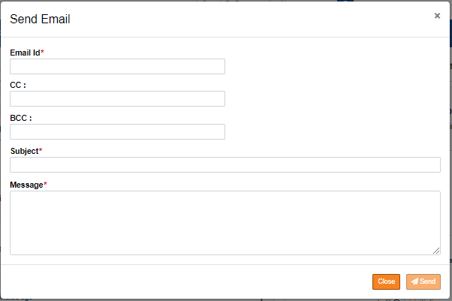
Manage Solicitations
CTsource Training 2
Formal/Informal
Manage
Evaluate
Award
Notes:
If you select Send Mail to Vendor, a Send Email box will open. Enter information and click Send.
[DEMO]

Slide 55
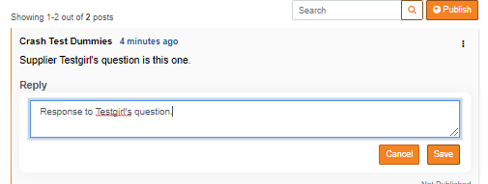
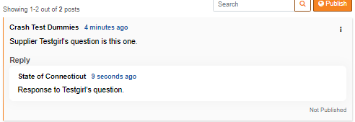
Manage Solicitations
CTsource Training 2
Formal/Informal
Manage
Evaluate
Award
Notes:
Respond to the question you would like to publish. Click Save. Notice the response in the Reply window. The response will not publish unless you proceed.
Click Publish and the Publishing Questions window opens. Select what you would like to publish and click Next.
[DEMO]

Slide 56
Manage Solicitations
CTsource Training 2
Formal/Informal
Manage
Evaluate
Award
Notes:
WebProcure will prompt you to answer. Answer and click Publish Now.
WebProcure will ask you if you are sure you want to proceed. Click Yes.
[DEMO]

Slide 57
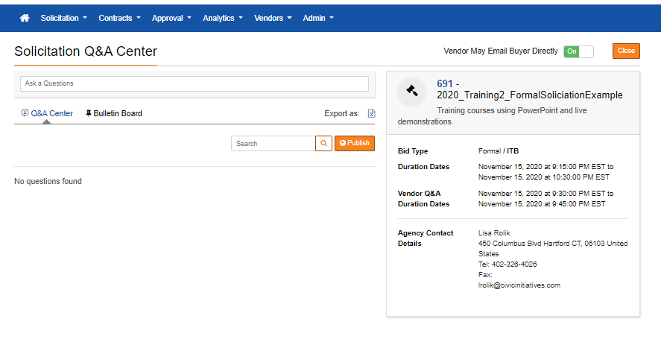
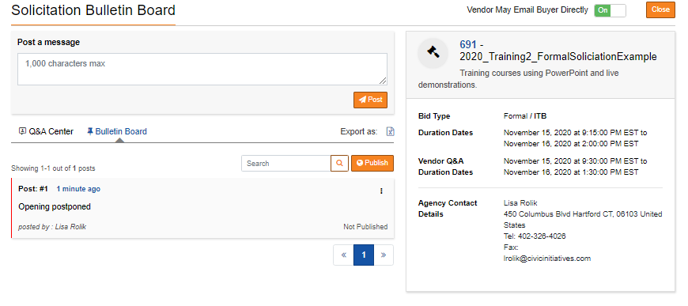
Manage Solicitations
v
v
v
v
v
v
v
CTsource Training 2
Formal/Informal
Manage
Evaluate
Award
Notes:
Inside the Q&A Center, you may also post information on the Bulletin Board for all CTsource suppliers to view. Click Bulletin Board. Type a message up to 1,000 characters in the box. Select Post.
[DEMO]

Slide 58
Manage Solicitations
CTsource Training 2
Formal/Informal
Manage
Evaluate
Award
Notes:
If you do not select the message to post, WebProcure will ask you to select at least one post before you click Publish.
[DEMO]

Slide 59
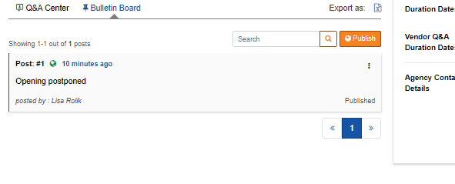
Manage Solicitations
CTsource Training 2
Formal/Informal
Manage
Evaluate
Award
Notes:
WebProcure then asks you if you would like to Notify Vendor via Email/Fax or Create an Addendum. Click the appropriate method. Select Publish Now. WebProcure asks if you are sure you want to proceed. Click Yes. WebProcure will publish the message.
[DEMO]

Slide 60
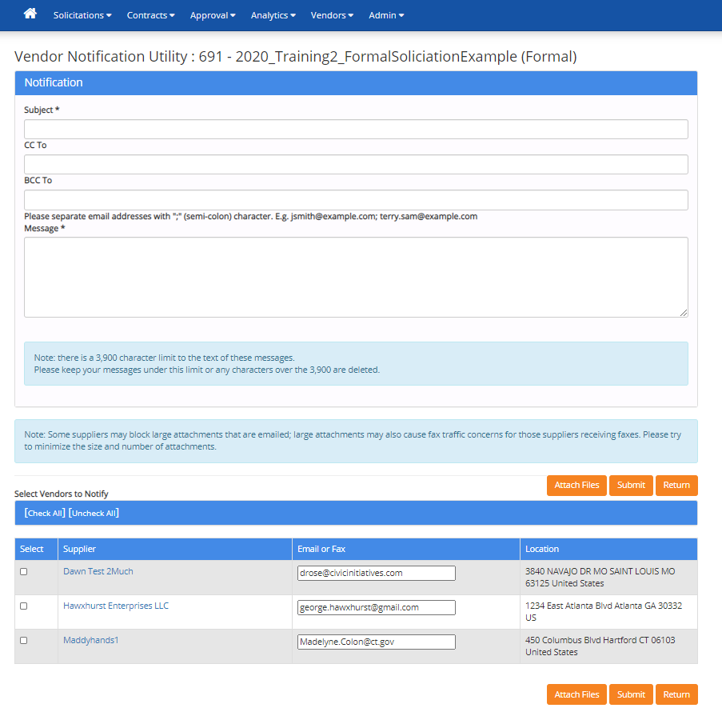
Manage Solicitations
CTsource Training 2
Formal/Informal
Manage
Evaluate
Award
Notes:
To view the history of the solicitation, select Solicitation History. [DEMO]

Slide 61
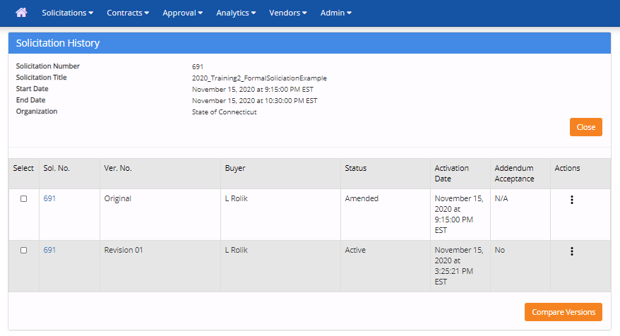
Manage Solicitations
CTsource Training 2
Formal/Informal
Manage
Evaluate
Award
Notes:
The Solicitation History screen appears and you can see activities in the solicitation. If you would like to compare versions, you may select and click Compare Versions.
[DEMO]

Slide 62
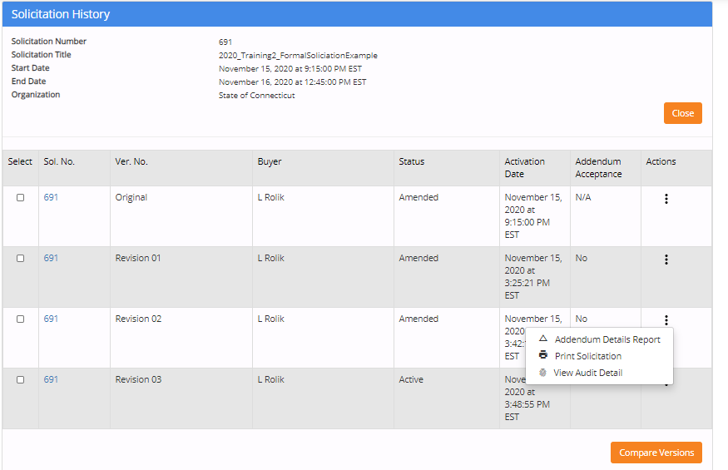
Manage Solicitations
CTsource Training 2
Formal/Informal
Manage
Evaluate
Award
Notes:
To view specifics within a revision to the solicitation, click in the Actions column (the three vertical dots). Select Addendum Details Report.
[DEMO]

Slide 63
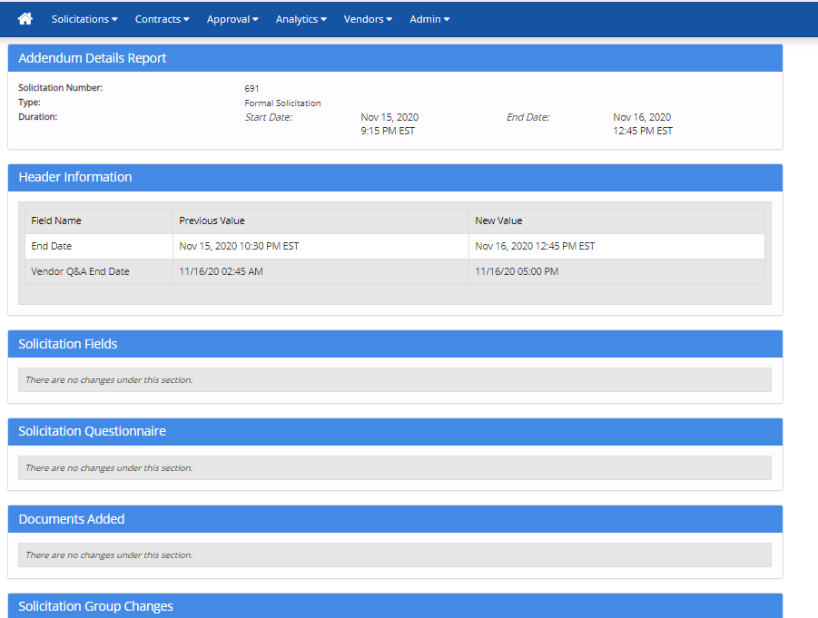
Manage Solicitations
CTsource Training 2
Formal/Informal
Manage
Evaluate
Award
Notes:
The Addendum Details Report provides information regarding that revision. Suppliers have a similar feature on their side of the WebProcure application.
[DEMO]

Slide 64
Questions & Answers
Please use the Q&A function at the bottom of the screen to continue asking questions.
We will answer as many questions as we can during the time we have allowed for this segment.
All questions and answers will be posted on our website for future reference, so please be sure to go to https://portal.ct.gov/DAS/CTSource/CTSource
CTsource Training 2
Formal/Informal
Manage
Evaluate
Award

Slide 65
Evaluate Responses
CTsource Training 2
Formal/Informal
Manage
Evaluate
Award
Notes:
The evaluation process is only available after the bid has closed. You may begin the process from the Solicitations dropdown menu, select Review/Award. This option is also available under the Solicitation Search (New) feature.
[DEMO]

Slide 66
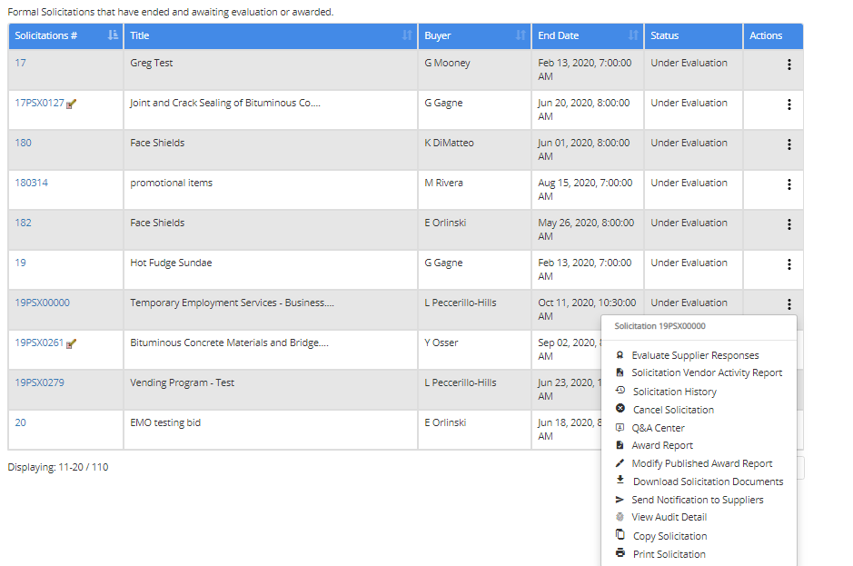
Evaluate Responses
CTsource Training 2
Formal/Informal
Manage
Evaluate
Award
Notes:
Search for and locate the solicitation to evaluate. Select Evaluate Supplier Responses.
You may elect at this time to produce bid opening results to post on the website if required by your organization’s procurement rules. Different steps are necessary to complete this process depending whether or not your solicitation contains line items. See slides 85-87 for more details.
[DEMO]

Slide 67
Evaluate Responses
CTsource Training 2
Formal/Informal
Manage
Evaluate
67
Award
Notes:
For Evaluate and Award, you have the opportunity to review the summary of suppliers’ responses under Questionnaire and Requirements sections, and review submitted suppliers’ documents.

Slide 68
Evaluate Responses
CTsource Training 2
Formal/Informal
Manage
Evaluate
Award
Notes:
You may review and download documents submitted by suppliers by selecting Review Vendor Documents. Click Continue.
[DEMO]

Slide 69
Evaluate Responses
CTsource Training 2
Formal/Informal
Manage
Evaluate
Award
Notes:
The View Suppliers and Documents window opens. View each suppliers attached response to determine award, then click Close. At this time, you may enter Evaluation Notes, however these notes are not editable and are permanent.
Under actions you may select Recommend as Finalist, this only applies if your organization has enabled the ability to create solicitation rounds (multi-round solicitations). This topic can be discussed at a later date if your organization would like to take advantage of this advanced functionality.
[DEMO]

Slide 70
Evaluate Responses
CTsource Training 2
Formal/Informal
Manage
Evaluate
Award
Notes:
You may select Manage Evaluation Committee to establish your team, if applicable.
[DEMO]

Slide 71
Evaluate Responses
CTsource Training 2
Formal/Informal
Manage
Evaluate
Award
Notes:
You have the option of creating an Evaluation Team. You may add a Team Name and Team Members.
[DEMO]

Slide 72
Evaluate Responses
CTsource Training 2
Formal/Informal
Manage
Evaluate
Award
Notes:
Enter the name of the evaluation team. Click on Add Team.
[DEMO]

Slide 73
Evaluate Responses
CTsource Training 2
Formal/Informal
Manage
Evaluate
Award
Notes:
“Training Evaluation Team” appears below Solicitation Teams. Click on the icon to add people. You will now be able to enter team members in the Team Members field.
[DEMO]

Slide 74
Evaluate Responses
CTsource Training 2
Formal/Informal
Manage
Evaluate
Award
Notes:
Enter team members in the Team Members field (only for CTsource users if the individual is not a user you must add an external user).
Enter a name and click Add External User.
[DEMO]

Slide 75
Evaluate Responses
CTsource Training 2
Formal/Informal
Manage
Evaluate
Award
Notes:
External Team Member Information window opens. Enter member’s information and click Save. (Or Close if you wish to exit.)
[DEMO]

Slide 76
Evaluate Responses
CTsource Training 2
Formal/Informal
Manage
Manage
Evaluate
Award
Notes:
Continue entering all members. When finished, click Next.
[DEMO]

Slide 77
Evaluate Responses
CTsource Training 2
Formal/Informal
Manage
Evaluate
Award
Notes:
Evaluation Materials window opens. Select all files for the team to evaluate.
[DEMO]

Slide 78
Evaluate Responses
CTsource Training 2
Formal/Informal
Manage
Evaluate
Award
Notes:
The files you select will populate in the Selected Files window on the right. Unselect check boxes under the Selected Files column for those files that do not need to be evaluated by the team.
[DEMO]

Slide 79
Evaluate Responses
CTsource Training 2
Formal/Informal
Manage
Evaluate
Award
Notes:
If there are any additional documents that must be added to include in the evaluation, you have the option to Select Evaluation Documents and Upload. Click Next.
[DEMO]

Slide 80
Evaluate Responses
CTsource Training 2
Formal/Informal
Manage
Evaluate
Award
Notes:
You may send a customized email to the evaluation team at this time.
[DEMO]

Slide 81
Evaluate Responses
CTsource Training 2
Formal/Informal
Manage
Evaluate
Award
Notes:
This is an example of what appears is the system-generated email that you may revise at this time. Click Save.
[DEMO]

Slide 82
Evaluate Responses
CTsource Training 2
Formal/Informal
Manage
Evaluate
Award
Notes:
Publishing Documents occurs and this may take a while depending on the number/size of documents.
The systems is flowing and compiling all the information into a zip file to be then emailed to the Evaluation Committee members.
[DEMO]

Slide 83
Evaluate Responses
CTsource Training 2
Formal/Informal
Manage
Evaluate
Award
Notes:
Once the document is published to the Evaluation Committee successfully, click Proceed. Once you click Proceed, the system generates and sends the email.
You will be returned to the Summary, click Close. Return home.
[DEMO]

Slide 84
Evaluate Responses
CTsource Training 2
Formal/Informal
Manage
Evaluate
Award
Notes:
The Evaluation Team member receives an email with a link to download documents. View download and open zip file. As you can see, the system summarizes the downloaded material for you into file folders. Miscellaneous documents will be listed outside of the folders. [DEMO]

Slide 85
Evaluate Responses
CTsource Training 2
Formal/Informal
Manage
Evaluate
Award
Notes:
You may post bid opening results for solicitations without line items by producing your own summary document and post (or publish) it to the Bid Board. Follow the process steps in this flow chart to complete the task.

Slide 86
Evaluate Responses
CTsource Training 2
Formal/Informal
Manage
Evaluate
Award
Notes:
If a solicitation contains line items, an Export Bid Tab button is available on the Evaluate and Award page. CTsource will export the item response data into Excel to create a workbook to summarize a Bid Tab to be posted to the Bid Board.

Slide 87
Evaluate Responses
CTsource Training 2
Formal/Informal
Manage
Evaluate
Award
Notes:
This slide displays a sample of Export Bid Tab results. If you choose to utilize the Item spec functionality in the future, this bid tab report provides various summarizes of the vendors’ responses for you to choose from or use all of them. This is a great feature if your organization is required to provide this level of detail.

Slide 88
Evaluate Responses
CTsource Training 2
Formal/Informal
Manage
Evaluate
Award
Notes:
The slide above details the process steps to evaluate and award solicitation responses.

Slide 89
Questions & Answers
Please use the Q&A function at the bottom of the screen to continue asking questions.
We will answer as many questions as we can during the time we have allowed for this segment.
All questions and answers will be posted on our website for future reference, so please be sure to go to https://portal.ct.gov/DAS/CTSource/CTSource
CTsource Training 2
Formal/Informal
Manage
Evaluate
Award

Slide 90
Award
CTsource Training 2
Formal/Informal
Manage
Evaluate
Award
Notes:
To Award select radio button and click Continue. [DEMO]

Slide 91
Award
CTsource Training 2
Formal/Informal
Manage
Evaluate
Award
Notes:
Select the check box for the supplier to award. If awarding to more than one supplier, select check box Award to Multiple Suppliers, then select the suppliers to award.
Then click Done.
[DEMO]

Slide 92
Award
CTsource Training 2
Formal/Informal
Manage
Evaluate
Award
Notes:
Click Done when ready to move forward and finalize the award.
Finalizing the award will change the solicitation status on the bid board to Awarded. You can elect to send notifications to all suppliers if you choose. You may also post award information if you choose.
[DEMO]

Slide 93
Award
CTsource Training 2
Formal/Informal
Manage
Evaluate
Award
Notes:
Select Finalize Award from the actions window of the solicitation.
[DEMO]

Slide 94
Award
CTsource Training 2
Formal/Informal
Manage
Evaluate
Award
Notes:
Prior to finalizing this process, you may send a notification. The system will automatically send a generic email stating the solicitation has been awarded or you can create a customized notification via the Create Notification button. If you choose not to send a notification, select Uncheck All. You may also choose to publish the information to the Bid Board via the Publish button.
When ready to finalize, enter YES in the Confirmation box. Click Submit.
This will move the solicitation to the Award status and the solicitation document can be found under Solicitations – View Archived
[DEMO]

Slide 95
Award
CTsource Training 2
Formal/Informal
Manage
Evaluate
Award
Notes:
Click Publish or Close. [DEMO]
Note: DAS does not publish award information due to the fact that the fully executed published contract is considered the award.

Slide 96
Award
CTsource Training 2
Formal/Informal
Manage
Evaluate
Award
Notes:
Posting some information on the Public Bid Board is at your organization’s discretion. If you wish to publish the award or bid tab to the bid board, use this functionality.
Notice that the Show me how it looks button is not activated at this time. You will need to go through the publishing process first.
Choose from the Publish menu how you would like to proceed. Click Next.
[DEMO]

Slide 97
Award
CTsource Training 2
Formal/Informal
Manage
Evaluate
Award
Notes:
Choose whether to Display any attachments provided by the responding suppliers. Click Next.
[DEMO]

Slide 98
Award
CTsource Training 2
Formal/Informal
Manage
Evaluate
Award
Notes:
It is recommended to include Award Notes based upon the information you choose to post. The system will provide notes but you may modify them or elect to delete them. Click Next.
[DEMO]

Slide 99
Award
CTsource Training 2
Formal/Informal
Manage
Evaluate
Award
Notes:
You may determine to attach other related award documents by clicking the hyperlink and the upload documents window appears. Click Save.
[DEMO]

Slide 100
Award
CTsource Training 2
Formal/Informal
Manage
Evaluate
Award
Notes:
Now the Show me how it looks button is activated. Click to see.
[DEMO]

Slide 101
Award
CTsource Training 2
Formal/Informal
Manage
Evaluate
Award
Notes:
The summary of the information published will display. You may change the information if necessary. This is your opportunity to revise information before it is publicly displayed on the Bid Board. Click Close and Close again.
[DEMO]

Slide 102
Award
CTsource Training 2
Formal/Informal
Manage
Evaluate
Award
Notes:
Go to the Bid Board to see your published award. Note the status is flagged as awarded. You may view your published award information in the “View award report” in the top right corner. [DEMO]
The information displayed should mirror the report under “Show me how it looks”.

Slide 103
Questions & Answers
Please use the Q&A function at the bottom of the screen to continue asking questions.
We will answer as many questions as we can during the time we have left.
All questions and answers will be posted on our website for future reference, so please be sure to go to https://portal.ct.gov/DAS/CTSource/CTSource
CTsource Training 2
Formal/Informal
Manage
Evaluate
Award

Slide 104
CTsource Training 2
This concludes Training 2. Training 3 will be LIVE (on-line) training events in webinar format with a LIVE Question & Answer segment at the end of the training.
Training 3: Contracts/Master Agreements is scheduled for January 27, 2021
Trainings 2 & 3 are recorded for those who cannot attend the training events to view at a later date. Questions and answers as well as links to the recordings will be posted @
https://portal.ct.gov/DAS/CTSource/CTSource
For any questions after the webinar or to request a username and password to the Stage Environment contact DAS Procurement Services by emailing: das.ctsource@ct.gov
Thank you!
CTsource Training 2

