Slide 2
Agenda
- Introduction to ACN/Digital BackOffice
- DBO managed services integrated with CEN
- Benefits to the State of Connecticut
- Questions

Slide 3
A Connecticut Business
1991 - Advanced Corporate Networking first customer GE Capital
1998 – Opened first Digital BackOffice data center
2000 - Awarded ISP services contract for 60+ public K-12 schools
2002- Stamford Public Schools awards DBO contract for WAN services partially funded by federal E-Rate program
2004- City of Norwalk awards DBO contract to build fiber optic MAN
2004 to present – Multiple K-12 school districts contract for DBO MOE funded by E-rate to connect buildings to CEN.
2009 – DBO launches Netwatch remote hands services
2010 – ACN/DBO Certified as minority/small business by Ct DAS
2014 – DBO signs first customers for VOIP on CEN
2016- DBO upgrades data centers with Palo Alto Next Gen firewalls

Slide 4
Managed Services Are the Future
Worldwide Public IT Cloud Service Revenue in 2018 is predicted to be $127B. Managed Services is projected to reach $256B by 2018.
Many schools, municipalities and SMBs do not have the structure or scale to support legacy infrastructure
MSP’s offer extensible architecture minimizing the need to select, integrate and deploy a disparate collection of products.
MSP’s bring innovation, financing and accountability.
Digital BackOffice integrates managed services with CEN while contributing revenue and breadth of services.
DBO Managed services and CEN are a powerful combination!

Slide 5
DBO Managed VOIP Service
Integration with CEN infrastructure provides highest voice quality and reliability.
DBO and CEN are trusted advisors.
Local provisioning team to customize user interface, unify communications and port legacy systems .
Experienced, trained staff located in-state
Immediate operational efficiencies with simplified admin interface and virtually $0 cost of ownership
Cloud based switching eliminates local trunking costs
OP-Ex and Cap-Ex acquisition options

Slide 6
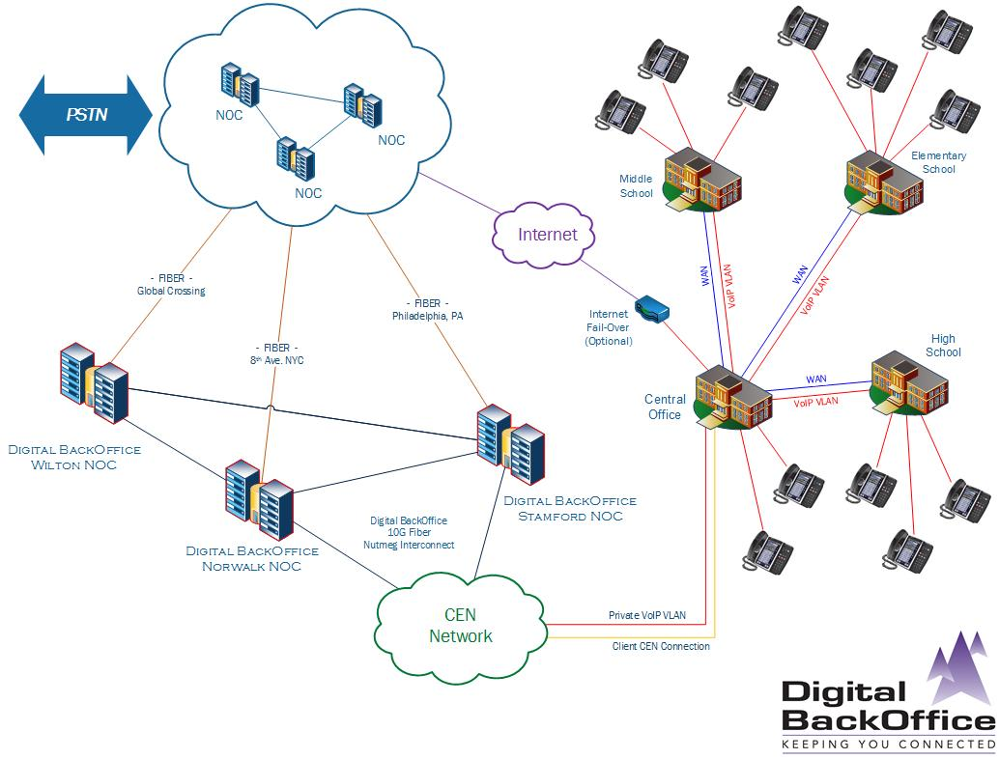

Slide 7
DBO Managed Security Services
DBO and CEN are trusted advisors.
Local provisioning team to customize perimeter security.
Experienced, trained staff located in-state
Classifies all traffic based on application, user and content for known and unknown threat protection.
Immediate operational efficiencies and threat prevention.
Integrated with CEN infrastructure
Scalable bandwidth from 100Mb to 10 GB with no premise based hardware
No Cap-Ex required and eligible for Cat 1 E-Rate discount funding

Slide 8
A Public/Private Partnership
DBO is a CEN customer and conference sponsor.
DBO managed services include an SLA and add value and to CEN.
Some DBO Managed services qualify for E-Rate Cat 1 funding for K-12 schools and leverage Op-Ex budgets
DBO NOC provides a 24x7 extension to in-district IT staff
DBO Small/Minority certification status complements state and local CHRO earmark goals
DBO managed services provide access to private financing while leveraging the CEN infrastructure
DBO adds breadth of services to CEN at no additional cost to the state!

Slide 9
And Secure

