Slide 1
Uniform Licensing
A Guide to the BIZNET Online Filing System
STATE OF CONNECTICUT
DEPARTMENT OF CHILDREN & FAMILIES (DCF)
DEPARTMENT OF DEVELOPMENTAL SERVICES (DDS)
DEPARTMENT OF PUBLIC HEALTH (DPH)

Slide 2
We are pleased to announce that our agencies have signed a Memorandum of Understanding regarding the creation of a Uniform Licensing Application and the operation of a web-based filing and storage system for required licensing documents.
Our goal in developing this common application and utilizing the web-based system is to improve the efficiency of the licensing process by consolidating the requirements of each agency's licensing process and eliminating unnecessary duplication of documents submitted for licensing purposes.

Slide 3
The Uniform Licensing Application and online posting process is being implemented for the following licenses and services: DPH Private Freestanding Mental Health Day Treatment Facilities Connecticut General Statutes Section 19a-491 and/or 19a-506 Private Freestanding Mental Health Community Residence Connecticut General Statutes Section 19a-491 and/or 19a-506 Private Freestanding Mental Health Residential Living Centers Connecticut General Statutes Section 19a-491 and/or 19a-506 Private Freestanding Facilities for the Care or Treatment of Substance Abuse or Dependence Connecticut General Statutes Section 19a-491 and/or 19a-506 Private Freestanding Psychiatric Outpatient Clinics for Adults Connecticut General Statutes Section 19a 491 and or 19a-506

Slide 4
DCF
Extended Day Treatment Connecticut General Statutes Section 17a-147
Out-Patient Psychiatric Clinic for Children Connecticut General Statutes Section 17a-20
Residential Treatment Connecticut General Statutes Sections 17a-145 & 17a-151
Residential Education Connecticut General Statutes Section 17a-145
Group Home Connecticut General Statutes Sections 17a-145 & 17a-151
Temporary Shelter Connecticut General Statutes Sections 17a-145 & 17a-151
Child Placing Agency Connecticut General Statutes Section 17a-150

Slide 5
DDS
Community Living Arrangement for persons with intellectual disability and/or person with autism spectrum disorder Connecticut General Statutes Section 17a-227

Slide 6
The Uniform Licensing application will be used for the following processes:
- Initial Application - Renewal Application
- Adding an Additional Site - Change in Location (DCF)
- Change in Capacity - Removing a location/Site
- Relocation of facility (DPH) - Relocation of Parent Site
- Change in age range (DCF) - Change of Ownership
- Change of Licensee or - Change of Services (DPH)
D/B/A name
Note: The new filing system will not replace direct communication with agency licensing staff, although they will receive an automated notification when your documents are uploaded or updated.

Slide 7
Organizations must have a BIZNET account to apply for the previously stated licenses.
Begin by going to Biznet.ct.gov
Next, click “CT Procurement”

Slide 8
Then, click “Company Information.”

Slide 9
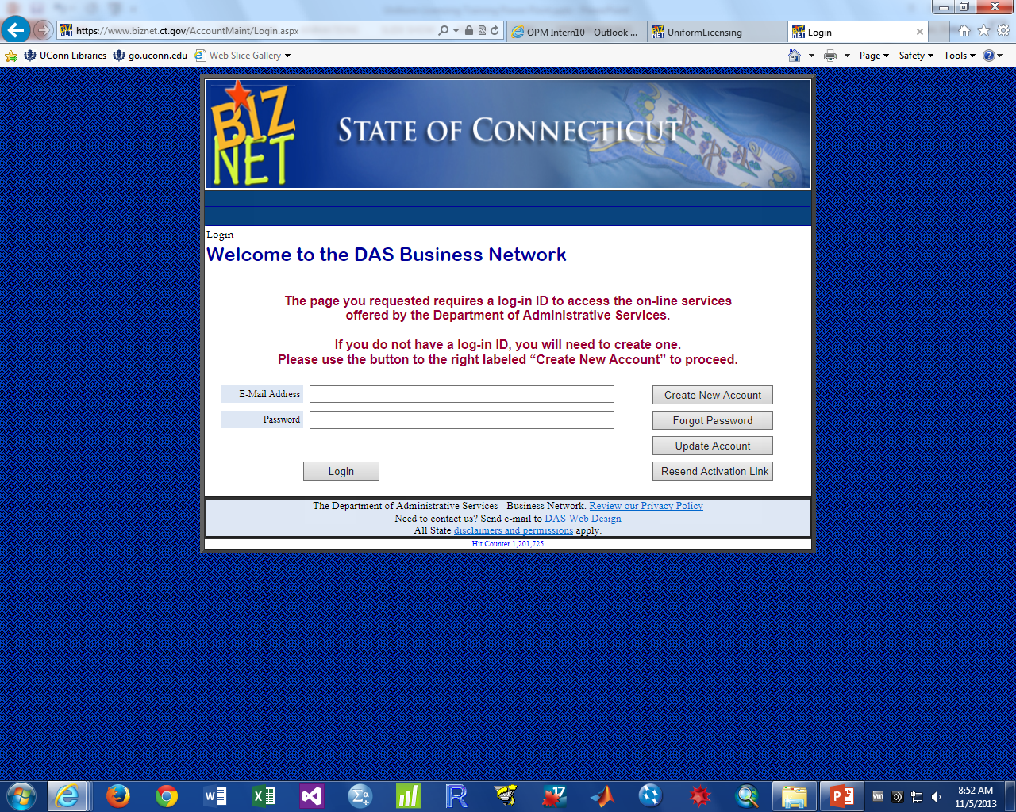
If you already have a BIZNET account, sign in to the account.
For more information about the Uniform Licensing process for companies that already have, or may already have a BIZNET account, see slide 9.
If not, click “Create New Account”

Slide 10
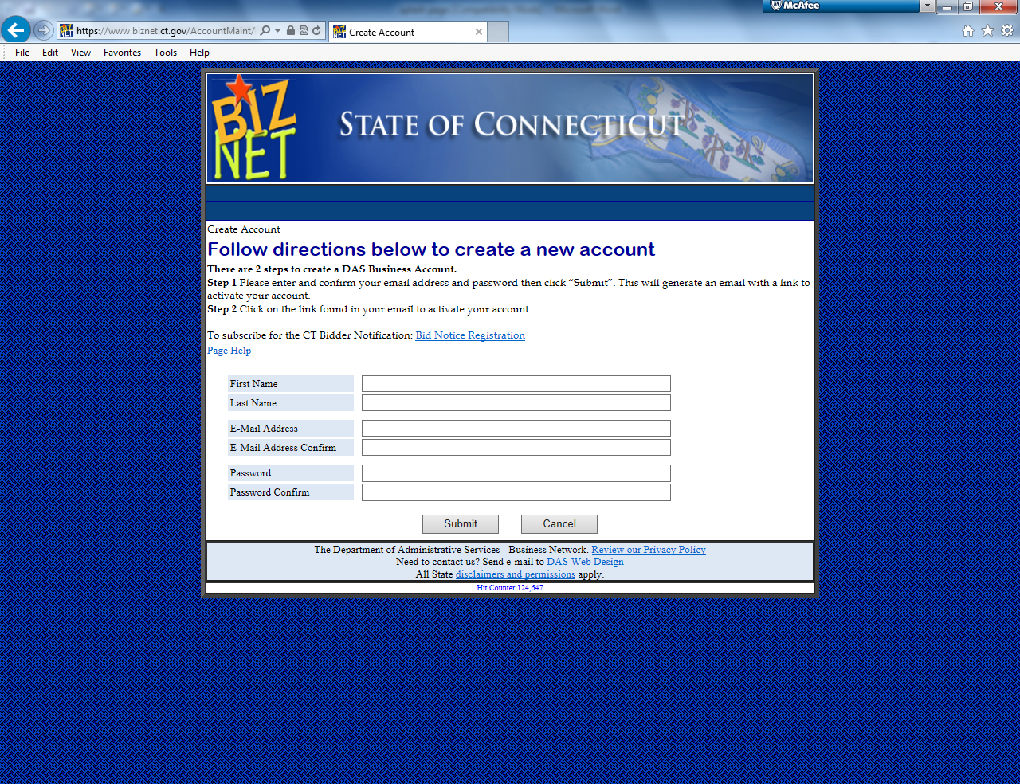
Enter in your first name, last name, and email address.
Next choose a password.
Once all fields are filled in, click “Submit.” DAS will send you an automated email to activate your account.
Note: Additional users can be easily added to your organization’s BIZNET after your account has been activated.
For more help creating a BIZNET account: DAS Instructional Video: Creating a Biznet Account

Slide 11
I know my company already has a BIZNET account:
If you do not have access to the account, ask whoever is currently in charge of the account to add you using the process described on slide 14.
Be sure that your organization’s account has “Yes” selected next to “Click Yes if you are applying for a license or updating a license with any of these agencies” on the “Company Information” page, then proceed by following the same directions as a new BIZNET user.
I’m not sure if my company has a BIZNET account:
If you are not sure whether your company has a BIZNET account, begin the process by following the steps on slide 5.
Once you have completed the “Company Information” page, BIZNET will inform you if an account already exists by searching your FEIN #/Taxpayer ID in the database.
If an account already exists, you will be provided with the contact information of the person who is in charge of the account, and they can add you using the process specified on slide 14.
Note: In either case, if the user in control of the account is no longer with the company, contact DAS. After confirming that you are a legitimate employee of the company with permission to access its BIZNET account, you will be given access.

Slide 12
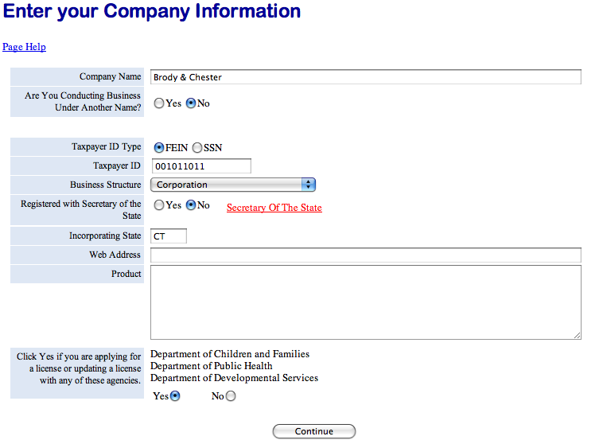
If your organization is new to BIZNET, fill in your “Company Information”
The “Business Structure” you choose for your organization has no impact on the Licensing process, so there is no need to select “Non-profit” unless that selection fits best.
Note: Your work will be saved automatically and can be returned to at any time.
At the bottom of the page, answer “Yes” to the question, “Click Yes if you are applying for a license or updating a license with any of these agencies.”
If “Yes” is not selected, BIZNET will not allow you to upload licensing documents.
Next, click “Continue”.

Slide 13
Next, check all agencies your organization is applying to be licensed with or is currently licensed by.
IMPORTANT: Be sure to select any agency you are currently licensed by, not only the agency you are applying or renewing a license with. If you are licensed by an agency and the box next to that agency is not checked, that agency will not be able to access your licensing documents. This may create a problem if the agency needs to review these documents between licensing periods or in the future when you are renewing a license with that agency.
When done selecting all applicable agencies, click “Save and Continue”.

Slide 14
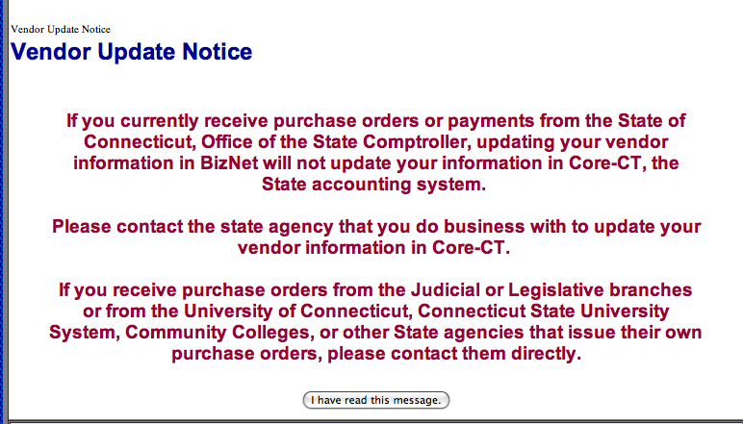
All BIZNET users receive the “Vendor Update Notice” after they have edited their “Company Information”. After reading the message, click “I have read this message”.

Slide 15
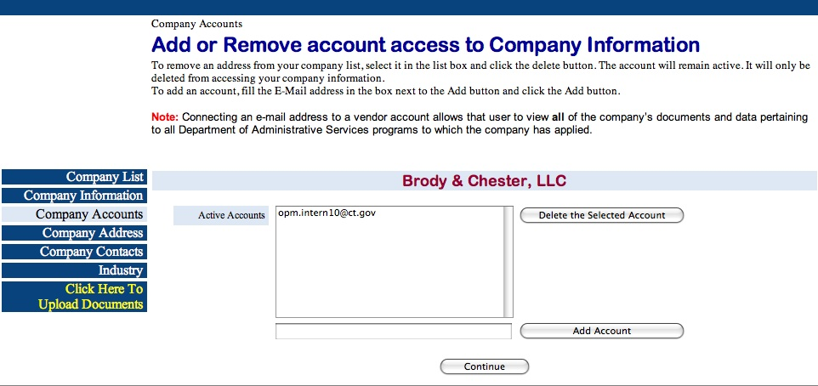
Next, the “Add or Remove Account Access” page will appear.
Any user under “Active Accounts” can add or remove other users.
Note: Adding an account will give that user the ability to view and edit all of your organization’s BIZNET account, not only the Uniform Licensing sections. Use caution when choosing who to give access to your account.

Slide 16
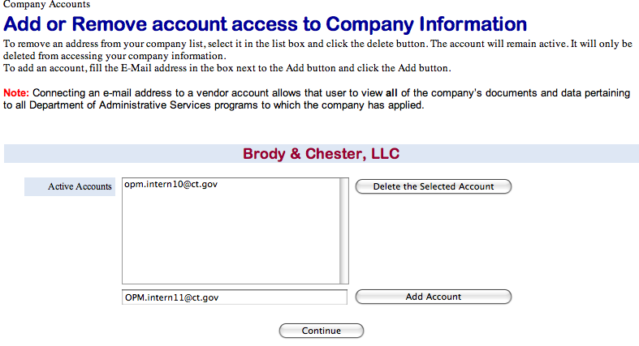
To add an account:
Type in the email address of the user you would like to add.
Next, click “Add Account”.
When done, click “Continue”.

Slide 17
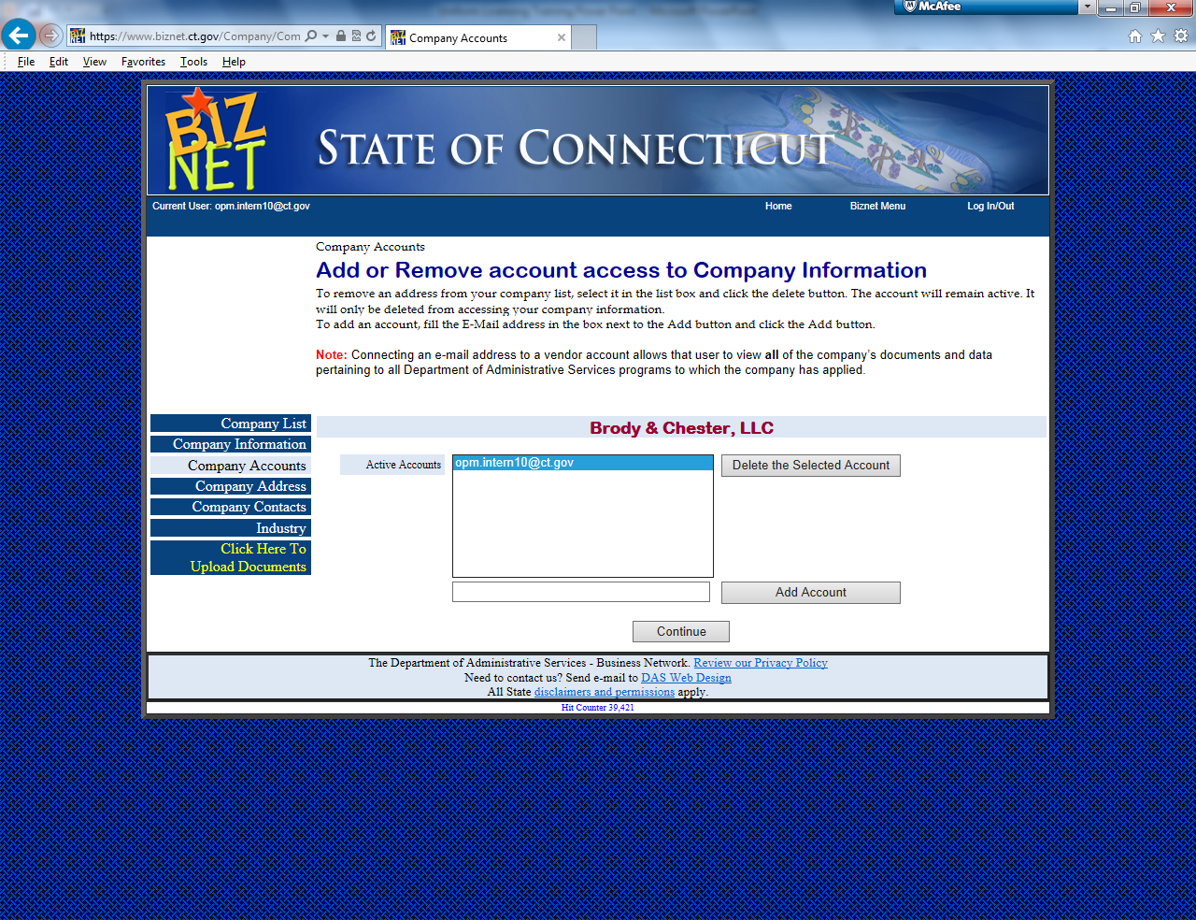
To Delete an Account:
To remove an account, highlight the email address of the user you would like to remove.
Next, click “Delete the Selected Account”.
When done, click “Continue”.

Slide 18
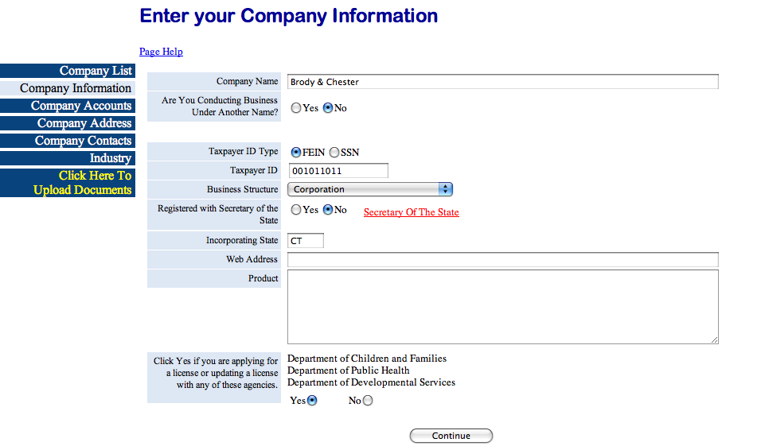
The “Company Accounts”, “Company Contacts”, and “Industry” sections are all optional for the licensing process.
After you have decided whether to fill in these sections, press “Click Here To Upload Documents” to continue to the Uniform Licensing section.

Slide 19
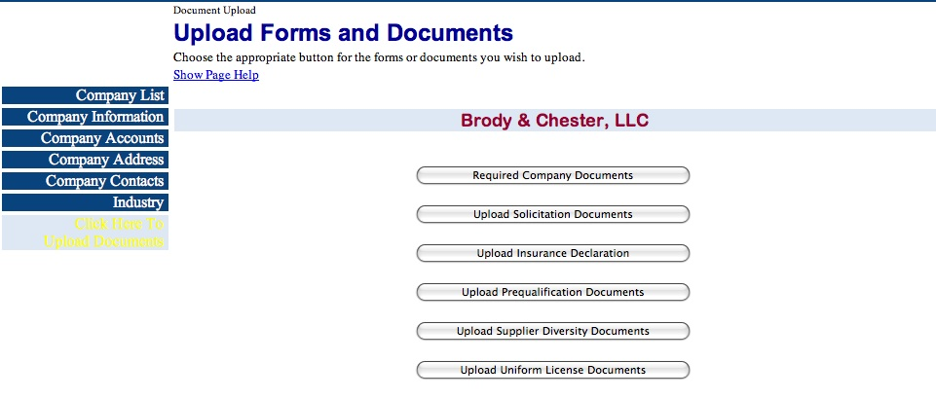
Next, click “Upload Uniform License Documents”.

Slide 20
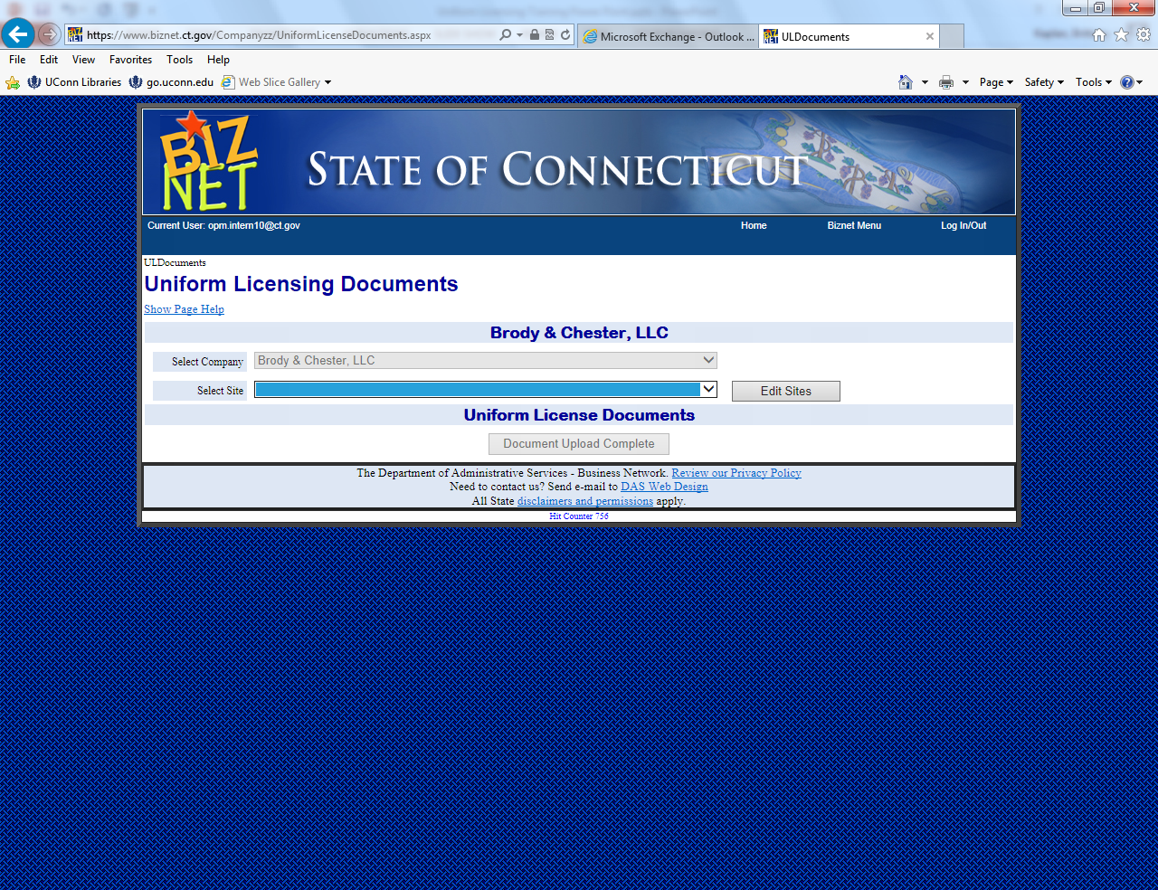
You will be brought to the internet based filing system for Uniform Licensing.
Each facility being licensed will have its own page in the filing system.
To proceed, click “Edit Sites”.

Slide 21
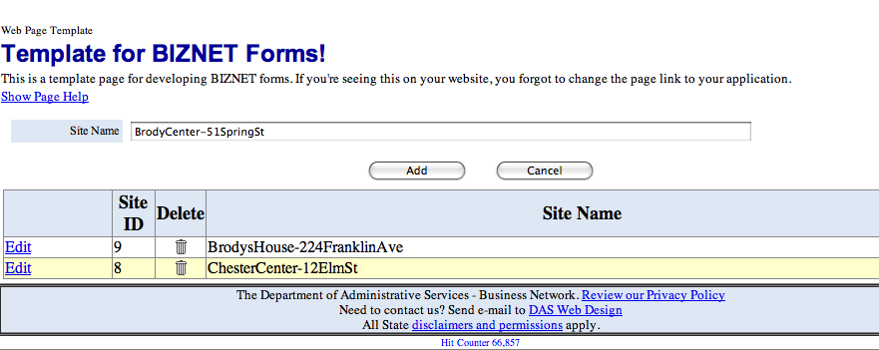
Begin by typing your facility’s doing business as/program name and the address (NumberStreetname) of the facility next to “Site Name”.
Next click “Add”.

Slide 22
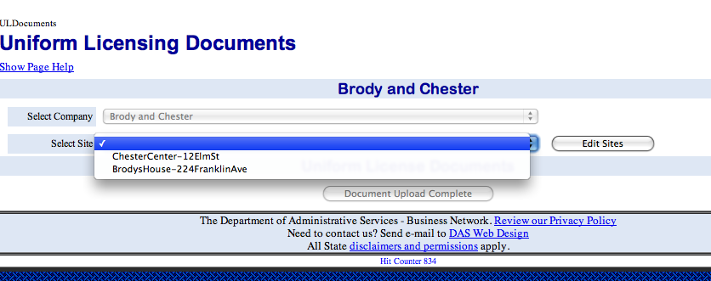
To begin the application process, select the site you would like to upload documents for from the drop down menu.

Slide 23
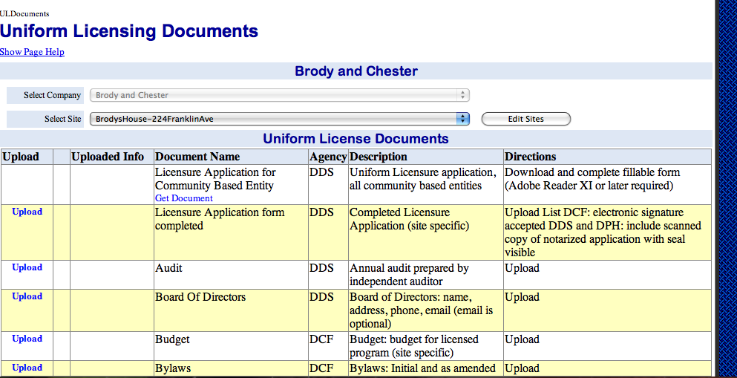
The agency boxes checked off in the “Company Information” section will determine which documents BIZNET displays on the “Uniform Licensing Documents” page.

Slide 24
Column Descriptions
Upload: This column contains the links for uploading documents.
Uploaded Info: This column will display the uploaded document. Documents requiring multiple uploads will be displayed by clicking “Upload List” next to the document.
Document Name: This column names the required document.
Agency: This column displays which agency or agencies is requesting the document.
Description: This column describes the document and any specific requirements of the document by an agency.
Directions: This column describes how the document should be provided.

Slide 25
“Upload” and “Upload List”
The “Upload List” button is for sections that require or may require more than one document to be uploaded.
The “Upload” button is for uploading a single document.

Slide 26
Universal and Site Specific Documents
Universal documents are documents that do not differ by facility.
Universal documents will appear in each site’s documents page after being uploaded once.
Examples include: Board of Directors and Bylaws
Note: Changing a universal document for one site will change that document for all other sites.
Site specific documents must be tailored to a single facility.
A document is identified as being site specific in the “Description” column.
Examples include: Floor Plan and Staffing List

Slide 27
Guidelines for Uploading Documents
Document Filename and Format:
IMPORTANT: No two files can have the same name. Each document must have its own unique filename or the most recently uploaded document with the shared filename will replace all other documents with that name.
Suggested naming convention for documents: Document type, site to be licensed, and date
For example: BoardofDirectors_ChesterCenter_2013.doc
Allowable formats for the uploaded documents include: .doc, .docx, .xls, .xlsx, .pdf, and .txt. If your documents are not in any of these formats, they must be converted into a usable format.
Tip: Organize your computer files before starting to upload.

Slide 28
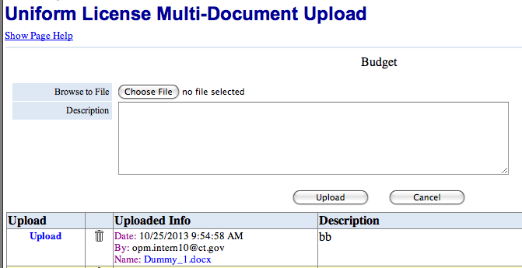
Document Change/Update Notifications:
The State Licensing Agencies you deemed appropriate to your organization (see slide 11) will receive a daily notification with changes made to your Licensing documents.
Verifying Successful Document Upload:
When your document has been successfully uploaded it will appear in the “Uploaded Info” column. The filename, date uploaded, and the email address of the “uploader” will be displayed.
If a document is uploaded using “Upload List”, it will appear with the same information as above, but on the “Upload List” page.

Slide 29
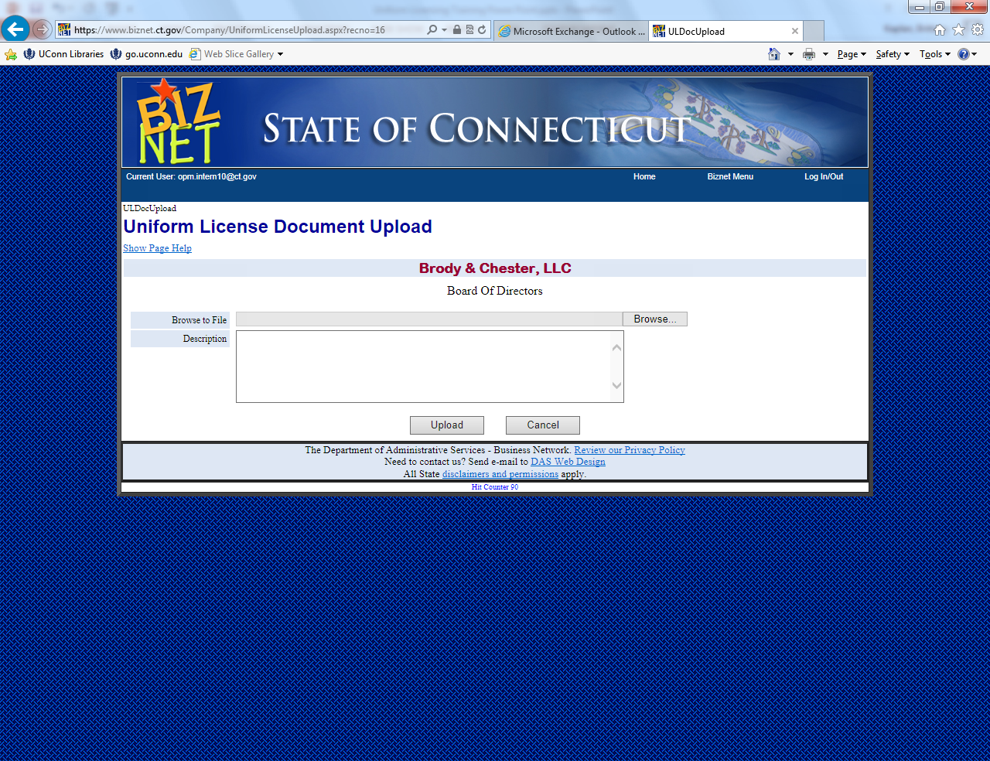
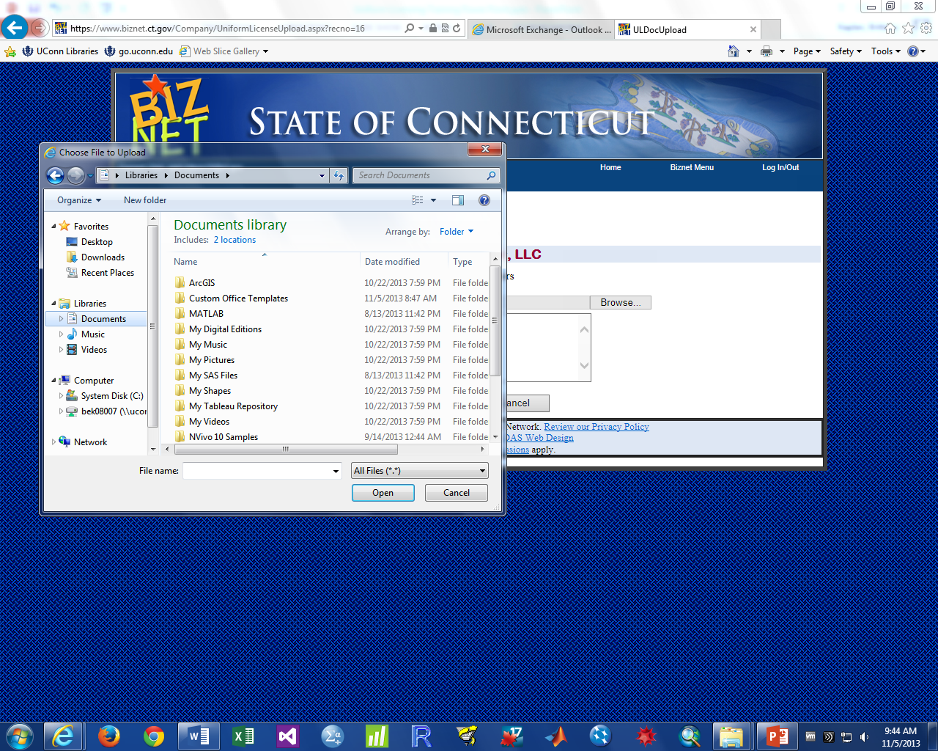
To upload a document click “Upload or “Upload List”.
Next, click “Browse”.
Select the file you wish to upload from your computer using the pop up window.
Next, click “Open”.

Slide 30
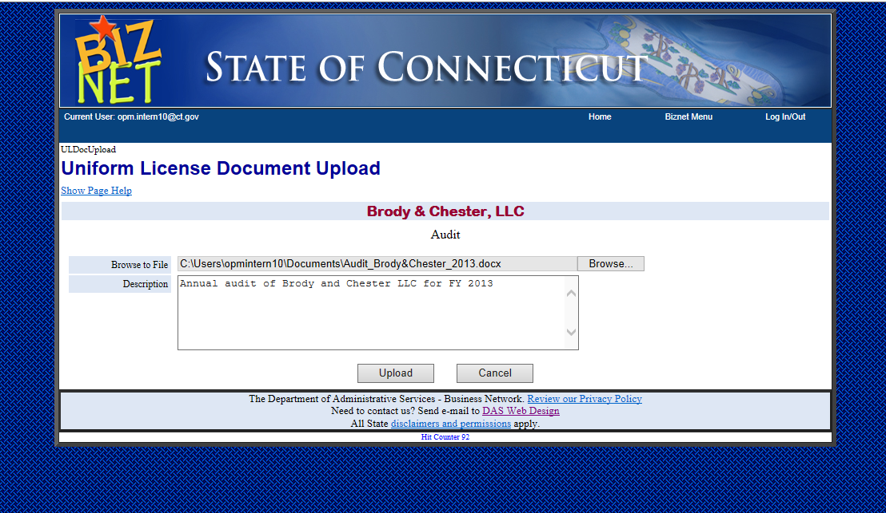
Next, type a description of the document into the “Description Box”. Please include the document name, the site name, and the dates that document is relevant for.
When finished, click “Upload”.

Slide 31
To delete a document, click the trashcan icon next to that document.
Be sure to save a copy of the old document before deleting it from the BIZNET site.
Note: BIZNET stores all deleted documents. If a document is accidently deleted and needs to be retrieved, contact licensing staff for assistance.

Slide 32
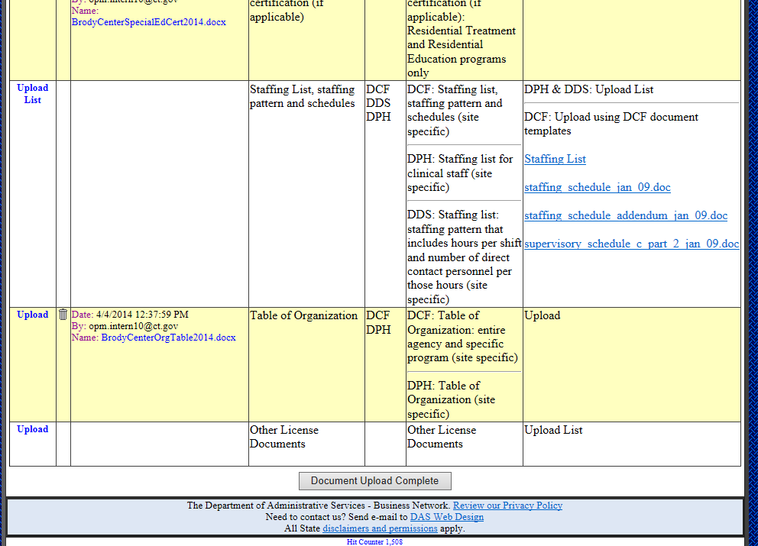
When done uploading documents, scroll to the bottom of the page and click “Document Upload Complete”
The state licensing agencies will receive an automated email notifying them of the documents that have been uploaded.

Slide 33
For further help with the Uniform Licensing system:
For questions regarding the Uniform Licensing process:
DPH | Sandra Bauer | Licensing Examination Assistant | Sandra.Bauer@ct.gov | (860) 509-8023
DCF | James McPherson | Program Manager | Jim.McPherson@ct.gov | (860) 550-6532
DDS | Claudine Testani | Quality Review Specialist Supervisor | Claudine.Testani@ct.gov | (860) 418-6100
Governor’s Nonprofit Liaison | Terry Edelstein | The Governor’s Nonprofit Liaison | Terry.Edelstein@ct.gov | (860) 524-7385
For problems with the BIZNET site:
Email DASIBI.webmaster@ct.gov

