Slide 1
It's Not Easy Being Green (Even when it Should Be)

Slide 2
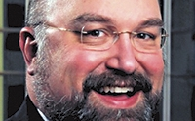

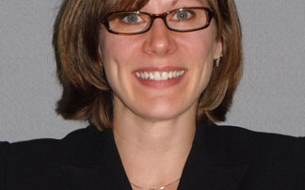
Lee D. Hoffman, Esq.
Chair, Environmental, Energy and Telecommunications Dept.
Pullman & Comley
Joe Jordan
Vice President, Energy Development
Lendlease
Melanie A. Bachman, Esq.
Executive Director
Connecticut Siting Council

Slide 3
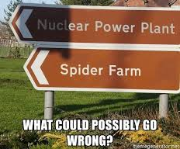
Everyone Loves Renewable Energy and Brownfield Redevelopment – Right?

Slide 4
Well, Everyone is SUPPOSED to….
Pros of Renewable Energy
  Reduces reliance on fossil fuels
  Response to climate change
  Lessens emissions of criteria pollutants
  Promotes green job development
  Enhances local tax base
  Doesn’t use many local resources
Pros of Brownfield Projects
  Remediates contamination
  Removes eyesores from the area
  Provides impetus for further development
  Takes advantage of existing infrastructure
  Promotes green job development
  Enhances local tax base

Slide 5
Not Everyone Feels This Way
Complaints Regarding Renewable Energy
  Too expensive
  Use too much land per MWH of energy generated
  Construction is on a large scale
  Habitat impacts
  Possible noise or visual impacts
Complaints regarding Brownfield Projects
  Remediation may be incomplete
  Environmental justice issues not addressed
  Possible noise or dust impacts
  Can take over/change existing neighborhoods
  Historic sites can be damaged

Slide 6
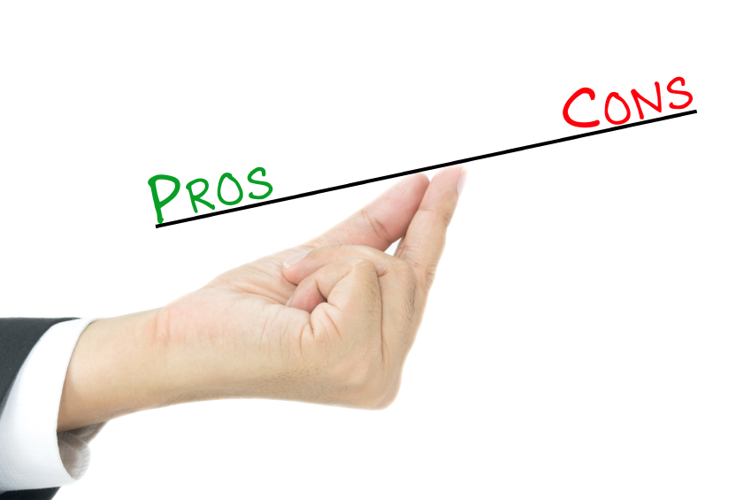
The Pros Do Outweigh the Cons

Slide 7
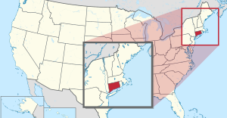

State of Connecticut Facts
Ranks 48th among the 50 states for total area
5,544 square miles
169 municipalities/8 counties
Average annual rainfall: 50 inches
Average number of sunny days: 194
Average high temperature: 60.1°F
Average low temperature: 39.5°F
Total population: 3,572,665
Population per square mile: 738.1
Installed Solar Capacity (2019): 525 MW

Slide 8
Connecticut Department of Energy and Environmental Protection
Public Utilities
Regulatory
Authority
Bureau of Energy
and Technology Policy
Outdoor Recreation & Natural Resources
Air Management, Water Protection & Land Reuse
ADMINISTRATIVE PURPOSES ONLY
(HR & IT)
Connecticut Siting Council
Office of Consumer Counsel

Slide 9
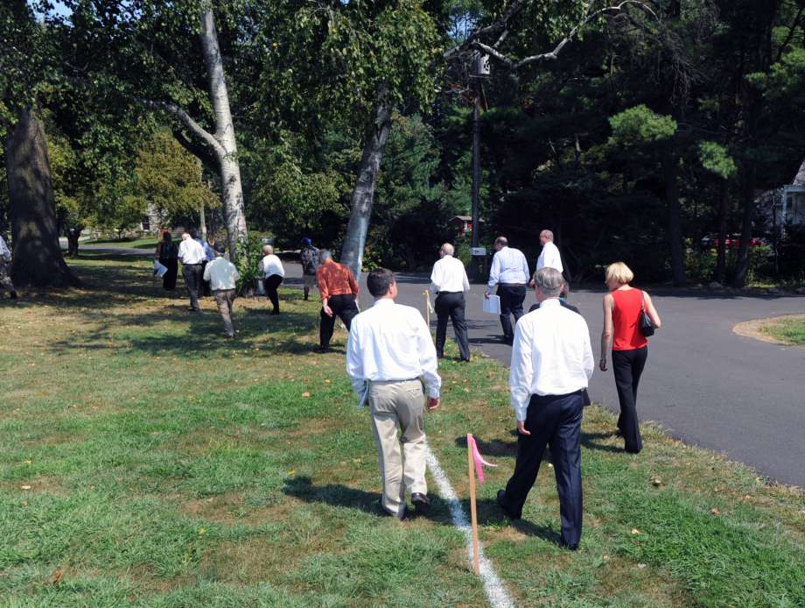
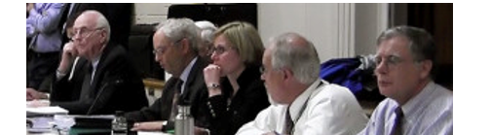
The Connecticut Siting Council
Executive branch administrative agency with the legislative purpose to end ad hoc town-by-town regulation of energy and telecommunications infrastructure in favor of regulation by a statewide body
CSC has exclusive jurisdiction over the construction, operation and maintenance of electric transmission lines, fuel transmission lines, electric generating facilities, electric substations and telecommunications towers
CSC consists of 9 per diem appointed members:
1) 5 public members appointed by Governor (one is Chairman);
2) DEEP Commissioner, or designee;
3) PURA Commissioner, or designee;
4) Speaker of the House designee; and
5) President Pro Tempore of Senate designee.

Slide 10

Connecticut Siting Council Purpose
To balance the need for:
Adequate and reliable public utility services at the lowest reasonable cost to consumers
Need to protect the environment and ecology of the state

Slide 11

Public Act 05-1: An Act Concerning Energy Independence
Legislative purpose to incent distributed resource projects and reduce peak electric demand consistent with state energy policy to diversity the state’s energy supply mix and to develop and utilize renewable sources to the maximum practical extent
Established a rebuttable presumption that there is a public benefit for a grid-side distributed resource projects with a capacity of 65 MW or less
Public benefit exists if a proposed electric generating facility is necessary for the reliability of the electric supply of the state or for the development of a competitive market for electricity
Act established “expedited siting” process for renewable projects with a capacity of 65 MW or less

Slide 12
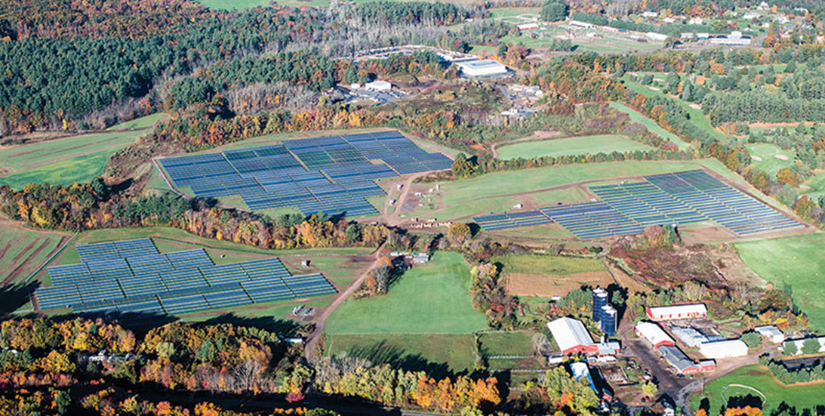
Public Act 17-218: An Act Concerning the Installation of Certain Solar Facilities on Productive Farmlands
Legislative purpose to discourage the use of prime farmlands and forest lands as locations for the siting of utility-scale solar photovoltaic facilities
For solar projects with a generating capacity of ≥ 2 MW, requires written confirmation from Agriculture OR DEEP that the project will not materially affect the status of such land as prime farmland or core forest
Only projects selected in a DEEP RFP issued prior to July 1, 2017 are exempt

Slide 13
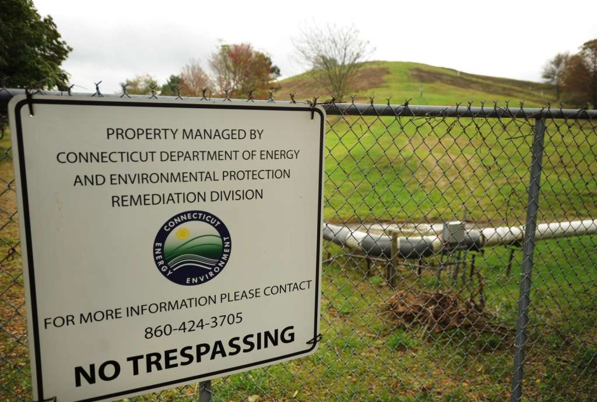
Siting Clean Energy on Connecticut Brownfields
Shelton officials burn while state discusses solar panels on landfill – CT Post, 11/5/2017
“Renewable energy, such as wind and solar, can be sited on land that has been or is perceived to be polluted and is now underused. These properties, called brownfields, may be particularly attractive because these types of renewable energy installations may require large sites, and brownfields are usually large sites in areas with the existing infrastructure needed to support development.” --- DEEP statement on Siting Clean Energy on Brownfields
“DEEP will identify priority areas in the state, such as brownfields, state properties or previously developed sites that would benefit from hosting Class I renewable energy sources or minimize siting issues.” --- 2018 CT Comprehensive Energy Strategy (priority area list last updated 1/29/16)
SHELTON — City officials said they were blindsided by the state’s plan to install solar energy panels on the site of the former landfill. “We could have a disaster—an explosion or fires—if the methane collection is disturbed.”

Slide 14
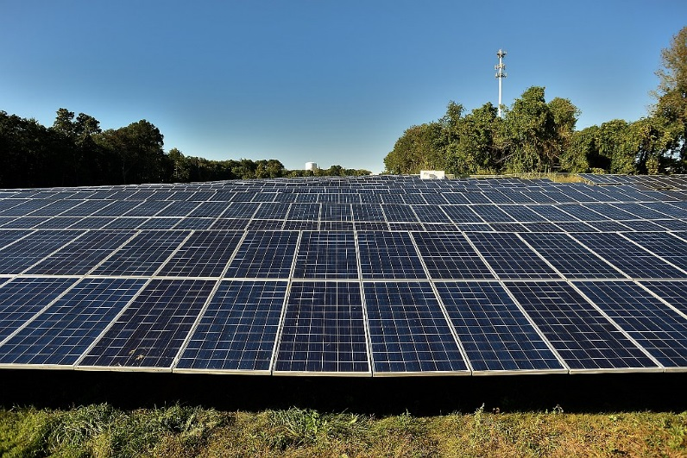
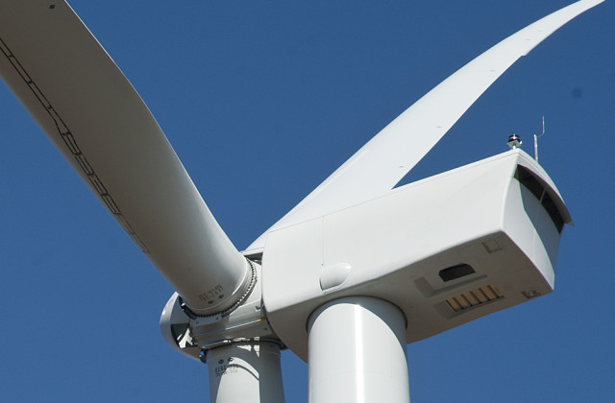
Public Utility Environmental Standards Act
Siting Evaluation Criteria
CSC shall approve by declaratory ruling the construction of any customer-side distributed resources facility or grid-side distributed resources facility with a capacity of not more than 65 MW as long as:
Such project meets air and water quality standards of DEEP;
CSC does not find a substantial adverse environmental effect; and
For a solar photovoltaic facility with a capacity of ≥ 2 MW, to be located on prime farmland or forestland, excluding any facility selected by DEEP in a RFP prior to July 1, 2017, Agriculture represents in writing such project will not materially affect the status of such land as prime farmland OR DEEP represents in writing such project will not materially affect the status of such land as core forest

Slide 15
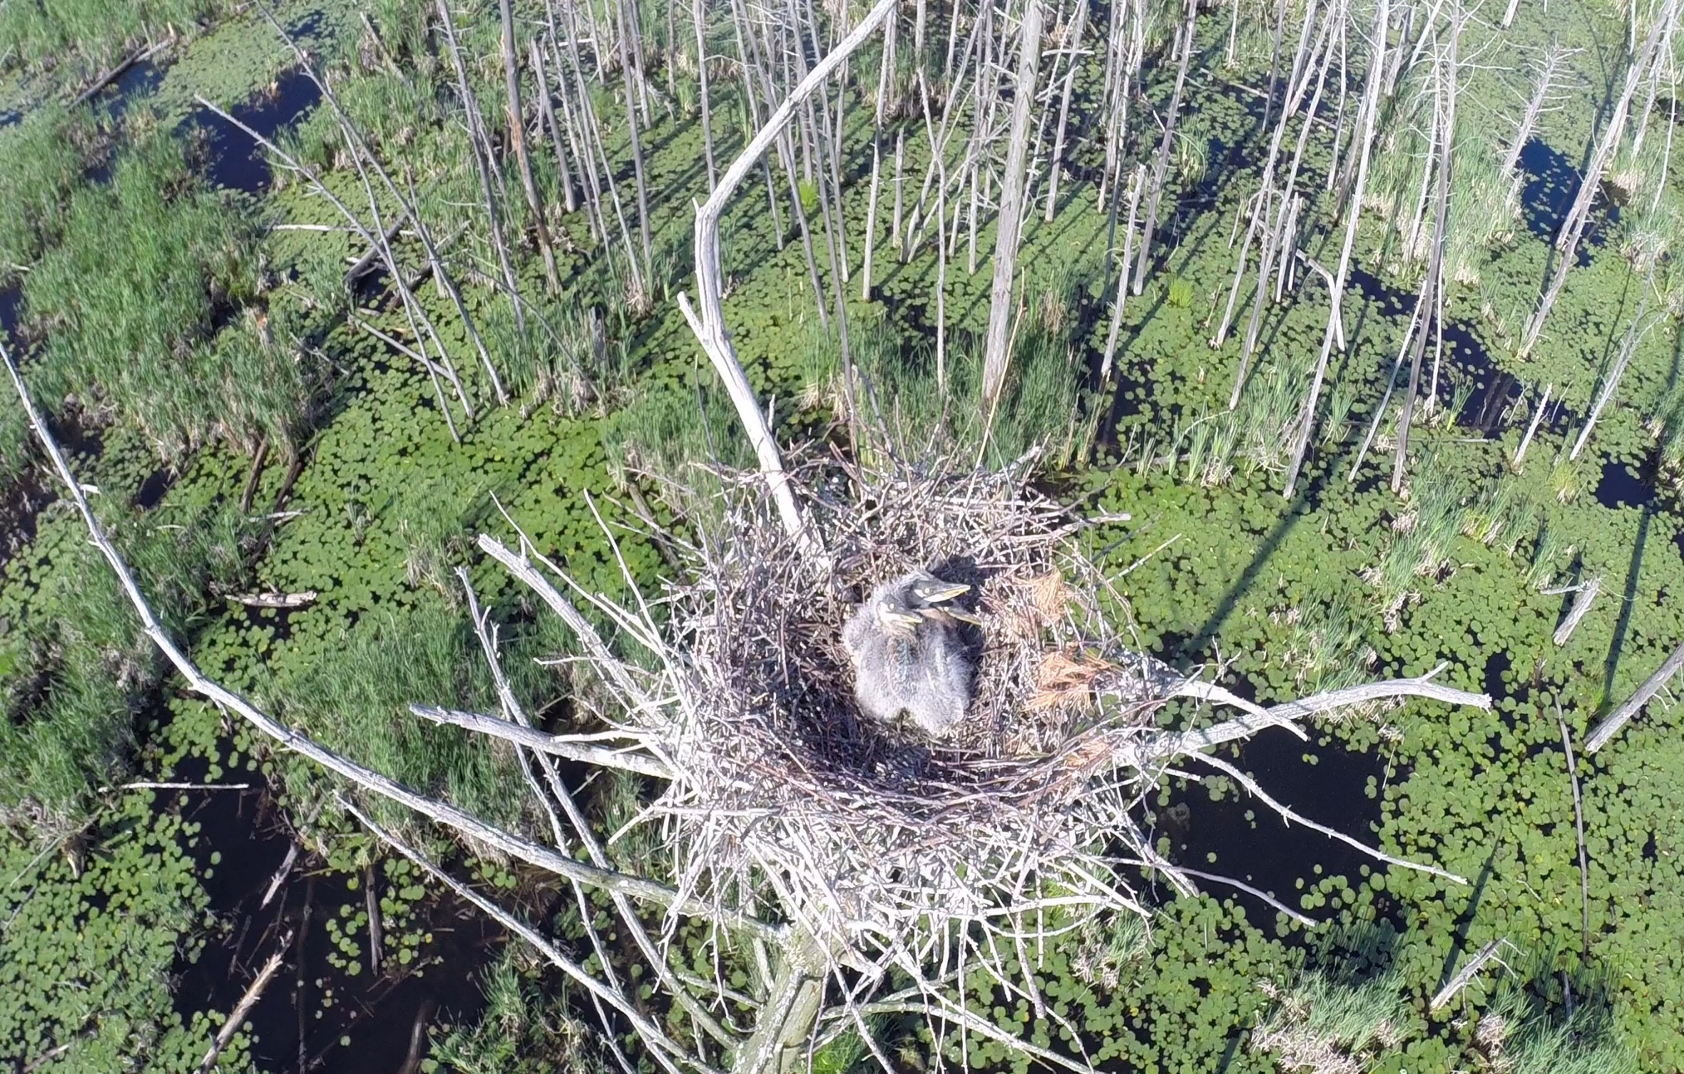
Evaluation of Substantial Adverse Environmental Effect
The nature of the probable environmental impact of the facility alone and cumulatively with other existing facilities, including a specification of every significant adverse effect, including, but not limited to,
electromagnetic fields that, whether alone or cumulatively with other effects, impact on, and conflict with the policies of the state concerning the natural environment,
ecological balance,
public health and safety,
(iv) scenic, historic and recreational values,
(v) agriculture,
(vi) forests and parks,
(vii) air and water purity, and
(viii) fish, aquaculture and wildlife.

Slide 16














Interaction with Federal, Regional and State Entities
Council on
Environmental
Quality
Public Utilities Regulatory Authority

Slide 17
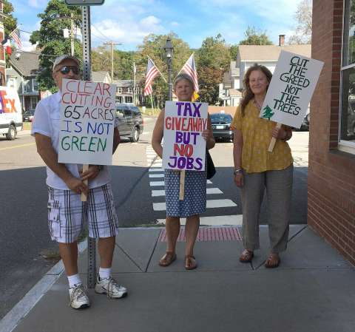

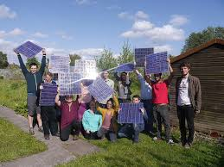
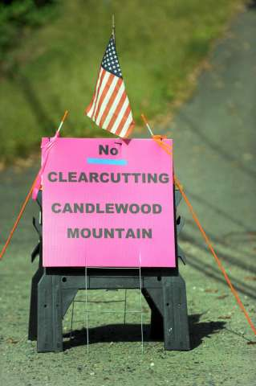
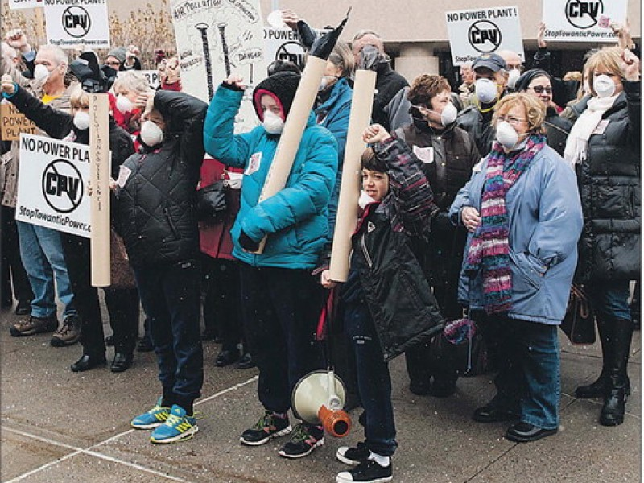

Interaction with the Public

Slide 18
Connecticut Solar Projects Sited on Landfills
 | Property owner | Landfill Status and Permits | Parcel acreage | Project acreage | CSC Process | State, Town and Public comments | DEEP Natural Diversity Database
Bridgeport 2.2 MW 2014 | City-owned Seaside Landfill | Authorization for Disruption and Post Closure Use from DEEP | 46 | 22 | Petition – Public Hearing | DEEP issued letter of support 5 legislators issued letters of support > 20 residents issued letters in opposition City requested party status in support City Councilman requested intervenor status in opposition | Listed animal, insect and plant species (5) Re-review required further surveys for additional species
Norwich 2.74 MW 2015 | City-owned Norwich Transfer Station | Authorization for Disruption and Post Closure Use from DEEP Solar Power Site License from City | 98.3 | 10.8 | Petition – Field Review | No state agency comments No legislator comments City comments in support No public comments | No impacts to state-listed species
Wallingford 19.99 MW 2018 *DEEP RFP | MIRA-owned (52 acres) City-owned (106 acres) | Authorization for Disruption and Post Closure Use from DEEP | 158 | 49 | Petition – Field Review | DEEP noted 12 conditions related to issues/concerns with management 7 pages + 4 pages of stormwater guidance + 4 pages of updated NDDB letter 1 legislator issued “general” letter of support Forest clearing concerns Reduce project by 20 acres or relocate panels to industrial land Potential interference with future bike trail MIRA and the City issued letters of support No public comments | Listed animal, insect and plant species (17) Re-review required further surveys for additional species

Slide 19
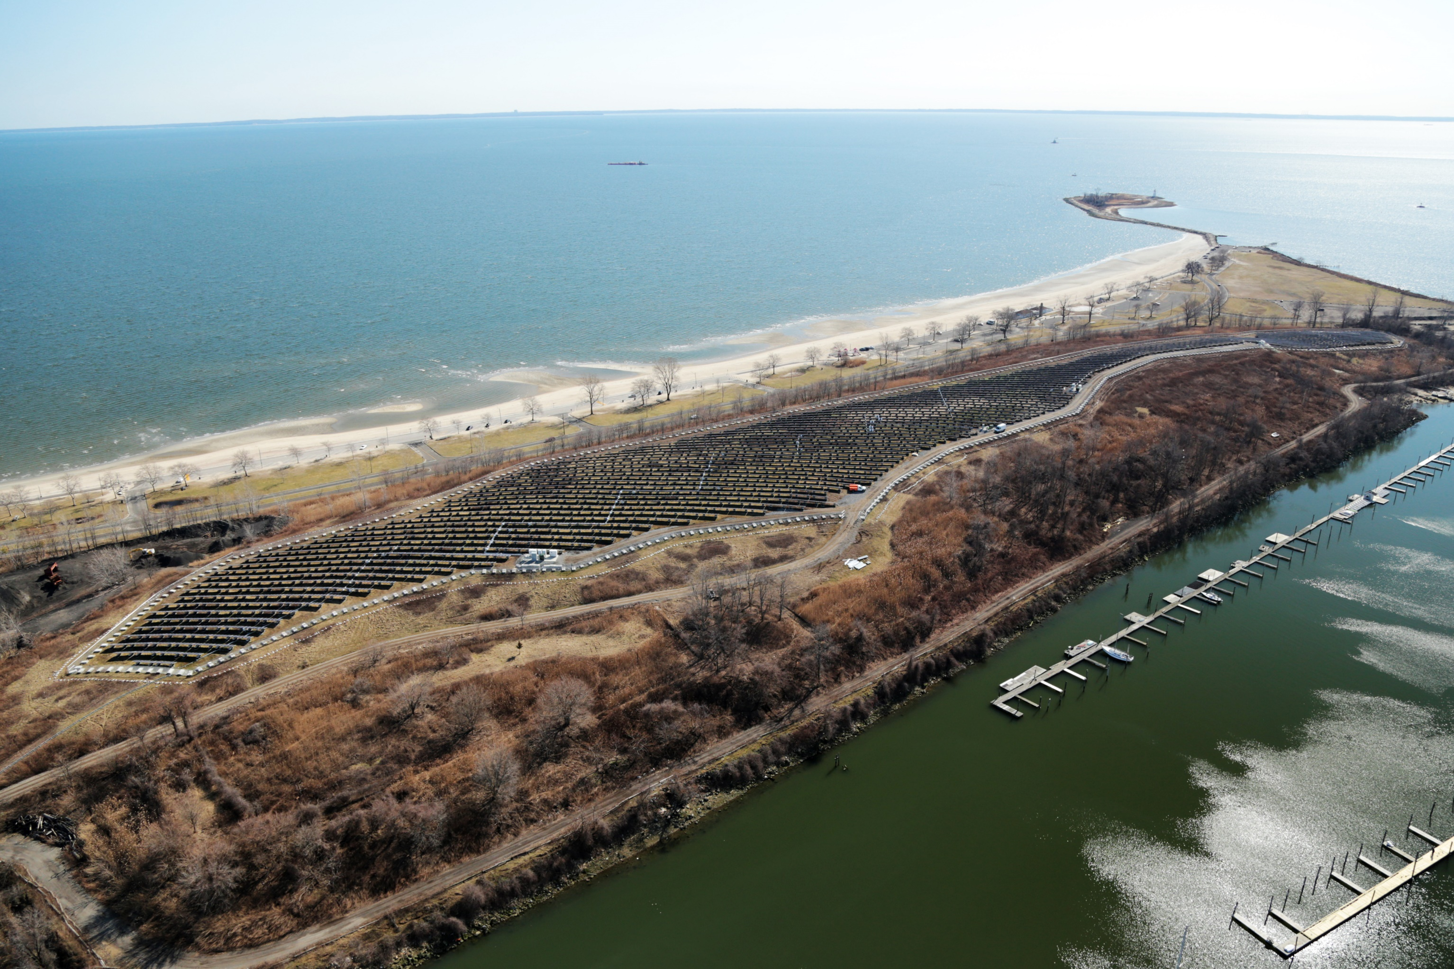
Bridgeport Seaside Landfill Project
Siting Evaluation:
Wildlife & Habitat
Wetlands
Historic Resources
Water quality
Visibility
Public safety
Development and Management Plan

Slide 20
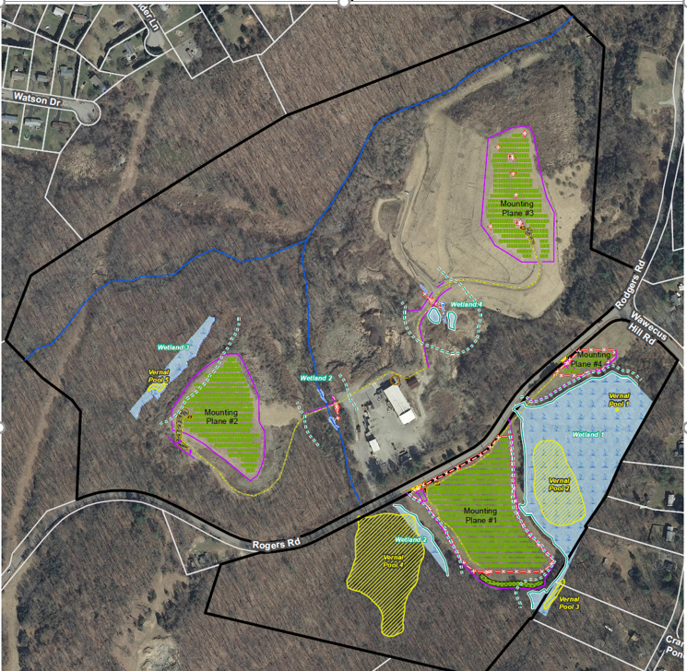
Norwich Rogers Road Landfill Project
Siting Evaluation:
Wildlife and habitat
Water quality
Wetlands
Visibility
Historic resources

Slide 21
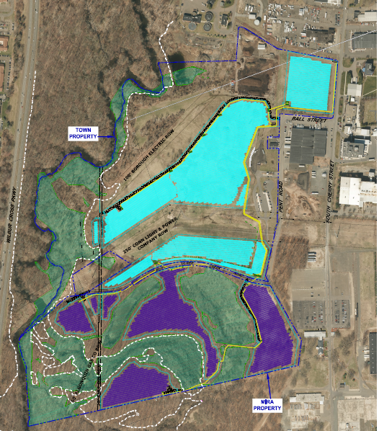
Wallingford Landfill Project
Siting Evaluation:
Wildlife & Habitat
Wetlands
Historic Resources
Water quality
Visibility
Public safety
Development and Management Plan

Slide 22
General Permit for the Discharge of Stormwater and Dewatering Wastewaters from Construction Activities
Stormwater Management at Solar Farm Construction Projects (2017)
APPENDIX I - Stormwater Management at Solar Array Construction Projects (2019)

Slide 23

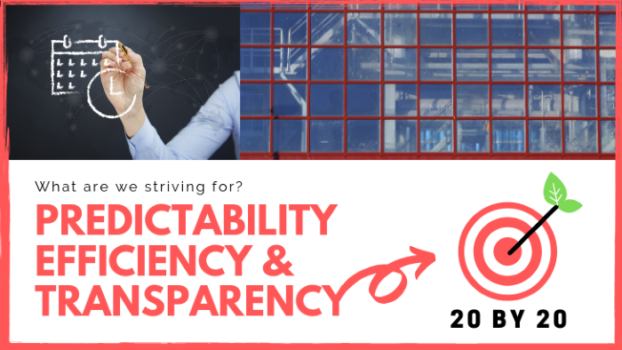
CT DEEP 20 BY 20: 20 goals aimed at increasing predictability, efficiency and transparency of DEEP’s regulatory processes to meet in 2020
Goal 1: Make permitting timeframes more transparent
Goal 2: Enhance pre-application assistance
Goal 7: Change individual permits to general permits
Goal 9: Simplify Natural Diversity Database Determinations
Goal 16: Increase stakeholder engagement in process improvement efforts

Slide 24
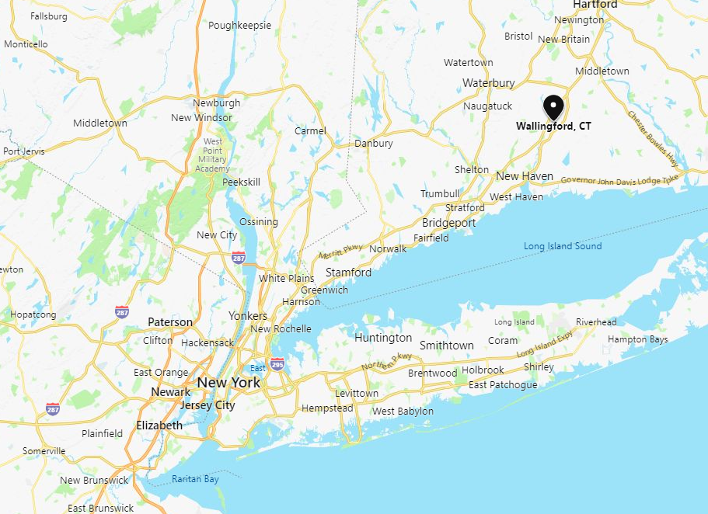
Wallingford Renewable Energy -
Project Overview
15 MW_{AC} solar project in central Connecticut
Power Purchase Agreements with two utilities through Connecticut Department of Energy and Environmental Protection (DEEP) RFP
Landfill / Brownfield Site
Lease agreements with Town of Wallingford, Materials Innovation and Recycling Authority (MIRA)
Electric interconnection with Wallingford municipal utility
Fully financed investment of approximately $40mm
90 Miles

Slide 25
Wallingford Value Drivers and Local Benefits
20-year Power Purchase Agreements with Eversource and United Illuminating
.25 miles from major substation in high industrial load area (25MW minimum load at substation)
Project neighbors are two chemical factories, steel extrusion plant, and a gas-fired peaker power plant
35-year lease agreements with Town and MIRA, approximately 60 acres of leased area, $1,500/acre, 2.5% annual escalation
Tax agreement with Town of Wallingford, $3mm over 20 years
Total service payments to municipal utility over project life of approximately $2.7mm (night load and O&M service)
Clean-up of an un-used and industrial-zoned site to prepare for approximately $40mm capital investment

Slide 26
Key Issues
Bankable lease agreements with two institutional counterparties (Town and MIRA)
Site remediation and clean-up on MIRA site
Obtaining records and background in a timely manner from state agencies for completion of Phase I ESA
Coordination with multiple state agencies within DEEP
Bankable indemnity agreement with DEEP for work on landfill and near water quality monitoring wells on both landfill and MIRA property
Changing stormwater regulations for solar projects
Threatened and endangered species and timely feedback from agency
Electric interconnection with a municipal utility with no experience interconnecting power generation projects

Slide 27
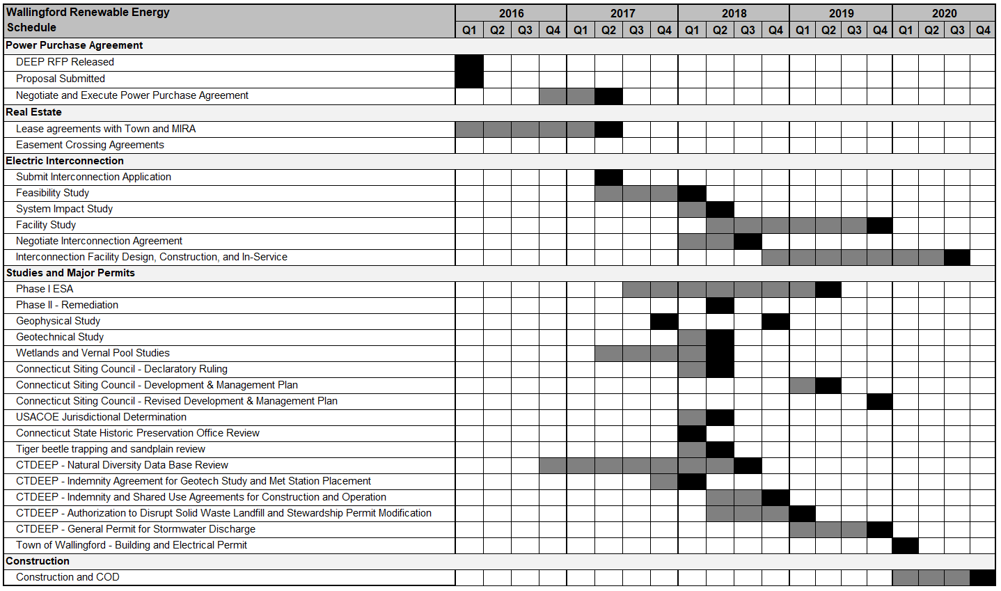
Wallingford Renewable Energy – Project Schedule

Slide 28
Key Lessons
Capital investment size relative to overall context matters when trying to get attention to resolve key project issues - $40mm is light in central Connecticut.
Engage agency stakeholders early and often. Identify and cultivate project advocates early.
Hire the right consultants – and if the right consultants aren’t on board don’t be afraid to make changes early before valuable money and time are lost. This is true for all projects, but especially true for brownfield projects – you don’t want your consultants to be learning to ski a double black diamond for first time on your dime.
Whatever you think schedule and budget should be at beginning – double it and add 50%.
As much as we would like to do everything in parallel – there are key sequential steps that need to be taken in order to get real traction on project.

Slide 29
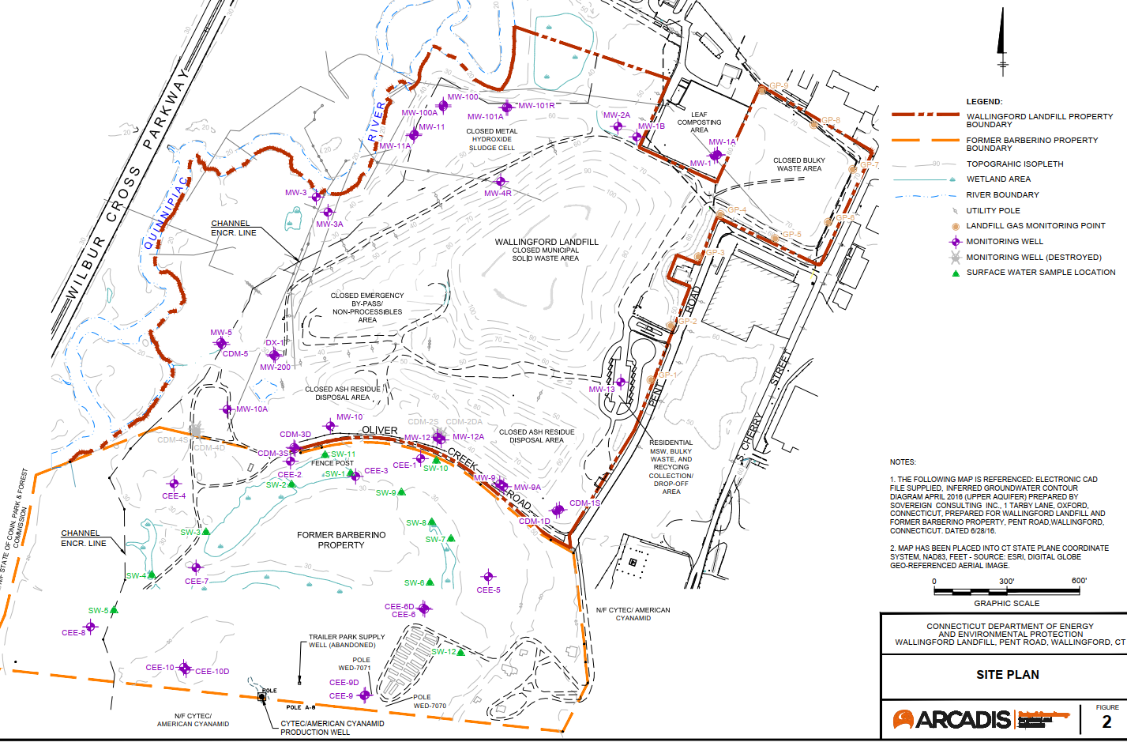

Slide 30
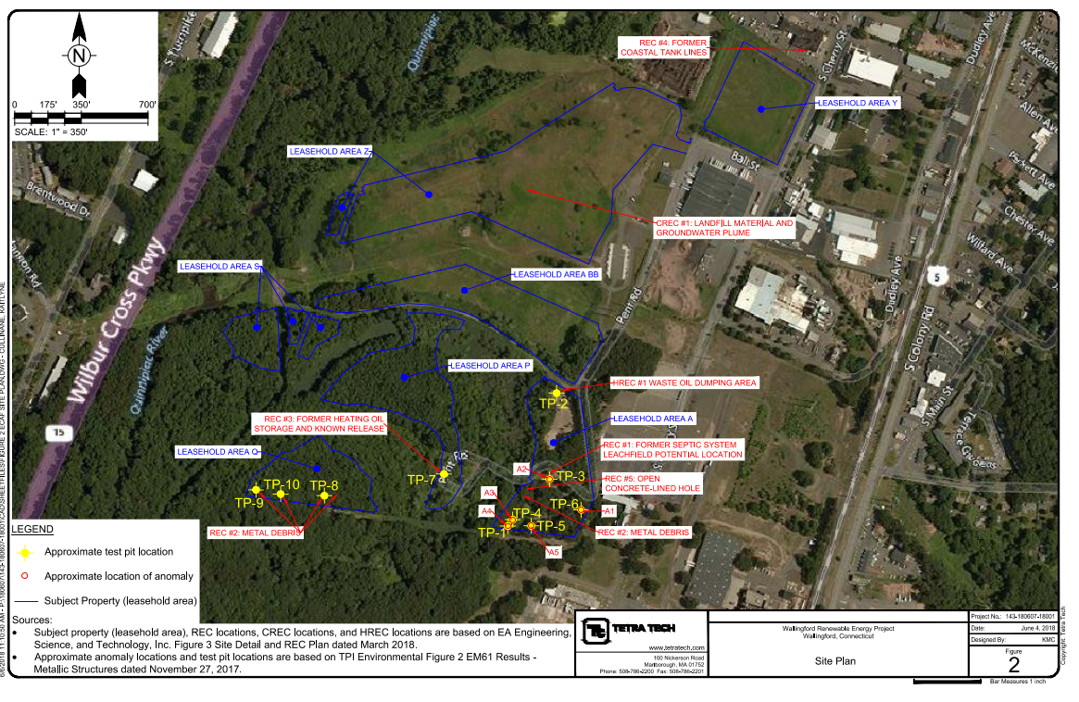

Slide 31
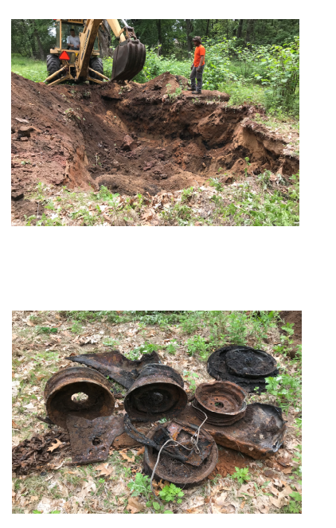
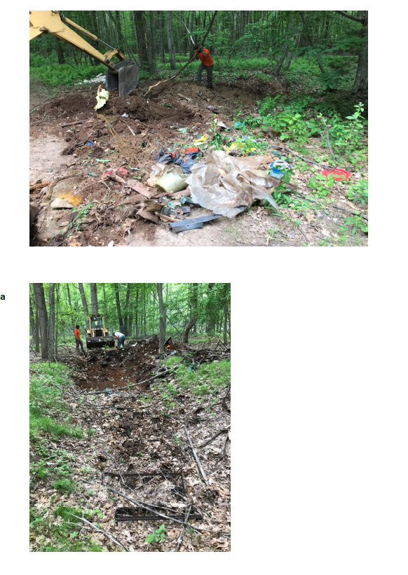
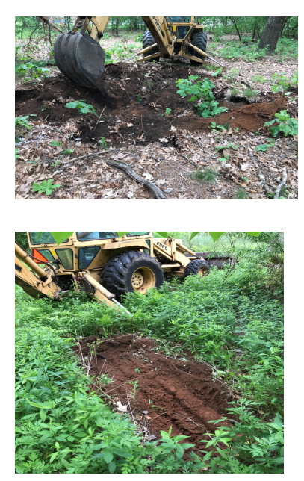

Slide 32
QUESTIONS?

