Slide 1
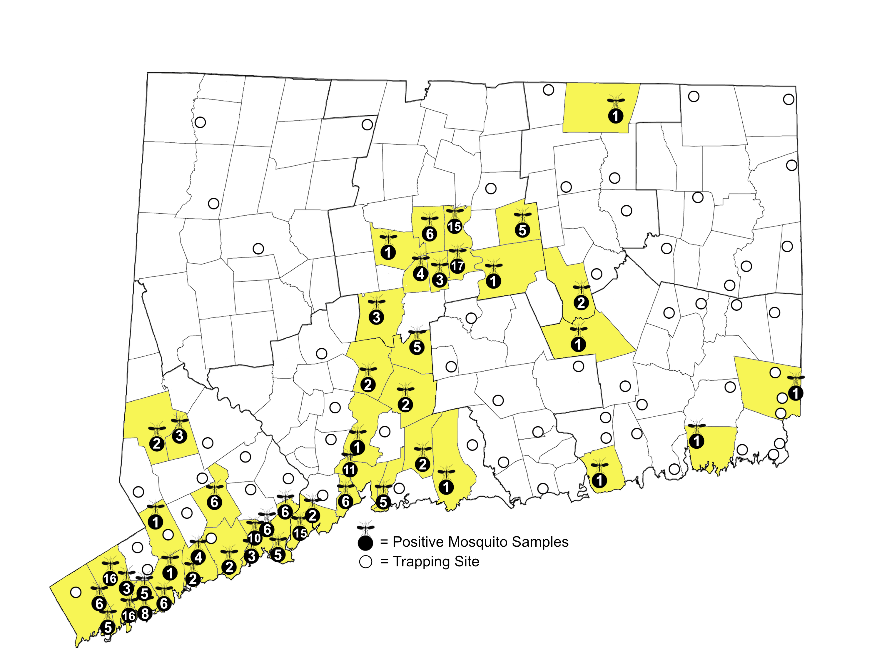
2025 West Nile Virus Activity
Positive Mosquitoes Samples = 230
Bird-biting Species
Culex pipiens = 162
Culex restuans = 29
Culiseta melanura = 4
Uranotaenia sapphirina = 2
Culex territans = 1
Mammal-biting Species
Culex salinarius = 8
Coquillettidia perturbans = 7
Culex erraticus = 5
Ochlerotatus japonicus =5
Anopheles quadrimaculatus = 2
Aedes albopictus = 1
Aedes cinereus = 1
Aedes vexans = 1
Anopheles punctipennis = 1
Anopheles walkeri = 1
Human Cases by County
Fairfield = 4
New Haven = 1
New London = 1

