Slide 1

Safety Skills in the Community
^{Date: September 3rd, 2026}
Developmental Services
Notes:
Title of presentation goes here

Slide 2
How to Play the Presentation
Open the presentation in PowerPoint.
Wait for slide show to load up (it may take a minute or two).
Click on arrows at the bottom of screen to go to the next slide or back a slide or click on the next slide in sequence on the left bar.
To hear recordings, press on the megaphone and press play.

Slide 3



Safety Skills in the Community
Pay attention to your surroundings: EX: your Home, your work office outside , in your neighborhood.
  Notice people, cars, noises, and anything that seems strange
Keep your phone charged and with you. Ex: portable phone charger, phone cable. To make an important phone call.
Developmental Services
Notes:
Basic slide to add information to

Slide 4




Continued pictures

Slide 5

Asking for help
Know safe people: store employees, security guards, police officers, bus drivers , or community helpers.
Practice asking for help clearly:’’ I need help. I'm lost. Can you help me?’’
Where to keep your emergency contact numbers. EX: in your wallet, in your Cell phone, in your bag.
Developmental Services
Notes:
Blank side on left is for images

Slide 6

Safe Travel Skills
Use crosswalks and follow traffic signals
Wait for buses in well-lit areas
  Sit near the driver or in areas with more people
Share your travel plan with someone you trust
  EX: like family or friends

Slide 8

What is Employment ?
Work life balance- means having enough time for both of your job and your personal life while staying safe and healthy in your community.

Slide 9
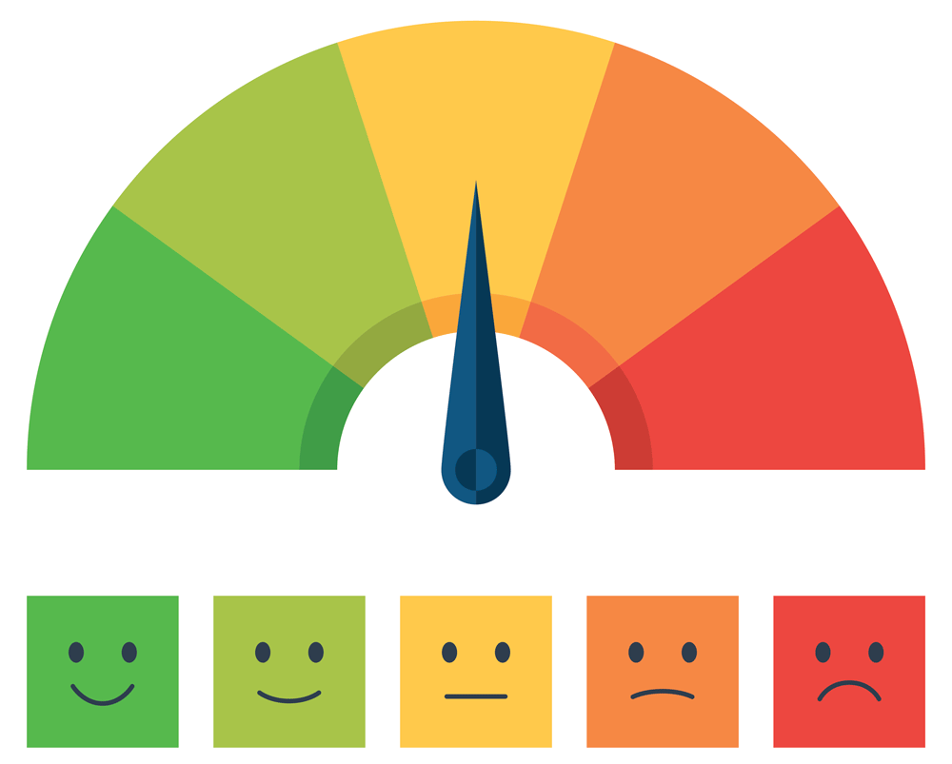
Feeling of Living Independent
Living Independent has its good days and the bad days
Make your home how you want it.
Some people enjoy living on their own, while others don’t
Try activities at home
Example: painting, writing, arts and crafts, cooking or baking.
Feeling of living independent
Notes:
Alida

Slide 10
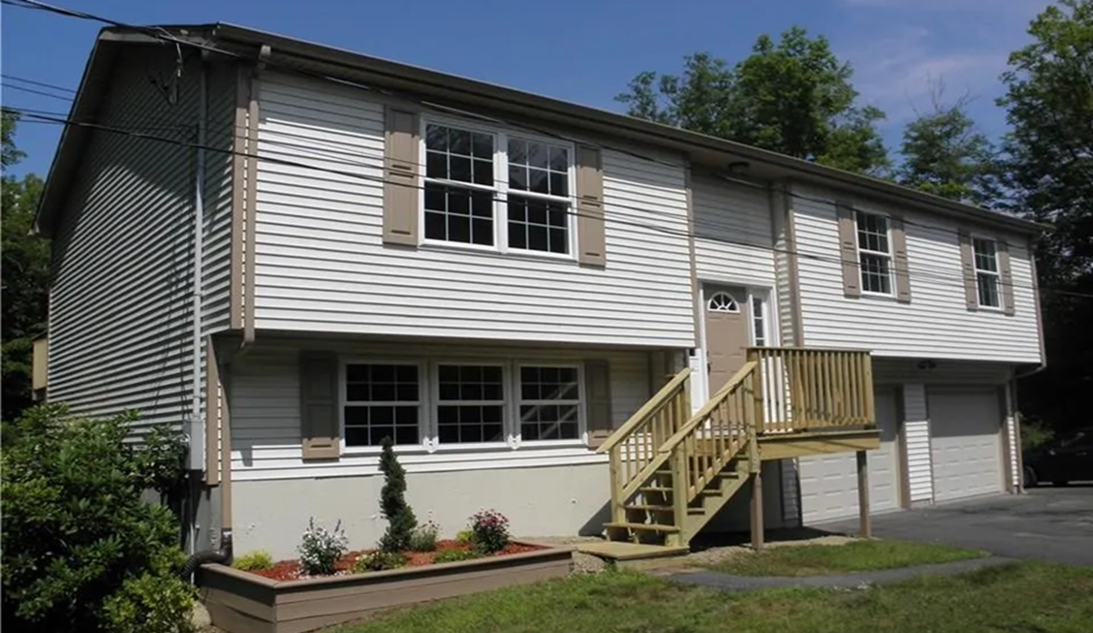
Inside chores:
Daily Tasks: Making beds, washing dishes, loading or emptying the dishwasher, wiping counters, and throwing away trash.
Weekly Tasks: Vacuuming floors, mopping, cleaning bathrooms, doing laundry, and watering plants.
Monthly Tasks: Washing windows, dusting hard-to-reach areas, and organizing closets.
Outside Chores:
Mowing: Cut the grass to keep your lawn healthy.
Weeding: Pull unwanted plants from flower beds and garden paths.
Watering: Hydrate plants and lawns using a hose, sprinkler, or watering can.
Sweeping: Clear walkways, porches, and driveways.
Chores
Don’t overwhelm yourself
Take one room a day.
Chores
Notes:
Alida

Slide 11
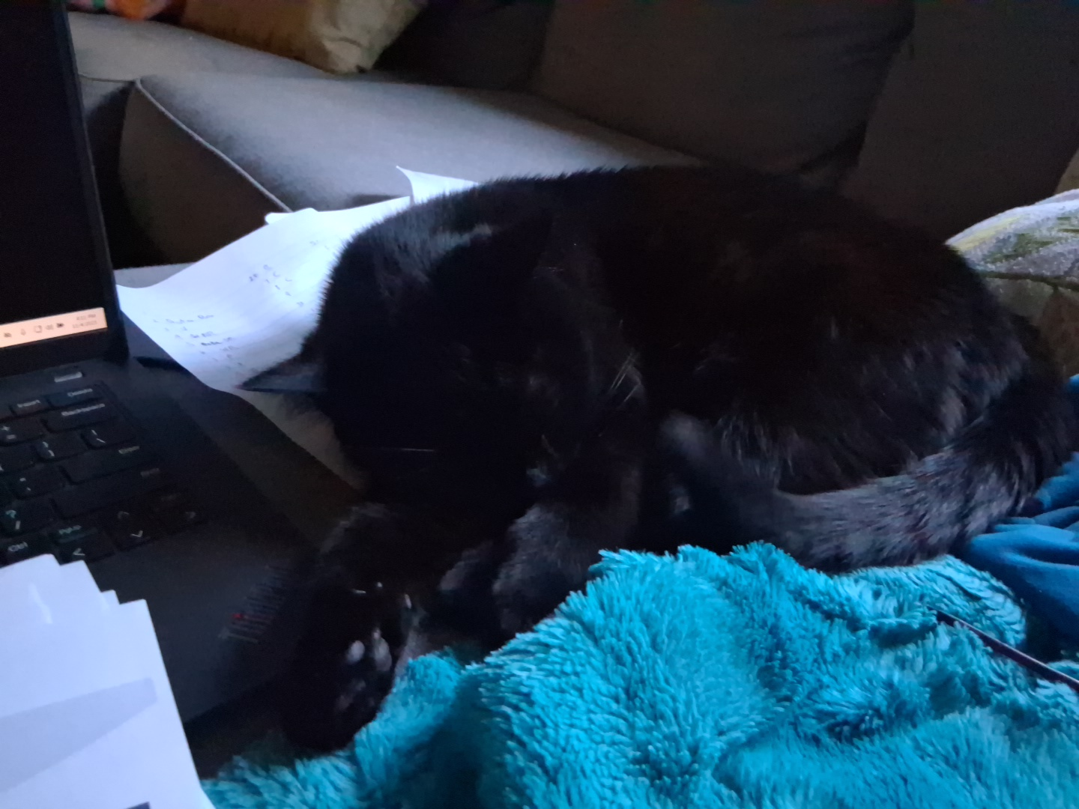

Having a Common Pet
Cats:
Feed cats as directed by your vet. Have one litter box per cat, plus one extra (e.g., two boxes for one cat). Scoop solid waste and clumps at least once a day.
Dogs:
Feed two meals per day. Serve meals at the same times each day to help regulate digestion. Walking your dog every day is a good thing for their health.
Meet Luna
Make sure that your place allows animal. Make sure you do your research before you get a new pet.
Having a common pet
Notes:
The common pets
Cat -Feed adult cats at consistent times twice a day or leave measured dry food out if recommended by your vet. Have one litter box per cat, plus one extra (e.g., two boxes for one cat). Scoop solid waste and clumps at least once a day to keep your cat happy and prevent accidents outside the box.
Dogs Feed two meals per day, spaced about 12 hours apart. Serve meals at the same times each day to help regulate digestion. Walking the every day is a good things for there health
Make sure that your place allows animal. Make sure you do your research before you get a new pet.
Meet luna she is a cat she is one of the sac

Slide 12

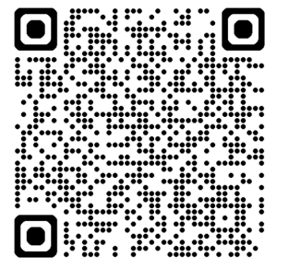
Employment
Minimum wage is $16.94 per hour
The job is matched to your abilities, career goals, and interests.
Support and/or accommodations may be provided if needed.
QR Code
CT Day and Employment Services
https://portal.ct.gov/dds/supports-and-services/employment-and-day-services?language=en_US
Employment

Slide 13

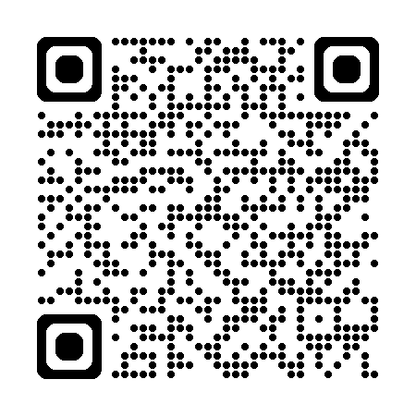
What is Self-Advocacy
Self-Advocacy is the ability to speak up for your own needs, rights, likes, and dislikes while taking action to achieve your personal goals. It means understanding yourself, clearly expressing your thoughts and needs to others, making informed choices, and taking responsibility for those choices. Self-advocacy is empowering and can be applied to all areas of life, including school, work, and personal relationships.
QR Code Advocates’ Corner
https://portal.ct.gov/advocatescorner
What is Self-Advocacy

Slide 14
Presentation title FAB topic Independent living
Date 9/8/2026
Developmental Services

Slide 15

Tips for Safe Independent Living/How to Get a Place of your Own
Game plan for individuals with disabilities looking for independent housing.
Explore community resources — Many organizations offer support for finding accessible housing and understanding rental agreements.
Consider financial assistance — Government programs can help cover housing costs for disabled individuals.
Developmental Services
Notes:
Housing

Slide 16
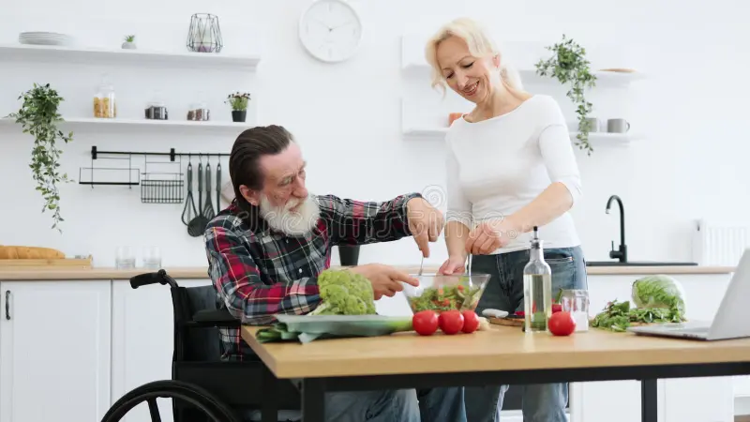
Utilize independent living services — These services provide training in essential skills like budgeting and meal preparation.
Look into shared living arrangements — This option allows individuals to live with a caregiver while keeping your independence.
Network with local advocacy groups. Understand your rights and responsibilities.
Developmental Services
Notes:
Housing

Slide 17
Types Of Independent Living (Housing)
Subsidized housing: Project-based housing, Tenant-based housing is government-supported. Renters typically pay about 30% of their monthly income toward rent and utilities, the government covers the rest of the balance.
Public Housing: Affordable apartments and townhomes administered directly by local public housing agencies (PHAs). Rent is based on income, making it affordable for eligible residents
Housing Choice Vouchers (Section 8): Tenant-based assistance enabling renters to choose private-market housing that comply program guidelines.
Project-Based Section 8: Subsidies tied directly to specific apartment buildings or complexes rather than an individual renter.
Developmental Services

Slide 18
Types of Supported Housing
Affordable Housing Program (AHP) (also known as Flex)
Housing for Elderly Persons
Congregate Development Program
https://portal.ct.gov/doh/doh/housing/programs
Developmental Services

Slide 19
Restricted Income
Community housing: These include group homes and supervised apartments
DDS supported housing
Low Income
Federal and State Subsidies: Section 8 housing choice voucher program, State Rental Assistance Program, Congregate Services Program and Connecticut housing Finance Authority.
Developmental Services

Slide 20
HOME CHDO Certification
State Housing Tax Credit Contribution (HTCC) Program
HUD Multifamily Housing Programs
Specially Adapted Housing Program
Developmental Services

