Slide 1

Aging
May 2026
Developmental Services

Slide 2
How to Play the Presentation
Open the presentation in PowerPoint.
Wait for slide show to load up (it may take a minute or two).
Click on arrows at the bottom of screen to go to the next slide or back a slide or click on the next slide in sequence on the left bar.
To hear recordings, press on the megaphone and press play.

Slide 3
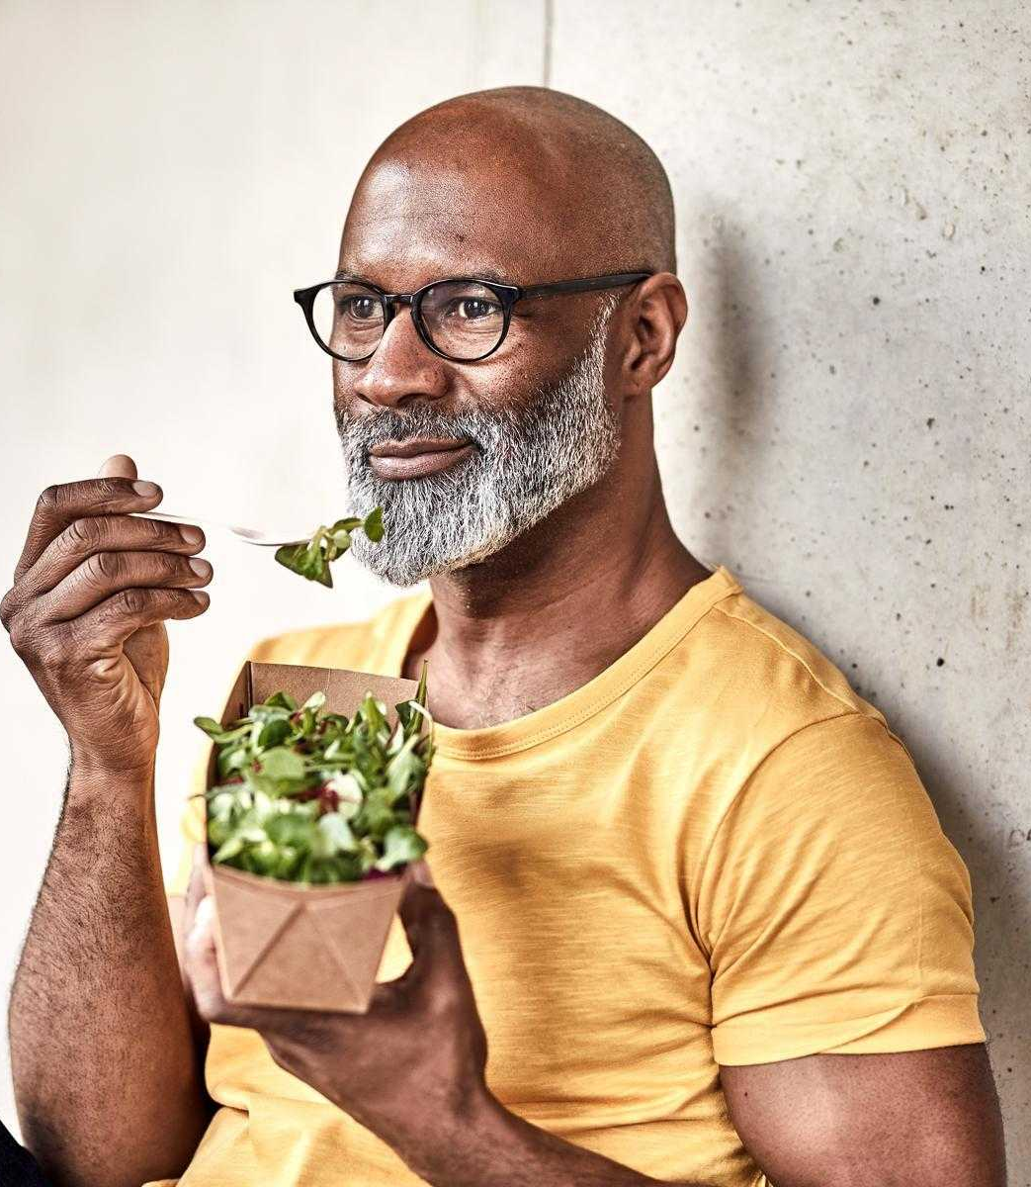
Healthy Aging

Slide 4
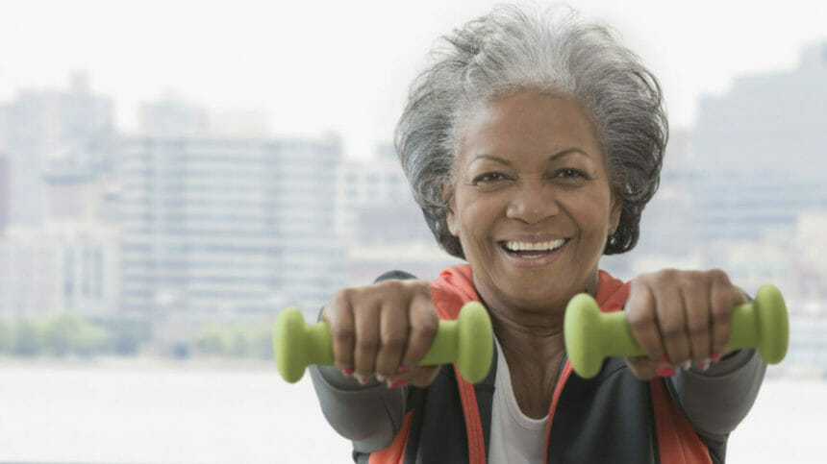
Get moving: Exercise and physical activity
Whether you love it or hate it, physical activity is important for healthy aging.
They enjoy more years of life without pain.
As people age, muscle function often declines.
Moderate to strong physical activity is strongly related with muscle function, regardless of age.
This suggests that exercise may be able to prevent age-related decline in muscle function.
Get moving: Exercise and physical activity

Slide 5
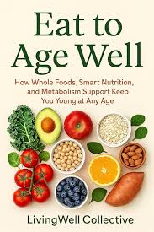
Healthy eating: Make smart food choices
Making smart food choices can help protect you from certain health problems as you age and may even help improve brain function.
Eating well is not just about your weight. Older adults with frequent migraines found that a diet lower in vegetable oil and higher in fatty fish could reduce migraine headaches.
Healthy eating: Make smart food choices

Slide 6
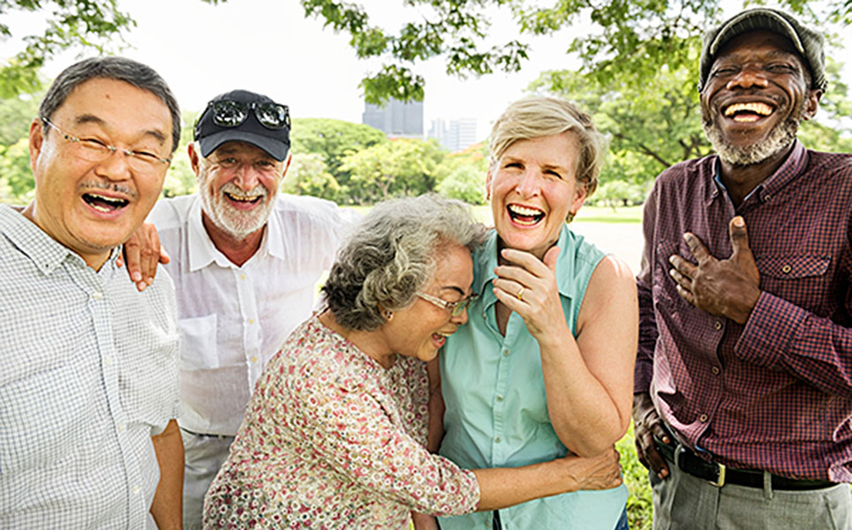
What Do We Know About Healthy Aging?
Many factors effect healthy aging.
Research has identified actions you can take to help manage your health.
to life as independently and maintain your quality of life as you age.
What Do We Know About Healthy Aging?

Slide 7
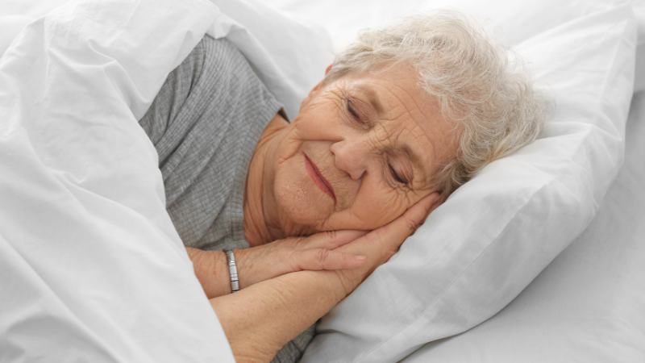
Getting a good night’s sleep
Getting enough sleep helps you stay healthy and alert.
Even though older adults need the same seven to nine hours of sleep as all adults, they often don’t get enough.
Not getting enough quality sleep can make a person moody, depressed, forgetful.
Try to fall asleep and get up at the same time each day.
Avoid napping late in the day, as this may keep you awake at night.
Getting a good night’s sleep

Slide 8
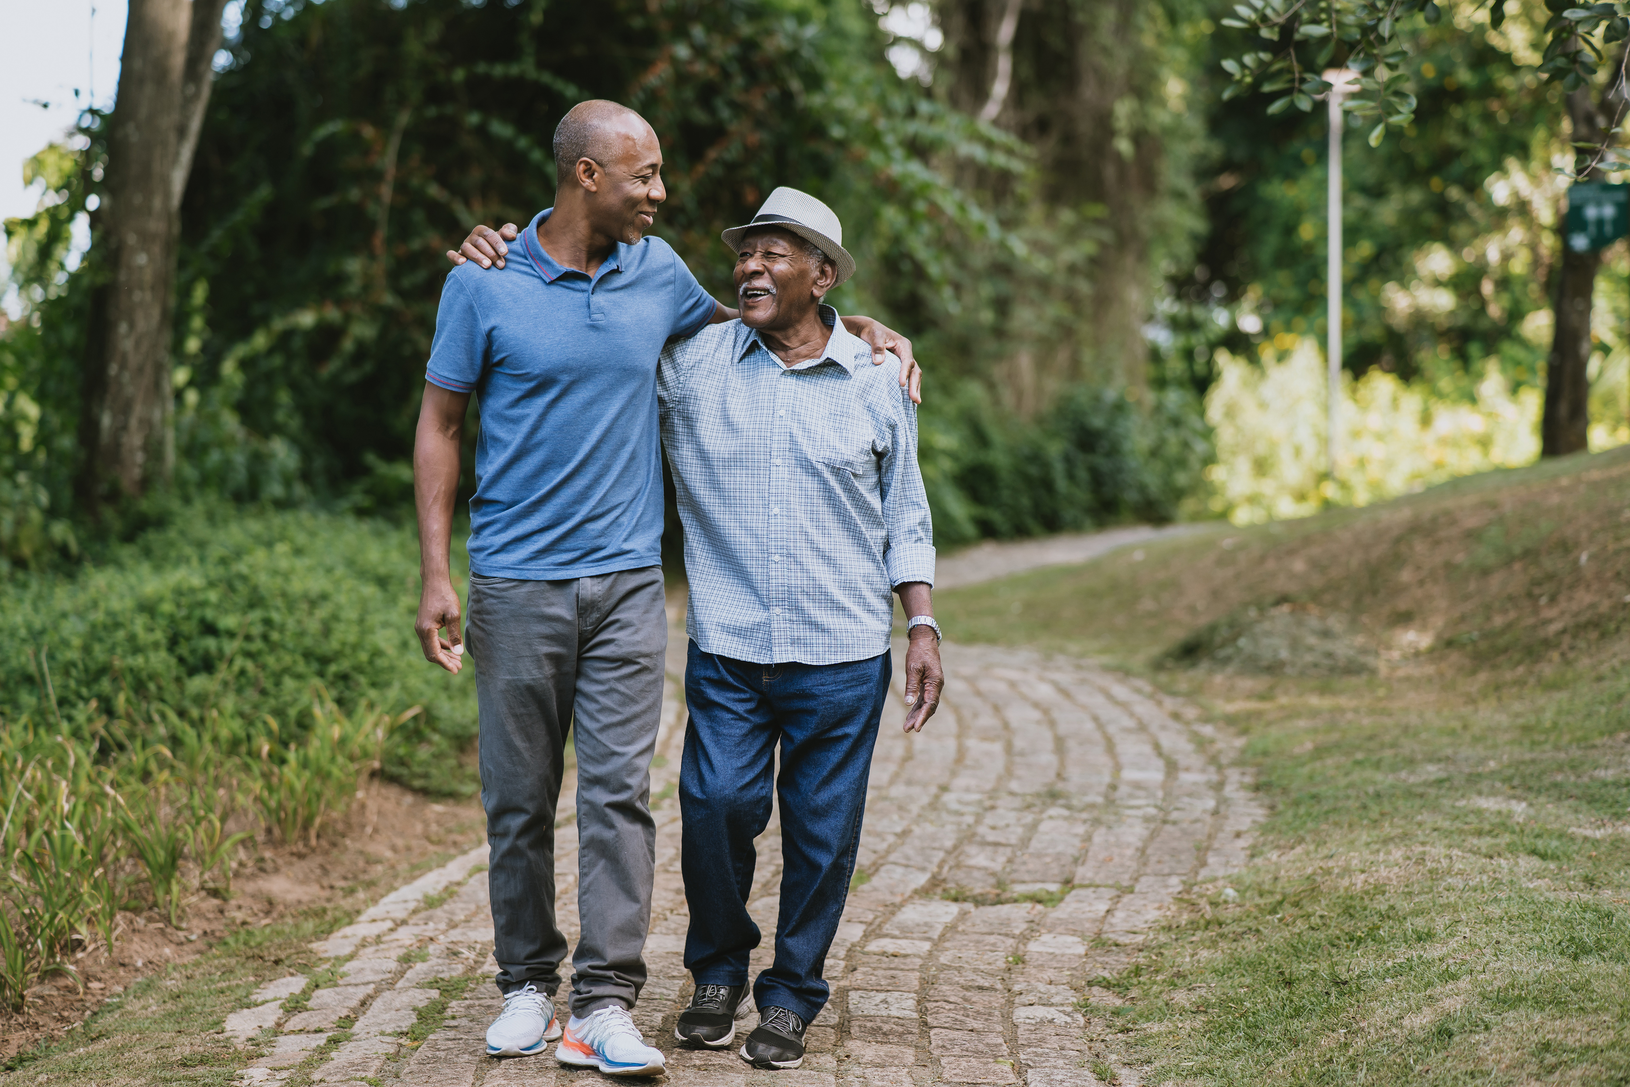
Aging Supports

Slide 9
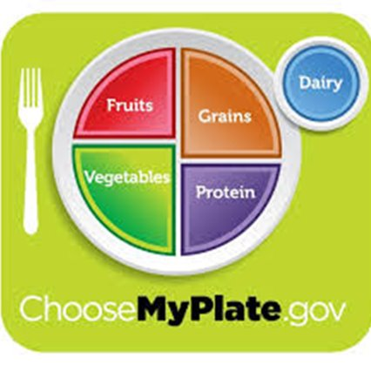
Nutrition
Nutrition plays a vital role in healthy aging, influencing everything from bone strength to brain function
Eating a variety of foods: Fruits, Vegetables, Dairy, Grains and Protein
Developmental Services

Slide 10

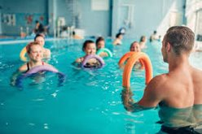
Stay Active
Keep moving daily- physical activity is one of the most powerful ways to support healthy aging.
You can do something you like: wheelchair rolls, short walks, chair stretches.
Developmental Services

Slide 11
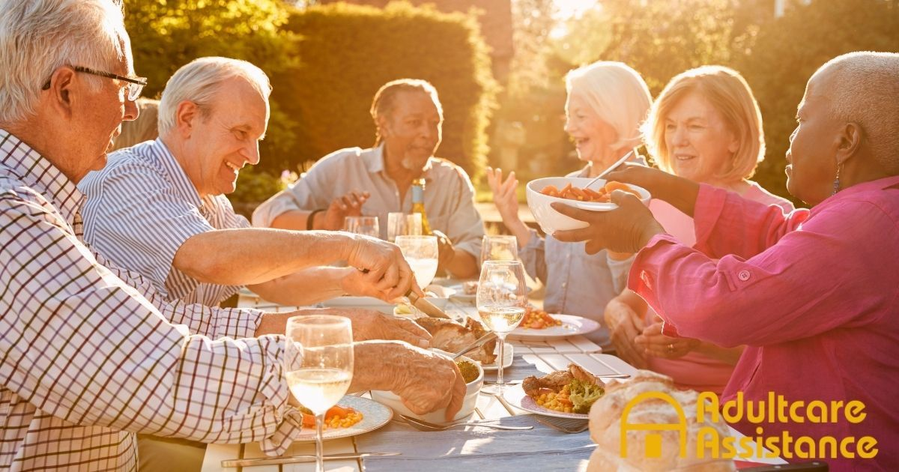
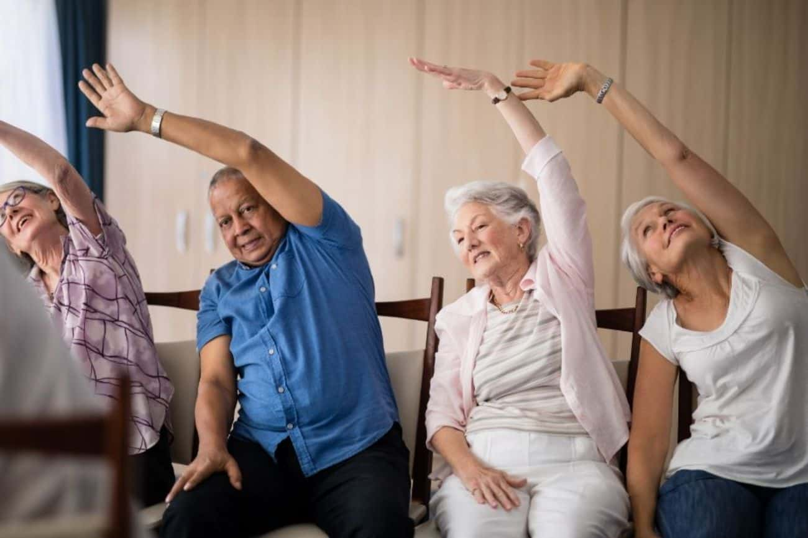
Brain health
Your brain needs as much attention as your body when it comes to aging well.
It is influenced by both lifestyle and medical factors
Developmental Services

Slide 12
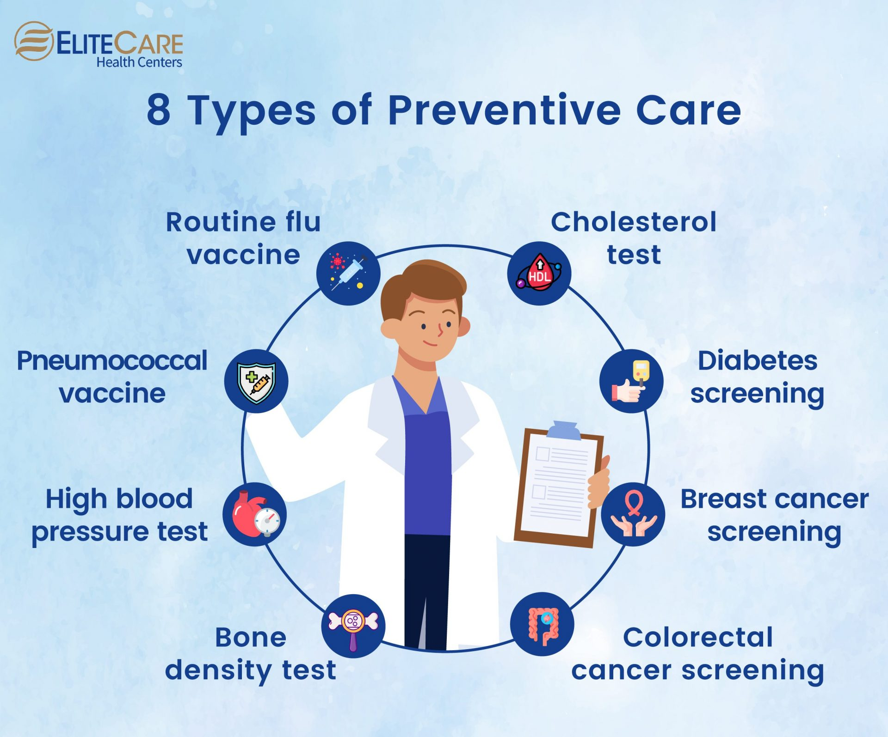
Preventive care
Regular check-ups are one of the most important ways to support healthy aging.
Prevent illness and disease by getting vaccines ,taking medications, living a healthy lifestyle

Slide 13
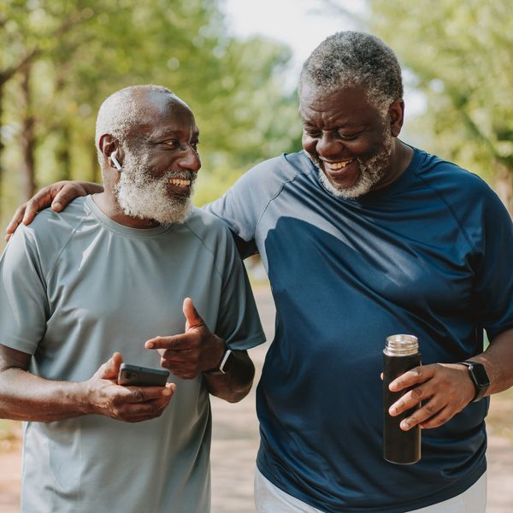
Aging Independently

Slide 14

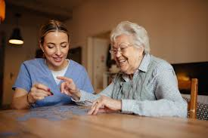
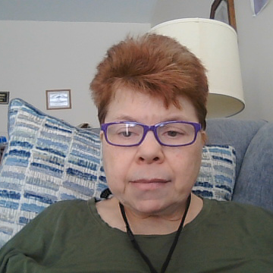
Tips on Aging Independently
Hire help. If your budget allows, schedule grocery delivery, someone to support you with cleaning and outside chores.
Take your time. Break up your tasks so you don’t get overwhelmed
Declutter. Simplify your life and give away things you no longer need.
Make cleaning easier. Use cleaning tools with extensions to reach higher or to clean baseboards, this will avoid having to reach up or bend down.
Get organized. Make a list of the things you need to do and prioritize the list. This not only helps you remember but also can help you not to be overwhelmed.

Slide 15
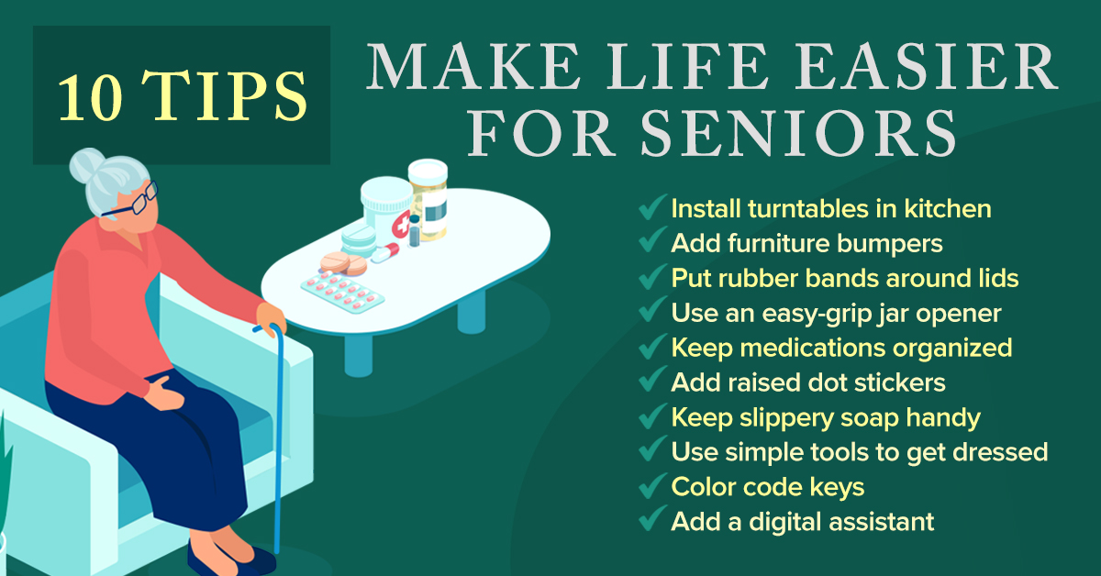
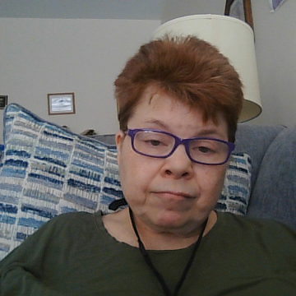

Slide 16
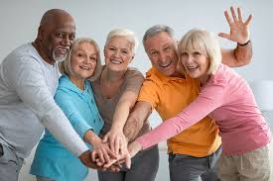

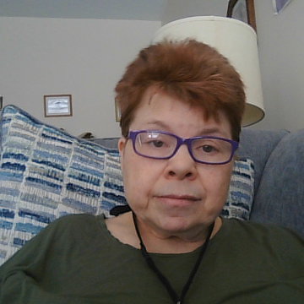
Helping someone to age independently
Allow Them Their Voice- We feel powerless if we cannot feel independent. Ensure any senior you’re working with has a significant say in all the choices affecting their lives.
Encourage Connections- Help them to remain socially active. Keep old friendships active and meet new people. Support them in visiting their local senior center.

Slide 17
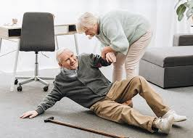
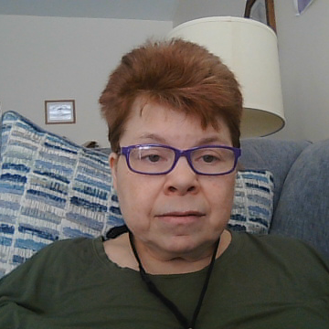
Promote Safety – As we age, we become more of a fall risk, assist them in securing rugs, installing handrails in bathrooms, and using a cane or walker.

Slide 18
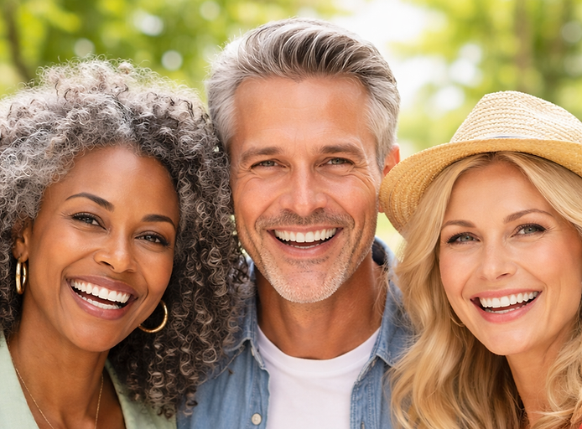
Aging Fabulously and
Youthfully

Slide 19
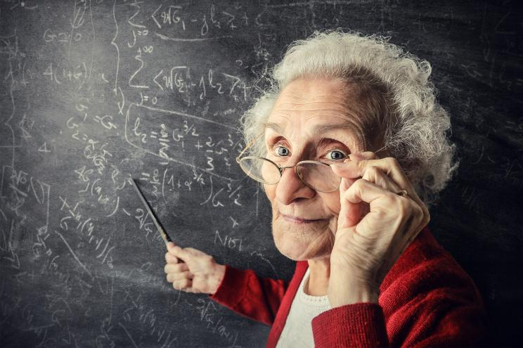
How to Feel Fabulous and Youthful as We Age
#1. The Wisdom of Aging: Embracing the Journey
Embrace all the lessons that life has taught you and honor yourself for your journey.
With each year, we gain more wisdom, more resilience, and a deeper understanding of who we are.
As we age, we are given the opportunity to focus less on trying to meet others’ expectations and more on living genuinely
Your body may change, but your inner strength and grace only grow

Slide 20
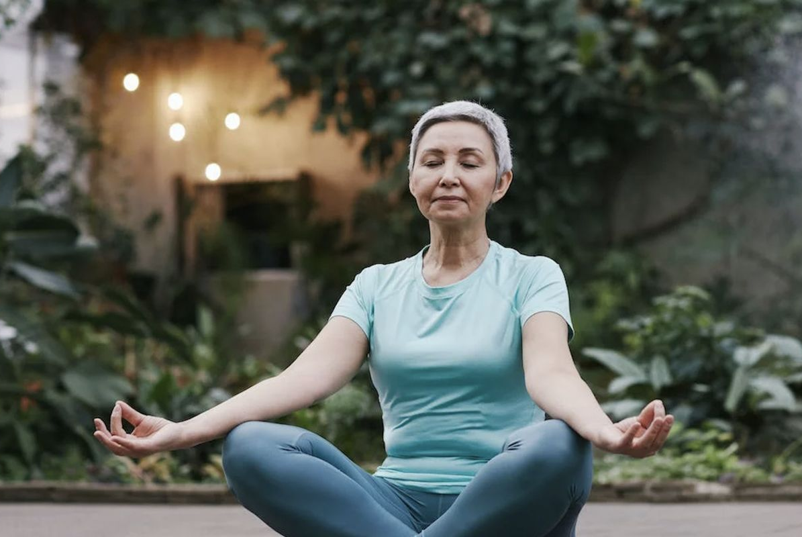
How to Feel Fabulous and Youthful as We Age
#2. Self-Care Is Essential
Your physical, mental and emotional health need to become your top priority. When you feel nourished and nurtured, you have energy to give and enjoy sharing it with others in a natural, easy way.
Prioritize your Health-eat healthy. drink plenty of water. and exercise.
Pamper your Skin- Moisturize and massage your skin
Nourish your soul - Allow yourself to rest without guilt, recharge your energy, and embrace the peace that comes with slowing down.

Slide 21
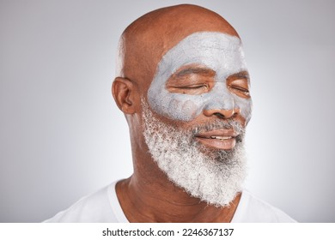
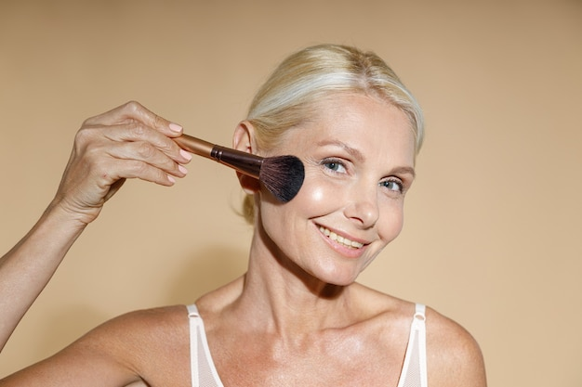
How to Feel Fabulous and Youthful as We Age
#3. Body Confidence at Any Age: Love What You See
in the Mirror
  It is not about perfection; it’s about acceptance, appreciation, and love for the body you have.
  Our bodies may change in ways we might not expect – but rather than focusing on what we don’t like, let’s celebrate the beauty and strength in our every wrinkle, line, and curve.
  Our bodies may look different, but they still hold the power to move, to create, and to love.
  There’s no one “right” way to dress at any age – just what makes you feel fabulous.
  there is a saying that “motion is lotion!” Whether it’s dancing, walking, swimming, or practicing yoga, regular movement helps build strength and keeps you feeling vibrant, energized and alive.

Slide 22
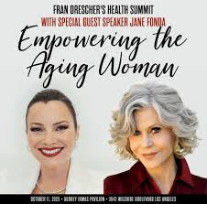
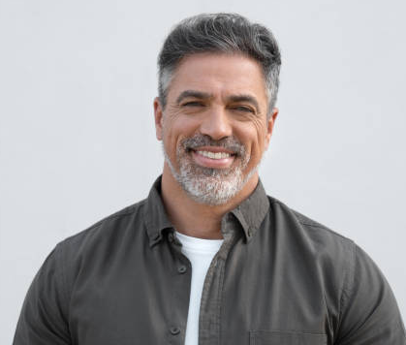
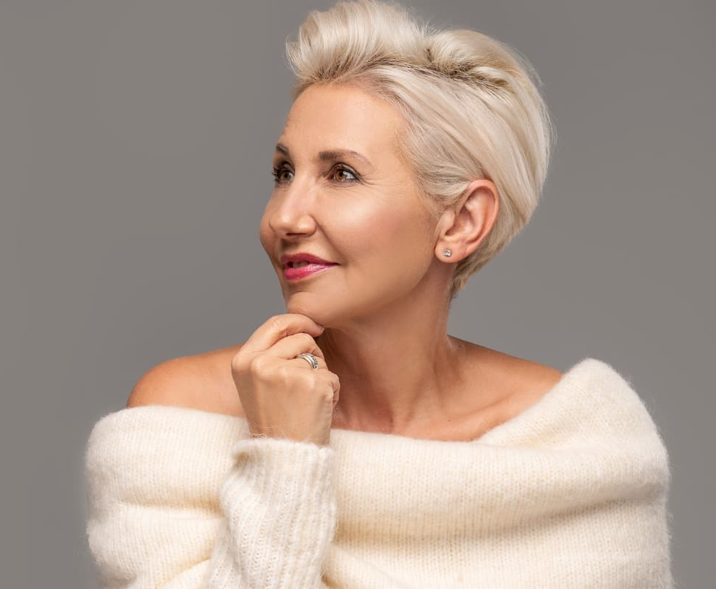
How to Feel Fabulous and Youthful as We Age
#5. Aging as Empowerment: Embrace every chapter
It’s a time to reclaim your voice, live boldly, and celebrate everything you’ve achieved.
In fact, you now have the wisdom and freedom to go after what you want without hesitation.
You’re never too old to pursue your passions or explore something new.
Step into your power and know that you are more than enough, just as you are.
So, here’s to feeling fabulous, confident, and empowered as we age. You are in the prime of your life – a time when self-love, body confidence, and self-care are more important than ever.
This is your time to shine even brighter, to live even bolder, and to love yourself fully.

Slide 23

How to Feel Fabulous and Youthful as We Age
Resources:
YouTube Video on Unlocking the Fountain of Youth: 8 Tips to Look Young After 40s
https://youtu.be/wEUxojz2ldk?si=j6DRuZXmq3pA2chw
Article from Sixty+Me website on Aging Fabulously
:https://sixtyandme.com/empowered-aging-feel-fabulous/
Article from Breslowmd website on superfoods that fight Aging
Fit, Fabulous, and Young: Five Superfoods That Fight Aging
Article from Overdose of Health website on Looking Fabulously
Naturally Younger: 16 Fabulous Tips for Forty+ - Overdose of Health

Slide 24
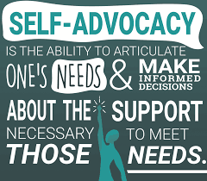
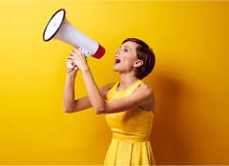
Self- Advocacy
Self –Advocacy means speaking or acting for yourself.
It means deciding what is best for you and taking charge of getting what you want.
Also, it means standing up for your rights as a person.
Self-Advocacy: The Basics (Infographic) - National Deaf Center

Slide 25

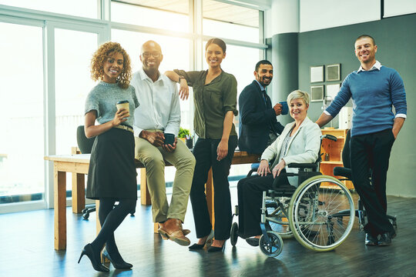
Employment
Employment plays an important role in our lives.
It gives us a purpose, and opportunities for growth.”
It offers a bi-weekly income.
Let’s us put our skills to good use.
And it helps us enjoy our other rights in life.
Developmental Services

Slide 26
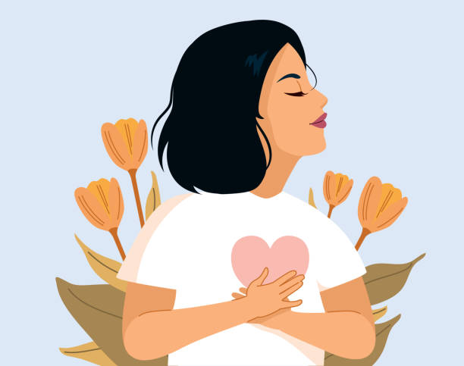
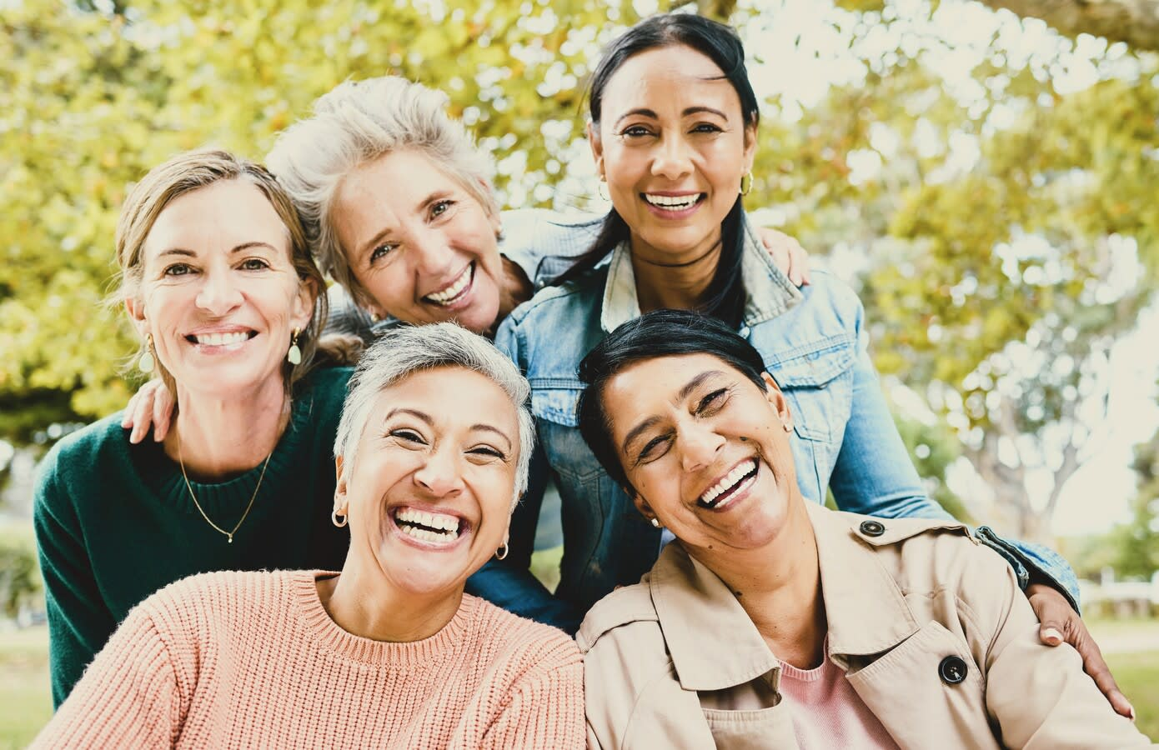
How to Feel Fabulous and Youthful as We Age
#4. The Power of Self-Love: Cultivating a Deep, Unshakable Love
for Yourself
This stage of life is an opportunity to show yourself compassion and to nurture and deepen the relationship you have with yourself.
Remind yourself each day that you are worthy of love, joy, and peace. Start your morning with an affirmation like, “I am beautiful, strong, and deserving of all the good things life has to offer.”
Never believe a self-limiting or negative thought – challenge it instead.
Ask yourself if the thought is true and let your answers come from your heart and your deepest knowing of who you genuinely are.
Surround yourself with people who support and celebrate you helps to cultivate a positive sense of self-love.

