Slide 1
Disability History/ Self-Advocacy

Slide 2

How to Play the Presentation
Open the presentation in PowerPoint.
Wait for slide show to load up (it may take a minute or two).
Click on arrows at the bottom of screen to go to the next slide or back a slide or click on the next slide in sequence on the left bar.
To hear recordings, press on the megaphone and press play.

Slide 3
Timeline of disabilities in society and how people have been treated through time (Yesterday and Today)
Developmental Services
Notes:
Section slide - to use when dividing presentation into categories.

Slide 4

Historical Timeline of Disability treatment
18th &19th century- Disability became viewed as a biological needing a ‘cure', leading to the rise of institutions, training school ( which became asylums), and a focus on segregation.
Early 1900s: Increased institutionalization occurred, with individuals seen as social burdens, peaking in 1920s-1940s with eugenics and Nazi Germany targeting disabled people.
Developmental Services

Slide 5

1960s-1970s( The Turning Point)
Inspired by the Civil Rights Movement, advocates pushed for change. The 1973 Rehabilitation Act marked the start of official rights.
Developmental Services

Slide 6

1990s-Present
The 1990 Americans with Disabilities Act (ADA) passed, prohibiting discrimination in employment, transportation, and public spaces. The focus shifted from the medical model (fixing the person)to the social model( removing environmental barriers.

Slide 7

Yesterday
People with disabilities have legal protections against discrimination, the right to reasonable accommodations, and a push for full participation in all aspects of life.
\

Slide 8

Today (Rights & Inclusion)
People with disabilities have legal protections against discrimination.

Slide 9
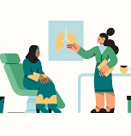
5 Tips for How to Advocate for Yourself at the Doctors.
Advocating for yourself at the doctor’s office takes some planning and practice.
There are tips you can follow before, during, and after an appointment to help you get the care you need and deserve.
Getting your healthcare needs met can be challenging.
If you have ongoing symptoms; you may have had many frustrating trips to the doctor’s office.

Slide 10
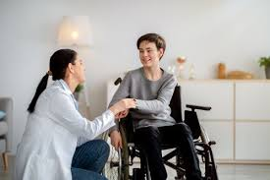
1. Book for success.
When you call the office to book, let the receptionist know what you want to discuss.
You don’t need to share your whole story, but giving some details ahead of time can ensure the appointment length is appropriate.
If you can, consider booking your appointment earlier in the day.
Your healthcare professional may feel more relaxed and better able to listen to your needs.

Slide 11
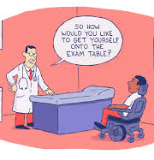
2. Practice what you’ll say.
It can be helpful to think about what you want to say and how you’ll say it.
Think about your main concern and how you can share this with your doctor.
It might be helpful to practice saying it out loud ahead of time.

Slide 12

3. Bring a close friend or family member.
If you find appointments overwhelming, you’re not alone.
Many people feel that way.
Consider bringing a close friend or family member.
Having an extra person can be helpful for many reasons.
This person can be a support if you feel frustrated or worried.
They can also be another set of ears and take notes for you.

Slide 13
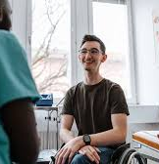
4. Prioritize your questions and concerns.
Get ready for your appointment by writing down your questions and concerns.
Many people may find it hard to remember everything they want to say once they’re in an appointment.
Keep in mind that you may not address everything in one appointment.
t’s a good idea to prioritize what you want to talk about to make the best use of your time.

Slide 14

5. Consider getting a second opinion.
If you feel unsure or uncomfortable with the advice from your doctor, you have the right to get a second opinion.
You can get a second opinion even if you’re just curious about other ideas or approaches.
People get second opinions all the time.
You won’t be the first person to ask for one.

Slide 15

Employment
Employment plays an important role in our lives.
It gives us a purpose, and opportunities for growth.”
It offers a bi-weekly income.
Let’s us put our skills to good use.
And it helps us enjoy our other rights in life.
Developmental Services

Slide 16
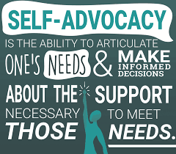
What Is Self-Advocacy?
Self-advocacy is the skill of speaking up for your own needs and taking action to achieve your personal goals.
It means understanding yourself, clearly express your thoughts and needs to others.

Slide 17

Developmental Services

