Slide 1
Presentation Title: Setting Goals to Independence (Small wins matter)
Date July 2026
Developmental Services

Slide 2
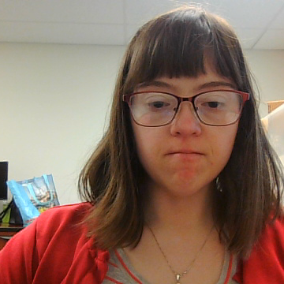
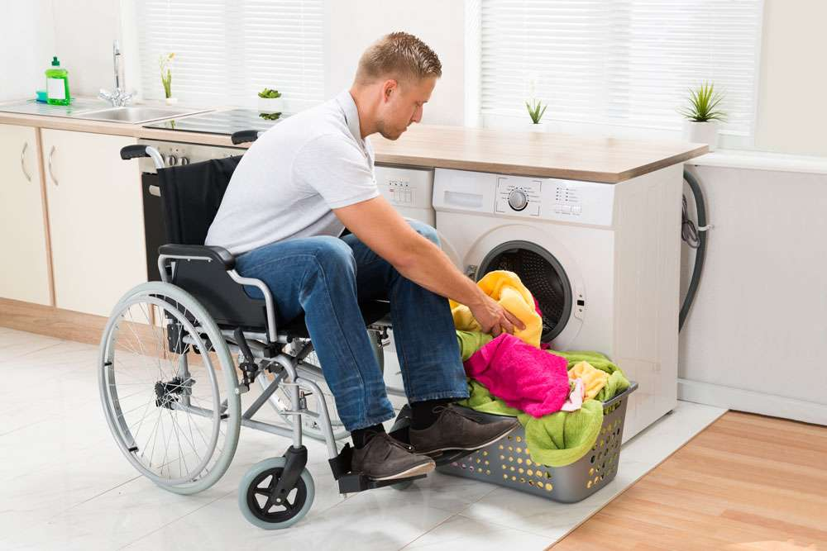
How You Can Promote Independence
The goal is to find the right balance between offering support and letting a person do it their way. You can practice this through:
The "You Start, I Finish" Method: Let them attempt a task (like brushing teeth or washing a dish), then step in to finish the job to ensure it is done properly.

Slide 3
How to Play the Presentation
Open the presentation in PowerPoint.
Wait for slide show to load up (it may take a minute or two).
Click on arrows at the bottom of screen to go to the next slide or back a slide or click on the next slide in sequence on the left bar.
To hear recordings, press on the megaphone and press play.
Developmental Services

Slide 4

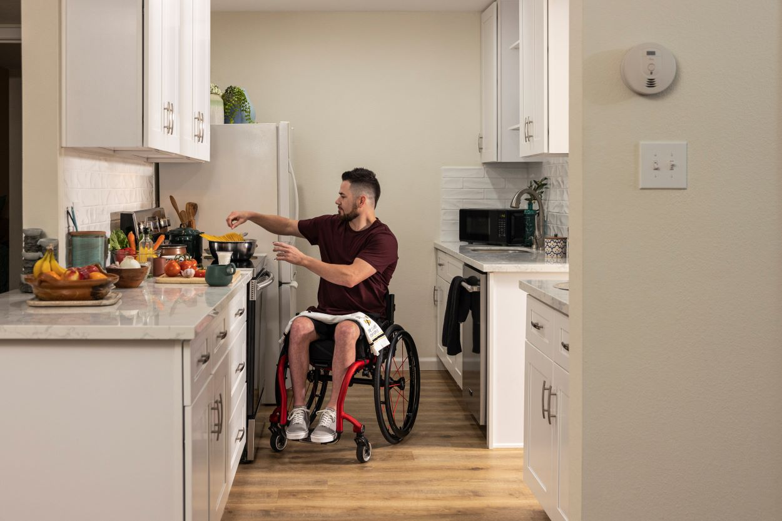
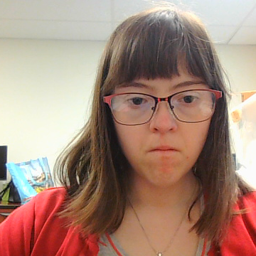
Promoting independence means supporting someone to do as much as they can for themselves. Instead of doing everything for them, you provide the right amount of help, encouragement, and tools so they can make their own choices, build confidence, and take care of their own daily needs.

Slide 5

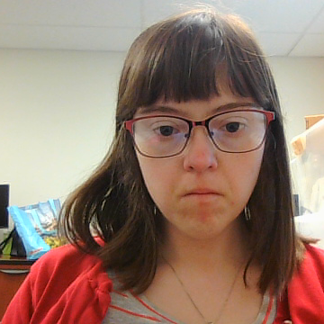
Real-Life Examples
For Older Adults: Instead of dressing an aging parent, laying out their clothes and letting them do the buttons themselves.
For People with Disabilities: Providing modified tools, like a reacher, so they can grab items from high shelves without needing constant assistance.

Slide 6

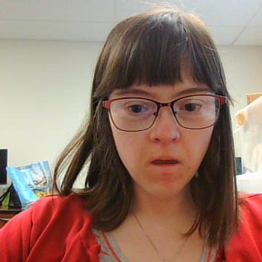
Offering Choices:
Give limited, manageable
options (e.g., "Do you want to
go for a walk in the morning
or the afternoon?").
Waiting Patiently: Allow the person
to take their time, even if
it’s much slower than if
you were doing it yourself.

Slide 7
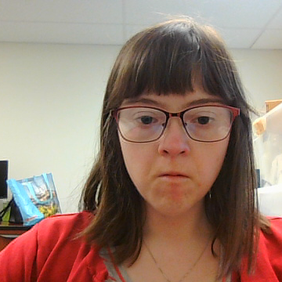
Steps to get your own place
Step 1. Save for a deposit
Step 2. Discuss this with your case manager to find out what you are eligible for.
Step 3. Once you know what you can afford you can look in your area to see what is available.
Step 4. Starting to get your paperwork in order for ex. Paystubs, bank statements, legal ID, birth certificate, proof of social security benefits.

Slide 8

Small wins matter(micro-achievements
Date: July,2026
Developmental Services

Slide 9

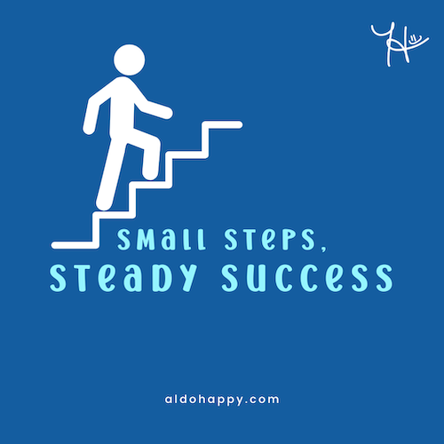
Small Wins Matter
“Small wins” are everyday achievements or step by step milestones that bring you closer to a larger goal!
Developmental Services

Slide 10

The Benefits of Celebrating ‘’Small Accomplishments”
Be clear on what goals you would like to achieve.
Decide ahead of time what your small rewards will be.
Decide what your big rewards will be for the big wins.

Slide 11
Why Celebrating Small Wins Matter
https://summer.harvard.edu/blog/why-celebrating-small-wins-matters/

Slide 12

Employment
Employment is important for everyone. Also, it helps people earn a decent living, learn independence, and builds self-confidence
Job Search for Hourly & Local Jobs Hiring Now

Slide 13
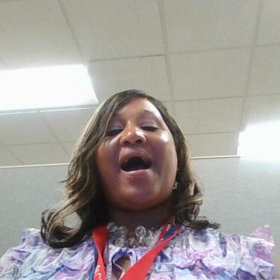
How To Get Over Self-Doubt
Developmental Services

Slide 14
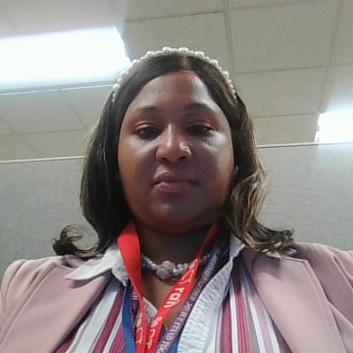


Overcome Self Doubt To Be Independent
Self Doubt is an ongoing state of uncertainty or a lack of confidence in one's own abilities, judgments, and self-worth. It is the internal feeling that you are not good enough, often leading you to constantly second-guess your decisions. Self Doubt can stop you from being Independent. When you step out on your own, every decision falls on your shoulders, and that can be scary. If you relax and follow the 5 steps I am about to share, you will feel more confident and achieve your independence. It is stressful at first, but it is worth it in the end.

Slide 15
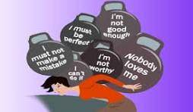
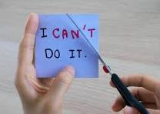

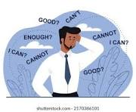

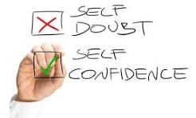
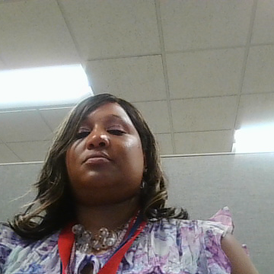
5 Steps To ignore Self-Doubt

Slide 16

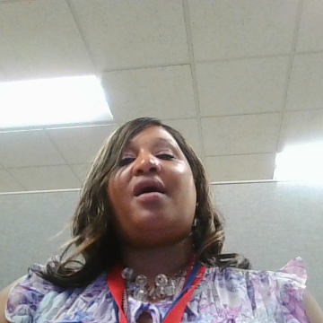
1. Believe In Yourself
If you do not believe in yourself, how do you expect others to believe in you.

Slide 17

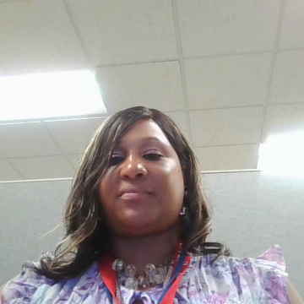
2. Build Yourself Up With Positive Words
Give yourself grace, be patient, tell yourself that you are wonderful, amazing, smart, caring, dependable, and worth it.

Slide 18
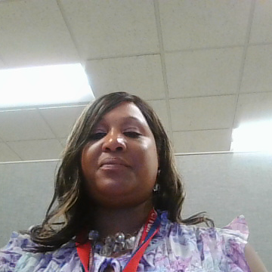
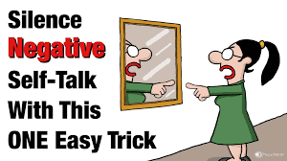
3. Try Not To Self Negative -Talk
Challenge your doubts by asking for proof. When a thought like "I always mess up“ pops up, actively think about times you tackled similar situations and succeeded.

Slide 19

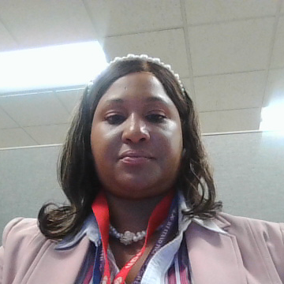
4. Write Down Your Accomplishments
Keep a physical or digital list of wins and proud moments. Review this list when you are down on yourself to remind yourself of your capabilities.

Slide 20
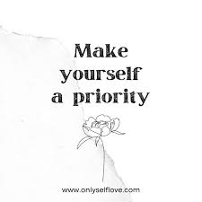
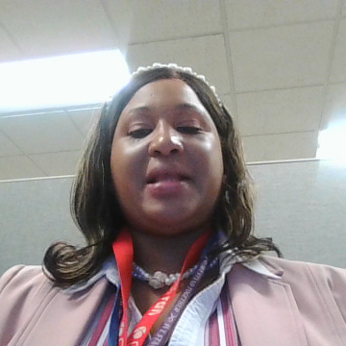
5. Give A Day For Yourself
Take a day, and do what you like to do, whether it is going to the park, reading, taking a nap or going to the gym.

Slide 21

https://www.youtube.com/watch?v=tlp2cpXuzfw
Do This To Overcome Self Doubt | Courtney Mcleod |

