Slide 1

Public Safety
Developmental Services

Slide 2
Open the presentation in PowerPoint.
Wait for slide show to load up (it may take a minute or two).
Click on arrows at the bottom of screen to go to the next slide or back a slide or click on the next slide in sequence on the left bar.
To hear recordings, press on the megaphone and press play.
How to Play the Presentation
Developmental Services
Notes:
AL

Slide 3
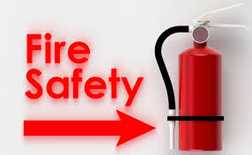
Fire safety at home
Install smoke alarms
Practice fire drills
Get out of your house- and Stay Out! Then call 911
Crawl low under the smoke
Feel doors with the back of your hand for heat before opening
Developmental Services

Slide 4

Fire safety in public places
Know your exits
Participate in drills
Stay calm
Alert others
Exit immediately
Developmental Services

Slide 5
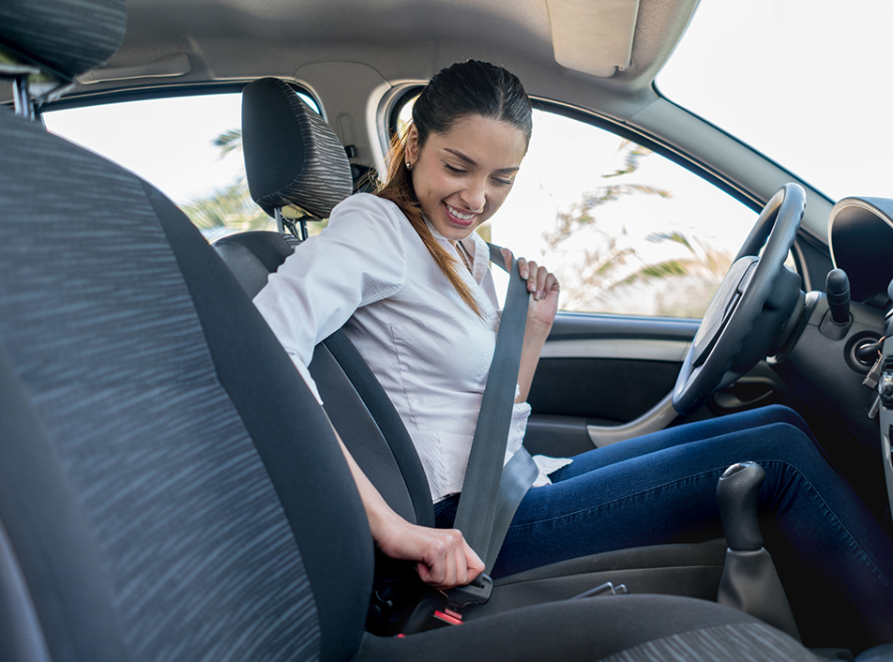
Vehicle Safety
Buckle up
Adjust your seat and mirrors
Keep items organized
Check medications
Stay alert
Developmental Services

Slide 6

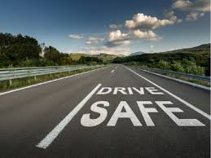
Vehicle Safety –maintenance
Regular inspections
Proactive maintenance
Check tire, lights, brakes.
Airbags
Emergency kits

Slide 7
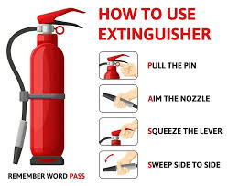
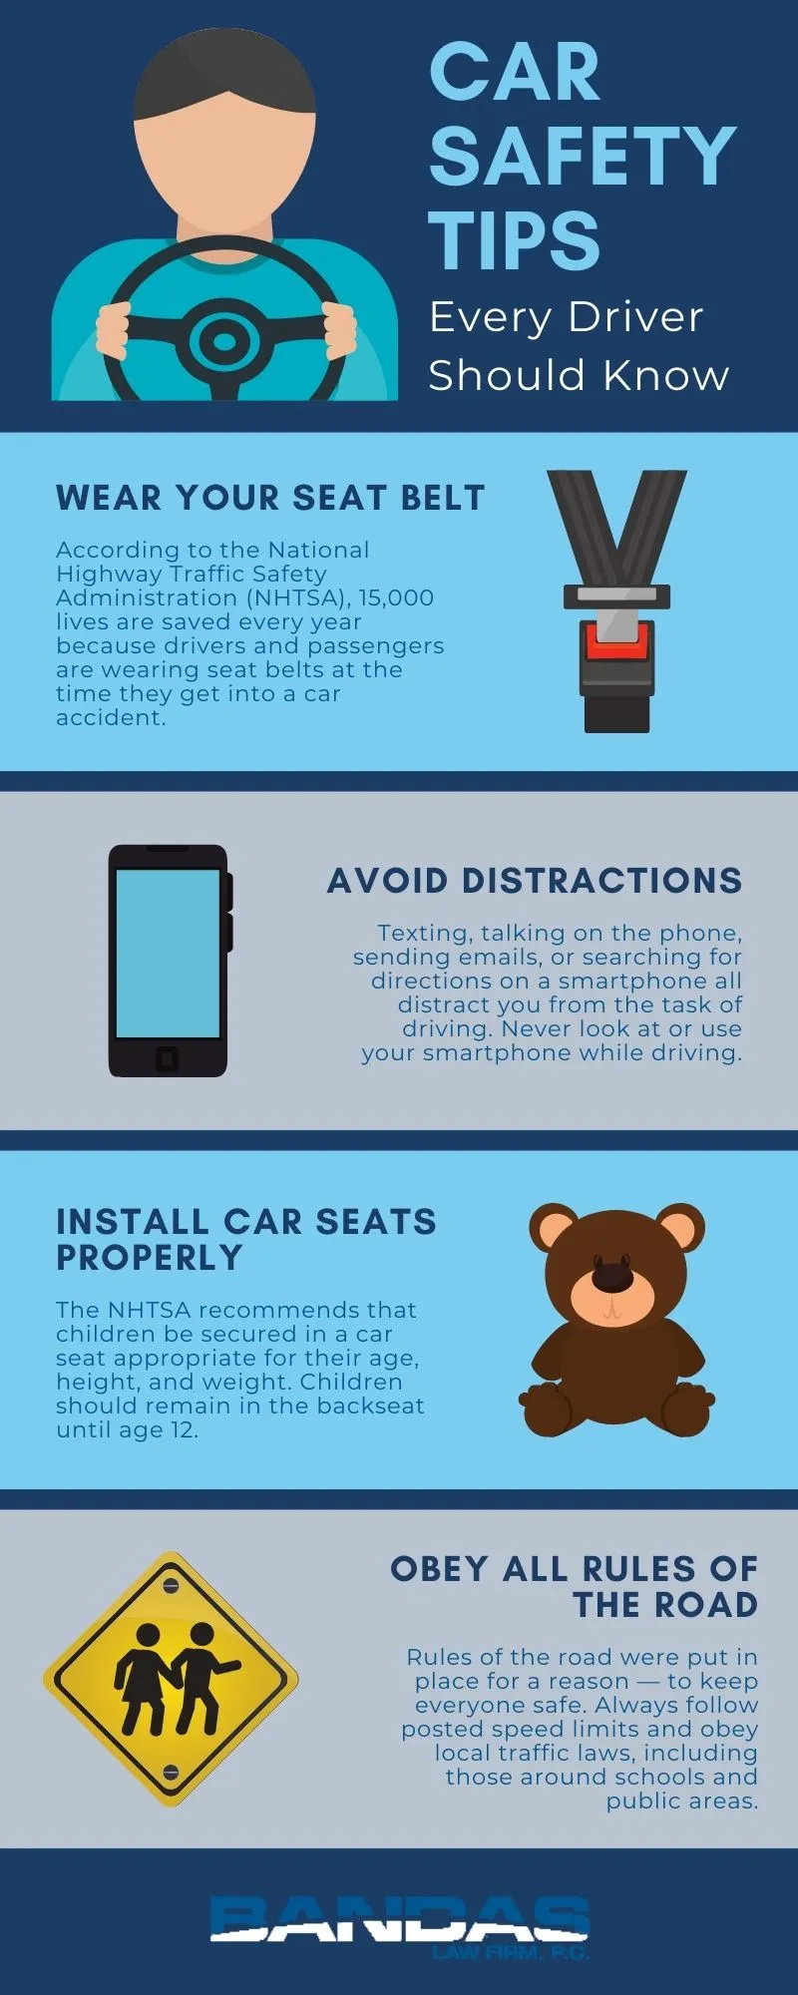
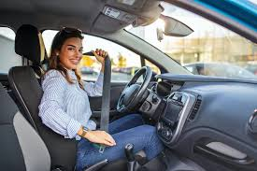
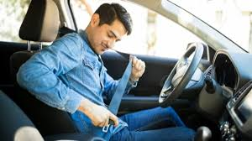
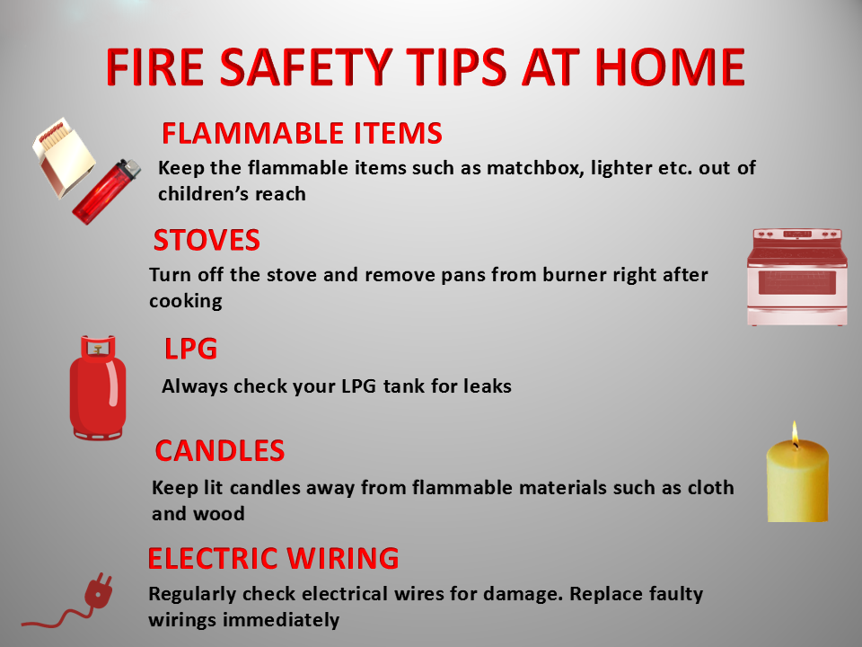
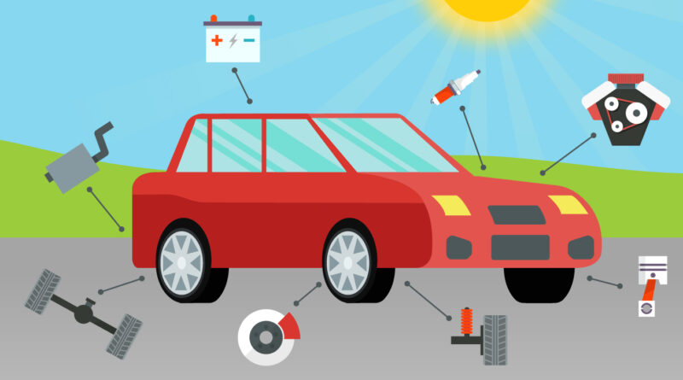

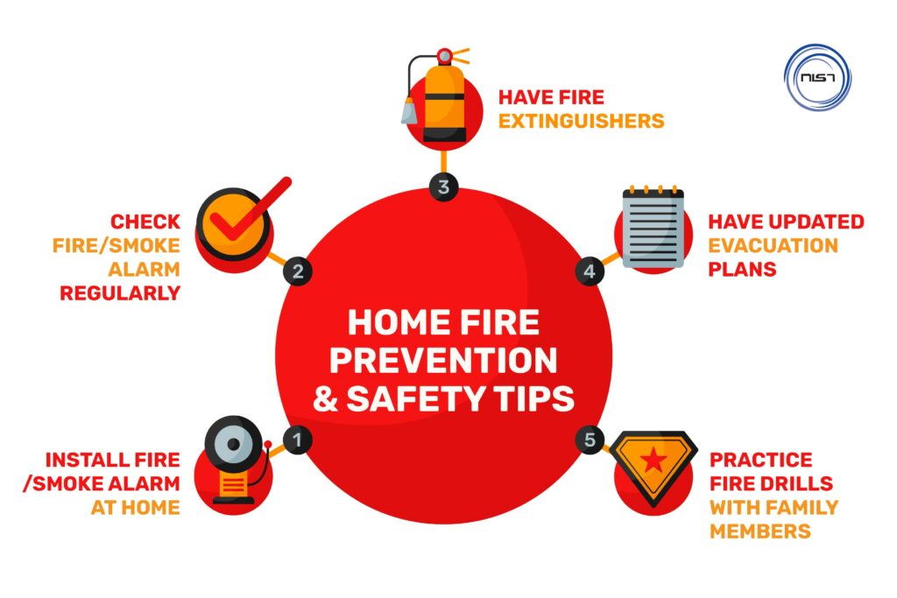
Pictures

Slide 8
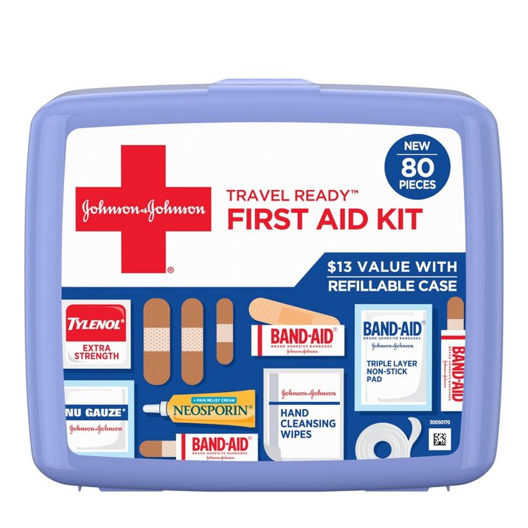


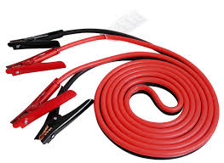

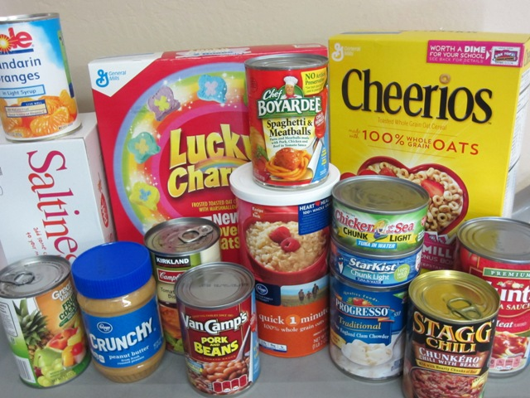
Emergency Kit
1) First Aid Kit
2) Flashlights and Extra batteries
3) Jumper Cables
4) Water and Non-Perishable foods
-

Slide 9

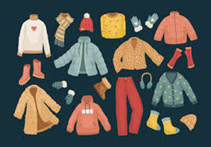


5) Blankets and Warm Clothing
6) Tire repair kit and Inflator

Slide 10



Emergency kit continued
7) Road flares or Reflective Triangles
8) Shovel and sand
9) Portable power bank

Slide 11
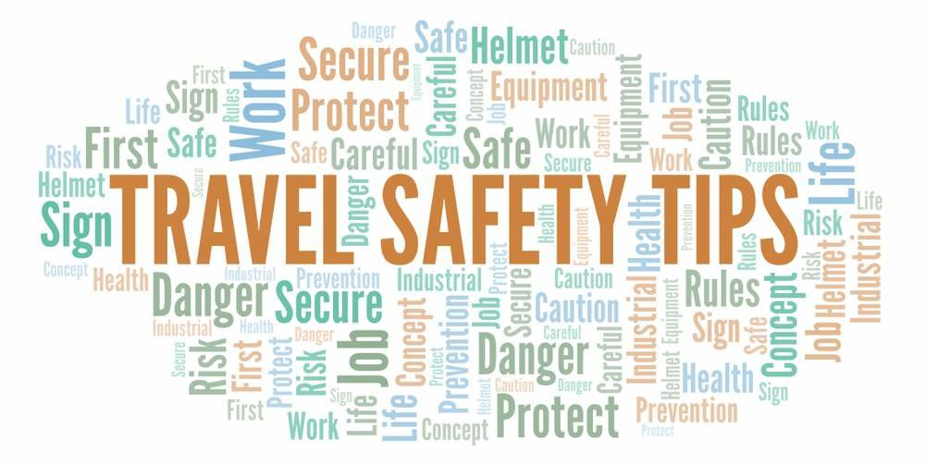
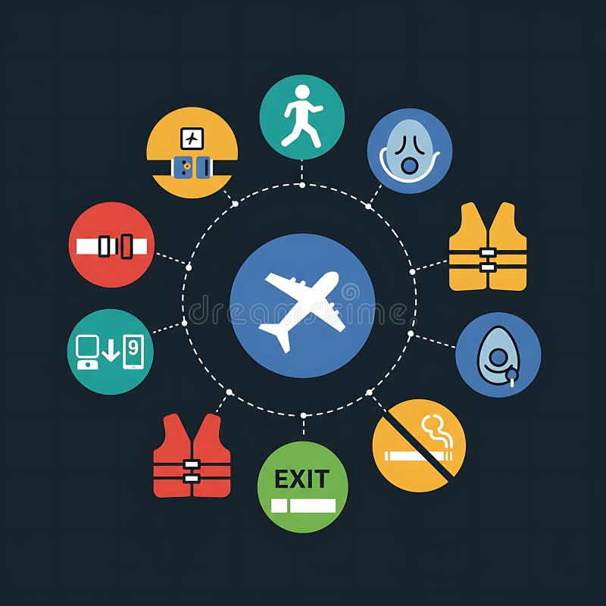

Travel Safety
Developmental Services

Slide 12
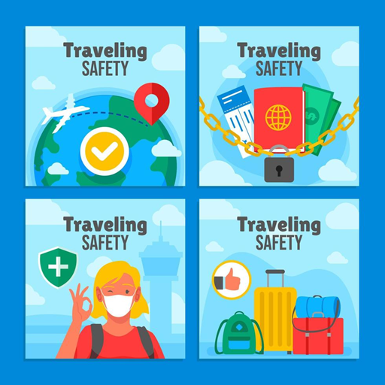
Before you go

Slide 13
Research your destination: It is a good idea to read up on local laws and research customs for the location you are traveling to.
Share your itinerary: Let someone you trust know when and where you are traveling. Give them the phone number for the hotel that you are staying at.
Make copies of documents: It is advised keep both physical and digital forms of important travel documents. Physical copy should NOT be the original.
Inform your bank: Let your bank know you will be travelling. Make sure to have a cash fund on you as well as bank cards.

Slide 14
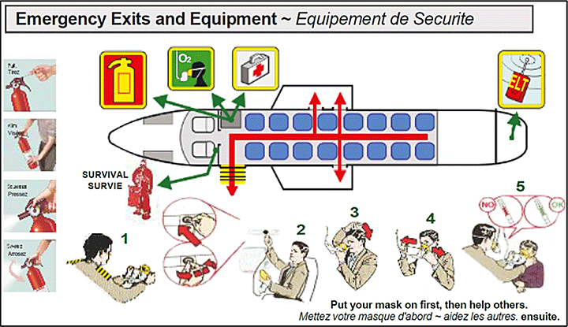
Precautions you should
take on your flight.

Slide 15

Pay attention to safety Measures: Listen to the flight attendant's safety instructions and read the safety guide card provided in your seat pocket.
Keep seatbelt fastened: Keep your seatbelt on at all times while seated, or whenever the "fasten seatbelt" sign is lit.
Locate exits: Count the rows to the nearest emergency exits in front of and behind you so you can find them easily.
Avoid hazardous materials: Do not bring anything deemed as hazardous materials onboard.
Listen to the crew: Follow all instructions from the flight crew. They are professionals who are trained for various situations.

Slide 16
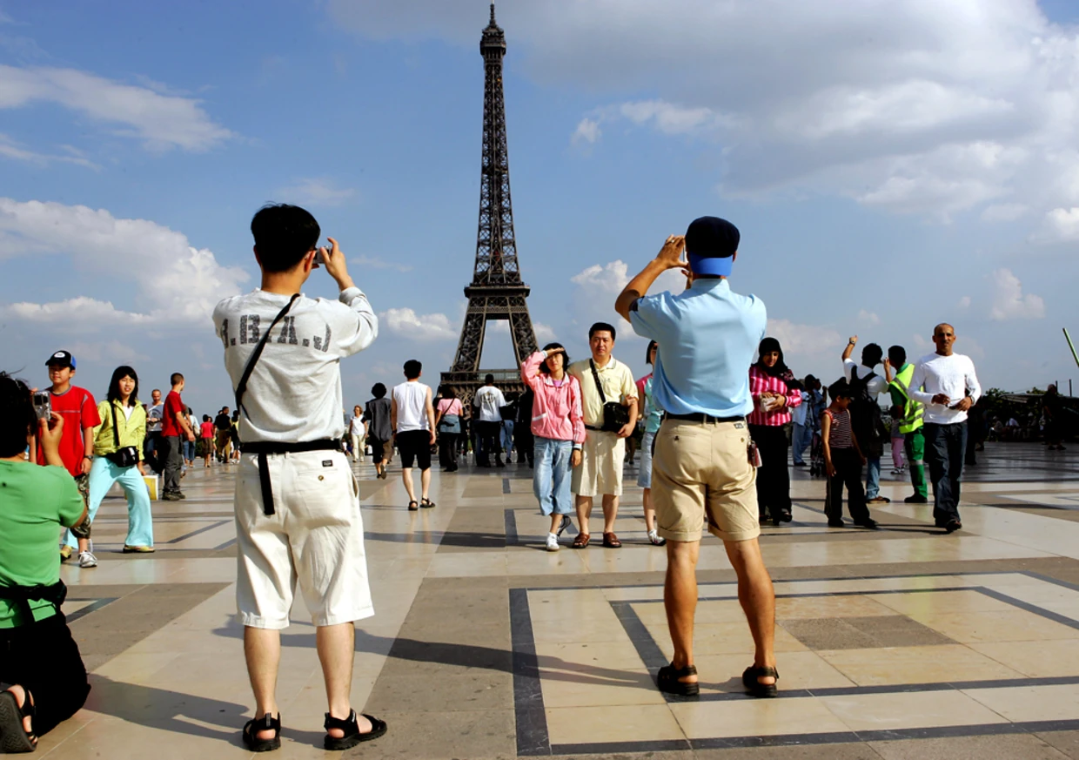
During your trip

Slide 17
Be aware of your surroundings: Pay attention to what's happening around you and avoid being distracted by your phone while walking.
Secure your belongings: Don't flash expensive items and use locks on luggage and personal bags.
Use reputable transportation: Stick to well-known taxi companies or official rideshares and avoid traveling alone at night.
Keep valuables hidden: Don't keep all your cash or cards in one place; use multiple locations and consider using an RFID-blocking wallet.
Trust your instincts: If a person or situation feels unsafe, remove yourself from it as quickly as possible

Slide 18


Video
Stay SAFE While Exploring New Places (Travel Safety Tips) - Travel Video

Slide 19


What Is Self-Advocacy?
Self-advocacy is the skill of speaking up for your own needs, rights, and your likes and dislikes, and taking action to achieve your personal goals. It means understanding yourself, clearly express your thoughts and needs to others, making informed choices, and taking responsibility for those choices. Self-advocacy is empowering and can be apply in all parts of your life, such as school, work, and personal relationships.
Developmental Services

Slide 20


Employment
Look on the- Hartford, CT Jobs Paying $19 - $19 per hour - Now Hiring | Snagajob
Find A Job | Goodwill Careers | Goodwill Jobs
Also look on Project SEARCH
All individuals are treated fairly in the workplace and have equal opportunities.

Slide 21


