Slide 1

Open the presentation in PowerPoint.
Wait for slide show to load up (it may take a minute or two).
Click on arrows at the bottom of screen to go to the next slide or back a slide or click on the next slide in sequence on the left bar.
To hear recordings, press on the megaphone and press play.
HOW TO PLAY PRESENTATION
Developmental Services

Slide 2


Mental & Physical Health
FAB Topic April 2026
Developmental Services

Slide 3
Mental Health

Slide 4

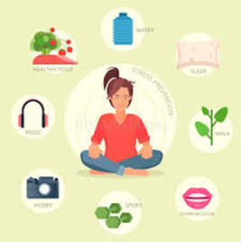


What is Mental Health?
Mental health is how you feel, think, and act every day. It shapes how you deal with stress, talk to people, and make choices.
WHAT IS MENTAL HEALTH?
Developmental Services

Slide 5
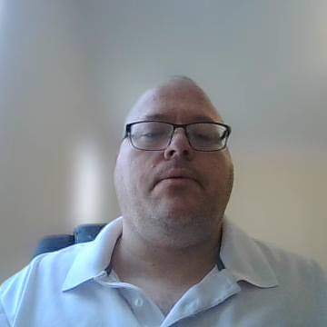
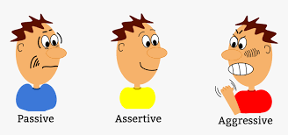
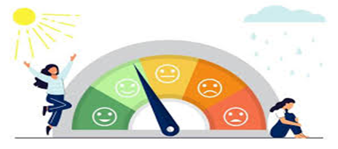

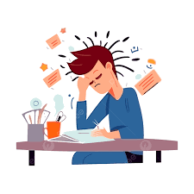

Why is mental health important?
Mental health is essential because it dictates how we think, feel, behave, and interact with the world, acting as the foundation for overall well-being and physical health. It enables individuals to cope with daily stress, work productively, build strong relationships, and realize their potential.
WHY IS MENTAL HEALTH IMPORTANT?
Developmental Services
Notes:
why is mental health important? Mental health is essential because it dictates how we think, feel, behave, and interact with the world, acting as the foundation for overall well-being and physical health. It enables individuals to cope with daily stress, work productively, build strong relationships, and realize their potential.

Slide 6
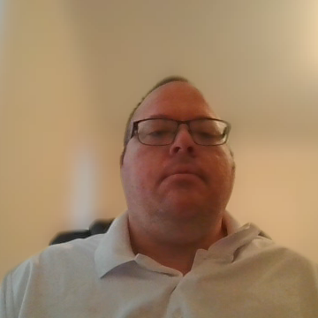
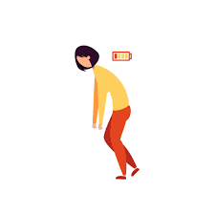
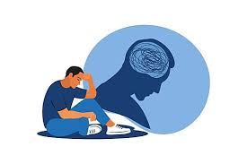
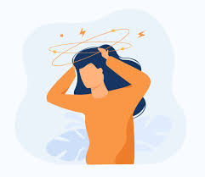

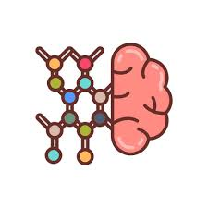


Mental Health!
Mental health exists on a scale that can range from positive, healthy functioning to experiencing periods of stress, tiredness, or, at the other end, mental illness.
What Influences It? It is shaped by life experiences, your biology (like genes or brain chemistry), and family history.
MENTAL HEALTH
Developmental Services
Notes:
Main parts of mental health include:
A range: Mental health exists on a scale that can range from positive, healthy functioning to experiencing periods of stress, tiredness, or, at the other end, mental illness.
What Influences It: It is shaped by life experiences, your biology (like genes or brain chemistry), and family history.

Slide 7


5 Ways to Support Your Mental Health
Take Care of Your Body: Move your body for 30 minutes a day. Eat well and sleep 7–9 hours a night.
Manage Stress & Feelings: Try deep breathing, meditation, or writing in a journal when you feel stressed.
Set Limits & Build a Routine: Stick to a daily routine. It’s okay to say no. Take breaks from the news and social media.
Stay Connected With Others: Talk to friends, family, or a support group. You don’t have to go through hard times by yourself.
Ask for Help When You Need It: Talk to a therapist, counselor, or doctor. Help is out there — in person and online.
5 WAYS TO SUPPORT YOUR MENTAL HEALTH
Developmental Services

Slide 8

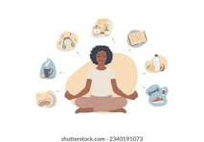
Self-Reflection Questions:
Which of the 5 mental health tips do you already use in your daily life ?
Think about sleep, exercise, stress habits, staying connected, or asking for help.
2. What is ONE small step you can take this week to better support your mental health?
Maybe it is going to bed earlier, calling a friend, or trying 5 minutes of deep breathing or changing the way you eat.
SELF-REFLECTION QUESTIONS
Developmental Services

Slide 9
Physical Health

Slide 10



Benefits of the plunge
Physical Health Benefits & Mental Health Benefits
BENEFITS OF THE COLD PLUNGE
Developmental Services

Slide 11
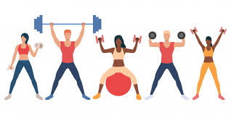
Physical Health Benefits
Relieves Muscle Soreness Enhances Blood Circulation Decreases Inflammation | Boosts Immune Function Supports Metabolism Improves Sleep
PHYSICAL HEALTH BENEFITS
Developmental Services
Notes:
Physical Health Benefits:
Relieves Muscle Soreness:
Cold water causes blood vessels to constrict, which slows blood flow and helps reduce swelling, inflammation, and pain after intense exercise,
Enhances Blood Circulation:
Improves overall circulation, delivering oxygen and nutrients to tissues more effectively.
Decreases Inflammation:
The effects of cold plunging can benefit those with inflammatory conditions like arthritis, though more research is needed on its effects on chronic inflammation.
Boosts Immune Function:
Some evidence suggests regular cold exposure may increase the production of white blood cells, Possibly enhancing the body's ability to fight off infections.
Supports Metabolism:
The body works harder to generate heat when exposed to cold, which can temporarily increase the metabolic rate and activate brown fat, a type of fat that burns calories to produce heat.
Improves Sleep:
Some individuals report that cold plunges help them sleep better,
possibly due to the calming effect on the nervous system and the drop in core body temperature.

Slide 12
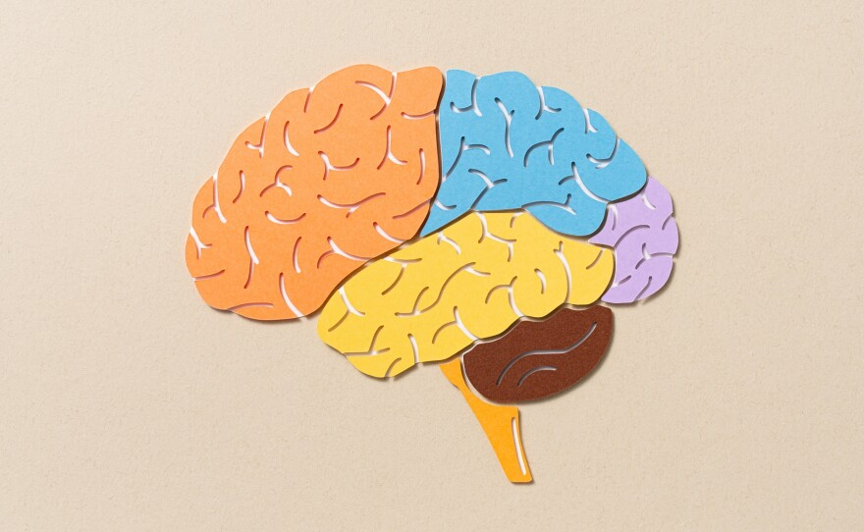
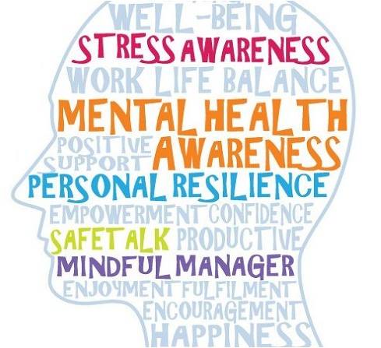
Mental Health Benefits
Improves Mood and Reduces Stress
Increases Energy and Focus
Enhances Mental Resilience
MENTAL HEALTH BENEFITS
Developmental Services
Notes:
Mental Health Benefits:
Improves Mood and Reduces Stress: :
Cold plunges trigger the release of endorphins which can lead to improved mood, a sense of happies, and reduced stress and anxiety.
Increased Energy and Focus:
The initial shock of the cold-water acts as a natural wake-up call, boosting alertness and mental clarity.
Enhanced Mental Resilience:
Dipping into a cold plunge daily can help build mental strength and a greater ability to handle stress in other areas of life.

Slide 13
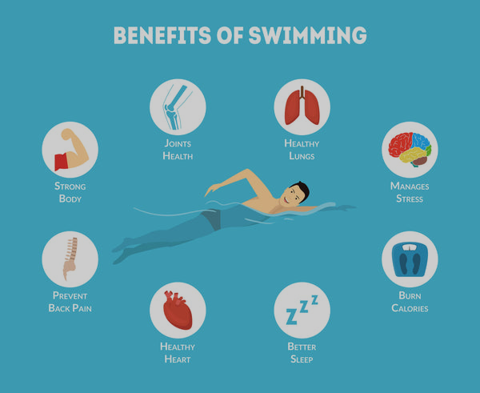
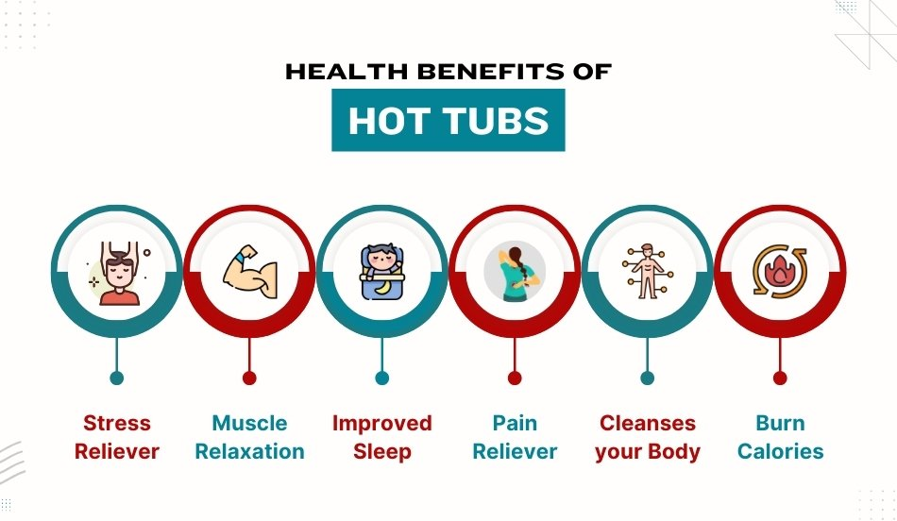
Key Physical Health Benefits of a Hot Tub and Pool
KEY PHYSICAL HEALTH BENEFITS OF A HOT TUB AND POOL
Developmental Services

Slide 14
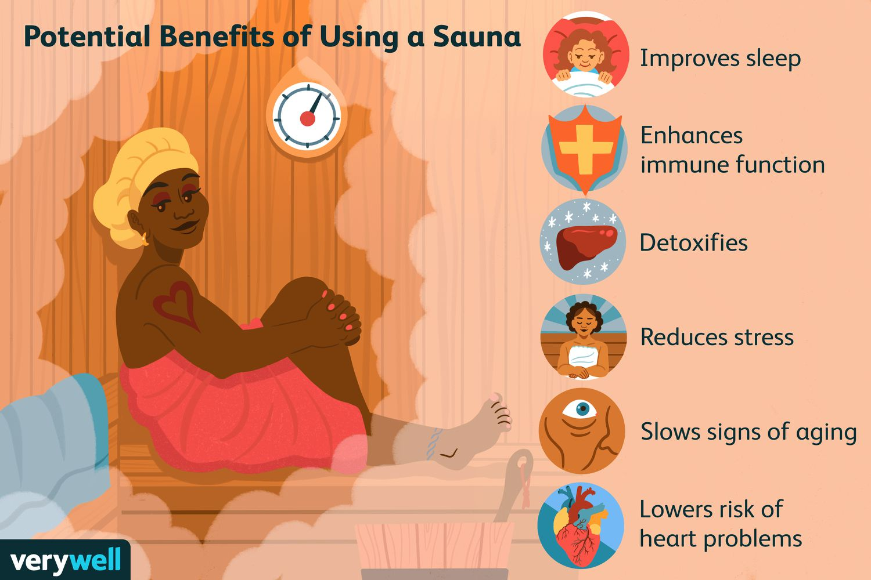
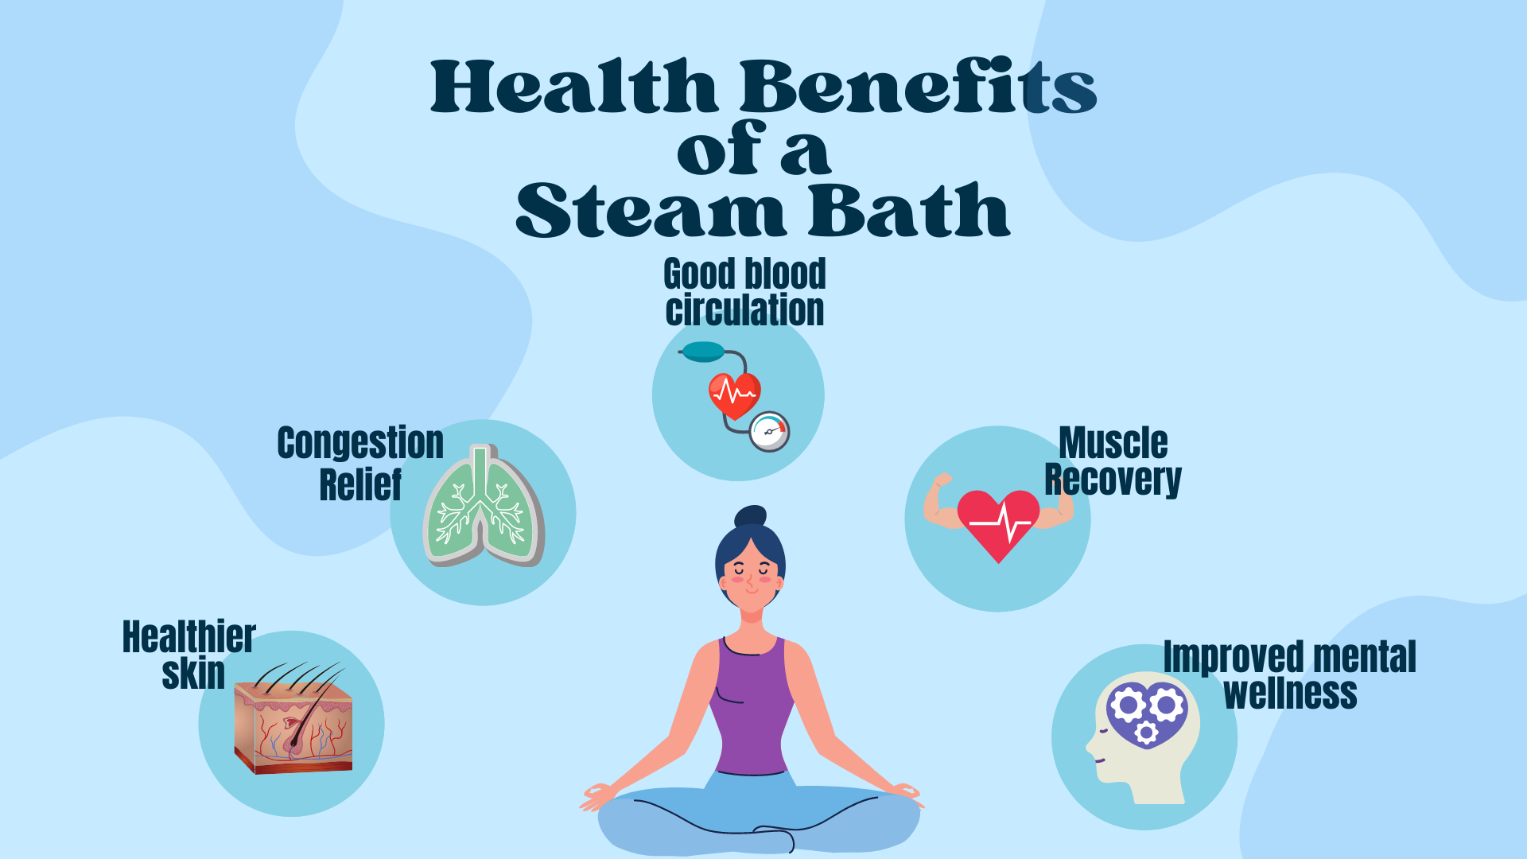
Key Health Benefits Of Sauna and Steam room
KEY PHYSICAL HEALTH BENEFITS OF SAUNA AND STEAM ROOM
Developmental Services

Slide 15


Pre-Entry and Hygiene for the pool, hot tub, steam and sauna
Shower First: Always rinse off sweat, oils, and lotions before entering to keep the water/room clean.
Use a Towel: Sit or lay on a towel to avoid direct skin contact with benches.
Proper Attire: Wear appropriate swimwear or a towel, shorts (especially in shared/public facilities).
No Jewelry/Phones: Remove jewelry as it heats up and keep electronics out to prevent damage from moisture.
Having water helps you stay hydrated.
PRE-ENTRY AND HYGIENE
Developmental Services

Slide 16
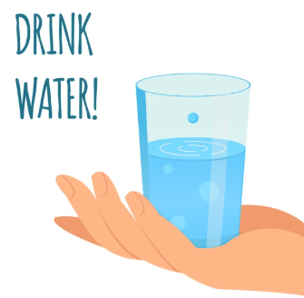


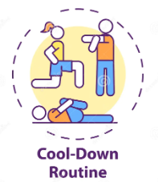
Safety Guidelines: pool, tub, steam, and sauna room
Hydrate: Drink water before, during, and after your session to prevent dehydration.
Time Limits: Limit sessions to 10–20 minutes, especially for hot tubs and high-heat steam rooms.
Health Defenses: Consult a doctor if pregnant, or if you have heart disease, high/low blood pressure, or diabetes.
Cool Down: Allow your body to cool down for 5–10 minutes after exercise before entering and or between the pool and hot tub.
SAFETY GUIDELINES
Developmental Services

Slide 17
Self-Advocacy and Employment

Slide 18
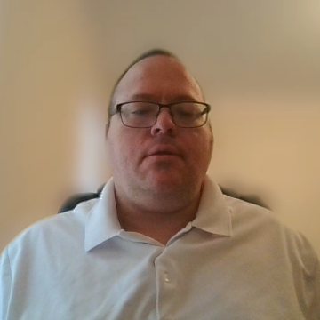

Self-Advocacy
The Self-Advocate Coordinator have Self-Advocacy Group all throughout the State of Connecticut with Private Providers that meet Virtual, In-Person or Hybrid which means Virtual & in Person at the same time.
SELF-ADVOCACY
Developmental Services

Slide 19



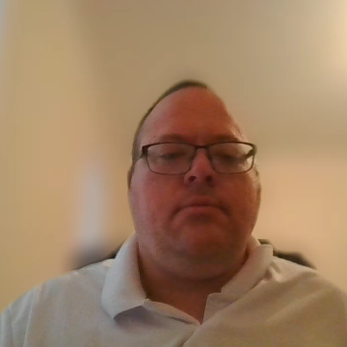

Self-Advocacy
Anyone can be a self-advocate. Speaking up for yourself or someone else can help you be independent, and in charge of decisions for your life.
https://wapave.org/self-advocacy-becoming-an-active-member-in-your-community/
CT DDS advocates corner
SELF-ADVOCACY
Developmental Services

Slide 20


Employment
Minimum wage is $16.35
Effective January 1, 2026, the minimum wage in Connecticut will increase to $16.94 per hour.
The job is matched to your abilities, career goals, and interests
Support and/or accommodations may be provided if needed
CT Day and Employment Services
https://portal.ct.gov/dds/supports-and-services/employment-and-day-services?language=en_US
Employee
Developmental Services

