Slide 1
FAB TOPIC Relaxation
OCTOBER 2025
Developmental Services

Slide 2
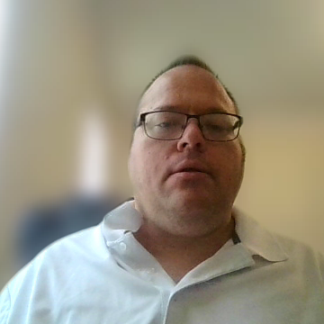
How to play the presentation.
Open the presentation in PowerPoint.
Wait for slide show to load up (it may take a minute or two).
Click on arrows at the bottom of screen to go to the next slide or back a slide or click on the next slide in sequence on the left bar.
To hear recordings, press on the megaphone and press play.
Developmental Services

Slide 3
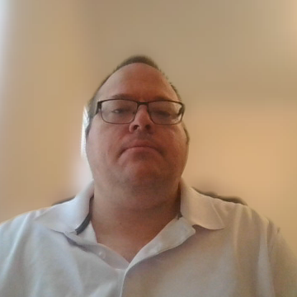
Relaxation!
How to Relax Your Body and Mind!
When you are feeling tense and stressed out, it can feel overwhelming, so it’s important to find a relaxation strategy that is simple to do. You also want it to be a technique that doesn’t take too long. Set aside five minutes in your day to focus on yourself and practice relaxation techniques for your mind and body.
Developmental Services
Notes:
How to Relax Your Body and Mind!
When you are feeling tense and stressed out, it can feel overwhelming, so it’s important to find a relaxation strategy that is simple to do. You also want it to be a technique that doesn’t take too long. Set aside five minutes in your day to focus on yourself and practice relaxation techniques for your mind and body.

Slide 4
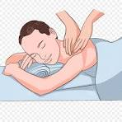
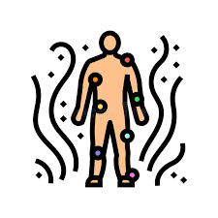
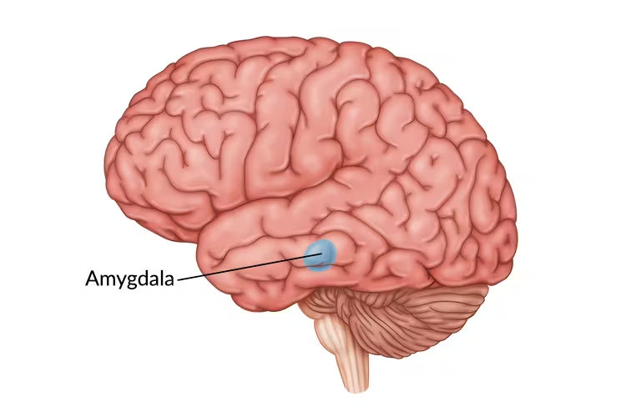

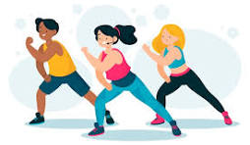
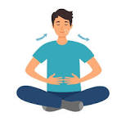
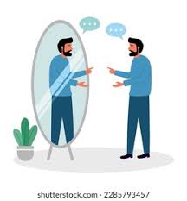
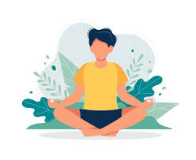
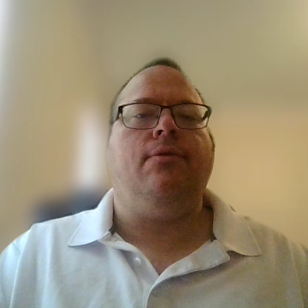
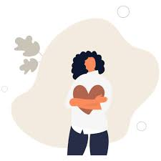
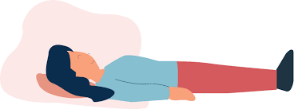
Relaxation!
How to Relax Your Body and Mind!
Key takeaways
Stress starts in a part of your brain called the amygdala, and it can have plenty of physical and emotional effects.
Relaxing your body can start with practices like breathwork, yoga, exercise, massage, and progressive muscle relaxation.
You can relax your mind with help from practices like gratitude, meditation, body scans, and positive self-talk.
Developmental Services
Notes:
How to Relax Your Body and Mind!
Key takeaways
Stress starts in a part of your brain called the amygdala, and it can have plenty of physical and emotional effects.
Relaxing your body can start with practices like breathwork, yoga, exercise, massage, and progressive muscle relaxation.
You can relax your mind with help from practices like gratitude, meditation, body scans, and positive self-talk.

Slide 5

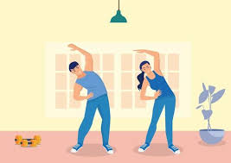
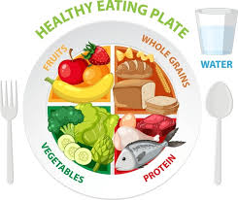
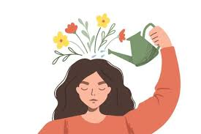
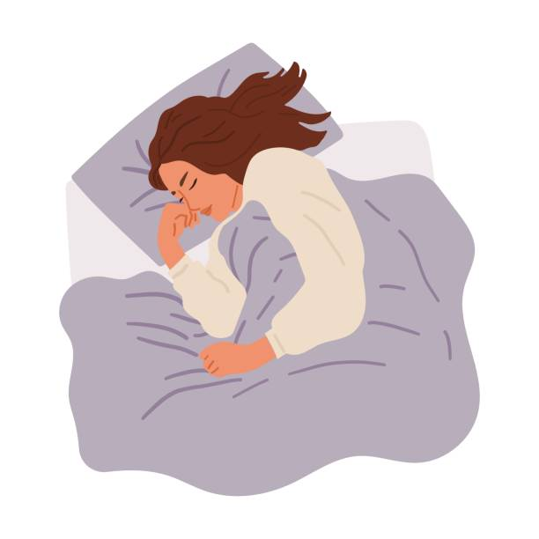

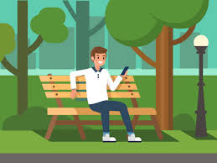

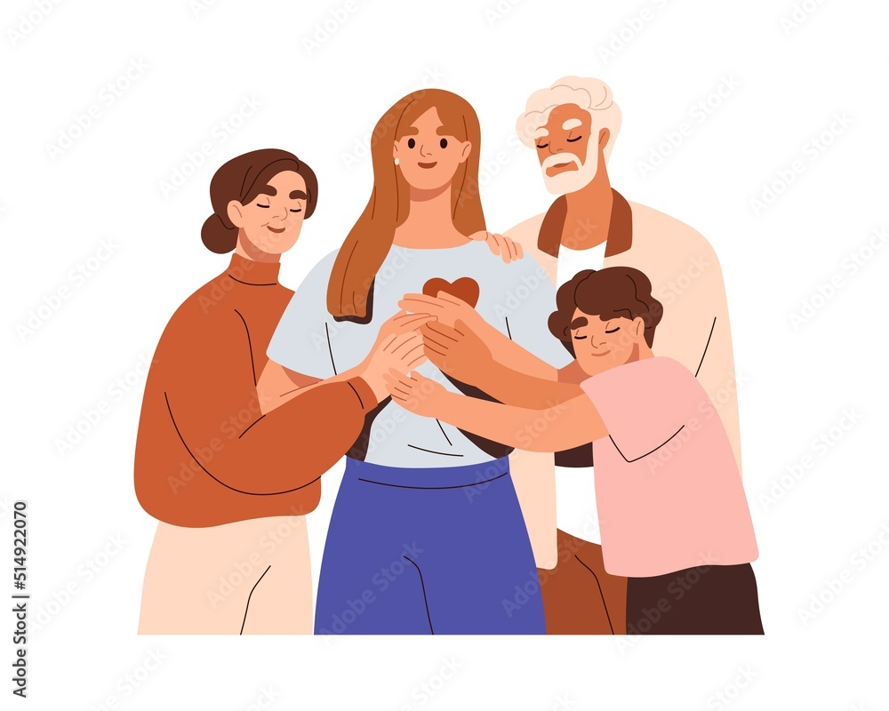
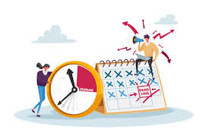
Relaxation!
To get the most benefit, use relaxation techniques along with these other positive coping methods:
Exercise regularly.
Think positively.
Find humor.
Solve problems.
Manage time and priorities.
Eat a healthy diet.
Get enough sleep.
Spend time outside.
Reach out to supportive family and friends.
Developmental Services
Notes:
To get the most benefit, use relaxation techniques along with these other positive coping methods:
Think positively.
Find humor.
Solve problems.
Manage time and priorities.
Exercise regularly.
Eat a healthy diet.
Get enough sleep.
Spend time outside.
Reach out to supportive family and friends.

Slide 6
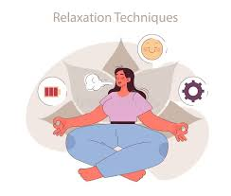
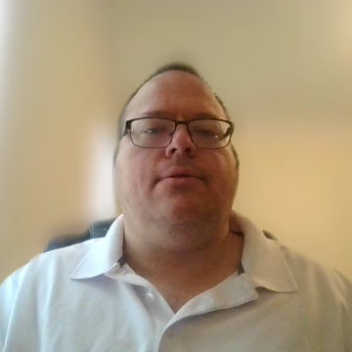

Relaxation!
Relaxation techniques take practice.
As you learn relaxation techniques, you can become more aware of muscle tension and other physical ways your body reacts to stress. Once you know what the stress response feels like, you can try to do a relaxation technique as soon as you start to feel stress symptoms. This can prevent stress from getting out of control and lowering your quality of life.
Developmental Services
Notes:
Relaxation techniques take practice
As you learn relaxation techniques, you can become more aware of muscle tension and other physical ways your body reacts to stress. Once you know what the stress response feels like, you can try to do a relaxation technique as soon as you start to feel stress symptoms. This can prevent stress from getting out of control and lowering your quality of life.

Slide 7
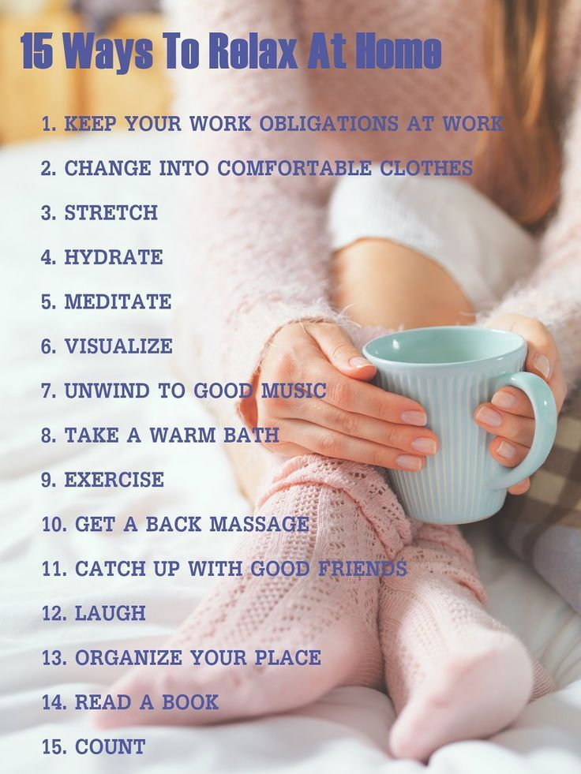
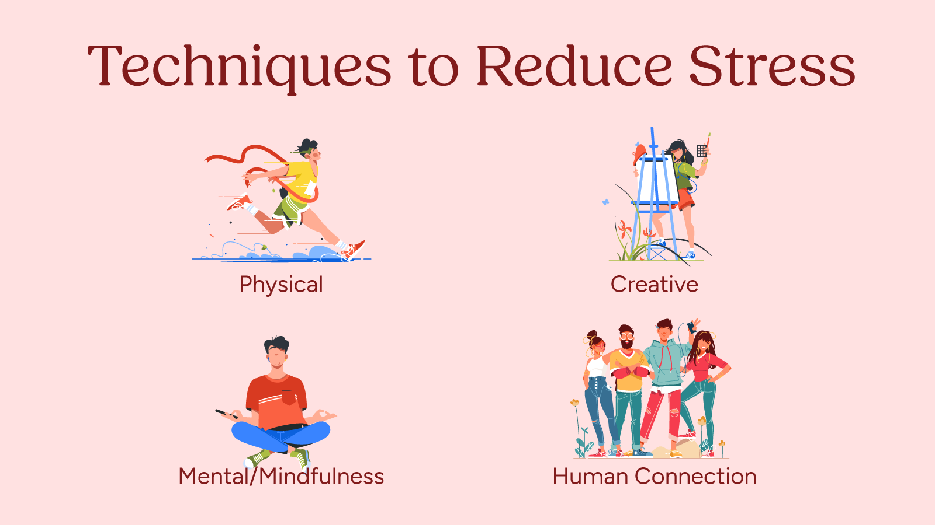
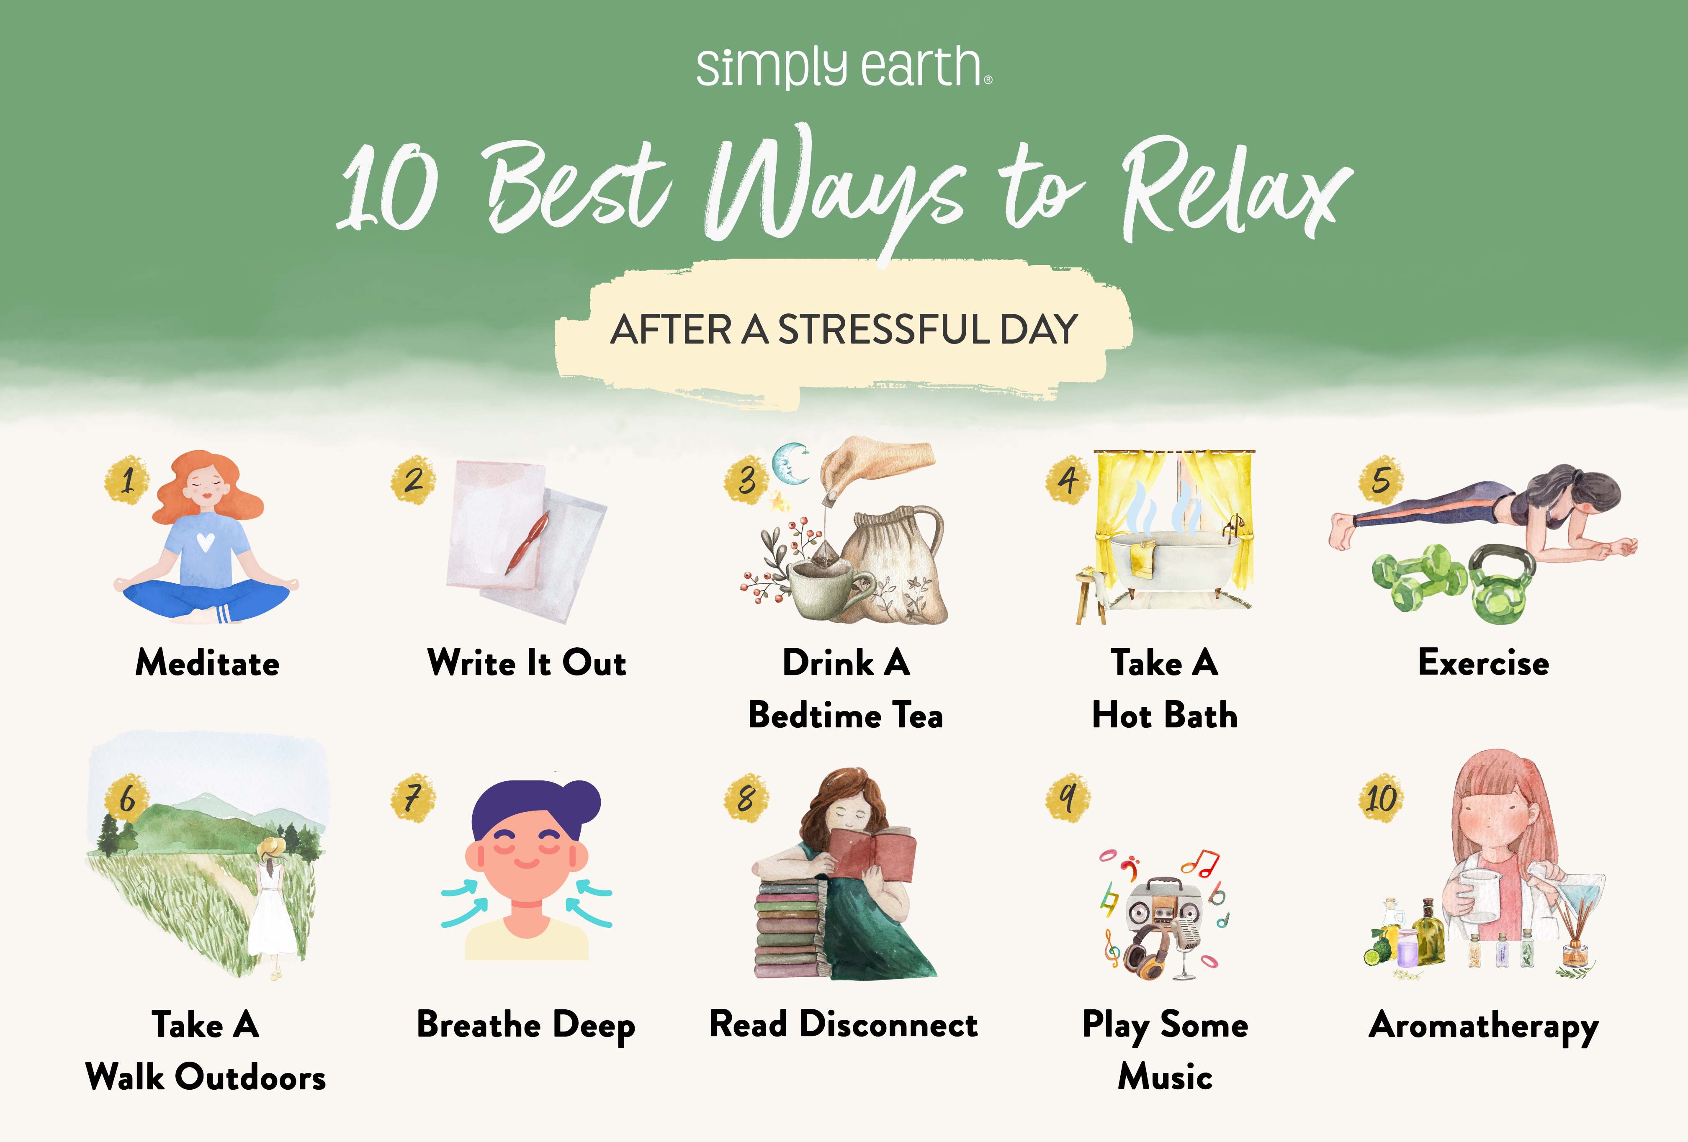
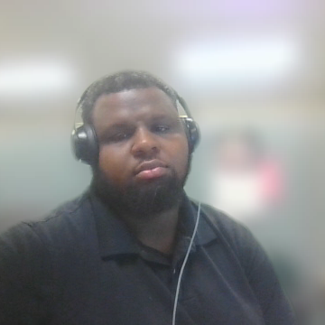

Activities That Help You Unwind and Relax After Work
Going for a long walk while listening to music
Cooking/Baking
Playing games
Hanging out with friends or family
Going shopping/Planning a fun trip
Developmental Services

Slide 8
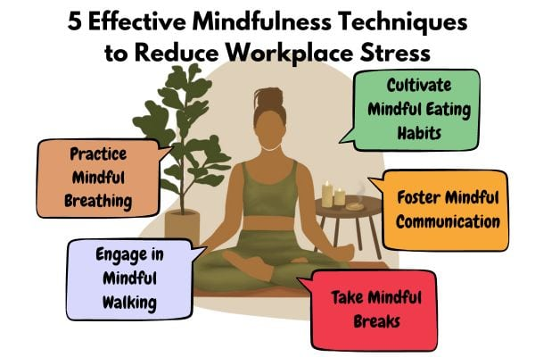
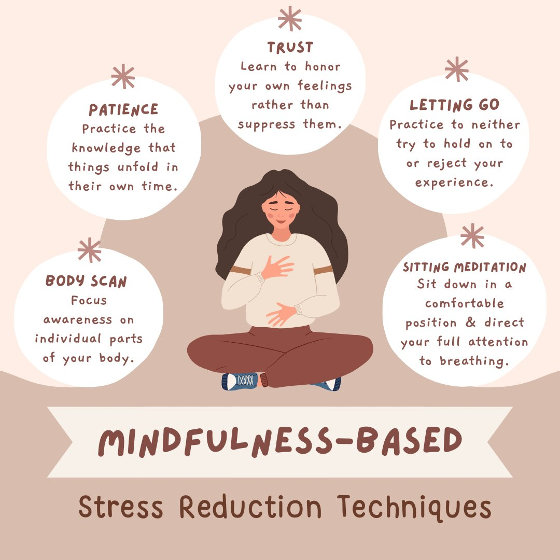
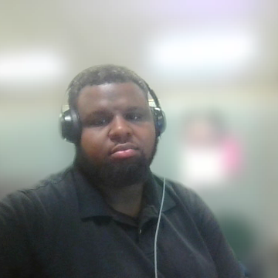
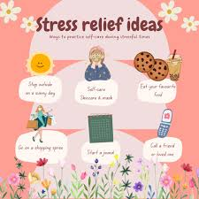
Effective Stress-Relief Activities for the Workplace
Mindfulness Meditation-Briefly focus on your breath and bodily sensations to anchor yourself to the present moment.
Stretching-Perform simple stretches for the neck, shoulders, and back to release tension.
Daydream or Doodle-A short mental break can help your de-stress and re-energize.
Exercise- Support employees in going for walks during lunch breaks or provide access to fitness facilities.
Developmental Services

Slide 9
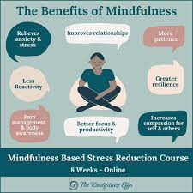

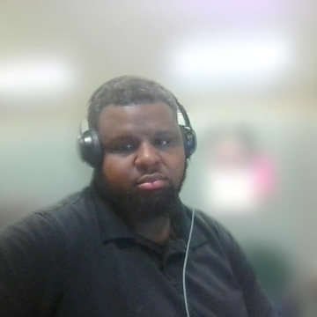
What to Eat When You're Stressed
Berries -Blueberries, strawberries, and raspberries are high in antioxidants which can combat stress-related damage.
Dark Chocolate-In moderation, it can help reduce stress hormones and boost mood.
Whole Grains-Brown rice, oats, and quinoa stabilize blood sugar, which helps mood and energy levels.
Developmental Services

Slide 10


Music For Stress Relief
Music is one of the most used tools for stress reduction.
There are many ways that music can be used for stress relief.
Some people find that listening to calm, relaxing music helps to reduce their stress levels.
Developmental Services

Slide 11

Resources on How Music Relieves Stress
Did you know that listening to music improves memory functioning, promotes healing, and improves your workouts and more.
Doctors will often use music and lyric recall to help individuals retrieve lost memories.
A perfect example is Tony Benett had Alzheimer's disease.
Developmental Services
Notes:
Patients with memory loss can often remember songs and specific song lyrics.
Certain music can trigger particularly unique memories- music from a specific time will trigger memories from that period. Want to remember something from the past? Listen to songs you listened to during that time!

Slide 12



More info on how music
can relieve stress
Developmental Services

Slide 13


Relaxing with friends
Developmental Services

Slide 14


Ways to relax with friends
Going to the beach in the summertime.
Going to an amusement park.
In the winter, you can have some hot cocoa or hot chocolate.
Have a movie night with a funny movie.
Developmental Services

Slide 15


Relaxing is a good way to relieve stress
When you relax, you relieve stress.
You are more centered.
And you can focus more fully when it’s time to work.
Friends can boost that effect as well, after all, we all need help at some point in our lives.
Developmental Services

Slide 16
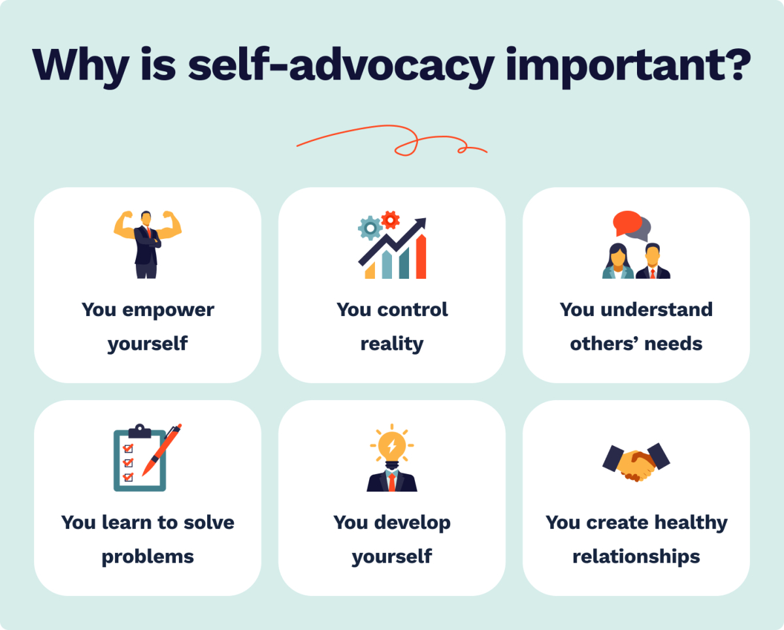
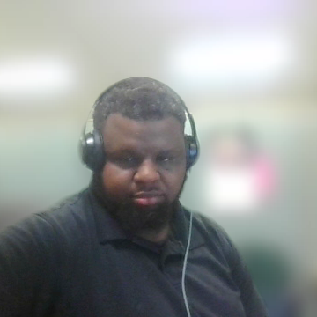
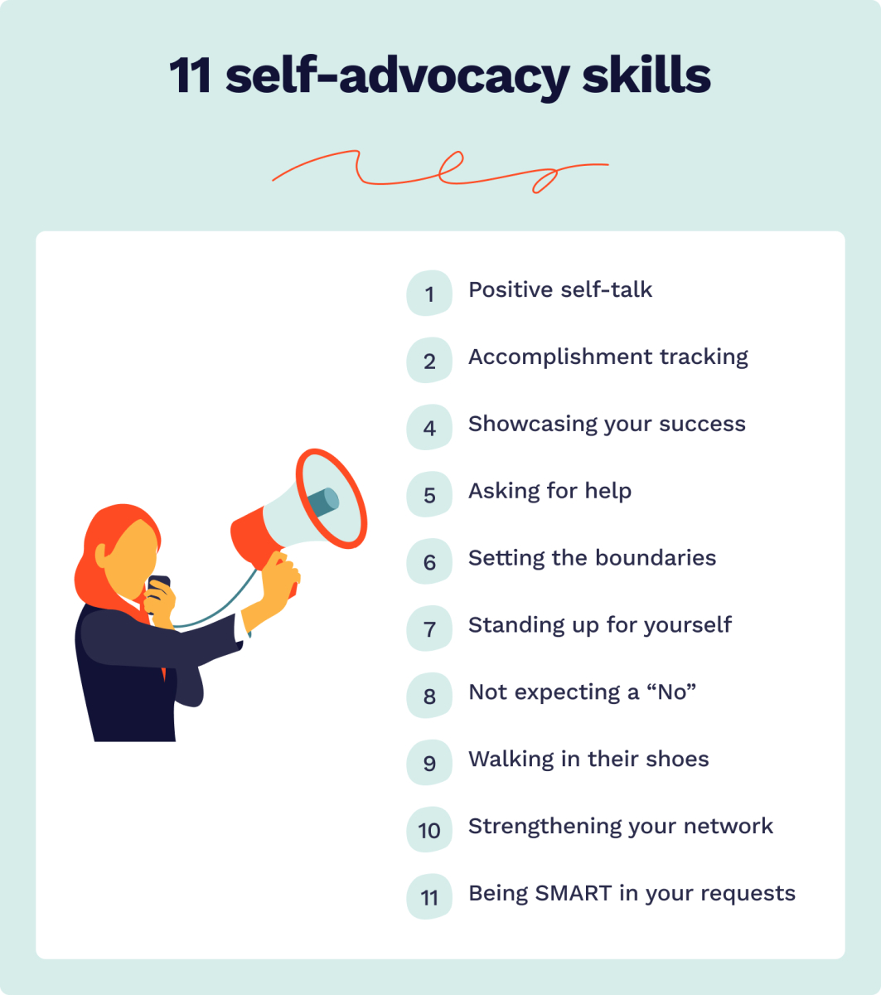
Tools and Resources for Advocating for Yourself
Know Your Rights-Familiarize yourself with your legal rights and organizational policies related to your situation.
Clear Communication-Practice expressing your needs calmly and clearly.
Keep Records-Document important conversations, emails, or incidents. This helps provide evidence if needed.
Professional Help-Consider talking to a counselor, coach, or advocate if you need guidance on complex situations.
Developmental Services

Slide 17


Employment
Employment is an important part of living one’s life.
It offers a weekly income.
Let’s us put our skills to good use.
And it help us enjoy our other rights in life.
Jobs Near Me jobs in 06053, CT | Jobs2Careers
Developmental Services

Slide 18

Developmental Services
Notes:
Thank you.

