Slide 1
Quality of Life
Fab Topic
Developmental Services
Notes:
Title of presentation goes here

Slide 2
Open the presentation in PowerPoint.
Wait for slide show to load up (it may take a minute or two).
Click on arrows at the bottom of screen to go to the next slide or back a slide or click on the next slide in sequence on the left bar.
To hear recordings, press on the megaphone and press play.
How to Play the Presentation
Developmental Services
Notes:
Blank side on left is for images

Slide 3

Moving to where you want to live- We will explain more on the other slide

Slide 4
Preparing to move
Finances and planning
Create a budget-find a place you can afford, list your income, list your expenses. get a budget book , use a computer .this is the website- How to Make a Budget: 5 Simple Steps – Ramsey
Establish a moving timeline- get organized, start sorting, research moving companies. This is the website
Moving Checklist: A Timeline for Your Upcoming Move | Moving.com

Slide 5
Planning continued
Start by researching the area-go to visit the area, drive to the place, research online
Its cost of living- including housing, food, transportation, healthcare
Job market- figure out how much money you make, research jobs online , job application.
Weather conditions- Look at The Weather Channel, The News
Developmental Services
Notes:
Basic slide to add information to

Slide 6
When you moved in
Organize your belongings- declutter and throw it in the trash
Finally, connect with your new community and adjust to your new surroundings -Check out the bulletin board at the library or volunteer in the community, such as the food pantry.

Slide 7
Having a career instead of a job- we will explain more on the other slide
Developmental Services
Notes:
Section slide - to use when dividing presentation into categories.

Slide 8
  Just a job
  Short- term-ex: I used to work at the ice arena organizing skates.
  Having responsibilities-Ex- clean the tables and the arcade.
  Earning spending money
Career
Long-term path-ex- My long term is Self- Advocate Coordinator
Professional growth and advancement – Stepping up for new responsibilities, making an effort
Job satisfaction- Ex- I'm happy with my role and excited to come to work
Financial security- making enough to live off of

Slide 9
How to get your Permit and Driver License

Slide 10
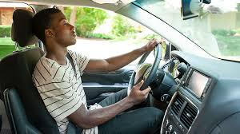
We are now going talk the steps to getting your Permit and Driver License
Driving is a privilege. Try to get practice with a driving instructor or a responsible and experience driver before you go to take your DMV Driving test

Slide 11

Driver’s Manuals:
You can find information about your exams on the Connecticut DMV website see below.
Download Driver’s Manual | CT.gov
https://portal.ct.gov/dmv/licenses-permits-ids/ct-drivers-manuals?language=en_US
Please STUDY - STUDY - STUDY !

Slide 12
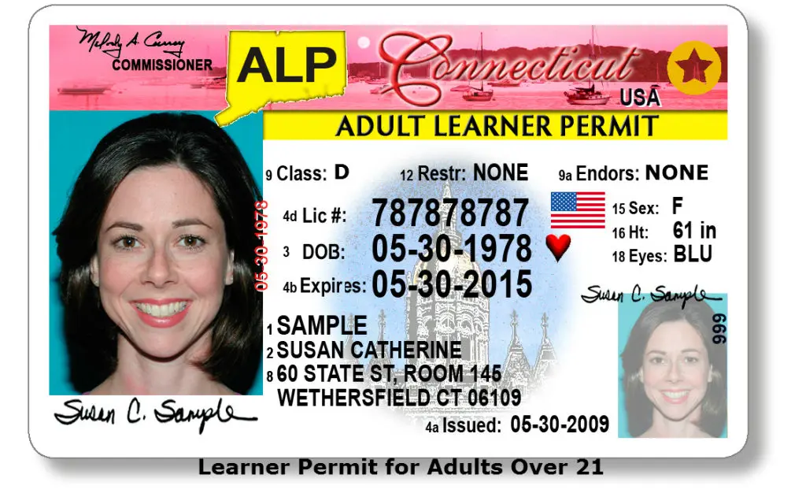
We will talk about the Permit and Driver License
This is an example of a Leaner Permit for Adults Over 21

Slide 13

Video

Slide 14

Location of DMV
https://portal.ct.gov/dmv/resources/locations-office-hours?language=en_US
It Does Not Open Sunday and Monday
Developmental Services

Slide 15

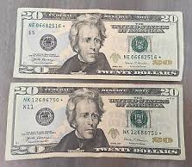
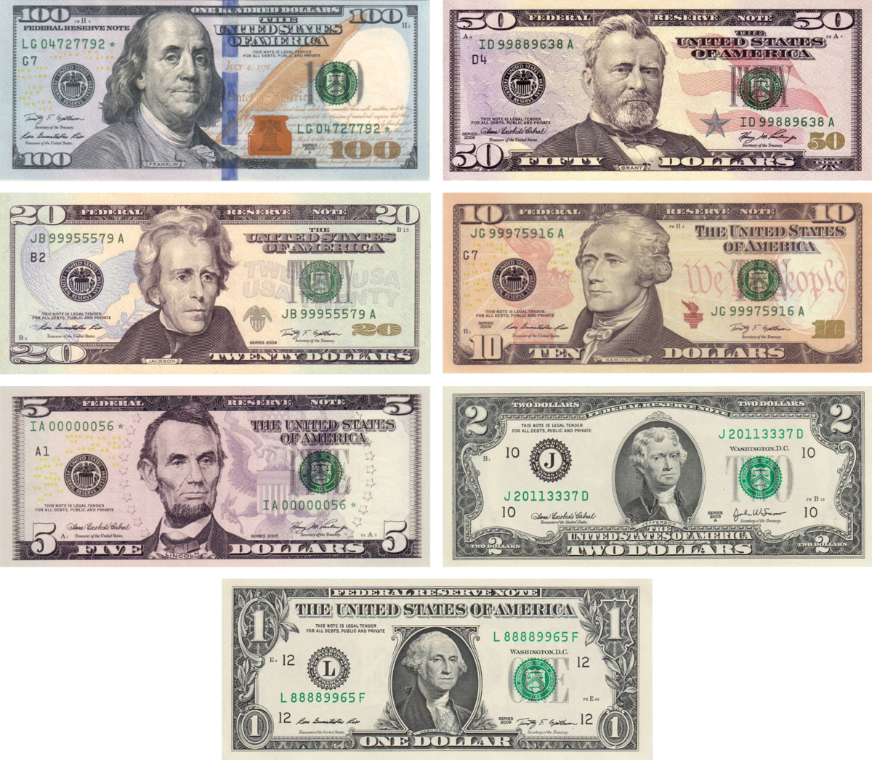
Fees Your fees are paid online when your appointment is scheduled:
Learner’s permit(class D) $19
Testing fee – covers vision, knowledge, and road tests $40
Provide you with the link below:
https://portal.ct.gov/dmv/resources/dmv-fees?language=en_US
There are more fee to get your license. you must pay for your mandatory 8 hours Course

Slide 16

Now go to your DMV on your scheduled date and time.

Slide 17

The documents needed for the DMV
I am going to explain what to bring with you

Slide 18

Social Security Card:
It must be the original no copy and not Laminated

Slide 19


Other forms to bring :
U.S. passport or U.S. birth certificate

Slide 20
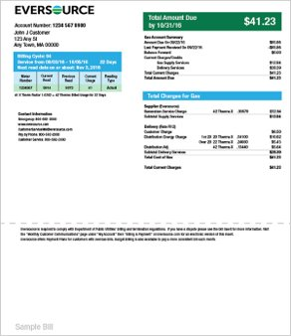


Proof of Connecticut Residency:
Two pieces of mail or utility bill from two different sources dated within 90 days to prove that you live in Connecticut

Slide 21

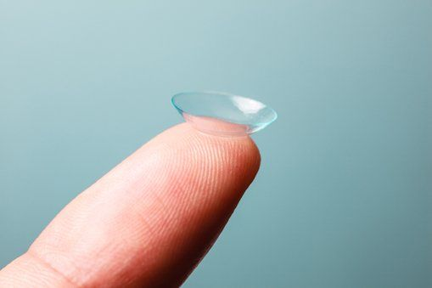
Eye Exam:
Please bring in your eye glass or eye contact lenses
You need them for the Eye Exam

Slide 22

Testing Exam:
It’s done on the computer. If you need accommodations, please ask.

Slide 23



Take a GOOD OR BAD Pictures
Make sure you look good before get your Id because it will stay like that for 16 years
Don’t wear sunglasses or hats
Samples

Slide 24


Bad Pictures or Good Pictures
If you wear glasses bring them with you

Slide 25
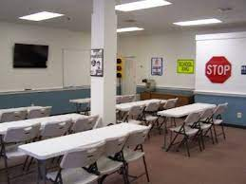
Take an eight-hour Safe Driving Practices Course
First time driver in Class

Slide 26

Driving Exam:
Practice before you go to your exam
How to back up the vehicle
Make show you can stop
How to turn left and right
Check your speed
Not being close to the other vehicle
And more

Slide 27
Thank you

