Slide 1
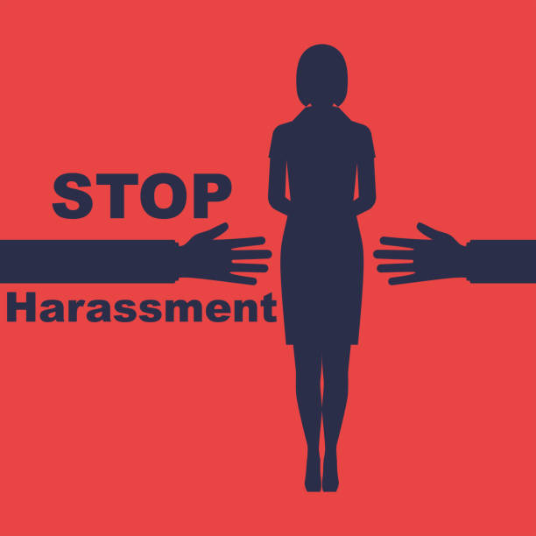

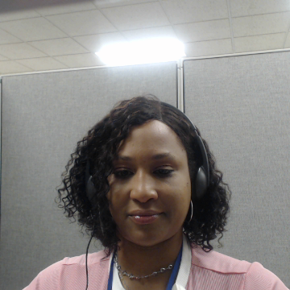
November Fab Topic
Healthy Relationships
Anti-Bullying Awareness

Slide 2

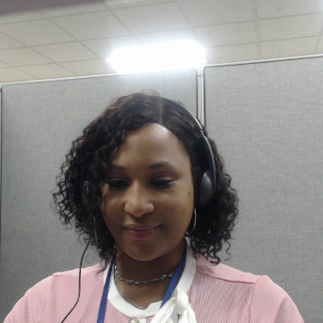
Agenda
Prevent Bullying!
Who Can You Trust?
Why Is It Important to stop Bullying?
Being a voice for those who can’t stand up for themselves.

Slide 3
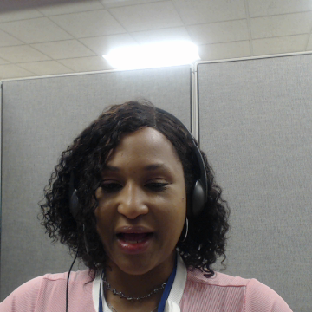
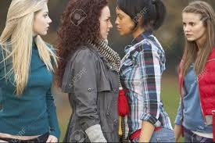
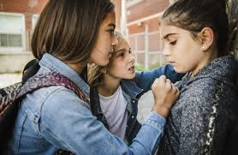
Prevent Bullying
Be Educated about bullying. ...
How Can I Help Prevent Bullying?
Talk openly and frequently about it ...
Be a positive role model. ...
Help build your self confidence. ...
Be aware of cyber bullying.
Here Are Some Other Ways you Can Improve The Situation And Feel Better: .
Avoid the bully
Don’t react right away, go outside to get some air.
Act brave, walk away, and ignore the bully. ...
Talk about it to someone you trust.
If you can not tell your counselor, at least tell your close friend.

Slide 4
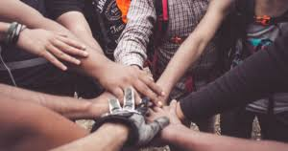
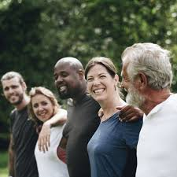
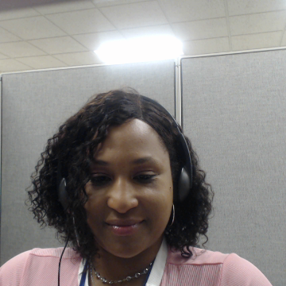
Who Can You Trust?
On the left side are a list of people you should be able to talk to about what is going on. Never be afraid to say that you are being bullied, teased or made fun of. Once one person speaks up, we all can!
Counselor
Parents or Family Friend
Sister or Brother
Teacher
Best Friend
Therapist
Social Worker
Pastor
Neighbor
Grandparent

Slide 5

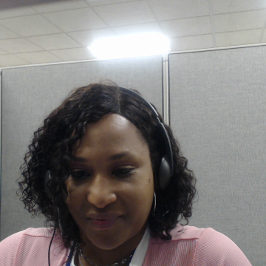
Why is it Important To Stand Up to Bullying?
1.Bullying negatively affects those who are bullied, those who bully others, bystanders, and others in the community.
2. Bullying is linked to many negative outcomes including impacts on mental and physical health, substance use, educational experience, violence, and suicide.
3. Those who witness bullying and violence are more likely to have mental health difficulties. Violence and bullying negatively affect learning and social development.

Slide 6


Being A Voice For Those Who Can’t
Being a voice for others can involve using your voice to share your thoughts, beliefs, and values to influence others. Here are some tips for using your voice:
Be confident
Believe in what you're saying and speak loudly enough to be heard.
Be assertive
Express yourself effectively, stand up for what you believe, and respect the views of others.
Speak from your diaphragm
Take deep breaths and speak from your belly to project your voice more clearly and powerfully.
Amplify the voices around you
Share resources that represent your thoughts and feelings, especially if they are coming from marginalized people.
Be self-aware
Assess what kind of leader you are and what kind you want to be, and intentionally live in those values.
Consider how your voice sounds
Your voice can send unconscious messages that impact how the audience perceives you.

Slide 7

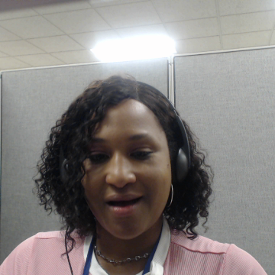
Self Determination
To be Self-DetermineD is to have a sense of direction and a purpose in life. for yourself. It’ s knowing what you want and need in your life. It’s what you want to work towards, your goal.

Slide 8
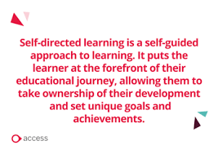
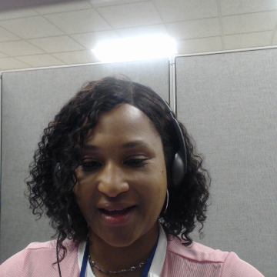
Self-Direction
Self –Direction and Self –Determination go hand and hand. To have self direction is to be more free as a person, saying what you want done, whether it is job related or your living situation. If you need a home support, DSP or a job coach to navigate your life, it’s the best way possible.

Slide 9
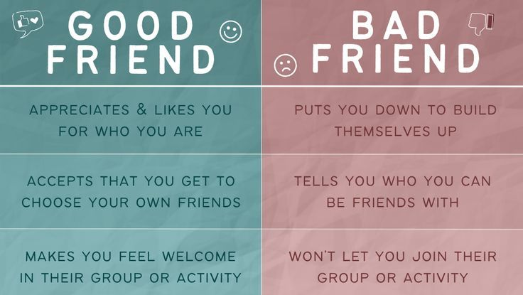
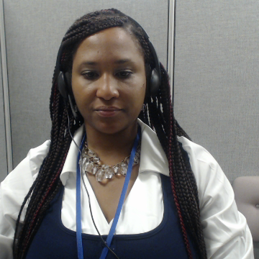
Topic of discussion
To have a good friend, you need to be a good friend. Steps to a friendship.
Different type of good and bad friendships.

Slide 10

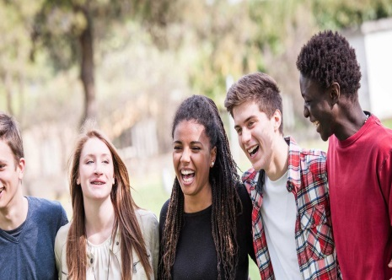


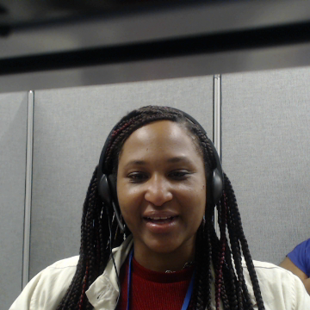
Part1 building a good friendship
Trust
Respect
Appreciation
Encouragement
Compassion Sense of Humor

Slide 11

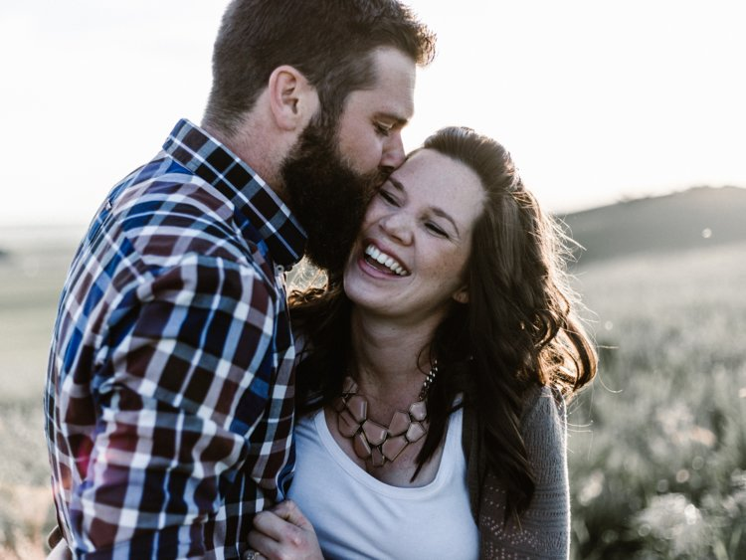
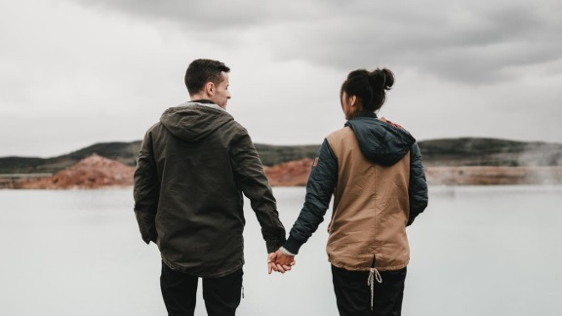
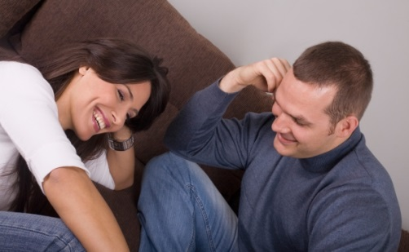
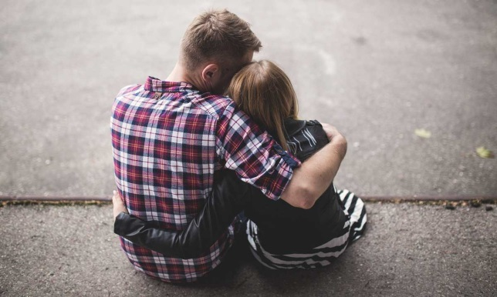

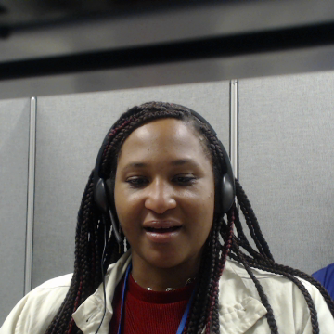
Steps to Building a Good Friendship Part 2
Getting to know each other
Good communication
Respect for one another
Spending time together
Being supportive of each other

Slide 12
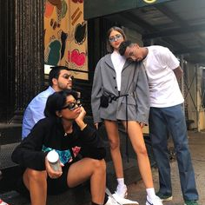
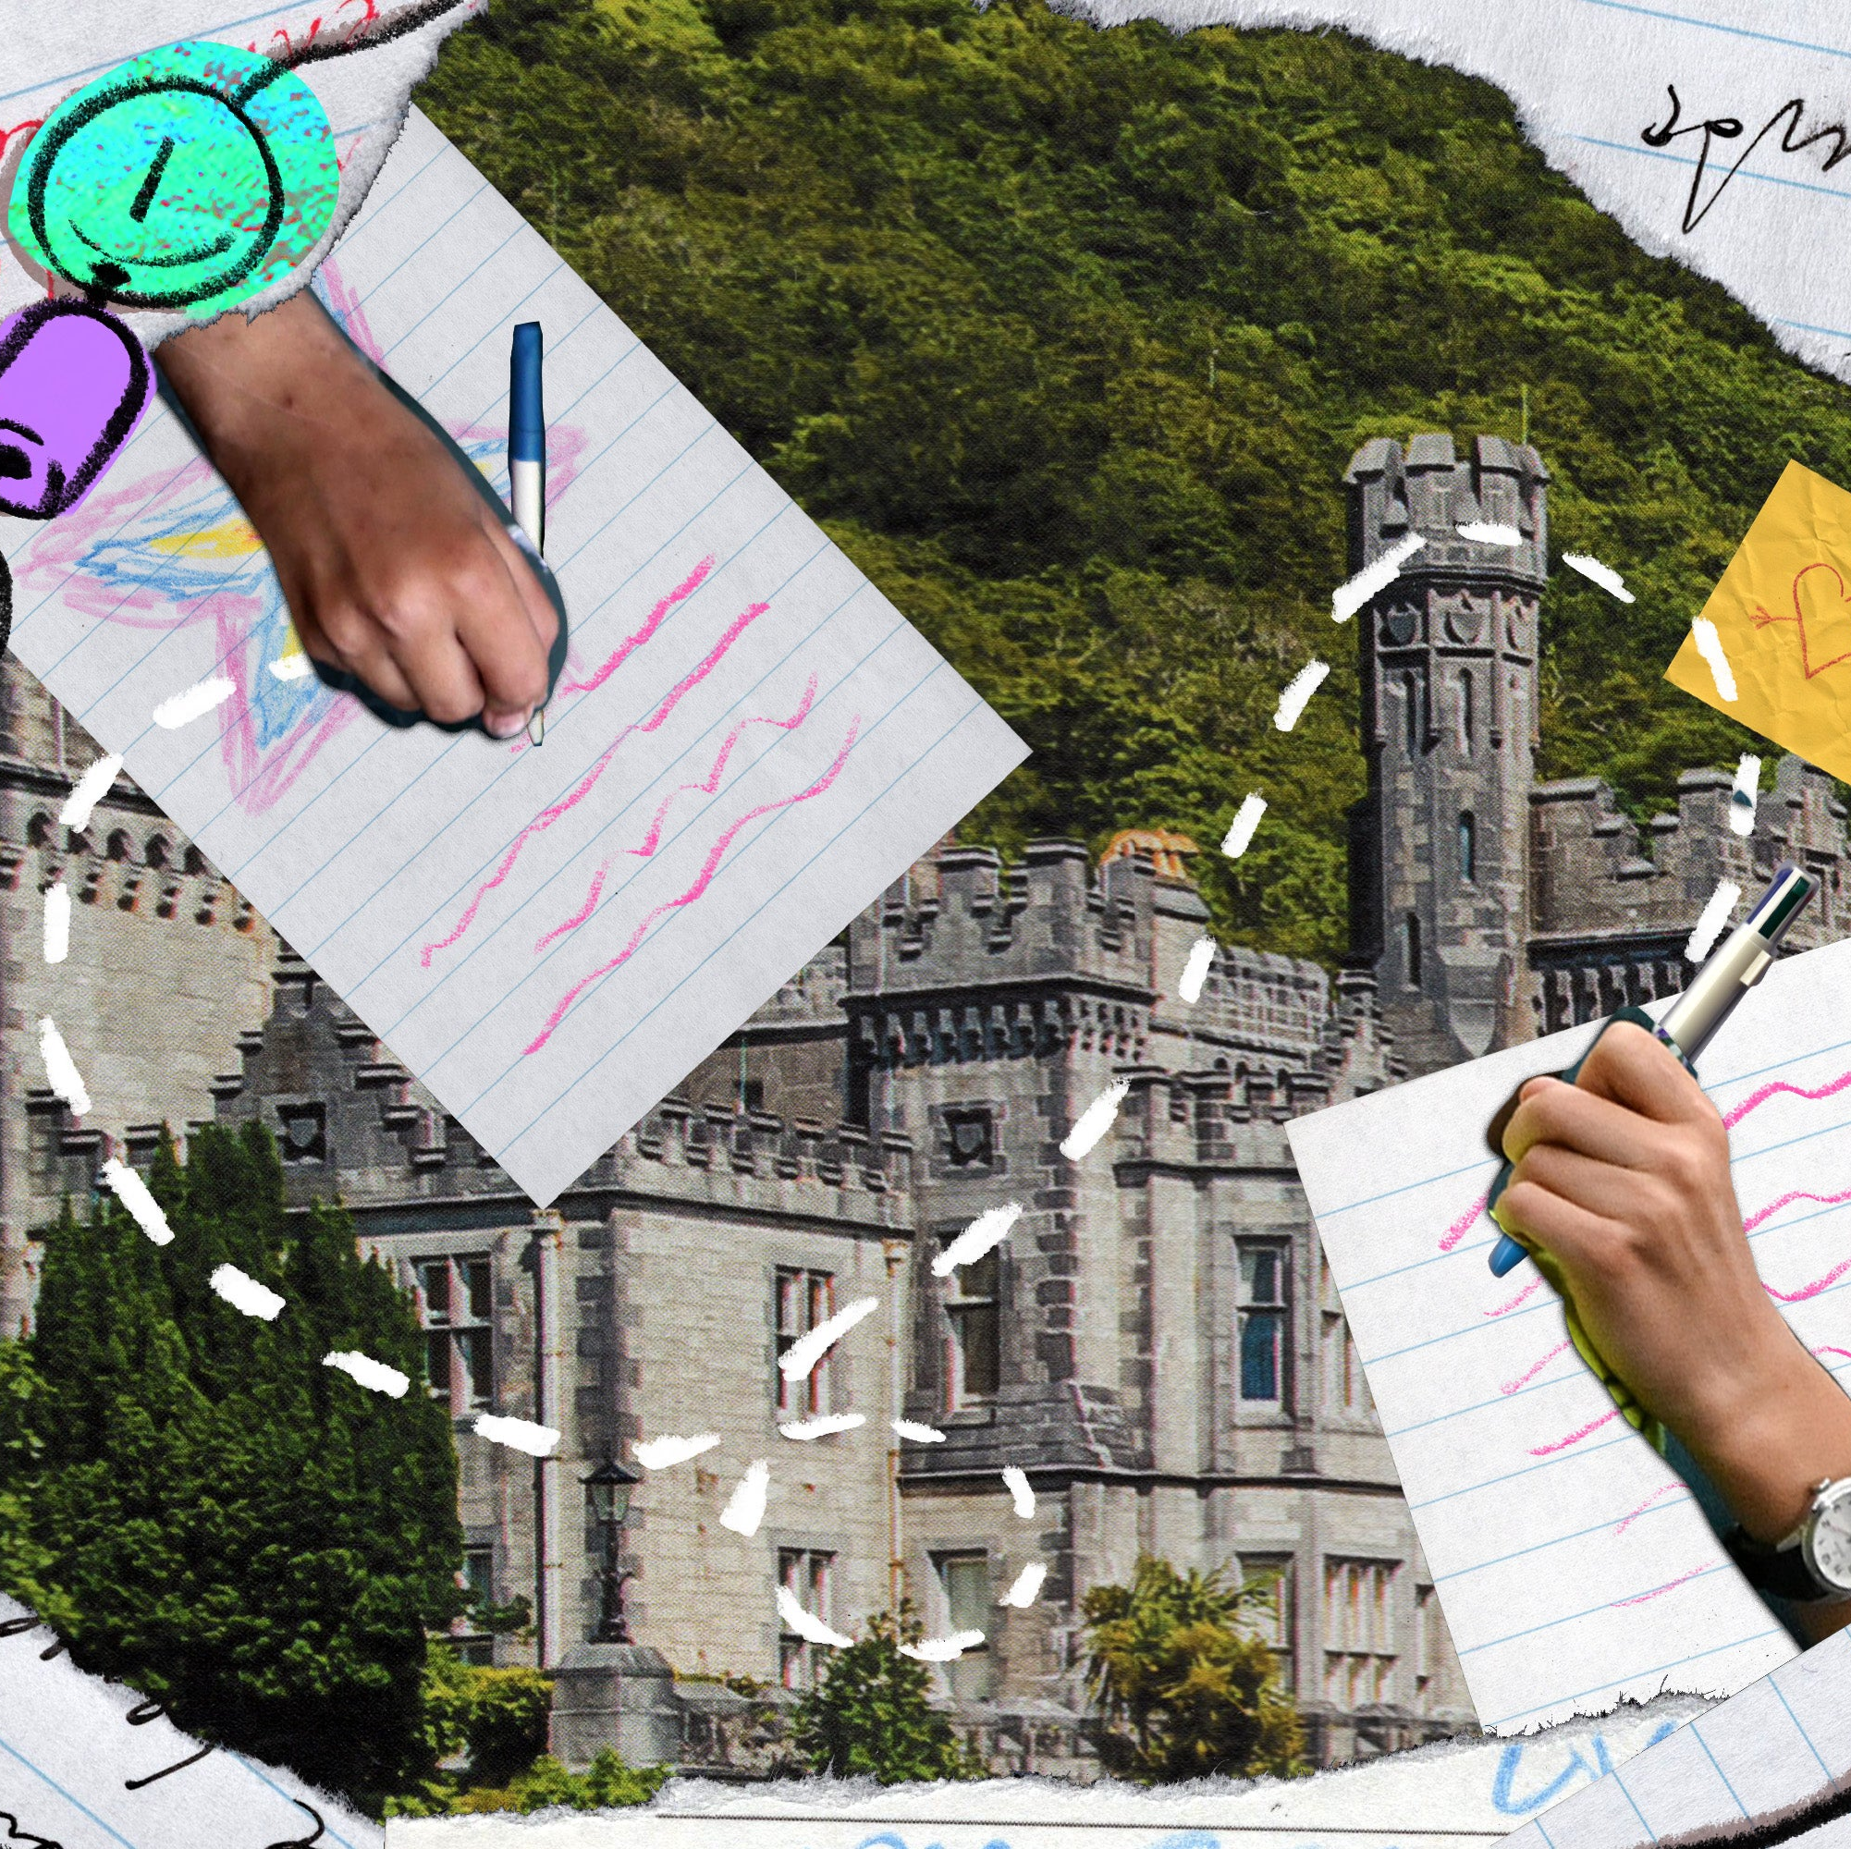
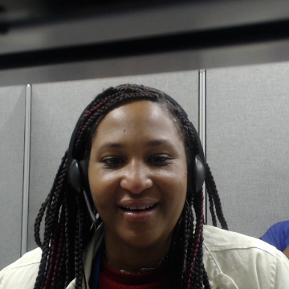
Different Types of Friendships
Bestie/Best friend is someone who you are close with.
Friend is a person you talk or hangout with.
Friendzone is a situation in which a friendship exists between two people, one of whom has an unreciprocated romantic or sexual interest in the other.
Casual Friends are those who are there when they want to be.
The Long-Distance friend is one that lives far away, for example, one lives down South and the other lives in CT.

Slide 13
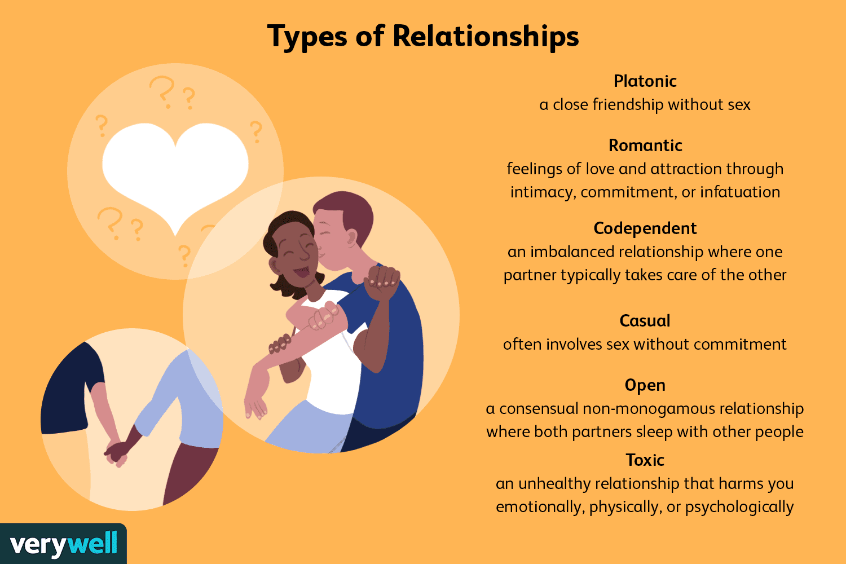
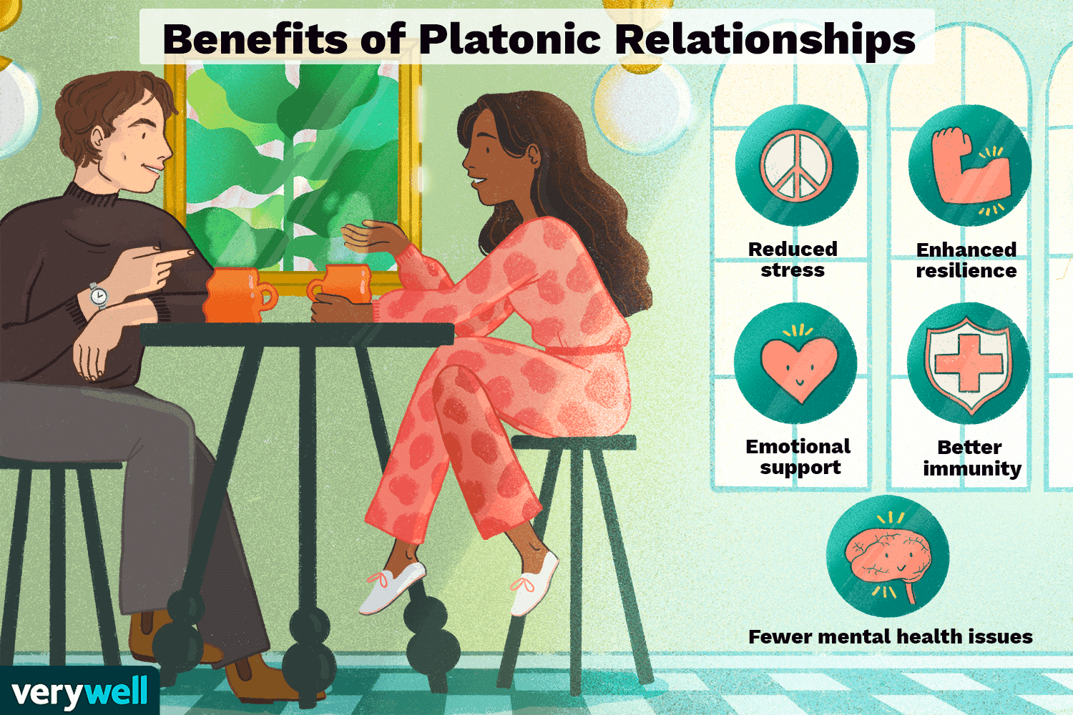
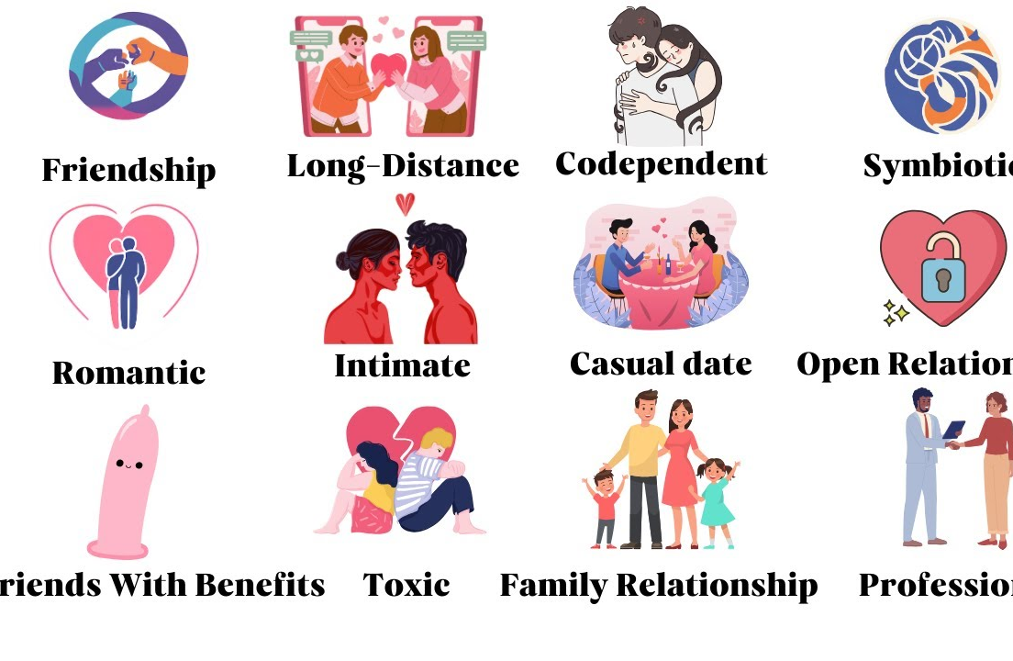
Types of Relationships
Family Relationships
Work Relationships
Romantic Relationships
Sexual Relationships
Online Relationships

Slide 14
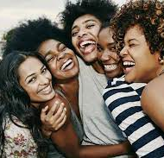
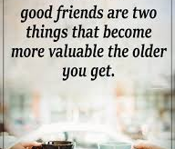
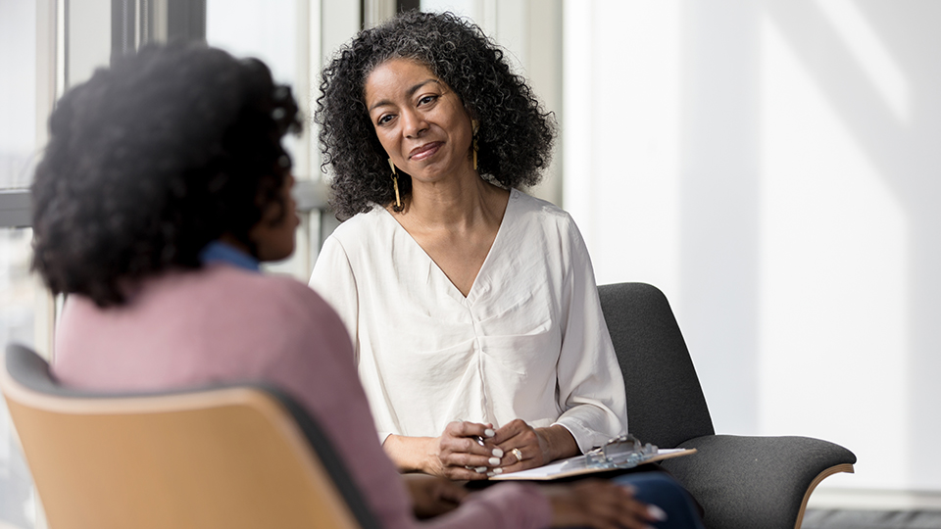
Types of Good Friends
The Wise One is someone who is very wise.
The Loyal is a friend that is loyal to you and you only.
The Listener is someone who loves to listen to you when you talk.
The Nonjudgmental is a person who doesn’t judge you for who you truly are.
The Fun Friend is a friend who is very outgoing.

Slide 15
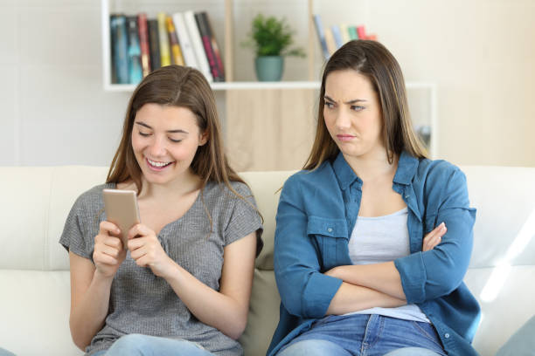
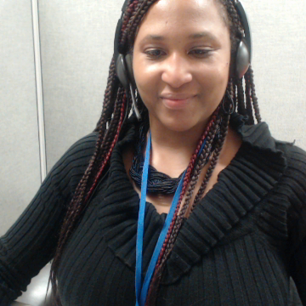

Types of bad friendships
The Jealous Friend is someone who is hating you because of your succuss.
The Negative Friend is always complaining.
The Controlling Friend is someone who tells you what do.
The Gossiping Friend is someone who is always gossiping about others or you.
The Selfish Friend is always about themself and no one else.
The Fake Friend is someone who will smile in your face, but talk about you behind your back to other people.

Slide 16
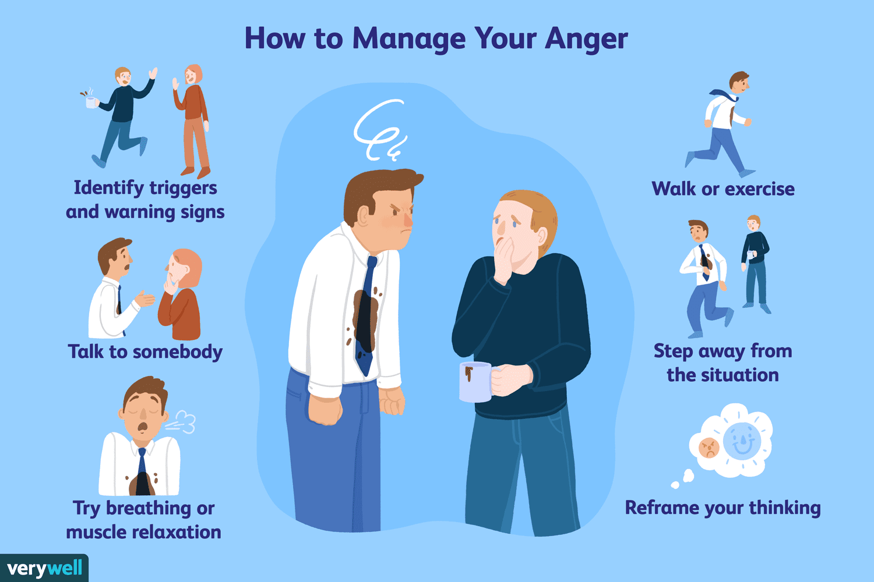
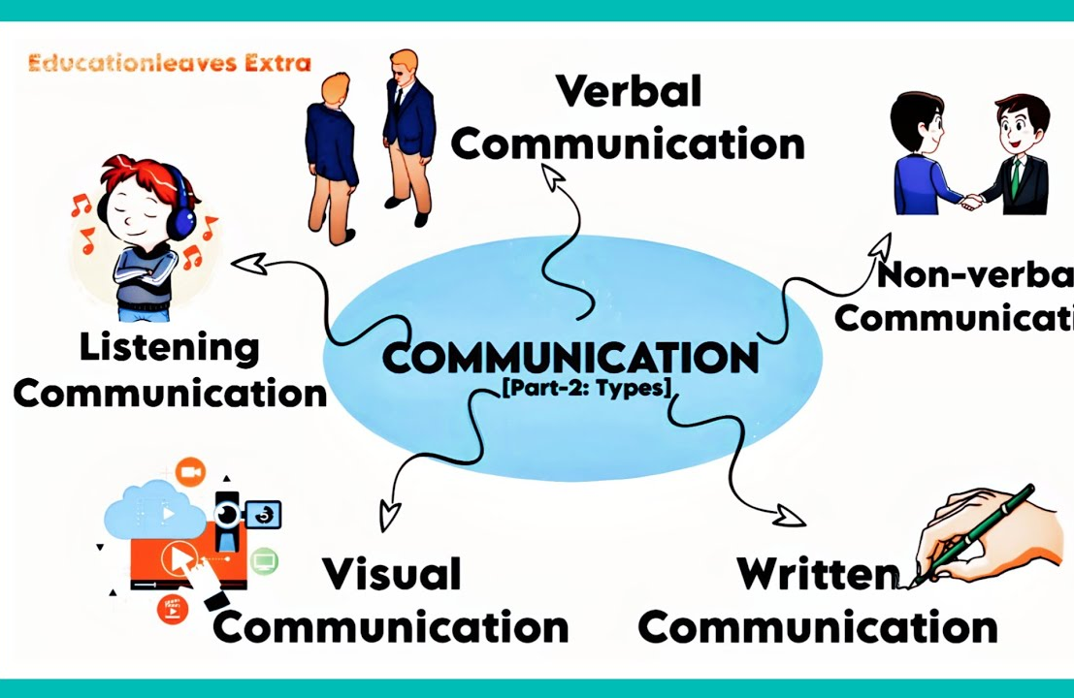
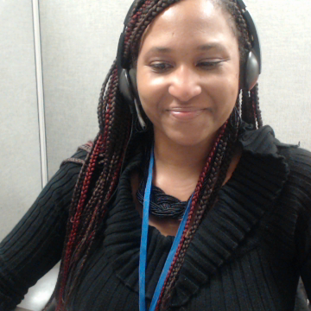
How to Resolve any issue within the Friendship/Relationship
Communicate
Communicate with each other.
End
End with a Win-Win Solution
Calm
Calm Your Feelings
Prepare
Prepare For The Conversation
Manage
Manage Your Reactions
Take
Take All Perspectives Seriously

Slide 17
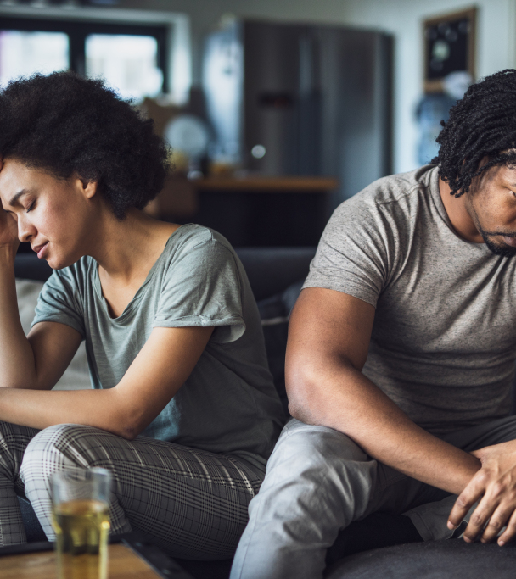
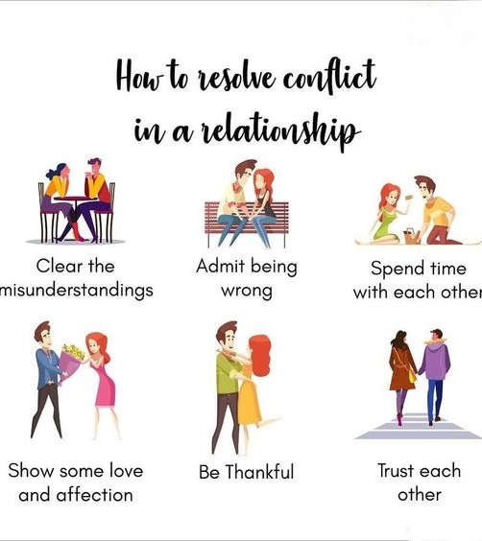
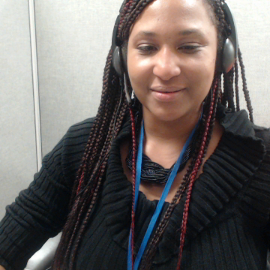
Relationship Conflict Resolution

Slide 18
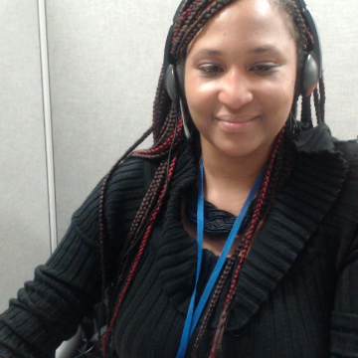
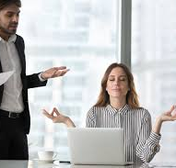
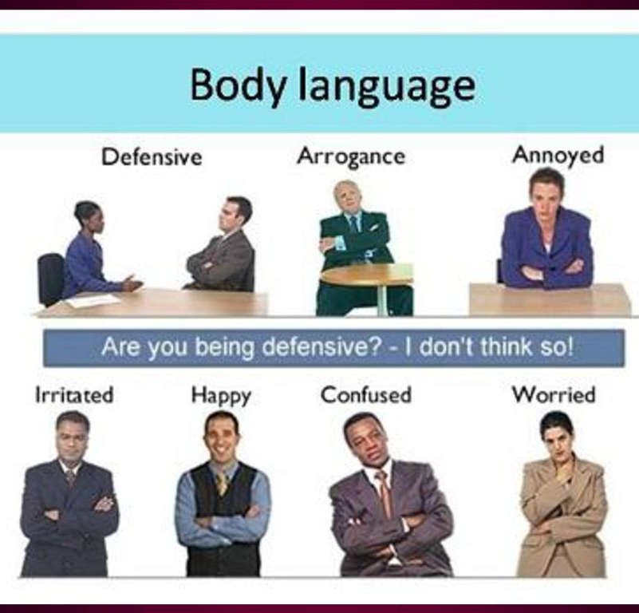

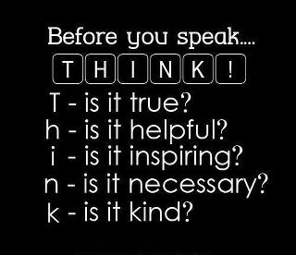
How to disagree respectfully
Take a pause for a moment.
Don't make it personal.
Listen to the other point of view.
Stay clam.
Think before speaking.
Be mindful of your body language.

Slide 19
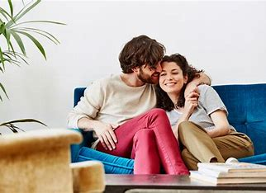

What are Healthy Relationships

Slide 20
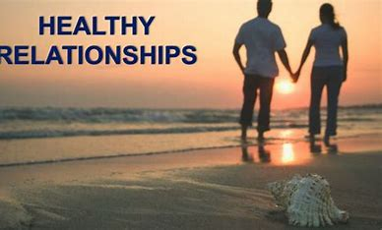
How do you know if you are in a healthy relationship?

Slide 21

Pros and Cons of Relationships
Pros: You are both in agreement on the plan for today.
Pros: There is no abuse of any kind from either person.
Cons: You both are always fighting.
Cons: One, or both people use lies to cover up mistakes, or other kinds of information.

Slide 22
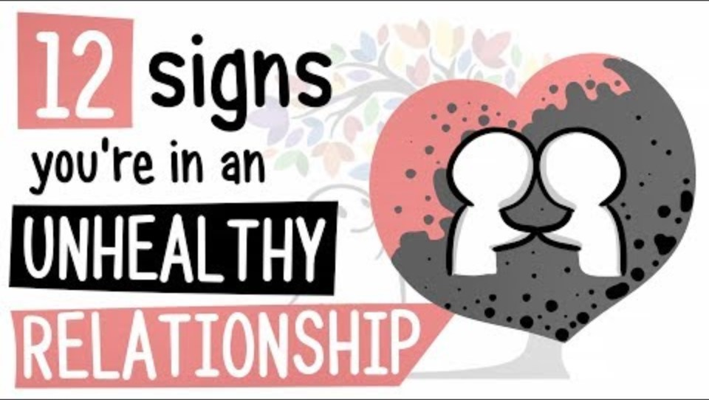

Slide 23
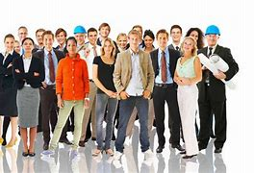
Employment
We give many services on Employment here in DDS.
Advocates' Corner

Slide 24

Employment
employment jobs in CT - Google Search
Click this to find job that are hiring.

Slide 25
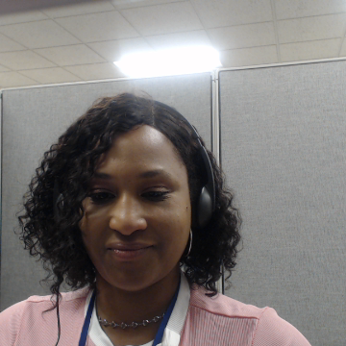
Thank You !!
Shaunte’ Taylor
Jeremy Powell
Kevin Arce

