Slide 1
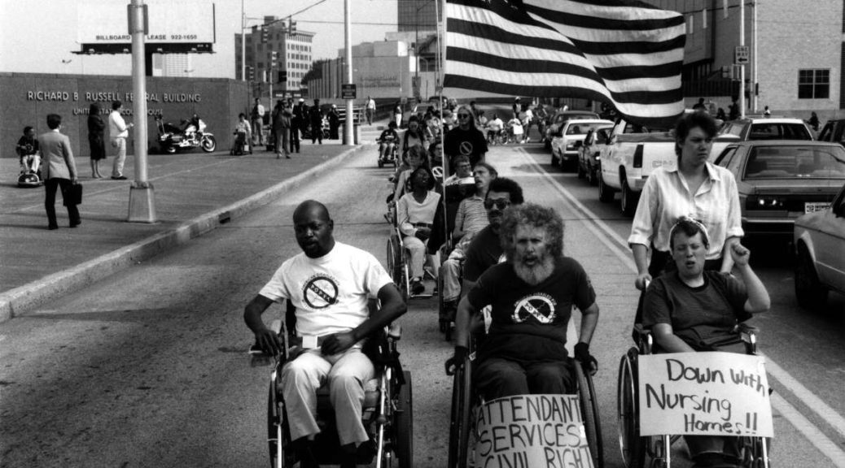

Disability History
By Kevin Arce & Carol Grabbe

Slide 2


What is Disability History?
It is the history of all people with disabilities, and how they can and have made a difference in the world, which all started with the Disability Rights Movement.

Slide 3
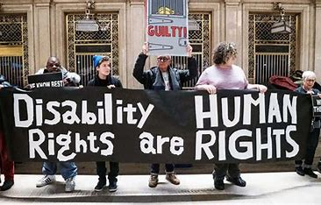

The Disability Rights Movement
Disability Rights Timeline | Temple University College of Education and Human Development, Institute on Disabilities

Slide 4



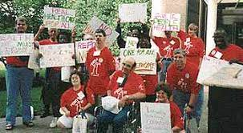
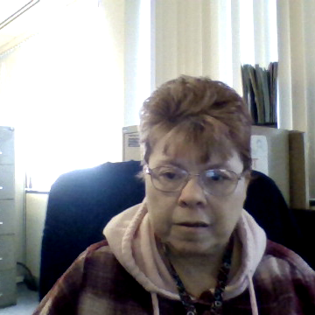

How and Why it Began
By the 1970s, people with developmental disabilities were moving out of the large public institutions. But barriers to social integration still existed in the community. Perhaps the greatest barrier was the attitude of many people, including parents, who thought that individuals with developmental disabilities were not capable of living and growing in the community.
Notes:
By the 1970s things had progressed for findividuals with disabilities, however barriers still existed.

Slide 5

Interview with Rosemary
And Gunnar Dybawd

Slide 6


More Information about
People First
https://www.peoplefirstofcanada.ca/about-us/history/#:~:text=In%20Canada%2C%20the%20People%20First,to%20get%20out%20of%20institutions

Slide 7

1974 1st People First Conference

Slide 8

History of the Special Olympics
The Beginning of a Worldwide Movement
It all began in the 1950s and early 1960s, when Eunice Kennedy Shriver saw how unjustly and unfairly people with intellectual disabilities were treated. She also saw that many children with intellectual disabilities didn’t even have a place to play. She decided to take action.
Eunice Kennedy Shriver's vision began to take shape. She held a summer day camp for young people with intellectual disabilities (ID) in her own backyard.
Notes:
in the 1950s Eunice Kennedy Shriver saw how unfairly people with disabilities were being treated and decided to create a day camp for young people with disabilities in her backyard

Slide 9


Video

Slide 10
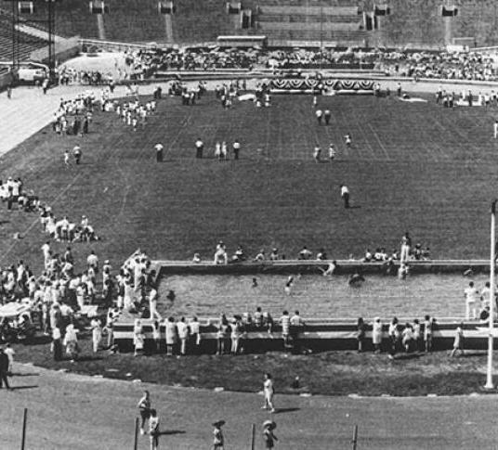

First International Olympic Games
About 1,000 athletes with intellectual disabilities from the USA and Canada competed in the first Special Olympics International Summer Games in Chicago. The Opening Ceremony included a teen runner carrying a torch to light a 45-foot high "John F. Kennedy Flame of Hope." Over 200 events were offered, including broad jump, softball throw, 25-yard swim, 100-yard swim, high jump, 50-yard dash, water polo and floor hockey. The event was so successful that Eunice Kennedy Shriver soon pledged that more games would be held in 1970 and every two years thereafter in a "Biennial International Special Olympics."
Notes:
July 20th 1968 About 1,000 people with intellectual disabilities from usa and Canada competed in the first international Olympic summer games

Slide 11

Important Dates
June 1962
Eunice Kennedy Shriver starts an innovative summer camp for young people with intellectual disabilities at her home in suburban Washington, D.C. The goal is to see if these young people—most of whom lived in institutions—could participate in sports and physical activities. This was a revolutionary idea at the time.
March 1968
Eunice Kennedy Shriver and the Chicago Park District hold a news conference to announce plans for the first "Olympic" games for young people with intellectual disabilities.
Fall 1967
The Chicago Park District begins plans for a citywide track meet modeled after the Olympics. A proposal is made to Eunice Kennedy Shriver and the Kennedy Foundation. Shriver embraces the project and asks Anne McGlone Burke to enlarge the scope to include athletes from around the country.
1960s: The Beginning of a Worldwide Movement (specialolympics.org)
Notes:
These are important dates about how Eunice Kennedy Shriver started a world wide movement for people with intellectual disabilites

Slide 12


Self-Advocacy

Slide 13

Employment
Under the Americans with Disabilities Act (ADA), employers with 15 or more employees must
provide reasonable accommodations for individuals with disabilities to help them perform the essential functions of their position.
Adjustments might include relocating a workstation for easier access or offering flexible hours.
Ensure staff are trained regarding the ADA, its requirements and how to identify discrimination issues.
https://www.insperity.com/blog/employment-for-people-with-disabilities/
Notes:
Under the Americans with Disabilities Act (ADA), employers with 15 or more employees must
provide reasonable accommodations
for individuals with disabilities to help them perform the essential functions of their position

Slide 14


