Slide 1

How to Play the Presentation
Open the presentation in PowerPoint.
Wait for slide show to load up (it may take a minute or two).
Click on the arrows at the bottom of screen to go to the next slide or back a slide or click on the next slide in sequence on the left bar.
To hear recordings, press on the megaphone and press play.

Slide 2

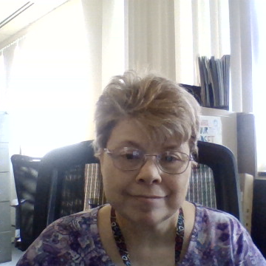

Community Relationships
Today you will learn about community outreach, recreation and volunteering.

Slide 3
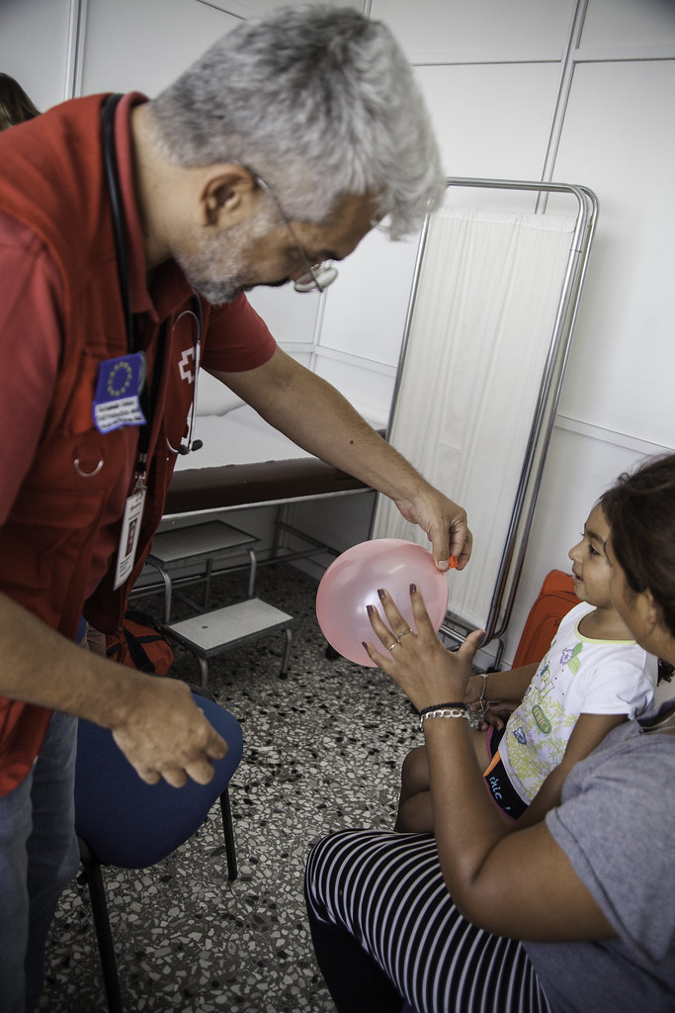
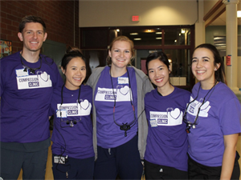
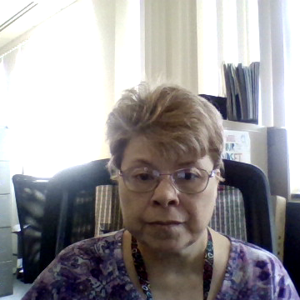
Community outreach has lots of choices that involve providing professional services, or services of a specific expertise, to a group of people who may not otherwise have access to those services. It is performed where those in need are located. Some examples being, providing dental services or education at a homeless shelter, nursing to people living in a homeless shelter.

Slide 4
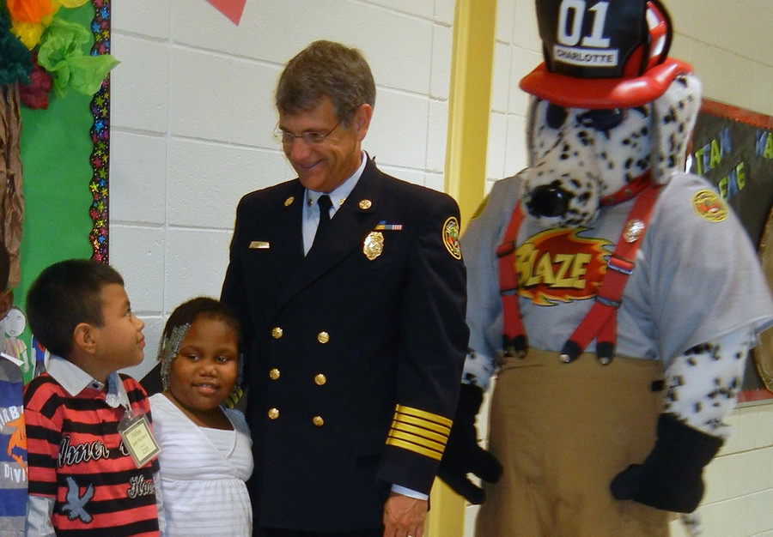

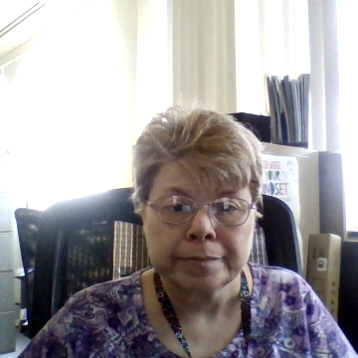
Another example would be a professional paid fire fighter that teaches fire safety in schools.

Slide 5
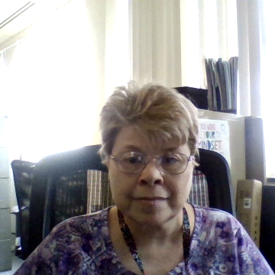
Informational Link
https://www.asdanet.org/index/programs-events/community-outreach
https://typeset.io/questions/what-are-some-of-the-most-common-examples-of-community

Slide 6
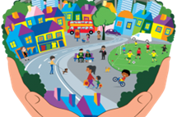
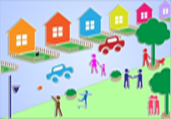
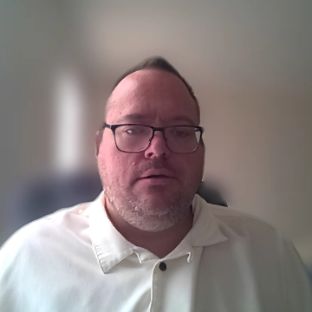
Community Recreation!

Slide 7







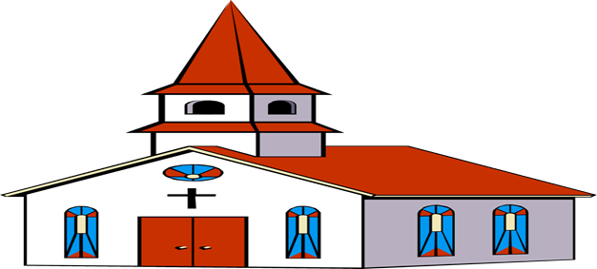

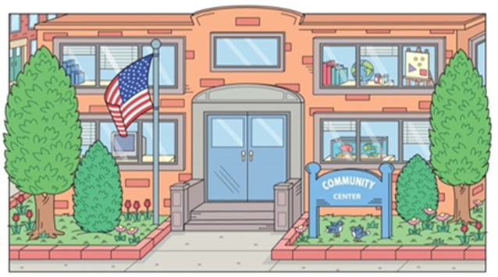
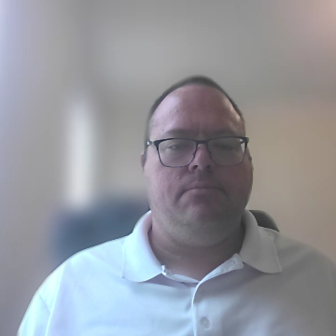
Community Recreation!
What is Community Recreation?
Community Recreation!
Community recreation means recreational, social or multipurpose uses owned or operated by a public entity. Typical uses include public parks, sports facilities, senior citizen centers, nature centers, teen centers, playhouses, auditoriums and recreational centers.
https://www.lawinsider.com/dictionary/community-recreation#:~:text=More%20Definitions%20of%20Community%20recreation,playhouses%2C%20auditoriums%20and%20recreational%20centers

Slide 8

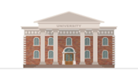


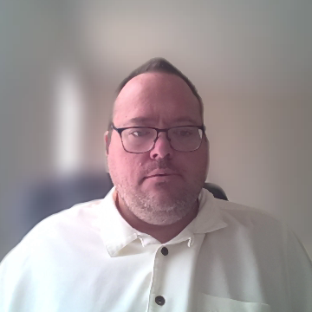
Community Recreation!
Community Recreation!
There are all kinds of Community recreation such as DDS Virtual Recreation, Best Buddies, Special Olympics, The Y, Churches, Community Centers, Libraries, Town Halls, Community Colleges, State Universities American Legion, VFW & Elks!

Slide 9


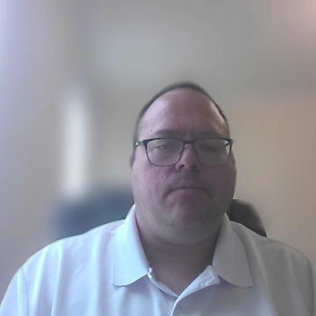


Community Recreation!
Community Recreation!
Community recreation Links!
211CTCommunityCenters
https://crpa.com/resources/departments
GoogleConnecticutCommunityCenters
https://www.bestbuddies.org/bbu/bbo/
SpecialOlympicsConnecticutLocalPrograms
ConnecticutLibraries
https://www.elks.org/
https://www.legion.org/
https://www.vfw.org/
ConnecticutStateUniversities
TownHallsConnecticut
Recreation Therapy Assistant II Corinne H. Jackson corinne.jackson@ct.gov
https://www.ymca.org/
GoogleConnecticutChurches

Slide 10
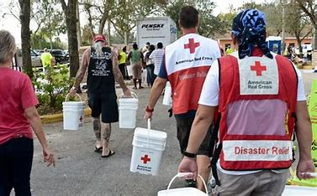
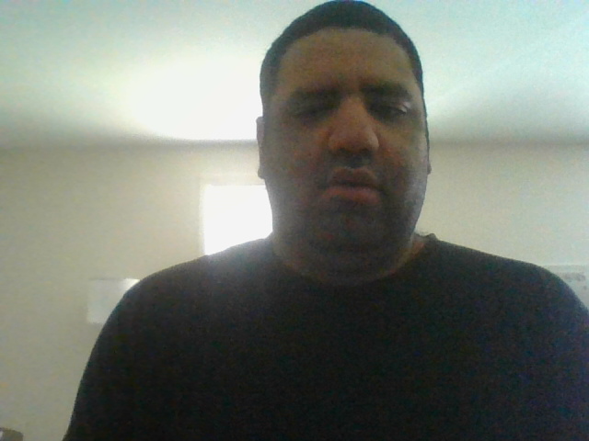
Volunteering

Slide 11
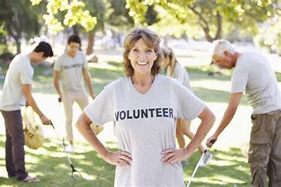
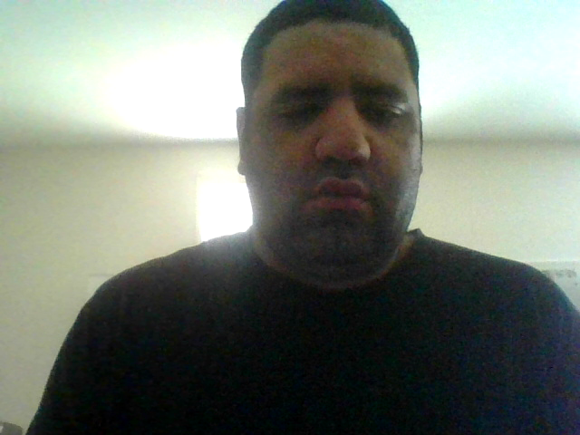
What is volunteering?
The act of doing a job, or task without any pay.
Volunteering is also done freely; it cannot be forced upon.

Slide 12
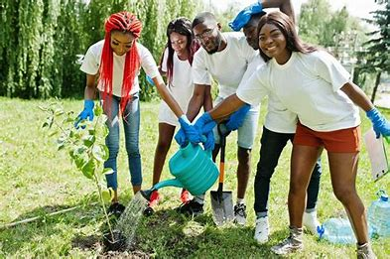
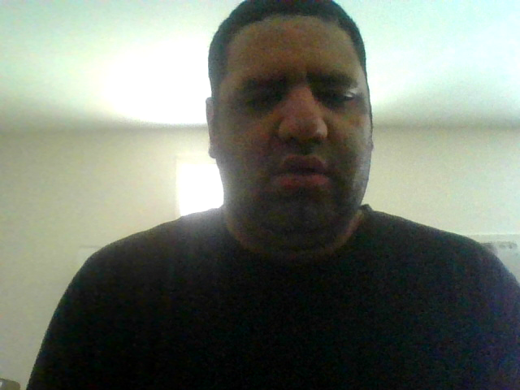
Resources
https://www.bing.com/search?q=volunteer+opportunities+near+me+ct&FORM=SBRS01

Slide 13
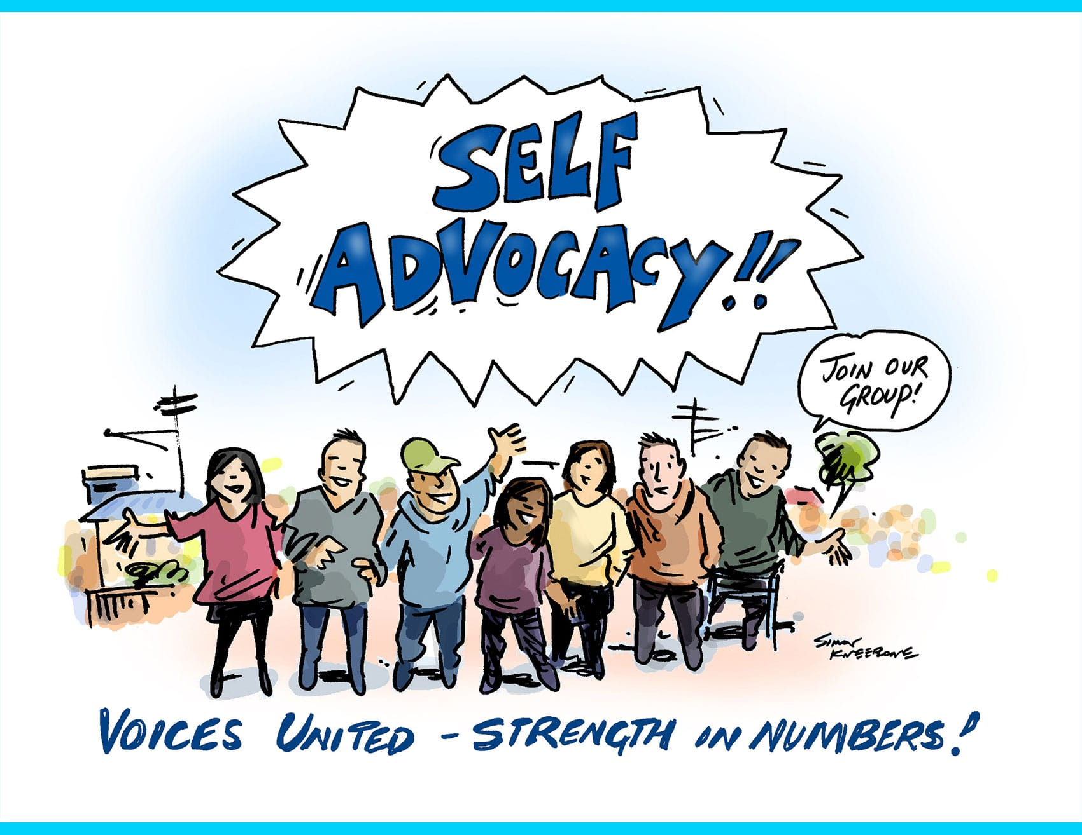
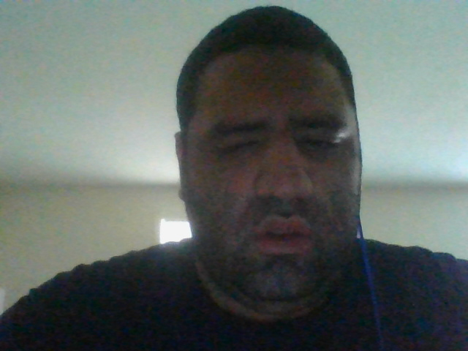
Self-Advocacy

Slide 14

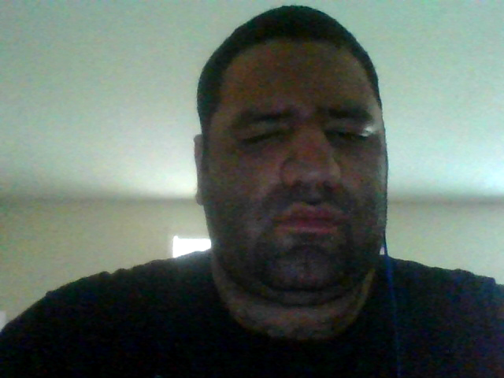
Employment

Slide 15
Thank you!
https://portal.ct.gov/advocatescorner

