Slide 1
How To Play This Presentation
Wait for slide show to load up ( it may take a minute or two)
Go to Slide Show in the toolbar
Click on the option that says From Beginning
Viola!
To watch videos, double click on video picture
Click on arrows at the bottom of screen to go to the next slide or back a slide.

Slide 2
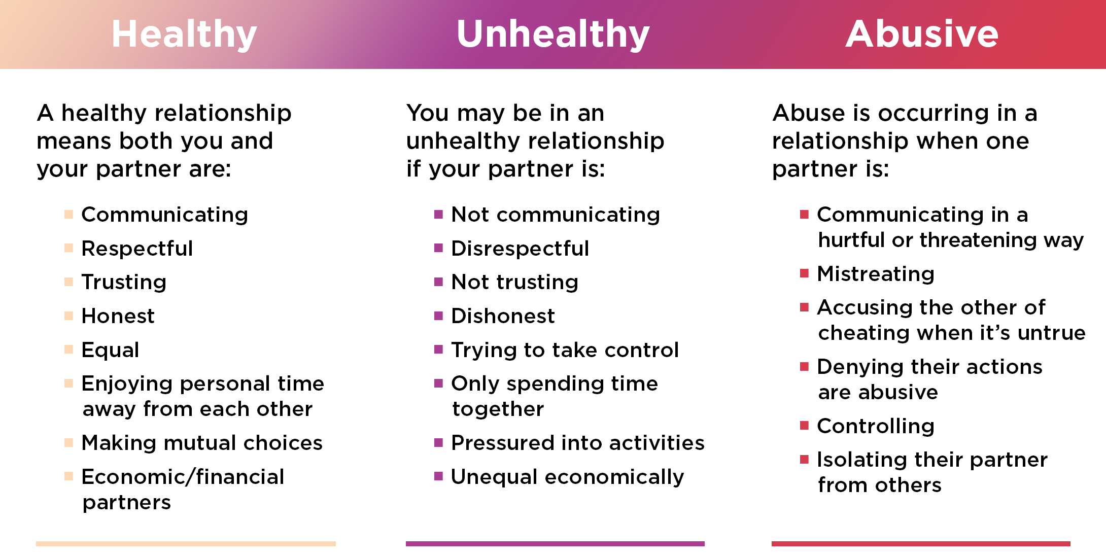
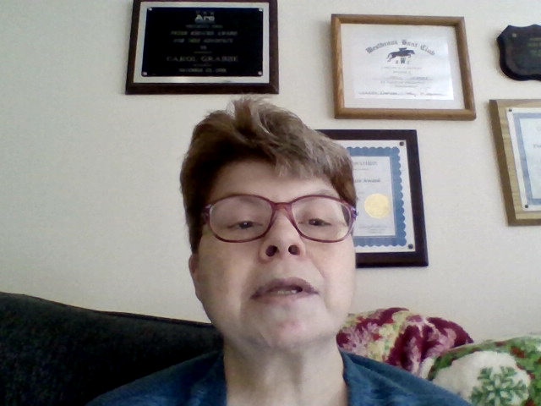

Slide 3

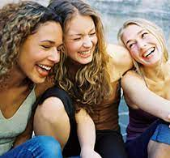

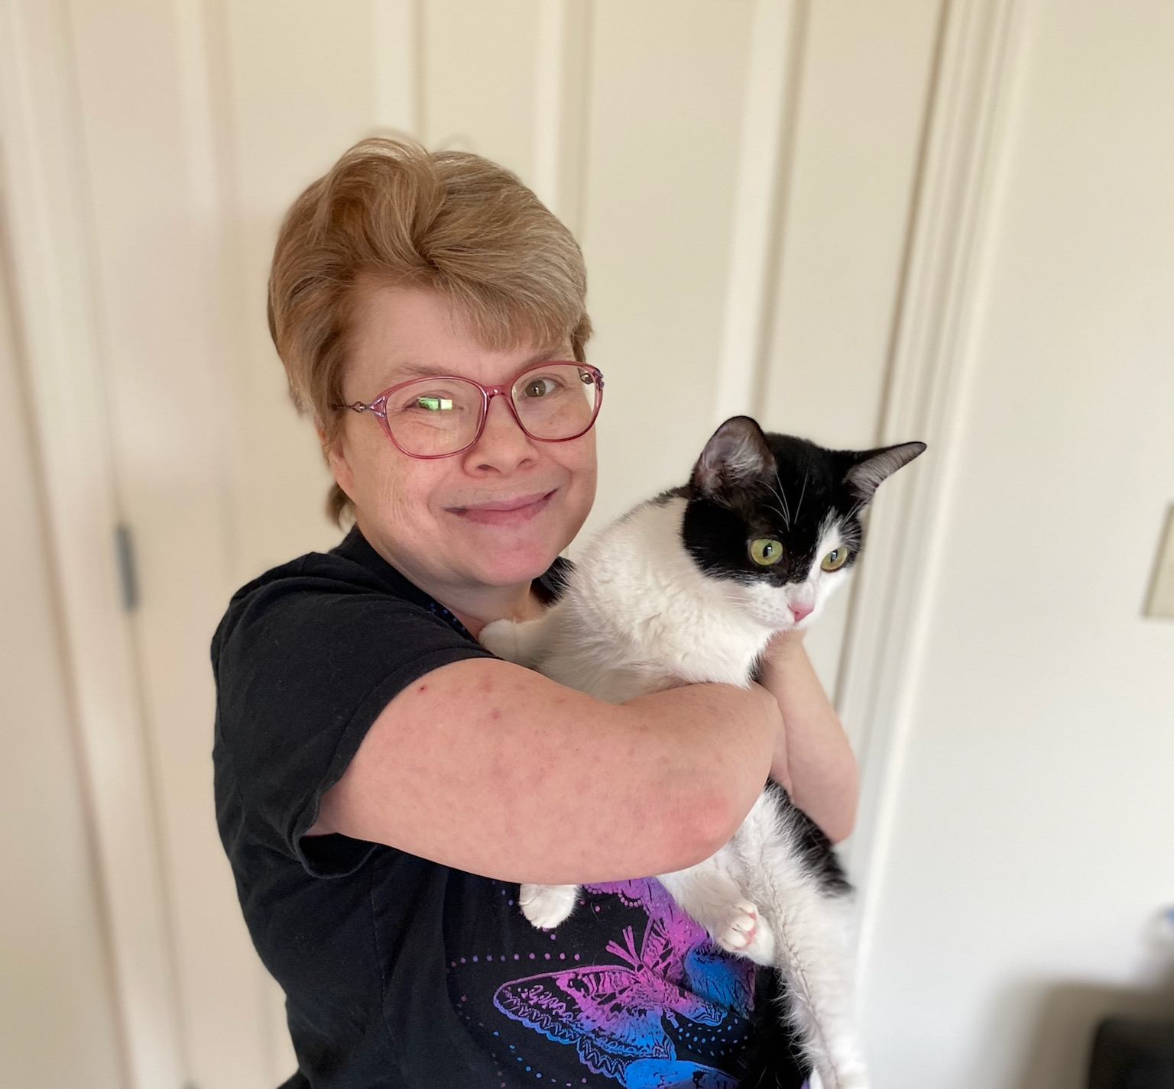
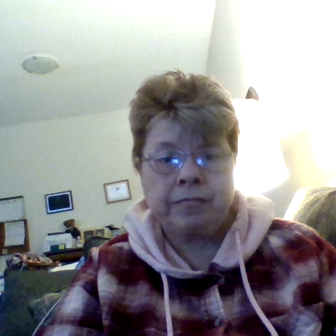
Types of Relationships
parent /child
siblings
friends
Pet/owner
romantic
Notes:
There are many different types of relationships examples include:

Slide 4
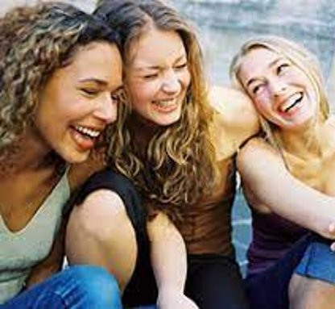


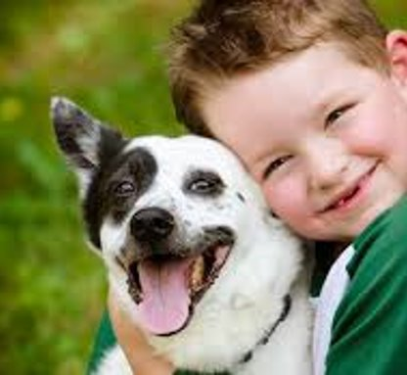
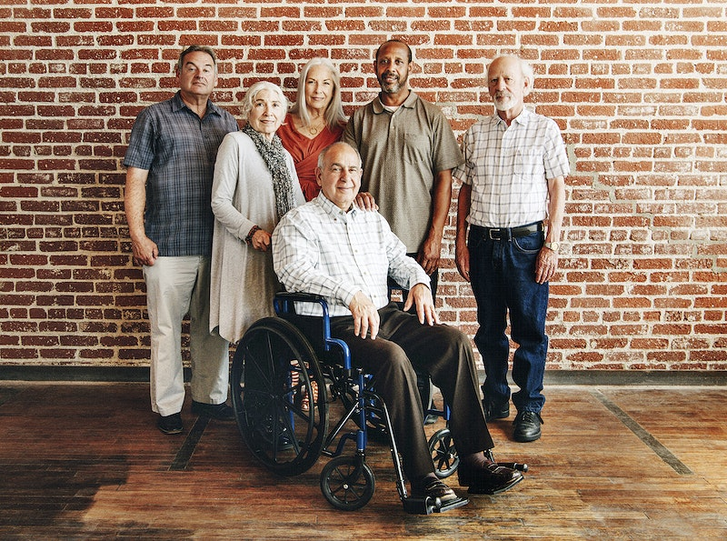
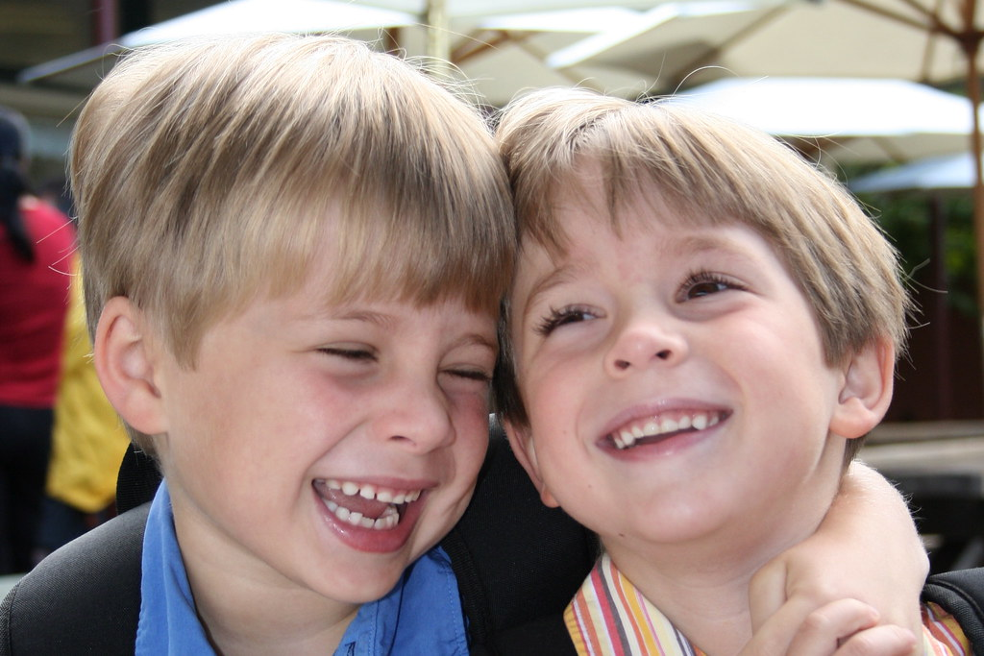

Slide 5

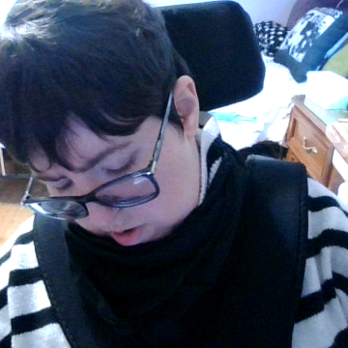


How to Make Friends and Connections
How to make friends and connections
•Making friends can be difficult, Here are a few tips on getting to know some new friends:
• Realize your fear is in your head.
• Start small talk with people you know.
• Put yourself out there. Do some Volunteer work or join a club.
• Take the first step simply by saying hello.
• Don’t be judgmental. People have different hobbies and have different backgrounds.
• Get to know the person. What do they like? Do they have any goals or dreams?
• Be yourself.
• Make the effort to stay in touch.

Slide 6


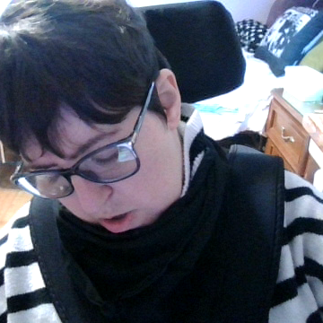
4 Requirements for a Strong Friendship.

Slide 7
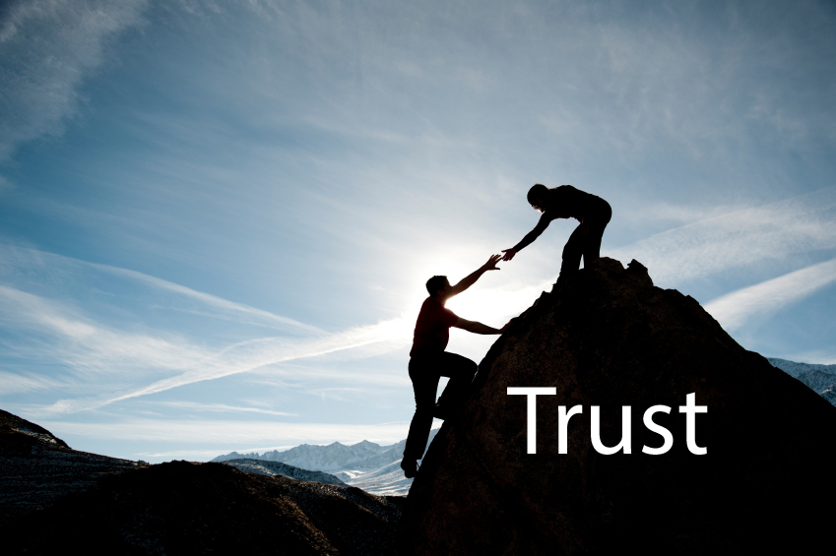

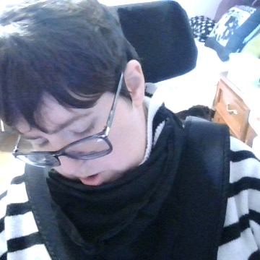
Trust
Being able to have trust and confidence in your friend is one of the most important requirements of a strong relationship because true friendship means you can count on one another.

Slide 8

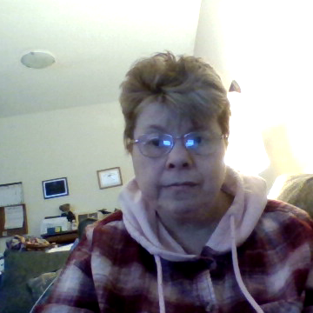
Trust
Both partners should feel confident that they can believe each other and that they won’t be lied to, manipulated or exploited.

Slide 9

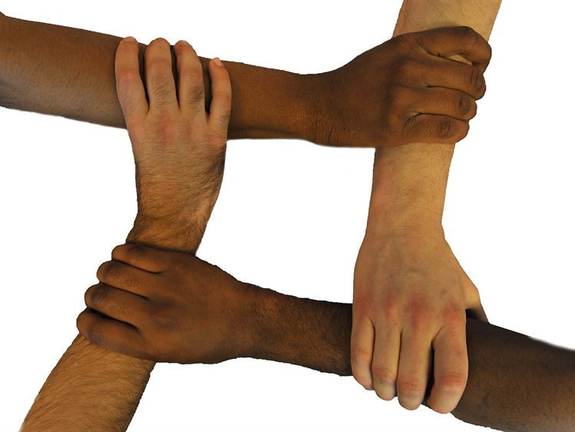
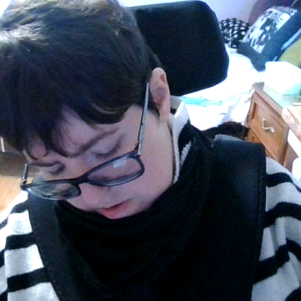
Equality
Equality is another super important factor in healthy friendships that often gets overlooked when one friend seems to have more say than the other.
For example, just because one friend is confident doesn’t mean they should be making all the decision making in a friendship.
A friend that is naturally nervous should challenge themselves to speak up about the things they are interested in doing, like seeing a certain movie or eating somewhere new, without worry of being rejected.

Slide 10
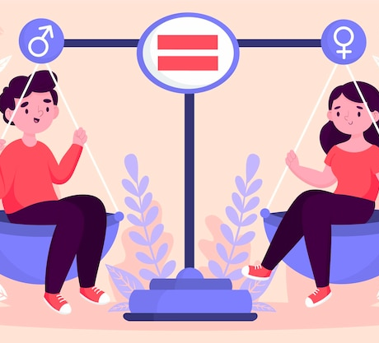
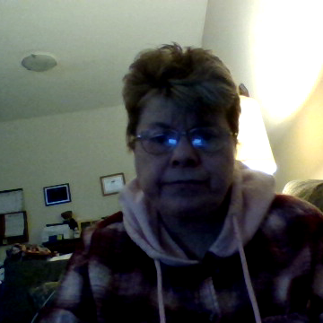
Equality
A healthy relationship also requires equality.
This means that as partners in a relationship, things should be equal between you.
There should be equal power in decision making.
Notes:
Example: where you want to go for dinner and both paying.
You should both have an equal say in how you want the relationship to be.

Slide 11
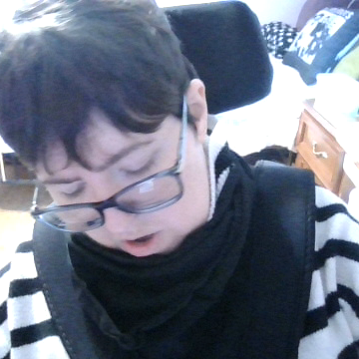
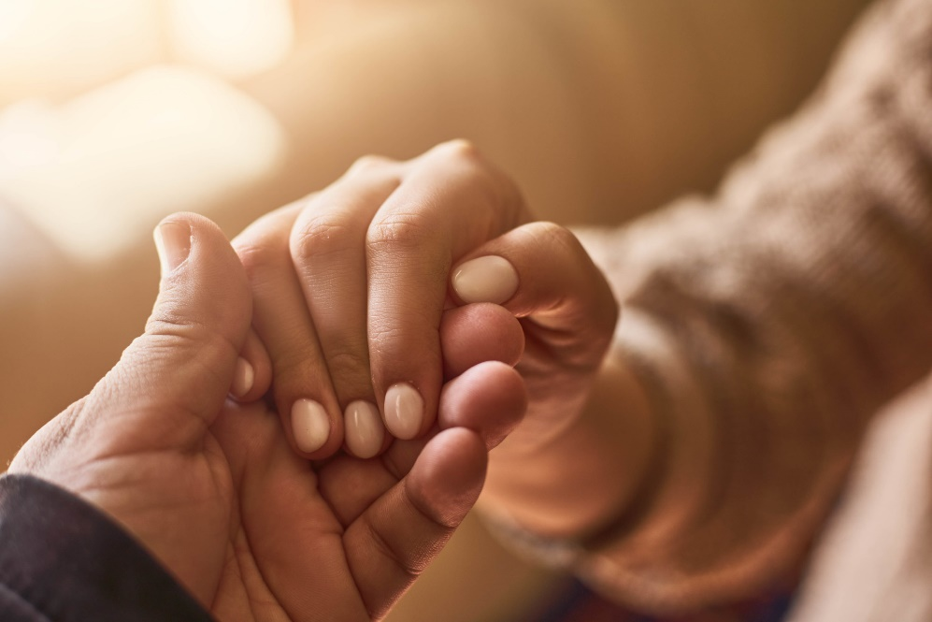
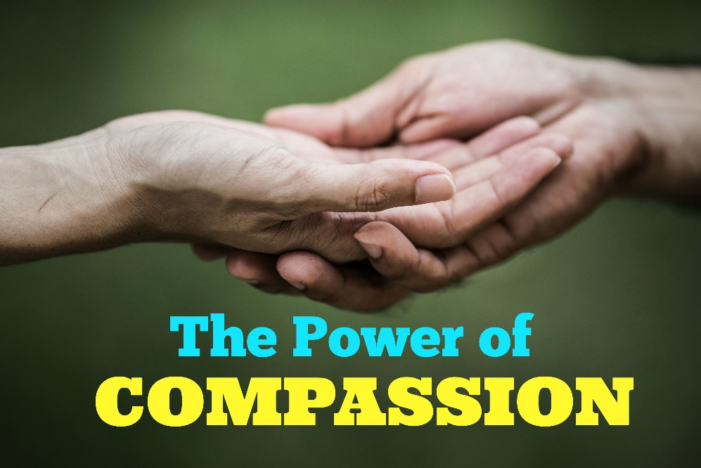
Compassion
Having compassion is when you can be empathetic and genuinely there for your friends on a daily basis and during times of need.

Slide 12
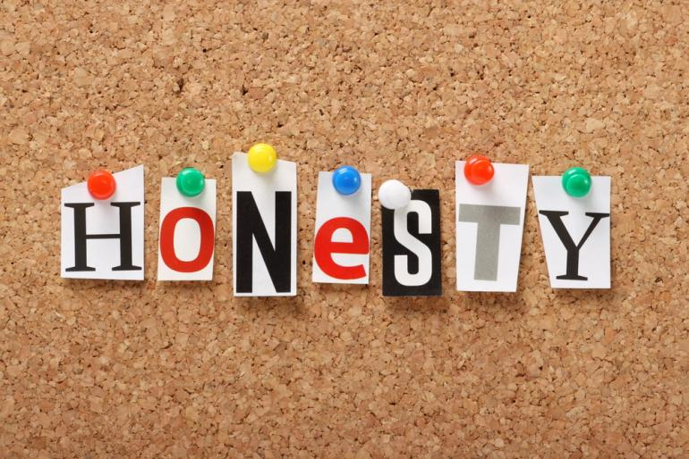
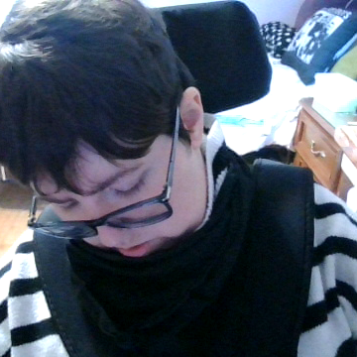
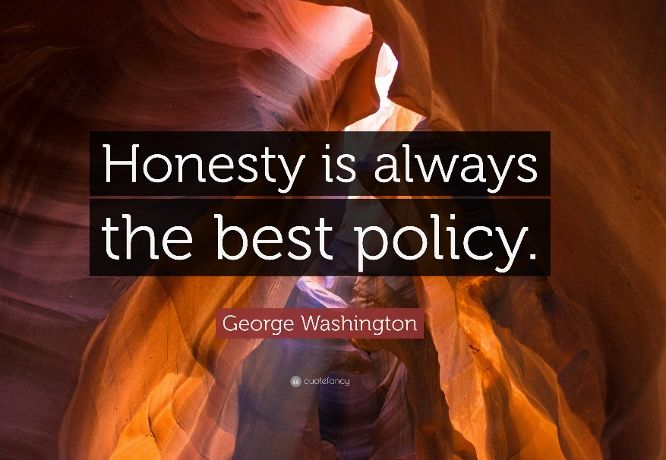
Honesty
Honesty is a requirement for a strong and successful friendship because, at the end of the day, people usually will be more hurt when the truth is being hidden than by the truth itself,
Even though being honest may mean having more difficult conversations with your friend.
it will make for a stronger and better friendship.

Slide 13

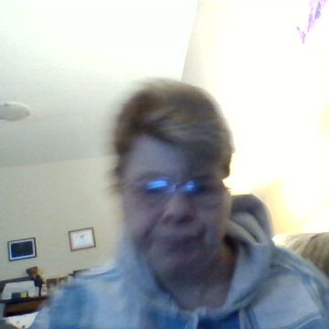
https://www.rareadvocacymovement.com/post/dating-healthy-relationships-for-people-with-disabilities
Safety
Both partners should feel confident in the fact that the other would never intentionally harm them in any way - including physically, emotionally, or mentally.

Slide 14
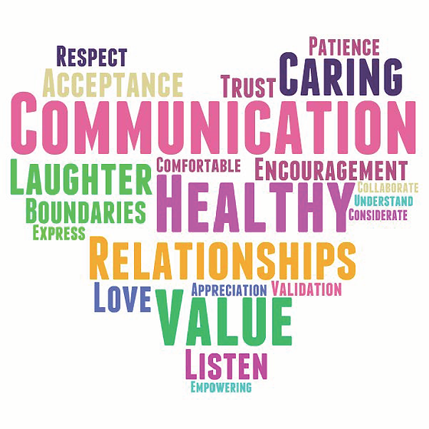
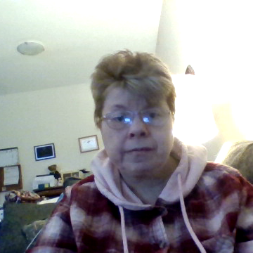
Other Tips to Healthy Relationships
Always make it a point to communicate with clarity, compassion, and honesty, no matter the topic, and make sure that your partner feels comfortable verbalizing their feelings to you.

Slide 15
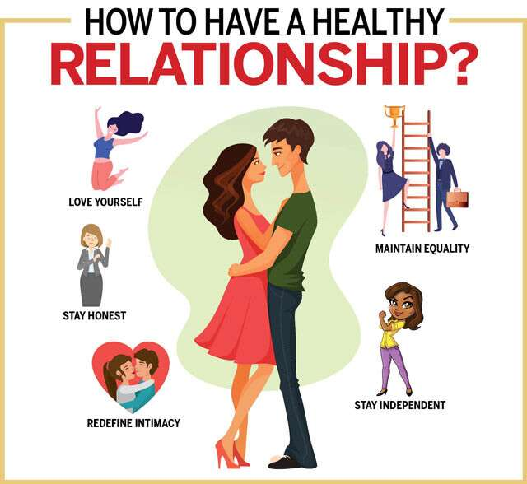
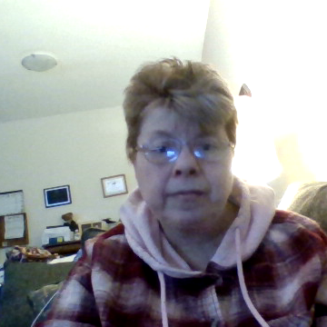
Tips to a Healthy Relationship Cont..
Have a sit-down meeting with your partner in which you both take time to learn about your medical condition(s), how those conditions impact you, the care involved in treating and living with them, and what that may mean for the relationship.

Slide 16
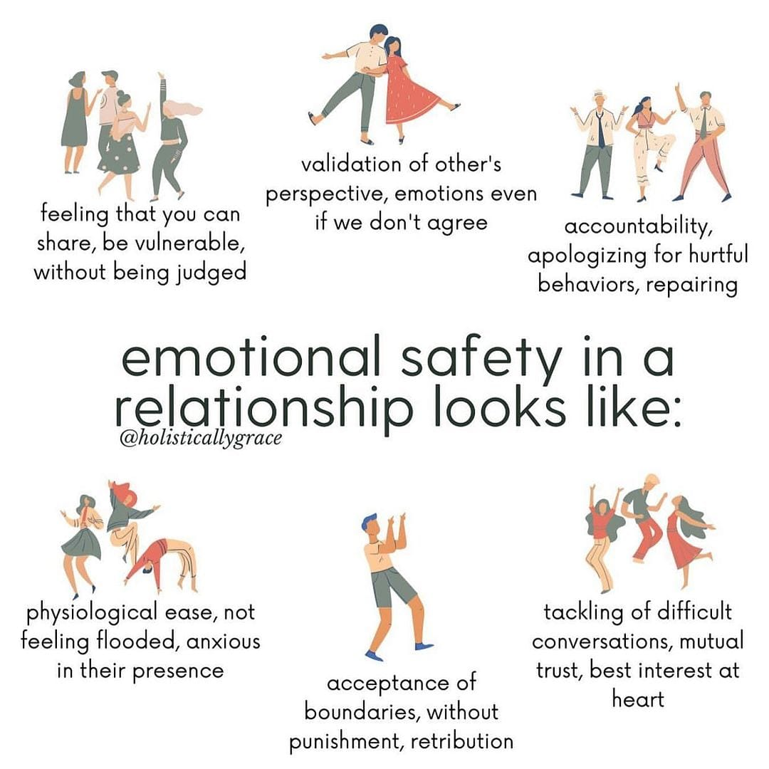
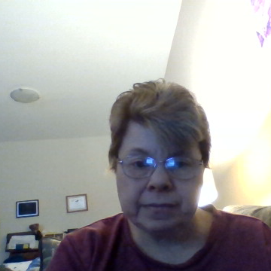

Slide 17

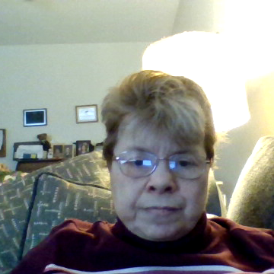
Employment Resources
Job listings for anyone with a disability
AbilityOne.gov helps people who are blind or have significant disabilities find jobs. Job openings are with nonprofit agencies nationwide.
USAJOBS has tips for people with disabilities who want to get a job in the federal government. You can also contact an individual federal agency’s Selective Placement Program Coordinator (SPPC) for help.
JAN, the Job Accommodation Network, answers your questions about workplace accommodations.
https://www.usa.gov/disability-jobs-training
Notes:
Job listings for anyone with a disability
AbilityOne.gov helps people who are blind or have significant disabilities find jobs. Job openings are with nonprofit agencies nationwide.
USAJOBS has tips for people with disabilities who want to get a job in the federal government. You can also contact an individual federal agency’s Selective Placement Program Coordinator (SPPC) for help.
JAN, the Job Accommodation Network, answers your questions about workplace accommodations.

