Slide 1
How to Play this Presentation
Open the presentation in PowerPoint
Wait for slide show to load up ( it may take a minute or two)
Click on arrows at the bottom of screen to go to the next slide or back a slide or click on the next slide in sequence on the left bar.
To hear the voiceover recordings, press on the megaphone or picture on the bottom right corner and press play

Slide 2
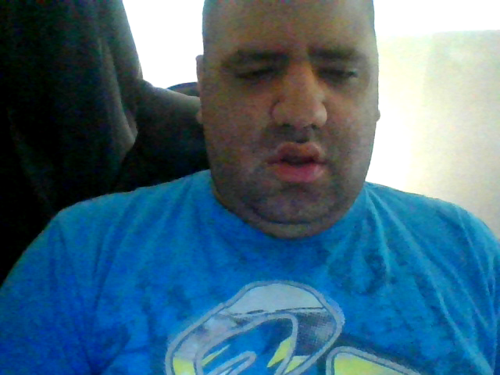
November Virtual Board
Human Rights
By Kevin Arce , Jeremy Powell & Jossie Torres

Slide 3
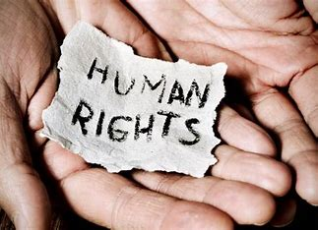
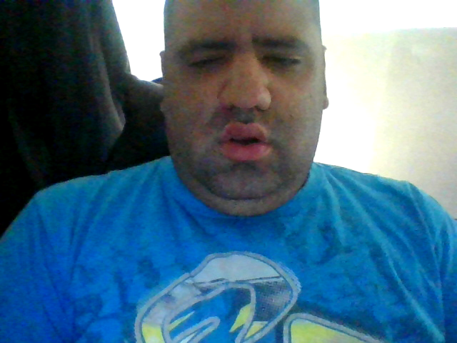
Human Rights
Human rights are the universal rights that every human being has from birth.
No one can take these rights away from you.

Slide 4
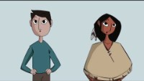
Human Rights Origin

Slide 5
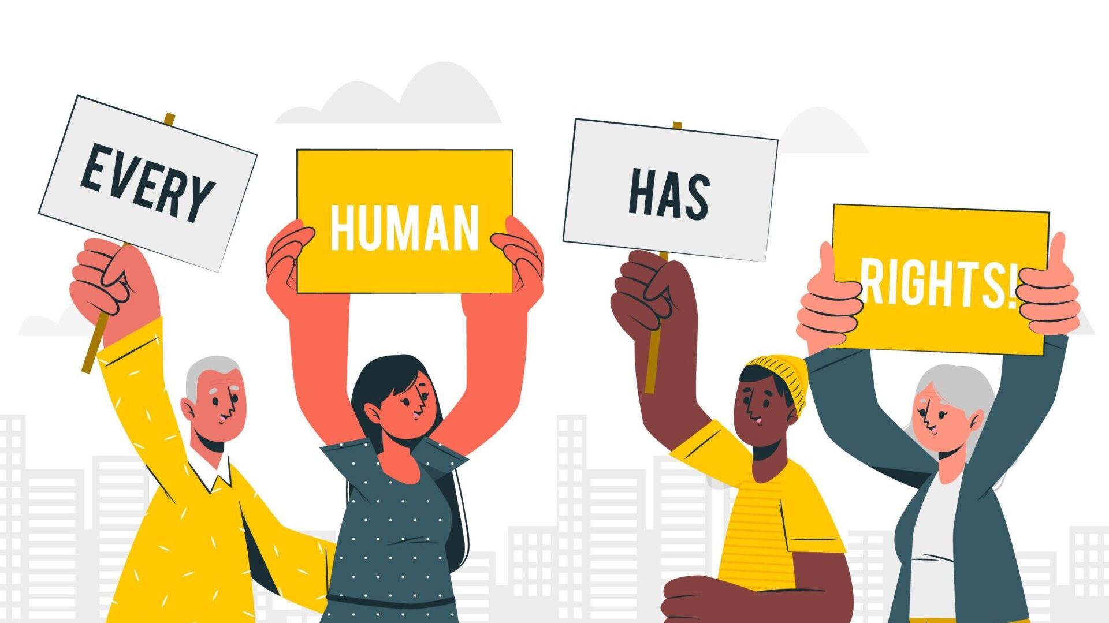

A Right to Choose your Rights
By the SACS of DDS

Slide 6
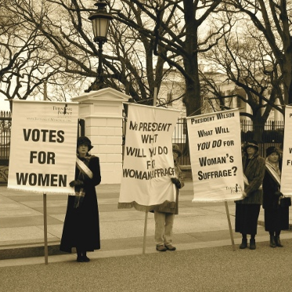

The Right to Choose your Rights under the Constitutional Laws
Is there a right to freedom of choice?
The Bill of Rights of the United States Constitution guarantees individuals the right to personal autonomy, which means that a person's decisions regarding his or her personal life are none of the government's business.

Slide 7
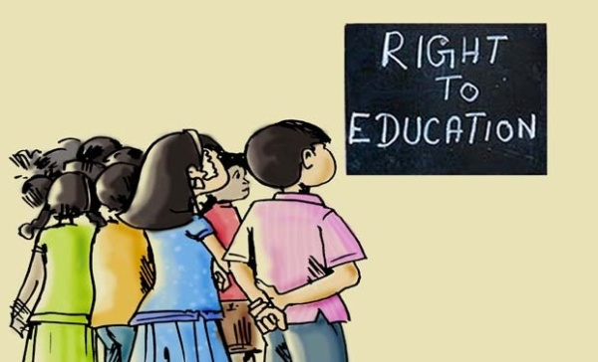
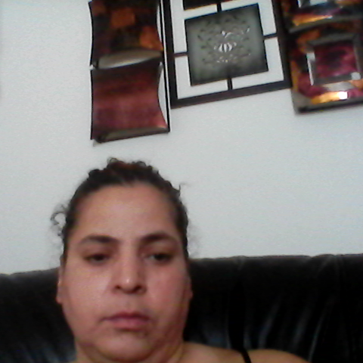
What are human rights? | Equality and Human Rights Commission (equalityhumanrights.com)

Slide 8



A video of the Right to Choose
https://youtu.be/gKcBWUfyvlI?si=DuaOP8kILGdYxErn

Slide 9
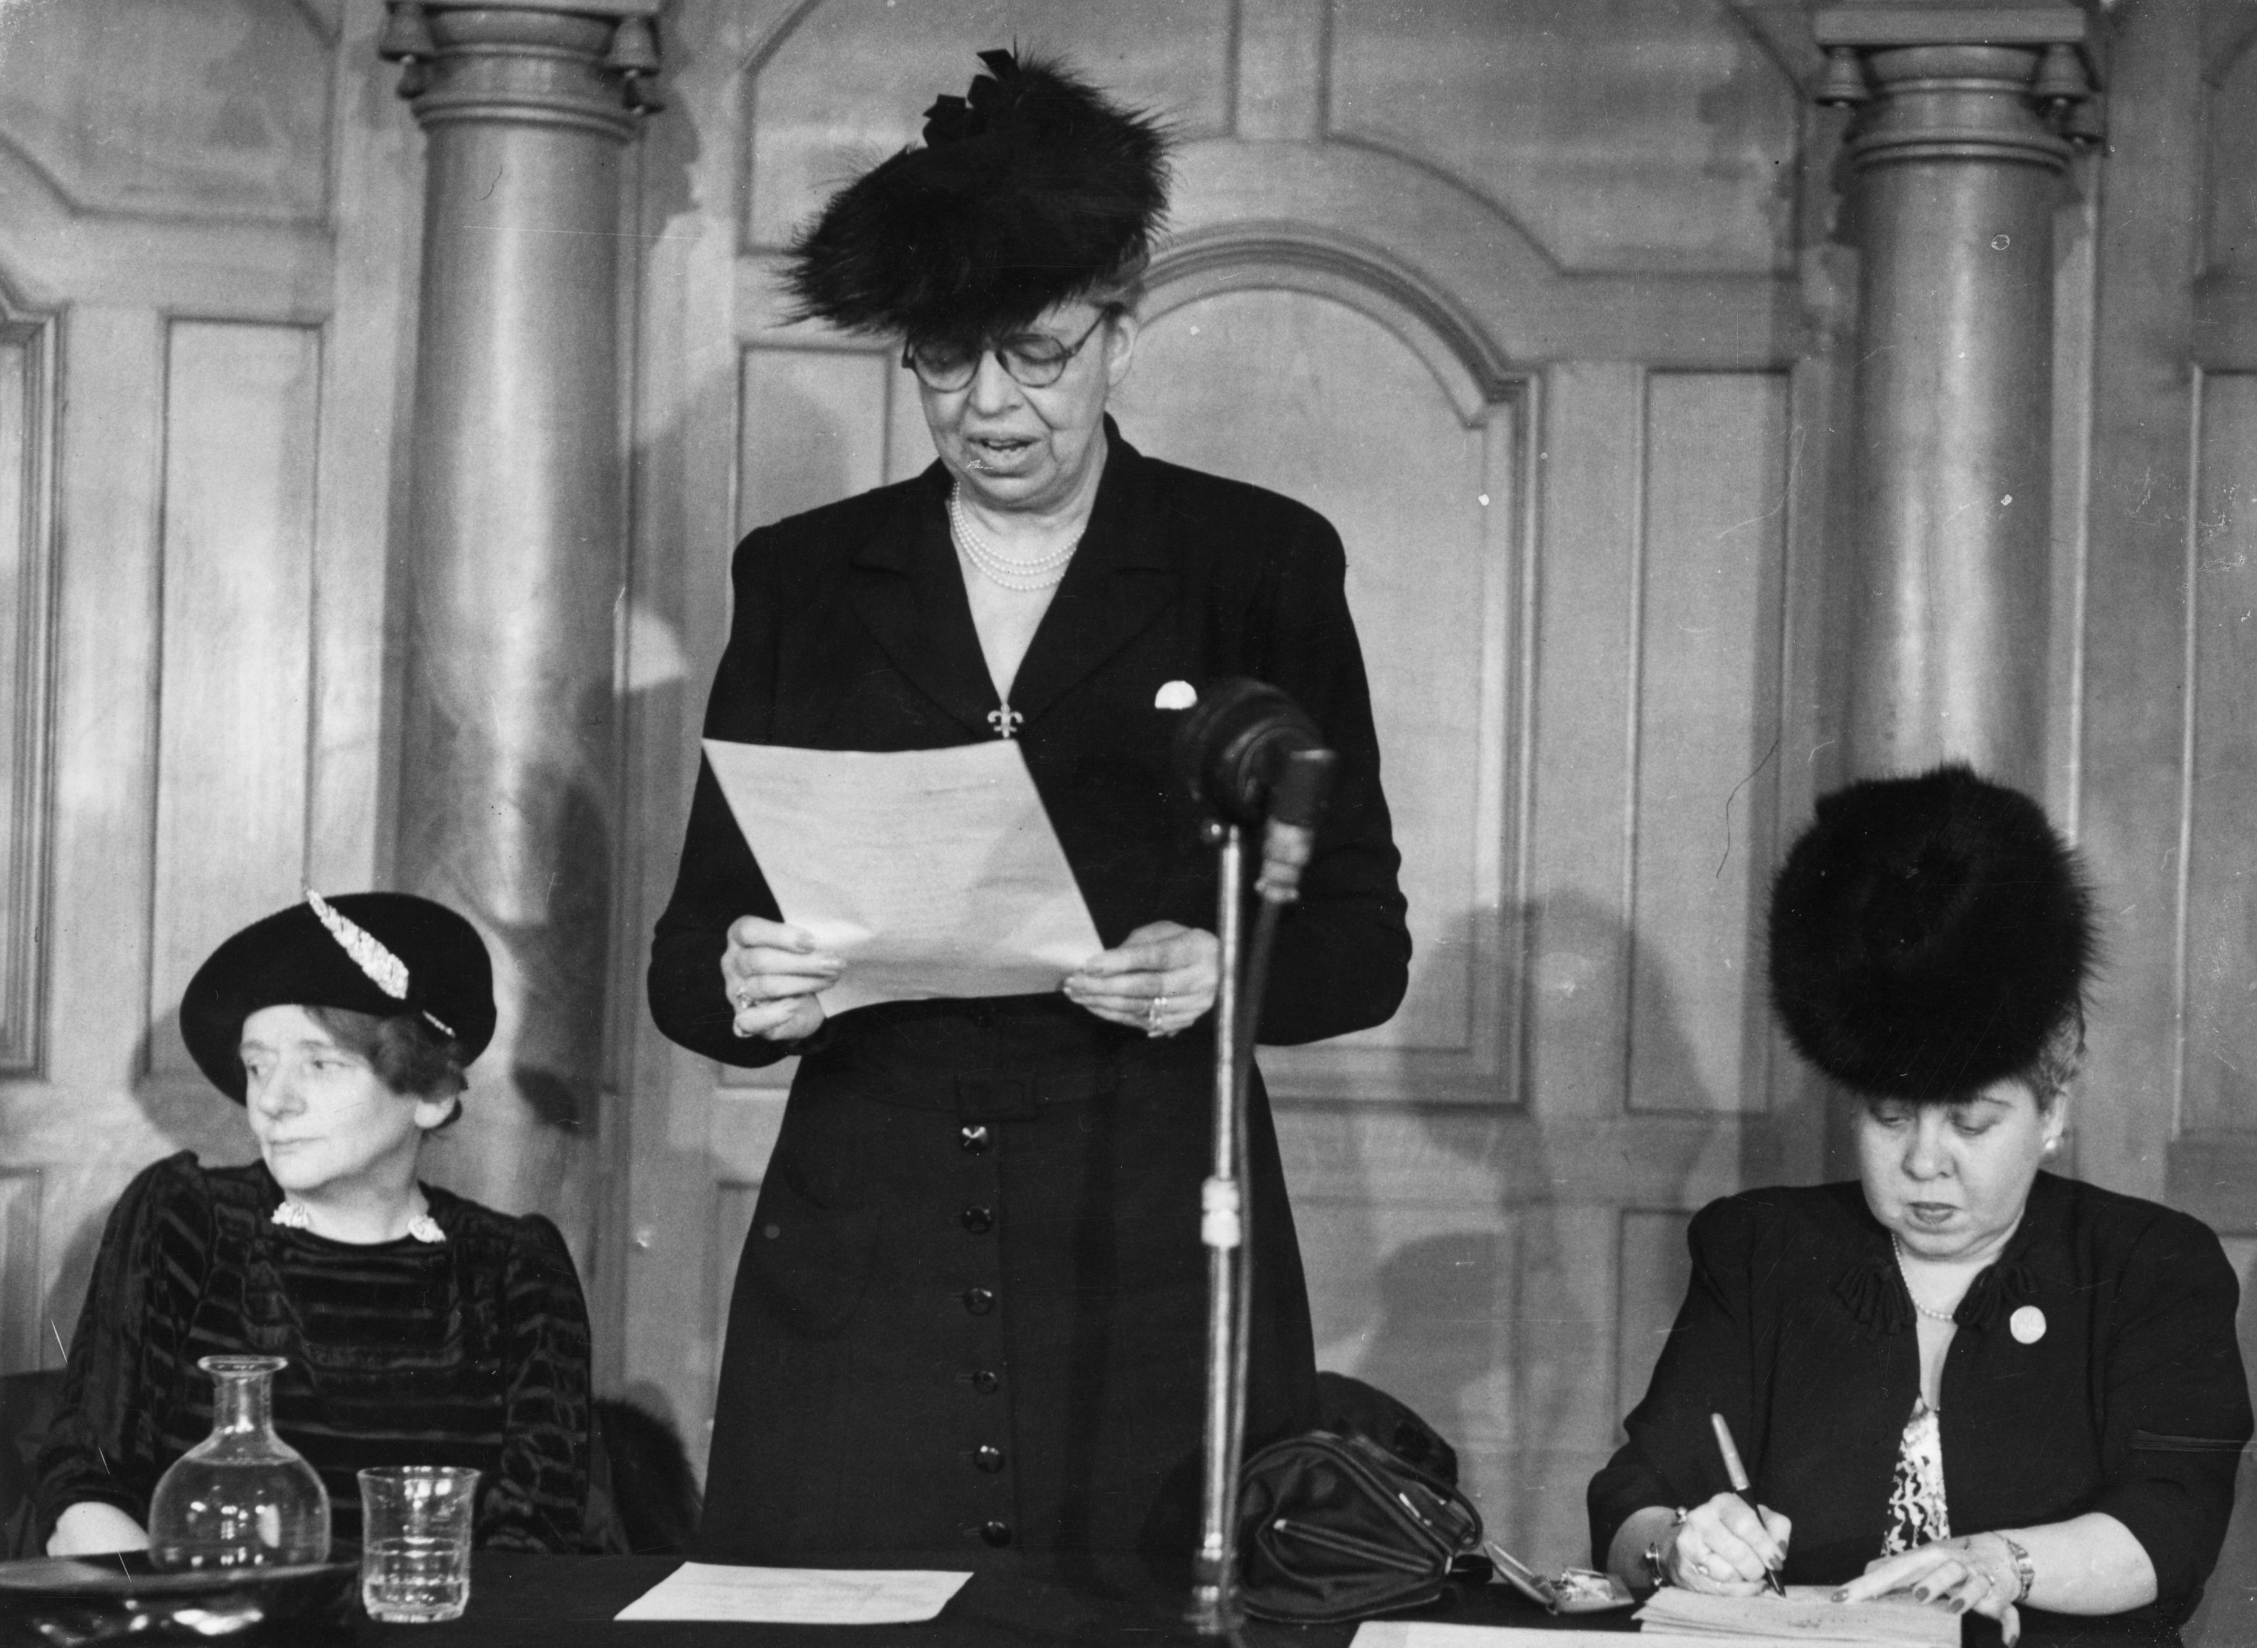
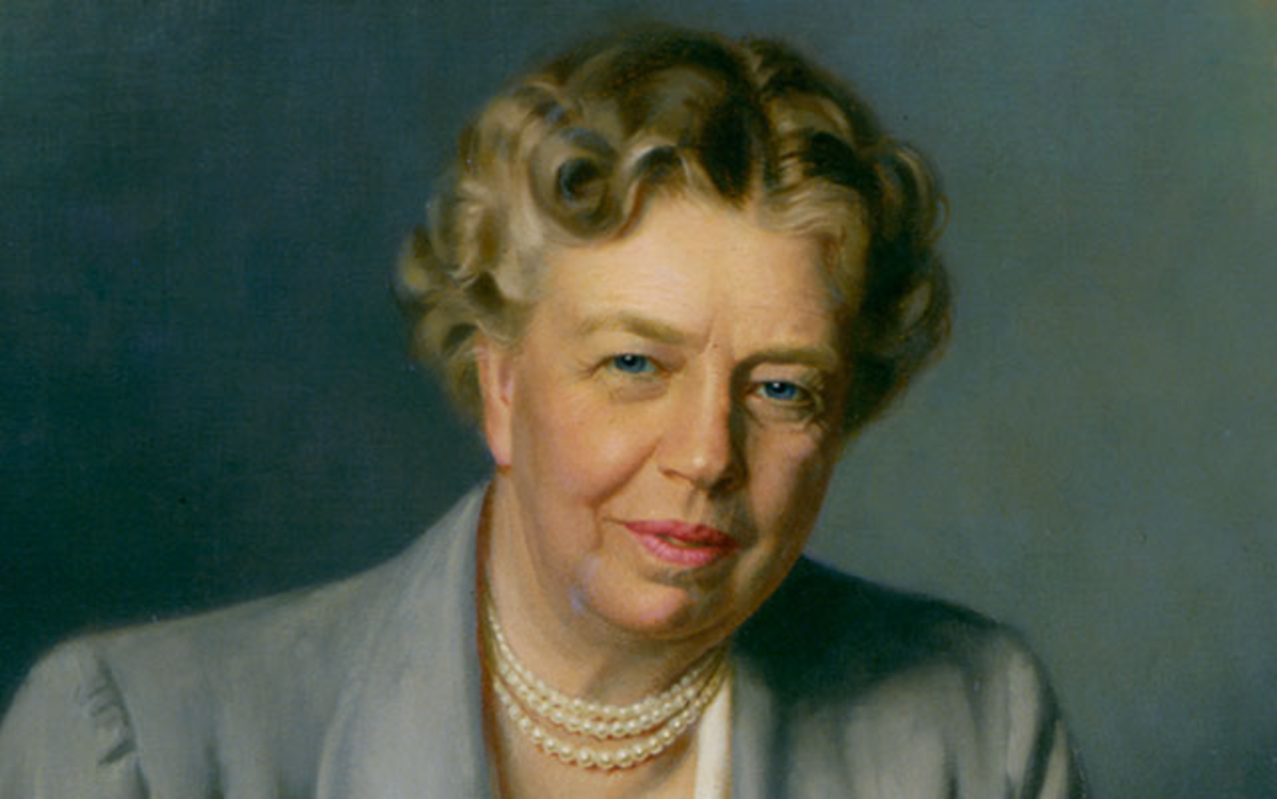
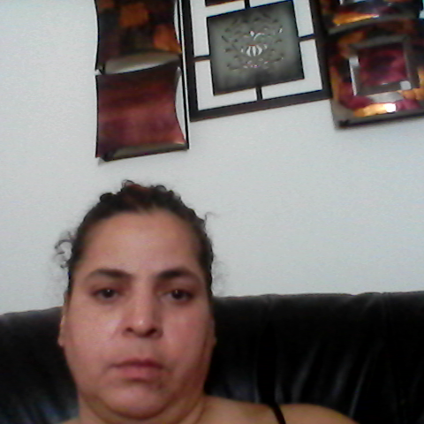
Video on: Everyone Has the Right: Eleanor Roosevelt and the Universal Declaration of Human Rights
https://youtu.be/KDPriYA3E4I?si=6vwdcZH4hhkiTBPq

Slide 10
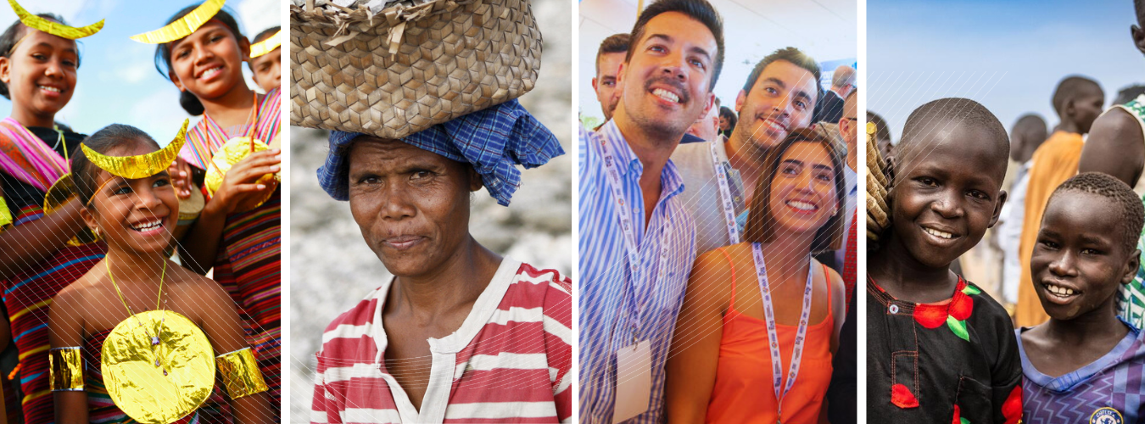

Video on Human Rights Day!/ Diversity Video
https://youtu.be/EWUS8WpFGu0?si=OsAhO0rJw_nxmiTF
https://youtu.be/maw6hmlNh44?si=HQOmmNKACeoTeshb

Slide 11
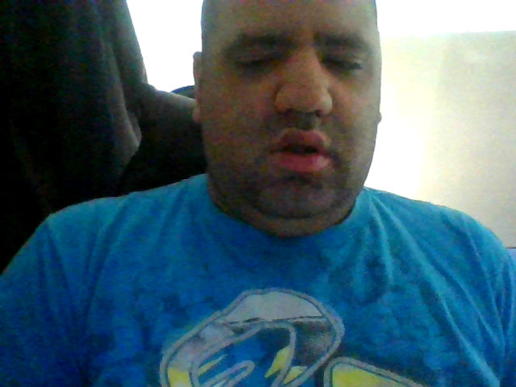
Interacting with Law Enforcement
Law Enforcement are there to help and protect you.
However, just like us, they are not perfect. There will be times when mistakes happen, or they may not know how to help someone with a disability stay calm.

Slide 12
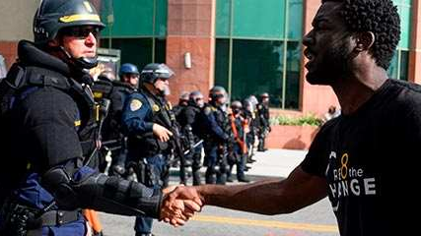
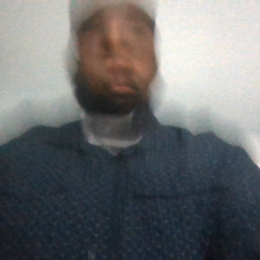
Interacting with Law Enforcement
Authority
Treatment of Minorities

Slide 13
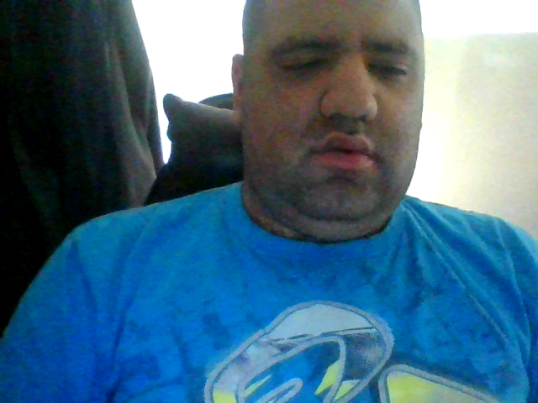
Law Enforcement
The most important thing to remember when you are stopped by the police is to stay calm. Make sure you have your hands in front of you and answer the questions they have.
There are certain rights you have when being stopped by the police.

Slide 14
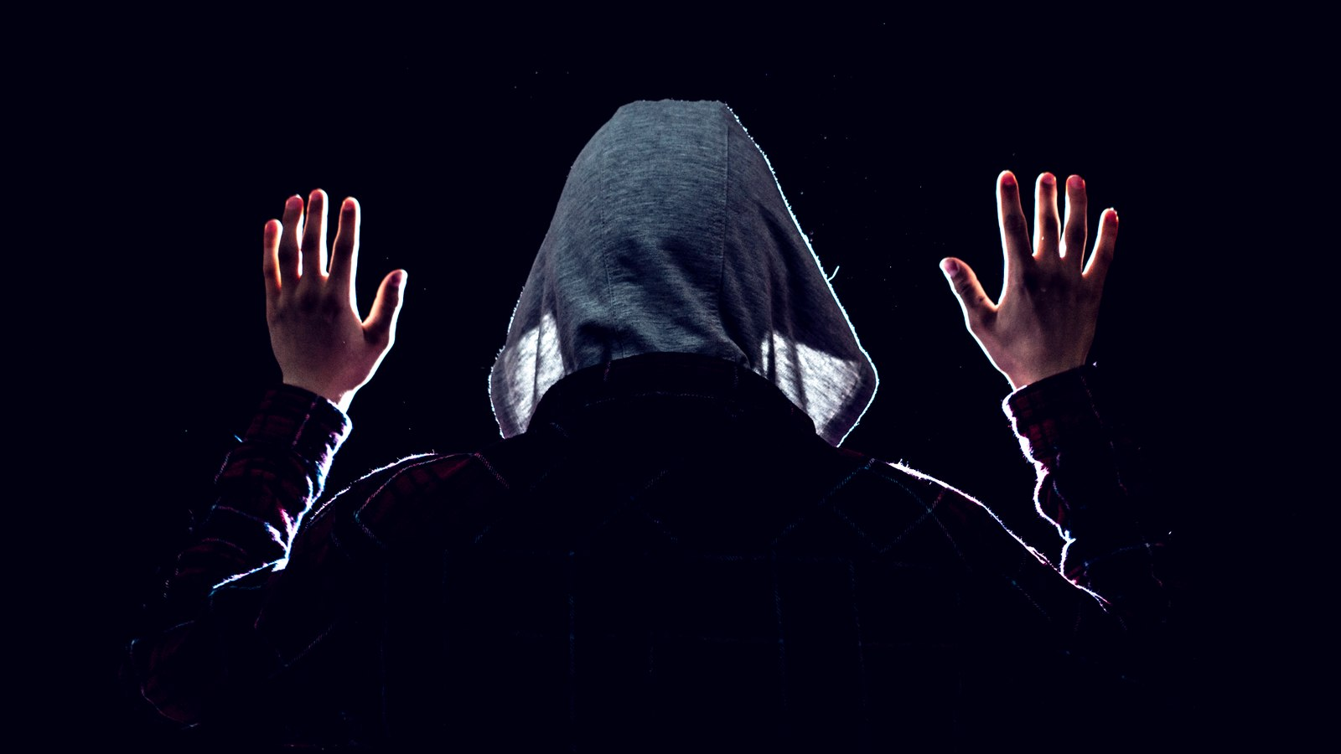
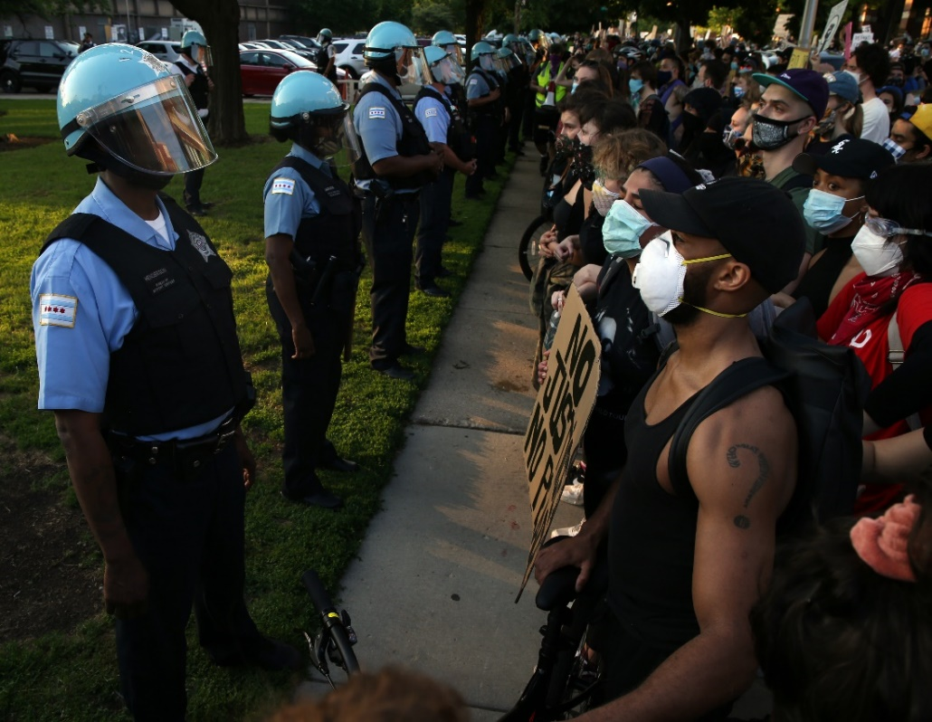
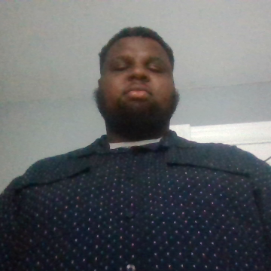
Interacting with Law Enforcement
Not all cops are bad police officers
Always keep your hands where they can see them. Don’t reach for anything without letting them know. Don’t give them a reason to let them think their life is in danger.
We as people are sometimes of afraid of cops because they have the ability to end a life.
Make sure to have a recording when interacting with the police.
When interacting with police officers always stay calm.
You have the right to not speak unless a lawyer is there.
You have the right to decline your vehicle to be inspected by
law enforcement .

Slide 15
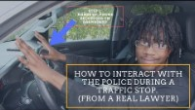

Slide 16
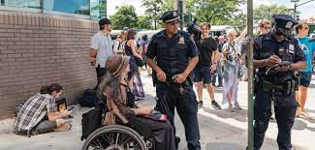
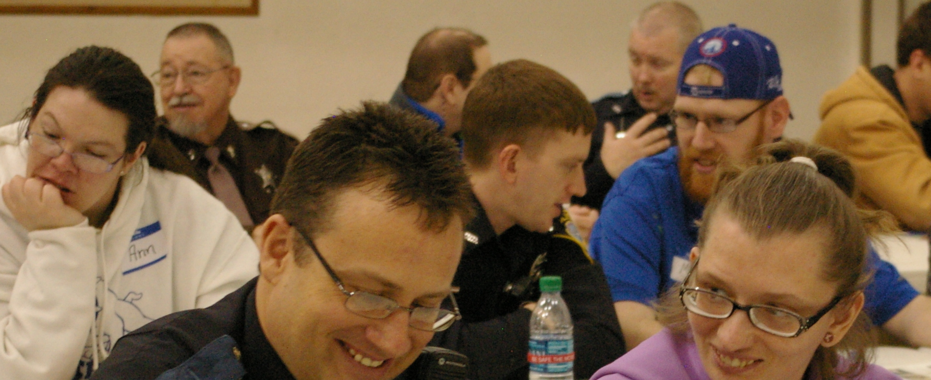
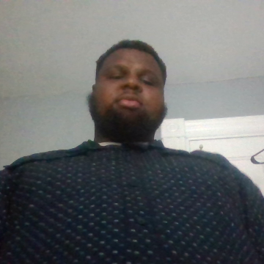
Interacting with Law Enforcement with People with Disabilities
Be mindful of what behavior the individuals is having when interacting with cops.
If there is a staff member with them help advocate for them.
Let the police officer know if they are nonverbal or have behavior problems.
People with disabilities are afraid of calling or dealing with cops.
Help the cops understand when an individual has a behavior issue, it doesn’t mean they are aggressive

Slide 17
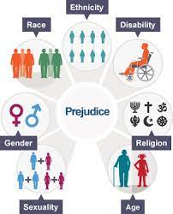
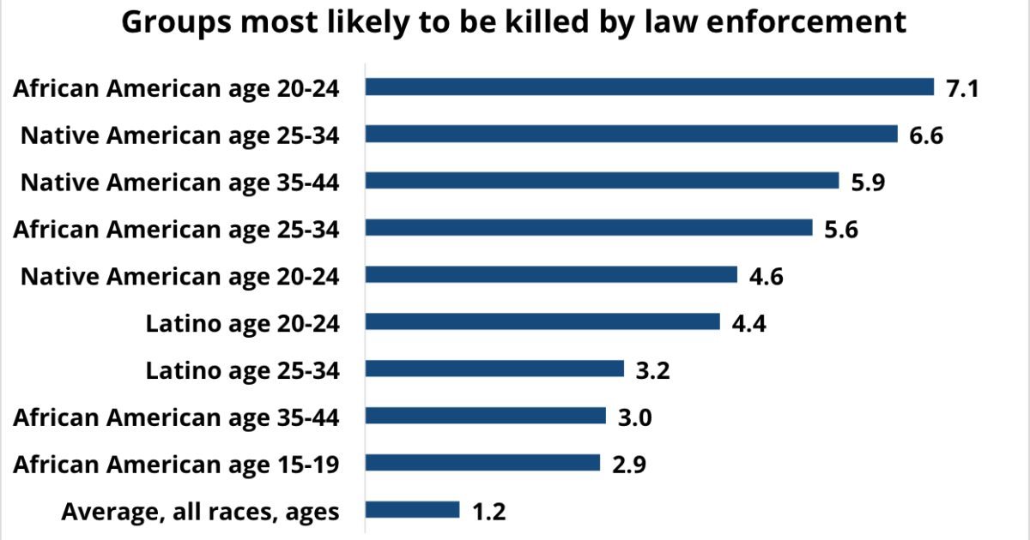
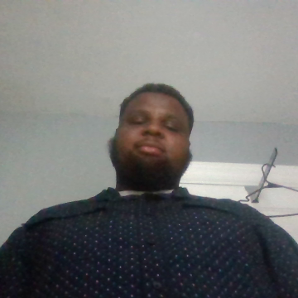
Authority
Treatment of Minorities
We as minorities get looked at and treated differently than the average person does.
Minorites aren’t always bad. We are good people.
We get judged based on our color of skin.

Slide 18
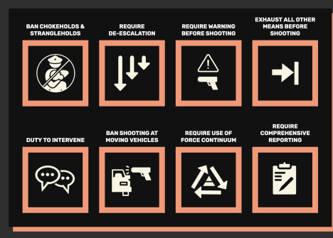
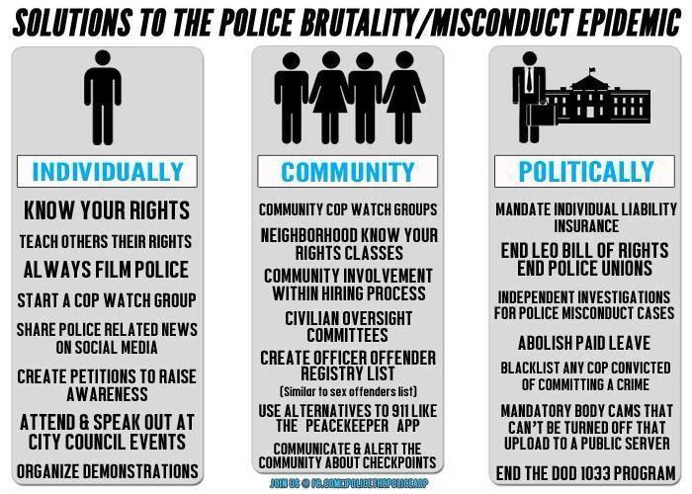

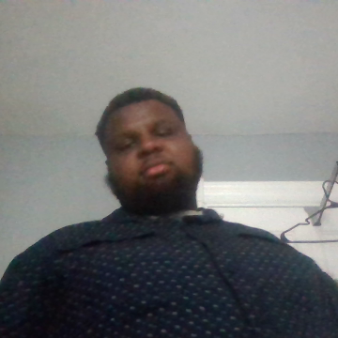
How to Prevent Police Brutality
Restricting or banning chokeholds and strangleholds.
Think of other ways to train cops on how to interact with people of races and color.
Don’t look at skin color because we all are human beings. Holding police officers accountable for their actions.
Restrictions on them pulling their gun at first when Interacting with people or not holding their gun waist.
Just remember everyday or month we as people are being targeted for police brutality just because we look different.

Slide 19







