Slide 1



How to play this PowerPoint
Open the presentation in the desktop version of PowerPoint.
Wait for slide show to load up ( it may take a minute or two)
Go to Slide Show in the toolbar
Click on the option that says From Beginning
Viola!
To watch videos, double click on video picture or the megaphone symbol
Click on arrows at the bottom of screen to go to the next slide or back a slide.
Notes:
April VBB

Slide 2
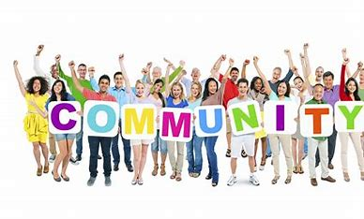

July Virtual Board
By Kevin Arce, Paige Librandi and Jossie Torres.
Notes:
This our presentation, connecting with communities and how that connection benefits our community as well as our selves.

Slide 3


Connecting with your community
The Importance of Connection and Community - Mind the Product

Slide 4

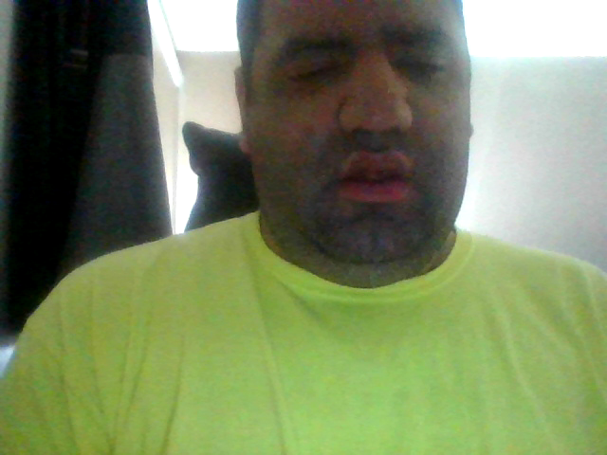
What the community can give you.
6 Meaningful Ways to Give Back to the Community | CaringBridge

Slide 5
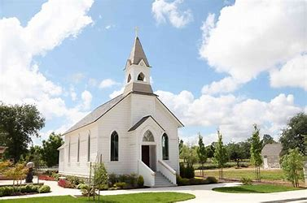



Spiritual connections
People who are part of a spiritual group feel that they are happier, and more content.
Having the personal support you need in times of stress is extremely important.
Regardless of your beliefs, the sense of belonging and connection helps improve your overall well being.
Support of compassion, understanding, and acceptance within these groups helps nurture community involvement and connections.
Notes:
Being part of a

Slide 6


5 Benefits of Volunteering
Many nonprofit organizations rely on volunteers to accomplish their mission.
Some smaller organizations might even depend only on volunteers for their first few years of operation.
Volunteers are so important to nonprofit organizations that they would not be able to do their dynamic work without the power of volunteer work.

Slide 7
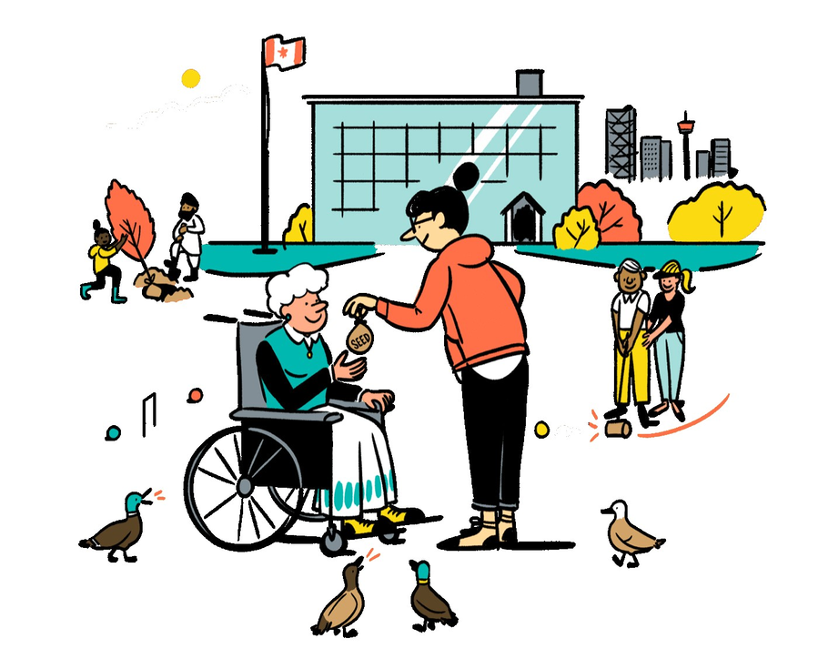

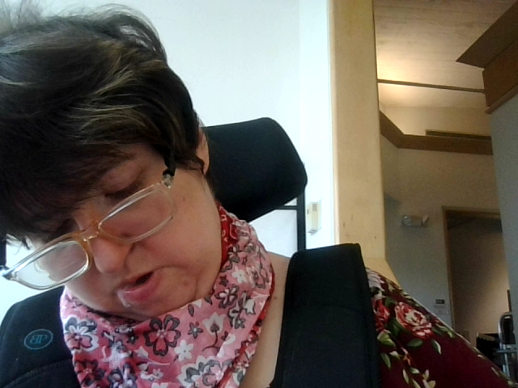
1. Builds Strong Communities
When you volunteer, you make connections with other volunteers to tackle challenges facing your community.
Even helping out with a small task can make a big difference in the lives of others.

Slide 8

2. Increases Socialization
Loneliness and social isolation are two severe rises in the world today that can lead to major health risks.
Although loneliness can affect anyone, older adults have a higher risk for loneliness and social isolation because they are more likely to face factors such as living alone and the loss of family or friends.
Volunteering connects people and helps strengthen bonds between friends, family, and coworkers.

Slide 9


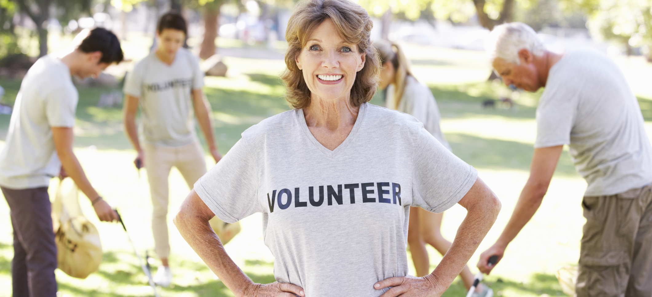
3. Improves Self-Esteem
Volunteering can be life-changing in many ways, especially for those who suffer from low self-esteem.
Helping others and the community can boost confidence by providing a sense of accomplishment.
Volunteering can also give you a sense of pride and identity.

Slide 10




4. Provides a Sense of Purpose and Direction
Volunteering can add new meaning to the lives of young people who haven’t yet found their path and older adults, especially those who have retired or lost a spouse.
Regardless of your age or life situation, volunteering can help take your mind off your worries.
Volunteering keeps you mentally motivated and adds more zest to your life.

Slide 11
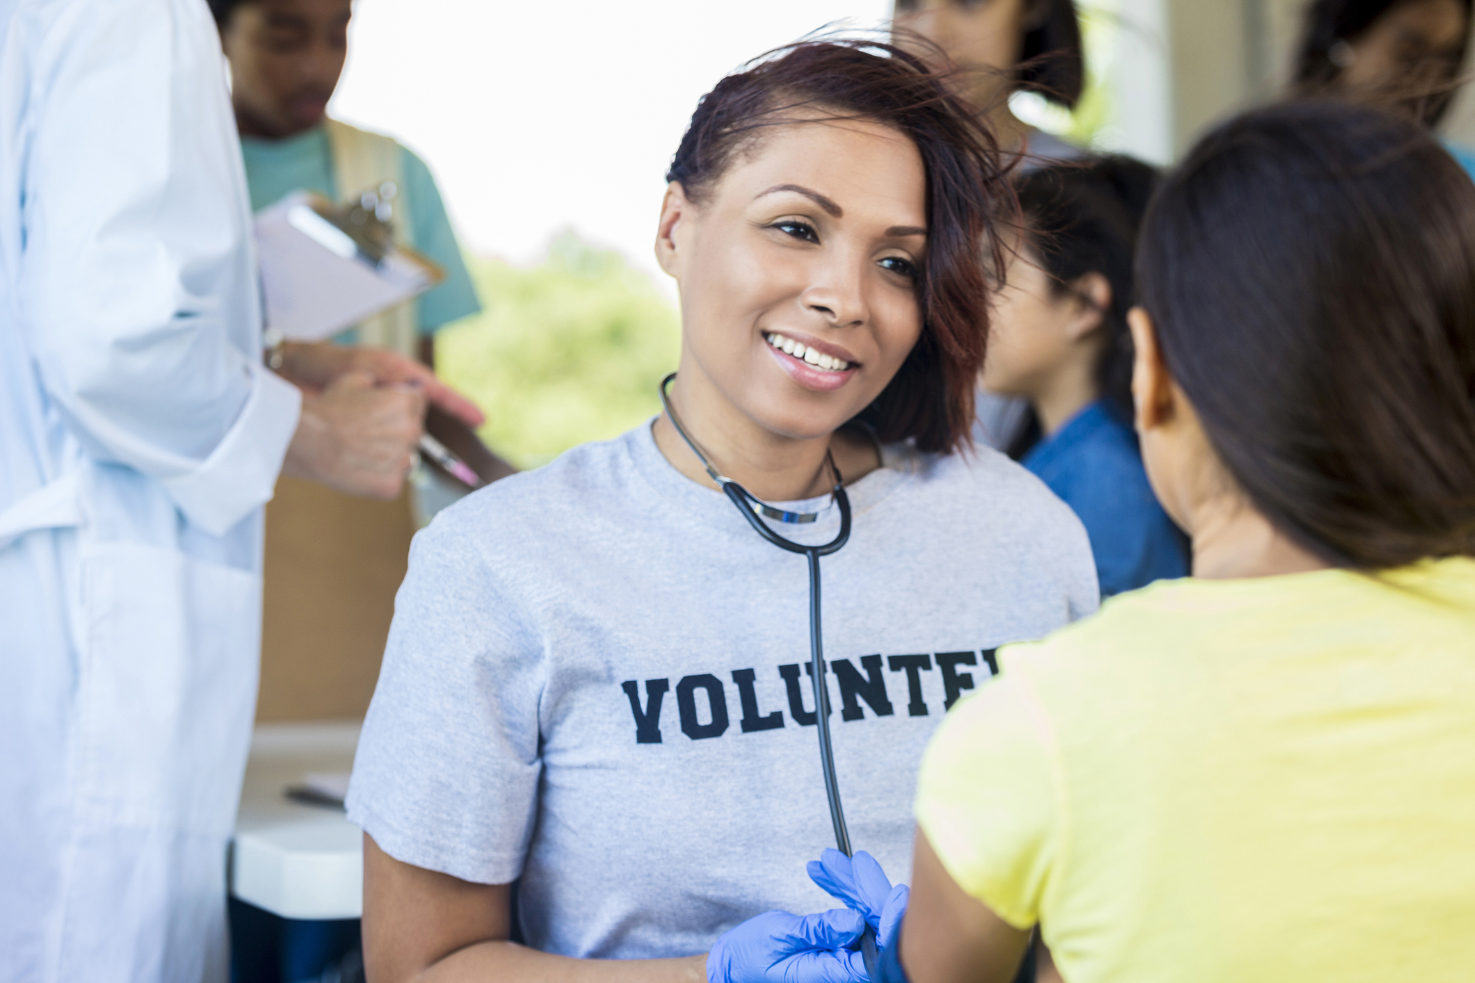
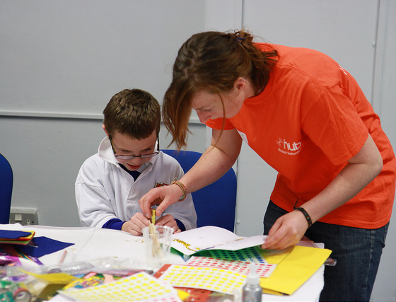
5. Improves School and College Experience
Young people still in school gain social skills and develop awareness as volunteers.
It can also boost college applications, and job resumes.
Volunteering can also help college students improve their job search post-graduation.

Slide 12



Self-advocacy is the ability to speak-up for yourself and others and the things that are important.
Self-advocacy has three key elements:
  Understanding your needs
  Knowing what kind of support, you might need
  Communicating these needs to others
Self-Advocacy
Notes:
To connect to the community you need to advocate for yourself, and understand and communicate your needs.

Slide 13

Advocacy
Employment
Self-advocacy means taking the initiative to communicate your needs and wants to others in order to support your overall well-being. By advocating for yourself at work, for example, you can develop a plan to achieve your goals.
Employment is an agreement between an employer and an employee that the employee will provide certain services. In return, the employee is paid a salary or hourly wage. Although employees can negotiate certain items in an employment agreement, the terms and conditions are primarily determined by the employer.
Notes:
Both Advocacy and employment are important parts of community connections Advocating for yourself can help you make the most of community resources. Employment serves as a bridge to community.

Slide 14


Employment Website Resources
Jobs, Employment in Connecticut | Indeed.com
Careers and Career Information - CareerOneStop
LinkedIn: Log In or Sign Up
CareerBuilder Employer's Products | CareerBuilder for Employers
2023 Monster.com Reviews: Job Posting Sites (consumersadvocate.org)
https://youtu.be/QBlEPmOhvuQ
Notes:
Here are some resources

Slide 15
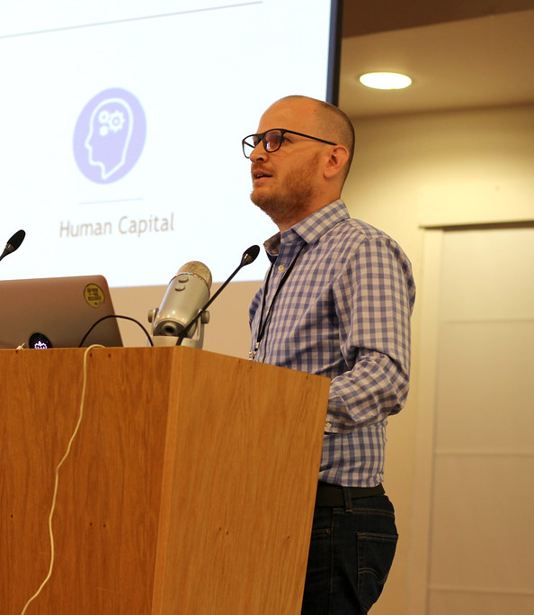

A 2023 Connecticut Employment Summit
https://youtu.be/9VrvqOzrXSI
This Photo by Unknown author is licensed under CC BY.
Notes:
Here is a great video about the employment 2023 Summit

Slide 16
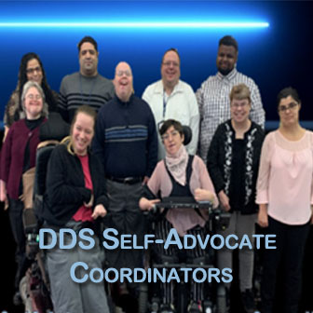

Advocates' Corner (ct.gov)
Notes:
And here is the Advocates corner for more information on Advocacy and more or assistance on finding SA groups in your area, and connecting to the community through these SA Groups..

Slide 17


Thank you for viewing our presentation for more info please contact jossie.torres@ct.gov, paige.librandi@ct.gov, kevin.arce@ct.gov.

