Slide 1
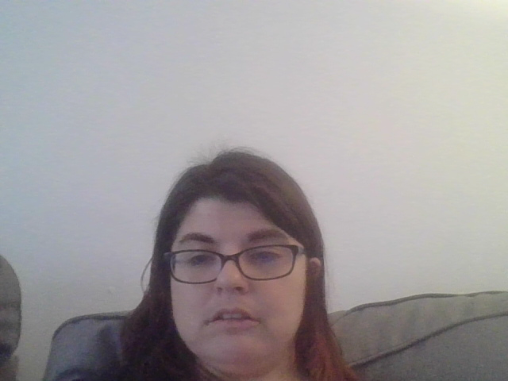
As A Voter With A Disability You have the right to…
Have someone help you vote.
To be able to vote in a location that is accessible to you
To be able to have an alternate format for your ballot that is accessible to you ( for example braille, large print or audio)
To be able to vote by mail if you cannot get to your polling place or its not accessible to you.
If you have concerns about voting or feel that you were discriminated against at the polling place, please call Disability Rights CT at
(800) 842-7303 (toll-free in CT)
(860) 297-4300 (voice)
(860) 509-4992 (videophone)
Notes:
Yana

Slide 2
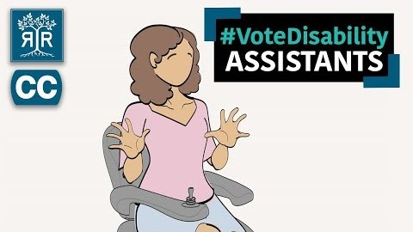

Slide 3
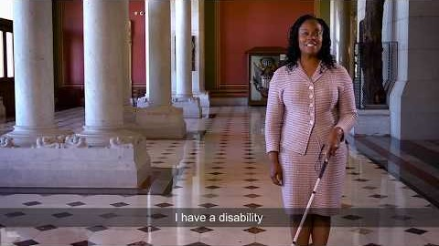

Slide 4
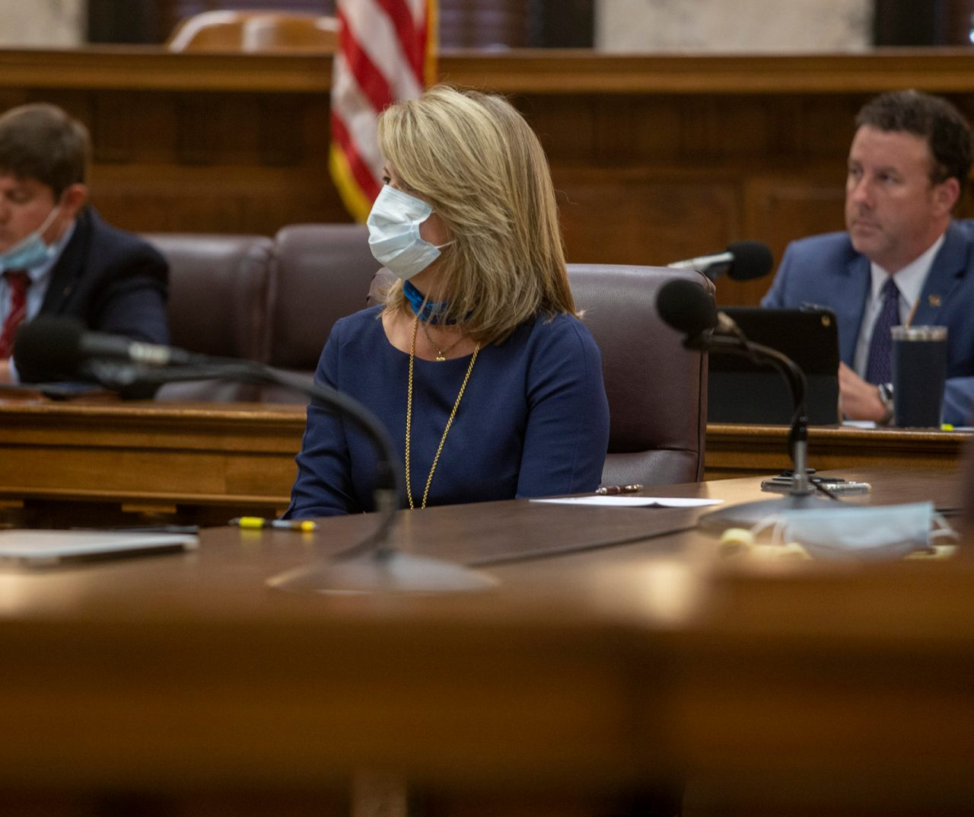

The Stages a Bill takes as It Moves Through Congress

Slide 5
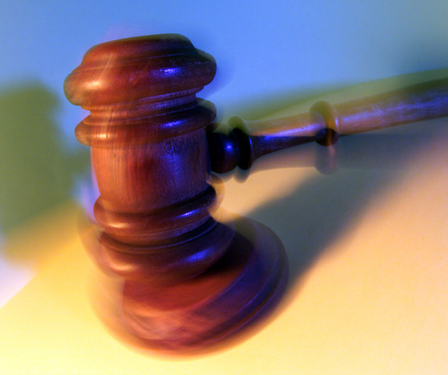
How to work with your legislator's step by steps

Slide 6
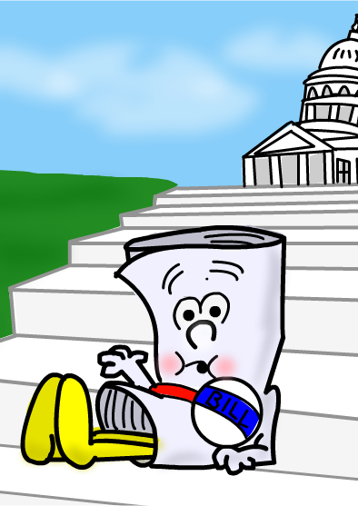
Step #1
First Steps: Introducing the Bill
The bill is drafted. A bill can be drafted by anyone but must be sponsored and introduced by a member of Congress, then presented in either the House or Senate. The president or a member of the cabinet may also draft a bill, but a member of Congress must introduce it. When a member of Congress chooses to introduce a bill, he or she becomes a sponsor of that bill.
The bill is introduced and then goes to the appropriate committee or committees, where it is studied, and its chances of passing are determined.

Slide 7

Step #2
The Bill in Committee Review
Intel's 3 steps in one
The bill is introduced and then goes to the appropriate committee or committees, where it is studied, and its chances of passing are determined.
The subcommittee "marks up" the bill, making changes and amendments, then reports to the full committee. The bill can be killed if the committee takes no action on it
The committee debates, then votes on its presentation of the bill to the full House or Senate, a process called "ordering the bill to be reported."

Slide 8

Step #3
The Bill Goes to the House and Senate
After committee debate and approval of amendments, the bill is scheduled for consideration on the floor of the chamber, which will usually debate and then vote to either pass or defeat it. If it is passed in one chamber it is called an "act."
After a bill is passed by either the House or Senate, it is then referred to the other chamber where it will go through similar committee and floor actions (except when the other chamber is already considering its own similar legislation). That chamber may then approve, reject, ignore or change the bill.
If there are significant differences between versions of a bill passed in both houses, a bicameral conference committee attempts to reconcile the differences between House and Senate versions -- the two houses must approve identical versions. A report with the committee members' requests for changes is given to both the House and Senate for approval. If they do not agree on approval, the bill dies.
This is a three- step process

Slide 9

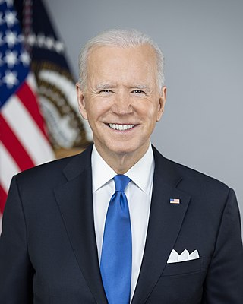
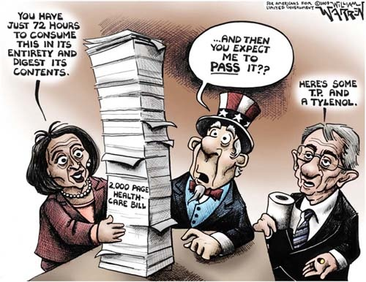
Step #4
Last Stop: The President
The approved bill is sent to the president for review, and becomes a law if the president signs it, or if it remains unsigned on the president's desk over a 10-day period while Congress remains in session. If the president doesn’t agree with the legislation, he can veto it and send it back to Congress with an explanation. However, if Congress adjourns within the 10-day period and the bill remains unsigned, it also fails to become law -- this is known as a "pocket veto."
If the president vetoes a bill, Congress has the option of overriding it. The bill goes back to Congress for a vote. If the bill receives a two-thirds majority vote in both chambers, it overrides the presidential veto and becomes law.
Intel's a 2 -step process.

Slide 10

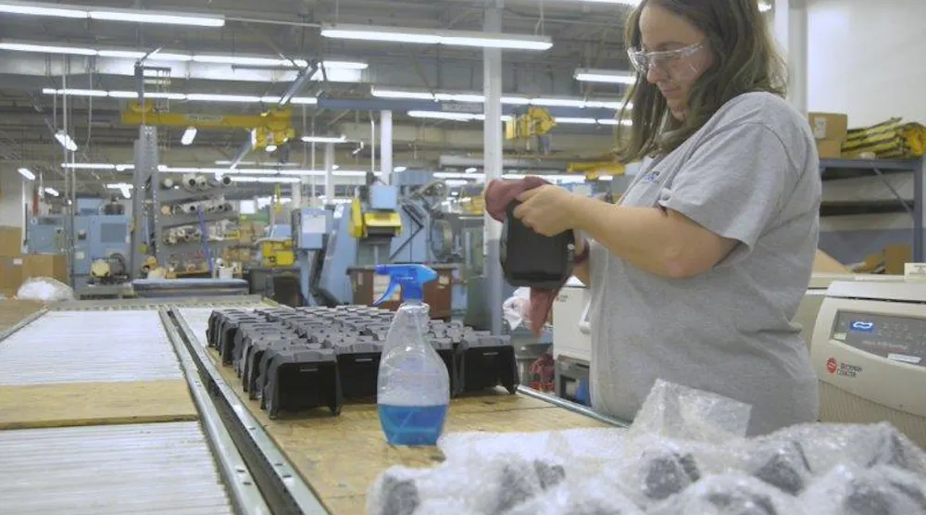
Manufacturers Finding New Sources of Talent |
Talent with disabilities have a wide range of education, degrees, professional certifications, work experience and skills.

Slide 11
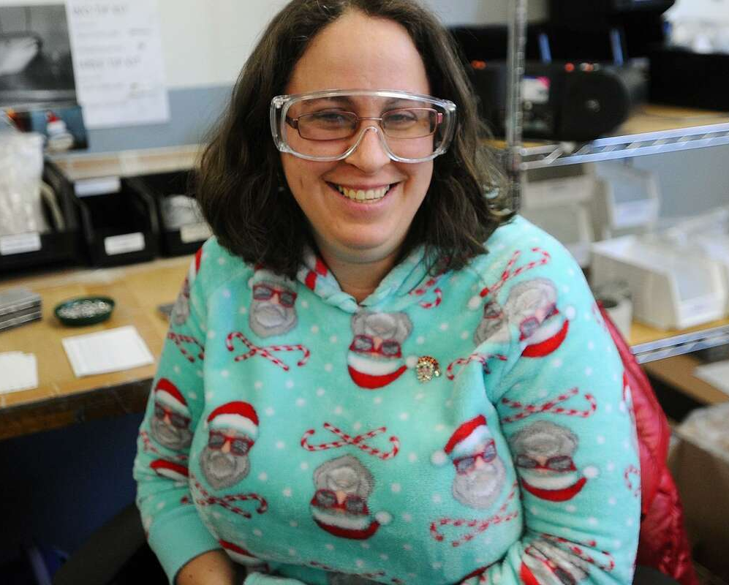
Bethel-based Ability Beyond’s job program helps change lives (newstimes.com)
Ability Beyond Individual Amie Giordano has found a good fit packaging parts used in medical testing at Tier One Machining in Newtown, CT

Slide 12

Collettey’s Cookies The sweetest small business success story | Collette Divitto - YouTube
Collettey’s Cookies the sweetest small business success story
Collette Divitto (born 1990) is an entrepreneur and disability activist based in Boston Massachusetts. Collette’s cookie business is located in Ridgefield, CT.
Notes:
Redo Slide 4 aw voiceover.and share voiceover next week.

Slide 13


Slide 14

Meet Washington's first registered lobbyist with Down syndrome –Kayla McKean

Slide 15

How to Volunteer as a Poll Worker on Election Day | POPSUGAR News
HOW TO VOLUNTEER AS A POLL WORKER ON ELECTION DAY

