Slide 1

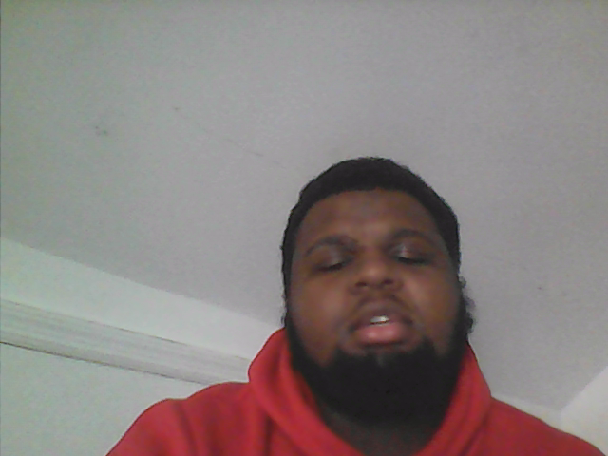
Budgeting
Living better
Being happy
Financially stable
Set a monthly entertainment budget

Slide 2

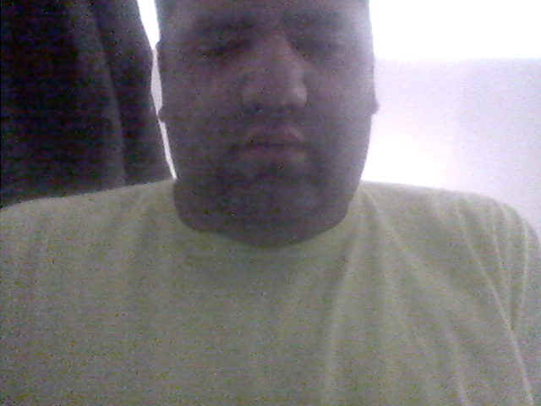
Identity Theft
By Kevin Arce, Jeremy Powell, and Kellie Hartigan

Slide 3
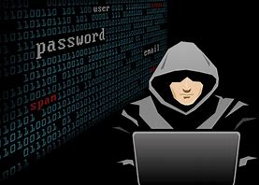
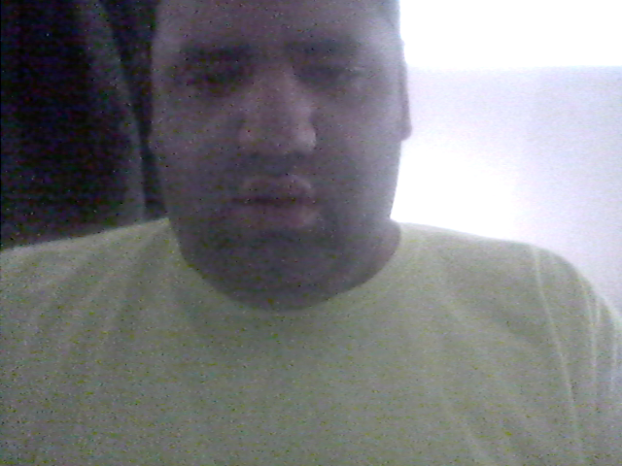
If someone learns your personal information, they can use that information to access your finances, or, bank account, and use all of your money under your name.

Slide 4
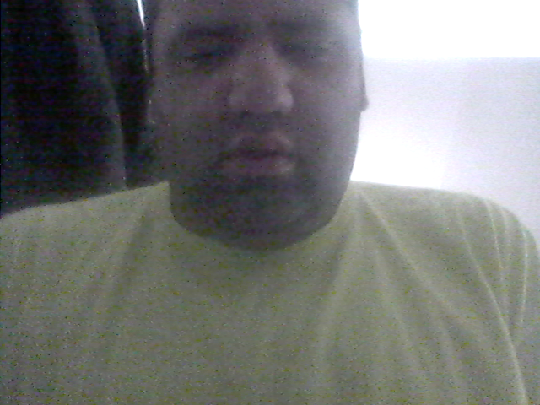
What is Identity Theft?
It is when someone steals information, money, etc., under your name.
Identity theft is against the law.
It’s also why you should keep personal information a secret and not share it with anybody.

Slide 5

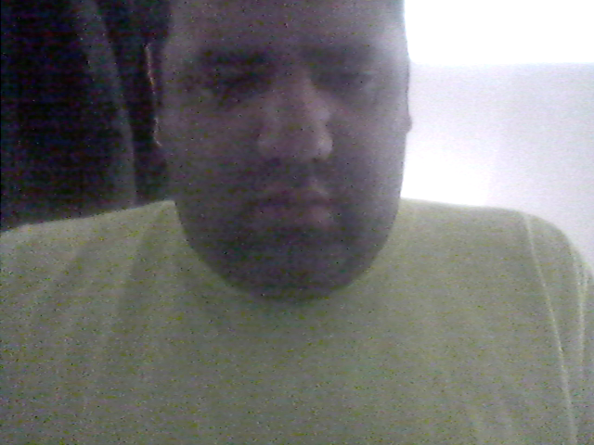
In Conclusion
Keep your personal info safe, do not share it with anyone, and know it all by heart. These steps can help you prevent identity theft and protect the important things in your life.

Slide 6
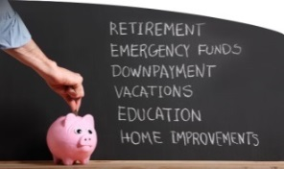






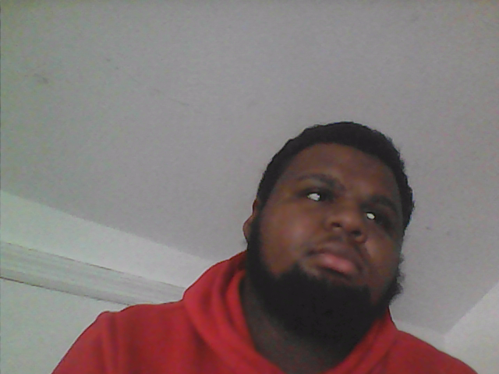
How to Create Better Spending Habits
Don’t buy food when you can bring food from home
Stop shopping impulsively
Cut back on online shopping
Avoid your spending triggers
Start Small. Think “big,” with a short-term goal
Don't just save money, save for your future
Cut ties with cable. Most people are using fire sticks. Also, Netflix and Hulu are the most popular apps to use for T.V. shows and movies.

Slide 7

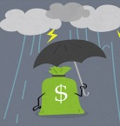

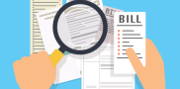
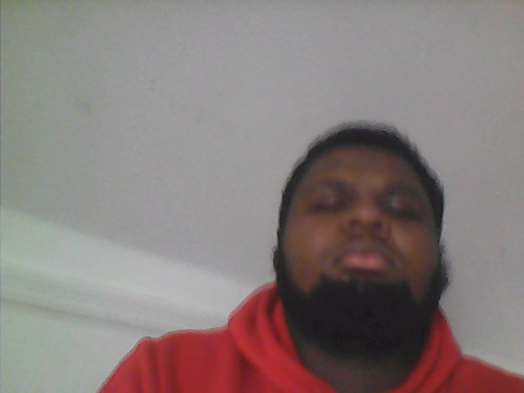
Why is it important to manage your money?
Saving for a rainy day/ emergency funds
You won’t overdraft your account or go into debt.
You can get a cheaper service if you compare prices.
Feel excited when you save your money into a savings account

Slide 8
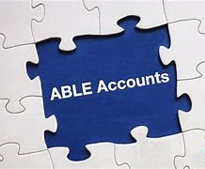

ABLE ACCOUNTS
For the first time in public policy, the ABLE Act recognizes the extra and significant costs of living with a disability.
ABLE Accounts are tax-advantaged savings accounts for individuals with disabilities and their families.

Slide 9

Am I eligible for an ABLE account?
The ABLE Act limits eligibility to individuals with significant disabilities. Under all circumstances, the onset of the disability must have begun prior to age 26.
If you meet this age criteria and are also receiving benefits already under SSI and/or SSDI, you are automatically eligible to establish an ABLE account.

Slide 10
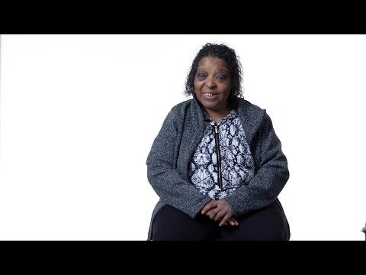
https://www.youtube.com/watch?v=Zkiydp7VCXk

Slide 11
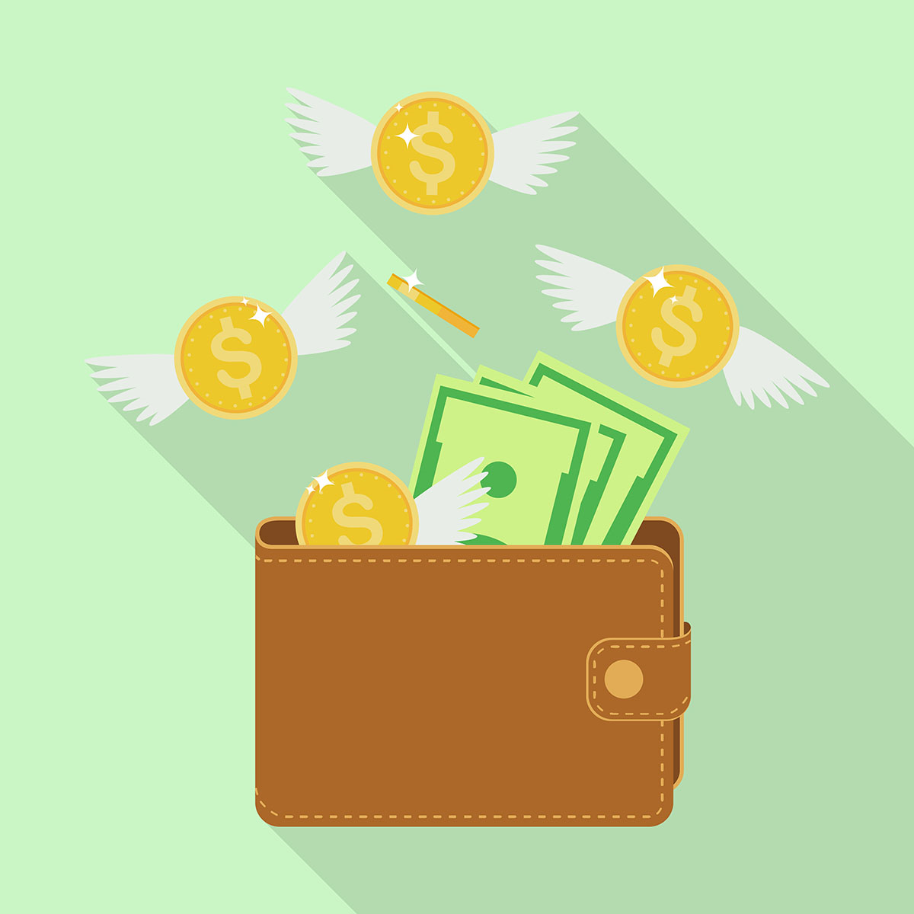
ABLE ACCOUNTS
QUICK FACTS:
The ABLE Act limits the opportunity to one ABLE account per eligible individual.
An ABLE Account will provide more choice and control for the beneficiary and family.
A "qualified disability expense" means any expense related to the designated beneficiary as a result of living a life with disabilities.

Slide 12
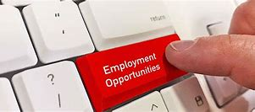
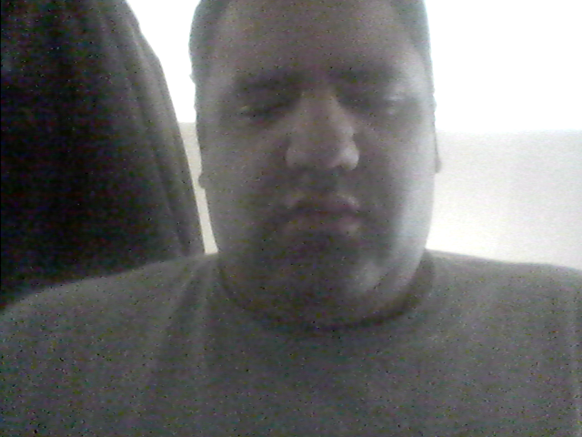
Employment, skills and education - YouTube

Slide 13
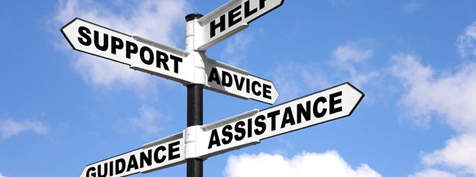
SELF ADVOCACY
Self-advocacy is the ability to speak-up for yourself and the things that are important to you!
SPEAK UP!
SPEAK OUT!
Self-advocacy means you are able to ask for what you need and want.

Slide 14
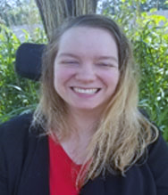
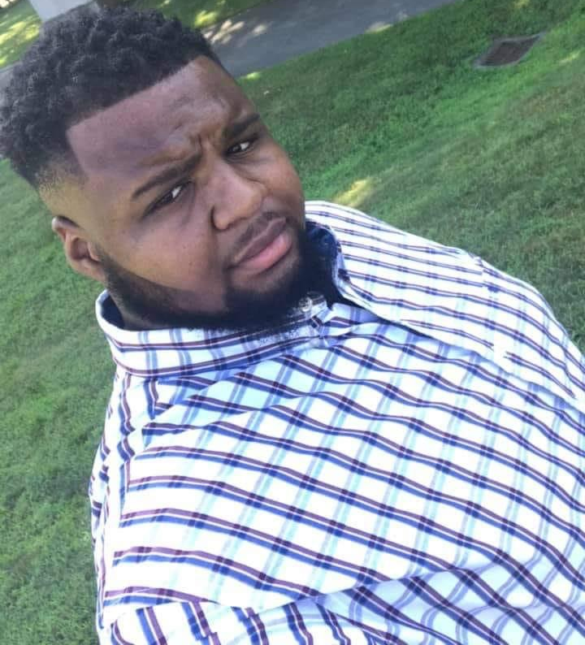
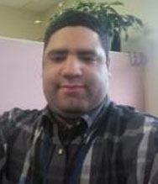
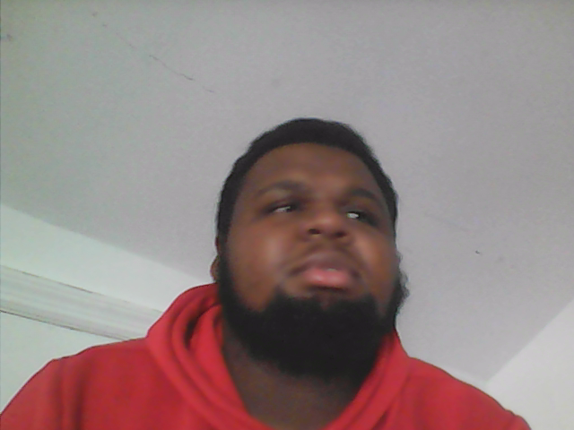
By the DDS Self-Advocates Coordinators
Kevin, Kelli, Jeremy
Remember Speak up Speak out loud

