Slide 1


Rights and Diversity
Human Rights, Interacting with Law Enforcement and Diversity.
Kellie Hartigan, Kevin Arce, Jeremy Powell

Slide 2

How to View this PowerPoint
Open the presentation in the desktop version of PowerPoint.
Wait for slide show to load up ( it may take a minute or two).
Go to Slide Show in the toolbar.
Click on the option that says From the beginning.
To watch videos, double click on video picture.
Click on arrows at the bottom of screen to go to the next slide or back a slide.

Slide 3

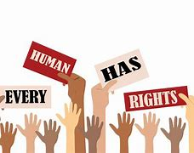

Human Rights

Slide 4

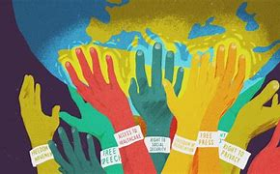

What are Human rights?

Slide 5

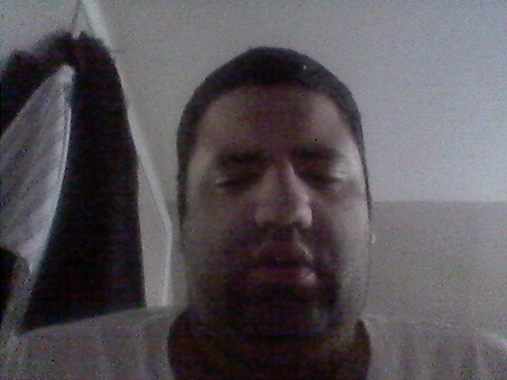
Why are Human rights important?

Slide 6
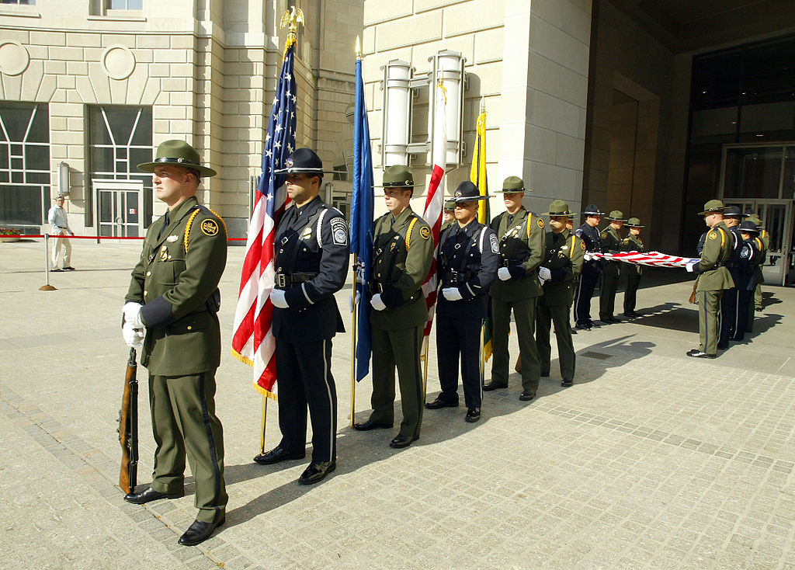
Interacting with Law Enforcement:
Unfortunately there are not many trainings offered to our law enforcement about individuals with disabilities.
This can cause issues in communication when interacting with different individuals.
There are some trainings on how to communicate with both people with Autism and Audism, but it is important to always follow guidelines on how to stay safe when in a situation where law enforcement is involved.
This Photo by Unknown Author is licensed under CC BY-SA

Slide 7
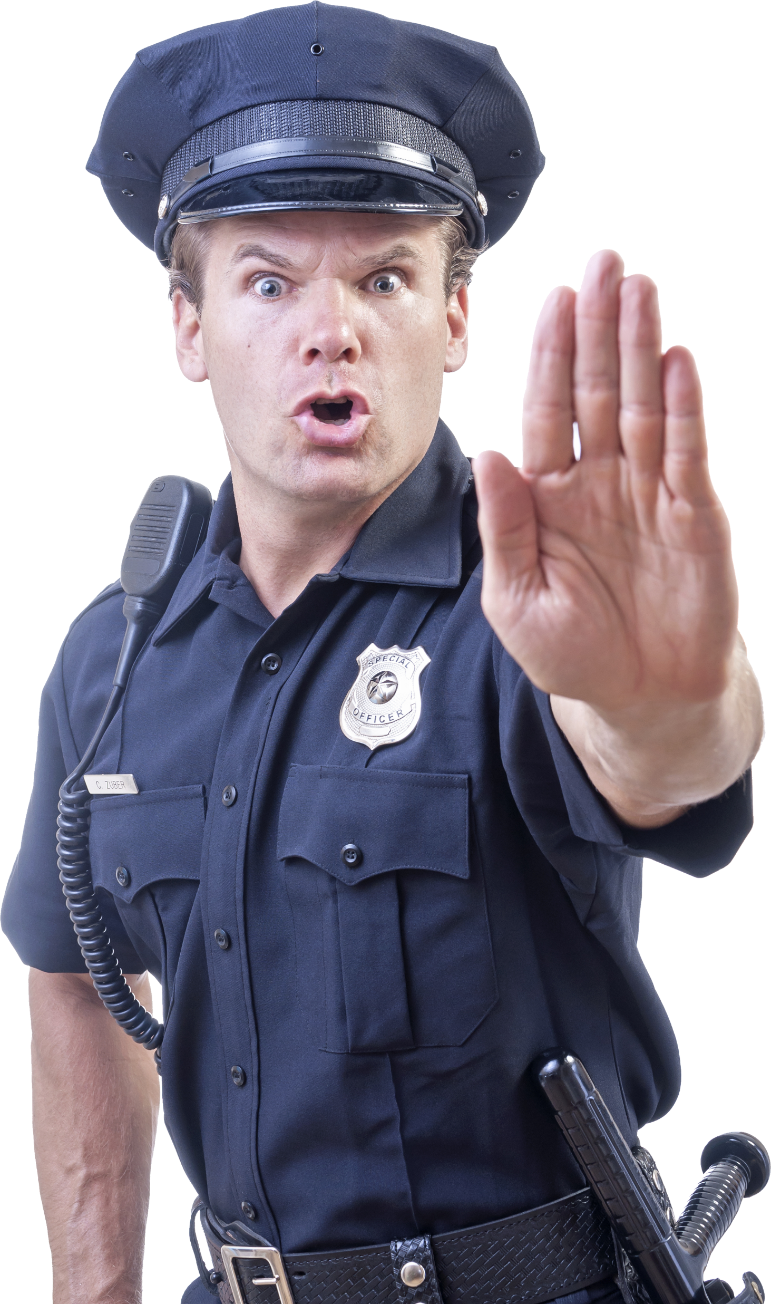
It can be quite challenging for law enforcement officers to spot an individual with intellectual or developmental disabilities (I/DD), which often have no outward or obvious signs.
As a result, people with I/DD are often mistakenly perceived as suspicious when, in actuality, the behavior is related to their disability

Slide 8
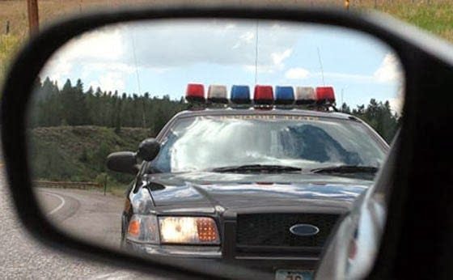
Tips when Interacting with Law Enforcement on the road
1. Slowly pull over- If the location seems dangerous, continue driving until you find a safe, well-lit place to stop.
2. Be wary of unmarked vehicles- If the officer is driving an unmarked vehicle, don't be afraid to question their validity. You can call 911 to verify that the unmarked vehicle pulling you over is an on-duty officer.
3. Follow the officer's instructions- Roll down the window and place both hands on the wheel. Do exactly what the officer asks, including providing your license and registration once requested. Alert the officer before reaching into the backseat, the glove compartment or into a purse or other bag.
4. Stay calm- Talk to the officer in a calm manner to avoid escalation of the situation.

Slide 9
INTELLECTUAL & DEVELOPMENTAL DISABILITIES PODCAST SERIES
(I/DD)
This special series takes an in-depth look at measures that law enforcement officers and agencies can use to more effectively and appropriately serve individuals with intellectual and developmental disabilities.
Promising Practices for Officers Interacting with I/DD
https://cops.usdoj.gov/html/podcasts/the_beat/05-2019/TheBeat_Johnson_Watson_052019.mp3
The Arc Resources to Inform Law Enforcement about I/DD
Applying Procedural Justice to People with I/DD
https://cops.usdoj.gov/html/podcasts/the_beat/05-2019/TheBeat_Davis_Simms_052019.mp3
https://cops.usdoj.gov/html/podcasts/the_beat/05-2019/TheBeat_Atkins_Davis_052019.mp3

Slide 10
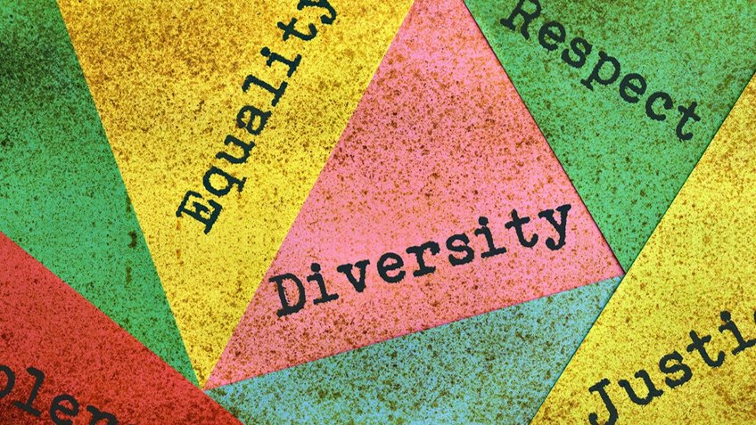
Understanding Diversity Internal
Diversity is based on sexual, religious, racial, political beliefs and gender.

Slide 11
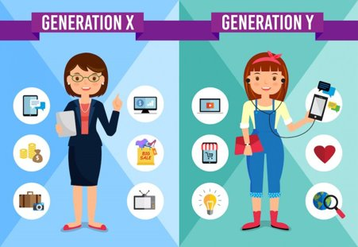
External Diversity
Life Experience​
Education​
Personal Interests​
Relationship’s Status

Slide 12
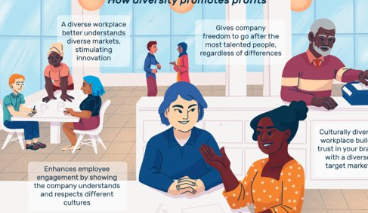
Why is Diversity important?
Come together as a community ​
Understanding everyone's culture​
Promotes more creativity ​
Leads To Better Problem Solving ​
A Fair Workplace

Slide 13
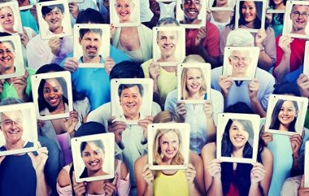
Everyday life in diversity
Help make the world a better place (All lives Matter) no matter what color you are.​
​
Everyone can be themselves no matter the (Gender Identity, Sexual Orientation, Age or Religion)

Slide 14

How can we promote Equality and Diversity?
Treating everybody equal​
Not being judgmental towards everyone’s lifestyle choice ​
Educate individuals to understand that everyone is different. For example, no matter what their disability, race, age, sexual orientation or religion is.

Slide 15
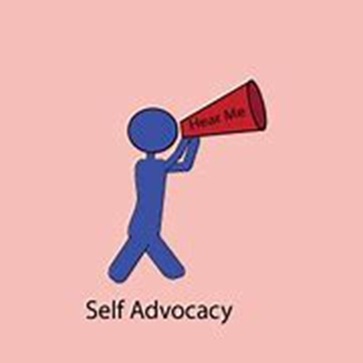
SELF ADVOCACY
Self-advocacy is the ability to speak-up for yourself and others and the things that are important.
Self-advocacy has three key elements:
-Understanding your needs
-Knowing what kind of support you might require
-Communicating these needs to others

Slide 16

Self Advocacy
Self-Advocacy: What It Is and Why It’s Important | Understood - For learning and thinking differences

Slide 17

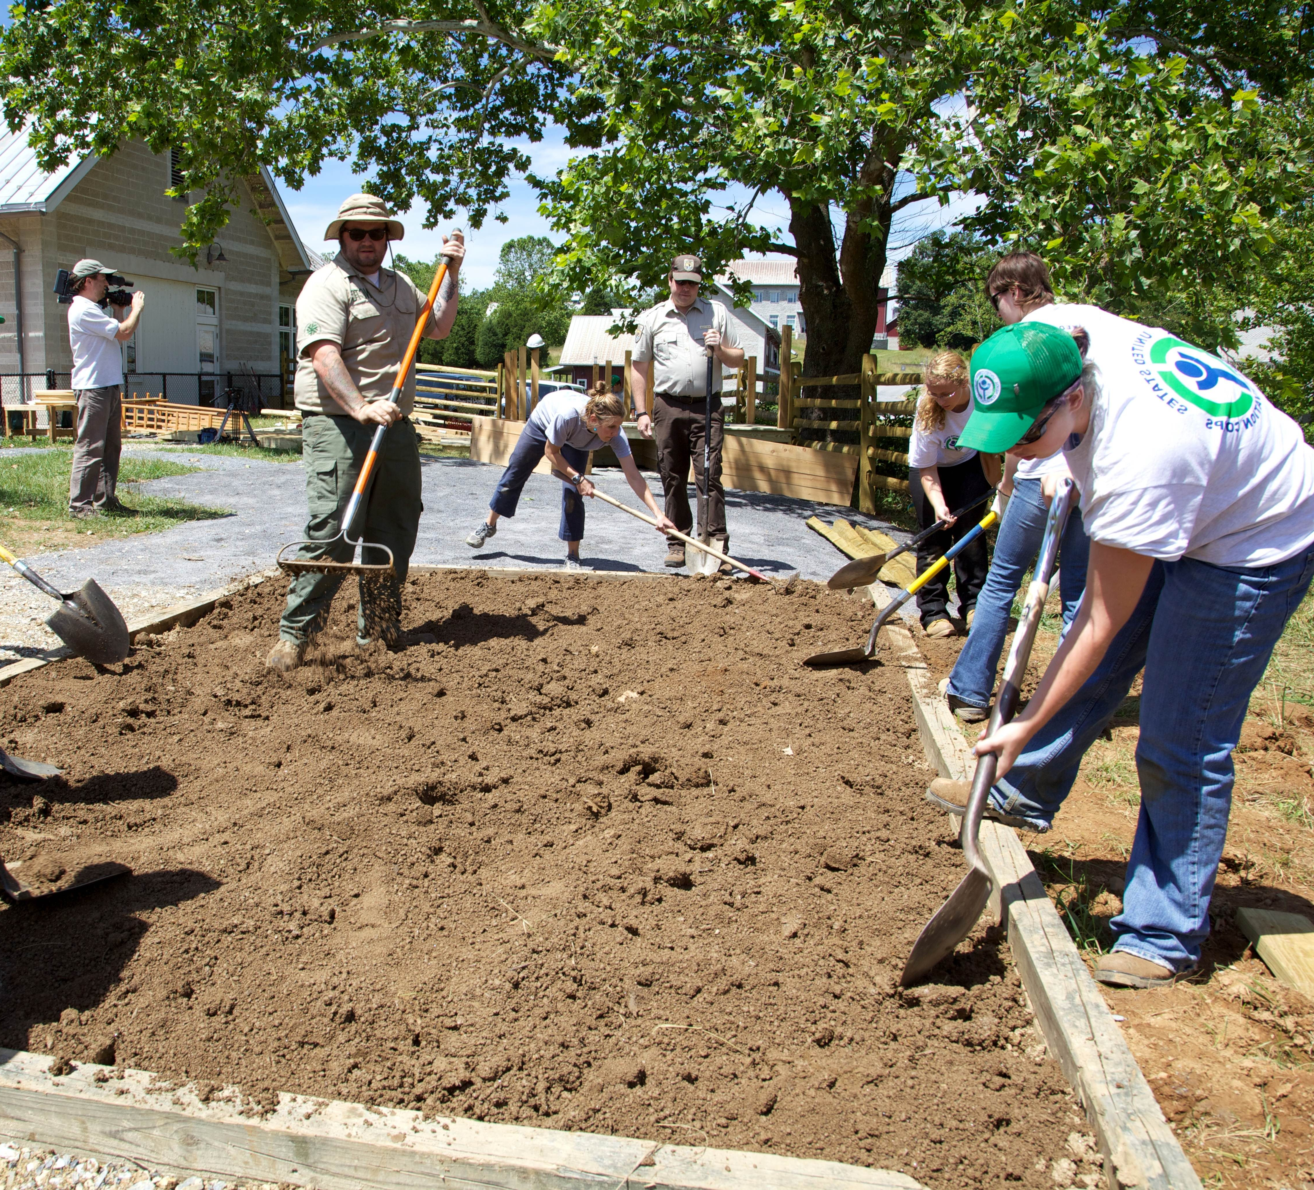
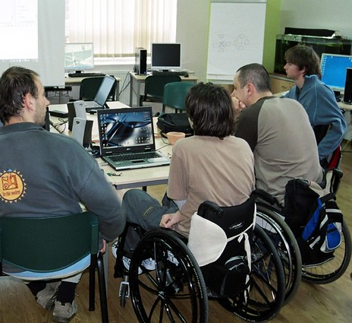
Employment for Everyone

Slide 18
Thank you for viewing our PowerPoint. Kellie Hartigan, Jeremey Powell and Kevin Arce

