Slide 1
How To Play This slide show
Download the presentation to open it in the desktop version of Powerpoint
Click on Slide Show in the upper toolbar.
Then click on from beginning in the drop down menu
Viola
click on megaphone symbol in corner for voice overs if they don’t play automatically.
Please email Yana at yana.Razumnaya@ct.gov if you need assistance

Slide 2


Autism Acceptance Month
Because Awareness isn’t enough…

Slide 3


Slide 4
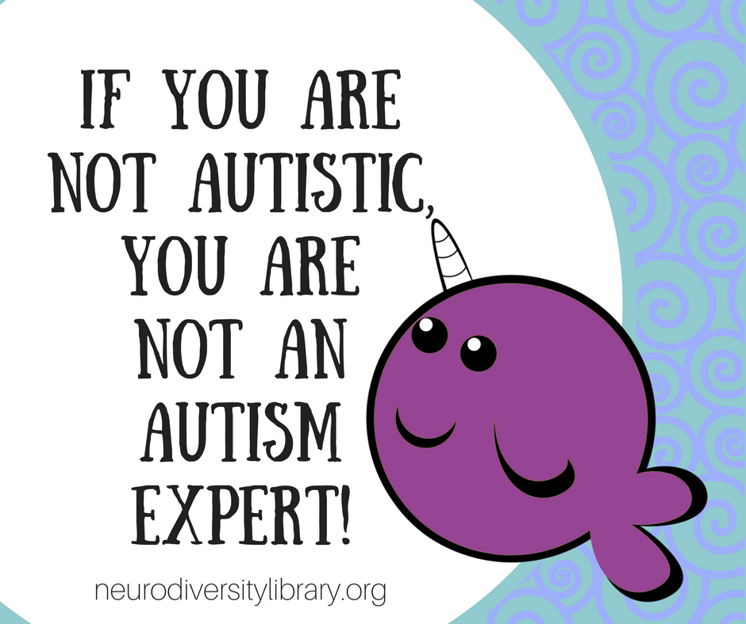

Slide 5
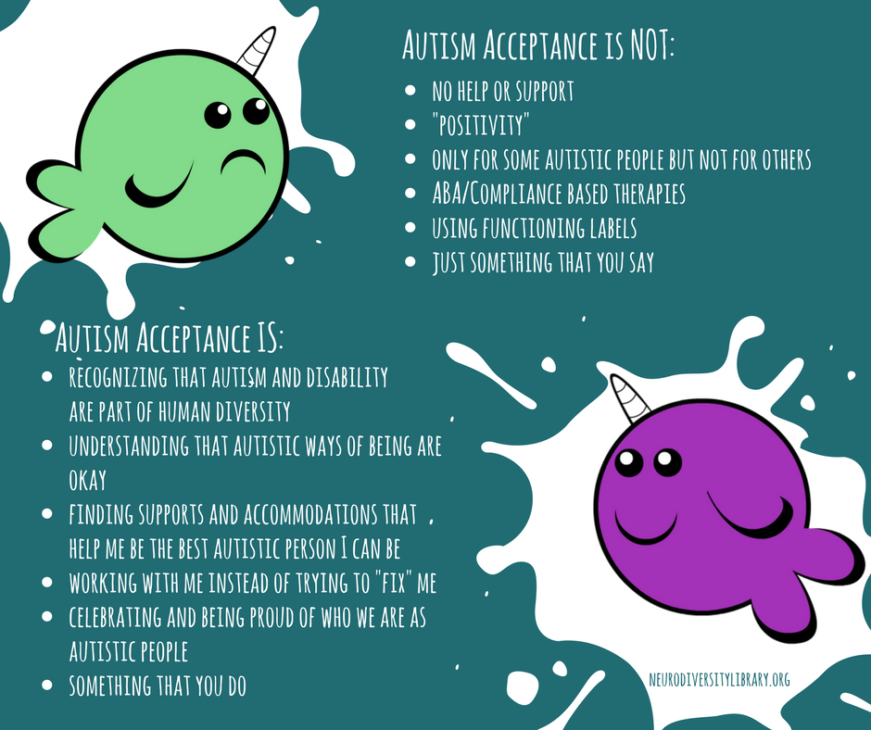

Slide 6
About autism
Autism is a developmental disability.
Every autistic person experiences autism differently but there are some things that many of us have in common.
  We think differently.
  We process our senses differently
  We move differently
  We communicate differently
  We socialize differently
  We are different….not less!
Notes:
We think differently. We may have very strong interests in things other people don’t understand or seem to care about. We might be great problem-solvers, or pay close attention to detail. It might take us longer to think about things. We might have trouble with executive functioning, like figuring out how to start and finish a task, moving on to a new task, or making decisions.Routines are important for many autistic people. It can be hard for us to deal with surprises or unexpected changes. When we get overwhelmed, we might not be able to process our thoughts, feelings, and surroundings, which can make us lose control of our body.
We process our senses differently. We might be extra sensitive to things like bright lights or loud sounds. We might have trouble understanding what we hear or what our senses tell us. We might not notice if we are in pain or hungry. We might do the same movement over and over again. This is called “stimming,” and it helps us regulate our senses. For example, we might rock back and forth, play with our hands, or hum.
We move differently. We might have trouble with fine motor skills or coordination. It can feel like our minds and bodies are disconnected. It can be hard for us to start or stop moving. Speech can be extra hard because it requires a lot of coordination. We might not be able to control how loud our voices are, or we might not be able to speak at all–even though we can understand what other people say.
We communicate differently. We might talk using echolalia (repeating things we have heard before), or by scripting out what we want to say. Some autistic people use Augmentative and Alternative Communication (AAC) to communicate. For example, we may communicate by typing on a computer, spelling on a letter board, or pointing to pictures on an iPad. Some people may also communicate with behavior or the way we act. Not every autistic person can talk, but we all have important things to say.
We socialize differently. Some of us might not understand or follow social rules that non-autistic people made up. We might be more direct than other people. Eye contact might make us uncomfortable. We might have a hard time controlling our body language or facial expressions, which can confuse non-autistic people or make it hard to socialize.Some of us might not be able to guess how people feel. This doesn’t mean we don’t care how people feel! We just need people to tell us how they feel so we don’t have to guess. Some autistic people are extra sensitive to other people’s feelings.

Slide 7
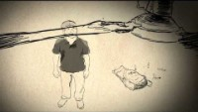
Autism Sensory Overload Video

Slide 8
Masking VS Camouflaging
Masking is taking on a persona that is felt to be more neurotypical ( non-autistic)
Camouflaging is hiding behavior that might be viewed as socially unacceptable or “performing” social behavior that is felt to be more neurotypical.
It is a survival skill that can be draining.
( Attwood, 2007; Lai et al, 2017)

Slide 9
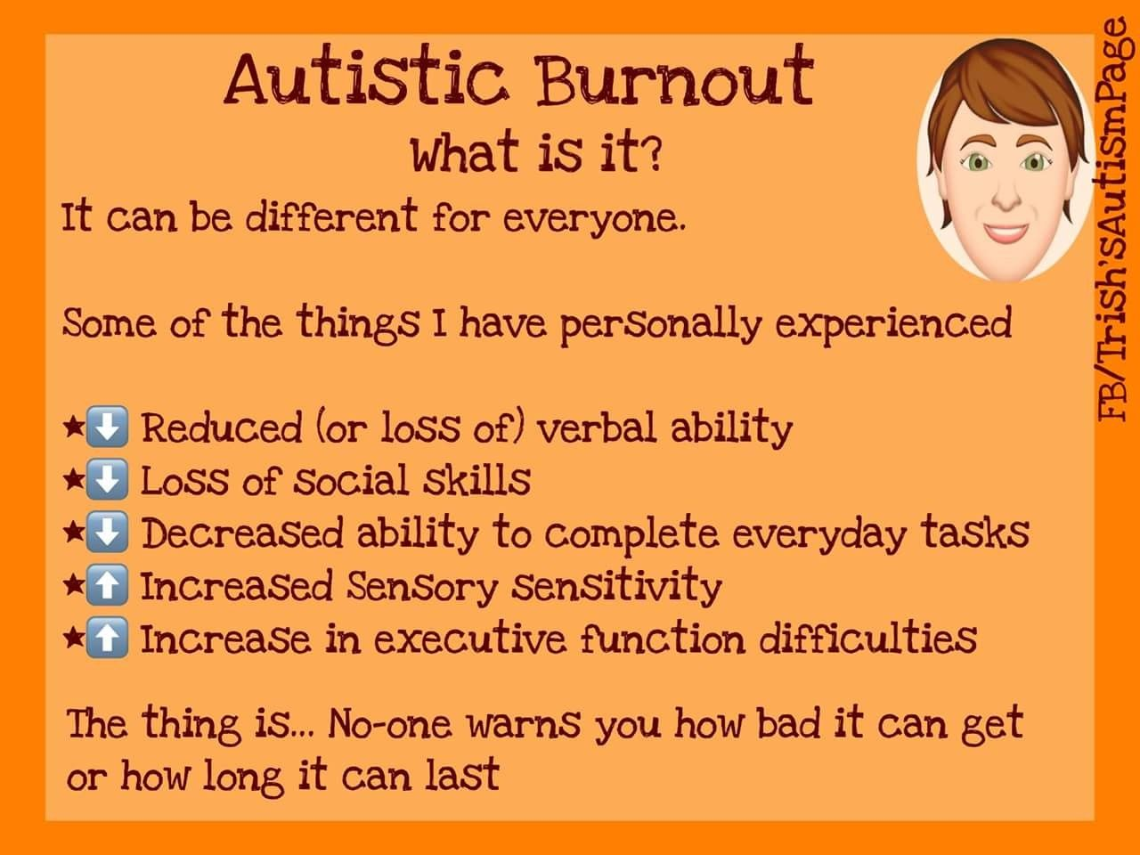

Slide 10
Remember…
Masking and camouflaging lead to stress and burnout.
Encourage individuals to be then best autistic person that they can be.
Neurodiversity makes the world a better place.
Autistic pride!

Slide 11
Is Autism a boys club?
It certainly looks like it is!
There is 1 autistic girl for every 4 autistic boys.
Why this disparity?
  Women are frequently misdiagnosed with other co-morbid conditions
  Women more often diagnosed after their children are diagnosed.
  Diagnostic criteria are written with boys in mind.
  Masking skills

Slide 12

All people on the spectrum are savants or geniuses.- nope!
All people with autism are male- an autistic woman created this presentation!
Autism is caused by vaccines. - this has been disproven in a major medical journal.
All people with autism are like Dustin Hoffman’s character in “Rainman”- some are but not all of us
Autism is a disorder of childhood- Children with autism grow up to be adults with autism. We don’t fall off of the face of the earth after we turn 21.
People on the spectrum don’t want friends. – we do want friends but have a hard time making friends.
People with autism can’t feel emotion or express empathy-we can feel emotions but we show them differently then a Neurotypical or non-autistic person does. Same goes for empathy.
Autism can be “cured” – Autism is not a medical disease. Therefore it cannot be cured. To say it can, is not only medically inaccurate but incredibly offensive.
Individuals with autism “don’t”, “shouldn’t”, “can’t or won’t:
Actually we do, we will and we can!

Slide 13
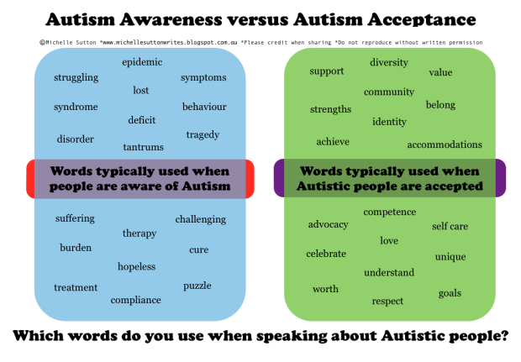

Slide 14
How To Be An Ally
Respect us:
Don’t say degrading things about autism or call autism a disease that needs to be cured. Autism is part of who we are not an epidemic.
Respect stimming or repetitive movements. They can be very useful and relaxing to us.
Don’t use functioning labels ( low functioning or high functioning)
Don’t try to fix us-we aren’t broken
Don’t use the R-word or other slurs that are used to bully people with autism or any disability.
Honor different communication styles. Some people with autism use assistive or adaptive technology to communicate. This is just as valid as verbal communication
Listen to people with autism!
Support organizations that feature autistic voices.

Slide 15
Take The pledge
Too often conversations about autism take place about us without us.
Organizations, conferences, and panels on autism often don’t include autistic voices. We are asking you to help solve this problem!
One easy way you can help fix this is by taking The Autism Self Advocacy Network’s Pledge for Autistic Inclusion. The pledge tells event organizers that you won’t come to their events if they don’t include autistic people.
That means event organizers will try harder to include autistic people!
Please click here to take the pledge

Slide 16
What you can do to help adults on the autism spectrum
Help us get real work for real pay
Advocate for affordable housing and supportive housing for people on the spectrum.
Advocate for more funding and resources for the DSS autism division.
As of January 2022, there are 1949 individuals currently on the waitlist for autism services at DSS.
Do things with us, not for us.

Slide 17
Famous people with autism
Greta Thunberg- environmental activist. Calls autism her superpower.
Susan Boyle- Singer- finalist on Britain’s Got Talent
Carly Fleischman was born with non-verbal autism. Doctors told her parents that she wouldn’t develop intellectually beyond the abilities of a small child. She now has profound conversations with people through the use of her computer and has co-authored a book with her father about her journey
Albert Einstein- wasn’t able to speak till age 4. teachers said he would not amount to much. Became one of the world’s greatest scientists.

Slide 18
In Conclusion…
Autism is not a tragedy. Ignorance is.
Autistic people aren’t broken and don’t need to be fixed.
Neurodiversity is awesome!
The world needs all kind of thinkers.
Thank You!!

Slide 19





Autism Resources
https://autisticadvocacy.org/
www. awnnetwork.org
Autism Services And Resources CT
www.ct-asrc.org
Special needs financial planning.
www.planningacrossthespectrum.com
https://autismdriving.com/

