Slide 1


CONNECTICUT STATE DEPARTMENT OF EDUCATION
(Insert School or District Name)
A Presentation of Connecticut SAT School Day Results
(Insert Meeting Title)
(Insert Date)
Notes:
This is an editable PowerPoint prepared as a courtesy by the CSDE to provide basic information.
Slides can be added or deleted as needed. We encourage customization to your local context.
For this slide, insert appropriate information for your district / school and meeting and date

Slide 2

Connecticut SAT School Day
Presentation Objectives:
Points to remember about testing
  The purpose of annual state testing
  Annual standardized assessment — what can/can’t it tell us about our students?
  Multiple measures of student learning are important
  Growth over time matters
  Avoid comparisons to previous test results and other districts’ results
Background information on the assessment
Assessment participation by grade/subgroup
Presentation of data by grade
  What is the performance for all students in English language arts and math?
  What are other local measures/indicators in these subjects for all students?
  What is the performance for our students in subgroups in ELA and math?
  What are other local measures/indicators in these subjects for our students in subgroups?
School and classroom strategies to support students and demonstrate growth in performance over time
CONNECTICUT STATE DEPARTMENT OF EDUCATION
Notes:
Take a moment to unpack the presentation and remind your audience of the most salient/ important points for your local context.
This presentation reviews the background/ overall components of the assessment.

Slide 3
Connecticut SAT School Day
Points to Remember About Annual State Testing
REQUIRED: By federal and state law, universal student assessment is required in English language arts and mathematics in Grades 3-8 and once in high school annually. The CSDE and local education agencies (LEAs) are legally responsible to administer these assessments to all students.
USEFUL FOR THESE PURPOSES: An annual assessment is intended to:
  Accurately describe student achievement and growth as part of program evaluation and school, district, and state accountability systems.
  Provide valid, reliable, and fair measures of students’ progress/attainment of the knowledge and skills required to be college- and career-ready at the end of Grade 12.
  Provide an annual snapshot of student achievement that should be used along with other information, such as class work and other tests, when making educational decisions.
CONNECTICUT STATE DEPARTMENT OF EDUCATION
Notes:
The switch to the SAT satisfies the requirements of Connecticut Public Act No. 15-238, which states that effective in the 2015-16 school year students enrolled in Grade 11 should be administered a nationally recognized college readiness assessment that is approved by the State Board of Education (October 7, 2015) and that measures essential and grade-appropriate skills in reading, writing and mathematics.

Slide 4
Connecticut SAT School Day
Points to Remember about Annual State Testing (continued)
NOT USEFUL AS:
  A sole measure of student achievement, program evaluation or school, district, and state accountability systems.
  A source of guidance for curriculum or instruction. The Connecticut Core Standards provide the only needed blueprint for student learning. The Connecticut SAT School Day is a global measure. “Teaching to the test” is never quality instruction and does not result in student engagement or genuine, long-lasting learning.
  A substitute for a wide variety of other relevant ways to assess student learning, such as:
    ➲ - classroom assessments  - teacher observations
    ➲ - student work portfolios  - universal screening
    ➲ - frequent progress monitoring  - detailed diagnostic assessment or evaluation
CONNECTICUT STATE DEPARTMENT OF EDUCATION
Notes:
This slide presents an opportunity to highlight a “mixed measures” approach to student performance and what other ways educators evaluate student learning.

Slide 5
Connecticut SAT School Day Alignment
The CSDE conducted an independent study of test content alignment to the Connecticut Core Standards.
  “In both ELA and Mathematics, the majority of the Connecticut Core Standards have a strong or moderate match to the Connecticut SAT School Day.”
    SAT Reading alignment is solid.
    SAT Writing (without the essay) addresses most standards.
    SAT Math is strong in Number & Quantity, Algebra, and Statistics & Probability, but has some gaps in Functions and Geometry.
CONNECTICUT STATE DEPARTMENT OF EDUCATION
Notes:
Educators from Connecticut were invited to participate in the alignment process for the Connecticut SAT School Day. The meeting occurred in January 2016.

Slide 6
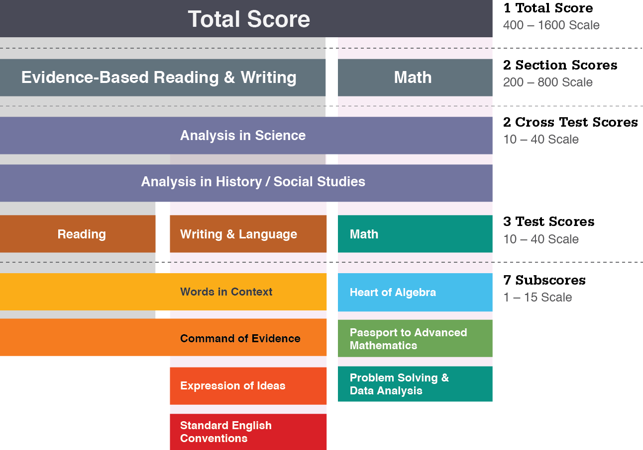
SAT Scores & Subscores
CONNECTICUT STATE DEPARTMENT OF EDUCATION
Notes:
Total Score: Sum of Evidence- Based Reading and Writing, and Math.
It is not a “composite” score. Evidence- Based Reading and Writing: the combination of the Reading Test and the Writing and Language Test. The optional Essay is not
factored in to these test scores.
Cross-test Scores: Analysis in Science and Analysis in History/Social Studies. Questions used to determine the score come from all tests. The optional Essay does not contribute to these scores, but it separately assesses many of these skills with reading, writing and analysis scores.

Slide 7
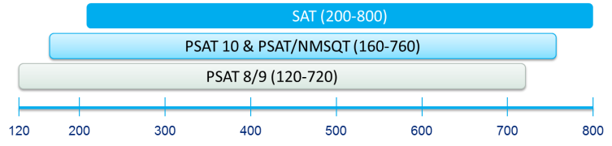
Longitudinal Progress Monitoring
Total score and section scores will be placed on a vertical scale.
The CSDE strongly recommends that this vertical scale be treated as preliminary.
CONNECTICUT STATE DEPARTMENT OF EDUCATION
Notes:
All of the tests in the SAT Suite of Assessments will include the same score categories: Total score, section scores, test scores, cross-test scores, and subscores. (Notable exceptions: SAT only will have Essay scores, and the PSAT 8/9 will not have a subscore in Passport to Advanced Math.) In this system, by design, the assessments are created to cover a slightly different range of content complexity that increases from PSAT 8/9 to PSAT/NMSQT to SAT. This increase in content complexity also corresponds to an increase in the difficulty level of each test. As one could easily imagine PSAT/NMSQT is more difficult/challenging than PSAT 8/9, and SAT is more difficult than PSAT/NMSQT. To support these differences in test difficulty, and to also support a common metric against which students can be measured over time, the test scores and cross-test scores will be vertically equated across SAT, PSAT/NMSQT, and PSAT 8/9. Vertical Equating refers to a statistical procedure whereby tests designed to differ in difficulty are placed on a common metric. This allows the tests to function as a system where student performance over time can consistently be measured against a common metric, allowing us to show growth over time for a student (or at an aggregate).
The min-max scores vary from assessment to assessment to show the difference in complexity of knowledge on the different tests. Theoretically, if a student were to take the PSAT 8/9, PSAT 10, and SAT on the same day, they would score the same on each assessment, but if they scored “perfectly” on all three, they would only get a 720 versus
an 800 for Math in PSAT 8/9 versus SAT – because the difficulty of questions is that much harder on SAT.

Slide 8
Reading Test Features
The overall aim of the Reading Test is to determine whether students can demonstrate college- and career-readiness proficiency in comprehending a broad range of high-quality, appropriately challenging literary and informational texts in the content areas of U.S. and world literature, history/social studies, and science.
The test will comprise a series of passages and associated multiple-choice questions. Some question sets will refer to paired passages, others will refer to only one passage.
Students must refer to the specific language in the passages.
CONNECTICUT STATE DEPARTMENT OF EDUCATION
Notes:
The overall aim of the Reading Test is to determine whether students can demonstrate college and career readiness proficiency in comprehending a broad range of high-quality, appropriately challenging literary and informational texts in the content areas of U.S. and world literature, history/social studies, and science.
The test is comprised of a series of passages and associated multiplechoice questions. Some question sets will refer to paired passages, others will refer to only one passage.
Students must refer to the specific language in the passages and use careful reasoning to draw supportable inferences.

Slide 9
SAT Writing & Language Test Features:
Passage-based
Cross-disciplinary contexts:
  Humanities
  History/social studies
  Science
  Careers
Informational graphics
Multiple text types: argument, informative, nonfiction narrative
Focus on:
  Expression of ideas
  Standard English conventions
  Words in context
  Command of evidence
CONNECTICUT STATE DEPARTMENT OF EDUCATION

Slide 10
SAT Math Test Features:
Focus on content that matters most for college- and career-readiness
Assesses fluency with, understanding of, and ability to apply mathematical concepts
Algebra and linear equations
Problem solving and data analysis
Advanced mathematical practices
Certain key elements will be woven throughout the Math Test:
Emphasis on mathematical application and reasoning
Problems from a range of disciplines addressing real-world problems drawn from science, social studies, and careers
Inclusion of both calculator and no-calculator portions, as well as attention to the use of a calculator as a tool
Includes both multiple-choice questions and student-produced response
CONNECTICUT STATE DEPARTMENT OF EDUCATION
Notes:
In the calculator section of the Math Test, students can use their calculators to make computations more efficiently, enabling them to focus on complex modeling and reasoning. However, the calculator is a tool that students must use strategically, deciding when to use it —and when not to. There will be some questions in the calculator section that can be answered more efficiently without a calculator. In these
cases, students who make use of structure or their ability to reason will most likely reach the solution more rapidly than students who use a calculator.
On Student-Produced Response questions, students grid in their answers, which often allows for multiple correct responses and solution processes. Such items allow students to freely apply their critical thinking skills when planning and implementing a solution.

Slide 11
Score Reporting
Students receive their Connecticut SAT test results through their online College Board account
Students receive a total score and section scores
CONNECTICUT STATE DEPARTMENT OF EDUCATION

Slide 12
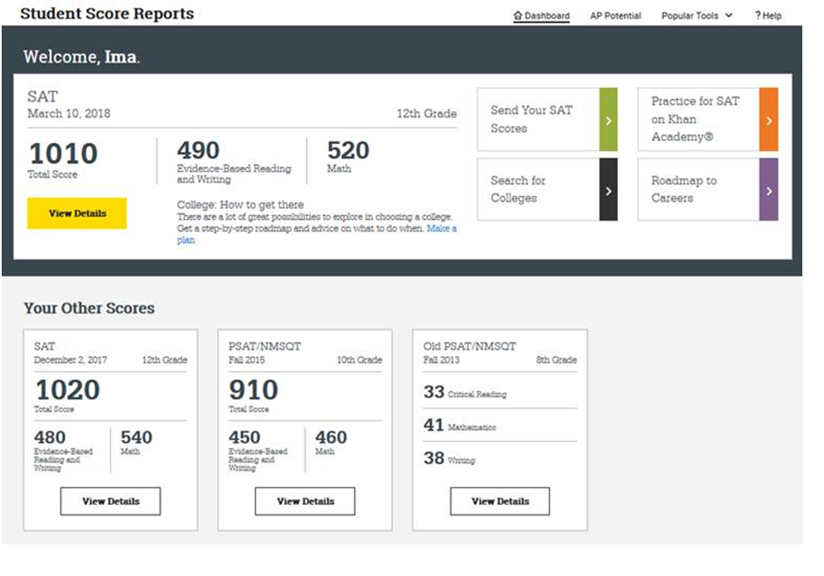
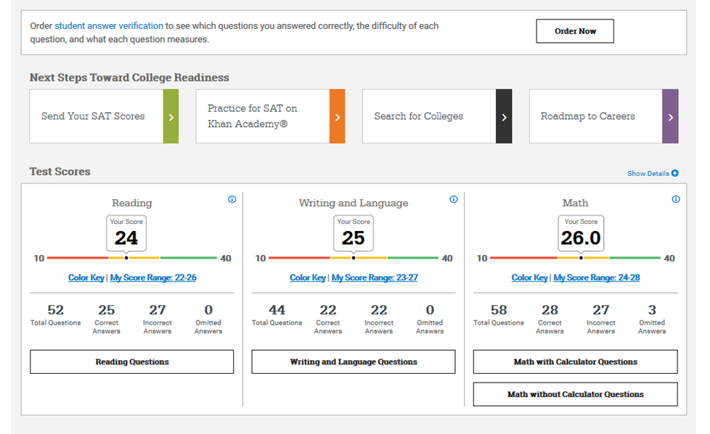
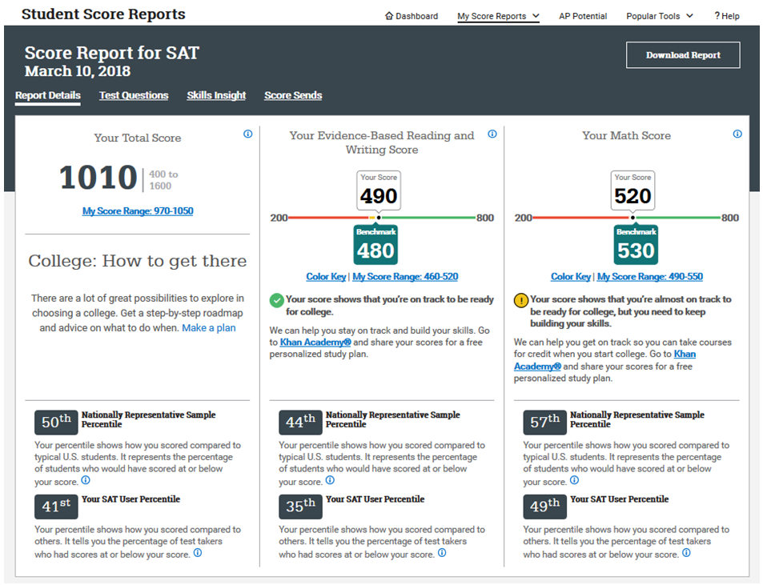
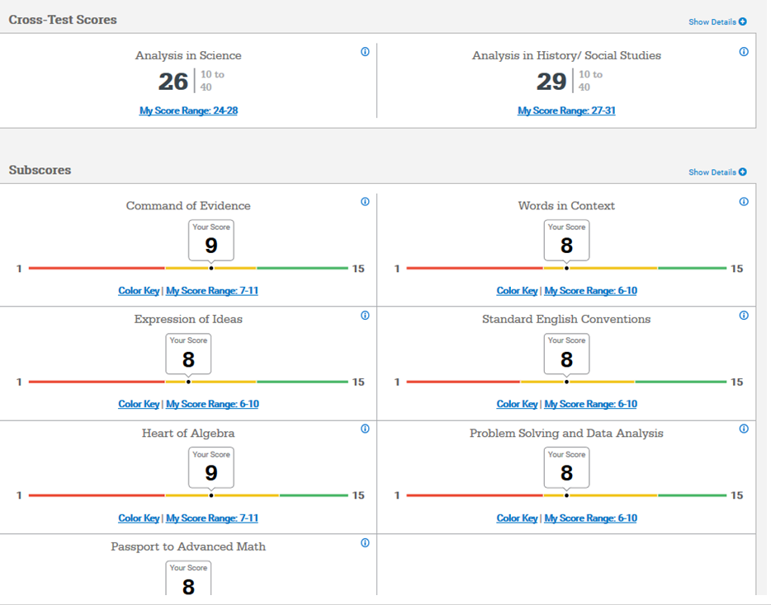
Student Online Score Report
CONNECTICUT STATE DEPARTMENT OF EDUCATION

Slide 13
Score Cancelling
Students who take the test and receive college reportable scores have the option to cancel their scores; however, the scores will still be provided to the CSDE for accountability purposes.
If cancelled, the student, school and university will not receive any score; however, the state will still receive the score.
CONNECTICUT STATE DEPARTMENT OF EDUCATION

Slide 14
Sending Scores to Colleges
All students who take the SAT are eligible for four free “score sends.”
To send scores, student/family must expressly authorize the colleges or scholarship organizations to which they want to send the scores.
CONNECTICUT STATE DEPARTMENT OF EDUCATION

Slide 15
Score Choice
Students will choose to have the College Board send scores to the institutions identified.
For students who have only taken the SAT once, that will be the only score that is sent to colleges/universities.
For students, who have taken the SAT multiple times, they can use Score Choice and select which scores, by test date for the SAT, to send to colleges.
If students do not use Score Choice, all scores will be sent. However, it is up to a student/family to understand the Higher Education institutions policies. Some institutions will require all scores to be sent if the student has taken more than one SAT.
CONNECTICUT STATE DEPARTMENT OF EDUCATION

Slide 16
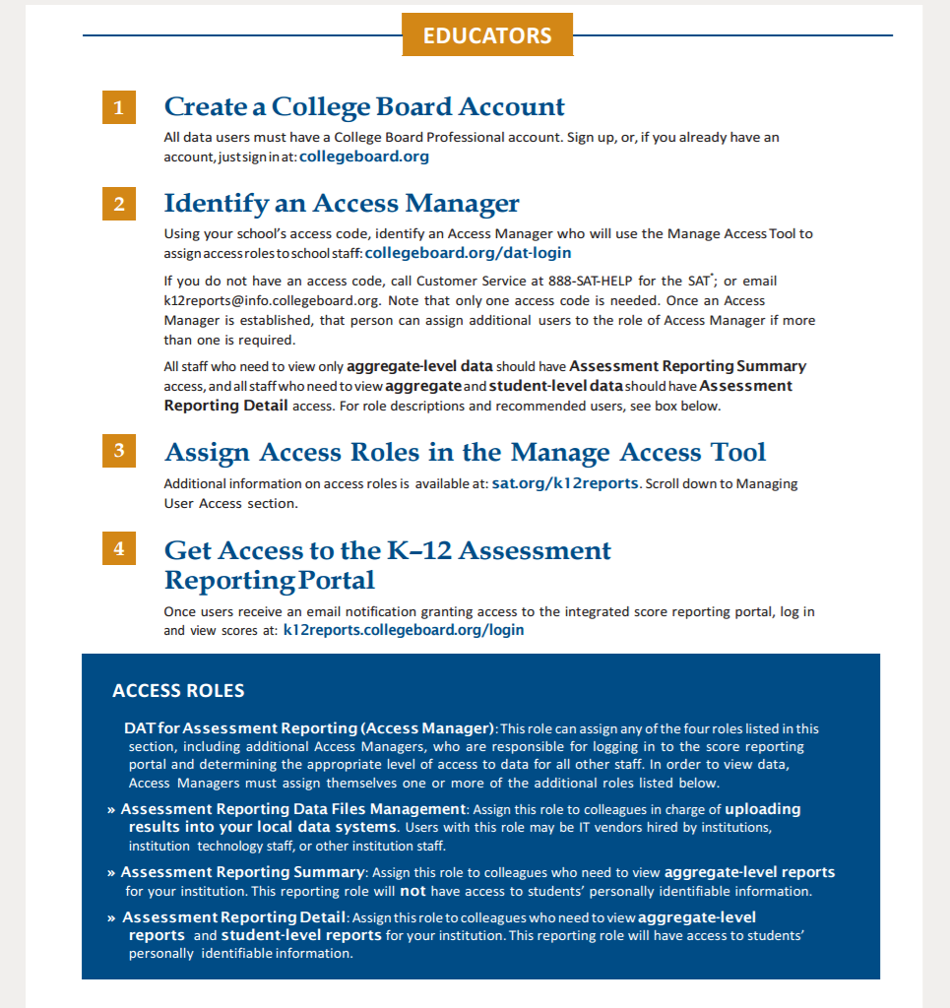
Reporting
Districts can access the test results through the College Board online score report portal http://collegeboard.org/dat-login
Summary results are posted on CSDE’s EdSight system http://edsight.ct.gov
Student level results are posted to CSDE’s EdSight Secure
CONNECTICUT STATE DEPARTMENT OF EDUCATION

Slide 17
Standard Setting
Connecticut standards were set for the Connecticut SAT School Day during a multi-state standard setting process held in June 2016
The College Board released preliminary college readiness benchmarks
CONNECTICUT STATE DEPARTMENT OF EDUCATION

Slide 18
Connecticut SAT School Day
Districtwide Results:
Evidenced-Based Reading and Writing
Average Score and Percent of Students Achieving Levels 1-4
District | Subject | Total Number with Scored Tests | Level 1 Not Met |  | Level 2 Approaching |  | Level 3 Met |  | Level 4 Exceeded |  | Level 3 or 4 Met or Exceeded
 |  |  | Count | % | Count | % | Count | % | Count | % | Count | % | Average Score
XXXXX | XXXXX | XXXXX
CONNECTICUT STATE DEPARTMENT OF EDUCATION

Slide 19
Connecticut SAT School Day
Districtwide Results:
Mathematics
Average Score and Percent of Students Achieving Levels 1-4
District | Subject | Total Number with Scored Tests | Level 1 Not Met |  | Level 2 Approaching |  | Level 3 Met |  | Level 4 Exceeded |  | Level 3 or 4 Met or Exceeded
 |  |  | Count | % | Count | % | Count | % | Count | % | Count | % | Average Score
XXXXX | XXXXX | XXXXX
CONNECTICUT STATE DEPARTMENT OF EDUCATION

Slide 20
Connecticut SAT School Day
Districtwide Results: Evidence-Based Reading and Writing
Average Score and Percent of Students Achieving Levels 1-4
Grade | Subgroup | Average Total Score | Level 1 | Level 2 | Level 3 | Level 4
11 | Black | N=( ) ___ | N=( ) ___ | N=( ) ___ | N=( ) ___ | N=( ) ___
 | Hispanic
 | English Learner
 | Special Education
 | Free/Reduced Lunch
CONNECTICUT STATE DEPARTMENT OF EDUCATION

Slide 21
Connecticut SAT School Day
Districtwide Results: Mathematics
Average Score and Percent of Students Achieving Levels 1-4
Grade | Subgroup | Average Total Score | Level 1 | Level 2 | Level 3 | Level 4
11 | Black | N=( ) ___ | N=( ) ___ | N=( ) ___ | N=( ) ___ | N=( ) ___
 | Hispanic
 | English Learner
 | Special Education
 | Free/Reduced Lunch
CONNECTICUT STATE DEPARTMENT OF EDUCATION

Slide 22
Connecticut SAT School Day
District Data Highlights
CONNECTICUT STATE DEPARTMENT OF EDUCATION

Slide 23
Connecticut SAT School Day
District Data Implications
CONNECTICUT STATE DEPARTMENT OF EDUCATION

Slide 24
Connecticut SAT School Day
District Next Steps in Curriculum and Instruction
CONNECTICUT STATE DEPARTMENT OF EDUCATION

Slide 25
College Board Resources
www.collegereadiness.collegeboard.org
Training Modules
Sample full-length tests
Test Specifications
KHAN Academy Resources
CONNECTICUT STATE DEPARTMENT OF EDUCATION

Slide 26
Connecticut SAT School Day
In Summary/Closing
CONNECTICUT STATE DEPARTMENT OF EDUCATION

