Slide 1
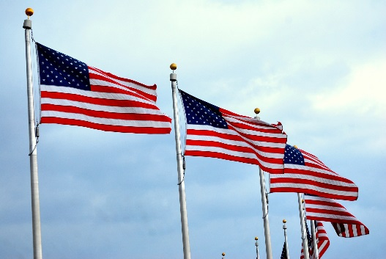
CONNECTICUT STATE DEPARTMENT OF EDUCATION
Civil Rights Your Responsibilities in the Child and Adult Care Food Program (CACFP)
Revised September 2023

Slide 2
The language in this PowerPoint addresses compliance with the U.S. Department of Agriculture (USDA) civil rights requirements and should not be modified
This presentation is available on the CSDE’s Civil Rights website at https://portal.ct.gov/SDE/Nutrition/Civil-Rights-for-Child-Nutrition-Programs#CACFP
https://portal.ct.gov/-/media/SDE/Nutrition/CivilRights/ Civil_Rights_CACFP_Presentation_Overview.pdf
https://portal.ct.gov/-/media/SDE/Nutrition/CivilRights/ Civil_Rights_CACFP_Presentation.pptx

Slide 3
Civil Rights Requirements
The U.S. Department of Agriculture (USDA) requires that all staff members who interact with program participants receive annual civil rights training
Front line staff who interact with applicants or participants
Supervisors of frontline staff

Slide 4
Civil Rights Requirements
Ensures that people involved in all levels of CACFP administration understand civil rights laws, regulations, procedures and directives

Slide 5
Civil Rights Requirements
Federal legislation establishes regulations and requirements for recipients of federal funds to prohibit discrimination and ensure equal access to all programs and activities of the recipients

Slide 6
What is discrimination?
The act of distinguishing one person or group of persons from others either
intentionally or
by neglect or
by the effect of actions or lack of actions based on their protected classes
Notes:
What is the definition of discrimination?
Discrimination is defined as the act of distinguishing one person or groups of persons from others, either intentionally or by neglect, OR by the effect of actions or lack of actions based on their protected classes.

Slide 7
Six Protected Classes
Race
Color
Sex
Age
National Origin
Disability
Notes:
When we talk about Civil Rights at the federal level, we need to know that there are six protected classes.
The six protected classes are:
Race
Color
Sex
Age
National origin and
Disability

Slide 8
Civil Rights Goals
To eliminate barriers that prevent or deter people from receiving benefits of a government sponsored/funded program
To provide equal treatment in the delivery of programs and services to all applicants, participants and beneficiaries of a federal program

Slide 9
Civil Rights Goals
To ensure that all applicants and participants understand their rights and responsibilities
To show respect and dignity to all

Slide 10
Assurances
A civil rights assurance is incorporated in all agreements between the CSDE and participating institutions to ensure that ALL participants have access to Child Nutrition Programs

Slide 11
Requirements for CACFP
Collection and Use of Data
Public Notification
Complaint Procedures
Compliance Review Techniques
Resolution of Noncompliance
Reasonable Accommodation for Persons with Disabilities
Language Assistance
Conflict Resolution
Customer Service

Slide 12
1 — Collection and Use of Data
Two required forms
Civil Rights Potential Beneficiary Data Determination Form
CACFP Civil Rights Beneficiary Data Collection Form
Complete annually, sign, date, and maintain on file with CACFP records
Notes:
Collection and Use of Data
There are two forms that must be completed annually by all participating CACFP institutions.
The first form is the Civil Rights Potential Beneficiary Data Determination Form. This form illustrates the racial/ethnic make-up of the potential population that could be served by the institution.
To complete the form, you must list the primary towns that are to be served by your institution.
The Child Nutrition Unit provides the school enrollment data for all of the towns in Connecticut.
After you list the primary towns in your institution’s service area, you then copy the racial/ethnic data from the attached listing for each town.
You need to complete one Potential Beneficiary Data Determination Form for your INSTITUTION (not one for each center), sign and date it and maintain it on file with your other CACFP records.

Slide 13
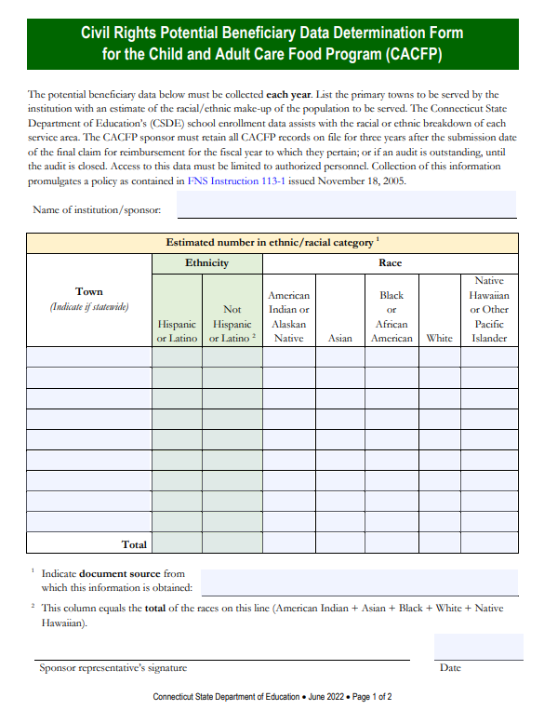
Civil Rights Potential Beneficiary Data Determination Form
All towns in the service area of the institution
Record racial/ethnic school data for each town
One form per institution
https://portal.ct.gov/-/media/SDE/Nutrition/CivilRights/ Civil_Rights_CACFP_Potential_Beneficiary_Data_Determination_Form.pdf

Slide 14
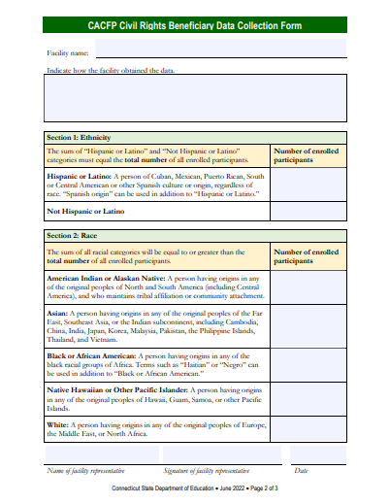
CACFP Civil Rights Beneficiary Data Collection Form
Number of participants who are “Hispanic or Latino” and “Not Hispanic or Latino”
Number of participants in each racial category
https://portal.ct.gov/-/media/SDE/Nutrition/CivilRights/ Civil_Rights_CACFP_Potential_Beneficiary_Data_Determination_Form.pdf

Slide 15
Visual Identification Not Allowed
CACFP facilities cannot use visual observation and identification to collect race or ethnicity data
CACFP 11-2021 and SFSP 07-2021: Collection of Race and Ethnicity Data by Visual Observation and Identification in the Child and Adult Care Food Program and Summer Food Service Program – Policy Rescission

Slide 16
Visual Identification Not Allowed
Preferred data collection method is self-identification and self-reporting from other sources in which respondent has self-identified race or ethnicity
CACFP income eligibility applications
Data for other funding sources, e.g., Head Start
CACFP 11-2021 and SFSP 07-2021: Collection of Race and Ethnicity Data by Visual Observation and Identification in the Child and Adult Care Food Program and Summer Food Service Program – Policy Rescission

Slide 17
Visual Identification Not Allowed
CACFP facilities should
explain importance of data to participants
encourage participants to self-identify and self-report
CACFP facilities must
make applicants and participants aware that failure to provide racial or ethnic identity information will not impact CACFP eligibility
CACFP 11-2021 and SFSP 07-2021: Collection of Race and Ethnicity Data by Visual Observation and Identification in the Child and Adult Care Food Program and Summer Food Service Program – Policy Rescission

Slide 18
Race and Ethnic Categories
Separate categories must be used to collect and report ethnicity and race
Ethnicity | Race
Hispanic or Latino – A person of Cuban, Mexican, Puerto Rican, South or Central American, or other Spanish culture or origin, regardless of race Not Hispanic or Latino | American Indian or Alaskan Native Asian Black or African American Native Hawaiian or Other Pacific Islander White

Slide 19
2 — Public Notification System
Includes three components
“And Justice for All” poster
Program Availability
USDA Nondiscrimination Statement

Slide 20
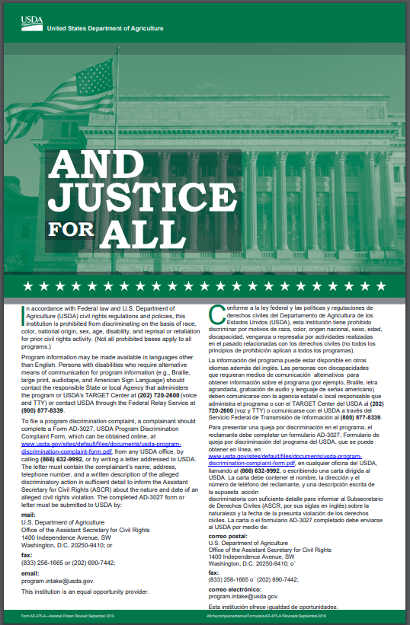
And Justice for All Poster
Display “And Justice for All” poster in a prominent place at each center
Must be 11 x 17 inches
CSDE issues an annual statewide public release on behalf of all participating CACFP institutions
To obtain copies of this poster, please contact the CSDE CACFP Staff
Notes:
Public Notification System
Every participating CACFP institution must display the And Justice for All poster in a central location at each site.
In addition, the CSDE Child Nutrition Unit issues an annual statewide public release on behalf of all participating institutions.

Slide 21
And Justice for All Poster
USDA is revising current poster
CSDE will provide revised posters when available
Continue to use current poster until notified otherwise

Slide 22
Program Availability
Inform participants and prospective participants of their CACFP rights and responsibilities and the steps necessary for participation
Notes:
Public Notification System
The purpose of a public notification system is to advertise Program Availability, or more specifically, to:
Inform participants and prospective participants of their Program rights and responsibilities and the steps necessary for
participation.

Slide 23
USDA Nondiscrimination Statement
Include USDA’s nondiscrimination statement on all publications informing the public about CACFP, including websites
Public (news) release
“And Justice for All” poster
Parent/ household letter
Notes:
Another part of the public notification system is the Nondiscrimination Statement.
The nondiscrimination statement must be included on all publications, including web sites, that inform the public about CACFP.
Examples of places where the nondiscrimination statement should be listed include: Public (news) release; “And Justice for All” poster;
parent/ household letter.

Slide 24
USDA Nondiscrimination Statement
In accordance with federal civil rights law and U.S. Department of Agriculture (USDA) civil rights regulations and policies, this institution is prohibited from discriminating on the basis of race, color, national origin, sex (including gender identity and sexual orientation), disability, age, or reprisal or retaliation for prior civil rights activity.
Program information may be made available in languages other than English. Persons with disabilities who require alternative means of communication to obtain program information (e.g., Braille, large print, audiotape, American Sign Language), should contact the responsible state or local agency that administers the program or USDA’s TARGET Center at (202) 720-2600 (voice and TTY) or contact USDA through the Federal Relay Service at (800) 877-8339.
To file a program discrimination complaint, a Complainant should complete a Form AD-3027, USDA Program Discrimination Complaint Form which can be obtained online at: https://www.usda.gov/sites/default/files/ documents/ad-3027.pdf, from any USDA office, by calling (866) 632-9992, or by writing a letter addressed to USDA. The letter must contain the complainant’s name, address, telephone number, and a written description of the alleged discriminatory action in sufficient detail to inform the Assistant Secretary for Civil Rights (ASCR) about the nature and date of an alleged civil rights violation. The completed AD-3027 form or letter must be submitted to USDA by:
1. mail: U.S. Department of Agriculture
Office of the Assistant Secretary for Civil Rights
1400 Independence Avenue, SW
Washington, D.C. 20250-9410; or
2. fax: (833) 256-1665 or (202) 690-7442; or
3. email: program.intake@usda.gov
This institution is an equal opportunity provider.

Slide 25
3 — Complaint Procedures
Must advise participants of their rights and the complaint procedures, including how to file a complaint
Written or verbal
Anonymous complaints handled the same as any other complaint
Notes:
In addition to the nondiscrimination statement, the public notification system must also include complaint information.
This means that participants must be advised of their rights and the complaint procedures, including how to file a complaint.

Slide 26
3 — Complaint Procedures
Right to File a Complaint Any person alleging discrimination based on race, color, sex, age, national origin or disability has a right to file a complaint within 180 days of the alleged discriminatory action

Slide 27
3 — Complaint Procedures
Participating institutions must immediately notify CSDE of a civil rights complaint
CSDE must forward all civil rights complaints to the USDA’s Regional Office or the Food and Nutrition Service (FNS) Office of Civil Rights (OCR) Director

Slide 28
4 — Compliance Reviews
Civil rights compliance must be evaluated during
Pre-approval Reviews
Question on pre-approval form
Observation of practices
Post-award or routine reviews
CSDE administrative reviews
Sponsor and CSDE monitoring visits
Notes:
Compliance with Civil Rights compliance must be evaluated by both the institution and the state agency during:
Pre-Approval Reviews (for example, there is a question on the pre-approval form and in observation of practices); and Post-Award or routine reviews (state agency administrative reviews; sponsor and state agency monitoring visits)

Slide 29
What is Civil Rights Noncompliance?
A factual finding that any civil rights requirement, as provided by law, regulation, policy, instruction or guidelines, is not being adhered to
Noncompliance may result from
routine review
special review
investigation

Slide 30
5 — Resolving Noncompliance
Once civil rights noncompliance is determined, must take steps to immediately obtain voluntary compliance
Continued noncompliance may lead to suspension or termination

Slide 31
6 — Reasonable Accommodations for Persons with Disabilities
Americans with Disabilities Act (ADA) prohibits discrimination based on disability in all services, programs and activities provided to the public by state and local governments
Persons with disabilities must have
program accessibility, e.g., phone, mail
effective communication with staff
easy access to buildings

Slide 32
7 — Language Assistance
Participating institutions have responsibility to take steps to ensure meaningful access to their programs and services by persons with Limited English Proficiency (LEP)
LEP: Individuals who do not speak English as their primary language and who have a limited ability to read, speak, write or understand English
Notes:
Language Assistance
Participating institutions have a responsibility to take steps to ensure meaningful access to their programs and services by persons with Limited English Proficiency (LEP).
The term ‘LEP’ refers to individuals who do not speak English as their primary language and who have a limited ability to read, speak, write or understand English

Slide 33
8 — Resolving Conflict
Conflict may arise from differences in needs, values and motivations
Through differences, we may complement each other but sometimes will conflict
Conflict is not a problem in itself – what we do with it is what counts
Conflict Resolution Network https://www.crnhq.org/12-skill-summary/
Notes:
Resolving Conflict
Conflict may arise from differences in needs, values and motivations. Through differences, we may complement each other,
but sometimes we will conflict.
Conflict is not a problem in itself – it is what we do with it that counts.
Strategies to resolve conflict can be found at the Conflict Resolution Network: http://www.crnhq.org/twelveskills.html

Slide 34
9 — Customer Service
Providing good customer service
is key to avoiding the appearance or perception by anyone of unlawful discriminatory statements or actions
decreases the likelihood of complaints

Slide 35
Equal Opportunity for Religious Organizations
Ensures a level playing field for the participation of faith-based organizations (FBOs) and other community-based organizations (CBOs) in USDA programs
Creates new opportunities to serve more people in need
USDA working to ensure FBOs and CBOs have equal access to funding opportunities

Slide 36
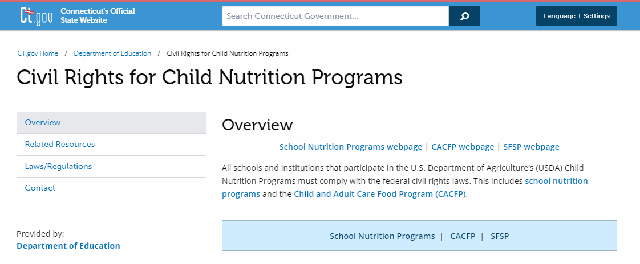
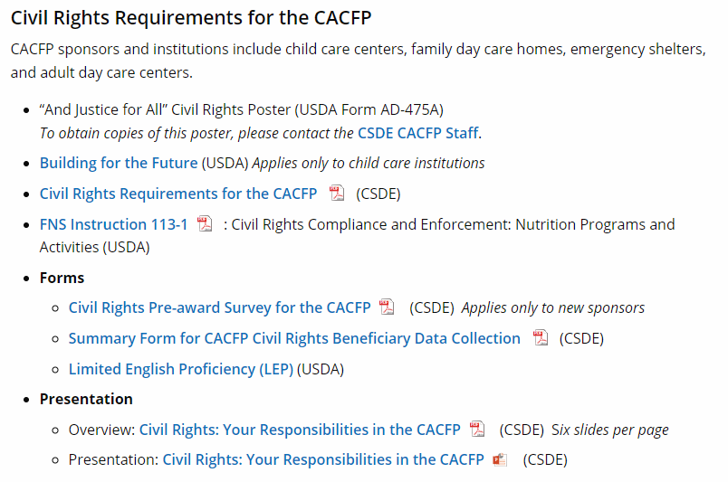
CSDE CACFP Civil Rights webpage
Click on “CACFP” at the top of the webpage
https://portal.ct.gov/SDE/Nutrition/Civil-Rights-for-Child-Nutrition-Programs#CACFP

Slide 37
CSDE CACFP Staff Contact Information
Child and Adult Centers
Susan Boyle susan.boyle@ct.gov 860-807-2074
Benedict Onye benedict.onye@ct.gov 860-807-2080
Child and Adult Centers
Flor Sprouse flor.sprouse@ct.gov 860-713-6849
Evelyn Vicente-Quiñones evelyn.vicente-quinones@ct.gov 860-807-2117
Connecticut State Department of Education School Health, Nutrition and Family Services 450 Columbus Boulevard, Suite 504
Hartford, CT 06103-1861

Slide 38
USDA Nondiscrimination Statement
In accordance with federal civil rights law and U.S. Department of Agriculture (USDA) civil rights regulations and policies, this institution is prohibited from discriminating on the basis of race, color, national origin, sex (including gender identity and sexual orientation), disability, age, or reprisal or retaliation for prior civil rights activity.
Program information may be made available in languages other than English. Persons with disabilities who require alternative means of communication to obtain program information (e.g., Braille, large print, audiotape, American Sign Language), should contact the responsible state or local agency that administers the program or USDA’s TARGET Center at (202) 720-2600 (voice and TTY) or contact USDA through the Federal Relay Service at (800) 877-8339.
To file a program discrimination complaint, a Complainant should complete a Form AD-3027, USDA Program Discrimination Complaint Form which can be obtained online at: https://www.usda.gov/sites/default/files/ documents/ad-3027.pdf, from any USDA office, by calling (866) 632-9992, or by writing a letter addressed to USDA. The letter must contain the complainant’s name, address, telephone number, and a written description of the alleged discriminatory action in sufficient detail to inform the Assistant Secretary for Civil Rights (ASCR) about the nature and date of an alleged civil rights violation. The completed AD-3027 form or letter must be submitted to USDA by:
1. mail: U.S. Department of Agriculture
Office of the Assistant Secretary for Civil Rights
1400 Independence Avenue, SW
Washington, D.C. 20250-9410; or
2. fax: (833) 256-1665 or (202) 690-7442; or
3. email: program.intake@usda.gov
This institution is an equal opportunity provider.

Slide 39
CSDE Nondiscrimination Statement
The Connecticut State Department of Education is committed to a policy of equal opportunity/affirmative action for all qualified persons. The Connecticut Department of Education does not discriminate in any employment practice, education program, or educational activity on the basis of race; color; religious creed; age; sex; pregnancy; sexual orientation; workplace hazards to reproductive systems, gender identity or expression; marital status; national origin; ancestry; retaliation for previously opposed discrimination or coercion, intellectual disability; genetic information; learning disability; physical disability (including, but not limited to, blindness); mental disability (past/present history thereof); military or veteran status; status as a victim of domestic violence; or criminal record in state employment, unless there is a bona fide occupational qualification excluding persons in any of the aforementioned protected classes. Inquiries regarding the Connecticut State Department of Education’s nondiscrimination policies should be directed to: Attorney Louis Todisco, Connecticut State Department of Education, by mail 450 Columbus Boulevard, Hartford, CT 06103-1841; or by telephone 860-713-6594; or by email louis.todisco@ct.gov.

