Slide 1
Selecting Best Practices Using the Hexagon Tool
Caryn Ward
Sophia Farmer
November 19th, 2021

Slide 2
Welcome to a Safe Co-Learning Space!
Please share your story and perspectives as we learn together.
Your questions help us all learn!
Pay attention to how you are feeling and what your body needs and remember to breathe (take a break as you need).
Get up and stretch as needed.

Slide 3
Learning Objectives
Center equity in key exploration activities to prepare for the successful selection of new initiatives
Understand the components of the Hexagon Tool to select best practices within a case illustration
Apply learning to planning for the use of the Hexagon Tool
Together we will…

Slide 4
Think, Pair, Share
In your experience, what is a key factor in the successful selection of a new program or initiative?

Slide 5
Why Implementation Science?
What Is Implementation Science?

Slide 6
Science to Service Gap
Research and Evidence of Best Practices
Teaching and Learning
=
What is adopted is not used with fidelity
What is used with fidelity is not sustained
What is used with fidelity is not used to scale

Slide 7
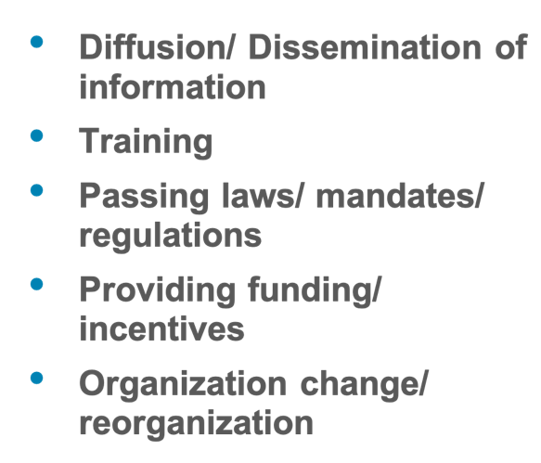
When used alone…
Use of Practice as Intended
=
Return on Investment: 5-15%

Slide 8
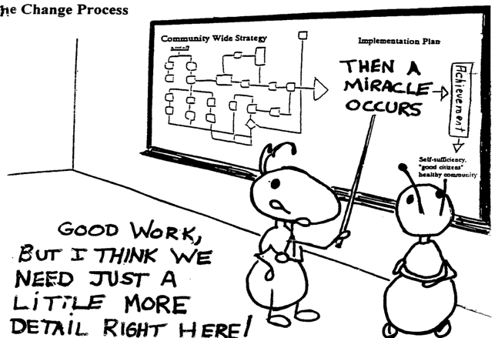
Implementation
Implementation science refers to the “methods or techniques used to enhance the adoption, implementation, and sustainability” of an intervention (Powell et al., 2015)
Implement = Use

Slide 9
Equitable Implementation
Occurs when strong equity components (including explicit attention to the culture, history, values, assets and needs of the community) are integrated into the principles and tools of implementation science to facilitate quality implementation of effective programs for a specific community or group of communities
(DuMont, Metz, & Woo, 2019)

Slide 10
Maximizing our Potential for Improved Outcomes Begins with Exploration

Slide 11
Journey: Implementation Stages
Prior to selecting something new, districts need to engage in exploration. In this stage, districts assess the need, fit, and feasibility for the innovation. Staff are asking “Should we do it?” If the innovation is selected, districts move into the installation stage. It is in installation where resources are allocated, supports are developed, and systems are set up. Once the initial components are installed, districts transition into initial implementation and begin to use the practice. Data is collected to improve supports and staff are working to do it right! Full implementation is when the practice is consistently used as intended (at least 50% of practitioners) and it is having a positive impact on outcomes. During this stage, data is being used to continuously improve the use of the innovation.

Slide 12
Implementation Stages Planning Tool

Slide 13
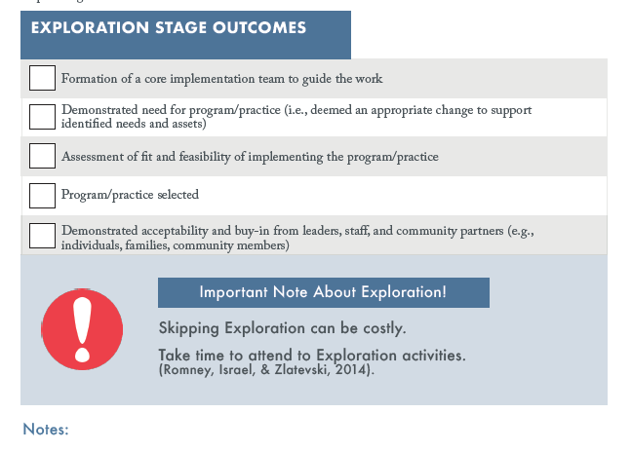

Slide 15
Who?

Slide 16
Think, Pair, Share
Who do you typically engage in a selection process of practices/programs?
What are the advantages/disadvantages to WHO you have included?

Slide 18
Needs Assessment Toolkit
If we engage in careful examination of quantitative and qualitative data to determine the most significant challenges to students’ success, and we further consider the factors contributing to the challenge and identify root causes, then we can develop action steps to address root causes and implement change that will lead to equitable, improved student outcomes.

Slide 19
Assessing & Understanding Need
Engage diverse collaborators – whiteness and those in power should not control the narrative
Uses multiple methods and data sources (at least 3 sources; and disaggregated race/ethnicity and other identifying factors)
Improves implementation and sustainability potential
Comprehensive understanding of the needs of our students, families and staff from their perspective!

Slide 20
Think, Pair, Share
In what ways does bias show up in your data analysis and discussions? What strategies do you employ to acknowledge and counteract the bias?

Slide 21
The Hexagon Tool

Slide 22
The Hexagon Tool
NEED
SUPPORTS
Identification of focus population and subpopulations
Use of multiple data sources and disaggregated data to understand needs and assets
Community perception of needs and assets
Helps organizations evaluate the fit and feasibility of implementing programs or practices in a given context.
Designed to be used by a team to facilitate discussion and ensure diverse perspectives are represented in a discussion of the six contextual fit and feasibility indicators.
Expert assistance
External resources for implementing sites
SUPPORTS
NEED
EVIDENCE
EVIDENCE
Outcome, fidelity and cost effectiveness data
Strength of evidence: for whom and in what conditions
CAPACITY
USABILITY
FIT
CAPACITY
Implementation costs
Resources needed and available for implementation
FIT
Fit with community values, culture and history
Impact on other initiatives
Alignment with other priorities of the implementing site
USABILITY
Well-defined program
Adaptations for context and populations
Notes:
Developed for use in implementation informed assessments
Reviewed and edited by the Racial and Ethnic Equity and Inclusion Team (REEI)
For use by organizations and communities
Most often used in exploration…can also be used to evaluate EBPs that may not be working as anticipated in order to enhance implementation or stop the implementation of that practice.
Note the two colors:
Program Indicators (green) - Program indicators assess the extent to which new or existing programs or practices that will be implemented demonstrate evidence, supports for implementation, and usability across a range of contexts.
Implementing Site Indicators (blue) - Implementing site indicators assess the extent to which a new or existing program or practice aligns with the implementing site along the following domains: population need, fit and capacity. The assessment specifies suggested conditions and requirements for a strong match to need, fit and capacity for the identified program or practice.

Slide 23
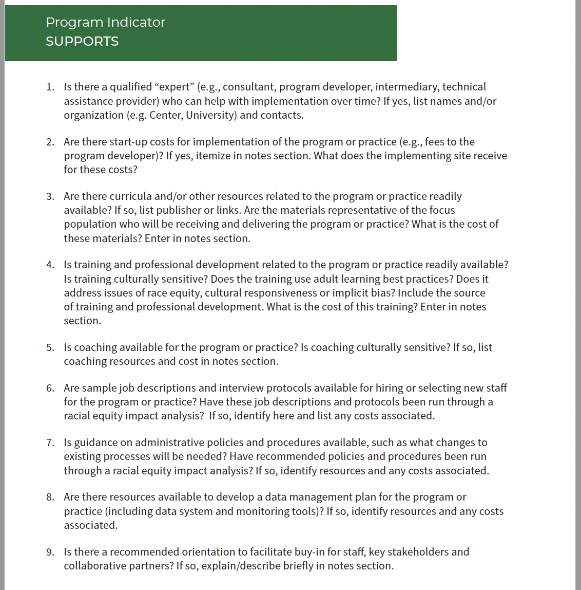
The Hexagon Tool
Questions

Slide 24
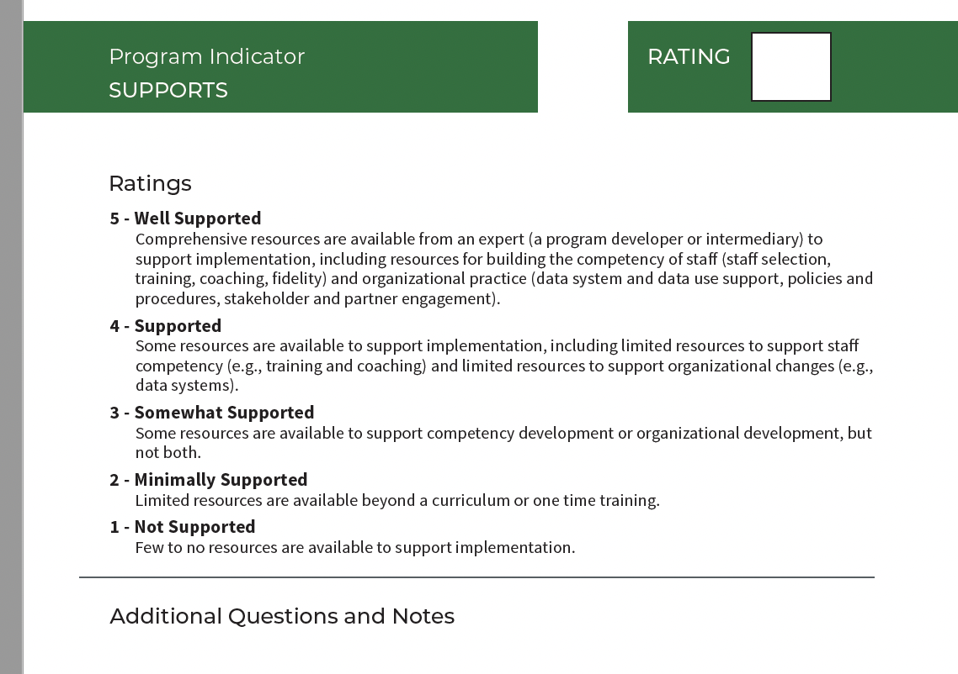
The Hexagon Tool
Rating Scale

Slide 25
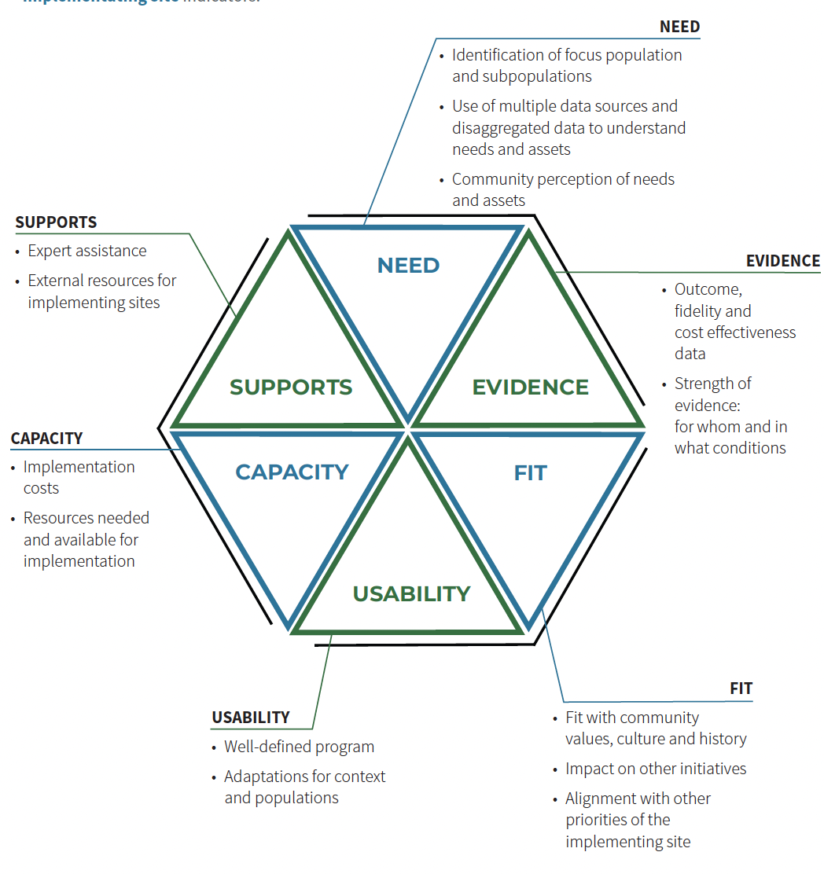
Which indicator(s) do you think LEA’s consider most frequently in their selection?
Why?

Slide 26
Centering Equity
Using the Hexagon Tool with a race equity lens can prompt teams to consider the impact of the program or practice on the focus population and whether implementation of the program or practice could advance equitable outcomes for all individuals and families.
Fully and actively engage the focus population and community partners in the process – know the history and values of the community
The team should be knowledgeable of social justice in order to apply these concepts in the discussion and decisions
Disaggregate ALL data!
Notes:
The focus population and community partners should be engaged in determining the broad need, as members of the discussion team and in the selection of programs and practices to be considered.
The team conducting the assessment should either have a background in or be provided with training on DEI so that they can apply these concepts in their assessment of fit and feasibility.
All data (programmatic, fidelity, outcome, etc.) used to assess need and evidence should be disaggregated by race/ethnicity where appropriate, as well as by sub-population characteristics (e.g., gender, socioeconomic status, geography).

Slide 27
Breakout Jigsaw!
You will be randomized into 1 of 12 groups by indicator (i.e., Need A, Need B, Capacity A, Capacity B, etc.)
In your groups, select a facilitator and TWO reporters.
Facilitator: keep your group on task.
Reporters: jot down notes to share with the whole group.
The groups should be able to answer 3 questions:
What is this indicator helping us to determine? (Reporter 1 on Menti)
Which questions do we already typically consider?
Which questions do we NOT typically consider and are excited to discuss? (Reporter 2 in Chat)
Be prepared to help others understand your indicator!
Notes:
20 minutes

Slide 28
Site Indicators

Slide 29
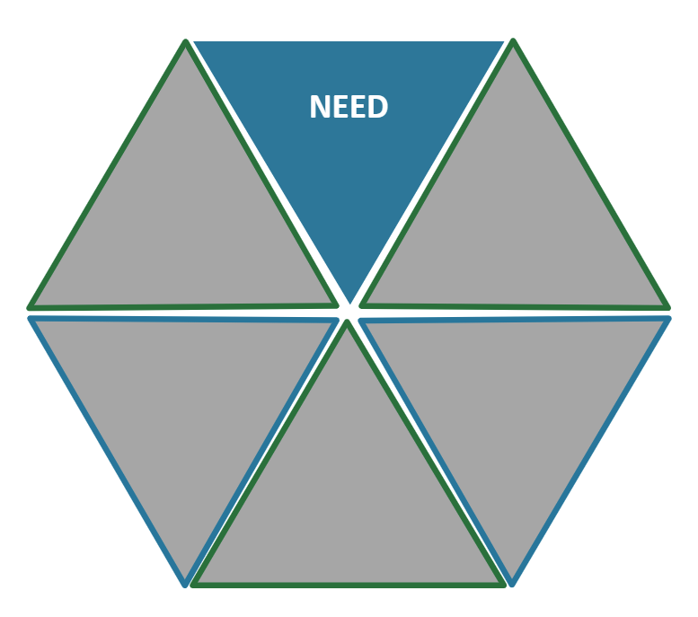
Need: Do we need this program or practice?
Notes:
Refer to the handout of the Hexagon Tool. Remember, there are several questions that assess each indicator. The team would want to be sure to answer all/most. The ones hi-lighted here are those we would want to prioritize to ensure equitable outcomes.

Slide 30
Fit: Does the program fit our needs?

Slide 31
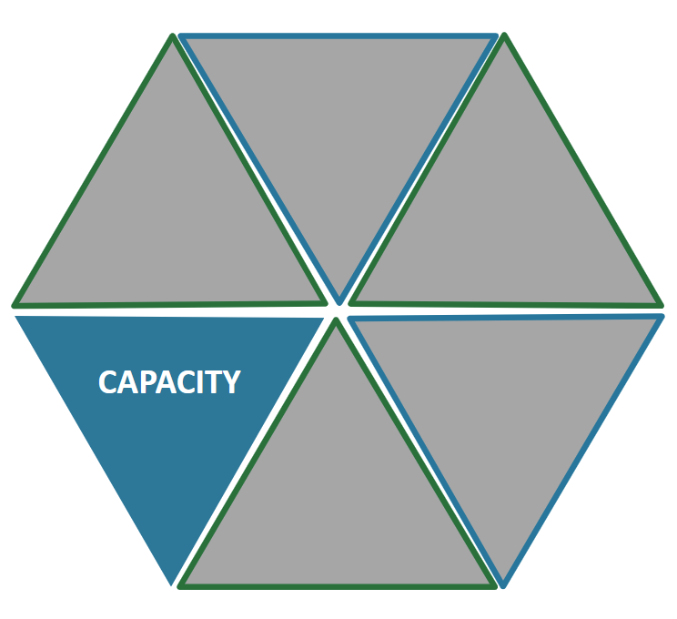
Capacity: Can we implement the program?
Notes:
Leadership knowledgeable and in support
Staff not a strong match – relationships perceived as ‘generally’ ok

Slide 32
Program Indicators

Slide 33
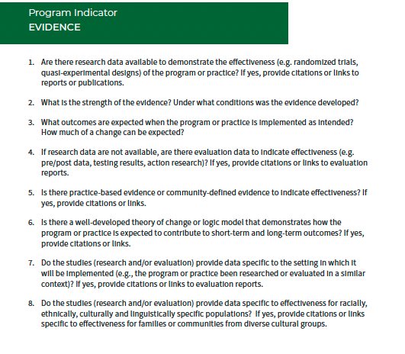
Evidence: Has this program gotten results?

Slide 34
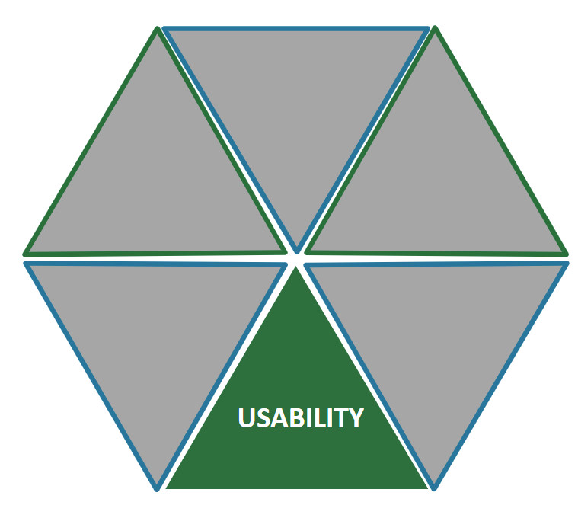
Usability: Is the program designed so that we can implement it well?

Slide 35
Supports: What kind of help can I get to implement the program?

Slide 36
Breakout Planning!
You will be placed in a breakout room by school.
In your groups, select a facilitator, a notetaker and a reporter.
Facilitator: keep your group on task.
Notetaker: take notes to document your action planning.
Reporter: be prepared to share out one action item.
The groups should:
Determine who should be on a team to re-examine an existing program. Who might not be on a team but from whom you might need information? (Hint: Form a new team? Repurpose a team? Think of the stakeholder ‘circle’. )
For each indicator determine what data and/or data reports are needed to fully answer each question.
Determine action steps for getting the data needed.

Slide 37
Share your next action step!

Slide 38
Next Steps:
Convene the team you planned for during breakout sessions.
Select a program or practice that you are currently implementing.
Gather the data needed as determined in your action plan for your school (site indicators) and program (program indicators).
Complete the Hexagon process.
Bring your notes and Hexagon data to the next session on February 25th.

Slide 39
Copyright

Slide 40
FPG Branding

