Slide 1
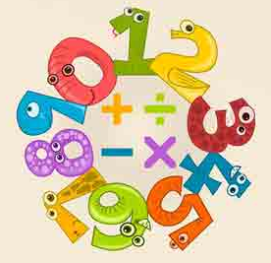


Instructional Coaching in the Elementary Mathematics Classroom
MSP Grant
Area Cooperative Education Services
EdAdvance
(Formerly Education Connection)

Slide 2

What is the greatest need?
Notes:
Anticipation Guide. What is the greatest need for mathematics in elementary school? That the quality of mathematics teaching depends on teachers’ knowledge of the subject. Research done by Deborah Lowenberg Ball – University of Michigan. We administered the Mathematical Knowledge for Teaching Measures.
mathematical knowledge of most American adults is as weak, and often weaker. increasing the quantity of teachers’ mathematics coursework will only improve the quality of mathematics teaching if teachers learn mathematics in ways that make a difference for the skill with which they are able to do their work. The goal is not to produce teachers who know more mathematics. The goal is to improve students’ learning. Teachers need to be people who can work and reason with mathematics, and who possess particular mathematical qualities. Teaching requires being able to represent ideas and connect carefully across different representations – symbolic, graphical, and geometric. Representation is a central feature of the work of teaching; skill and sensibilities with representing particular ideas or procedures is as fundamental as knowing their definitions. Using mathematical language with care, and understanding how definitions and precision shape mathematical problem solving and thinking is another element crucial to understanding how teachers must use –– and therefore know –– mathematics. Because teaching involves cultivating students’ interest in mathematics, teachers need to be people who are themselves curious and interested in mathematics and who are fascinated by students’ mathematical curiosities and interests.

Slide 3
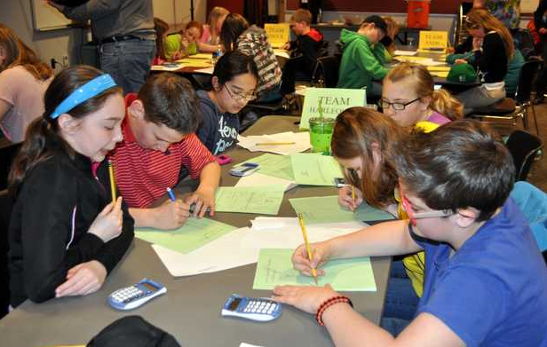
Student Mathematical Proficiency

Slide 4
What does it take to teach for mathematical proficiency?
Notes:
Have participants complete the anticipation guide.

Slide 5
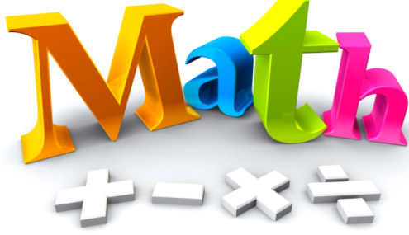


Knowledge Base for Teaching Mathematics
Knowledge of the Mathematics
Knowledge of the Students
Knowledge of the Instructional Practices
Notes:
3 Kinds of Knowledge are crucial

Slide 6
It takes the ability to:
Design mathematically accurate explanations that are comprehensible and useful for students;
Use mathematically appropriate and comprehensible definitions;
Represent ideas carefully, mapping between a physical or graphical model, the symbolic notation, and the operation or process;

Slide 7
Interpret and make mathematical and pedagogical judgments about students’ questions, solutions, problems, and insights (both predictable and unusual);
Be able to respond productively to students’ mathematical questions and curiosities;
Make judgments about the mathematical quality of instructional materials and modify as necessary;
Be able to pose good mathematical questions and problems that are productive for students’ learning;
Assess students’ mathematics learning and take next steps.

Slide 8
Survey – How often do you have professional learning in mathematics?
Notes:
Cohen and Hill 1998 report: “Capable math teachers must know many things, but their knowledge of mathematics and how it is taught and learned are central.” The National Center for Education Statistics 2005 released study on Professional Development noted that across the country mathematics had the least number of hours of professional development. Partner districts had similar responses. The limited number of hours in mathematics professional development correlates with the response of 55% of the teachers stating that they seldom or only sometimes are provided professional learning in use the standards and/or research materials to strengthen instructional and student performance.

Slide 9
CMT Needs Assessment Participating Districts

Slide 10
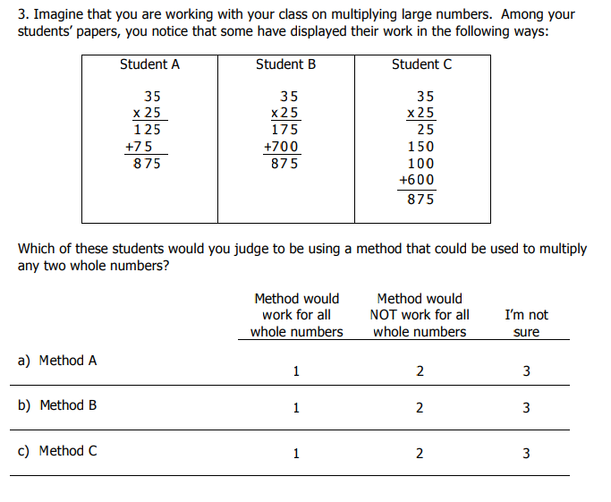
Mathematical Knowledge for Teaching Measures Survey
Notes:
Sample Item Type

Slide 11
Teacher Leadership
Nowhere has the use of teacher leaders been more visible and played a more significant role in efforts to achieve reform of teaching practices than in mathematics and science (Weiss et al. 1999, Briars 1999).
Supported by;
TIMSS Studies
Coburn 2001, 2006
Notes:
Nowhere has the use of teacher leaders been more visible and played a more significant role in efforts to achieve reform of teaching practices than in mathematics and science (Weiss et al. 1999, Briars 1999).
Educational Leadership Self Inventory (CSDE, 2001), the majority of teachers expressed a lack of knowledge of the leadership role of facilitating new learning in a variety of formats, such as workshops. 68% of the partner teachers that responded answered that only sometimes did they work with teachers to create a variety of formal and informal opportunities for teachers to further develop their understanding of the learning process and to examine the implications of the learning process for teaching, and 6% seldom worked in this area. A very small portion or 2% of the teachers surveyed almost always work with staff to design professional development activities to improve teaching and learning. 7% stated that they frequently work on professional development, however 25% sometimes work on it and 66% seldom are involved in the planning of professional development. These responses indicate that the majority of teachers have not had experience in designing professional development activities.

Slide 12
Teacher Leadership Capacity
Notes:
The results of the Education Leadership Self Assessment that was a tool from the CSDE.

Slide 13
Project Goals
Raise student achievement in elementary mathematics
Strengthen and deepen teachers’ understanding of mathematics content and process
Strengthen teachers’ knowledge of content-specific pedagogy
Interpret and make professional decisions to respond to students math needs
Equip participants in the proficient selection and use of effective instructional strategies specific to elementary mathematics

Slide 14
Project Goals
Develop participants’ understanding of the principles and practices related to establishing collegial coaching relationships with teachers
Develop participants’ abilities to facilitate collaborative analysis and discussions around qualitative and quantitative student data and work.
Increase district and school support for instructional coaching as a tool for improvement in mathematics teaching and learning

Slide 15

Training/Implementation 160 Contact Hours
Content and pedagogy instruction combined from faculty at CCSU and Quinnipiac each year.
On-line course “Teaching Mathematics” Colorado State University
Instructional Coaching Training – University of Kansas Model
Cognitive Coaching Model
Higher Education Visits- CCSU
Master Coach Trainer Visits
Developing Leadership – Creating the Capacity for Improving Math Teaching - CCSU

Slide 16
CMT Outcomes Participating Districts

Slide 17
Student Outcomes - CMT Results
Notes:
13 School districts - Average increase of 14% achieving goal.

Slide 18
Teacher Outcomes
The average increase of teachers/coaches on the Mathematical Knowledge for Teaching Measures Survey was 37%
92% of participants who completed the three years of training obtained full-time math coaching or teacher leader positions.
2 participants won the Presidential Award for Excellence in Mathematics and Science Teaching (in mathematics)

Slide 19
Outcomes
1 participant was hired by a math intervention company to develop and train teachers in intervention strategies for mathematics.
1 participant has moved on to the role of Asst. Superintendent
4 have moved on to school level administration positions.

