Slide 1


Connecticut Core Standards for Mathematics
Systems of Professional Learning
Module 2 Grades 6-12:
Focus on Content Standards
Notes:
(Slides 1-5, including the pre-assessment, will take about 10 minutes total.)

Slide 2

The Progression of the Content Standards
Section 3
Page 16
Notes:
Section 3: The Progressions of the Content Standards
Section 3 Time: 80 minutes
Section 3 Training Objectives:
To provide participants with information on, and experience with, identifying standards that address conceptual understanding, procedural skill and fluency, and application of mathematics.
To have participants experience how concepts are developed within and across grade levels.
To provide participants practice with identifying concept progressions.
To provide participants with an understanding of how connections between standards across multiple domains can be made to support the deepening of mathematical understanding.
Section 3 Outline:
The definitions of “conceptual understanding”, “fluency”, and “application” developed in the previous session are used to help participants analyze the content standards in three different ways. In Exploring the Standards Part 1, participants explore the content standards for one domain, at one grade level, and determine which standards focus on conceptual understanding, procedural skill and fluency, and application of mathematics.
In Exploring the Standards Part 2, participants explore the content standards for one domain across grade levels and record five general observations about the progression of the concepts and two connections to the Practice Standards.
In Exploring the Standards Part 3, participants explore all of the domains for one grade level to identify connections across domains that can be referenced in a lesson or unit in order to support the deepening of mathematical understanding.
Participants will then discuss and reflect as a large group on the importance and instructional implications of the progressions and any new insights they now have into the standards.
The activity will conclude with having participants view the video Gathering Momentum for Algebra in order to see where the K-5 content progressions impact the larger K-12 learning pathway.
Supporting Documents:
Standards for Mathematical Practice
Exploring the Content Standards Observation Sheet
Materials
Chart paper, markers
Sets of Standards Progression Cards (one color per domain) (1 full domain color set per table group)
Signs made for tables: 6, 7, 8
Video
Gathering Momentum for Algebra
Notes: In this activity you will have full sets of content standards with one standard per card. Each of the cards is color coded for each domain that it belongs under. You begin by giving a table one grade level set that has all of the domains for that grade level and with that set they complete part 1. Then ask participants to give all of a particular domain to one table, so one table will have all of the Expressions and Equations standards, one table will have all of the Geometry standards, etc. With that domain they complete part 2. Then, have participants separate the domain by grade level again and give each table the full grade level set again so that they can complete part 3. While participants should have a full set of print-based standards, having them work with the standards in this card format allows them to physically manipulate the standards, create connections, and see the progressions side-by-side rather than having to flip through multiple pages.

Slide 3
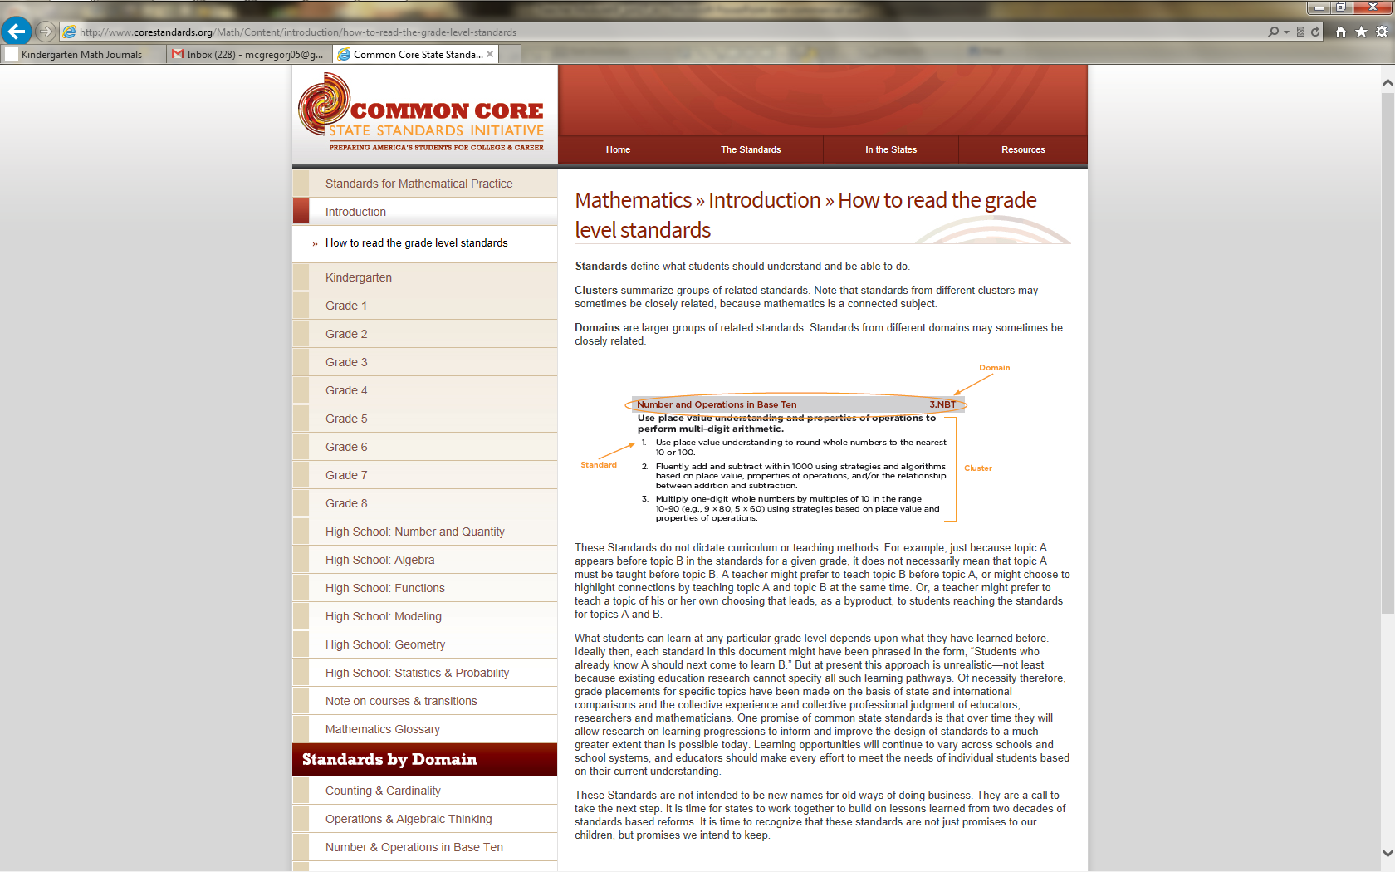
The Organization of the Standards
Notes:
The Organization of the Standards
Quickly go through the organization of the Content Standards with the participants. Each grade level is organized by domains and within each domain there are associated groups of standards that make up a cluster. There can be multiple clusters within a domain. Transition to the next slide by explaining that domains span several grade levels.

Slide 4
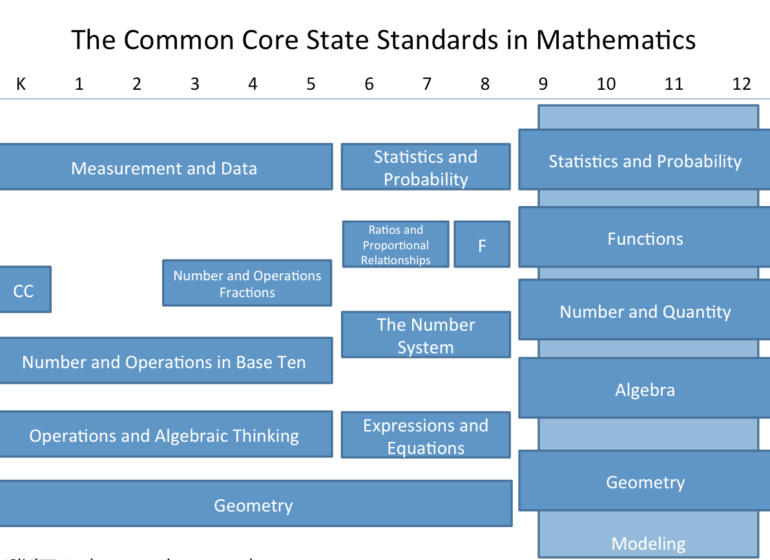
Domain Distribution
http://www.definingthecore.com
Notes:
Domain Distribution
Explain that in K–8, there are four or five domains per grade level. Note that the Geometry domain is the only domain that spans K-8. When students are developmentally ready and have a solid foundation in Number and Operations in Base Ten, Number and Operations – Fractions is layered on beginning in third grade. In high school, there are 5 “conceptual categories”. In the background of these is the Modeling conceptual category – modeling standards appear throughout the high school standards and are indicated by a star symbol (★). Each conceptual category is broken up into 4-6 domains. Transition to the next slide by reminding participants that the domains and conceptual categories were determined based on a very specific and coherent roadmap for learning called a progression.

Slide 5
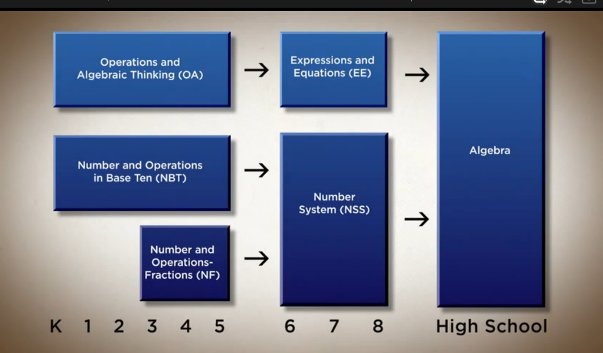
Domain Progression
For More Information: http://commoncoretools.me/category/progressions/
Notes:
Domain Progression
Remind participants that the domains were written so concepts build on each other grade after grade so that, in this particular progression, there is a clear pathway to high school Algebra. The video at the end of this section is an explanation of the progressions from CCSS-Math Co-Author, Bill McCallum.
More information about specific domain progressions can be found at the Common Core Tools Website: http://commoncoretools.me/category/progressions/. Have participants make a note of this resource.

Slide 6
Exploring the Content Standards
Ratios and Proportional Relationships
and Functions
The Number System
Expressions and Equations
Geometry
Statistics and Probability
Notes:
Exploring the Content Standards
Participants will be divided into grade level groups (6, 7, and 8) to complete the three parts of Exploring the Standards. Signs for each grade, 6–8, should be posted around the room. Assign each table one of the 6–8 Content Standard domains and pass out the color coded domain cards to each group. Explain to high school participants that they are being included in the middle school groups at this time because, to fully understand the expectations at the high school level, it is important that they first understand the mathematics expectations at the middle school level. As they work through the activities, ask them to specifically think about how the progression of the middle school standards will impact student learning in high school and how their new understandings will impact their instructional practices.

Slide 7
Exploring the Content Standards
Part 1
Examine your assigned domain and determine which standards focus on: Conceptual Understanding (CU) Procedural Skill and Fluency (PSF) Application (A)
8.EE.1
Know and apply the properties of integer exponents to generate equivalent numerical expressions.
8.EE.3
Use numbers expressed in the form of a single digit times an integer power of 10 to estimate very large or very small quantities, and to express how many times as much one is than th eother.
8.EE.2
Apply Use square root and cube root symbols to represent solutions to equations of the form x²=p wheand x3=p where p is a positive rational number.
Page 16
Notes:
EXPLORING THE CONTENT STANDARDS PART 1
Exploring a Progression
For Part 1 of Exploring the Content Standards, ask participants to examine their assigned domain and determine which standards focus on Conceptual Understanding, Procedural Skill and Fluency, and Application of Mathematics. Participants should use sticky notes to mark the card with either CU, PSF, or A according to how they sorted the cards. After sorting and marking the cards, have participants answer the following questions on page 16 in their Participant Guide:
What are the expectations around conceptual understanding at this grade level?
What are the fluency expectations at this grade level?
What are the opportunities for application at this grade level?
Prompt the high school teachers to think about how the language and approach to conceptual understanding, fluency, and application to mathematics will prepare students for the standards in the courses that they teach.

Slide 8
Explore the Content Standards
Part 2
Examine your assigned domain across the 6-8 grade band and record five general observations about the progression and two observations about the relationship between the Content and Practice Standards.
8.NS.1
Know that numbers that are not rational are called irrational. Understand informally that every number has a decimal expansion; for rational numbers show that the decimal expansion repeat eventually…
7.NS.1
Apply and extend previous understandings of addition and subtraction to add and subtract rational numbers; represent addition and subtraction on a horizontal or vertical number line diagram.
6.NS.1
Interpret and compute quotients of fractions, and solve word problems involving division of fractions by fractions, e.g. by using visual fraction models and dquations to represent the problem.
Page 17
Notes:
EXPLORING THE CONTENT STANDARDS PART 2
Exploring a Progression
Now, ask participants to examine the Content Standards in their assigned domain across grade levels and complete the observation worksheet on which they record five general observations about the progression and two observations about how the Practices are integrated into the content. Ask high school participants to think specifically about how the middle school progressions they are examining set the foundation for the mathematics they teach in their courses as they will discuss this as a group in Part 3. Allow each domain group to share their observations.
The goal here is for participants to see the progression of conceptual understanding, procedural skill and fluency, and application of mathematics and how they are developed across grade levels. Because they are using the cards, participants should be able to line up the grade level domain standards side by side so that the vertical alignment can be seen horizontally across their table allowing for a continuous comparison.
Transition to Part 3 of the activity by explaining to participants that teaching the standards is not just about understanding how the Content Standards progress across a domain, but also about understanding how the standards of different domains work together.

Slide 9
Exploring the Content Standards
Part 3
Examine all of the Content Standards for your assigned grade level. Make connections across domains and create clusters that can be taught as part of a lesson or unit.
7.RP.2
Recognize and represent proportional relationships between quantities.
7.EE.1
Apply properties of operations as strategies to add, subtract, factor, and expand linear expressions with rational coefficients.
7.NS.2
Apply and extend previous understandings of addition and subtraction to add and subtract rational numbers; represent addition and subtraction on a horizontal or vertical number line diagram.
Page 18
Notes:
EXPLORTING THE CONTENT STANDARDS PART 3
Making Connections
Ask participants to separate their domain cards by grade level. Direct participants to the areas around the room designated for each grade, 6–8 and high school. Middle school participants should take the cards for their grade level from the table to the designated area. For each grade, 6-8, the cards for all five domains will be combined so there is a complete set of Content Standards for each grade level. In larger groups there may be several complete sets so the grade groups can be broken into two or three smaller groups. Once they have their complete set of standards, ask participants to examine all of the Content Standards for their grade level and make connections across the domains that can be referenced as part of a lesson or unit.
While middle school participants work to identify connections across domains, ask high school participants to make connections between the work students complete in each of the middle school domains and the content for the high school courses. Also, have high school participants think about the progressions in reverse and determine what connections they feel that middle school teachers should be aware of in order to help students make the successful transition from middle school mathematics to high school mathematics.
Allow participants 10 minutes to create and record the connections and then take 10 minutes to allow each grade level the opportunity to share one or two of their connections. They can record their thoughts on page 18 in the Participant Guide. Note: Remind participants that even though there are differences in individual standards at each grade level and in structure (grade level structure in K‒8 and course structure in 9‒12), a constant in the CCS-Math for all grades K‒12 are the Practice Standards.

Slide 10
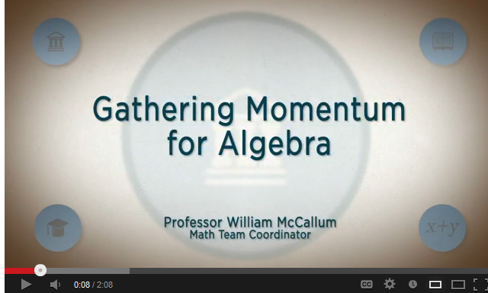
From the Authors
Watch Video
Notes:
To begin to wrap up this section, click on “Watch Video” to play the video Gathering Momentum for Algebra from here: http://www.youtube.com/watch?v=ONPADo_Nt14. The video is 2:08 long.
Use this video to transition to the next slide.

Slide 11

Reflect
  How might you help teachers at your school to fully understand the progressions of the content standards?
  What questions do you anticipate teachers having about the content standards?
Page 19
Notes:
Reflect
Now that participants have a deeper understanding of the CCS-Math expectations around conceptual understanding, procedural skill and fluency, and application of mathematics at their grade level, ask them to reflect on the two questions on the slide and record their answers on page 19 in their Participant Guide. As time permits ask for volunteers to share their responses. Allow 5 minutes.
Then, set up the after lunch activities by explaining to participants that they will build off of their understanding of the Content Standards to explore the implications for teaching and learning in the classroom.

