Slide 1
From Silos to Systems
City of Waterbury

Slide 2
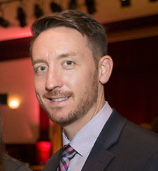
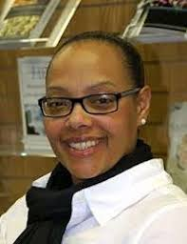
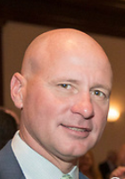

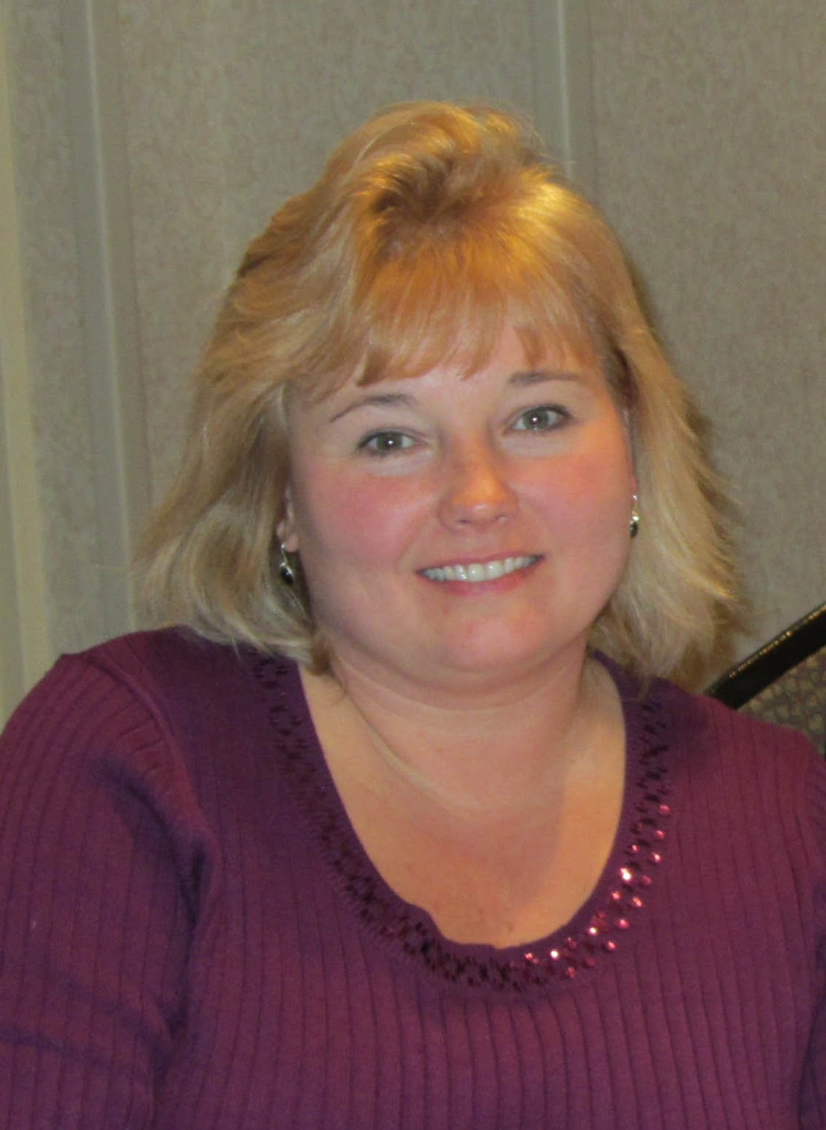
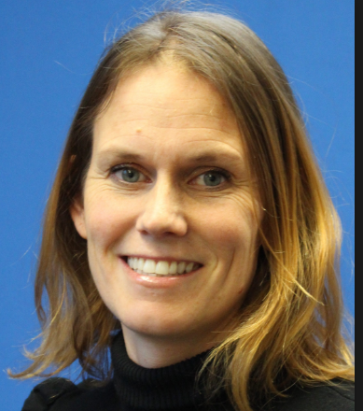
Presenters
Darren Schwartz, Chief Academic Officer, Waterbury Public Schools and School Readiness Co-Chair- dschwartz@Waterbury.k12.ct.us
Althea Marshall Brooks, Executive Director, Waterbury Bridge to Success director@waterburybridgetosuccess.org
Jim O'Rourke, Chief Executive Officer, Greater Waterbury YMCA jorourke@waterburyymca.org
David Morgan, TEAM Inc President/CEO, Waterbury Bride to Success Chair- dmorgan@teaminc.org
Karen Rainville, School Readiness Liaison, Chair of the Early Childhood Collaborative Action Network-krainville@Waterbury.k12.ct.us
Kris Noam, Waterbury Bridge to Success, Director of Research and Evaluation-data@waterburybridgetosuccess.org
Notes:
Who is in the room?

Slide 3
All communities have caring and passionate individuals, Stakeholders and providers who are working tirelessly to improve the outcomes of their youngest citizens.
Who are those individuals, stakeholders and providers in your community?

Slide 4
You can’t do it alone
Are we managing grants or do we need a paradigm shift to look at the whole child for community wide impact?

Slide 5
Essential Question
How do you take the silos that exist in schools and community and establish an effective partnership to improve common early childhood outcomes?
This presentation will explore how local councils and community relationships can be better leveraged under the Strive Together Theory of Action.

Slide 7

Our History
WPS Preschool
Community
School Readiness
Foundation Support

Slide 8
Bridge to success (BTS)
BTS is a cross-sector partnership of over 90 community and civic leaders, educators, and organizations. We work collectively to achieve equitable change by empowering Waterbury's children, youth, and families, to be successful in school, career, and life.

Slide 9
Collective Impact
A cradle to career vision-we recognize there is no singular program that will solve our community needs.
Rather, it is strategic collective work dedicated to specific goals in a framework of accountability.

Slide 10
How does collective impact show up?
Trusting relationships
Shared accountability
Purposeful engagement
Cross-sector partnership
Actionable data

Slide 11
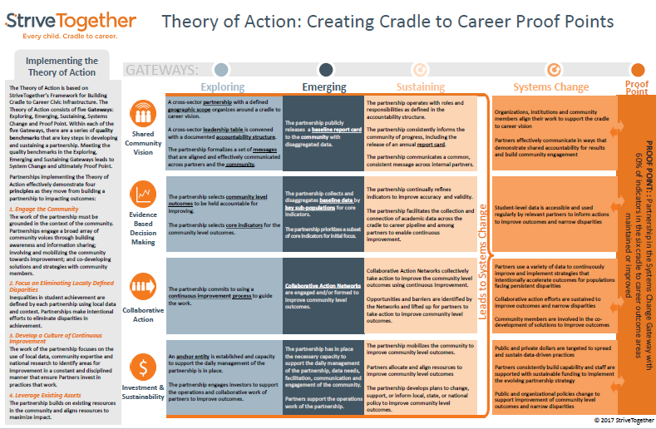
Cradle to Career – Theory of Action

Slide 12
BTS Collaborative action networks (CAN)
  Early Childhood and Education CAN -- promoting kindergarten readiness and early literacy development.
  Positive Youth Development CAN -- reducing summer learning loss, addressing youth's development assets, and reducing absenteeism to increase high school graduation rates.
  College and Career Pathways CAN -- focusing on youth’s economic, occupational, and educational development and success.
  Equity Matterz and Family Engagement Think Tank

Slide 13
School Readiness slots
Notes:
From losing to requesting seats

Slide 14
The Mayor took us to the barn
Changing how we go about the work of supporting our youth and families
Identify strategies to improve core elements of Waterbury’s Early Childhood system (All Children/All settings)
Establish roles and responsibilities for strategic partners in achieving objectives
Establish a plan that includes strategies, timelines, benchmarks and accountability
Notes:
Who was there?

Slide 15
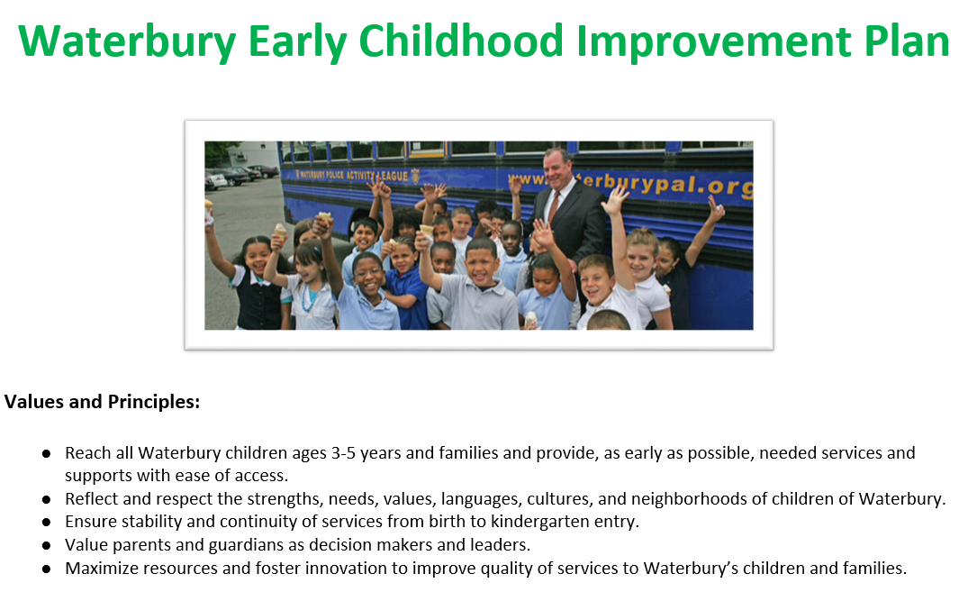

Slide 16
Improvement Plan Goals
Goal #1 Develop a plan to span the next 3 years by October 2016 for a system of strategies to improve quality of early childhood classrooms in Waterbury through engagement with community partners.
Goal #2 Develop classroom evaluation system by January 2017 to support continuous quality improvement (CQI) in four categories: 1) Child Outcomes, 2) Facility Curriculum & Learning Environment & Interactions, 3) Professional Development & Training, and 4) Family Engagement & Partnership. Include leadership and management practices in comprehensive center evaluations used for quality ratings necessary to achieve an accurate picture of the environment in which both children and adults develop in order to produce accurate evaluations of program quality,
Goal #3 Develop plan of resources and supports for early childhood programs in a variety of settings to improve program quality towards child outcomes by June 2017.
Goal #4 Develop and implement a plan for building greater stakeholder engagement for informed and responsive decision-making in Waterbury at every level through Local collaboration and coordination; Strategic communication at all levels to and between; Service providers; Administrators; and Leaders and policymakers towards shared understanding of common goals and roles. Develop of local system for EC data and use of available data for decision making.
Goal #5 Fill 100% of all School Readiness Slots every grant year by December 1st of each grant year.

Slide 17
Key “moves”
Establishing a Waterbury Office of Early Childhood
Focusing on the family rather than the provider
Collaborating with the CT Office of Early Childhood
Engage funders on common Early Childhood outcomes
Leveraging Data Haven Report and making decisions to relocate programs
City Hall and Board of Ed President Support
Quality Enhancement funding priorities and moving beyond “slots”
Prioritizing SEL outcomes and becoming a “pyramid” city
Defining Quality of programs and monitoring

Slide 18
Current Sample of Collective work around sel
Early Childhood Mental Health Symposium
Implemented a Universal Screening
Using QE dollars to provide a BCBA to school readiness sites
Funders aligning grants to the SEL priority
Private providers for shared professional development and quality conversations
Adopting PowerSchool for School Readiness Sites to document interventions
Early Intervention Supports provided by WPS
Common professional development for SEL and trauma informed practices

Slide 19
School Readiness Council
BTS Early Childhood CAN
Mayoral Task Force
Workforce Development
Transportation
Meeting the needs of our youth and families
Waterbury Public Schools PK
Funders
Business and Chamber of Commerce
Health and Wellness
Higher Education
Housing Authority
Faith Community
DCF

Slide 20
Questions for you
Who are those individuals, stakeholders and providers in your community?
Who is missing?
If you were a parent in your community, what would your experience look like when attempting to find quality care and education?
How will you determine current assets/needs around:
actionable data, purposeful engagement, trusting relationships, cross-sector partnerships and collective accountability?

Slide 21
Questions for us

