Slide 1
What to Know About
Standard Service and Suppliers
Connecticut Public Utilities Regulatory Authority –
Office of Education, Outreach, & Enforcement

Slide 2
Supply Portion of Your Electric Bill
Your electric bill is divided into two sections: Supply and Distribution
For the supply portion of the bill you may choose to receive supply from
Eversource or UI (called standard service).
Standard Service is regulated by the Public Utilities Regulatory Authority (PURA)
Standard Service is a pass through, meaning the utility charges you what it costs them and the utility does not profit from Standard Service supply.
OR
You may choose to contract with a third-party supplier
The rates charged by third-party suppliers are NOT regulated by PURA and therefore suppliers may profit from these rates.
If you do nothing, you will receive standard service supply.
No customer is required to contract with a third-party supplier.
Connecticut Public Utilities Regulatory Authority –
Office of Education, Outreach, & Enforcement
Connecticut Public Utilities Regulatory Authority

Slide 3
Standard Service Rate
The Standard Service rate remains fixed for six months.
It changes only on January 1 and July 1 each year.
The new rates are submitted in advance in Docket Nos. YEAR-01-01 (Eversource) and YEAR-01-02 (UI) (for example, 23-01-01 and 23-01-02)
The new rates are published on EnergizeCT.com as soon as they are approved by PURA.
Connecticut Public Utilities Regulatory Authority –
Office of Education, Outreach, & Enforcement
Connecticut Public Utilities Regulatory Authority

Slide 4
Enrolling With a Supplier
  To enroll with a supplier:
  Visit EnergizeCT.com
  Click Rate Board in the upper right corner
  Click Compare Energy Supplier Rates
  Choose your utility and rate class
  You may filter selections using information on the left side.
  Rates are displayed from least to most expensive as compared to the standard service rate.
Connecticut Public Utilities Regulatory Authority –
Office of Education, Outreach, & Enforcement

Slide 5
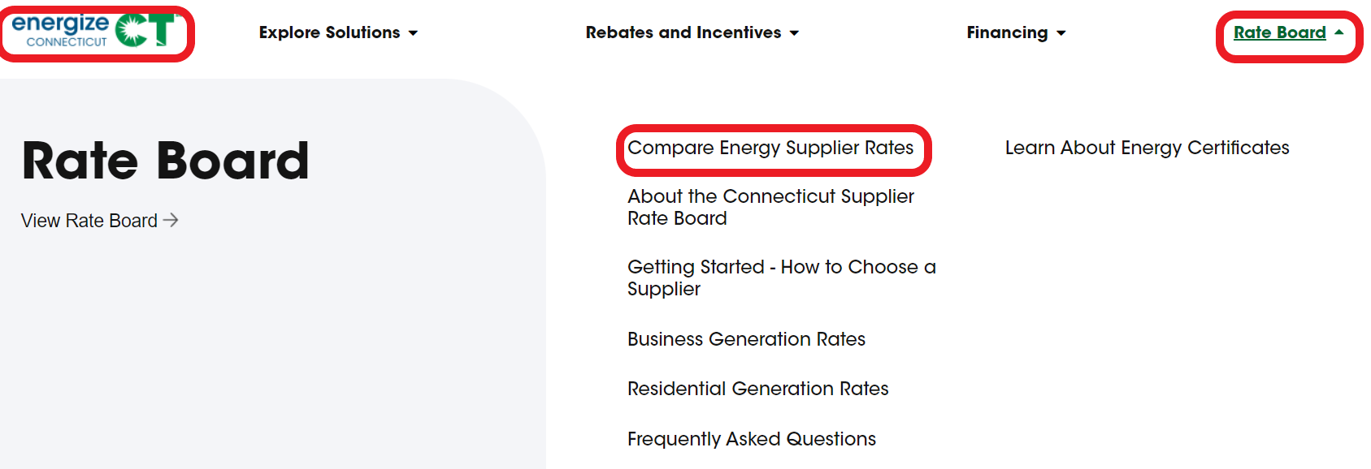
Enrolling With a Supplier
Below is the official Rate Board at EnergizeCT.com.
A search engine may give you other sites as top search results.
Be certain to visit the official site.
Connecticut Public Utilities Regulatory Authority –
Office of Education, Outreach, & Enforcement

Slide 6
Enrolling With a Supplier
If enrolling with a supplier you will need information from your electric bill:
  Your utility account number
  Your POD id (for UI customers)
  Your billing cycle
  Your meter read date
  Your name key
  Your service reference number
Connecticut Public Utilities Regulatory Authority –
Office of Education, Outreach, & Enforcement

Slide 7
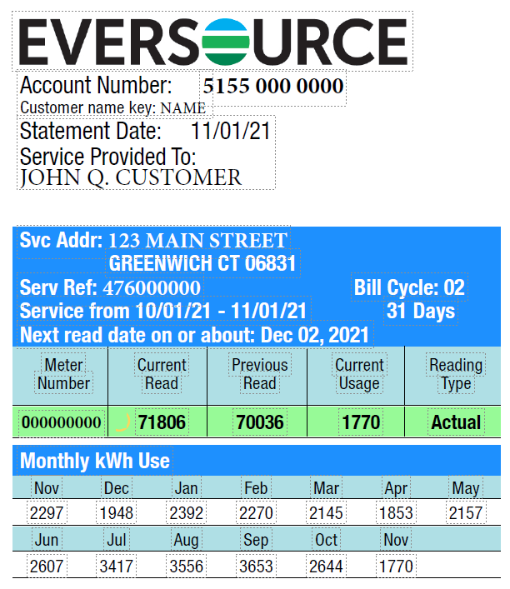
Enrolling With a Supplier
This information is in the upper left corner on the second page of an Eversource bill
Connecticut Public Utilities Regulatory Authority –
Office of Education, Outreach, & Enforcement

Slide 8
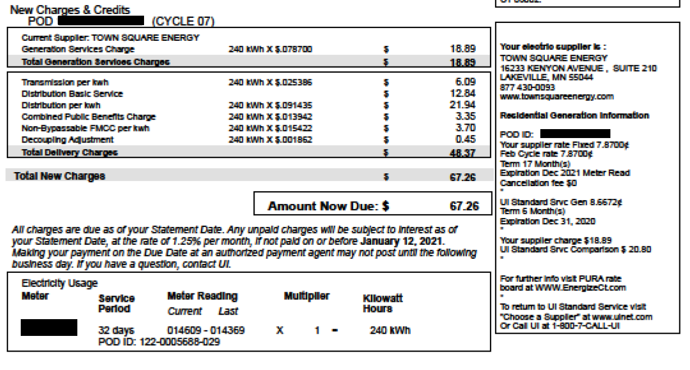
Enrolling With a Supplier
This information is on the first page of your UI bill.
Connecticut Public Utilities Regulatory Authority –
Office of Education, Outreach, & Enforcement

Slide 9
Cancellation Fees
Suppliers may not charge residential customers a cancellation or early termination fee.
Supplier may charge cancellation or early termination fees to business customers.
Before enrolling with a supplier, business customers should read the contract to find the early termination fees.

Slide 10
What to Know
Third party supplier rates for residential customers must be:
Fixed
Last for at least four months
Third party supplier rates for business customers may be variable or fixed for any contract length.
Third party supplier contracts often automatically renew for a rate different than the rate you are currently paying. You must cancel or renegotiate the contract if you do not want to renew at the renewal rate.
Connecticut Public Utilities Regulatory Authority –
Office of Education, Outreach, & Enforcement

Slide 11
What to Know
  If you choose to contract with a supplier:
  Know the rate you are contracting for
  Know the Standard Service rate to compare your supplier rate
  Know when your contract is scheduled to end. Most supplier contracts automatically renew at rates different than the current contract rate. If you do not take action to cancel the contract before the renewal, you will be charged the renewal rate.
Connecticut Public Utilities Regulatory Authority –
Office of Education, Outreach, & Enforcement

Slide 12
What to Know
Suppliers are not affiliated with Eversource or UI. Eversource and UI do not call you about supply.
There is no state-sponsored supplier or “energy choice” program. You do not have to contract with a supplier.
You do not have to speak with suppliers who call you with marketing. You may ask that they place you on their Do Not Call List.
Connecticut Public Utilities Regulatory Authority –
Office of Education, Outreach, & Enforcement
Connecticut Public Utilities Regulatory Authority

Slide 13
What to Know
Customers with a financial hardship or medical protection designation may not contract with a supplier.
Please review information on our website regarding financial hardship and medical protection.
You may contact the utility to relinquish your designation, but you will lose all of the associated benefits.
Connecticut Public Utilities Regulatory Authority –
Office of Education, Outreach, & Enforcement
Connecticut Public Utilities Regulatory Authority

Slide 14
What to Watch
If you contract with a supplier:
Look at your electric bill every month, particularly the supply summary section on the right side of page 1 (for both Eversource and UI).
The supply summary tells you:
Your supplier
Your current rate
The next rate you will be charged
When your contract will expire
Comparison between what you are paying and what you would pay on Standard Service
Connecticut Public Utilities Regulatory Authority –
Office of Education, Outreach, & Enforcement

Slide 15
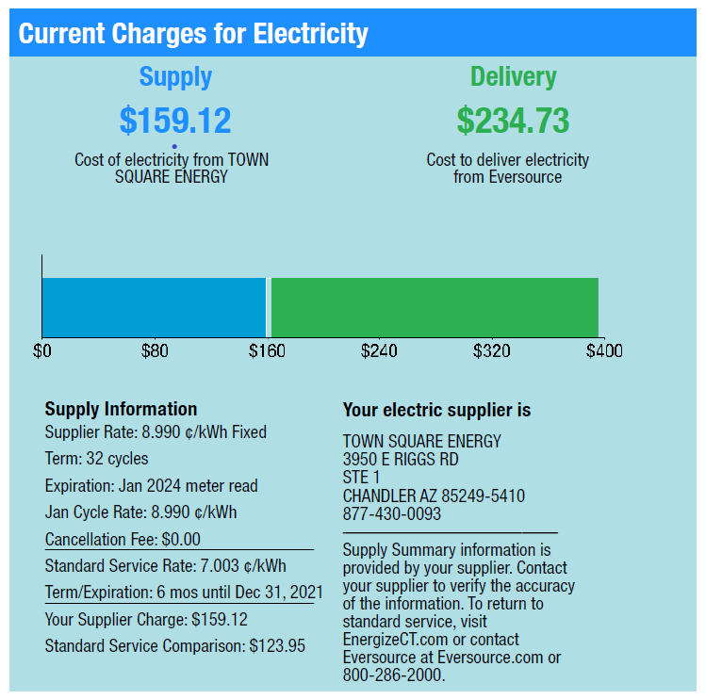
Supply Summary
The supply summary is on the right side of the first page of an Eversource bill
Connecticut Public Utilities Regulatory Authority –
Office of Education, Outreach, & Enforcement

Slide 16
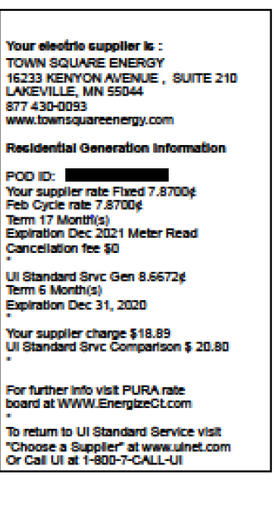
Supply Summary
The Supply Summary is on the right side of the first page of your UI bill.
Connecticut Public Utilities Regulatory Authority –
Office of Education, Outreach, & Enforcement

Slide 17
What to Watch
Calendar 60 days before your contract is scheduled to expire.
Look for communication from the supplier regarding the new contract rate.
If you do not have that communication, contact the supplier to ask for the new contract rate.
If you do not want to renew the contract, cancel it at least 45 days before your meter read date.
You may contact the utility to cancel your supplier and return to standard service at any time.
Connecticut Public Utilities Regulatory Authority –
Office of Education, Outreach, & Enforcement

Slide 18
Emergency Assistance
If you have questions about or issues with suppliers
Contact PURA Customer Affairs
1-800-382-4586
Pura.information@ct.gov
https://portal.ct.gov/PURA/Consumer-Services/Customer-Affairs
Connecticut Public Utilities Regulatory Authority –
Office of Education, Outreach, & Enforcement
Connecticut Public Utilities Regulatory Authority

Slide 19
How to Engage with PURA
Consumer Services –
Office of Education, Outreach, & Enforcement
Online
File a compliant via the PURA website at portal.ct.gov/pura
OR
email pura.information@ct.gov
Telephone Numbers ​
Toll Free Number: 1-800-382-4586​
Outside Connecticut: 1-860-827-2622​
TDD Telecommunications for the Deaf: ​
(860) 827-2837 - to be used only if you have a TDD machine​
Connecticut Public Utilities Regulatory Authority –
Office of Education, Outreach, & Enforcement
Connecticut Public Utilities Regulatory Authority

