Slide 1
DSS IT Capital Investment Briefing
March 13, 2013

Slide 2
Contents / Agenda
    ConneCT (Modernization of Client Service Delivery) and Health Insurance Exchange/Integrated Eligibility Project (CT HIX/IEP)
    Health Information Exchange / Health Information Technology (HIE/HIT)
    Shared Analytics and Business Intelligence

Slide 3
1/3 – ConneCT and
Health Insurance Exchange/ Integrated Eligibility Project (CT HIX/IEP)

Slide 4
ConneCT Project
Project Overview
Purpose: The DSS ConneCT project will modernize the agency’s existing infrastructure with the implementation of a Modernization of Client Service Delivery (MCSD) solution utilizing three (3) specific technologies: Internet-based Client Access and Web Services, Document Scanning and Work Flow Management, and Interactive Voice Response (IVR) and Call Center Services. These technologies will be integrated with our existing eligibility legacy system known as EMS. These functionalities will increase the efficiency and effectiveness in how DSS serves its customers.
Status of Project: As of December 31, 2012, two of the project's seven releases have been built and fully tested. These two releases feature Client Accounts and Pre-Screening functionality. In addition to Client Accounts and Pre-Screening, the state has completed the installation and configuration of approximately 95% of the new ConneCT Solution Platform.
Project Timeline: 07/01/11 - 08/13/13

Slide 5
Health Insurance Exchange & Integrated Eligibility System Project (HIX / IEP)
Project Overview
Purpose: The Department of Social Services Integrated Eligibility System project will replace the Department’s existing 24 year old Eligibility Management System (EMS). The integrated eligibility platform, once designed, developed and implemented, will provide a seamless eligibility and enrollment process for Medicaid, CHIP and the CTHIX, and will ultimately be used to determine eligibility for other social service programs (e.g., SNAP, TFA). Specifically, the planned integrated eligibility function will initially address federal requirements for eligibility determinations for advance premium tax credits and reduced cost sharing through the Exchange, MAGI-based eligibility for Medicaid, complete individual responsibility exemption determinations, and coordinate enrollment.
Anticipated Project Timeline: 02/1/12 - 12/31/15

Slide 6


Achieving Incremental “Wins” for DSS and Connecticut
Reach & Impact:
Enables cross-agency collaboration and the ability to serve the “whole client”.
Integrated Eligibility
(Cross-Agency)
Tier 4
Reach & Impact:
Increased automation to improve service delivery to all DSS clients.
Reach & Impact:
New population of clients who purchase/receive medical insurance.
New quasi-public agency.
Integrated Eligibility
(DSS)
Tier 2 and 3
Reach and Impact
Reach & Impact:
New channels for DSS clients to get information.
New technology tools for DSS workers.
Tier 1
Time
These projects build on each successful milestone to increase reach and impact.

Slide 7
Objectives - ConneCT
  Improve Client Access
    Anywhere/anytime access via web services.
  Achieve Better Quality Outcomes
    Makes processes faster and more efficient by reducing “back and forth” and generation of paper.
  Enhance Customer Service
    Empowers workers with tools to help clients.
    Increases the number of workers who can help a client.
  Reduce Costs
    Reduces the need for paper (and associated storage costs).
    More efficient retrieval of documents.
  Provide a Technological Framework for the Future
    Integrated technologies support the business and allow for expansion.
Through ConneCT we are using technology to generate positive business impact.

Slide 8
Building a Technological Framework for Future - ConneCT
 | Technical Milestone | Benefit to DSS and Connecticut
✓ | Built and deployed new server infrastructure at BEST Data Center. | Allows to BEST to host a modern web-based system for DSS.
✓ | Installed new telephone system at BEST and at three DSS offices. | Single, centralized telephony platform enables a state-wide workforce and provides redundancy.
✓ | Installed new optical fiber network. | Enables high-speed connectivity between the BEST data center and DSS benefit center offices to support voice and data.
✓ | Installed 700 new telephone lines at the BEST Data Center. | Allows DSS customers to reach DSS via a central location and access telephony services.
✓ | Deployed new web-based software platform. | Provides modern, web-based systems for DSS clients and DSS workers to use.
✓ | Installed leading COTS products including Rules Engine and Document Generation Software | Provides modern, web-based systems for DSS clients and DSS workers to use.
Extensible technical products support DSS now and in the future.

Slide 9







Release Update - ConneCT
 | Functional Overview | Status / Target Date
Client Accounts | Provides secure, anytime access to generic and case-specific information to clients via the Internet. | Currently Live (http://connect.ct.gov)
Pre-Screening | Allows clients to independently check for potential eligibility online without having to visit or call DSS. | Currently Live (http://connect.ct.gov)
Interactive Voice Response (IVR) | Provides secure, anytime access to generic and case-specific information to clients by phone. | Coming Soon: March 2013
Document Management and Workflow | Reduces the need for paper-based processing and provides centralized access to documents and visibility into document status. | March 2013 (Rollout Begins)
Benefit Center | Provides a centralized, consistent enterprise system for receiving and servicing incoming calls. | June 2013 (Rollout Begins)
Online Application | Allows clients to apply online and provides a dynamic verification checklist to clearly explain what verification is required. | August 2013
Change Reporting and Online Redeterminations | Allows clients to report changes and conduct redeterminations online. | August 2013

Slide 10
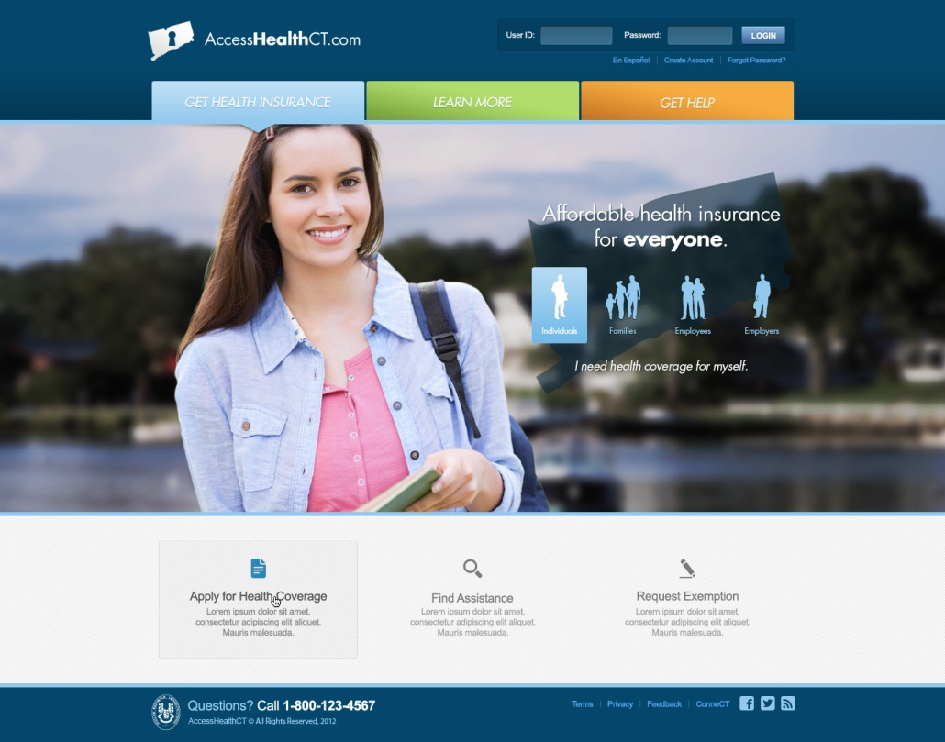
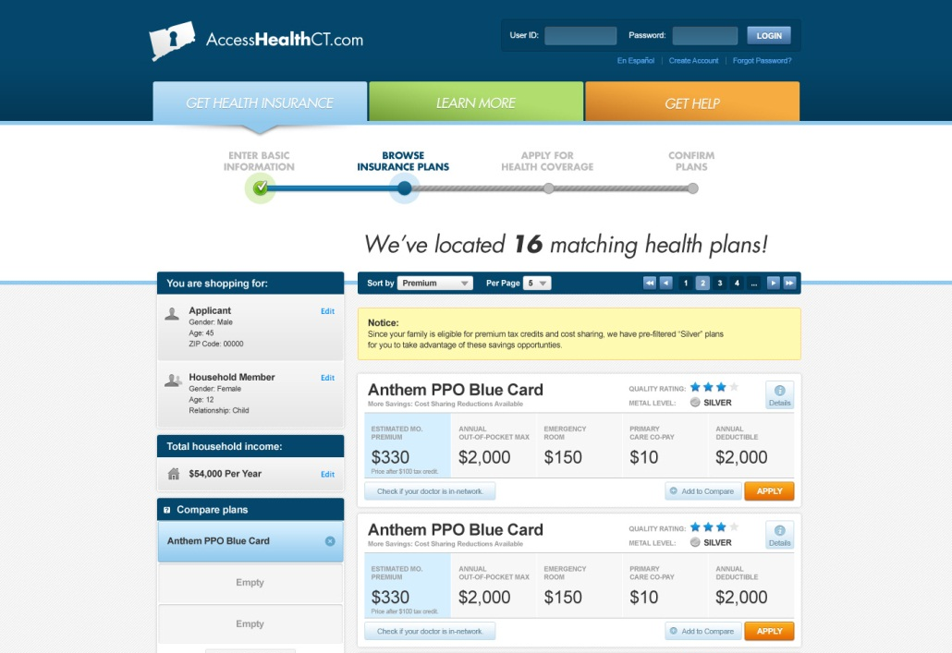
Tier 1 Update and Timeline – CT HIX
June 2013: Enables the Loading of Plan Data
 | O | N | D | J | F | M | A | M | J | J | A | S | O
R1: Plan Management
R2: Core Functionality
R3/R4: Deferred Functionality
October 2013: Allows Clients to Browse, Apply, Shop and Enroll
Provides Additional Functionality to Enhance the Exchange

Slide 11
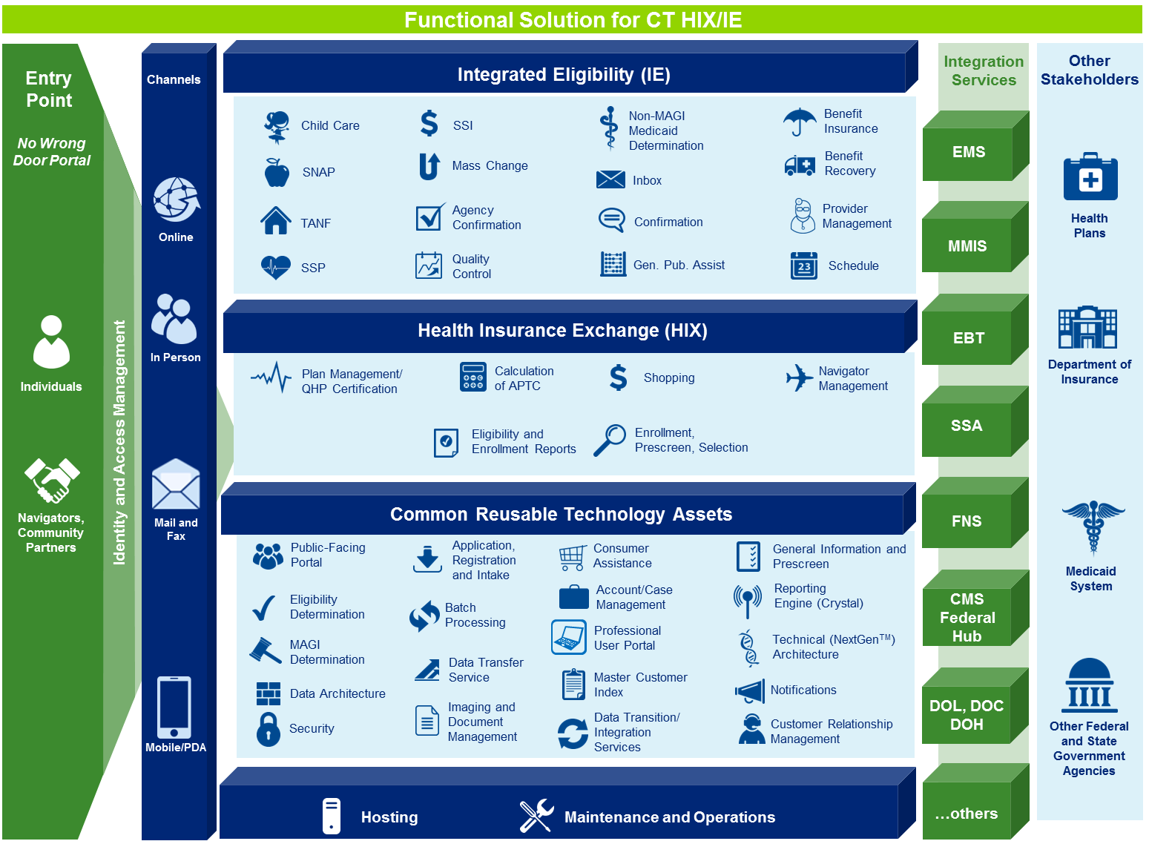
Platform Capabilities for Tiers 2, 3 and 4 - IEP

Slide 12
Financial Estimates (SFY 13 – SFY 14) - ConneCT
Estimated Total Development Cost | Estimated total Capital Funding Request | Estimated Annual Operating Cost | One Time Financial Benefit | Recurring Annual Financial Benefit
$21,401,663 | $8,550,041 | $4,652,061 | $10,478,858 | $2,279,510
Explanation of Estimates
Estimates are based on the information received from program staff. The total development cost is reimbursed by the Federal Government at a 49% FFP rate. The “One Time Financial Benefit” of $10,478,858 shown above reflects $2,279,714 of FFP against the Capital Equipment Purchase Fund expenditures of $4,652,478 in addition to the FFP of $8,199,144 for the federal share of this initiative.

Slide 13
Actual & Projected Expenditures – ConneCT
Actual and Projected Development Expenditures
Actual Expenditures:
SFY 2009 | 859,840
SFY 2010 | 441,458
SFY 2011 | 894,014
SFY 2012 | 4,793,671
SFY 2013 Jul - Feb * | 7,642,074
Total Actual Expenditures Through 02/28/13 | 14,631,057
Projected Expenditures:
SFY 2013 Mar - Jun * | 10,618,676
SFY 2014 | 3,140,913
Total Projected Expenditures | 13,759,589
Grand Total All Expenditures | 28,390,646
Total SFY 2013 expenditures are projected to be $18,260,750. Not all expenditures are subject to FFP, such as Benefit Center build out. The above total includes expenses for years prior to SFY 2013 and 2014, the years for which we are currently seeking IT Capital Fund support.
$7.0 m expended in prior years
$21.4 m SFY 2013 & 2014 costs
$28.4 m total project cost

Slide 14
Projected Expenditures (SFY 13 – SFY 14) - ConneCT
*Does not include Maintenance & Operation expenditures (SFY13 - $1.9m, SFY14 - $4.5m, SFY15 - $4.7m).

Slide 15
Financial Estimates (SFY 13 – SFY 16) – CT HIX/IEP
Estimated Total Development Cost | Estimated total Capital Funding Request | Estimated Annual Operating Cost | One Time Financial Benefit | Recurring Annual Financial Benefit
$103,843,568 | $15,308,659 | $13,782,851 | $88,534,909 | $10,337,138
Explanation of Estimates
The total development cost is reimbursed by the Federal Government at an 85% FFP rate. The estimated annual operating cost is calculated based on the SFY15 amount of $13,782,851. The recurring annual financial benefit is calculated by multiplying the estimated annual operating cost by 75%, as operating costs will be reimbursed at a 75% FFP rate. In the development of the cost estimates above, the majority of the cost is allocated to information technology systems and related support. These costs are highly dependent upon future activities, such as the structure of procurements, vendor solicitations, and the actual reusability of technology components. The costs also reflect assumptions on the approach to implementation including training, user acceptance test, pilot, conversion and the number of releases. The operational cost budget accounts for two (2) years of operations and maintenance, starting in January 1, 2014 and running through December 31, 2015. Assuming a full implementation of software around December 31, 2014, the estimate includes one full year of post implementation stabilization support. Furthermore, there is an anticipated future APD for Tier 4 Development Costs, which are not included in this submission.

Slide 16
Projected Expenditures (SFY 13 – SFY 16) – CT HIX/IEP
*Does not include Maintenance & Operation expenditures (SFY14 - $2.8m, SFY15 - $13.8m, SFY16 - $3.9m). *Does not include anticipated future APD for Tier 4 Development Costs, which are undetermined at this time.
*No Expenditures to date.

Slide 17
2/ 3 – Health Information Exchange and Health Information Technology
(HIE/ HIT)

Slide 18
Health Information Exchange / Health Information Technology (HIE / HIT)
Project Overview
Purpose: This project comprises a multi-faceted development of improvements to Health Information Technology capabilities within Connecticut. The project will improve the ability of Medicaid health care providers to share health care information to improve care coordination. Additionally, patients will be able to share data with providers as needed. The improved data sharing mechanisms established via this project will improve the efficiency and efficacy of patients’ health care.
Anticipated Project Timeline: 07/1/2012 - 06/30/15*
(*included in this package are projected expenditures through the end of SFY 2015. The HIT part of the project will be on-going until the federal EHR incentive program ends in 2021. HIE build support should end with the above date.)

Slide 19
Health Information Exchange and Information Technology – HIE/HIT
With enhancement of Connecticut’s Health Information Exchange and Information Technology (HIE/HIT) capabilities, DSS aims to:
improve the Medicaid population’s access to high quality, safe, affordable and efficient healthcare;
increase patients’ active engagement in their own health care
support active care coordination among care providers, patients, and families;
promote evidence-based medicine, public health programs, outcome monitoring, and research to improve treatment quality;
ensure the reliable, private, secure interoperable storage and sharing of healthcare data within Connecticut and between other states.

Slide 20
Health Information Exchange (HIE) – Business goals and benefits
Goal | Benefit
Create a master Medicaid health care provider directory | More accurate count, classification, and information on providers based on consolidated data and removal of obsolete listings
Implement Direct messaging to support secure communication among providers regarding patient care. | Reduced rates of hospital readmission for Medicaid patients; improved patient treatment outcomes
Create a Medicaid member portal, allowing patients to access their treatment data from all of their providers, and allowing them to designate who may view their data. | Providers will have more comprehensive data on patients, facilitating higher-quality, timely treatment; patients will become more involved in their own treatment.
Notes:
What problem of the universe are we trying to solve?

Slide 21
HIT - Business goals/benefits of HIT development
Goal | Benefit
Increase rate of Health IT adoption, implementation, and use of EHR’s among eligible professionals (EP’s - physicians, dentists, nurse practitioners, certified nurse midwives) and eligible hospitals (EH’s) via provision of EHR incentive payments | Improved access overall to high quality, safe, affordable and efficient healthcare in Connecticut through the Meaningful Use of Health IT Increased engagement of patients and their families in their own health care by facilitating health literacy and active care coordination among care providers, patients and families
Develop strategic plan for clinical data delivery, storage and usage; educate EP’s and EH’s about policies and enforce privacy and security requirements of MU stage 2 through audit strategy | Reliable, private, secure interoperable storage and sharing of healthcare data within Connecticut and between other states as required for safe, effective and efficient healthcare

Slide 22
HIT - Business goals/benefits of HIT development (cont)
Goal | Benefit
Develop functional and technical requirements for warehousing of clinical data from multiple sources, e.g., providers’ EHR’s; DPH systems | Clinical data is made available to support of evidence based medicine, public health programs, outcomes monitoring, and research

Slide 23
Financial Estimates (SFY 13 – SFY 15) – HIE/HIT
Estimated Total Development Cost | Estimated total Capital Funding Request | Estimated Annual Operating Cost | One Time Financial Benefit | Recurring Annual Financial Benefit
$14,836,928 | $1,577,156 | $0 | $13,259,772 | $0
Explanation of Estimates
The total development cost is reimbursed by the Federal Government at an 89% FFP rate.

Slide 24
Projected Expenditures (SFY 13 – SFY 15) – HIE/HIT
*Expenditures to date: $241,323 (UConn Health Center & HP HIT Payments).

Slide 25
3/3 – Shared Analytics and Business Intelligence (SA/BI)

Slide 26
Goal – SA/BI
The overarching goal is to move to an enterprise approach for health care business intelligence that will provide the State with an integrated health care data and information infrastructure, making decision support less reactive and more predictive and proactive.

Slide 27
Target Analytical and Decision Support Capabilities – SA/BI
Establishment of data governance and standards
Development of an integrated approach (within legal and regulatory constraints) to an Enterprise Date Warehouse / Business Intelligence (EDW/BI) infrastructure and data analytics
Strong reporting and BI capabilities for participating organizations and collaborations
Initial focus – DSS, private sector partners and UConn
Notes:
What problem of the universe are we trying to solve?

Slide 28
Target Analytical and Decision Support Capabilities – SA/BI
Provision of a robust BI capacity across the continuum of health care in the State:
  Real-time interactive access, queries, manipulation, analysis and modeling of data and information
  Greater support to anticipate, support and validate key decisions and activities at both the agency / program level and across the continuum of health care programs and services
  Predictive and “What If” analytic capabilities
  Addressing the key question “…we don’t know what we don’t know…”
Notes:
What problem of the universe are we trying to solve?

Slide 29
Target Analytical and Decision Support Capabilities – SA/BI
Enterprise data analytical capabilities that can support the protection and promotion of health and well-being at both the population and client level, across the State’s health care systems
Compliance with national HIT interoperability standards to strengthen public/academic/private partnerships to improve quality and produce better outcomes more efficiently
Compliance with Medicaid information technology architectural standards (MITA)
Notes:
What problem of the universe are we trying to solve?

Slide 30
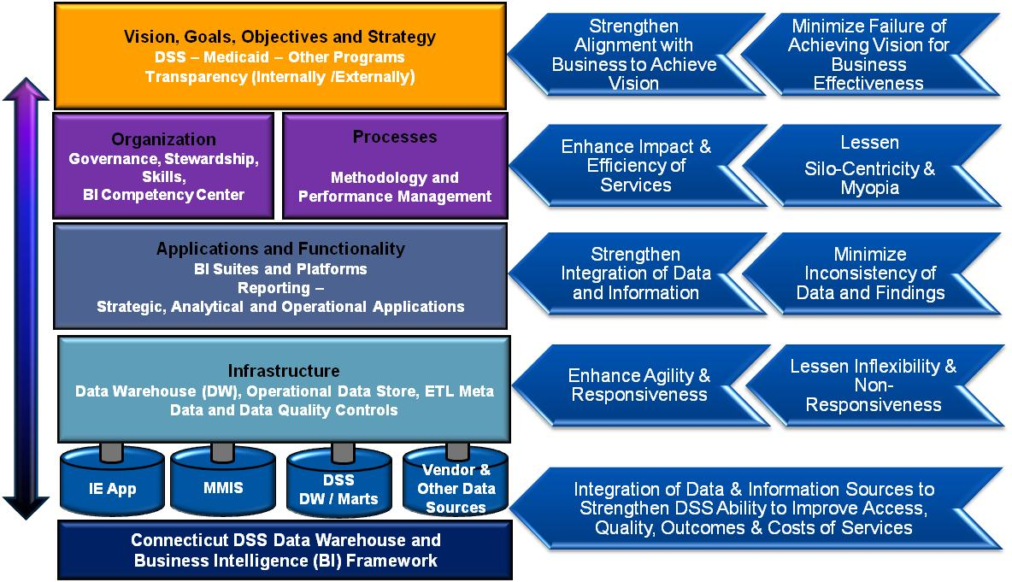
Shared Analytics and Business Intelligence Framework

Slide 31
Financial Estimates (SFY 13 – SFY15) – SA/BI
Estimated Total Development Cost | Estimated total Capital Funding Request | Estimated Annual Operating Cost | One Time Financial Benefit | Recurring Annual Financial Benefit
$21,745,000 | $5,436,250 | TBD | $16,308,750 | TBD
Explanation of Estimates
The total development cost is reimbursed by the Federal Government at a 75% FFP rate. The Estimated Annual Operating Costs and Recurring Annual Financial Benefits are undetermined at this time.
Anticipated Project Timeline:02/01/2013 - 06/30/2015

Slide 32
Projected Expenditures (SFY 13 – SFY 15) – SA/BI
*No Expenditures to date.

Slide 33
Questions?

