Slide 2
Department of Energy and Environmental Protection
Information Technology Investment Update
August 14, 2013

Slide 3

Pillars of Success
LEAN
Governance
Partnerships
3

Slide 4
LEAN
Over 50 LEAN projects undertaken to improve the business process
Benefits of LEAN:
  Empower staff to identify and implement the improvements, not management alone.
  Become more efficient, without lowering our environmental requirements.
  Promote tracking of performance indicators and use of visuals so staff adhere to standard processing time.
  Improve efficiency to give the agency more time to protect the environment, including addressing new environmental challenges.
  Increase the value of DEEP’s services to customers.
  Embrace a continuous improvement philosophy, bringing about cultural changes.
At DEEP all projects start with a LEAN event
4

Slide 5
Governance
State IT Investment Committee
OPM/DAS
DEEP Executive Steering Committee
DEEP Information Technology Advisory Committee
ITAC
Governors 7 Criteria
Program & Project Recommendations and Approvals
Priorities, Criteria, Budget, Staffing, Business Process Change
5

Slide 6
Partnerships
DEEP Business & Technology
Other State Agencies
Vendors
Public
6

Slide 7
Business Solutions

Slide 8
Storm Water General Permit is the Key ICM Pilot at DEEP
Paper intensive
  Large regulated universe (1500+ permits), many small business w/ no environmental expertise
  Time consumed by physical movement of paper
  Lacking thorough review of registrations
Current process too cumbersome
  Process 1500+ registrations in 4 months
  Requires significant compliance assistance
  Requires resource-intensive public participation process
8

Slide 9

ICM Delivers 21st Century Customer Service
Efficiency
Logic based forms
  Automated checks for completeness, consistency
  Information prompts based on user’s responses
Compliance assistance information imbedded in form (“Help” tools)
Streamlined intra-agency coordination (End. Species, Aq. Protection)
Paperless-processing ($15,390 saved per year in paper for Industrial GP)
Transparency
General Public
24/7 public access to review filing, comment on pending applications, and view DEEP responses to comments
Regulated Community
24/7 e-portal access to manage filings, receive DEEP email notifications confirming filing, registration status and disposition
9

Slide 10
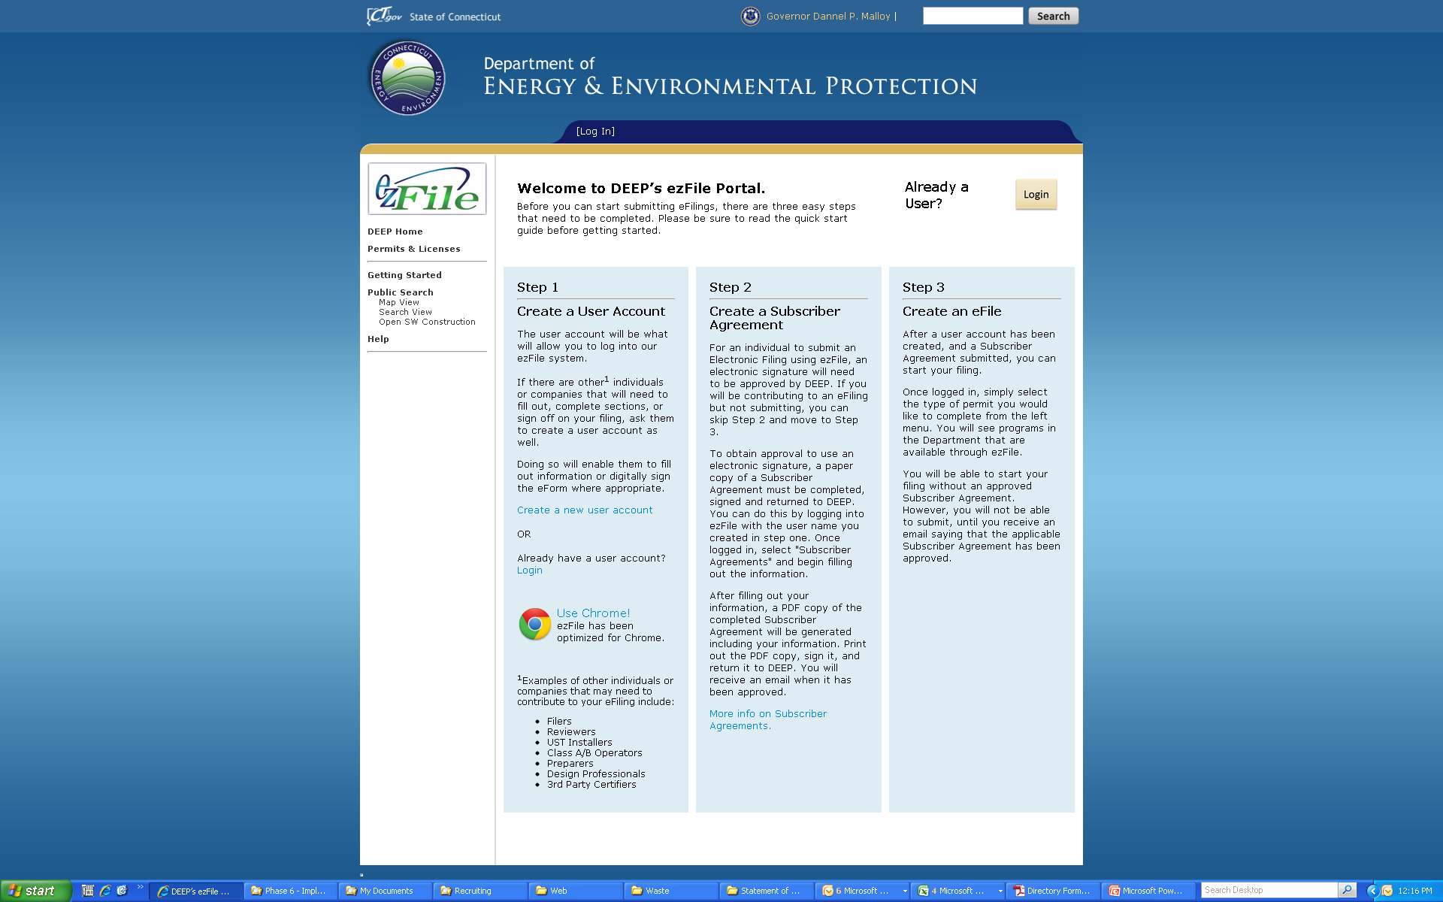
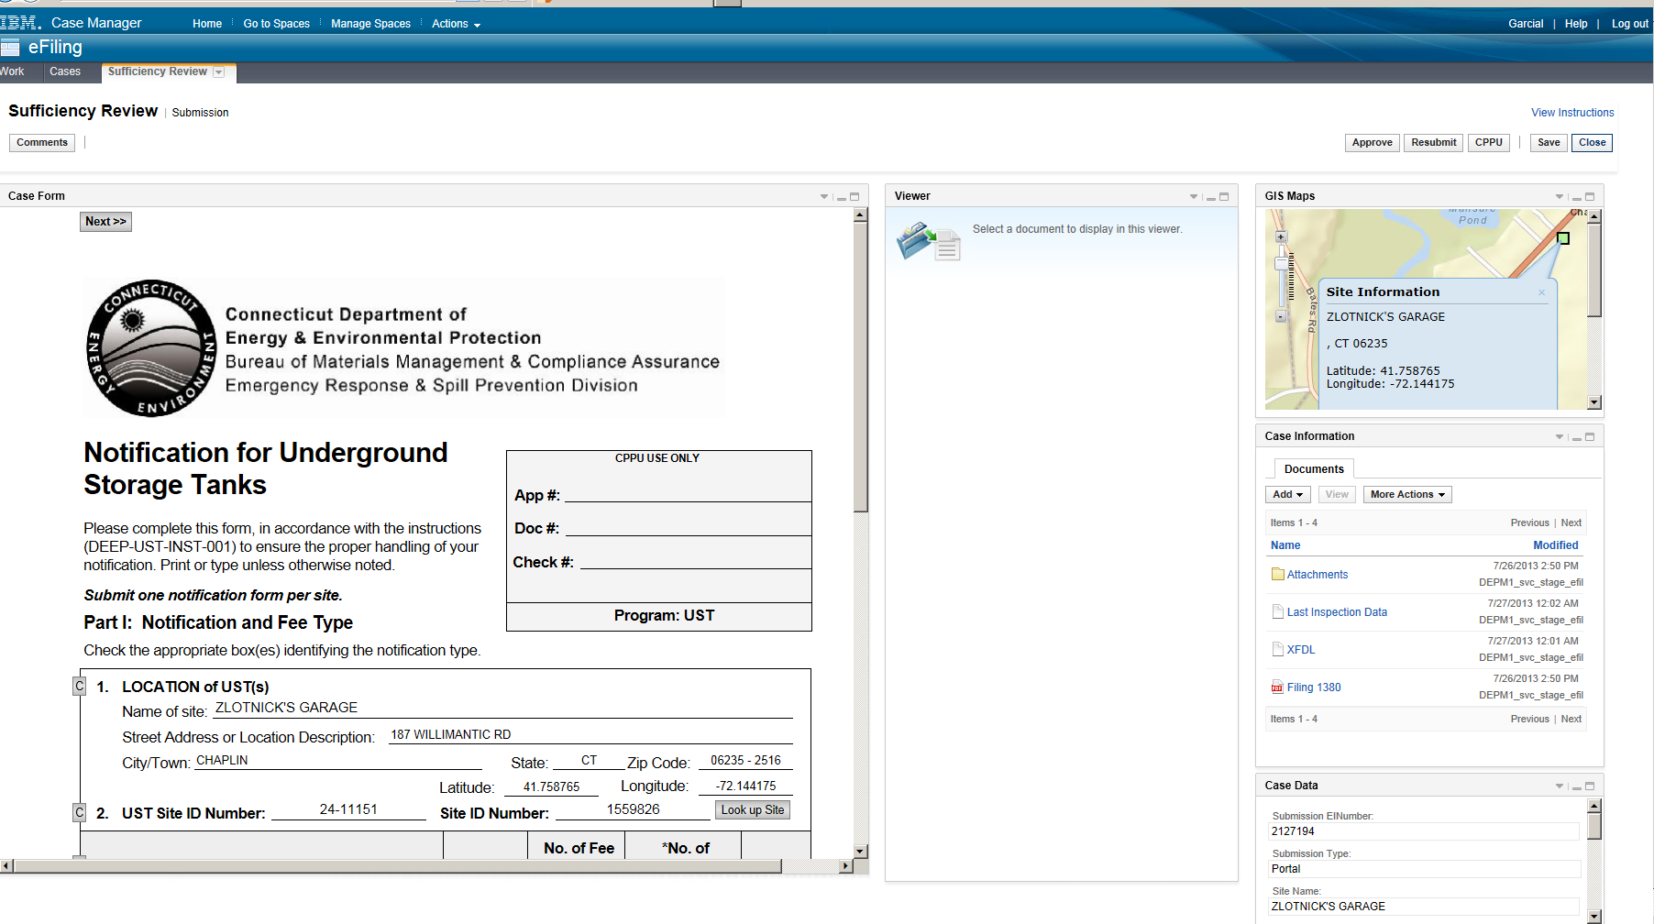
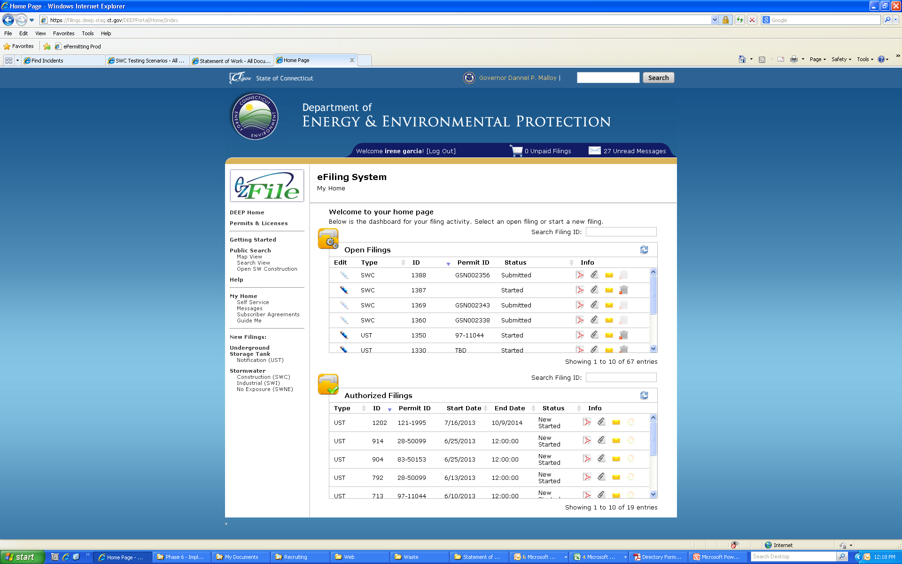
e-Permitting

Slide 11
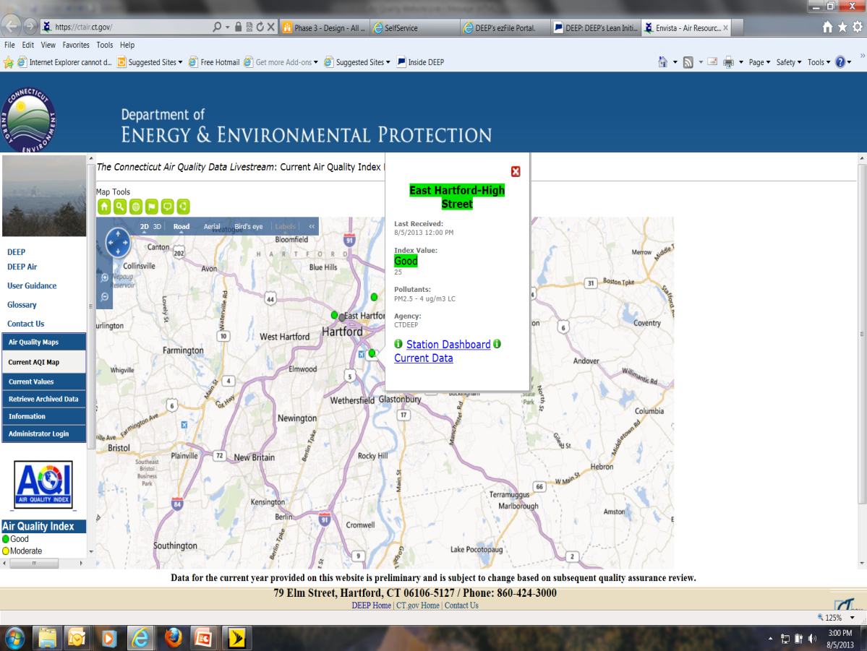
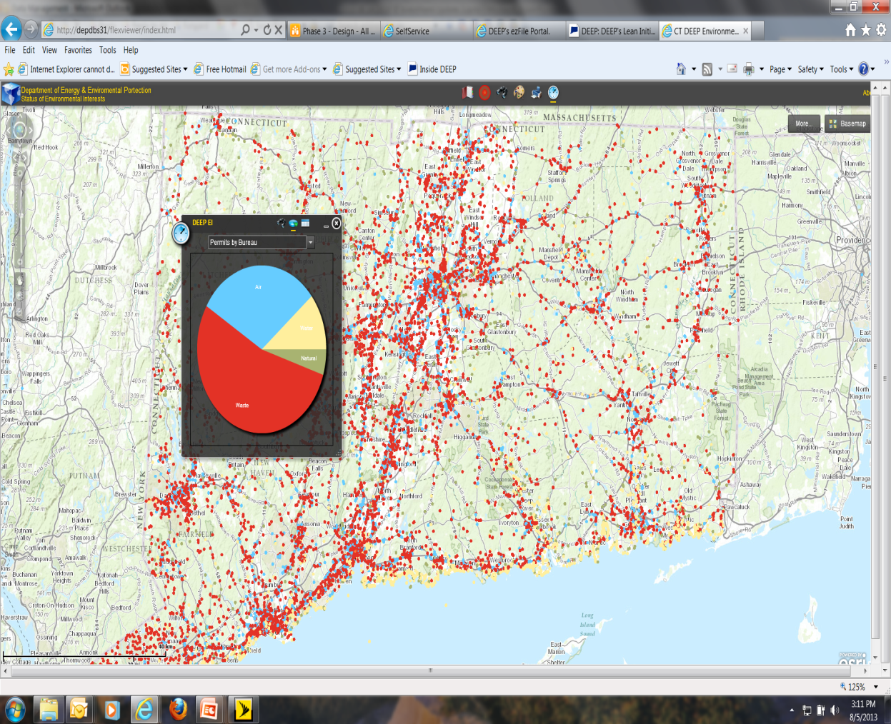
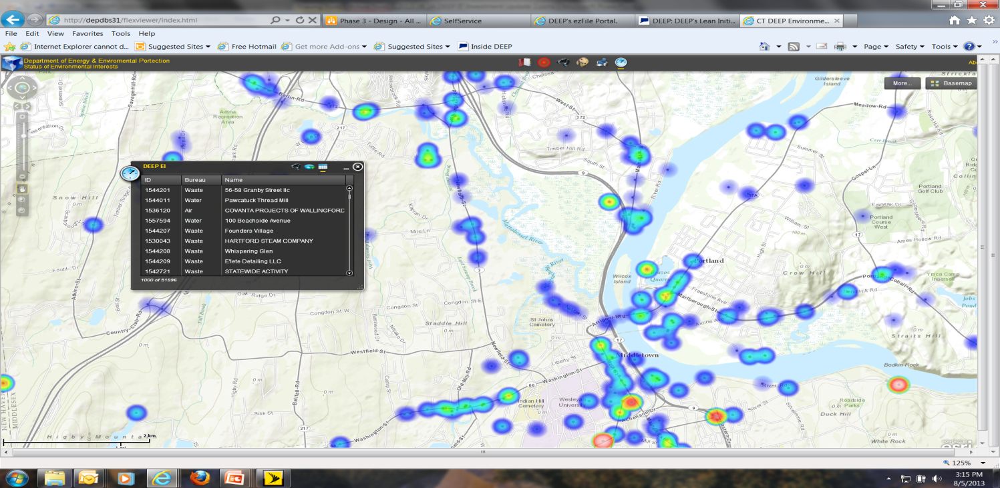
Data Management
Real Time Air Quality
Permit Distribution
Permit Intensity

Slide 12
ROI From MassDEP

Slide 13
Mass. Environmental Information and Public Access System (EIPAS) cost-benefit analysis shows that the project has a Utility Payback Period of ~5 to 6 years¹
EIPAS net benefits by year², with cumulative impact
$M
Net adjusted benefits
Cumulative net benefits
30
28
25
20
Example
15
15
11
11
Benefit value ($M)
10
5
5
0
-5
-2
-10
-7
-7
EIPAS Utility Payback Period breakeven point
-14
-15
1
2
3
4
5
6
7
Year
1 Payback period is 6 years with 0.25 benefit multiplier, 5 years with 0.35 multiplier; assumes 3% discount rate, figures shown assume average adjusted benefits using 0.25 to 0.35 benefit multipliers; includes revised one-time and O&M cost estimates
2 Adjusted benefit estimates (average of 0.25 to 0.35 adjustment for non-financial and indirect), discounted at 3% per annum
SOURCE: Interviews with EIPAS team and EEA SME’s, expert interviews, McKinsey IT benchmarks, team analysis

Slide 14
Program Briefs

Slide 15
DEEP’s High Priority IT Programs
Case Management
Records Management
Data Management
IT Infrastructure (VOIP)
15

Slide 16
Program/Investment Year | FY13 | FY14 | FY15 | FY16
Case Management | 1,150,000 | 3,750,000 | 3,050,000 | 0
Prior Agency Investment | 4,513,500 | 2013 Agency Investment | 657,198
DEEP’s Enterprise Case Management Program will create a public online, paperless interface to conduct the business of licensing, permitting, docket activities and registration of activities that are under DEEP jurisdiction.
Leverage common functions and interfaces while allowing for the submittal, review and internal routing of electronic data.
Provide instant, intuitive, online, 24/7 access for citizens, business, and local and state government to essential site documents, data and status updates. Provide a nimble and efficient business flow for applicants and agency staff saving both the agency and its constituents time and money.
Quarter/Fiscal Yr
Q4
Q1 FY14
Q2
  Q3
Q4
Q1 FY15
Q2
Q3
Program
Month
May
Jun
Jul
Aug
Sep
Oct
Nov
Dec
Jan
Feb
Mar
Apr
May
Jun
Jul
Aug
Sep
Oct
Nov
Dec
Jan
Active
UST
C
A
S
E
M
A
N
A
G
M
E
N
T
Storm Water Construction
Storm Water Industrial
PURA e-Filing
Site CMS (Remediation)
EC – Tournament Permits
Radiation DTX
Radiation RMI
Pending
Natural Diversity Database
Planned
HW Transporters
Pesticide Apps Surface Water
Marine Terminals
OLISP Certificate Permission

Slide 17
Program/Investment Year | FY13 | FY14 | FY15 | FY16
Records Management | 0 | 500,000 | 1,000,000 | 2,500,000
Prior Agency Investment | 780,000 | 2013 Agency Investment | 0
Build on the partnership DEEP has already begun with the Department of Administrative Services, Bureau of Enterprise Systems and Technology (DAS BEST) to build a online document repository and portal accessible by the public and comply with State Records Management laws and regulations.
Build on projects already underway as part of DEEP’s Lean Initiative that introduce new and enhanced agency procedures, both internal and external, that reduce, and where possible eliminate, the need to create and handle paper documents in the first place.
Cross-agency committee formed with BEST & State Library to establish business requirements for taxonomy, redaction and retention.
Quarter/Fiscal Yr
Q4
Q1 FY14
Q2
  Q3
Q4
Q1 FY15
Q2
Q3
Program
Month
May
Jun
Jul
Aug
Sep
Oct
Nov
Dec
Jan
Feb
Mar
Apr
May
Jun
Jul
Aug
Sep
Oct
Nov
Dec
Jan
Active
R
E
C
O
R
D
S
M
A
N
A
G
M
E
N
T
Manifest - Taxonomy
Oil Chemical Spills Taxonomy
Records Management Admin
(Indexing, Taxonomy, Redaction, Retention)
Pending
Document Portal
Bulk Scanning Pilot (Manifest)
Bulk Scanning of Records Center

Slide 18
Program/Investment Year | FY13 | FY14 | FY15 | FY16
Data Management | 300,000 | 1,450,000 | 500,000 | 250,000
Prior Agency Investment | 425,000 | 2013 Agency Investment | 336,412
The data management program will integrate critical data systems and develop a data warehouse to provide a common source for DEEP data.
Consolidated data allowing for ad hoc reporting and real time decision making. Provide visibility to all customers and DEEP personnel from one source and make data available to be leveraged by remote users utilizing multiple methods to access data.
Provide for better tactical and strategic decision-making based on a consolidated view of data
Quarter/Fiscal Yr
Q4
Q1 FY14
Q2
  Q3
Q4
Q1 FY15
Q2
Q3
Program
Month
May
Jun
Jul
Aug
Sep
Oct
Nov
Dec
Jan
Feb
Mar
Apr
May
Jun
Jul
Aug
Sep
Oct
Nov
Dec
Jan
Active
Ambient Water Quality
Lab Results -Chemistry
D
A
T
A
M
A
N
A
G
M
E
N
T
AWQ Lab Results -Fish
BEES Utility Company Transfer
Air Monitoring Website
Spatial View of Permits
Planned
Marine Fisheries
E-Lev (Low Emissions Vehicle)
Electronic Wetlands and
Watercourse Reporting
Electronic Diversion Rptng
Air Bureau GIS Proposal
Electronic Reporting Storage

Slide 19
Program/Investment Year | FY13 | FY14 | FY15
Infrastructure | 1,000,000 | 500,000 | 0
Prior Agency Investment | 366,785 | 2013 Agency Investment | 913,912
The New Britain Hearing Room project will replace an outdated audio infrastructure.
The Desktop and Server refresh will move the agency to updated software and hardware technology .
The VoIP project will replace the existing conventional telephone systems at DEEP headquarters and major satellite offices with an enterprise system. It will also expand the customer service call center capability (currently available only in the PURA and Energy office) to include the majority of DEEP programs.
Quarter/Fiscal Yr
Q4
Q1 FY14
Q2
  Q3
Q4
Q1 FY15
Q2
Q3
Program
Month
May
Jun
Jul
Aug
Sep
Oct
Nov
Dec
Jan
Feb
Mar
Apr
May
Jun
Jul
Aug
Sep
Oct
Nov
Dec
Jan
Active
INFRASTRUCTURE
New Britain Hearing Rooms
(No IT Inv Funds)
Hartford HQ Core Improvements
VoIP -Voice over Internet Protocol
Pending
Refresh
Infrastructure Assessment
Infrastructure Deployment

Slide 20
Project Updates

Slide 21
Case Management Project | Sponsor | Project Managers | Scope | Schedule | Resources | Project Phase | Est. End Date
UST | Y.Bolton | I. Garcia P. Zack |  |  |  | Implementation | 8/08/13
Scope: Application will provide for the online annual registration and fee payment for owners/operators of underground storage tanks. Allow owners and operators to access their facility specific information, to confirm its accuracy or update it, or to register a new facility; and also pay on-line the annual per tank fee.
Benefit: Make it easier for the regulated community to meet the requirements of annual registration of underground storage tanks and annual payment of the per tank fee. Cost savings for notification form and payment processing. Collection of updated data without paper and without errors associated with data entry of information on paper forms. Annual tank fees will be collected at the time of registration eliminating the need for staff time spent processing invoices and payments.
Case Management Project | Sponsor | Project Managers | Scope | Schedule | Resources | Project Phase | Est. End Date
Storm Water Construction Permit | Y.Bolton | I. Garcia O. Inglese |  |  |  | Testing | 9/17/13
Storm Water Industrial Permit | Y.Bolton | I. Garcia O. Inglese |  |  |  | Testing | 10/15/13
Scope: Application will provide for the online registration of stormwater general permits to be filed. Currently each registration application and registration fees are manually reviewed and processed, with associated data and other information manually entered into the DEEP’s Site Information Management System (SIMS).
Benefit: The stormwater general permit registration system will provide the regulated community with the capability and convenience to electronically file their registration applications and fee transactions through a user-friendly, internet-based interface. The system must enable DEEP to electronically process the registrations and fee transactions in lieu of a paper filing, with associated data and other information automatically entered into SIMS.
The Construction General Permit requires developers and builders to implement stormwater management plans that will prevent the movement of soil and sediments off construction sites and into nearby streams and water bodies.
The General Permit for the Discharge of Stormwater Associated with Industrial Activity regulates industrial facilities with point source discharges that are engaged in specific activities listed in the permit.
Project Budget | Amount Paid
892K | 752K

Slide 22
Infrastructure Project | Sponsor | Project Managers | Scope | Schedule | Resources | Project Phase | Est. End Date
VoIP - Voice over Internet Protocol | R. Klee | T. Botti E. Mcauliffe |  |  |  | Business Requirements | December 2013
This project will replace the existing conventional telephone systems at DEEP headquarters and major satellite offices with an enterprise system.
Expand customer service call center capability (currently available only in the PURA and Energy office) to include the majority of DEEP programs.
Project Budget | Amount Paid
2.0M | .9M
Year
2013
2014
Project
Month
Jan
Feb
Mar
Apr
May
Jun
Jul
Aug
Sep
Oct
Nov
Dec
Jan
Network Improvements
OPT-E-Man (No IT Inv Fund)
Hartford HQ Core
Improvements
VoIP
Hartford
New Britain
Field

Slide 23
Case Management Project | Sponsor | Project Managers | Scope | Schedule | Resources | Project Phase | Est. End Date
PURA e-Filing | K. Dykes | D. Holmes K. Collette |  |  |  | Business Requirements | July 2014
The PURA e-Filing system will serve customers (Utility companies, citizens, law firms, other businesses) through a Web-based system allowing the submission / tracking of all electronic requests/complaints/dockets providing customers with ease of access to information.
All submissions will be electronically routed, tracked and processed within PURA/BETP through more efficient and leaner processes
Agency is in final contract negotiations with selected vendor. Purchase order is pending.
Project Budget | Amount Paid
2.8M | 0
Year
2012
2013
2014
SDM Phase
Month
2
3
4
5
6
7
8
9
10
11
12
1
2
3
4
5
6
7
8
9
10
11
12
1
2
3
4
5
6
7
8
9
Business Issues
Business Requirements
Design
Construction
Testing
Implementation
Post Implementation

Slide 24
Budgets

Slide 25
Budget Summary
Investment Funds Approved:
DEEP is ready for the next round of funding for IT Investments in order to execute pending contracts.
DEEP is positioned to deliver value from these IT Investments during FY’14. Technology advances and benefits will continue to be shared with other agencies (example: currently working with OSC-CoreCT, DAS-BEST, DOT & Public Utilities to automate electronic transfer of utility billing and consumption information).
DEEP will continue to capitalize on federal and other funding sources to leverage against IT Investment dollars (federal funds contributed over 30% towards IT related investment expenses in FY’13).
26

Slide 26
Questions?

