Slide 1
THE STATE OF THE STATE'S TELEPHONY

Slide 2
CURRENT VIEW
Over 300 different, isolated, independent systems
No recovery options when systems fail
Over 200 sites with NO onsite systems but only expensive, direct telephone lines
Paying for calls between central and regional offices
Duplicate voice and data connections in every location
Many systems both “End of Life” and not recoverable, including: DOT, DESPP HQ, UCHC Hospital

Slide 3
FUTURE IMAGE
What are we hoping to attain
Service that is:
Better
More Resilient
Cheaper (over $11M annually) for all agencies

Slide 4
FUTURE IMAGE
Disaster Recovery and Site Survivability
Fully redundant hardware at multiple locations
Local survivability systems supporting other locations
Automated failover at the carrier level
Unified Communications
Voice, Text, Video combined
On the same wires
In the same servers
Within the same user programs
Reduction in number of lines (trunks) required
Notes:
Just as the State combines Agencies for maximum efficiency and effectiveness

Slide 5
FUTURE IMAGE
A centrally managed Enterprise System
Standardized design at participating locations
Automated moves, adds and changes
24x7 monitoring with proactive reporting
Common voice mail system
Ability to share across locations
Small Agencies / Offices able to have voice mail
Users choice to receive within eMail
Integrated digital fax, call center and IVR (Interactive Voice Response)
From small Agencies to large Agencies: the same standard features, capabilities and support

Slide 6
ENTERPRISE VISION
Educating Agencies
Vendor demonstrations
Multiagency work groups
Cross agency strategy sessions
Working for consensus
Capital Ave complex project put on hold
Hartford Office Shared Technology Needs initiative
Cross Branch cooperation

Slide 7
ENTERPRISE VISION
Not just a telephone
Know when someone is available
Dialog using voice or text, whichever is best
Face-to-Face without travel
Communication however and where ever
Community with vendors
Communication cross-agency
Collaboration with constituents

Slide 8
DAS/BEST’s Establish Enterprise Unified Communications Project
Total Capital Funding: | $13.6 million
Recurring Annual Benefit: | $11.1 million
Estimated Operating Cost: | $1.2 million
Making State Administration More Efficient? | Priceless
Lower Annual Operating Costs: $9.6 million
Lower Annual Capital Investment: $1.5 million
Truly an Enterprise project, with IT Managers and Staff coming together for strategy meetings, vendor briefings and one-on-one discussions, BEFORE funding is granted:
DESPP: State Police Headquarters and the State EOC
DOT: Newington Headquarters
DEEP: Already started the transition
DSS: Leveraging both their modernization effort and the move to 55 Farmington
DAS, SDE, DCP, DORS, Aging, Agriculture, SOS, OSC, OAG, OPM

Slide 9
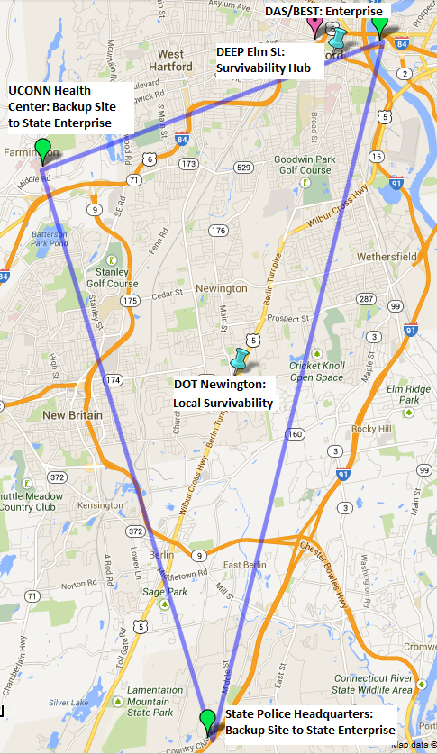
DAS/BEST’s Establish Enterprise Unified Communications Project
Statewide discount strategy for all Telephony projects.
Connecticut’s first Telephone Disaster Recovery Capability.
Cellular connectivity
24 Hour monitoring
Enterprise System at State Data Center.
Automatic Switching to State Police or UCHC hubs.

Slide 10
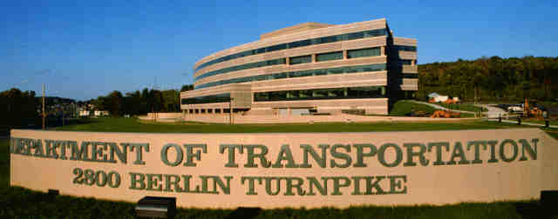
DOT Phone System Replacement
Current View:
Current hardware and software is not just at end of life but is so old that a failure would be unrecoverable.
No survivability - No failover capability or redundancy during emergency situations.
High cost - The cost of separate and expensive multiple phone lines is much greater than the cost provided by new technology.
Future View:
New phone system that is reliable, supportable and provides enhanced features.
Survivability – New system offers resiliency and survivability.
Savings – Recurring annual savings of 300,000.00 on inter state and long distance phone calls.
Leverage the BEST Enterprise Solution - DOT, DESPP, UConn Medical Center and all future state agency participants will share the same standardized solution for all of their communication needs.

Slide 11
UConn Health Center’s Telephony Needs
Current Communications Platform Nearing End of Avaya Support
Our Voice Communications are based on outdated technology
Some vital hardware in use is nearly 20 years old
Very expensive to maintain and difficult to find parts for
Ability to align our vision with the State’s Plan offers advantages to both teams
Enhanced Failover capacity shared among all locations
Significant opportunity for savings though combined purchase
Significant opportunity for savings based on reduced support costs and efficiency gains in trunking.
Better Service to the Community we serve!

