Slide 1
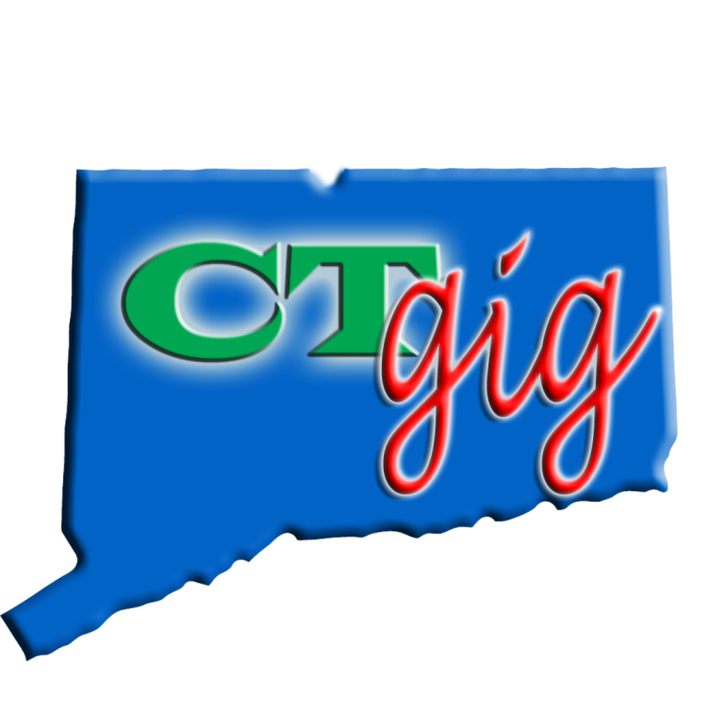
Manchester, CT
Board of Directors
Regular Meeting
Bill Vallee
CT Broadband Policy Coordinator
December 2, 2015
December 2, 2015
Manchester CT Board of Directors
1

Slide 2
Some policymakers wonder why there is any need for state or local government involvement in bringing high speed broadband Internet access into their communities.
December 2, 2015
Manchester CT Board of Directors
2

Slide 3
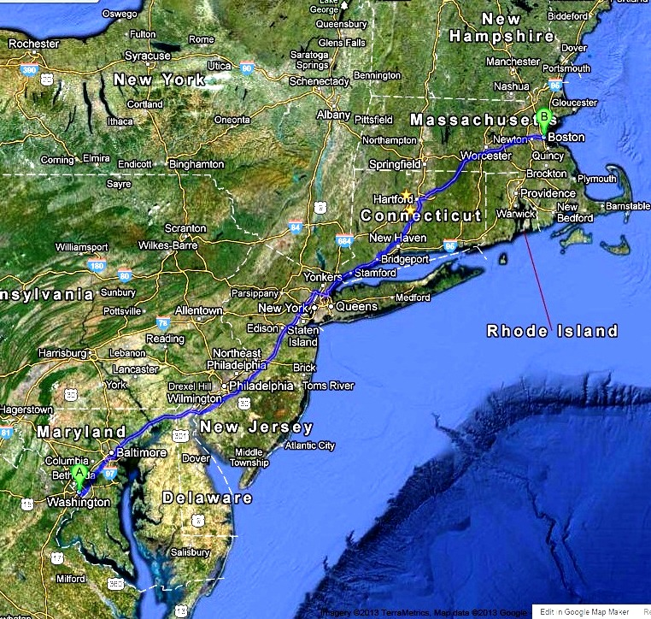
Notes:
BOSNYWASH, 444 miles long, straight line, 20% of US pop’n, 2% of land mass.
80 % of transportation, 80% of telecommunication that starts in BOSNYWASH, ends in BOSNYWASH
CT is not “between NY and BOS: it is the “heart of the NY/ BOS area.

Slide 4
Competitive, statewide, multimillion dollar, fiber network projects are now being developed by New York and Massachusetts, both of which have long supported state broadband agencies with budgets and strategic plans dedicated to developing fiber networks.
December 2, 2015
Manchester CT Board of Directors
4

Slide 5
Connecticut, one of the most high tech and advanced states in the Nation, should also have a significant program addressing the broadband digital divide that exists in Connecticut, particularly among unserved/underserved urban and rural communities.
December 2, 2015
Manchester CT Board of Directors
5

Slide 6
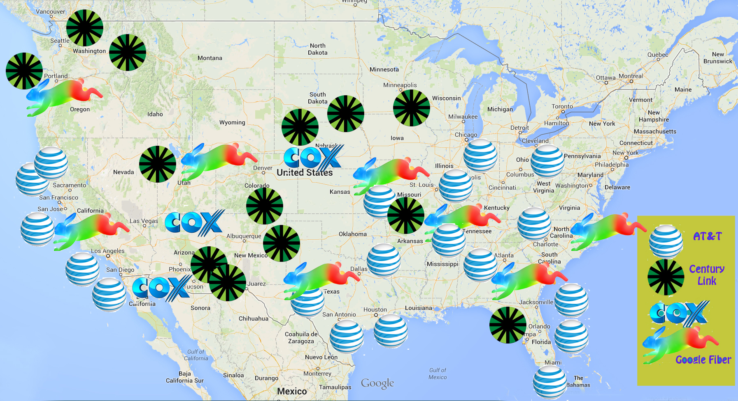
There are no fiber networks presently planned in Connecticut, New York, New England, or the entire Northeast US.

Slide 7
Demand For Fiber Networks Is Intense
Communities and businesses are demanding better, cheaper, faster broadband because it can be the difference between a successful and vibrant future, or economic decline.
December 2, 2015
Manchester CT Board of Directors
7

Slide 8
Demand For Fiber Networks Is Intense
Connecticut has a large number of high tech businesses and organizations that digitally manipulate massive data sets for manufacturing, health innovations, and research conducted by private groups and institutions of higher education.
December 2, 2015
Manchester CT Board of Directors
8

Slide 9
Demand For Fiber Networks Is Intense
The success of these new emerging high tech companies requires reasonably-priced, ultra-high Internet access speeds greater than those currently offered by the incumbents in Connecticut.
Broadband is no longer a luxury: it is an economic development necessity.
December 2, 2015
Manchester CT Board of Directors
9

Slide 10
The state of Connecticut and its municipalities cannot afford to be left behind as this wave of innovative approaches
December 2, 2015
Manchester CT Board of Directors
10
Notes:
The state of Connecticut and its municipalities cannot afford to be left behind as this wave of innovative approaches to stimulating the construction of Gigabit service networks sweeps the Nation.
Connecticut has several unique assets that will drive its ultra-high speed broadband future:

Slide 11
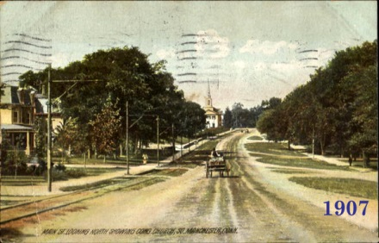
Notes:
Center Congregational Church built 1904
Diffusion lag: 2-horse, 4 wheeled milk truck, dirt roads, and the new electrified trolly sharing the roadway. Model T, 1908.
The Connecticut Company was the primary electric street railway company in the U.S. state of Connecticut, operating both city and rural trolleys and freight service. It was controlled by the New York, New Haven and Hartford Railroad (New Haven), which also controlled most steam railroads in the state.
New Haven bought Hartford, Manchester and Rockville Tramway and Stafford Springs Street Railway (East Hartford to Stafford Springs via Rockville): control January 25, 1906; property (of the former only) March 26, 1906
South Manchester Light, Power and Tramway Company, similarly leased to the Hartford, Manchester and Rockville Tramway

Slide 12
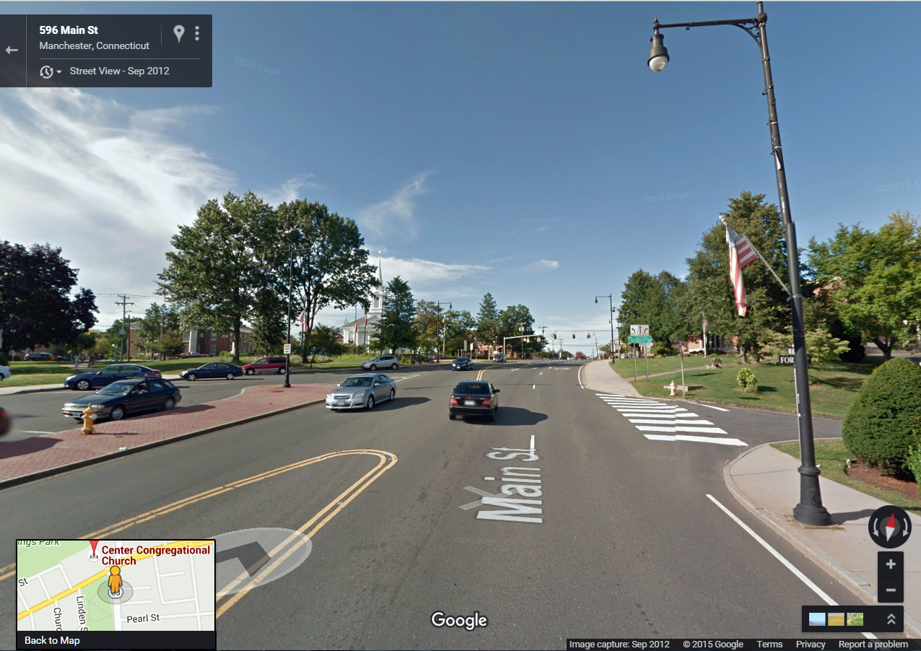

Slide 13
Demand For Fiber Networks Is Intense
The demand for fiber networks is being led by business leaders and community anchor institutions (e.g., schools, hospitals, public safety, and municipal governments), along with enlightened city and rural dwellers.
December 2, 2015
Manchester CT Board of Directors
13

Slide 14
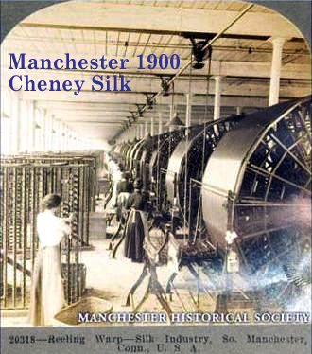

Slide 15
Why the CTgig Project ?
The CTgig Project is a coordinated effort by the Participating Municipalities to deliver an open access fiber network to every address in the state of Connecticut.
December 2, 2015
Manchester CT Board of Directors
15

Slide 16
The Goal of the CTgig Project
We need one fiber line into every address (residences, businesses, and community anchor institutions), just as we have one electric line, a water pipe, a road out front, and schools nearby.
These are all shared infrastructure projects, which is the basic work of every municipality in history.
December 2, 2015
Manchester CT Board of Directors
16

Slide 17
The CSBO has recently enlisted the help of national expert consultants to develop a public analysis of why and how Connecticut state government and the 169 municipalities should engage in boosting competition across the state to build fiber network projects.
December 2, 2015
Manchester CT Board of Directors
17

Slide 18
The report will
develop strategic options for municipalities as a complement to the state-level strategies,
summarizing a range of strategic options appropriate for the municipalities,
listing the tools and assets that the localities have at their disposal, as well as partnership opportunities that may exist.
December 2, 2015
Manchester CT Board of Directors
18

Slide 19
We will demonstrate that there are areas of Connecticut and often in many municipalities that are currently unserved by broadband that meets the FCC’s definition (25 mb/3mb), and indeed some areas are not served by any form of Internet access other than dial-up.
December 2, 2015
Manchester CT Board of Directors
19

Slide 20
The Digital Divide Can Be Eliminated
Building to every premise in a municipality can eliminate the digital divide by providing broadband access for all low income and high cost areas in each community.
When every address has inexpensive access to fiber, there can be no discrimination among residents or businesses for broadband access.
December 2, 2015
Manchester CT Board of Directors
20

Slide 21
The CSBO will request data and other information from the state and towns in order to develop a comprehensive plan for proceeding.
December 2, 2015
Manchester CT Board of Directors
21

Slide 22
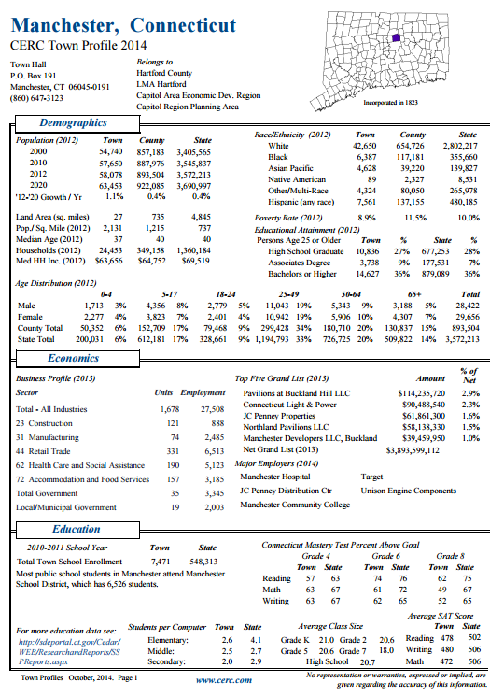

Slide 24
Only Competition Can Force A Monopoly To Upgrade
Cities must force competition into the market to get industry to cooperate in public-private partnerships to create a competitive broadband ecosystem.
December 2, 2015
Manchester CT Board of Directors
24

Slide 25
Even the threat of competition – tends to increase efficiencies in supply and demand.
December 2, 2015
Manchester CT Board of Directors
25
Notes:
Competition – even the threat of competition – tends to increase efficiencies in supply and demand by:
improving the performance and the offerings of the incumbents desired by consumers; and
improving service and quality;

Slide 26
Industry And Government Must Cooperate Together In Public-Private Partnerships To Create A Competitive Broadband Ecosystem.
December 2, 2015
Manchester CT Board of Directors
26
Notes:
V. Industry And Government Must Cooperate Together In Public-Private Partnerships To Create A Competitive Broadband Ecosystem.

Slide 27
Municipalities need to work with willing incumbents or new entrants,
entering into public-private partnerships,
developing their own networks, or
being served by other local communities which have the capacity to provide Gigabit services.
December 2, 2015
Manchester CT Board of Directors
27
Notes:
Municipalities need to work with willing incumbents or new entrants,
entering into public-private partnerships,
developing their own networks, or
being served by other local communities which have the capacity to provide Gigabit services.

Slide 28
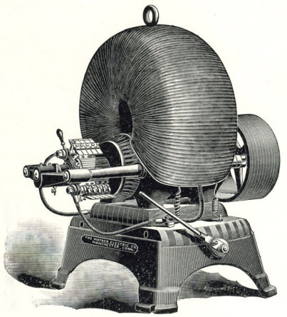
Mather Electric Co.
Manchester, CT
pre-1894,
electric dynamo

Slide 29
Manchester, had its first electrical power and lighting in a very limited way during 1890.
The Cheney Brothers office and the home of Rush Cheney were illuminated with electric bulbs powered by storage batteries.
The batteries were charged during the day by a very small generator located in the Cheney Brothers Old Mill engine room.

Slide 30
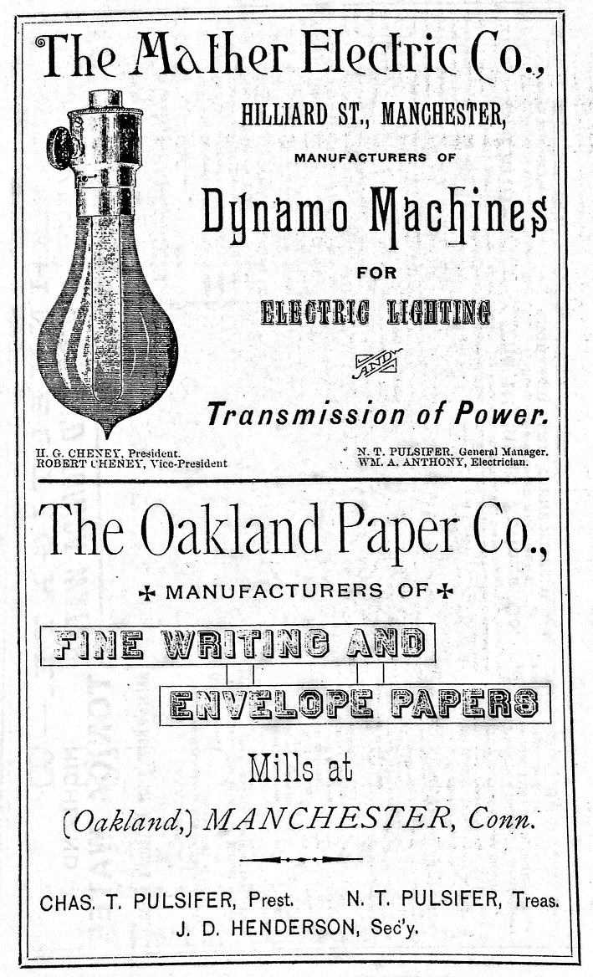

Slide 31
By 1920 the Manchester Electric Company had established itself as a branch of Cheney Brothers and was considered a department of the silk mill complex.
A pole line was constructed to Manchester Green to serve the eastern end of Manchester.
Other pole lines had been constructed over a 30-year period to Depot Square and to the southern portion of Manchester.
Poles were often paid for by the users along the route.

Slide 32
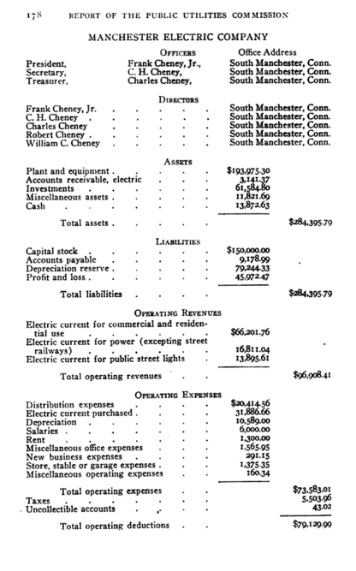
Notes:
1918 balance sheet
Electric current revenues: biz, res, power (note street railways- must have gotten from elsewhere since Cheney had owned the rail lines; perhaps New Haven RR which then owned the line), and street lights.
Note all the Cheney family
$285,000 business . . .

Slide 33
1936, the Manchester Electric Company, the Bolton Electric Company, and the Union Electric Light and Power Company merged with the Connecticut Power Company.

Slide 34
State RFQ for Gig Broadband

Slide 35
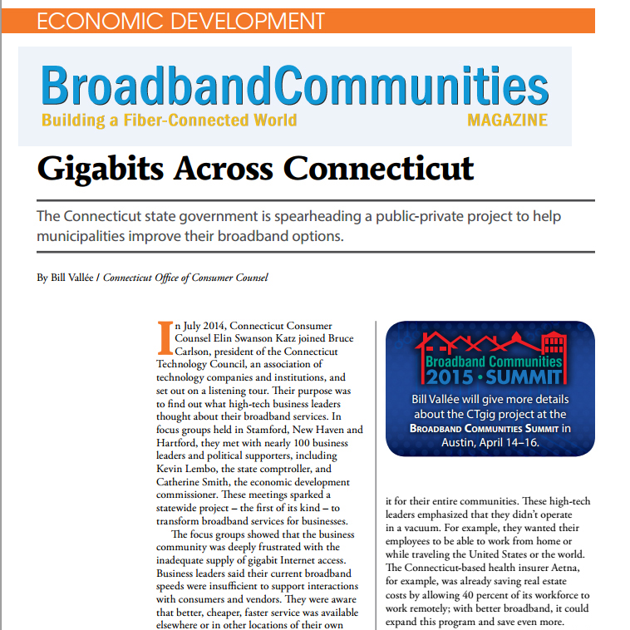
http://ow.ly/Jgs3R

Slide 36
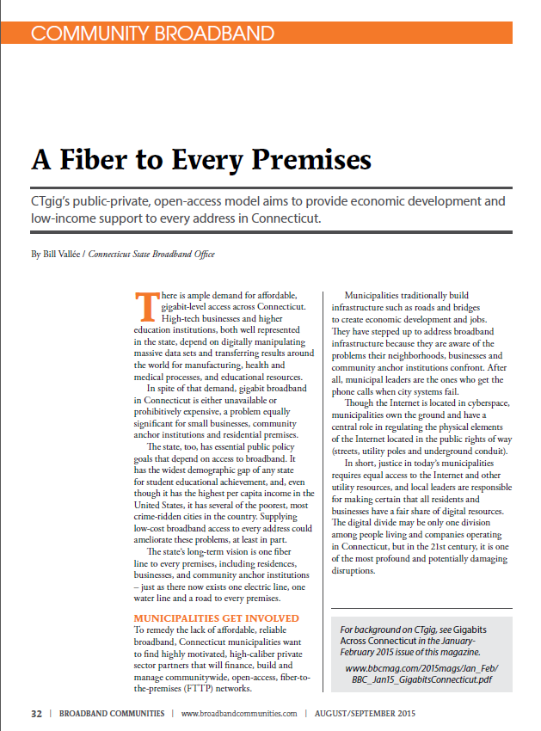

Slide 37
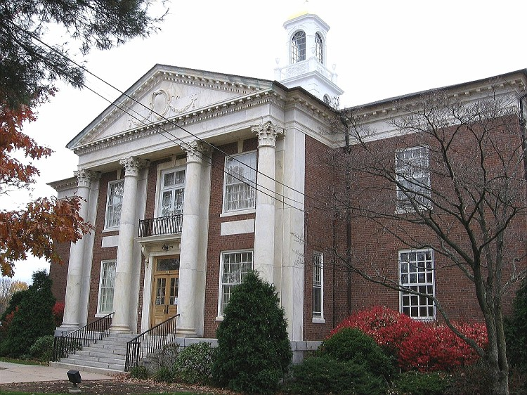
Manchester, CT
Board of Directors
Regular Meeting
December 2, 2015
Bill Vallee
State Broadband Policy Coordinator
860-827-2905
william.vallee@ct.gov

