Slide 1
Connecticut HUSKY Health:
Cost Drivers, Reform Agenda, Outcomes and Future State
Presentation to the Health Care Cabinet
June 14, 2016

Slide 2
Overview
Cost drivers
Reform agenda
Documented outcomes
Long-term strategies: future state

Slide 3
HUSKY Health
Overview

Slide 4
HUSKY Health at a Glance
Critical source of economic security and well-being to over 750,000 individuals (21% of the population of Connecticut).
Covers an extensive array of preventative services (primary care through Person-Centered Medical Homes, dental and behavioral health coverage) as well as care coordination.
Data driven.
Maintains a fully integrated set of claims data for all covered individuals and all covered services.
Uses data analytics to direct policy-making, program development and operations.
Already doing more with less.
Administrative costs are 5.2%. Total staffing (131 individuals) has held relatively constant while the number of individuals served has dramatically increased.
59% of Connecticut Medicaid and 88% of CHIP (HUSKY B) expenditures are federally reimbursed.
Serves adults, working families, their children, their parents and their loved ones with disabilities.
Health expenditures (70.7% of department budget) are increasing based on caseload growth, but trends in per person costs are stable and quality outcomes have improved.
Successful in improving quality, satisfaction and independence through prevention and integration.
Employs predictive modeling to identify both those in present need of care coordination, and those who will need it in the future.

Slide 5

HUSKY Health Financial Snapshot
Programs supported:
Medicaid, HUSKY B (Children’s Health Insurance Program), long-term services and supports
SFY’17 proposed program budget:
$3.20 billion (appropriated)
$6.87 billion (total)
SFY 2016 estimated staffing costs: $8.3 million
Administrative cost ratio: 5.2%
Estimated program federal reimbursement: 59% - Medicaid, 88% - HUSKY B (CHIP)
Estimated administrative federal reimbursement: 75% for systems, eligibility, MFP, specialized medical staff; 50% for all other activities
Program outcome highlights:
Supporting members in accessing primary care and avoiding use of the ED through ICM, PCMH, and comprehensive coverage of behavioral health and dental services
Integrating care through initiatives including DMHAS health homes and PCMH practices
Rebalancing long-term services and supports
Supporting providers through primary care investments, Person-Centered Medical Home initiative, and streamlined administration

Slide 6



HUSKY Health touches everyone.
Children. Working families and individuals.
Older adults. People with disabilities.
Your neighbor. Your cousin.
One in five CT citizens is served by HUSKY Health.

Slide 7




HUSKY Health . . .
extends financial security from the catastrophic costs of a serious health condition
enables people to stay well, through prevention, and to work
promotes the health, well-being and school readiness of children
supports independence in the community

Slide 8
HUSKY Health is mission-driven.
HUSKY Health works in partnership with stakeholders across the health care delivery system to ensure that eligible people in Connecticut receive the supports and services they need to promote self-sufficiency, improved well-being and positive health outcomes. We ensure that the delivery of these services is consistent with federal and state policies.

Slide 9





HUSKY Health is person-centered.

Slide 10
HUSKY Health is improving outcomes while controlling costs.
Health outcomes and care experience are improving. We are enabling independence and choice for people who need long-term services and supports.
Provider participation has increased.
Enrollment is up, but per member per month costs are stable.
The state share of HUSKY Health costs has decreased.

Slide 11
HUSKY Health has maximized benefits under the Affordable Care Act.
100% federal coverage for expansion of Medicaid eligibility (HUSKY D)
coverage of new preventative services including smoking cessation and family planning
new resources for behavioral health integration through DMHAS-led health homes
$77 million in funding under the State Balancing Incentive Program for home and community-based long-term services and supports (LTSS)

Slide 12
Conceptual framework
DSS and its state agency partners (DCF, DDS, DMHAS) are motivated and guided by the Centers for Medicare and Medicaid Services (CMS) “Triple Aim”:
improving the patient experience of care (including quality and satisfaction)
improving the health of populations
reducing the per capita cost of health care

Slide 13
  We are also influenced by a value-based purchasing orientation. The Centers for Medicare and Medicaid Services (CMS) define value-based purchasing as a method that provides for:
  Linking provider payments to improved performance by health care providers. This form of payment holds health care providers accountable for both the cost and quality of care they provide. It attempts to reduce inappropriate care and to identify and reward the best-performing providers.

Slide 14
Hypotheses
We have two critical reform hypotheses:
Centralizing management of services for all Medicaid beneficiaries in self-insured, managed fee-for-service arrangements with Administrative Services Organizations, as well as use of predictive modeling tools and data to inform and to target beneficiaries in greatest need of assistance, will yield improved health outcomes and beneficiary experience, and will help to control the rate of increase in Medicaid spending.

Slide 15
Building on current preventative and coordinative interventions (e.g. PCMH, ASO-based Intensive Care Management), DMHAS health home) by migrating such efforts to a more community-based approach and building in appropriate value-based payment strategies (e.g. pay-for-performance, bundled payments, episodes, shared savings arrangements) will yield further improvements in health outcomes and beneficiary experience, and will continue to control the rate of increase in Medicaid spending.

Slide 16
Cost Drivers

Slide 17
Key cost drivers for Medicaid include the following:
“high need, high cost” individuals with complex needs
individuals who receive long-term services and supports (LTSS)

Slide 18
High Need, High Cost Individuals
Using dates of services in CY 2014 and stratifying by child (0-20) and adult (21 +), the Administrative Services Organizations were asked to provide the department the following information:
Highest 10% members by cost, excluding nursing home (NH) residents
Highest 10% of members with hospital admission
Highest 10 % of members with ED utilization
Total unduplicated members from a, b, & c
Department of Social Services
18
Notes:
18

Slide 19
Hospital Inpatient Conditions Adults & Children
Inpatient Conditions | Total Adults admits: 7,457 | Total Children admits: 3,315
Infectious/Neoplasms/Nutritional/ Diseases of Blood | 1,459 (20%) | 419 (13%)
Mental Disorder | 1,413 (19%) | 669 (20%)
Diseases of Nervous/Circulatory/Genitourinary System | 1,251 (17%) | 264 (8%)
Diseases of Respiratory/Digestive | 1,627 (22%) | 654 (20%)
Pregnancy | 100 (1%) | 453 (14%)
Disease of Skin/Musculoskeletal | 351 (5%) | 154 (5%)
Ill defined conditions/Injury & Poisoning | 1,259 (17%) | 702 (21%)
19

Slide 20
Recipients of LTSS
Individuals who receive LTSS:
A relatively small number of individuals use LTSS, but their costs are a significant proportion of the Medicaid budget
Individuals who use LTSS typically have high needs and high costs and benefit from coordination of their services and supports
Average per member per month costs are less in the community.

Slide 22
A comparison of average community and institutional costs for individuals at nursing home level of care (2012)

Slide 23
Connecticut Medicaid Reform Agenda: Addressing Cost Drivers through Care Coordination, Practice Transformation and New Payment Modalities

Slide 24
HUSKY Health’s key means of addressing cost drivers include:
Streamlining and optimizing administration of Medicaid through . . . | a self-insured, managed fee-for-service structure and contracts with Administrative Services Organizations unique, cross-departmental collaborations including administration of the Connecticut Behavioral Health Partnership (DSS, DCF, DMHAS), long-term services and supports (LTSS) rebalancing plan (DSS, DMHAS, DDS, DOH) and the new ID Partnership (DDS and DSS)

Slide 25
Improving access to primary, preventative care through . . . | extensive new investments in primary care (PCMH payments, primary care rate bump, EHR payments) comprehensive coverage of preventative behavioral health and dental benefits
Coordinating and integrating care through . . . | ASO-based Intensive Care Management (ICM) PCMH practice transformation DMHAS-led behavioral health health homes Money Follows the Person “housing + supports” approach and Innovation Accelerator Program Medicaid Quality Improvement and Shared Savings (MQISSP) initiative

Slide 26
Re-balancing long-term services and supports (LTSS) through . . . | A multi-faceted Governor-led re-balancing plan that includes: Extensive collaboration by DSS, DMHAS, DDS, DOH State Balancing Incentive Program (BIP) activities LTSS waivers (DSS, DMHAS, DDS) Nursing home “right sizing” Workforce initiatives My Place consumer portal
Moving toward Value-Based Payment approaches through . . . | Hospital payment modernization Pay-for-performance (PCMH, OB) MQISSP shared savings initiative

Slide 27



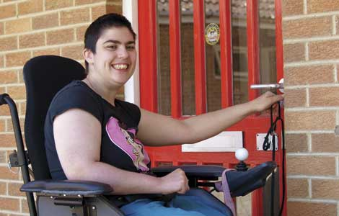

Past, Present and Future
 | Past | Present | Future
Administrative/ financial model | A mix of risk-based managed care contracts and central oversight | Self-insured, managed fee-for service model; contracts with four Administrative Services Organizations (ASOs) | Self-insured, managed fee-for-service model that incorporates health neighborhoods and Value-Based Payment (VBP) approaches
Financial trends | Double digit year-over-year increases were typical | Overall expenditures are increasing proportionate to enrollment; per member per month spending is trending down | Quality-premised VBP strategies will enable further progress on trends
Data | Limited encounter data from managed care organizations | Fully integrated set of claims data; program employs data analytics to risk stratify and to make policy decisions | Data match across human services and corrections data sets will enable more intelligent policy making

Slide 28
 | Past | Present | Future
Member experience | Members had different experiences depending on which MCO oversaw their services; MCOs relied upon traditional chronic disease management strategies | ASOs provide streamlined, statewide access points and Intensive Care Management; PCMH practices enable coordination of primary and specialty care; health homes enable integration of medical, behavioral health and social services | Health neighborhoods will address both health needs and social determinants of health (e.g. housing stability)
Provider experience | Provider experience varied across MCOs; payment was often slow or incomplete | ASOs provide uniform, statewide utilization management and ICM; providers can bill on a bi-weekly basis | Consideration of migration to health neighborhood self-management of provider relationships

Slide 29
Documented Outcomes

Slide 30
HUSKY Health analyses its outcomes through the following means:
Use of a broad array of HEDIS and hybrid measures
Use of CAHPS and mystery shopper approach
Geo-access analyses of provider participation
Provider surveys
Review of financial trends: overall expenditures and per member per month spend, stratified across all HUSKY Health coverage groups

Slide 31
What relevant results do we see in Connecticut, related to our Person-Centered Medical Home initiative?
PCMH practices achieved better results than non-PCMH practices on measures including, but not limited to ambulatory ED visits and asthma ED visits
Immediate access to care increased to 92.5% of the time, when requested by adults, and 96.7% of the time, when requested on behalf of children

Slide 32
What relevant results do we see in Connecticut, related to our Intensive Care Management (ICM) initiatives?
Over SFY’15. Connecticut Medicaid’s medical ASO, CHNCT, has:
  for those members who received ICM, reduced emergency department (ED) usage by 22.72% and reduced inpatient admissions by 43.87%
  for those members who received Intensive Discharge Care Management (IDCM) services, reduced readmission rates by 28.08%

Slide 33
Over SFY’15, through a range of strategies (Intensive Care Management, behavioral health community care teams) and in cooperation with the Connecticut Hospital Association, the Emergency Department visit rate was reduced by:
  4.70% for HUSKY A and B
  2.16% for HUSKY C
  23.51% for HUSKY D

Slide 34
Over SFY’15:
Overall admissions per 1,000 member months (MM) decreased by 13.2%
Utilization per 1,000 MM for emergent medical visits decreased by 5.4%
Utilization per 1,000 MM for all other hospital outpatient services decreased by 5.3%

Slide 35
Comparison with National Trends
* Expenditures are net of drug rebates and include DMHAS' behavioral health costs claimable under Medicaid. This depiction includes all hospital supplemental and retro payments.
Department of Social Services
35
Notes:
5/1/2017
35

Slide 36
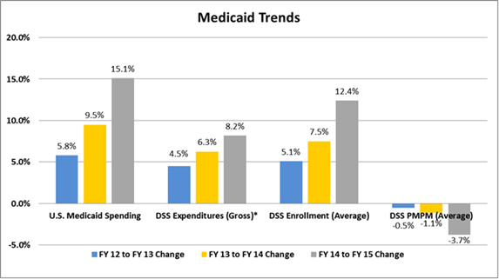
* Expenditures are net of drug rebates and include DMHAS' behavioral health costs claimable under Medicaid. This depiction excludes all hospital supplemental and retro payments.
Department of Social Services
36
Notes:
5/1/2017
36

Slide 37
Enrollment and PMPM
Expenditures have increased proportionate to the increase in enrollment, but per member per month costs have remained remarkably steady.
Department of Social Services
37
Notes:
5/1/2017
37

Slide 38
Long-Term Strategies for Cost Containment:
The Future State

Slide 39

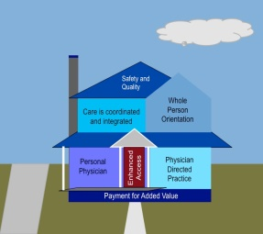






HUSKY Health 2017 and ongoing
Health neighborhoods composed of PCMH practices, specialties, CHWs and non-medical services and supports

Slide 40
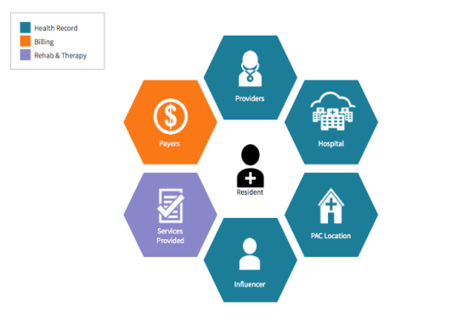


Development of additional value-based payment strategies
MQISSP
PCMH enhanced fees and performance payments
OB P4P
Shared savings arrangements
Episodes of care

Slide 41
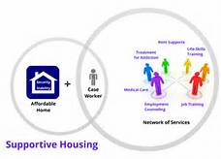
Achievement of a person-centered, integrative, rebalanced system of long-term services and supports
PHR System
BIP System
Personal Health Record
Pre-Screen
Service Provider
BIP System
Transportation
Assessment
Balancing Incentive Program
Person Centered View
MMIS System
Service Provider
LTSS
Services
Claims
Care Plan(s)
Financial
Eligibility
Case Management
BIP System

Slide 42
Key Terms
Term | Acronym | Detail
Administrative Services Organization | ASO | DSS has contracted with four organizations (CHN, Beacon, Benecare and Logisticare) to act as statewide ASOs. The ASOs perform many traditional member support functions , but are also responsible for data analytics and ICM.
Behavioral health home | BHH | DMHAS and DSS have partnered to implement this new means of integrating behavioral health, medical care and social service supports for individuals with Serious & Persistent Mental Illness.
Expansion group | HUSKY D | Connecticut’s Medicaid expansion group includes adults at 18-64 who are not otherwise eligible for another Medicaid coverage group.
Fee for Service | FFS | A method in which doctors and other health care providers are paid for each service performed. Examples of services include tests and office visits.
Intensive Care Management | ICM | A set of services that help people with complex health care needs to better understand and manage their care.
Long-term services and supports | LTSS | Long-term services and supports (LTSS) are a spectrum of health and social services that support elders or people with disabilities who need help with daily living tasks.
Medicaid Quality Improvement and Shared Savings Program | MQISSP | MQISSP is a Connecticut Medicaid initiative under which DSS will enter into shared savings arrangements with FQHCs and advanced networks.
Pay-for-performance | P4P | P4P rewards health care providers for attaining targeted service goals, like meeting health care quality or efficiency standards.
Person-Centered Medical Home | PCMH | PCMH is a model for the organization of primary care that ensures effective delivery of the core functions of primary health care.
Value-Based Payment | VBP | VBP links provider payments to improved performance on quality measures.

