Slide 1
HIX/Tier-1 Application Quick Links
An introduction to the HIX/Tier-1 Worker Portal
Module 118

Slide 2
The Quick Links options in the application landing page.

Slide 3
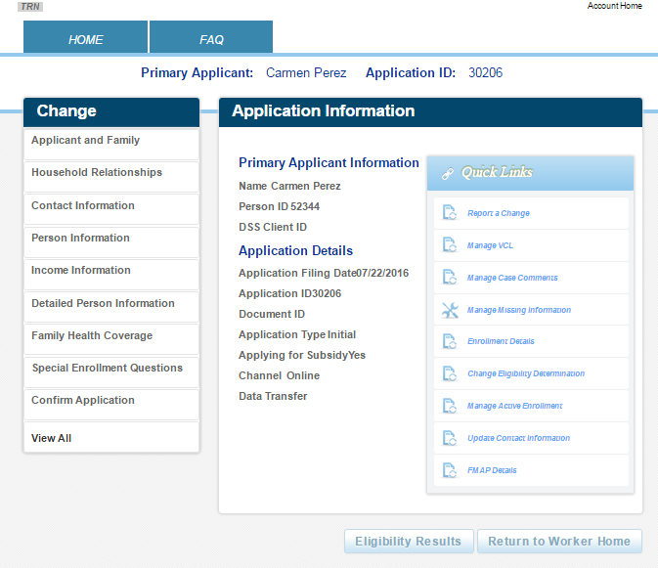
Quick Links
On the main landing page for a consumer, there are Quick Links for viewing and managing the application.
What is available depends on:
Your security.
The status of the application.

Slide 4
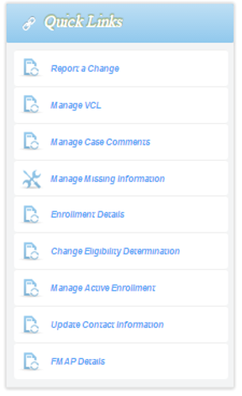
Report a Change
This is only available if the application is the most recent physical application, i.e., you can’t change history.
There are several upcoming modules that cover change reporting.

Slide 5
Manage VCL
This displays the verification checklist items.
These are items that require the client to mail documents to prove what they have said, e.g., mail copies of pay stubs in order to prove income.
There is a module dedicated to verifications.

Slide 6
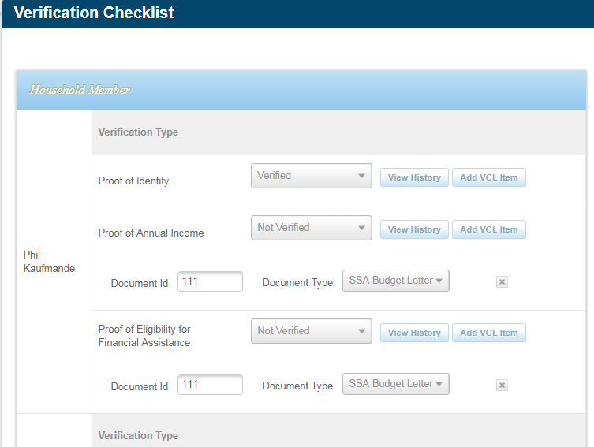
Manage VCL
Typically a CCR will not update this screen, i.e., will look at it in view-only mode.
The exception is when redundant repeat verifications are generated.
We cover how to manage these in an upcoming module.

Slide 7
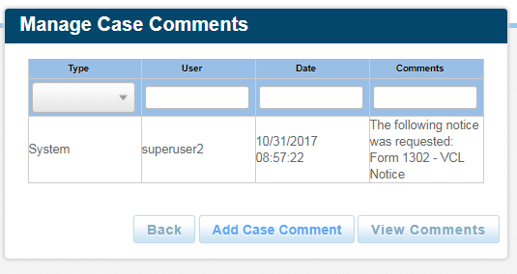
Manage Case Comments
This allows you to add and view comments. You will use this a lot.
Some comments are generated by the system and others are manually added.

Slide 8
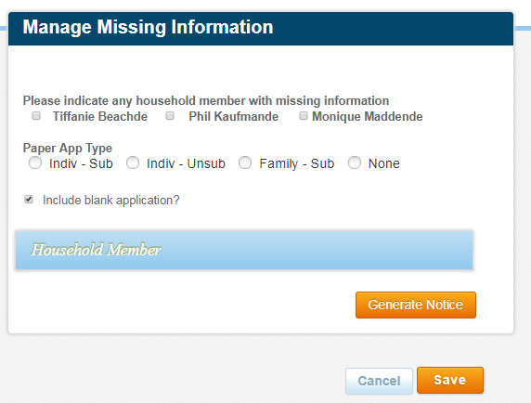
Manage Missing Information
This is used by data entry staff when there is information missing from a paper application.
You will not use this menu item.

Slide 9
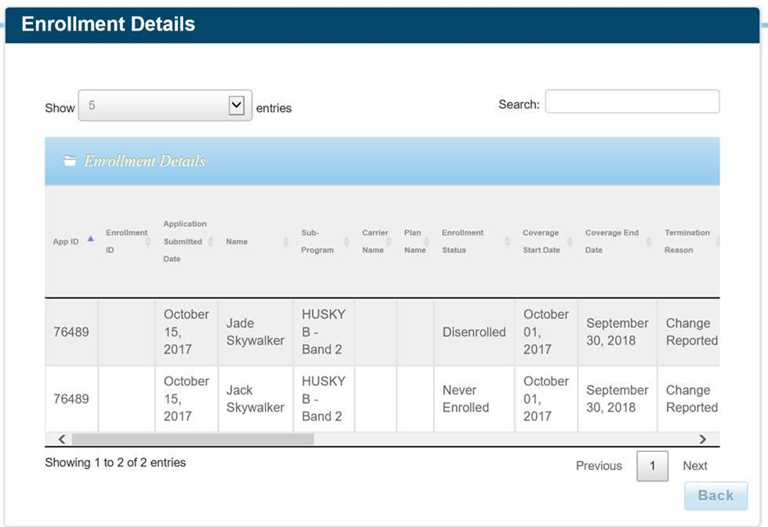

Enrollment Details
A view only screen that summarizes member eligibility and enrollment details.
Scroll right

Slide 10
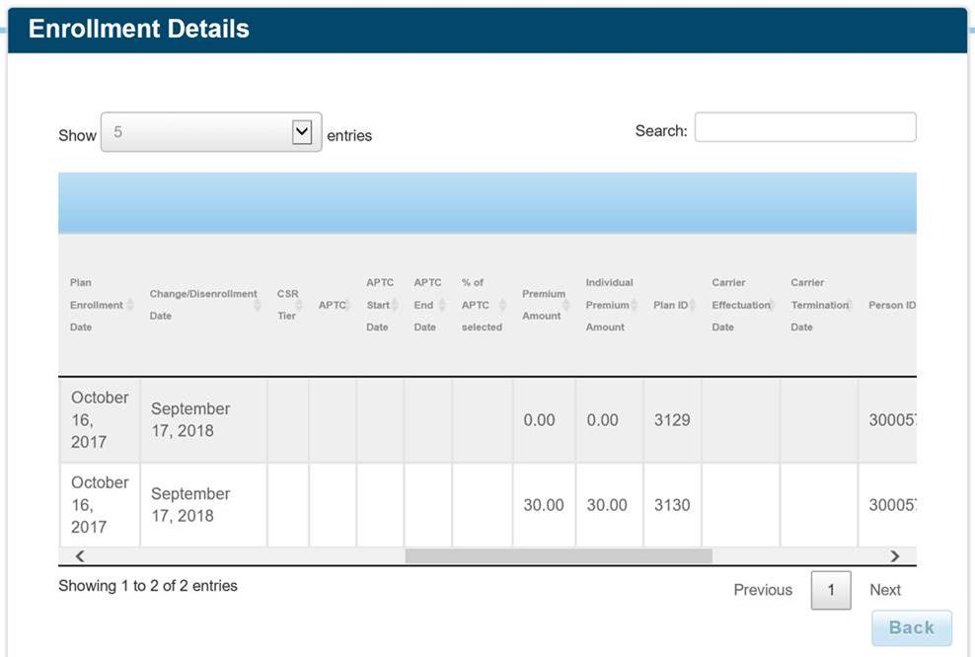
Enrollment Details
Scrolling right shows more columns.
Scroll right

Slide 11
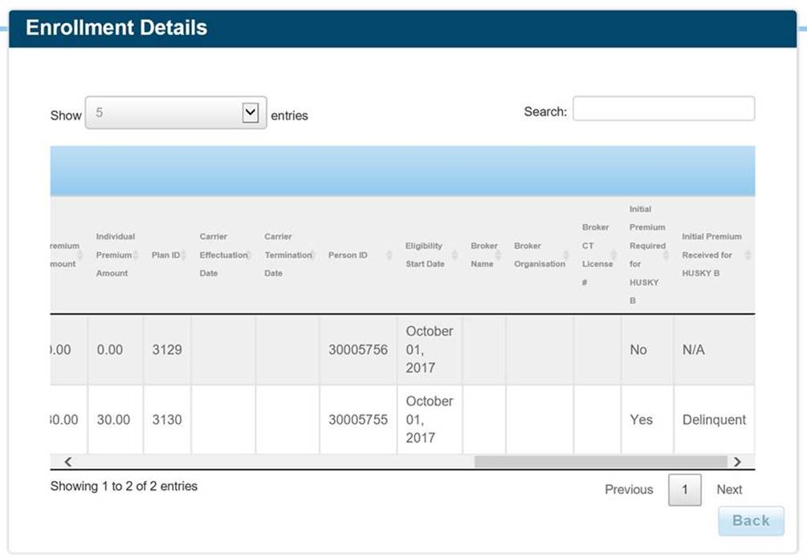
Enrollment Details
Scrolling to the end.

Slide 12
Change Eligibility Determination
View only screen that shows what members are eligible for and related verification issues.

Slide 13
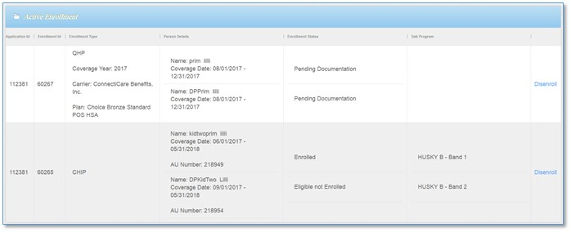
Manage Active Enrollments
A view only screen that summarizes active enrollment status details.

Slide 14
Update Contact Information
A simple way to update mailing addresses, email addresses and phone numbers without having to run eligibility and enrollment.

Slide 15
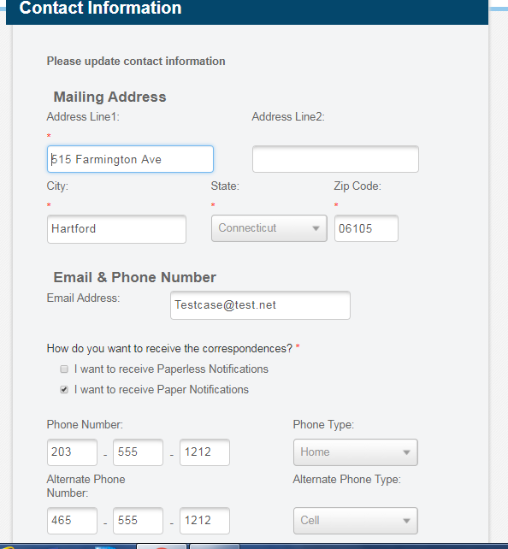
Update Contact Information

Slide 16
We introduced and reviewed the Quick Links options in the application landing page.

