Slide 1




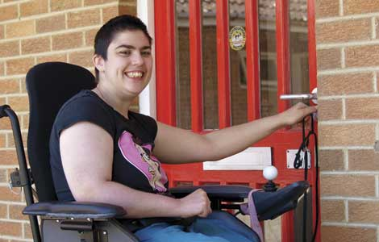
Overview of HUSKY Health Quality and Cost Trends

Slide 2
Agenda
Overview of Program Structure and Reform Agenda
Access
Adult and Child Measures
Long-Term Services and Supports
Experience of Care
Cost Trends
Impacts of COVID (foregone care, telehealth)

Slide 3
Overview of Program Structure and Reform Agenda
3
Notes:
1/7/2021
3

Slide 4
A Snapshot of the Program
Connecticut HUSKY Health (Medicaid and CHIP) serves 995,000 individuals (over 25% of the state population)
Connecticut is a Medicaid expansion state, and optimized use of many other aspects of the Affordable Care Act (preventive services, health homes, Community First Choice, Balancing Incentive Program, State Innovation Model Test Grant)
By contrast to many other Medicaid programs, Connecticut uses a self-insured, managed fee-for-service approach
Connecticut has also implemented complementary initiatives, including justice reform and efforts to eliminate homelessness

Slide 5
Details on Eligibility Groups
Coverage Group | Provides comprehensive medical, dental, and behavioral health services to . . . | Representing . . .
HUSKY A – Medicaid Adults with incomes of up to 160% of the Federal Poverty Level (FPL) Pregnant women with incomes of up to 258% FPL Children with incomes of up to 201% FPL | Over 509,097 parents and children | 57.2% of members and 29% of total Medicaid program costs
HUSKY B – Children’s Health Insurance Program Band 1: Children and caretaker adults with incomes of up to 254% FPL Band 2: Children and caretaker adults with incomes of up to 323% FPL | 19,312 children and caregivers | 100% of members and total CHIP costs
HUSKY C – Medicaid Older adults, individuals with disabilities, and refugees with incomes up to approximately 52% of FPL; home and community-based services programs have higher income limits | Over 84,000 older adults and people with disabilities | 9.5% of members and 46% of total Medicaid program costs
HUSKY D – Medicaid Eligible adults age 19-64 with incomes up to 138% of FPL | Over 295,000 expansion adults | 33.3% of members and 25% of total Medicaid program costs

Slide 6
Our Aims
A stronger and healthier next generation that avoids preventable conditions and is economically secure, stably housed, food secure, and engaged with community.
Families that are intact, resilient, capable, and nurturing.
Choice, self-direction and integration of all individuals served by Medicaid in their chosen communities.
Empowered, local, multi-disciplinary health neighborhoods.

Slide 7
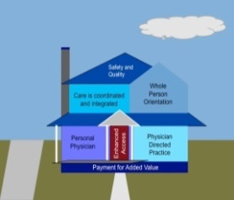
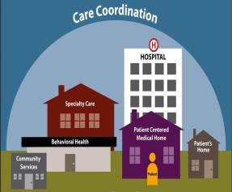



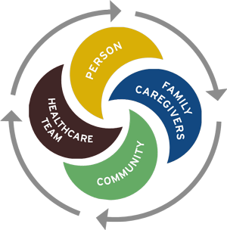
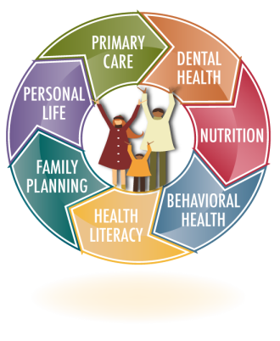



Graphic View of Reform Agenda
On a foundation of
Preventive services
and PCMH
ASO-based Intensive
Care Management
Pay-for-Performance
(PCMH, OB)
Data analytics/
risk stratification
we have built in
Community-based
care coordination through expanded care teams
(health homes, PCMH+)
Supports for social determinants
(transition/tenancy sustaining services, connections with community-based organizations)
Value-based payment approaches
(PCMH+ and other)
with the desired structural result of creating
Multi-disciplinary (medical, behavioral health, dental services; social supports) health neighborhoods

Slide 8
Means of Addressing Cost Drivers
HUSKY Health’s key means of addressing cost drivers include:
Streamlining and optimizing administration of Medicaid through . . . | a self-insured, managed fee-for-service structure and contracts with Administrative Services Organizations unique, cross-departmental collaborations including administration of the Connecticut Behavioral Health Partnership, long-term services and supports rebalancing plan and an Intellectual Disabilities (ID) Partnership

Slide 9
Improving access to primary, preventative care through . . . | extensive new investments in primary care (PCMH payments, primary care rate bump, EHR payments) comprehensive coverage of preventative behavioral health and dental benefits
Coordinating and integrating care through . . . | ASO-based Intensive Care Management (ICM) PCMH practice transformation behavioral health homes Money Follows the Person “housing + supports” approach and coverage of supportive housing services under the Medicaid State Plan PCMH+ shared savings initiative

Slide 10
Re-balancing long-term services and supports (LTSS) through . . . | A multi-faceted Governor-led re-balancing plan that includes: Transitioning institutionalized individuals to the community with housing vouchers + services Prevention of institutionalization Nursing home “right sizing” Workforce initiatives Consumer education
Implementation of Value-Based Payment approaches through . . . | Hospital payment modernization Pay-for-performance initiatives PCMH+ shared savings initiative Emerging efforts including development of a maternity bundle, hospital VBP, substance use disorder waiver, and InCK

Slide 11
HUSKY Health is improving outcomes while controlling costs.
Health outcomes and care experience are improving through use of data to identify and support those in greatest need, care delivery reforms and use of community-based services.
Provider participation has increased as a result of targeted investments in prevention, practice transformation, and timely payment for services provided.
Enrollment is up, but per member per month costs have been reduced. Connecticut has maximized use of federal funds. The state share of HUSKY Health costs is stable.

Slide 12
Summary of Quality Improvement Plan
12
Notes:
1/7/2021
12

Slide 13
HUSKY Health analyzes its performance through the following means:
Use of a fully integrated, statewide set of Medicaid claims data to report on a broad array of HEDIS and CMS Core Set measures (Connecticut voluntarily reported on 18 of 21 measures in the CMS Medicaid/CHIP Child Core set and on 15 of 16 measures in the CMS Adult Core set)
Extensive use of CAHPS and mystery shopper surveys
Geo-access analyses of provider participation
Financial trend analyses

Slide 14
Access
14
Notes:
1/7/2021
14

Slide 15
Federal Rule
On November 2, 2015, CMS published a final rule entitled, Medicaid Program; Methods for Ensuring Access to Covered Medicaid Services.*
CMS indicated that this rule, “provides for a transparent data-driven process for states to document whether Medicaid payments are sufficient to enlist providers to assure beneficiary access to covered care and services consistent with section 1902(a)(30)(A) of the Social Security Act (the Act)”
* https://www.gpo.gov/fdsys/pkg/FR-2015-11-02/pdf/2015-27697.pdf

Slide 16
Access Plan
Among other requirements, the rule directed Connecticut (and all other states with fee-for-service Medicaid programs) to develop, seek public comment on and submit to CMS an access monitoring review plan (AMRP) on several categories of service
The purpose of the AMRP was to assure that access is available to Medicaid members to the same extent that care is available to the general population, across geographic areas in the state

Slide 17
The rule did not define standards for assessing the availability of care to the general population, but instead directed states to, “analyze access issues within broad parameters in a manner that appropriately reflects the local health care delivery system of each state”
While the Trump administration CMS proposed to rescind the access rule, the rule remains in effect. CMS provided additional guidance to states regarding access requirements. See below:
https://www.govinfo.gov/content/pkg/FR-2019-07-15/pdf/2019-14943.pdf
https://www.medicaid.gov/federal-policy-guidance/downloads/CIB071119.pdf

Slide 18
Access Standards
DSS’ contracts with its Administrative Services Organizations (ASOs) require them to support the Department in recruitment and retention of providers, as well as facilitation of access to medically necessary services
The ASOs regularly monitor access through provider relations outreach, maintenance of detailed provider directories, geo-mapping and use of annual mystery shopper surveys

Slide 19
Overview of Enrolled Providers
Medical Providers
Primary care providers: 3,870
Specialists: 17,808
Change over calendar year 2019: 24.3%
Please note: The unusually high increase over 2019 resulted from DSS changing 3,249 providers from “out-of-state” to a “border” status.
Behavioral Health Providers
Behavioral Health Providers: 9,682
Change over calendar year 2019: 15.4%

Slide 20
Overview of Enrolled Providers
Dental Providers
Primary care providers: 1,827
Specialists: 622
Change over calendar year 2019: .9%
100% of members have access to 1 provider within 20 miles; 98.79% of members have access to 2 providers within 5 miles
Pharmacies
Pharmacies: 780
Change over calendar year 2019: -.51%

Slide 21
Adult and Child Measures
21
Notes:
1/7/2021
21

Slide 22
CMS Performance Measurement
All states report extensive data to the Centers for Medicare and Medicaid Services (CMS). CMS takes this data and creates two public facing reports of performance:
CMS Medicaid and CHIP Child and Adult Core Set. This report includes 23 child and 25 adult measure results. More detail is available at this link:
https://www.medicaid.gov/medicaid/quality-of-care/performance-measurement/adult-and-child-health-care-quality-measures/index.html
A subset of the Core Set is reported in the form of the annual CMS Medicaid and CHIP Scorecard. That Scorecard report has 9 child and 10 adult measures and is available at this link:
https://www.medicaid.gov/state-overviews/scorecard/index.html

Slide 23
MAC Scorecard
Last released in November, 2020, the MAC Scorecard features the following:
An overview of state health system performance in a range of health care quality domains, using data reported by states through the Transformed Medicaid Statistical Information System (T-MSIS)
Measures of state administrative accountability, including timeliness of reporting, program integrity investigations, and application processing times
Measures of federal administrative accountability, including timeliness of processing of State Plan Amendments and waivers

Slide 24
CMS Performance Measurement
All states report extensive data to the Centers for Medicare and Medicaid Services (CMS). CMS takes this data and creates two public facing reports of performance:
CMS Medicaid and CHIP Child and Adult Core Set. This report includes 23 child and 25 adult measure results. More detail is available at this link:
https://www.medicaid.gov/medicaid/quality-of-care/performance-measurement/adult-and-child-health-care-quality-measures/index.html
A subset of the Core Set is reported in the form of the annual CMS Medicaid and CHIP Scorecard. That Scorecard report has 9 child and 10 adult measures and is available at this link:
https://www.medicaid.gov/state-overviews/scorecard/index.html

Slide 25
Overview of Connecticut Results
Adult measures on which Connecticut performed well include the following:
Cervical Cancer Screening: Ages 21 to 64
Chlamydia Screening in Women Ages 21 to 24
Asthma Medication Ratio: Ages 19 to 64
Follow-Up After Emergency Department Visit for Alcohol and Other Drug Abuse or Dependence: Age 18 and Older- Follow up within 7 days & 30 days
Adult Measures on which Connecticut has room for improvement include:
Comprehensive Diabetes Care: Hemoglobin A1c Poor Control (>9.0%): Ages 18 to 75
Plan All-Cause Readmission: Ages 18 to 64
PQI 15: Asthma in Younger Adults Admission Rate: Ages 18 to 39

Slide 26
Adult Measures
Overview of Connecticut results on adult measures:
CMS 2020 Scorecard Review - CMS TimeLine (FFY2019) - CT Measurement Year (MY) 2018 - Summary
Total # of CT ADULT Measures based on CMS 2020 Scorecard = 10
 | # of CT Adult measures better than CMS Median | 9
 | # of CT Adult measures worse than CMS Median | 1
 | TOTAL ADULT Measures in CMS Scorecard 2020 | 10

Slide 27
This table shows the nine adult measures on which Connecticut performed better than the CMS Median Rate:
Items# | Med/ BH Dental | 9 Adult Measures that CT Rates are Better than CMS Median Rate | CT Rate for CMS (FFY 2019) (CT MY 2018) | CMS Median Rate | Difference from CMS Median
1 | Med | Breast Cancer Screening: Ages 50 to 74 | 60.7% | 53.4% | 7.1%
2 | Med | Comprehensive Diabetes Care: Hemoglobin A1c Poor Control (>9.0%): Ages 18-75 (Lower Rate is Better) | 36.9% | 38.8% | -1.9%
3 | Med | Prenatal and Postpartum Care: Postpartum Care | 68.2% | 61.2% | 7.0%
4 | Med | Asthma Medication Ratio: - % with Persistent Asthma who had a Ratio of Controller Medications to Total Asthma Medications of 0.50 or greater - Ages 19 to 64 | 64.2% | 54.6% | 9.6%
5 | Med | PQI 01: Diabetes Short-Term Complications Admission Rate: Age 18 and Older (Lower Rate is Better) | 15.2 | 19.1 | -3.9
6 | Med | Controlling High Blood Pressure: Ages 18-64 | 60.3% | 60.0% | 0.3%
7 | BH | Follow-Up After Emergency Department Visit for Mental Illness: Age 18 to 64: 7 Days After ED Visit | 45.4% | 38.4% | 7.0%
8 | BH | Follow-Up After Hospitalization for Mental Illness: Age 18 to 64: 7 Days After Discharge | 43.3% | 32.3% | 11.0%
9 | BH | Initiation and Engagement of Alcohol and Other Drug Abuse or Dependence Treatment: Age 18 and Older: Total AOD Abuse or Dependence Treatment Initiation | 45.9% | 42.0% | 13.5%

Slide 28
This table shows the one adult measure on which Connecticut performed worse than the CMS Median Rate:
Items# | Med/ BH Dental | 1 ADULT Measures that CT Rates are Worse than CMS Median Rate | CT Rate for CMS (FFY 2019) (CT MY 2018) | CMS Median Rate | Difference from CMS Median
1 | BH | Use of Opioids at High Dosage in Persons Without Cancer: Age 18 -64 (Lower Rate is Better) | 9.7% | 6.4% | 3.3%

Slide 29
Child Measures
Child Measures on which Connecticut performed well:
Adolescent Well-Care Visits: Ages 12 to 21
Well-Child Visits in the First 15 Months of Life
Childhood Immunization Status: Age 2 - % up to date on immunizations by 2nd birthday
Developmental Screening in the First Three Years of Life: Ages 0 to 3
Dental Sealants for 6-9 Year-Old Children at Elevated Caries Risk
Follow-Up after Hospitalization for mental illness Ages 6-17 - within 7 Days After Discharge
Use of First-Line Psychosocial Care for Children and Adolescents on Antipsychotics: Ages 1 to 17
Contraceptive Care: Postpartum Women Ages 15 to 20 - % provided with Most Effective or Moderately Effective Method of Contraception within 3 days of Delivery
Child Measures on which Connecticut has room for improvement:
Ambulatory Care: Emergency Department (ED) Visits: Ages 0 to 19
Asthma Medication Ratio: Ages 5-18
Follow-Up Care for Children Prescribed Attention-Deficit/Hyperactivity Disorder (ADHD) Medication: Ages 6 to 12

Slide 30
Overview of Connecticut results on child measures:
CMS 2020 Scorecard Review - CMS TimeLine (FFY2019) - CT Measurement Year (MY) 2018 - Summary
Total # of CT CHILD Measures based on CMS 2020 Scorecard = 9
 | # of CT Child measures Higher than CMS Median | 7
 | # of CT Child measures Lower than CMS Median | 2
 | TOTAL CHILD Measures in CMS Scorecard 2020 | 9

Slide 31
This table shows the seven child measures on which Connecticut performed better than the CMS Median Rate:
Items# | Med/ BH/ Dental | 7 CHILD Measures that CT Rates are Better than CMS Median Rate | CT Rate for CMS (FFY 2019) (CT MY 2018) | CMS Median Rate | Difference from CMS Median
1 | Med | Adolescent Well-Care Visits: Ages 12 to 21 | 69.5% | 50.6% | 18.9%
2 | Med | Immunizations for Adolescents: Age 13 - % receiving Meningococcal Conjugate and Tdap vaccines ( Combination 1) by 13th Birthday | 87.8% | 78.6% | 9.2%
3 | Med | Well-Child Visits in the First 15 Months of Life | 87.2% | 64.0% | 23.2%
4 | Med | Well-Child Visits in the Third, Fourth, Fifth, and Sixth Years of Life | 78.8% | 69.0% | 9.8%
5 | Med | Live Births Weighing Less Than 2,500 Grams (Lower Rate is Better) | 9.2% | 9.5% | 0.3%
6 | Dental | Percentage of Eligible Who Received Preventive Dental Services: Ages 1 to 20 | 61.5% | 49.1% | 12.4%
7 | BH | Follow-Up after Hospitalization for mental illness Ages 6-17 - within 7 Days After Discharge | 64.6% | 41.9% | 22.7%

Slide 32
This table shows the two child measures on which Connecticut performed worse than the CMS Median Rate:
Items# | Med/ BH Dental | 2 CHILD Measures that CT Rates are Worse than CMS Median Rate | CT Rate for CMS (FFY 2019) (CT MY 2018) | CMS Median Rate | Difference from CMS Median
1 | Med | Ambulatory Care: Emergency Department (ED) Visits: Ages 0 to 19 (Lower Rate is Better)* | 48.3 | 43.6 | 4.7
2 | Med | Asthma Medication Ratio: Ages 5 - 18 - % with persistent Asthma who had a ratio of controller medications to total Asthma medications of 0.50 or more - Ages 5-18 | 66.5% | 69.4% | -2.9%
*Rate per 1,000 Member Months

Slide 33
Please also see below important indicators for Connecticut Medicaid, detailing performance over time. These results reflect the trend from Calendar Year 2015 through Calendar Year 2018:
Indicator | Trend
Routine care – physician services | Up 16.5%
Hospital admissions per 1,000 | Down 8.1%
Hospital re-admissions per 1,000 | Up 0.2%
Average length of stay hospital | Down 3.5%

Slide 34
Long-Term Services and Supports
34
Notes:
1/7/2021
34

Slide 35
Rebalancing
Governor Lamont is deeply committed to ensuring that people served by Medicaid receive high quality long-term services and supports (LTSS) in the setting of their choice - be that in the community or in a nursing home. Under the Governor’s strategic “rebalancing” plan, Connecticut has implemented a range of tools and strategies designed to support these aims.
Rebalancing refers to reducing reliance on institutional care and expanding access to home and community-based services (HCBS). A rebalanced LTSS system gives Medicaid members greater choice in where they live and from whom they receive services. It also delivers LTSS that are integrated, effective, efficient, and person-centered.

Slide 36
Dashboard Indicators
The UConn Center on Aging, DSS’ longtime principal investigator for rebalancing work, tracks and analyzes numerous data points related to LTSS rebalancing and dashboards these on a quarterly basis. The latest report is available at this link:
https://health.uconn.edu/aging/wp-content/uploads/sites/102/2020/11/2020-Q3-MFP-report.pdf

Slide 37
Equity
37
Notes:
1/7/2021
37

Slide 38
Equity
DSS acknowledges that there remain serious disparities of access and outcomes for people of color served by HUSKY Health
Non-exclusive examples include maternal health outcomes including mortality rates and various measures related to chronic conditions
Connecticut HUSKY Health routinely collects self-reported member race and ethnicity data as a part of the Medicaid and CHIP eligibility process

Slide 39
Because HUSKY Health is self-insured, DSS is able to maintain a fully integrated, statewide set of claims data that enables its Administrative Services Organizations (ASOs) to perform analyses of access, utilization and outcomes by race and ethnicity – this is a longstanding interest and a major area of current focus
An example of current work is that CHN is using Admissions, Discharge and Transfer (ADT) data received from the Connecticut Hospital Association to track incidence of COVID by features including race and ethnicity

Slide 40
2020 All Hospital ADT Registration Events by Race/Ethnicity
Member Race | Unique Member Count - All Hospital Registrations* | % of Total
All Other/Multiple Races/Unknown | 4,762 | 30.78%
Asian Non-Hispanic | 291 | 1.88%
Black/African American Non-Hispanic | 2,884 | 18.64%
Hispanic | 3,386 | 21.89%
White/Caucasian Non-Hispanic | 4,147 | 26.81%
Total (unique members) | 15,470
* Includes Admissions (to ED, IP and hospital OP), Discharges, and Transfers
Black/African American/Non-Hispanics make up 14.4 % of the HUSKY population, but 18.6% of unique members with an ADT event, and 24.2% of those with an inpatient ADT event.
Member Race | Inpatient Registrations Unique Member Count
All Other/Multiple Races/Unknown | 442 | 26.37%
Asian Non-Hispanic | 42 | 2.51%
Black/African American Non-Hispanic | 406 | 24.22%
Hispanic | 377 | 22.49%
White/Caucasian Non-Hispanic | 409 | 24.40%
Total | 1676

Slide 41
Experience of Care
41
Notes:
1/7/2021
41

Slide 42
CAHPS
Through its medical Administrative Services Organization, CHN, DSS contracts with GreatBlue Research to conduct Consumer Assessment of Healthcare Providers & Systems (CAHPS) surveys for PCMH+ practices and separately with SPH Analytics for the Medicaid population at large
During the latest PCMH+ CAHPS survey cycle (July 8, 2019 to October 21, 2019), the sample universe consisted of adults enrolled in the HUSKY Health Program and measured their satisfaction with their healthcare over the previous six months. GreatBlue completed 5,875 surveys.
GreatBlue utilized the adult version of the PCMH+ CAHPS survey, augmented by six additional behavioral health questions.

Slide 43
PCMH+ CAHPS
PCMH+ survey results, which are shown on the next slide, show the following:
11 of 12 measures improved in 2019 compared to 2018
9 of 12 measures scored above 90%
In 2019, the vast majority of adult HUSKY Health members reported their provider “showed respect for what they had to say” (96.8% over 96.1% in 2018) and “listened carefully to them” (95.4% over 94.8% in 2018)
Areas of improvement include questions pertaining to specific health goals
It is exciting to note that in a 2018 cycle of CAHPS surveys that was conducted by the Yale School of Public Heath across payers under the auspices of the State Innovation Model grant, Medicaid recipients tended to report better care experiences than did commercially insured patients.

Slide 44
PCMH+ CAHPS: Survey Results
PCMH+ Results
 | 2017 | 2018 | 2019
Overall satisfaction…
Overall satisfaction (adult) | 92.5 | 93.0 | 93.6
Questions pertaining to access…
Access to routine care (adult) | 92.7 | 90.5 | 92.9
Access to care needed right away (adult) | 89.8 | 90.8 | 91.0
Questions pertaining to specialists…
Providers being up-to-date on care received from specialists (adult) | 89.0 | 88.8 | 90.4
Questions pertaining to contact with providers…
Able to get answers to medical questions the same day during regular office hours (adult) | 85.0 | 86.4 | 87.1
Questions pertaining to clerks and receptionists…
Clerks/receptionists were helpful (adult) | 89.9 | 91.7 | 92.4
Clerks/receptionists were courteous and respectful (adult) | 94.4 | 94.1 | 95.0
Questions pertaining to providers…
Showing respect for what you had to say (adult) | 95.5 | 96.1 | 96.8
Listening carefully to you (adult) | 94.2 | 94.8 | 95.4
Questions pertaining to specific health goals…
Talking about specific goals for your health (adult) | 68.0 | 66.7 | 68.6
Talking about things that make it hard to take care of your health (adult) | 50.0 | 55.5 | 53.7
Questions pertaining to smoking cessation…
Advising you to quit smoking or using tobacco | 90.1 | 88.3 | 90.4

Slide 45
CAHPS: General Population
SPH Analytics (SPH) a National Committee for Quality Assurance (NCQA) certified HEDIS® survey vendor was selected by the HUSKY Health program to conduct its 2020 CAHPS® 5.0H Medicaid Survey.
During the latest CAHPS surveys for the Medicaid population cycle (April 3, 2020 to June 16, 2020), the sample universe included adults, children, children with chronic care conditions (CCC) and HUSKY B children.
The survey measures how well plans are meeting their members’ expectations and goals; to determine which areas of service have the greatest effect on members’ overall satisfaction; and to identify areas of opportunity for improvement, which could aid plans in increasing the quality of provided care.

Slide 46
CAHPS Survey: HUSKY A/C/D Adult
The following slides provide summary results and comparisons to Quality Compass for the HUSKY A/C/D adult survey (Quality Compass is a tool developed by NCQA that allows for comparative ratings of health plans nationally, ranking an individual plan’s performance compared to national averages by percentile).
All survey responses were above the 50th percentile compared to national adult Medicaid responses
Responses to four questions rated at or above the 75th percentile compared nationally:
Getting Care Quickly (85.5% favorable responses, 75th percentile)
How Well Doctors Communicate (93.6% favorable responses, 75th percentile)
Customer Service (92.8% favorable responses, 90th percentile)
Rating of Personal Doctor (85% favorable responses, 75th percentile)
Areas of greatest opportunity:
Getting Needed Care (83.3%, 51st percentile)
Rating of Health Care (76.3%, 59th percentile)

Slide 47
Summary of Key Measures
HUSKY A/C/D ADULT
Composite Measures | 2017 % | 2018 % | 2019 % | 2020 % | 2020 n | 2020 Margin of Error | 2019 Quality Compass
Getting Care Quickly | 86% | 83% | 83% | 85% | 148 | +/- 8 | 82%
How Well Doctors Communicate | 93% | 91% | 96% | 94% | 179 | +/- 7 | 92%
Getting Needed Care | 82% | 86% | 85% | 83% | 177 | +/- 7 | 83%
Customer Service | 91% | 88% | 90% | 93% | 98 | +/- 10 | 89%
Overall Rating Measures
Health Care | 72% | 74% | 77% | 76% | 224 | +/- 7 | 75%
Personal Doctor | 82% | 80% | 85% | 85% | 240 | +/- 6 | 82%
Specialist | 83% | 82% | 88% | 85% | 121 | +/- 9 | 82%
Health Plan | 79% | 78% | 77% | 80% | 295 | +/- 6 | 78%
HEDIS® Measures
Flu Vaccinations (Ages 18-64) | 44% | 41% | 48% | 48% | 268 | +/- 6 | 42%
Advising Smokers and Tobacco Users to Quit* | 76% | 77% | 75% | 79% | 140 | +/- 8 | 77%
Discussing Cessation Medications* | 55% | 59% | 55% | 54% | 138 | +/- 8 | 53%
Discussing Cessation Strategies* | 50% | 52% | 45% | 45% | 140 | +/- 8 | 46%
Care Coordination | 83% | 84% | 93% | 86% | 106 | +/- 10 | 84%
/ Statistically higher/lower compared to prior year results.
2020 CAHPS® 5.0H Adult Medicaid Survey
HUSKY Health program (HUSKY A/C/D)
July 2020 47
*Measure is reported using a Rolling Average Methodology. The score shown is the reportable score for the corresponding year.

Slide 48
Comparison to Quality Compass
HUSKY A/C/D ADULT
 |  |  |  | 2019 Adult Medicaid Quality Compass
Adult Medicaid Survey Questions |  | 2020 | Percentile | Mean | 5th | 10th | 25th | 50th | 75th | 90th | 95th
 | Getting Care Quickly (% Always/Usually) | 85.5 | 78th | 81.97 | 73.66 | 76.06 | 80.02 | 82.34 | 85.08 | 86.74 | 87.89
 | How Well Doctors Communicate (% Always/Usually) | 93.6 | 76th | 91.99 | 88.01 | 88.84 | 90.83 | 92.04 | 93.39 | 94.73 | 95.35
 | Getting Needed Care (% Always/Usually) | 83.3 | 51st | 82.48 | 73.96 | 76.88 | 80.53 | 83.06 | 85.47 | 86.84 | 88.18
 | Customer Service (% Always/Usually) | 92.8 | 94th | 88.75 | 82.89 | 83.90 | 87.12 | 88.93 | 90.95 | 92.39 | 92.84
Q17 | Care Coordination (% Always/Usually) | 85.8 | 70th | 83.64 | 75.33 | 78.02 | 81.46 | 84.15 | 86.36 | 88.89 | 90.08
Q8 | Rating of Health Care (% 8, 9, 10) | 76.3 | 59th | 75.35 | 67.84 | 70.19 | 72.83 | 75.43 | 78.11 | 81.29 | 82.12
Q18 | Rating of Personal Doctor (% 8, 9, 10) | 85.0 | 78th | 82.10 | 76.29 | 77.53 | 79.78 | 82.34 | 84.62 | 86.54 | 88.08
Q22 | Rating of Specialist (% 8, 9, 10) | 85.1 | 74th | 82.29 | 75.66 | 77.00 | 79.40 | 82.62 | 85.22 | 86.67 | 87.59
Q28 | Rating of Health Plan (% 8, 9, 10) | 80.0 | 68th | 77.56 | 68.24 | 70.87 | 74.31 | 78.45 | 80.92 | 83.00 | 84.13
Legend:
95th = Plan score falls on or above 95th percentile
90th = Plan score falls on 90th or below 95th percentile
75th = Plan score falls on 75th or below 90th percentile
50th = Plan score falls on 50th or below 75th percentile
25th = Plan score falls on 25th or below 50th percentile
10th = Plan score falls on 10th or below 25th percentile
5th = Plan score falls below 10th percentile
The 2019 Adult Medicaid Quality Compass consists of 165 public and non-public reporting health plan products
(All Lines of Business excluding PPO/EPOs).
2020 CAHPS® 5.0H Adult Medicaid Survey
HUSKY Health program (HUSKY A/C/D)
July 2020 48

Slide 49
CAHPS Survey: HUSKY A/C Child- General Population
The following slides provide summary results and comparisons to Quality Compass for the HUSKY A/C child- general population survey:
7 of 9 questions were at or above the 50th percentile nationally
3 questions had favorable response rates at or above the 75th percentile
Rating of Health Care (90.9%, 75th percentile)
Rating of Personal Doctor (92.4%, 75th percentile)
Rating of Health Plan (91.0%, 90th percentile)
Areas of opportunity: 2 questions were below the 50th percentile
Getting Care Quickly (88.6%, 25th percentile)
Customer Service (80.9%, <5th percentile)

Slide 50
Summary of Key Measures
Child General Population
 | General Population
Composite Measures | 2019 % | 2020 % | 2020 n | 2020 Margin of Error | 2019 Quality Compass
Getting Care Quickly | 90% | 89% | 191 | +/- 7 | 89%
How Well Doctors Communicate | 96% | 95% | 252 | +/- 6 | 94%
Getting Needed Care | 92% | 86% | 192 | +/- 7 | 85%
Customer Service | 91% | 81% | 97 | +/- 10 | 88%
CCC Composite Measures
Access to Prescription Medicines | 93% | 90% | 175 | +/- 7 | NA
Access to Specialized Services | 86% | 79% | 124 | +/- 9 | NA
Family-Centered Care: Personal Doctor Who Knows Child | 93% | 92% | 274 | +/- 6 | NA
Family-Centered Care: Getting Needed Information | 88% | 90% | 287 | +/- 6 | NA
Coordination of Care for Children with Chronic Conditions | 76% | 75% | 134 | +/- 9 | NA
Overall Ratings Measures
Health Care | 92% | 91% | 286 | +/- 6 | 88%
Personal Doctor | 91% | 92% | 328 | +/- 5 | 90%
Specialist | 85% | 88% | 90 | +/- 10 | 87%
Health Plan | 92% | 91% | 402 | +/- 5 | 86%
Care Coordination | 86% | 86% | 114 | +/- 9 | 84%
/ Statistically higher/lower compared to prior year results.
NA=Data not available; NCQA does not provide data for this measure
2020 CAHPS® 5.0H Child Medicaid with CCC Survey
HUSKY Health program (HUSKY A/C/D)
July 2020 50

Slide 51
Comparison to Quality Compass
Child General Population
 |  |  |  | 2019 Child Medicaid Quality Compass General Population Results
Child Medicaid with CCC Survey Questions |  | 2020 | Percentile | Mean | 5th | 10th | 25th | 50th | 75th | 90th | 95th
 | Getting Care Quickly (% Always/Usually) | 88.6 | 34th | 89.38 | 80.94 | 82.95 | 87.01 | 89.98 | 92.43 | 94.17 | 95.30
 | How Well Doctors Communicate (% Always/Usually) | 95.3 | 68th | 93.97 | 90.20 | 91.08 | 92.44 | 94.13 | 95.70 | 96.57 | 97.05
 | Getting Needed Care (% Always/Usually) | 86.5 | 64th | 84.50 | 77.08 | 78.40 | 81.49 | 84.85 | 88.01 | 89.98 | 91.04
 | Customer Service (% Always/Usually) | 80.9 | <5th | 88.36 | 83.89 | 85.14 | 86.50 | 88.56 | 89.98 | 92.00 | 92.53
Q35 | Care Coordination (% Always/Usually) | 86.0 | 69th | 83.77 | 75.63 | 78.57 | 81.11 | 84.06 | 87.18 | 89.33 | 89.83
Q9 | Rating of Health Care (% 8, 9, 10) | 90.9 | 87th | 87.53 | 80.17 | 82.97 | 85.76 | 88.24 | 90.12 | 91.29 | 92.46
Q36 | Rating of Personal Doctor (% 8, 9, 10) | 92.4 | 77th | 90.05 | 84.65 | 86.55 | 88.69 | 90.49 | 92.02 | 93.16 | 93.63
Q43 | Rating of Specialist (% 8, 9, 10) | 87.8 | 56th | 87.45 | 83.92 | 84.25 | 85.83 | 87.29 | 89.00 | 91.18 | 91.78
Q49 | Rating of Health Plan (% 8, 9, 10) | 91.0 | 90th | 86.49 | 79.03 | 81.40 | 84.48 | 87.15 | 89.38 | 90.95 | 92.22
Legend:
95th = Plan score falls on or above 95th percentile
90th = Plan score falls on 90th or below 95th percentile
75th = Plan score falls on 75th or below 90th percentile
50th = Plan score falls on 50th or below 75th percentile
25th = Plan score falls on 25th or below 50th percentile
10th = Plan score falls on 10th or below 25th percentile
5th = Plan score falls below 10th percentile
The 2019 Child Medicaid Quality Compass consists of 112 public and non-public reporting health plan products
(All Lines of Business excluding PPO/EPOs).
2020 CAHPS® 5.0H Child Medicaid with CCC Survey
HUSKY Health program (HUSKY A/C/D)
SPH Analytics July 2020 51

Slide 52
CAHPS: HUSKY A/C Child- Chronic Conditions
The following slides provide summary results and comparisons to Quality Compass for the HUSKY A/C child- with chronic conditions (CCC) survey
10 of 14 measures at or above the 50th percentile nationally
4 measures at or above the 75th percentile
Care Coordination (86.3%, 75th percentile)
Rating of Health Plan (88.3%, 75th percentile)
Access to Specialized Services (83.5%, 90th percentile)
Family Centered Care: Personal Doctor Who Knows Child (92.6%, 75th percentile)
Areas of opportunity:
Getting Care Quickly (92.1%, 25th percentile)
How Well Doctors Communicate (94.4%, 25th percentile)
Rating of Specialist (84.7%, 5th percentile)
Family-Centered Care: Getting Needed Information (92.1%, 25th percentile)

Slide 53
Summary of Key Measures
CCC Population
 | CCC Population
Composite Measures | 2019 % | 2020 % | 2020 n | 2020 Margin of Error | 2019 Quality Compass
Getting Care Quickly | 92% | 92% | 278 | +/- 6 | 93%
How Well Doctors Communicate | 96% | 94% | 257 | +/- 6 | 94%
Getting Needed Care | 92% | 88% | 285 | +/- 6 | 87%
Customer Service | 88% | 86% | 92 | +/- 10 | 90%
CCC Composite Measures
Access to Prescription Medicines | 96% | 92% | 262 | +/- 6 | 92%
Access to Specialized Services | 84% | 84% | 109 | +/- 9 | 77%
Family-Centered Care: Personal Doctor Who Knows Child | 92% | 93% | 238 | +/- 6 | 91%
Family-Centered Care: Getting Needed Information | 90% | 92% | 266 | +/- 6 | 91%
Coordination of Care for Children with Chronic Conditions | 82% | 79% | 126 | +/- 9 | 77%
Overall Ratings Measures
Health Care | 88% | 87% | 266 | +/- 6 | 87%
Personal Doctor | 89% | 90% | 310 | +/- 6 | 89%
Specialist | 92% | 85% | 137 | +/- 8 | 88%
Health Plan | 87% | 88% | 324 | +/- 5 | 84%
Care Coordination | 87% | 86% | 153 | +/- 8 | 84%
No significant differences compared to prior year results are noted
2020 CAHPS® 5.0H Child Medicaid w CCC Survey
HUSKY Health program (HUSKY A/C/D)
July 2020 53

Slide 54
Comparison to Quality Compass
Summary of Key Measures
Summary of Key Measures
CCC Population |  |  |  | 2019 Child Medicaid Quality Compass CCC Population Results
Child Medicaid with CCC Survey Questions |  | 2020 | Percentile | Mean | 5th | 10th | 25th | 50th | 75th | 90th | 95th
 | Getting Care Quickly (% Always/Usually) | 92.1 | 39th | 92.55 | 87.16 | 88.24 | 91.41 | 92.59 | 94.58 | 95.76 | 96.31
 | How Well Doctors Communicate (% Always/Usually) | 94.4 | 43rd | 94.22 | 87.41 | 90.94 | 93.70 | 94.63 | 95.69 | 97.13 | 97.55
 | Getting Needed Care (% Always/Usually) | 88.0 | 57th | 86.82 | 81.22 | 82.61 | 84.50 | 86.30 | 89.72 | 91.36 | 91.58
 | Customer Service (% Always/Usually) | 85.6 | 4th | 89.65 | 86.43 | 87.58 | 88.30 | 89.45 | 90.35 | 92.86 | 94.33
Q35 | Care Coordination (% Always/Usually) | 86.3 | 78th | 83.74 | 78.18 | 80.00 | 81.56 | 83.50 | 85.61 | 88.32 | 89.78
Q9 | Rating of Health Care (% 8, 9, 10) | 87.2 | 54th | 86.89 | 82.54 | 83.33 | 85.43 | 87.01 | 88.35 | 90.31 | 91.16
Q36 | Rating of Personal Doctor (% 8, 9, 10) | 89.7 | 52nd | 89.35 | 85.93 | 86.11 | 87.46 | 89.49 | 91.10 | 92.39 | 93.82
Q43 | Rating of Specialist (% 8, 9, 10) | 84.7 | 8th | 87.83 | 82.57 | 85.19 | 86.21 | 87.85 | 89.35 | 91.60 | 93.64
Q49 | Rating of Health Plan (% 8, 9, 10) | 88.3 | 89th | 84.09 | 77.06 | 78.54 | 81.99 | 83.77 | 86.62 | 89.66 | 91.48
 | Access to Prescription Medicines (% Always/Usually) | 92.4 | 68th | 91.56 | 87.17 | 87.61 | 90.03 | 91.59 | 93.35 | 94.85 | 96.71
 | Access to Specialized Services (% Always/Usually) | 83.5 | 94th | 77.16 | 69.60 | 70.64 | 74.69 | 77.50 | 80.20 | 82.79 | 85.74
 | Family-Centered Care: Personal Doctor Who Knows Child (% Yes) | 92.6 | 77th | 90.97 | 87.89 | 88.26 | 90.01 | 91.29 | 92.23 | 93.32 | 93.66
 | Family-Centered Care: Getting Needed Information (% Always/Usually) | 92.1 | 49th | 91.40 | 83.59 | 86.48 | 90.38 | 92.29 | 93.40 | 94.49 | 95.10
 | Care Coordination for Children with Chronic Conditions (% Yes) | 78.6 | 69th | 76.91 | 71.92 | 73.33 | 74.82 | 77.40 | 79.15 | 79.62 | 79.87
Legend:
95th = Plan score falls on or above 95th percentile
90th = Plan score falls on 90th or below 95th percentile
75th = Plan score falls on 75th or below 90th percentile
50th = Plan score falls on 50th or below 75th percentile
25th = Plan score falls on 25th or below 50th percentile
10th = Plan score falls on 10th or below 25th percentile
5th = Plan score falls below 10th percentile
The 2019 Child Medicaid with CCC Quality Compass consists of 54 public and non-public reporting health plan products
(All Lines of Business excluding PPO/EPOs).
SPH Analytics
2020 CAHPS® 5.0H Child Medicaid with CCC Survey
HUSKY Health program (HUSKY A/C/D July 2020 54

Slide 55
CAHPS: HUSKY B- General Population
The following slides provide summary results and comparisons to Quality Compass for the HUSKY B general population survey:
7 of 9 measures were at or above the 50th percentile
6 measures were at or above the 75th percentile
3 measures were at or above the 90th percentile
How Well Doctors Communicated (96.7%, 90th percentile)
Rating of Health Care (92.4%, 90th percentile)
Rating of Personal Doctor (94.0%, 95th percentile)
Areas of opportunity: 2 measures were below the 50th percentile
Customer Service (88.4%, 25th percentile)
Rating of Health Plan (84.4%, 10th percentile)

Slide 56
Summary of Key Measures
HUSKY B: General Population
 | General Population
Composite Measures | 2019 % | 2020 % | 2020 n | 2020 Margin of Error | 2019 Quality Compass
Getting Care Quickly | 93% | 91% | 231 | +/- 6 | 89%
How Well Doctors Communicate | 96% | 97% | 318 | +/- 5 | 94%
Getting Needed Care | 89% | 90% | 219 | +/- 7 | 85%
Customer Service | 88% | 88% | 121 | +/- 9 | 88%
CCC Composite Measures
Access to Prescription Medicines | 93% | 90% | 195 | +/- 7 | NA
Access to Specialized Services | 80% | 84% | 42 | +/- 15 | NA
Family-Centered Care: Personal Doctor Who Knows Child | 90% | 92% | 172 | +/- 7 | NA
Family-Centered Care: Getting Needed Information | 91% | 89% | 341 | +/- 5 | NA
Coordination of Care for Children with Chronic Conditions | 78% | 73% | 77 | +/- 11 | NA
Overall Ratings Measures
Health Care | 92% | 92% | 343 | +/- 5 | 88%
Personal Doctor | 91% | 94% | 431 | +/- 5 | 90%
Specialist | 88% | 89% | 83 | +/- 11 | 87%
Health Plan | 87% | 84% | 493 | +/- 4 | 86%
Care Coordination | 86% | 89% | 113 | +/- 9 | 84%
No significant differences to prior year are noted
NA=Data not available; NCQA does not provide data for this measure
2020 CAHPS® 5.0H CHIP w CCC Survey
HUSKY Health program (HUSKY B)
July 2020 56

Slide 57
CAHPS: HUSKY B- Chronic Conditions
The following slides provide summary results and comparisons to Quality Compass for the HUSKY B with chronic conditions (CCC) survey
12 of 15 question survey responses were at or above the 50th percentile
10 question responses were at or above the 75th percentile
3 questions were at or above the 90th percentile
Getting Care Quickly (96.2%, 90th percentile)
How Well Doctors communicated (97.8%, 95th percentile)
Rating of Health Care (92.5%, 95th percentile)
Areas of opportunity: 2 questions were below the 50th percentile
Rating of Specialist (87.1%, 25th percentile)
Rating of Health Plan (80.9%, 10th percentile)

Slide 58
Comparison to Quality Compass
HUSKY B: General Population
 |  |  |  | 2019 Child Medicaid Quality Compass General Population Results
Child Medicaid with CCC Survey Questions |  | 2020 | Percentile | Mean | 5th | 10th | 25th | 50th | 75th | 90th | 95th
 | Getting Care Quickly (% Always/Usually) | 91.0 | 61st | 89.38 | 80.94 | 82.95 | 87.01 | 89.98 | 92.43 | 94.17 | 95.30
 | How Well Doctors Communicate (% Always/Usually) | 96.7 | 91st | 93.97 | 90.20 | 91.08 | 92.44 | 94.13 | 95.70 | 96.57 | 97.05
 | Getting Needed Care (% Always/Usually) | 89.6 | 88th | 84.50 | 77.08 | 78.40 | 81.49 | 84.85 | 88.01 | 89.98 | 91.04
 | Customer Service (% Always/Usually) | 88.4 | 47th | 88.36 | 83.89 | 85.14 | 86.50 | 88.56 | 89.98 | 92.00 | 92.53
Q35 | Care Coordination (% Always/Usually) | 88.5 | 87th | 83.77 | 75.63 | 78.57 | 81.11 | 84.06 | 87.18 | 89.33 | 89.83
Q9 | Rating of Health Care (% 8, 9, 10) | 92.4 | 94th | 87.53 | 80.17 | 82.97 | 85.76 | 88.24 | 90.12 | 91.29 | 92.46
Q36 | Rating of Personal Doctor (% 8, 9, 10) | 94.0 | 97th | 90.05 | 84.65 | 86.55 | 88.69 | 90.49 | 92.02 | 93.16 | 93.63
Q43 | Rating of Specialist (% 8, 9, 10) | 89.2 | 76th | 87.45 | 83.92 | 84.25 | 85.83 | 87.29 | 89.00 | 91.18 | 91.78
Q49 | Rating of Health Plan (% 8, 9, 10) | 84.4 | 24th | 86.49 | 79.03 | 81.40 | 84.48 | 87.15 | 89.38 | 90.95 | 92.22
Legend:
95th = Plan score falls on or above 95th percentile
90th = Plan score falls on 90th or below 95th percentile
75th = Plan score falls on 75th or below 90th percentile
50th = Plan score falls on 50th or below 75th percentile
25th = Plan score falls on 25th or below 50th percentile
10th = Plan score falls on 10th or below 25th percentile
5th = Plan score falls below 10th percentile
The 2019 Child Medicaid Quality Compass consists of 112 public and non-public reporting health plan products
(All Lines of Business excluding PPO/EPOs).
SPH Analytics
2020 CAHPS® 5.0H CHIP with CCC Survey
HUSKY Health program (HUSKY B)
July 2020 58

Slide 59
Summary of Key Measures
HUSKY B: CCC Population
 | CCC Population
Composite Measures | 2019 % | 2020 % | 2020 n | 2020 Margin of Error | 2019 Quality Compass
Getting Care Quickly | 95% | 96% | 163 | +/- 8 | 93%
How Well Doctors Communicate | 96% | 98% | 202 | +/- 7 | 94%
Getting Needed Care | 90% | 90% | 175 | +/- 7 | 87%
Customer Service | 91% | 91% | 78 | +/- 11 | 90%
CCC Composite Measures
Access to Prescription Medicines | 94% | 92% | 214 | +/- 7 | 92%
Access to Specialized Services | 83% | 83% | 75 | +/- 11 | 77%
Family-Centered Care: Personal Doctor Who Knows Child | 89% | 93% | 196 | +/- 7 | 91%
Family-Centered Care: Getting Needed Information | 91% | 93% | 226 | +/- 7 | 91%
Coordination of Care for Children with Chronic Conditions | 79% | 78% | 94 | +/- 10 | 77%
Overall Ratings Measures
Health Care | 89% | 93% | 226 | +/- 7 | 87%
Personal Doctor | 91% | 92% | 264 | +/- 6 | 89%
Specialist | 88% | 87% | 116 | +/- 9 | 88%
Health Plan | 85% | 81% | 277 | +/- 6 | 84%
Care Coordination | 82% | 87% | 124 | +/- 9 | 84%
No significant differences compared to prior year results are noted
2020 CAHPS® 5.0H Child Medicaid w CCC Survey
HUSKY Health program (HUSKY A/C/D)
July 2020 59

Slide 60
Comparison to Quality Compass
HUSKY B: CCC Population |  |  |  | 2019 Child Medicaid Quality Compass CCC Population Results
Child Medicaid with CCC Survey Questions |  | 2020 | Percentile | Mean | 5th | 10th | 25th | 50th | 75th | 90th | 95th
 | Getting Care Quickly (% Always/Usually) | 96.2 | 93rd | 92.55 | 87.16 | 88.24 | 91.41 | 92.59 | 94.58 | 95.76 | 96.31
 | How Well Doctors Communicate (% Always/Usually) | 97.8 | 97th | 94.22 | 87.41 | 90.94 | 93.70 | 94.63 | 95.69 | 97.13 | 97.55
 | Getting Needed Care (% Always/Usually) | 89.9 | 75th | 86.82 | 81.22 | 82.61 | 84.50 | 86.30 | 89.72 | 91.36 | 91.58
 | Customer Service (% Always/Usually) | 91.0 | 80th | 89.65 | 86.43 | 87.58 | 88.30 | 89.45 | 90.35 | 92.86 | 94.33
Q35 | Care Coordination (% Always/Usually) | 87.1 | 80th | 83.74 | 78.18 | 80.00 | 81.56 | 83.50 | 85.61 | 88.32 | 89.78
Q9 | Rating of Health Care (% 8, 9, 10) | 92.5 | 96th | 86.89 | 82.54 | 83.33 | 85.43 | 87.01 | 88.35 | 90.31 | 91.16
Q36 | Rating of Personal Doctor (% 8, 9, 10) | 91.7 | 81st | 89.35 | 85.93 | 86.11 | 87.46 | 89.49 | 91.10 | 92.39 | 93.82
Q43 | Rating of Specialist (% 8, 9, 10) | 87.1 | 43rd | 87.83 | 82.57 | 85.19 | 86.21 | 87.85 | 89.35 | 91.60 | 93.64
Q49 | Rating of Health Plan (% 8, 9, 10) | 80.9 | 16th | 84.09 | 77.06 | 78.54 | 81.99 | 83.77 | 86.62 | 89.66 | 91.48
 | Access to Prescription Medicines (% Always/Usually) | 92.1 | 65th | 91.56 | 87.17 | 87.61 | 90.03 | 91.59 | 93.35 | 94.85 | 96.71
 | Access to Specialized Services (% Always/Usually) | 82.8 | 88th | 77.16 | 69.60 | 70.64 | 74.69 | 77.50 | 80.20 | 82.79 | 85.74
 | Family-Centered Care: Personal Doctor Who Knows Child (% Yes) | 92.5 | 77th | 90.97 | 87.89 | 88.26 | 90.01 | 91.29 | 92.23 | 93.32 | 93.66
 | Family-Centered Care: Getting Needed Information (% Always/Usually) | 93.4 | 72nd | 91.40 | 83.59 | 86.48 | 90.38 | 92.29 | 93.40 | 94.49 | 95.10
 | Care Coordination for Children with Chronic Conditions (% Yes) | 77.9 | 52nd | 76.91 | 71.92 | 73.33 | 74.82 | 77.40 | 79.15 | 79.62 | 79.87
Legend:
95th = Plan score falls on or above 95th percentile
90th = Plan score falls on 90th or below 95th percentile
75th = Plan score falls on 75th or below 90th percentile
50th = Plan score falls on 50th or below 75th percentile
25th = Plan score falls on 25th or below 50th percentile
10th = Plan score falls on 10th or below 25th percentile
5th = Plan score falls below 10th percentile
The 2019 Child Medicaid with CCC Quality Compass consists of 54 public and non-public reporting health plan products
(All Lines of Business excluding PPO/EPOs).
^{SPH Analytics}

Slide 61
Cost Trends
61
Notes:
1/7/2021
61

Slide 62
Per Capita Expenditures
The recently issued annual CMS Medicaid and CHIP quality scorecard for the first time includes both results on adult and child quality measures and state-by-state detail on per capita Medicaid expenditures
This has enabled DSS to compare HUSKY Health’s per capita expenses to Medicaid programs in all of the New England states, New York and New Jersey
Excitingly, Connecticut had the lowest per capita expenditures among those states in 2017, and second lowest in 2018
62
Notes:
1/7/2021
62

Slide 63
Connecticut achieved these results through use of a managed fee-for-service approach; expansive eligibility guidelines that promote access; comprehensive coverage of preventative medical, behavioral health and dental services; and coordination and integration of care
State | 2018 per capita | 2017 per capita
Connecticut | $8,890 | $7,960
Maine | $10,673 | $10,221
Massachusetts | $10,386 | $9,561
New Hampshire | $9,905 | $9,425
New Jersey | $9,420 | $9,246
New York | $11,831 | $11,796
Rhode Island | $7,986 | $8,145
63
Notes:
1/7/2021
63

Slide 64
Other Important Fiscal Indicators
Connecticut’s administrative expenses of approximately 3.0 are well under Medicaid managed care norms of close to 12%*
Service investments including enhanced primary care expenditures and shifts to community-based waiver and related services have aligned with policy priorities
The DSS Medicaid account has shown great stability in PMPM cost, reflecting only a 1.35% PMPM average annual increase from SFY 2015 to SFY 2020
*Administrative loss ratio per 2018 Milliman Medicaid Managed Care Financial Results report, June 2019
64
Notes:
1/7/2021
64

Slide 65
This is also the case for the more comprehensive CMS-64 (quarterly expenditure report) representation of PMPM – the global PMPM has grown on average at 2.45% annually since SFY 2015
SFY 2020 state share of Medicaid expenses was only $108 million, or 4.4%, higher than the estimated SFY 2013 state share. This equates to an average annual increase of less than 1.0% (1.4% if adjusted to remove the federal COVID PHE enhanced reimbursement).
Connecticut also compares very favorably with respect to the share of the state budget appropriated to Medicaid costs, compared to both national averages and “peer” regional states (~ 4 % less)
65
Notes:
1/7/2021
65

Slide 66
Revenue Maximization
DSS has actively maximized federal revenue, including, but not limited to:
90% federal match on Medicaid expansion group
75% match on eligibility staff and systems operations
90% federal match on systems changes
Enhanced match on long-term services and supports (LTSS)
Inclusive of one-time system development costs, the federal share of Connecticut Medicaid administrative costs has increased from 56.7% in 2013 to 65.8% in FFY 2019
Enhanced systems reimbursement resulted in an estimated $400 million in federal reimbursement for projects pursued over the past several years

Slide 67
Connecticut’s Medicaid structure also ensures that all financial benefits accrue directly to the state, as opposed to managed care organizations. This includes:
All pharmacy rebates - note that 1) Connecticut Medicaid had a rebate rate of 68.9% in SFY 2019 (11th highest in the country), before declining to 65.8% in SFY 2020; and 2) net pharmacy spend after rebates declined by $53 million from SFY 2015 to SFY 2020
Any lapse of funds including current under-spending related to COVID pandemic (e.g., reduced utilization)

Slide 68
Areas of current focus for revenue maximization include:
Efforts to create a Medicaid state plan benefit that will allow federal reimbursement for a portion of state-funded residential care home services, while integrating those services into a continuum of Medicaid LTSS
Development of an 1115 waiver to enhance substance use disorder services through additional reimbursement for Institution for Mental Disease (IMD) services
Review of certified public expenditure claiming processes to ensure continued access to federal reimbursement for a wide array of services managed by DSS’ sister agencies

Slide 69
Impacts of COVID
69
Notes:
1/7/2021
69

Slide 70
The COVID public health emergency has, despite implementation of telehealth, had dramatic effects on utilization. Please see in the next several slides some nonexclusive examples of year-over-year comparison.

Slide 71
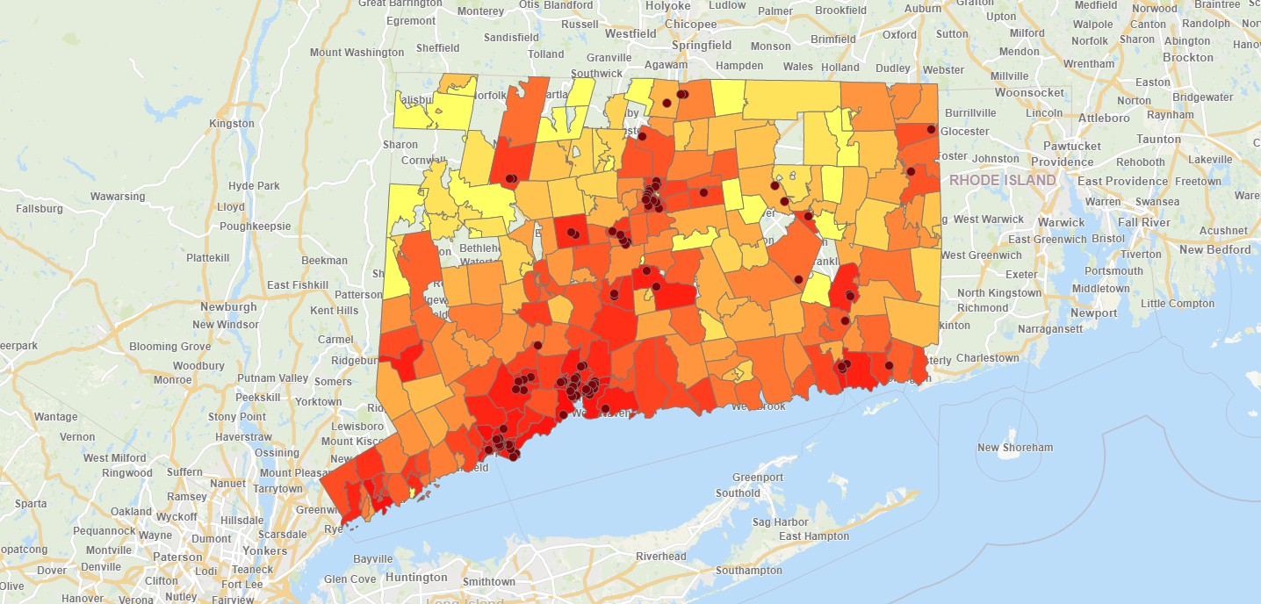

Covid-19
V
V
Map
Registrations
15,743
IP Admissions
1,852
ED Visits
3,676
OP Visits
1,374
Discharges
6,724
Facility Count
27
Currently Inpatient
100
Q. Admit Status
Admitted Discharged Registered
Facility
Q. Diagnosis Type
Exposure
Other
Positive
Member City
Q. Member State
CT NY MA
Member Zip Code
Hospital Admission, Discharge and Transfer Data by Zip Code
* Currently showing a limited data set.
© OpenStreetMap contributors

Slide 72
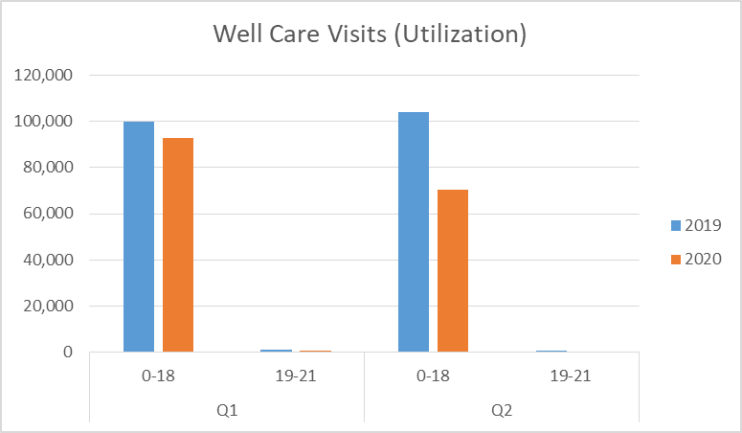

Slide 73
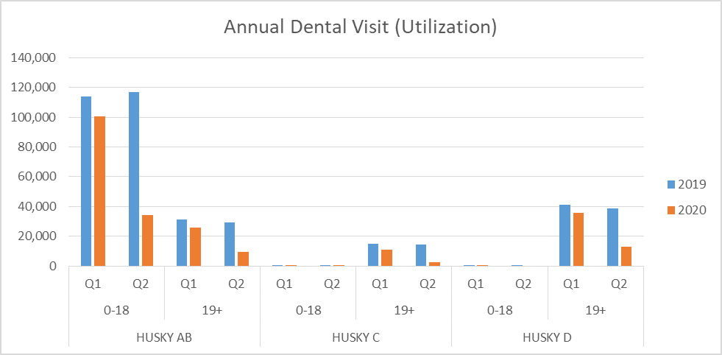

Slide 75
Appendix: Additional Detail on
Connecticut Medicaid Finances
75
Notes:
1/7/2021
75

Slide 76
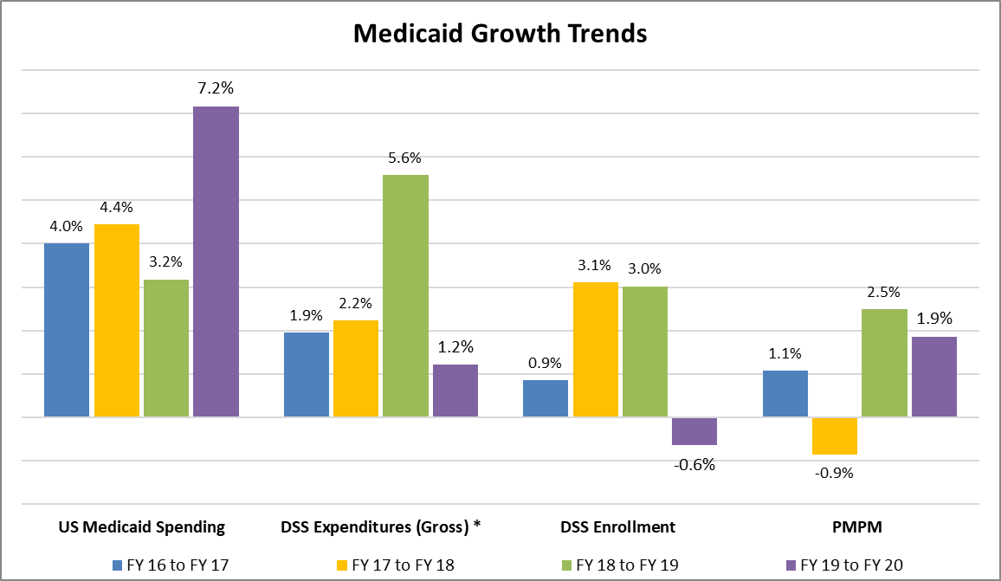
Comparison to National Trends
* Expenditures are net of drug rebates and exclude hospital supplemental payments given the significant variance in that area over the years
76
Notes:
1/7/2021
76

Slide 77
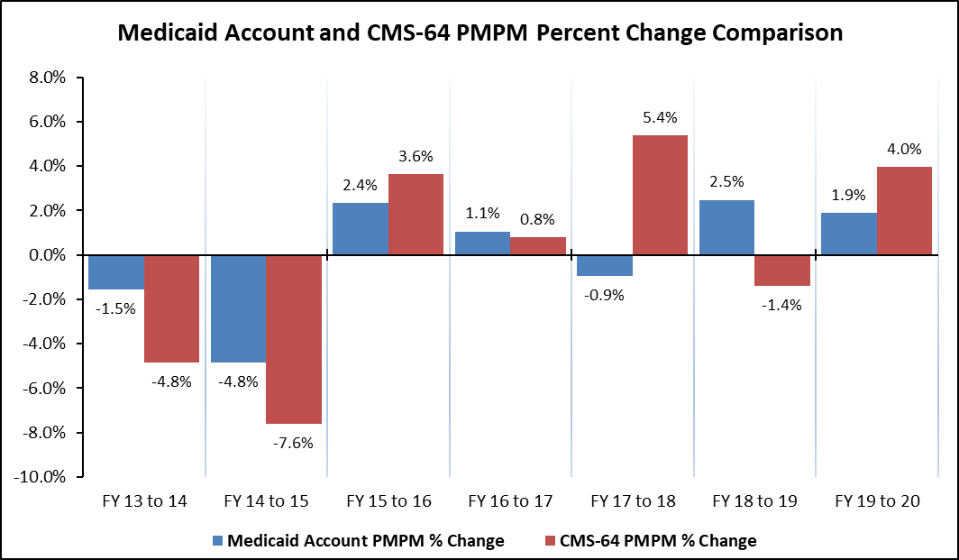
Per Member Costs
Please note SFY 18 includes significant additional expenditures associated with hospital supplemental payment increases ($480 million above SFY 2017 levels)

Slide 78
Annual Per Member Costs
Review of Global Per Member Annual Costs*
MACPAC publishes data on the annual cost per enrollee, which they call the spending per full year equivalent enrollee
The table below summarizes data for a peer state cohort that includes New England states, New York and New Jersey
CT is the third lowest cost state in this cohort with costs that are close to $1,000 lower than the group average
*from FFY 2018 MACPAC report, Exhibit 23
Notes:
1/7/2021
78

Slide 79
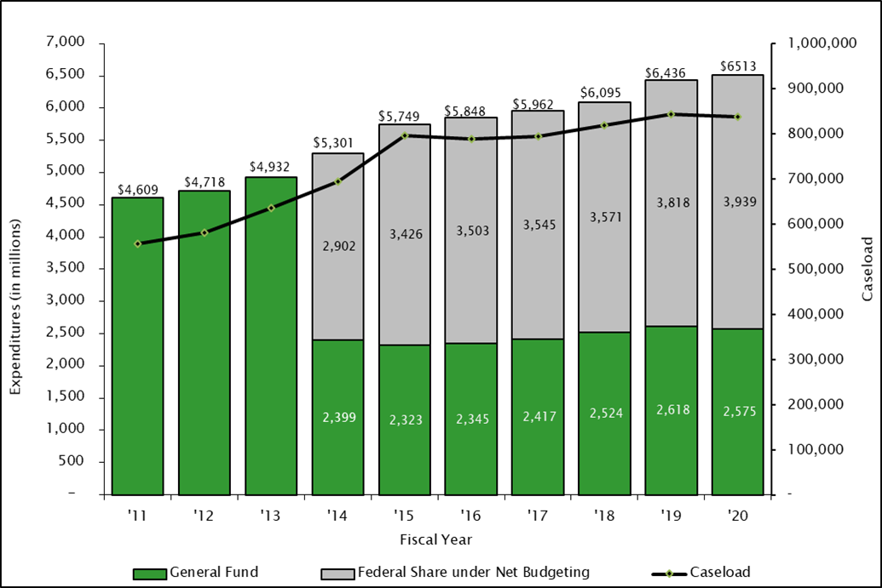
Federal and State Share of Medicaid
While the state share of costs was virtually unchanged from SFY 2013 to 2017, since then the state share has risen due to lower federal reimbursement for single adults.
SFY 2020 state share was only $108 million, or 4.4%, higher than the estimated SFY 2013 state share - this was impacted by enhanced 6.2% federal COVID-19 PHE reimbursement for the Jan-Jun 2020 period. If adjusted to remove the extra reimbursement, the increase would be $248 million, or 10.1%, for an annual growth rate of 1.4%.
*Excludes hospital supplemental payments
79
Notes:
1/7/2021
79

Slide 80
Medicaid Share of Total CT Budget
In SFY 2020, the “all states” average Medicaid expenditures as a percentage of total State expenditures was 28.6%*.
Connecticut’s SFY 2020 Medicaid expenditures as a percentage of total State expenditures was 24.8%*.
For the past decade, CT compares extremely favorably to its “peer” states (New England, NY and NJ). For the entire period, we have consistently been among the lowest three states.
In SFY 2015 through 2017, CT had the lowest percentage share of the total state budget of all our peer states and had the second lowest percentage in SFY 2018 and 2019 (0.1% higher than NJ in both years). In SFY 2020, CT was the third lowest.
* Per the most recent National Association of State Budget Officers (NASBO) State Expenditure Report; includes both federal and state Medicaid shares

Slide 81
Medicaid Administrative Costs
CT’s managed fee-for-service system clearly demonstrates administrative cost efficiencies – with two adjustments, we estimate that CT ranks best in the nation for the lowest percent of administrative spending for FFY 2019 (2.8% versus the national average of 8.2%).
The first adjustment removes eligibility staff and systems expenses – this recognizes eligibility as a service, not an administrative cost, and neutralizes the impact of one-time systems development costs.
The second, more important adjustment recognizes that managed care organization administrative costs are treated as program costs per CMS reporting conventions, significantly understating administrative costs for states with managed care.

