Slide 1
Childhood Lead Poisoning in Connecticut,
2013 surveillance data
Tracy Hung, M.H.S.
Epidemiologist
Connecticut Department of Public Health

Slide 2
Statewide Screening
Children under 6 years of age
  75,749 children under age of 6 were tested
Notes:
83,739 blood lead tests for children under age of 6 received by the Lead and Healthy Homes program.
40,000 in 2008. dropped to 36,000 in 2011
2005 41,722
37,227
4495 fewer births
39247
37883
2010 36762
36212

Slide 3
Statewide Blood Lead Screening-
1 and 2 years old
55,862 (71.0%) children between 9 months and 35 months years old were tested
Notes:
Conduct lead screening at least annually for each child “9 to 35 months of age inclusive” per CT statutes
Steady increase in screening rate over the past 10 years
2.2% increase (1,338 children) in the screening rate from 2012 to 2013
Denominator is 2010 and 2011 birth

Slide 4
Statewide Blood Lead Screening compliance among birth cohort 2010
Notes:
Only around half of children received two annual screenings as required by CT Statutes.
84.6 by age 2, 97.6% tested by age 3 and 52.5% for two annual screenings among cohort 2009.
(NY state 53% received 2 annual screenings)
84% NY children were tested by age 3.

Slide 5
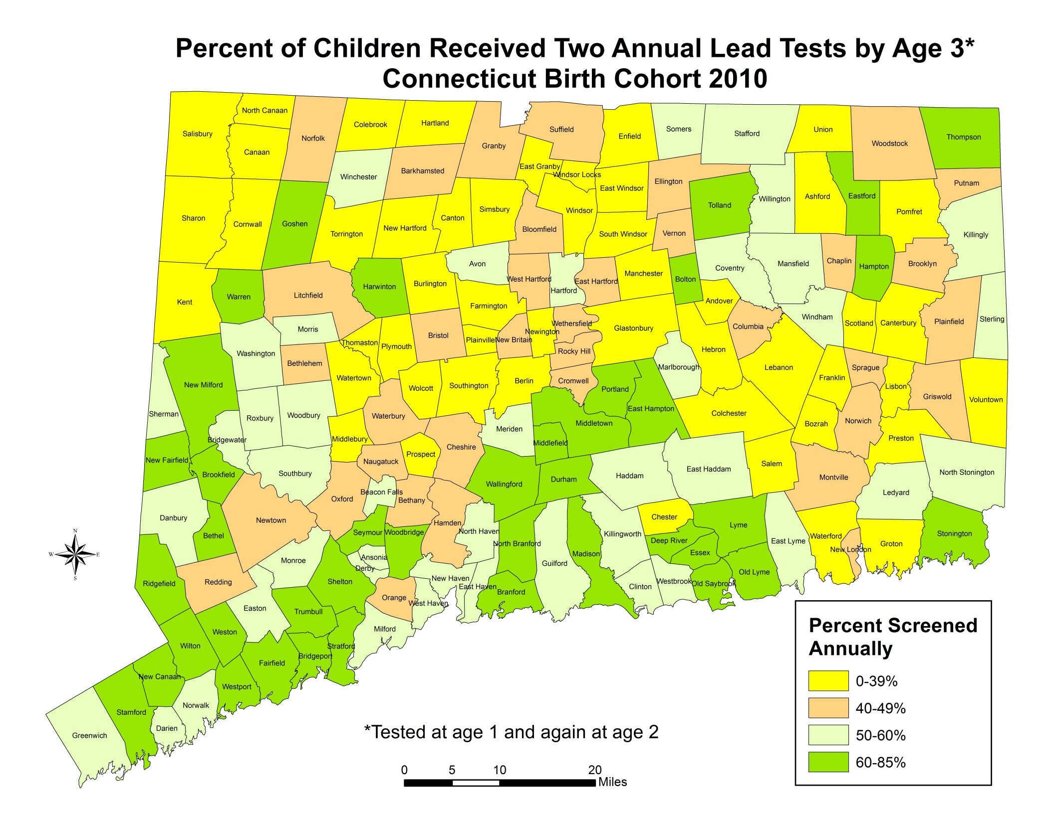

Slide 6
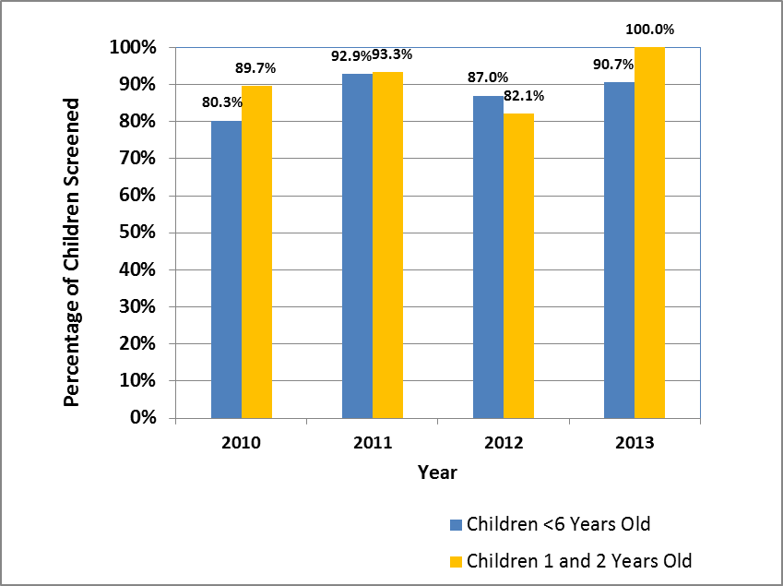
Refugee Children Screening Rate, 2010-2013
Notes:
Children newly arrived.
EPSDT is the Early Periodic, Screening, Diagnosis and Treatment program

Slide 7
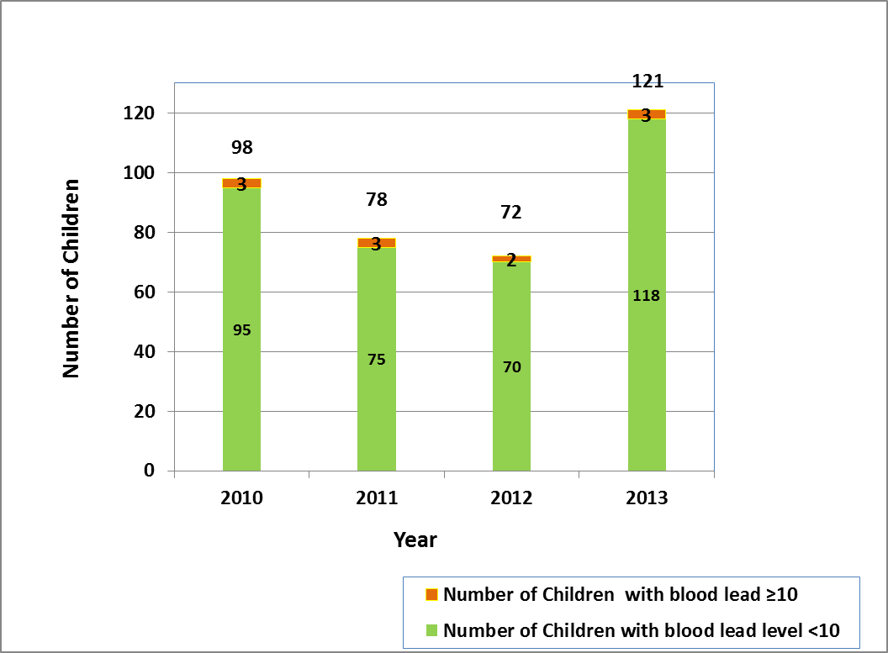
Total Screened and Elevated Blood Lead Levels among Refugee Children Under 16 Years of Age, 2010 - 2013
Notes:
3/98=3.1%, 3/78=3.9%, 2/72= 2.8% 3/121=2.5%

Slide 8
Prevalence Trends
Number of children under 6 years of age with lead poisoning, Connecticut 2002-2013
Notes:
14 more children had a BLL >=5mcg/dL. 3 more -10mcg/dL,
18 more >=15 mcg/dL.
4 more >=20 mcg/dL.

Slide 9
Prevalence Rate of
Childhood Lead Poisoning –
Connecticut 1995-2013
Notes:
Action level lowered to 5 in the second half year of 2013

Slide 10
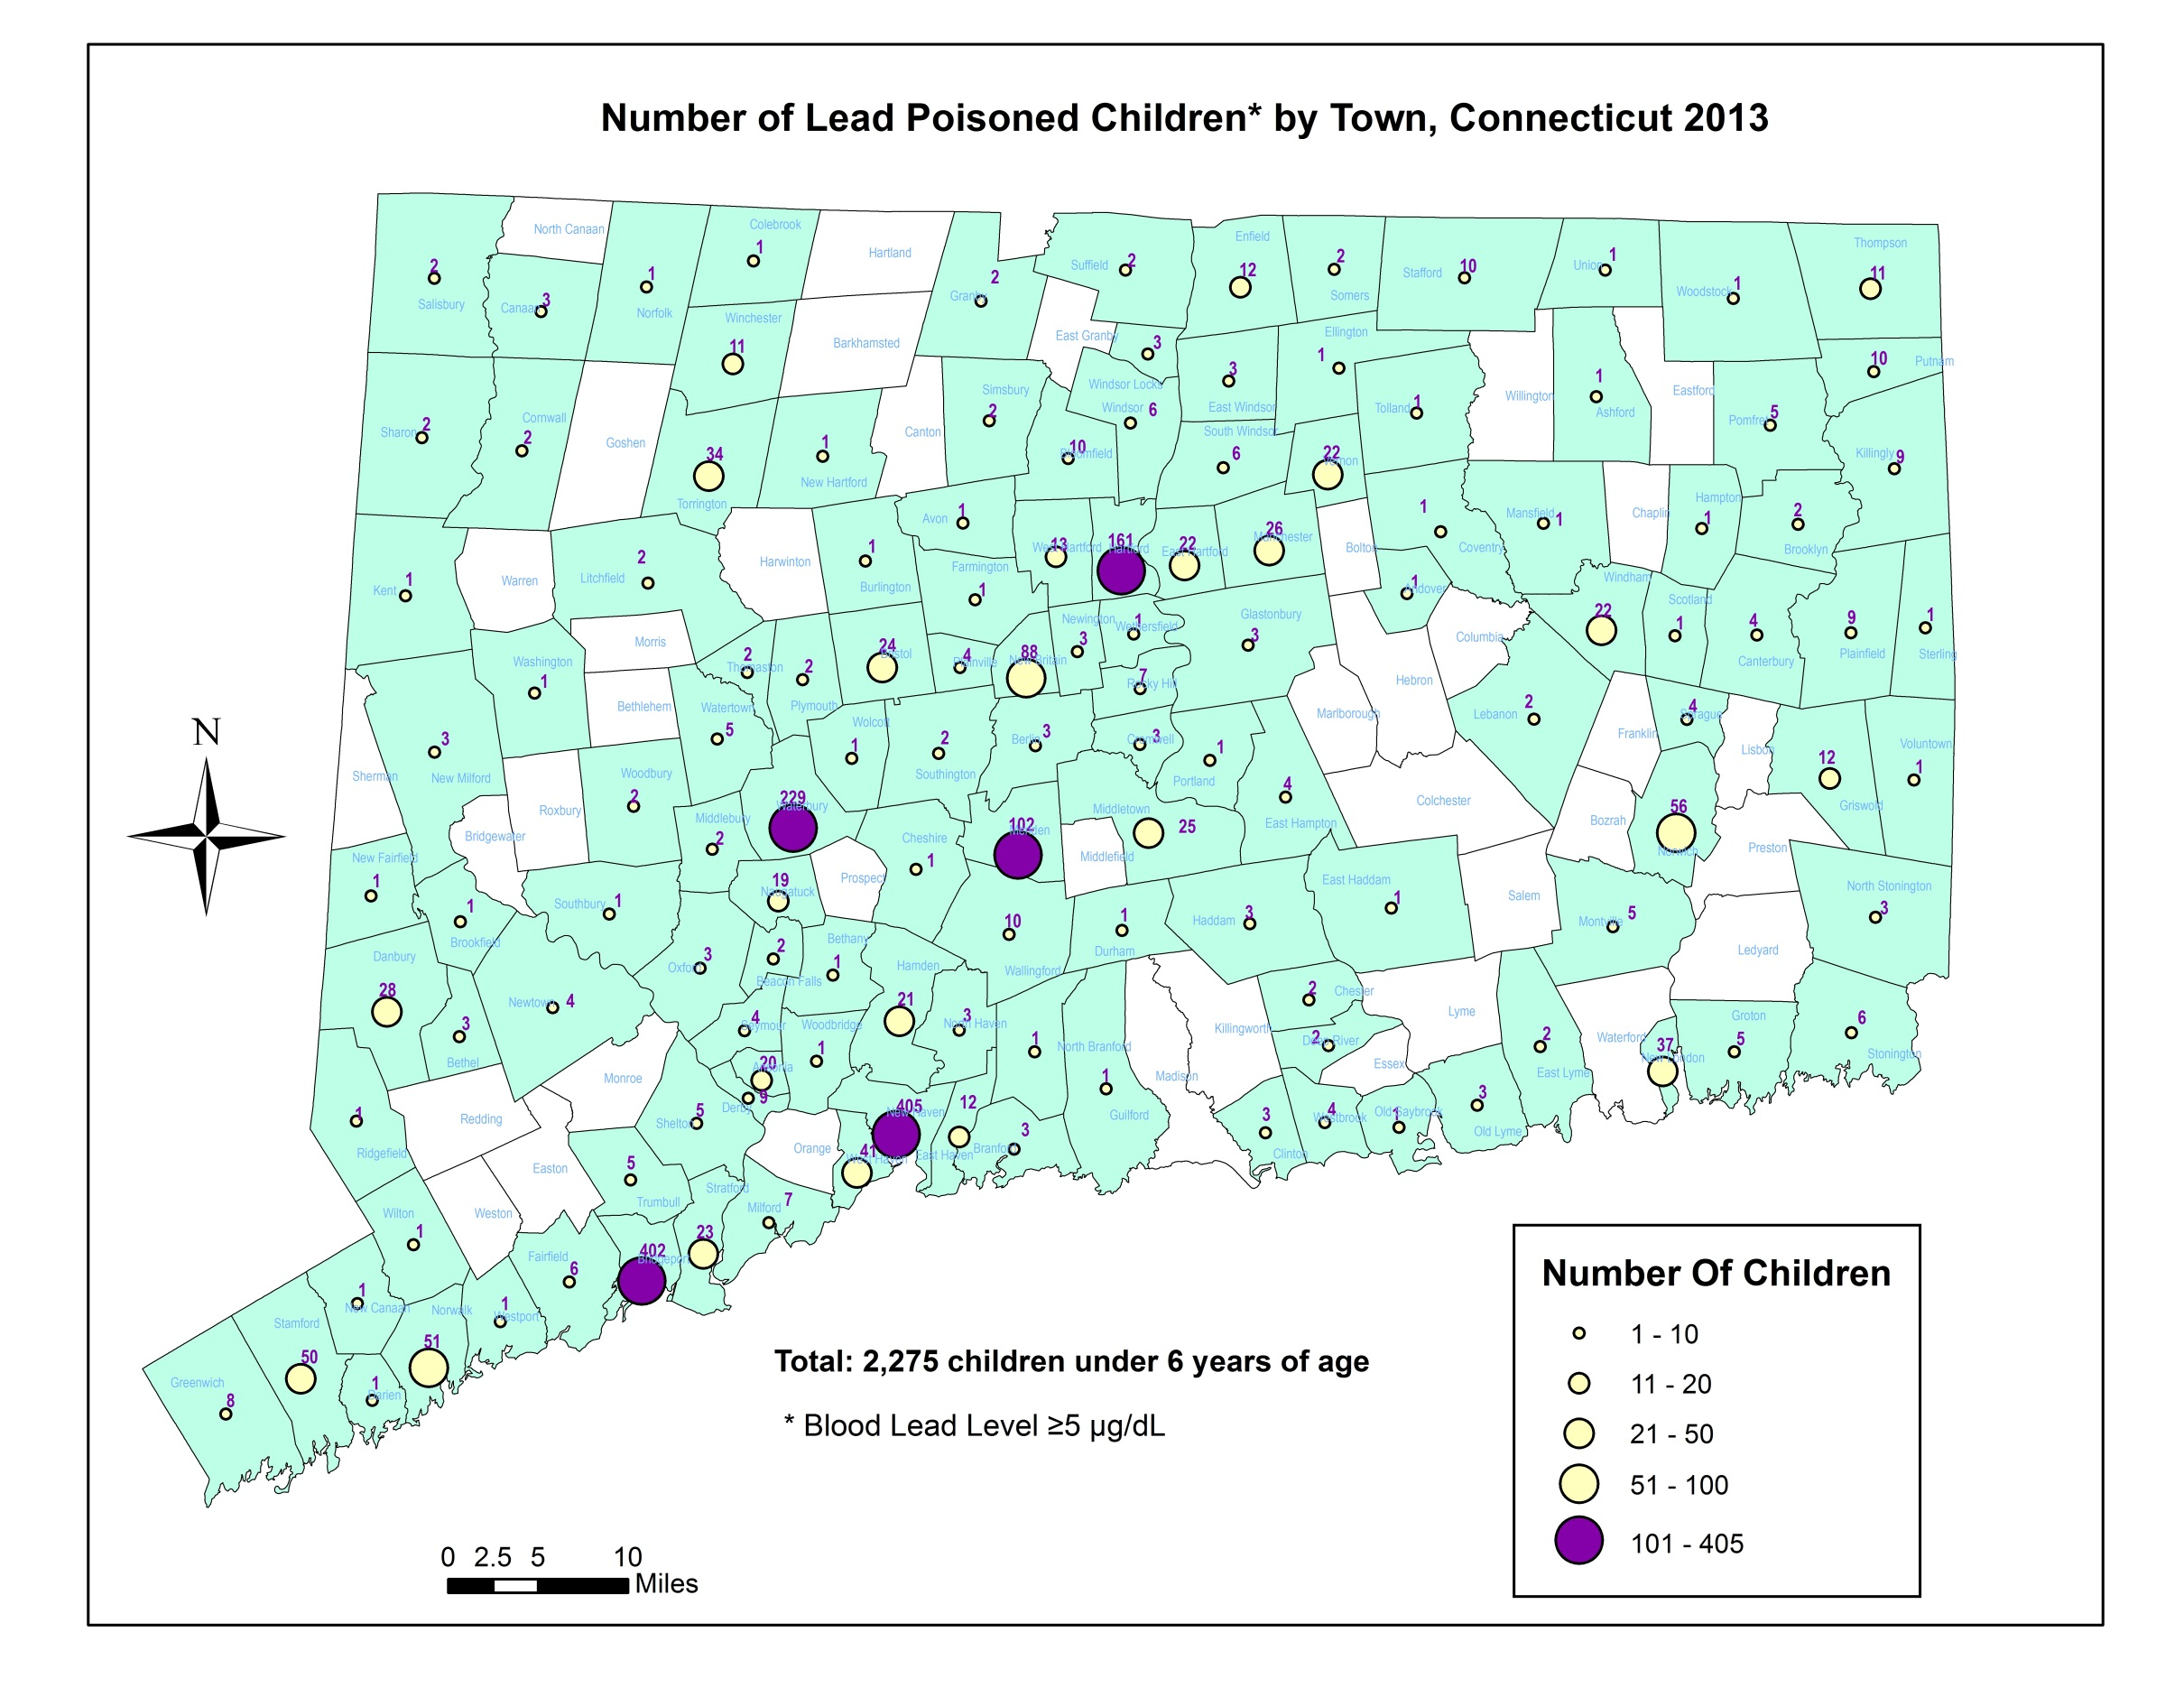
NEW HAVEN | 405
BRIDGEPORT | 402
WATERBURY | 229
HARTFORD | 161
MERIDEN | 102
 | 1299
Notes:
Top 5 cities accounted for 57% of cases

Slide 11
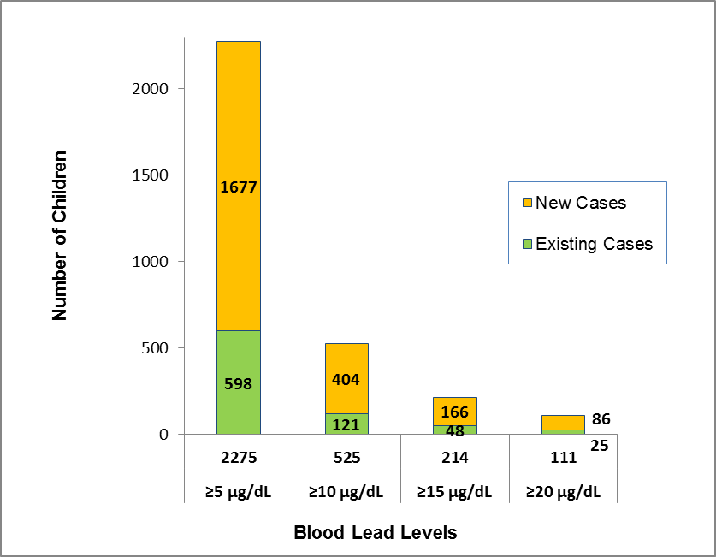
Number of existing and new cases of lead poisoning among children under 6 years of age, Connecticut CY 2013
Notes:
Of the 2,275 children who were found to have blood lead levels ≥5 μg/dL in 2013, 1677 (73.7%)
Of the 525 children who were found to have blood lead levels ≥10 μg/dL, 404 (77.0%)
Of the 214 children ≥15 μg/dL in 2013, 166 (77.6%)
Of the 111 children ≥20 μg/dL in 2013, 86 (77.5%)

Slide 12
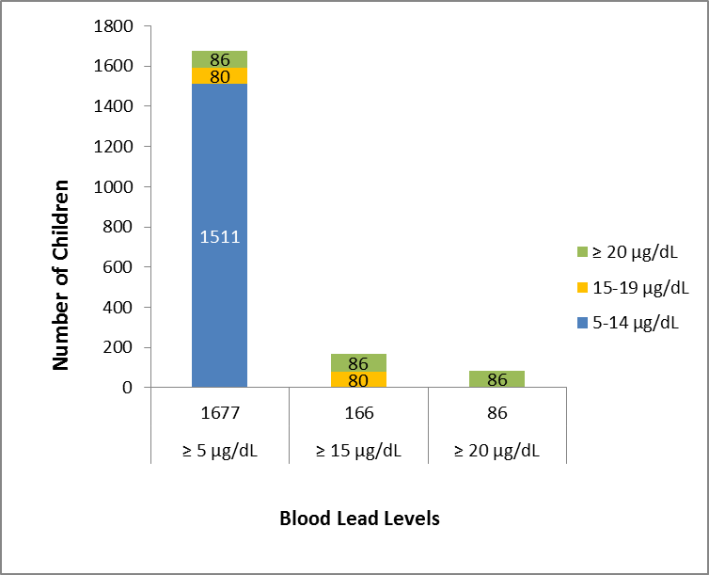
Incidence of lead poisoning by blood lead levels, 2013
Notes:
Additional info: This shows 5-14 and 15-19

Slide 13
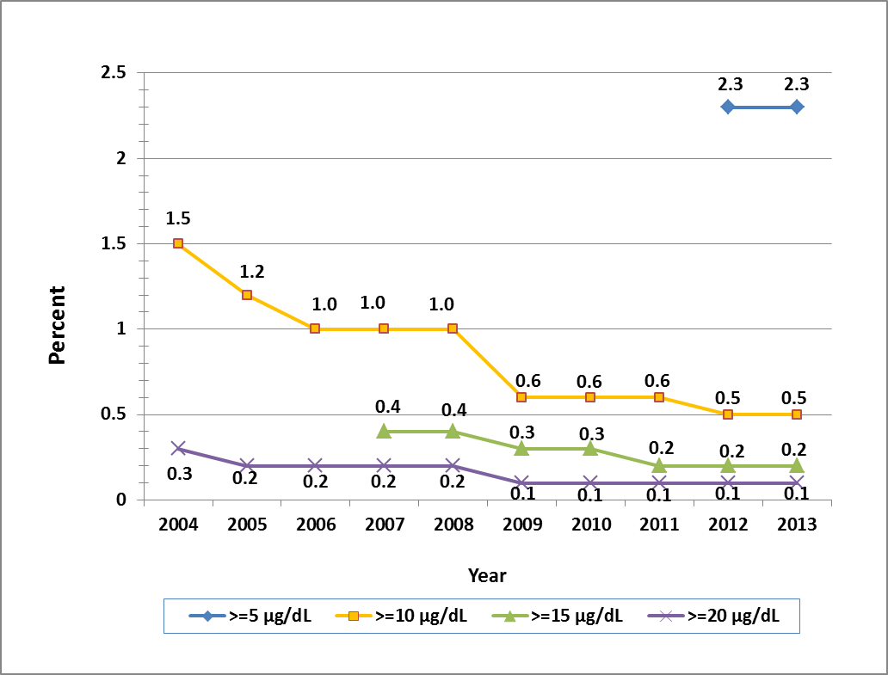
Incidence Rate of Lead Poisoning
among Children under 6 Years of Age
2004-2013
Notes:
Trends cross years

Slide 14
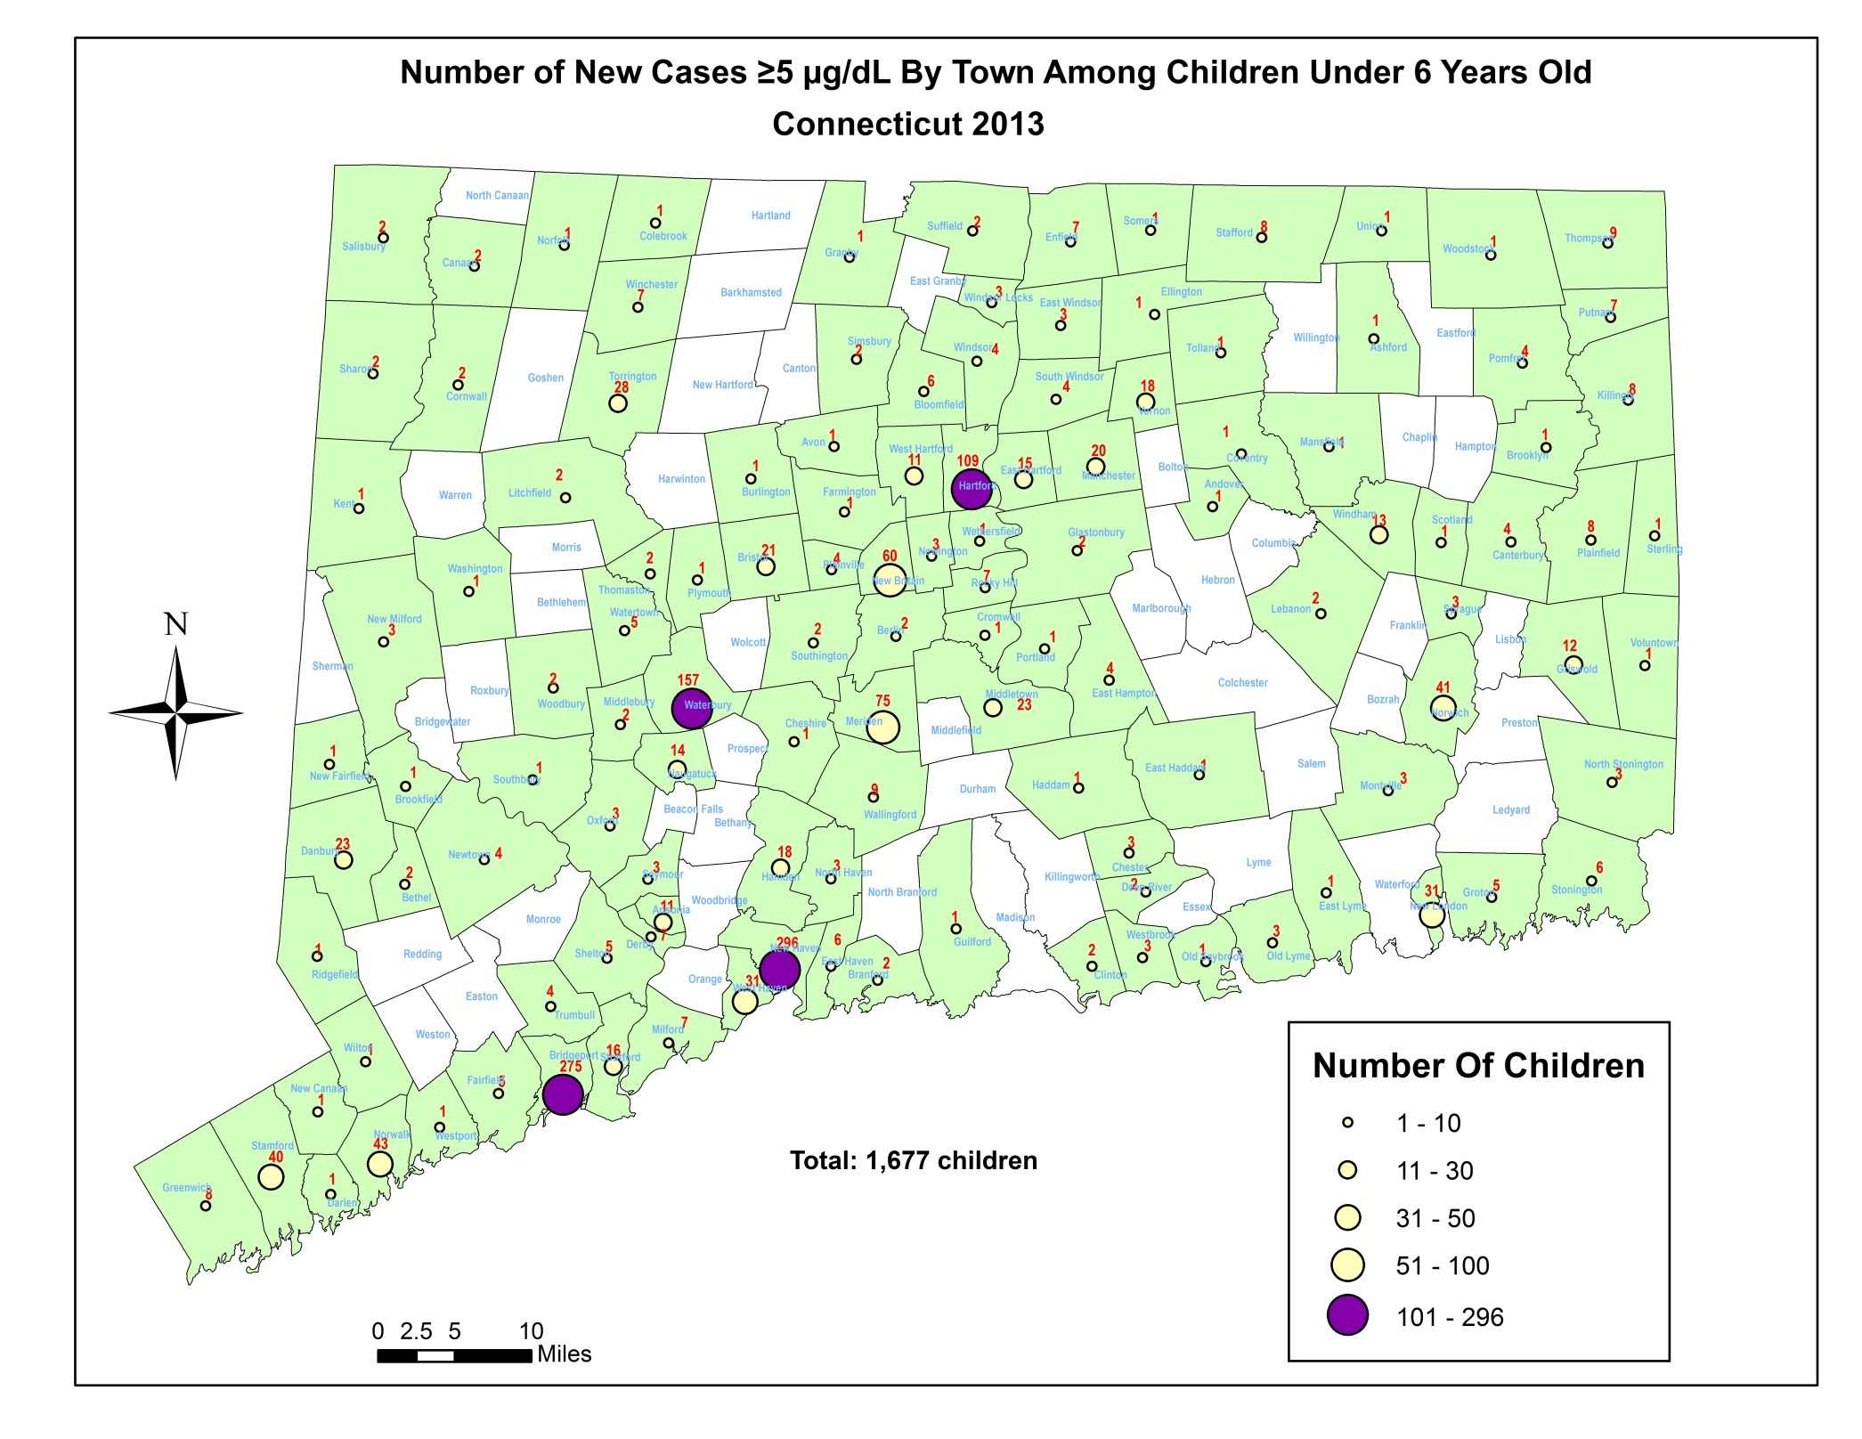
NEW HAVEN | 296
BRIDGEPORT | 275
WATERBURY | 157
HARTFORD | 109
MERIDEN | 75
NEW BRITAIN | 60
 | 972
Notes:
Top 5 cities accounted for 54% of cases

Slide 15
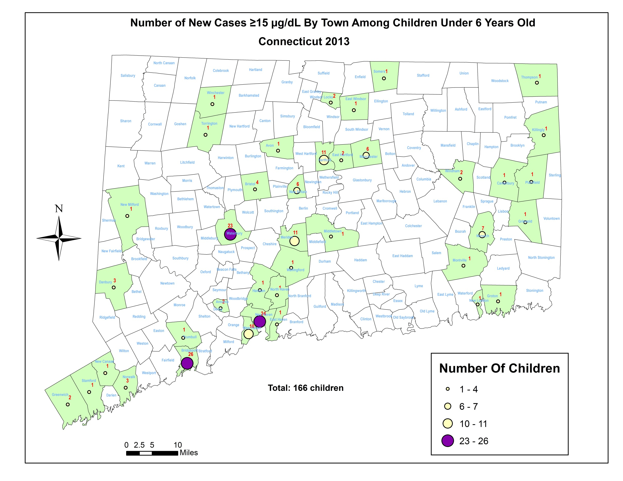
BRIDGEPORT | 26
NEW HAVEN | 24
WATERBURY | 23
HARTFORD | 11
MERIDEN | 11
WEST HAVEN | 10
 | 105

Slide 16
Environmental Investigations & Dwelling Type
149 environmental cases were opened; 137 were inspected; 10 post-1978 housing
101 (73.7%) were multi-dwelling
3 Section 8 housing
(17 children who were tested with a venous >=5 in 2013 resided at a section 8 dwelling unit)
Notes:
11 children who were tested with a venous >=10 in 2013 resided at a section 8 housing

Slide 17
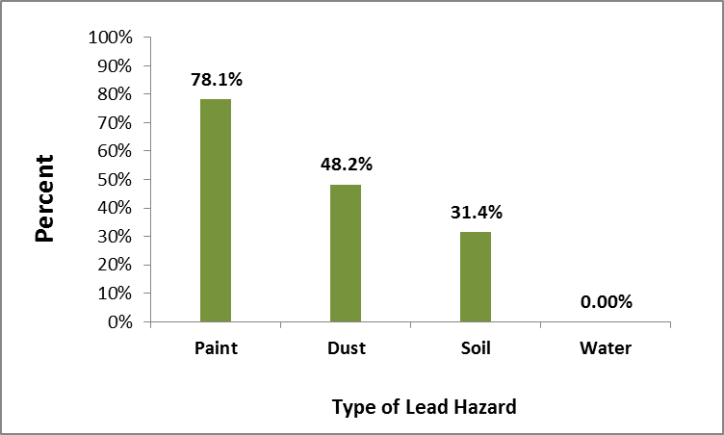
Environmental Lead Hazards Identified by Source
137 dwelling unit inspected
Notes:
Lead based paint is still the primary cause of lead poisoning.
10 homes are not pre-1978 housing

Slide 18
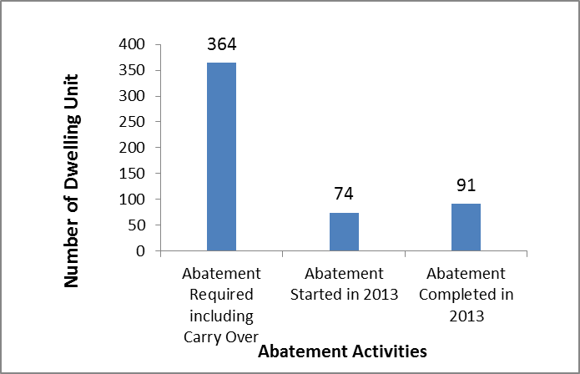
Abatement activities among dwelling units requiring abatement of lead hazards

Slide 19
How long does it take to complete abatement
365 days
*Order issue date to compliance letter issue date
Notes:
17 days (soil only)-1975 max

Slide 20
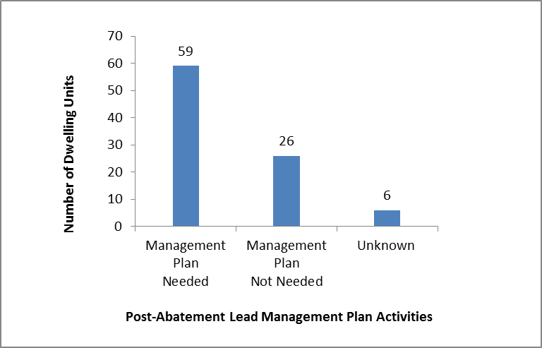
Lead management plans among dwelling units where lead abatement was completed in 2013
Notes:
59 (64.8%) of the dwelling units required lead management plans, 26 (28.6%) did not require lead management plans. the status of 6 (6.6%) dwelling units was not reported.

