Slide 1
Hemorrhage Control for the EMS Provider
Connecticut EMS Advisory Board
Education and Training Committee
January 2018

Slide 2
Program Goals
Provide participants with current information regarding bleeding control
  Application of pressure dressings
  Wound packing techniques
  Use of tourniquets

Slide 3
Objectives
This program will enable participants to:
  Discuss current techniques for hemorrhage control
  Demonstrate how to apply a pressure dressing

Slide 4
Objectives (Con’t)
  Discuss the components of a mechanical tourniquet
  Demonstrate how to apply a mechanical tourniquet
  Demonstrate how to pack a wound

Slide 5
Objectives (Con’t)
  Discuss alternatives for commercially available hemorrhage control supplies
  Review the State protocol (6.17) for tourniquet application

Slide 6
Disclosure
This program references several commonly available products for controlling hemorrhage.
Students should be familiar with the hemorrhage control products approved for use by their medical control.
Use of a specific product in this program should not be construed as an endorsement of that particular product.

Slide 7
Types of External Hemorrhage
Bleeding can be categorized in two ways:
Minor bleeding that is easily controlled
Bleeding that is potentially life-threatening and not easily controlled
Notes:
Instructor Notes:
Arterial bleeding, no matter how small, can produce life-threatening blood loss.

Slide 8
Hemorrhage Control
Uncontrolled extremity hemorrhage is a cause of preventable death.
A femoral artery and/or vein disruption can lead to the loss of one's complete blood volume within 3 minutes. (TECC, 2017)
Notes:
Instructor Notes:
In lab studies, 10% of animals died within 3 minutes when hemorrhage control measures were not performed. (C-TECC presentation).

Slide 9
Hemorrhage Control
Components of Bleeding Control
  Direct Pressure
  Wound Packing
  Pressure Dressing
  Tourniquet Application
Notes:
These components are listed in no particular order. The provider should use the hemorrhage control technique that is most likely to immediately control the bleeding. For example, in some cases it will be appropriate to begin with tourniquet application. Additionally, some wounds may be controlled with a combination of a wound packing and pressure dressing.

Slide 10
Personal Safety
As with the provision of any medical care, appropriate measures should be taken to reduce provider exposure to blood.
Appropriate PPE for the care of injured persons includes that which is necessary to adequately isolate the provider from direct contact with blood.
Minimum PPE includes gloves and eye protection. Additional protective items may be necessary as the situation dictates.
Notes:
Stress the importance of proper body substance isolation and hygene practices.

Slide 11
Direct Pressure
Use your hand or fingers
- Use two hands, if at all possible
Effective most of the time for external bleeding
- Direct pressure can stop even major arterial bleeding
To be effective, apply pressure with the victim on a firm surface to provide support
Don’t release pressure to check the wound
(Bleeding Control Basic, ACS 2017)
Notes:
“Direct pressure or a pressure dressing, applied directly over a bleeding site, is the initial technique employed to control external hemorrhage.” (PHTLS, 8th Ed, 2016, p. 232)

Slide 12
Wound Packing
Notes:
For this lesson the instructor will need:
Rolled or folded gauze for wound packing
Hemostatic dressing examples
Pressure dressing
Wound packing trainer prop – commercial or meat or other.

Slide 13
Wound Packing
Some wounds are not amenable to tourniquets or pressure dressings alone
Filling the wound cavity aids in creating pressure on bleeding vessels
Notes:
Not all severe bleeding can be managed with a tourniquet or a pressure dressing. Some anatomical locations are difficult to wrap or compress and require a more aggressive approach to hemorrhage control.

Slide 14
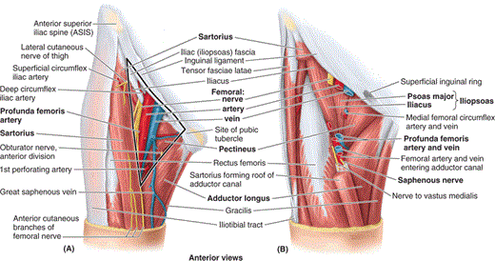
Critical Vascular Area
Femoral Triangle
Notes:
https://healtheappointments.com/wp-content/uploads/2016/12/Structures-of-femoral-triangle.gif
Anatomical review of the Femoral Triangle. Example of a location that is difficult to manage with tourniquets and pressure dressings.

Slide 15
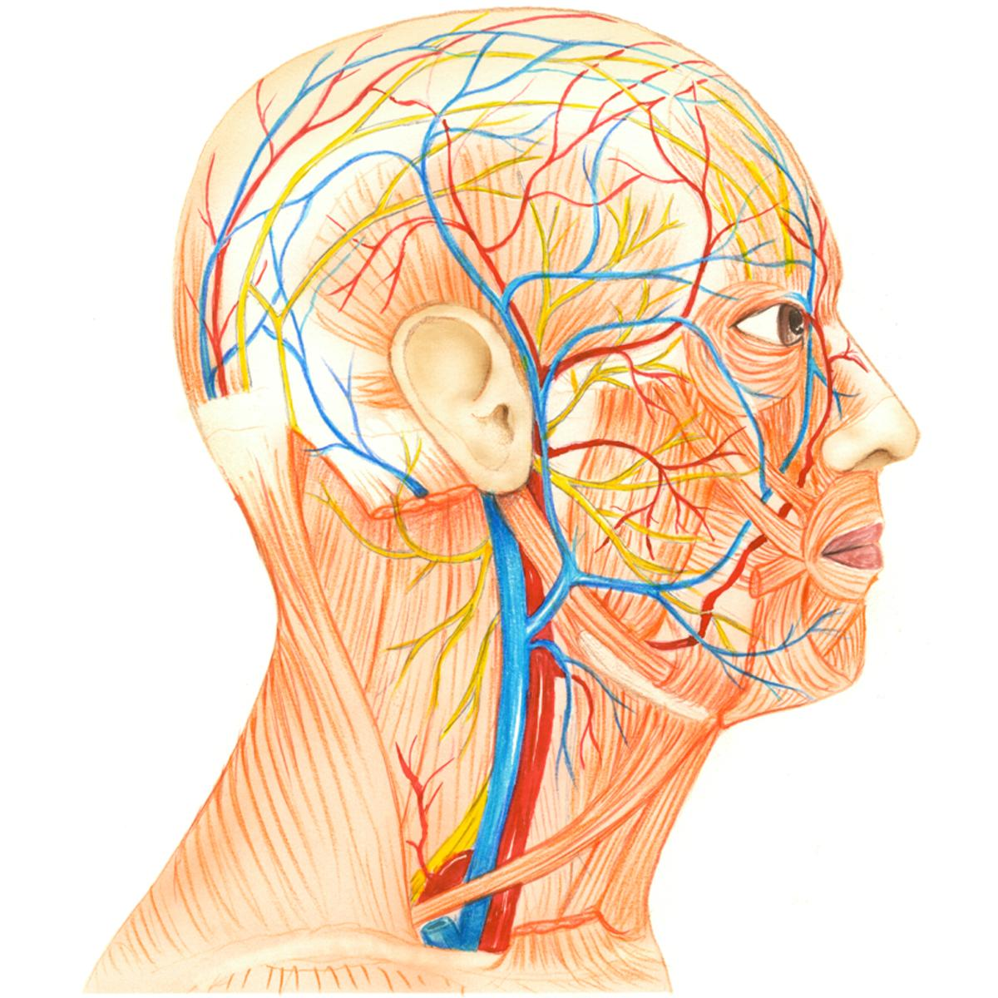
Critical Vascular Area
Anterior Triangle of the Neck
Image: C-TECC, Smith et al. 2017
Notes:
Anatomical review of the Anterior Triangle of the neck. Example of a location that is difficult to manage with tourniquets and pressure dressings.

Slide 16
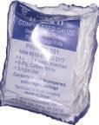
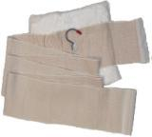
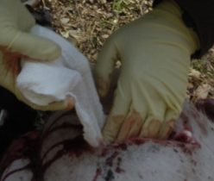
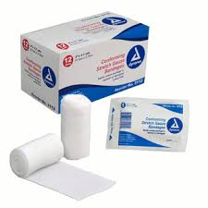
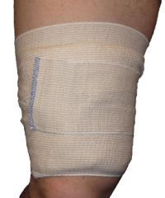
Wound Packing
Gauze
Placing gauze into a wound creates pressure against bleeding vessels and encourages clotting. Hemostatic dressings are preferred but any sterile gauze can be used for wound packing.
Images: C-TECC, Smith et al. 2017
Notes:
Wound packing can be accomplished using plain, sterile rolled gauze, kerlix gauze, or gauze treated with a hemostatic agent. After packing a wound, it should be covered with an appropriate dressing. Images taken from C-TECC Presentation.

Slide 17
Wound Packing
When considering wound packing:
Do not pack wounds of the abdomen and chest or open skull fractures
Only for use on limbs, neck, shoulders, hips and groin.
Use hemostatic products for wound packing if available and in accordance with manufacturers recommendations.
Pack wound and hold direct pressure according to the manufacturer’s recommendation.
Notes:
Direct pressure is typically required for at least 3 – 5 minutes. Several factors influence clotting time. Direct pressure for 8 to 10 minutes or more in some cases may be required.

Slide 18
Hemostatic Agents
Chemical impregnated gauze incorporating chemicals designed to promote rapid blood coagulation.
Hemostatic agents can establish hemostasis by means of different mechanisms:
  concentrating coagulation factors
  adhesion to the tissues
  delivering procoagulant factors to the hemorrhage site.
(Khoshmohabat, Paydar, Kazemi, & Dalfardi, 2016)
Notes:
Application must be per manufacture’s recommended guidelines.
CELOX still uses a powder form of hemostatic agent
https://www.ncbi.nlm.nih.gov/pmc/articles/PMC4869418/
(khoshmohabat, Paydar, Kazemi, & Dalfardi, 2016)
Hemostatic dressings can be classified based on their mechanism of action.
Factor concentrators: This class of hemostatic agents work through fast absorption of the water content of blood; consequently, concentration of its cellular and protein components results in clot formation. QuikClot (Z-Medica LLC., Newington, CT, USA), QuikClot ACS (advanced clotting sponge) (Z-Medica LLC., Newington, CT, USA), TraumaDex (Medafor Inc, Minneapolis, MN, USA), and self-expanding hemostatic polymer (Payload Systems Inc., Cambridge, MA, USA) are examples of this group.
Mucoadhesive agents: these agents act through a strong adherence to the tissues, and physically block bleeding from wounds. HemCon (HemCon Medical Technologies Inc. Portland, OR, USA) and Celox (Medtrade Products Ltd. Crewe, UK) are the main examples of this group.
Procoagulant supplementors: agents placed in this group act mainly through delivering procoagulant factors to the hemorrhagic wound. The dry fibrin sealant dressing (DFSD) is an example of these agents.
(khoshmohabat, Paydar, Kazemi, & Dalfardi, 2016)

Slide 19
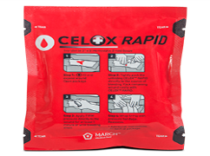
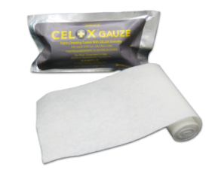
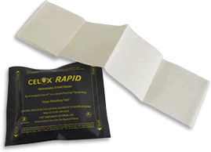
Celox Products
Various forms
  Celox Rapid (30-45 sec)
  Celox Trauma Gauze
  Celox powder
Notes:
Celox is an entirely biocompatible and biodegradable substance, a chitosan (a mucoadhesive component that maintains the silica in contact with the wound) granule that promotes clot formation through adsorption and dehydration, and the advancement of red blood cell bonding. It is a pearl colored, nontoxic and odorless derivative of chitin. Once directly exposed to the blood, the positively charged Celox will bind with the negatively charged red blood cells, independent of the body’s clotting mechanism. Such phenomena will result in clot formation, without exothermic reaction or damage to the surrounding tissues. Celox will be efficacious in those who receive antiplatelet or anticoagulant medications, and in conditions of hypothermia. It does not cause a clot to form remote from the site of application. Celox can be removed by irrigating the wound with water or saline once clotting has occurred. This product is available in both the granular and bandage forms. The granular form of Celox is a lightweight powder, and is reported to be more difficult to apply, particularly in low-visibility and windy settings (22, 30, 37, 38).
Smith AH, Laird C, Porter K, Bloch M. Haemostatic dressings in prehospital care. Emerg Med J. 2013;30(10):784–9. doi: 10.1136/emermed-2012-201581.
Devlin JJ, Kircher S, Kozen BG, Littlejohn LF, Johnson AS. Comparison of ChitoFlex(R), CELOX, and QuikClot(R) in control of hemorrhage. J Emerg Med. 2011;41(3):237–45. doi: 10.1016/j.jemermed.2009.02.017. [PubMed] [Cross Ref]
Millner RW, Lockhart AS, Bird H, Alexiou C. A new hemostatic agent: initial life-saving experience with Celox (chitosan) in cardiothoracic surgery. Ann Thorac Surg. 2009;87(2):e13–4. doi: 10.1016/j.athoracsur.2008.09.046. [PubMed][Cross Ref]
Pozza M, Millner RW. Celox (chitosan) for haemostasis in massive traumatic bleeding: experience in Afghanistan. Eur J Emerg Med. 2011;18(1):31–3. doi: 10.1097/MEJ.0b013e32833a5ee4. [PubMed] [Cross Ref]

Slide 20
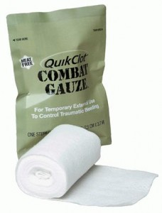
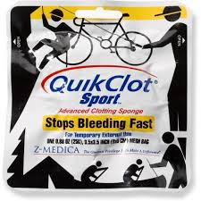
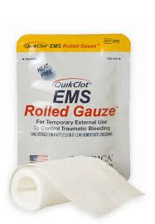
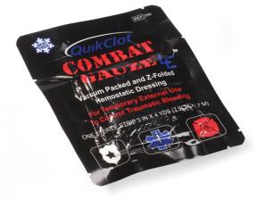
QuikClot Gauze
Standard surgical gauze impregnated with Kaolin
  Promotes coagulation through coagulation cascade
Notes:
Kaolin works on contact with blood to immediately initiate the clotting process.
QuikClot, a manufactured granular mineral zeolite, is composed of oxides of silicon, sodium, aluminium and magnesium. It also includes small amounts of quartz. This agent acts as a molecular sieve and rapidly adsorbs water. It holds the water molecules in pores, by hydrogen bonds, through a nonchemical, physical reaction. The main mechanism resulting in hemostasis following the use of QuikClot is the absorption of water and the rapid concentration of platelets and clotting factors that further catalyze a rapid clot formation. This process generates heat (via an exothermic reaction). The second generation of QuikClot, the advanced clotting sponge (ACS), is produced from larger beads of the same composition as QuikClot, and packaged into mesh bags. Due to the exothermic reaction resulting from the application of QuikClot and QuikClot ACS, a modified formulation, the ACS+, was introduced in 2006, and claimed to produce less exothermia.
Rhee P, Brown C, Martin M, Salim A, Plurad D, Green D, et al. QuikClot use in trauma for hemorrhage control: case series of 103 documented uses. J Trauma. 2008;64(4):1093–9. doi: 10.1097/TA.0b013e31812f6dbc. [PubMed] [Cross Ref]
Arnaud F, Tomori T, Carr W, McKeague A, Teranishi K, Prusaczyk K, et al. Exothermic reaction in zeolite hemostatic dressings: QuikClot ACS and ACS+. Ann Biomed Eng. 2008;36(10):1708–13. doi: 10.1007/s10439-008-9543-7.

Slide 21
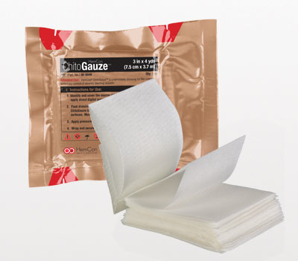
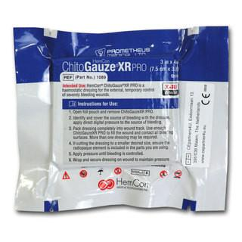
Chitogauze
Chitosan based impregnated gauze
Notes:
Chitosan is a linear polysaccharide consisting of glucosamine and N-acetyl glucosamine chains and is derived mainly from shellfish. It has been used in many technical applications such as medical products, water purification, in cosmetics and as a fat-binding weight control product. Cationic nature of chitosan gives this polymer a mucoadhesive property which can be further activated for wound care applications
http://www.axiobio.com/chitosan/

Slide 22
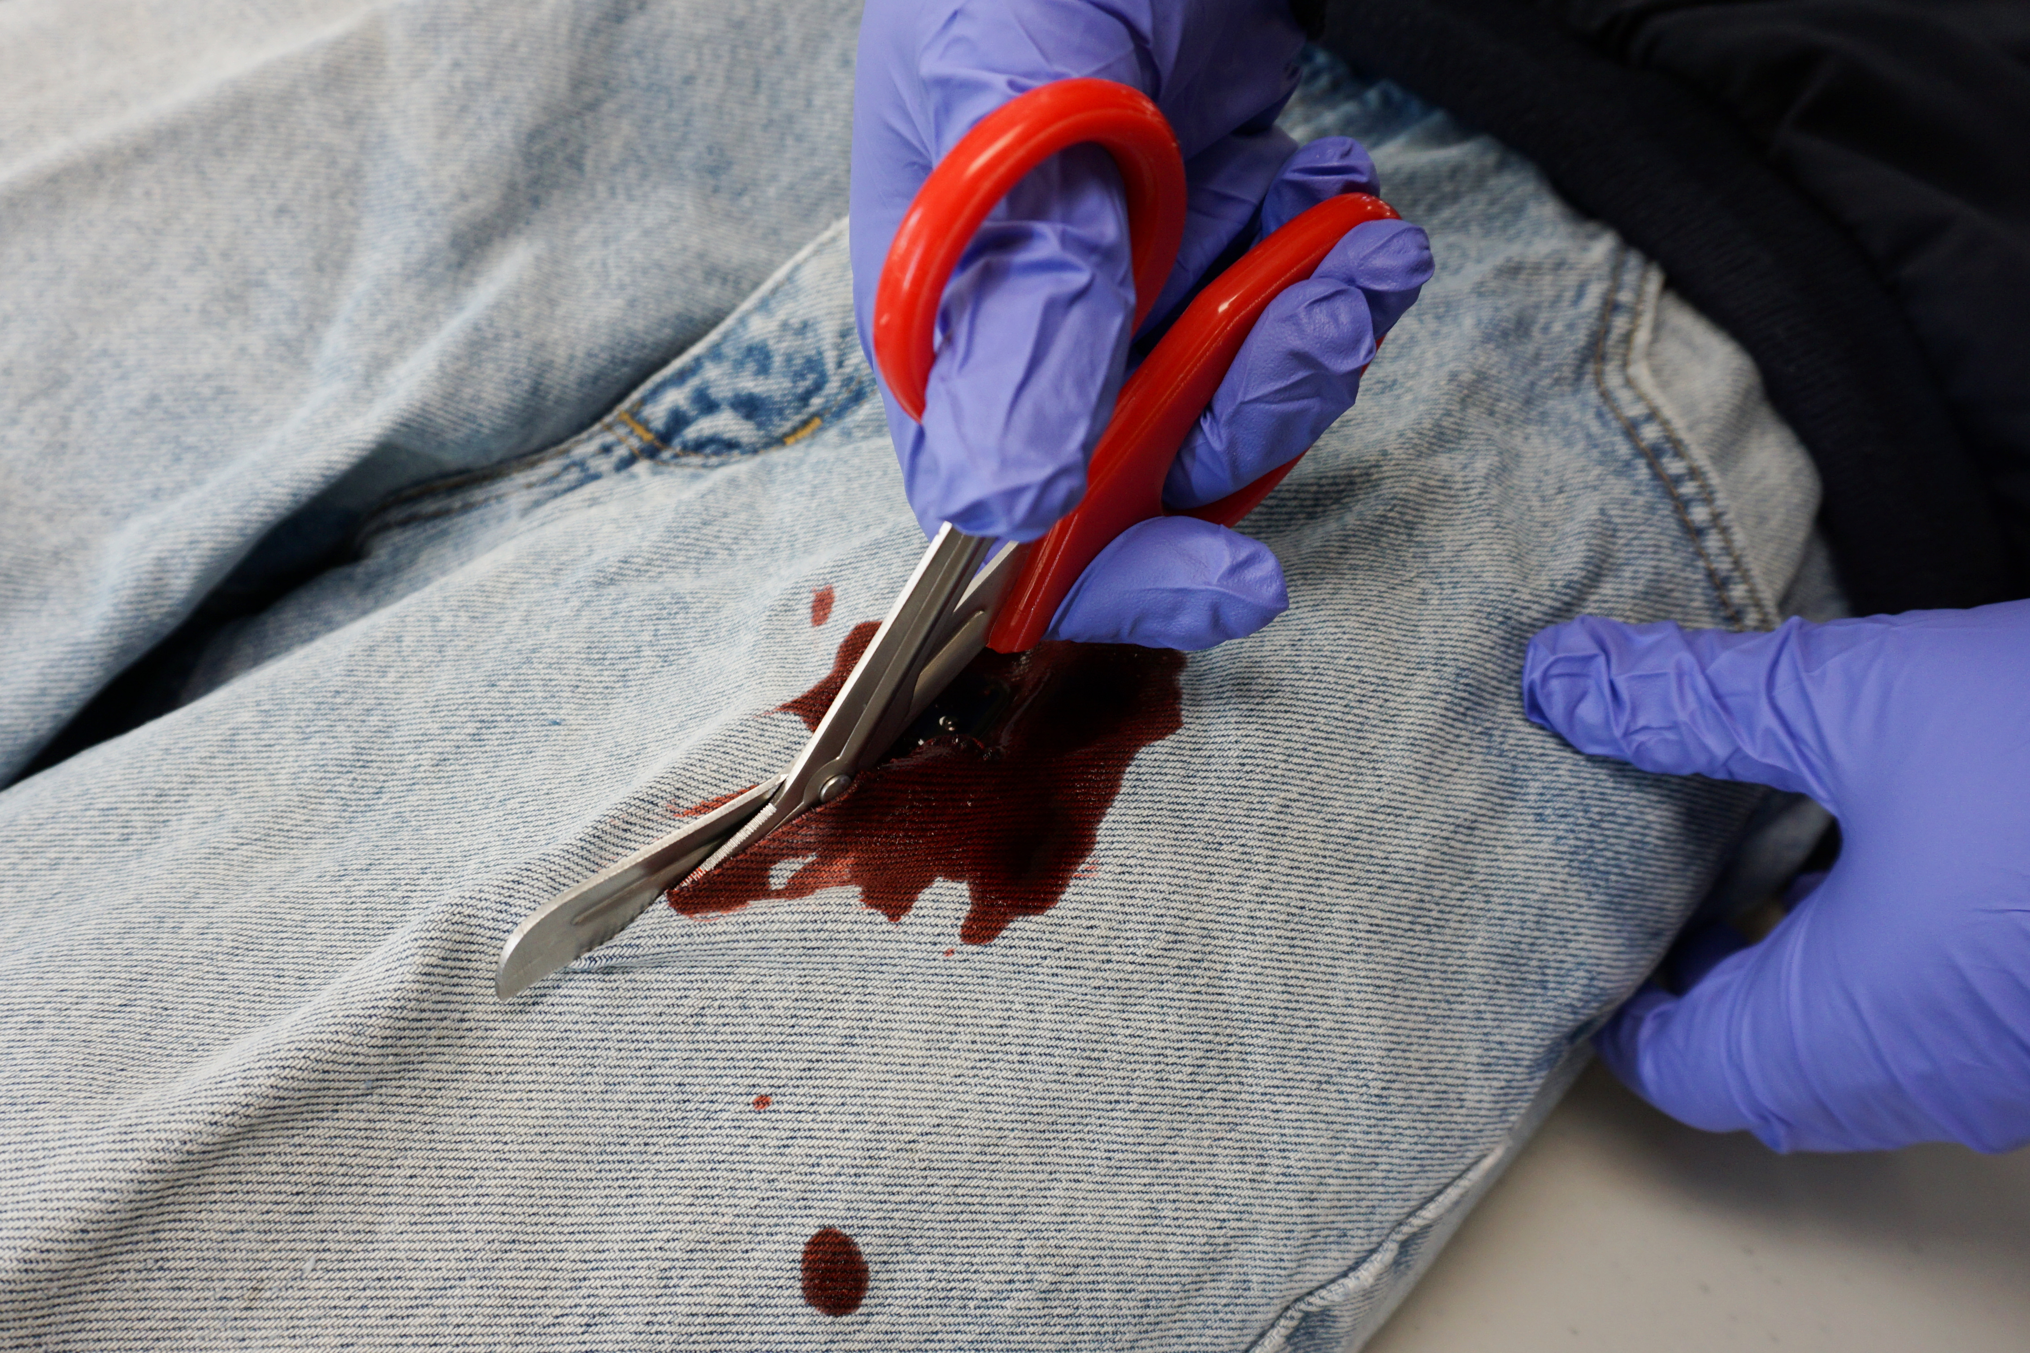
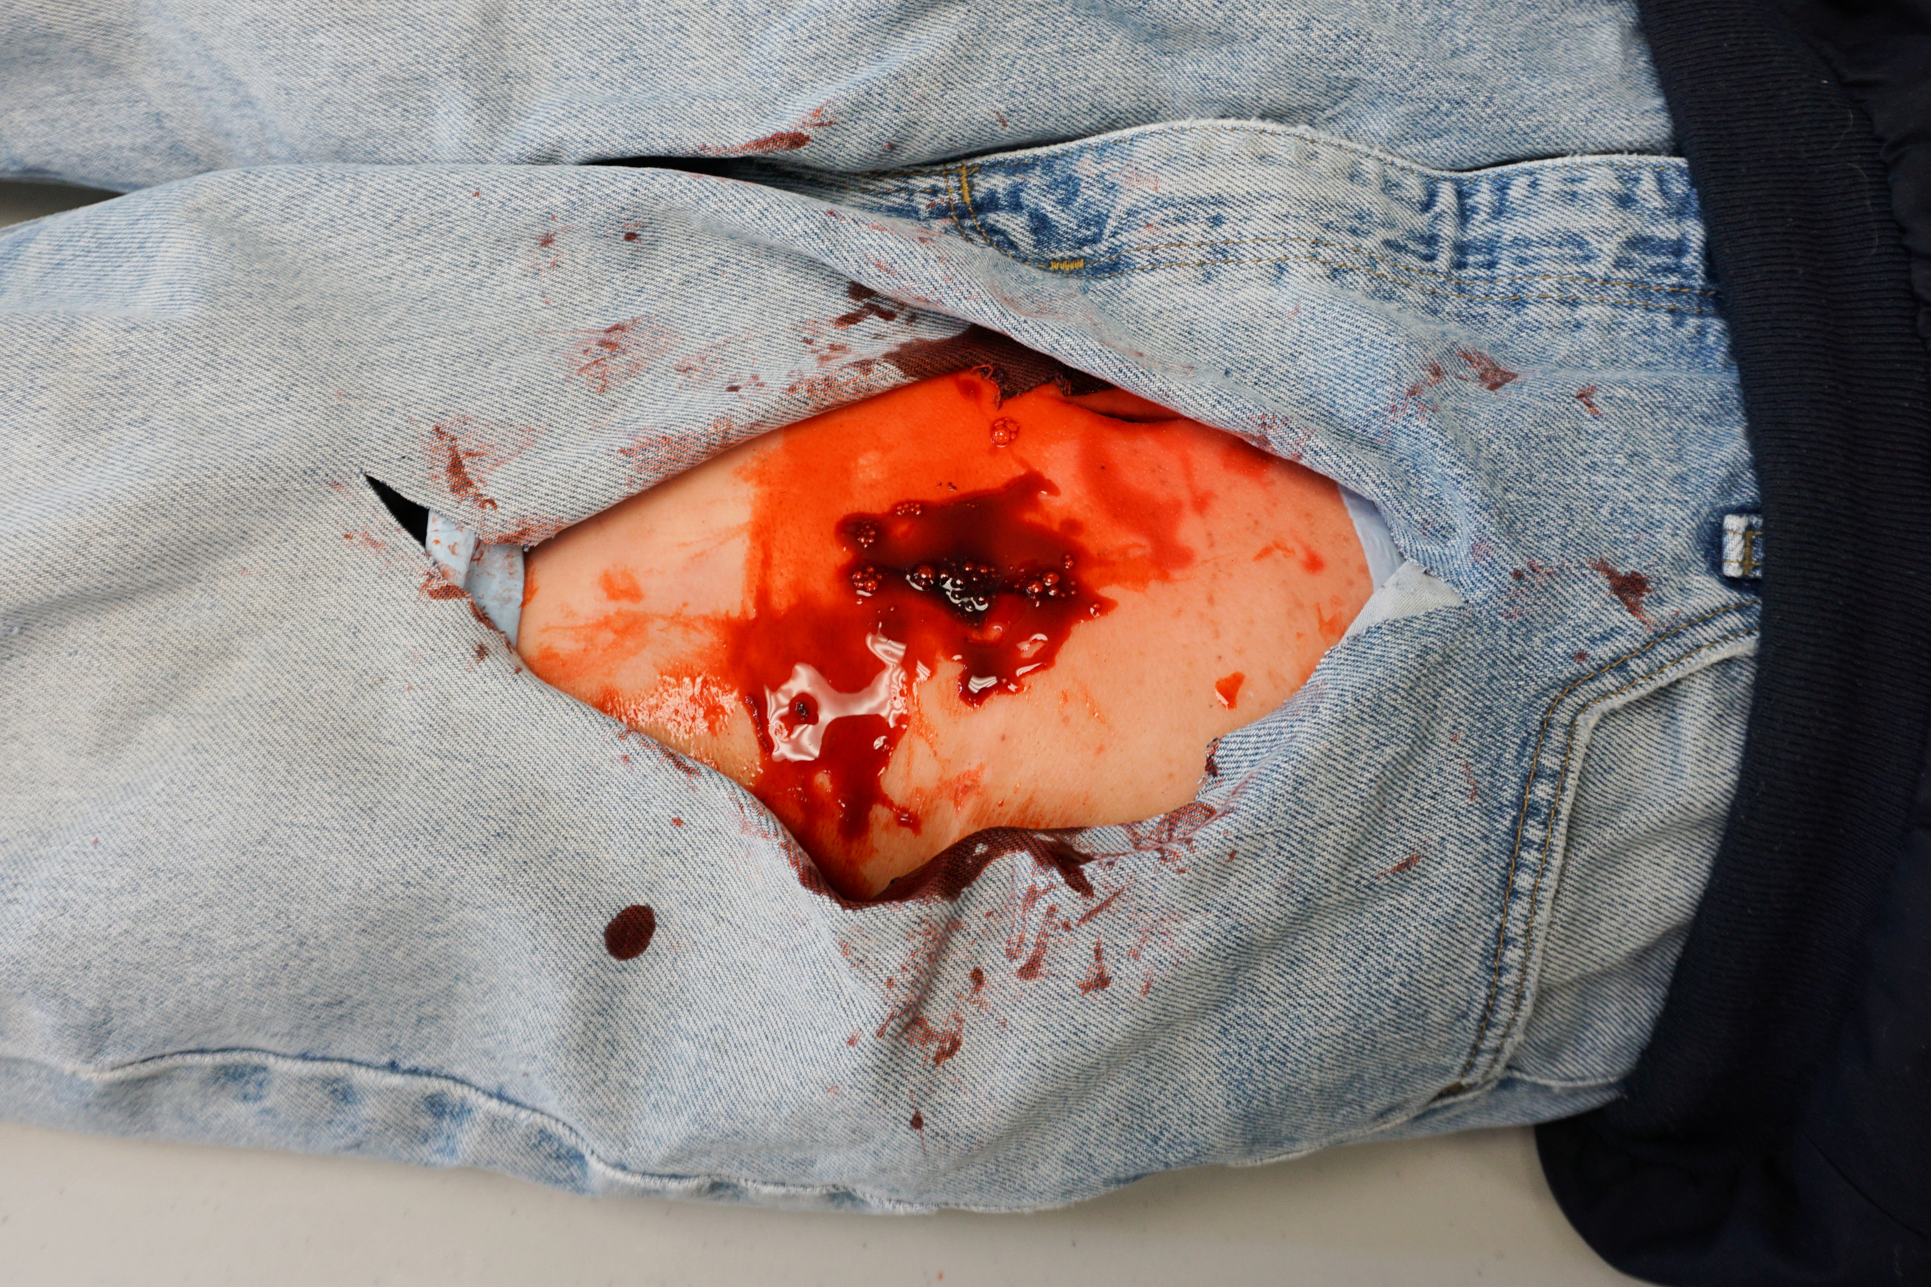
Wound Packing Procedure
Expose Wound and Identify Bleeding
  Open Clothing around the wound.
  Remove excess pooled blood from the wound while preserving any clots already formed in the wound.
  Locate the source of the most active bleeding.
Photo: J. Beaulieu
Notes:
Instructors Note: Reinforce with your students that tourniquets should be used to control bleeding from the extremities whenever possible. The images in this series are meant to depict a wound that, due to its location in the groin area, is not amenable to tourniquet use.

Slide 23
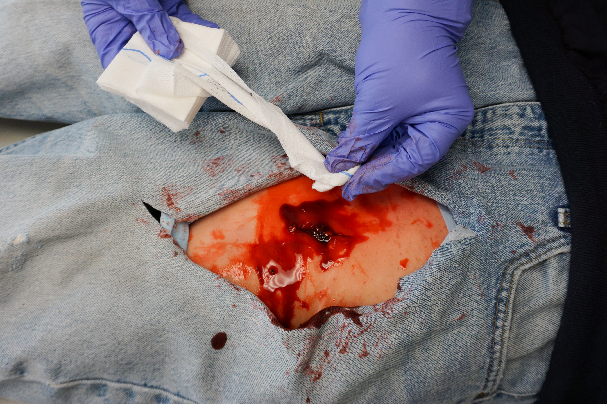
Wound Packing Procedure
Pack Wound Completely
  Pack gauze tightly into wound and directly onto the source of bleeding.
  More than one gauze may be required.
Photo: J. Beaulieu
Notes:
Instructors Note: Reinforce with your students that tourniquets should be used to control bleeding from the extremities whenever possible. The images in this series are meant to depict a wound that, due to its location in the groin area, is not amenable to tourniquet use.

Slide 24
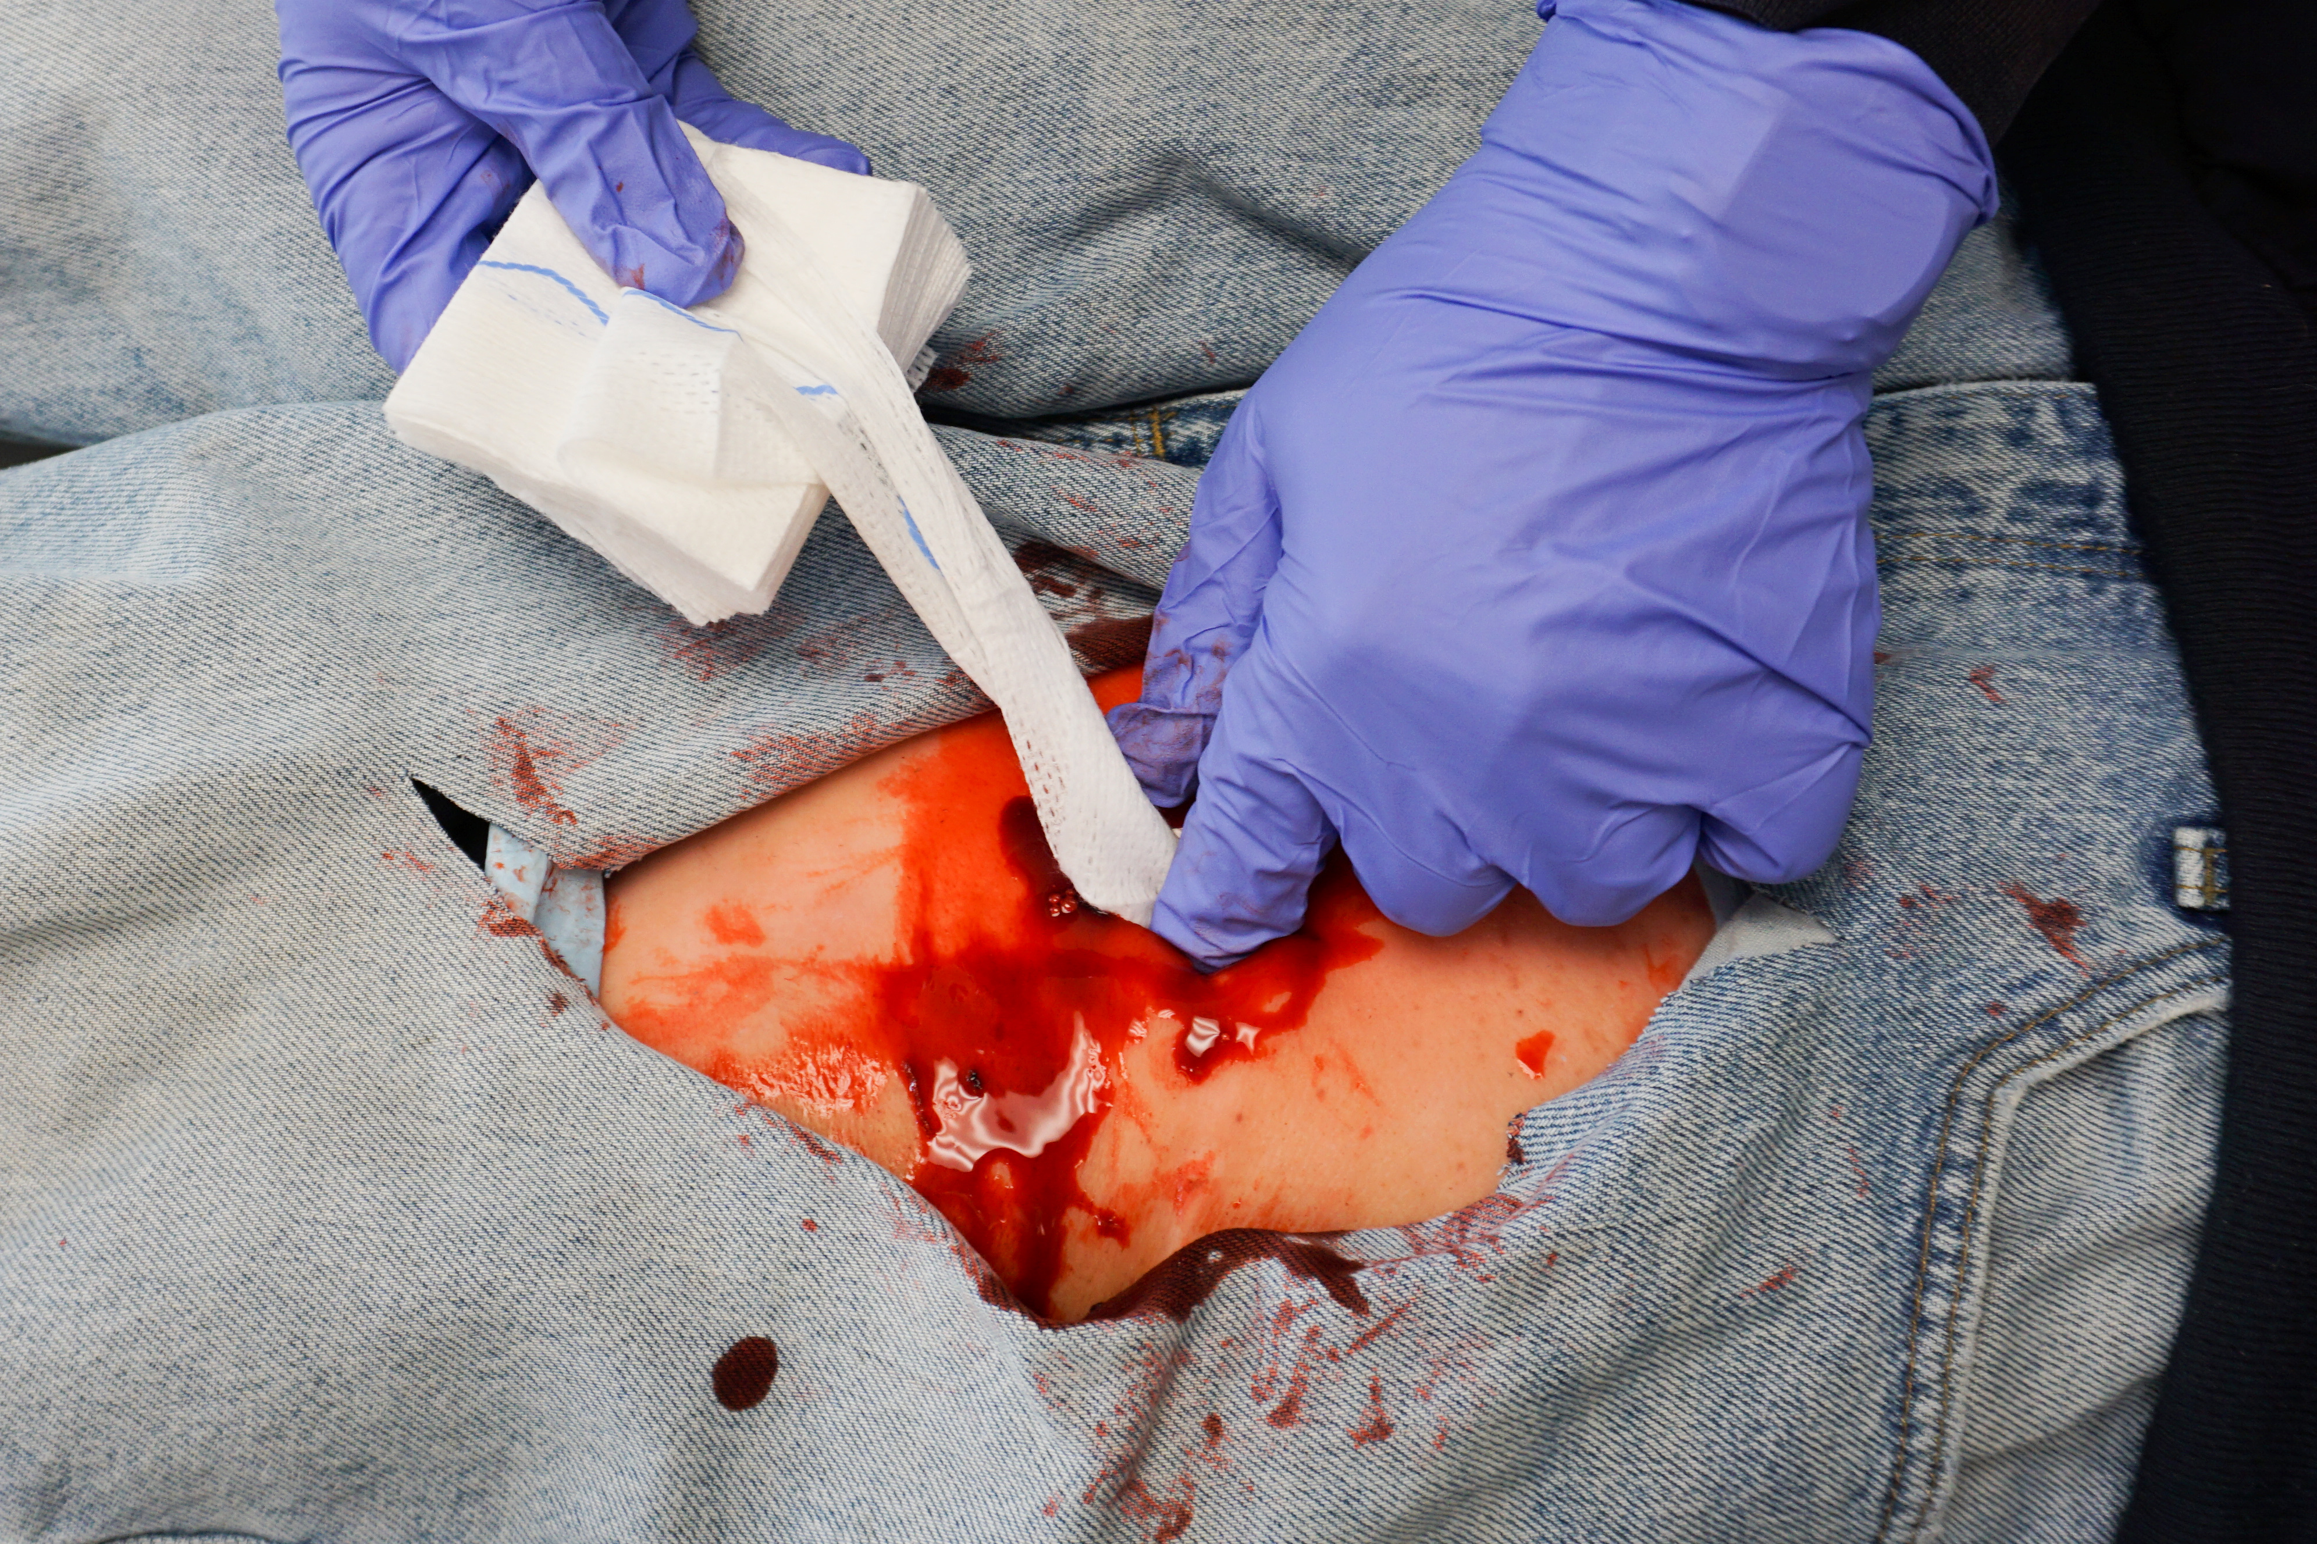
Wound Packing Procedure
Pack Wound Completely
  Use one gloved hand to feed gauze and the other to maintain pressure and hold gauze in place
  Use gloved fingers to maintain pressure and hold gauze. Proper technique will allow for continuous pressure.
  Be cautious of sharp fracture edges and foreign bodies when packing wounds!
Photo: J. Beaulieu

Slide 25
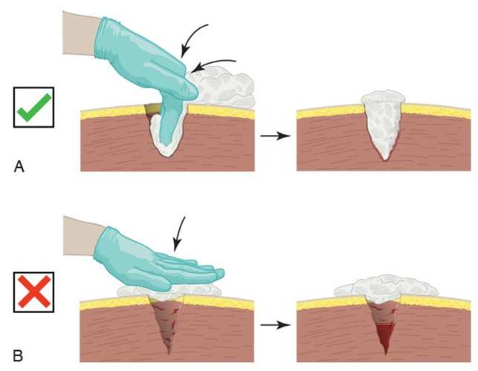
Wound Packing Procedure
Pack Wound Completely
2017 American College of Surgeons - Bleeding Control Basic V 1.0
Notes:
2017 American College of Surgeons - Bleeding Control Basic V 1.0

Slide 26
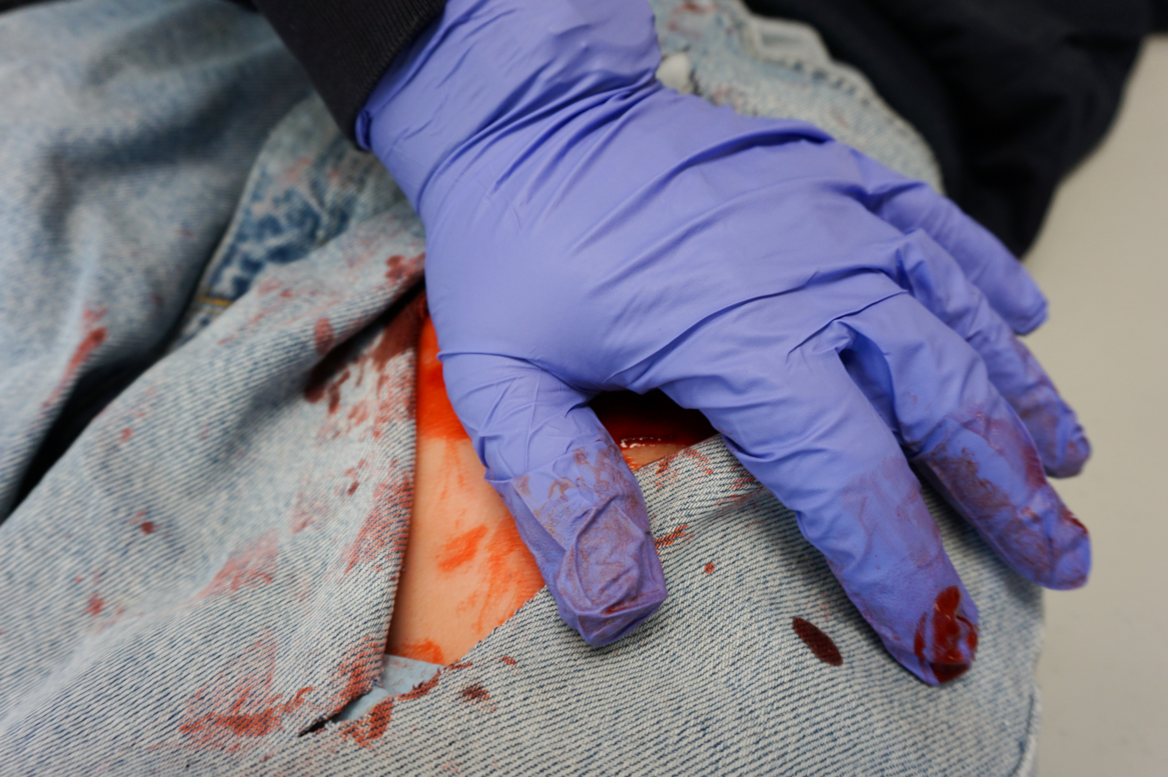
Wound Packing Procedure
Apply Direct Pressure
  Apply and hold continuous direct pressure.
  The time to hold pressure will be longer when not using hemostatic gauze.
  Reassess bleeding while holding continuous direct pressure.
Photo: J. Beaulieu
Notes:
If using regular gauze (meaning – NO HEMOSTATIC AGENT ON THE GAUZE), direct pressure will have to be maintained for longer (approximately 8- 10 min).
When using Hemostatic gauze, follow the manufacturers recommendation for holding direct pressure.
Do not remove would packing. ****if more than one gauze is inserted, the number of packs should be counted.
Instructors Note: Reinforce with your students that tourniquets should be used to control bleeding from the extremities whenever possible. The images in this series are meant to depict a wound that, due to its location in the groin area, is not amenable to tourniquet use.

Slide 27
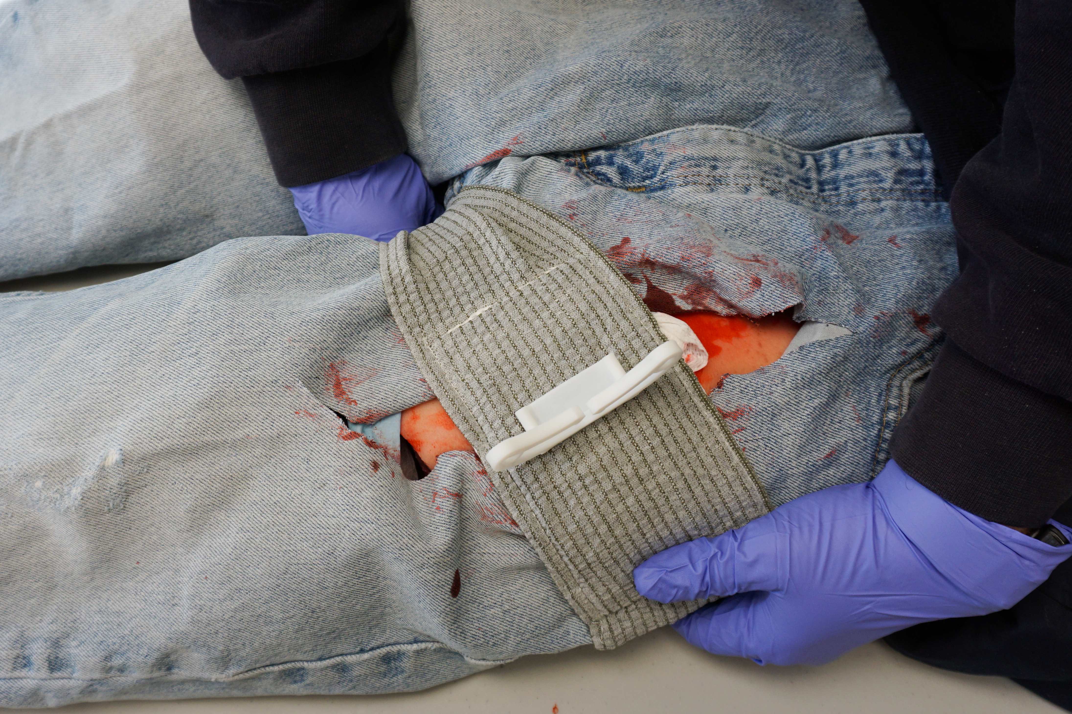
Wound Packing Procedure
Bandage over Gauze
  Apply a pressure dressing to provide ongoing pressure and secure the wound packing in place.
Photo: J. Beaulieu

Slide 28
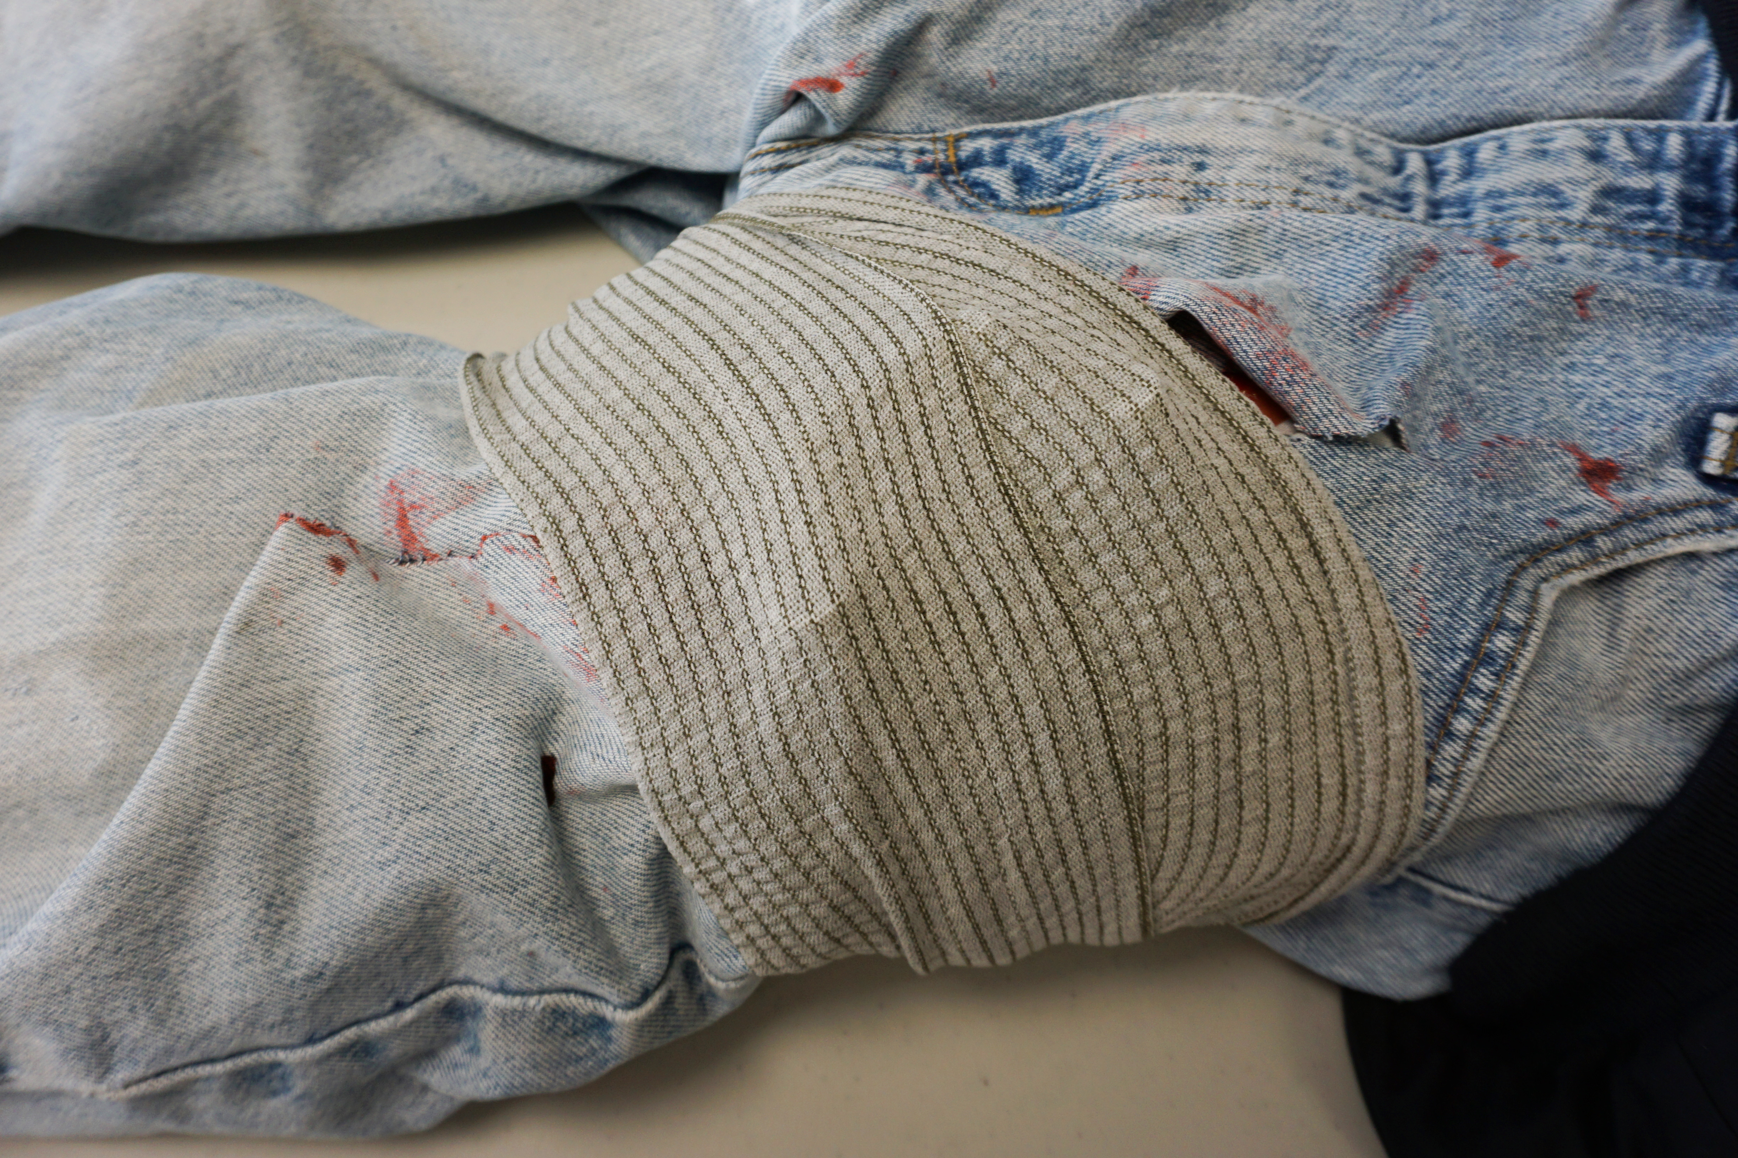
Wound Packing Procedure
Transport and Monitor
  Do not remove the bandage or gauze
  If practical – attach gauze wrapper to pressure dressing so that the next care provider is aware gauze is in place in wound.
Photo: J. Beaulieu
Notes:
Instructors Note: When practical, keep track of how many gauze rolls were used to pack a wound.
Transport Decision: Minimize delay in transport whenever possible. Consider additional or ongoing patient management while enroute to the hospital whenever practical.

Slide 29
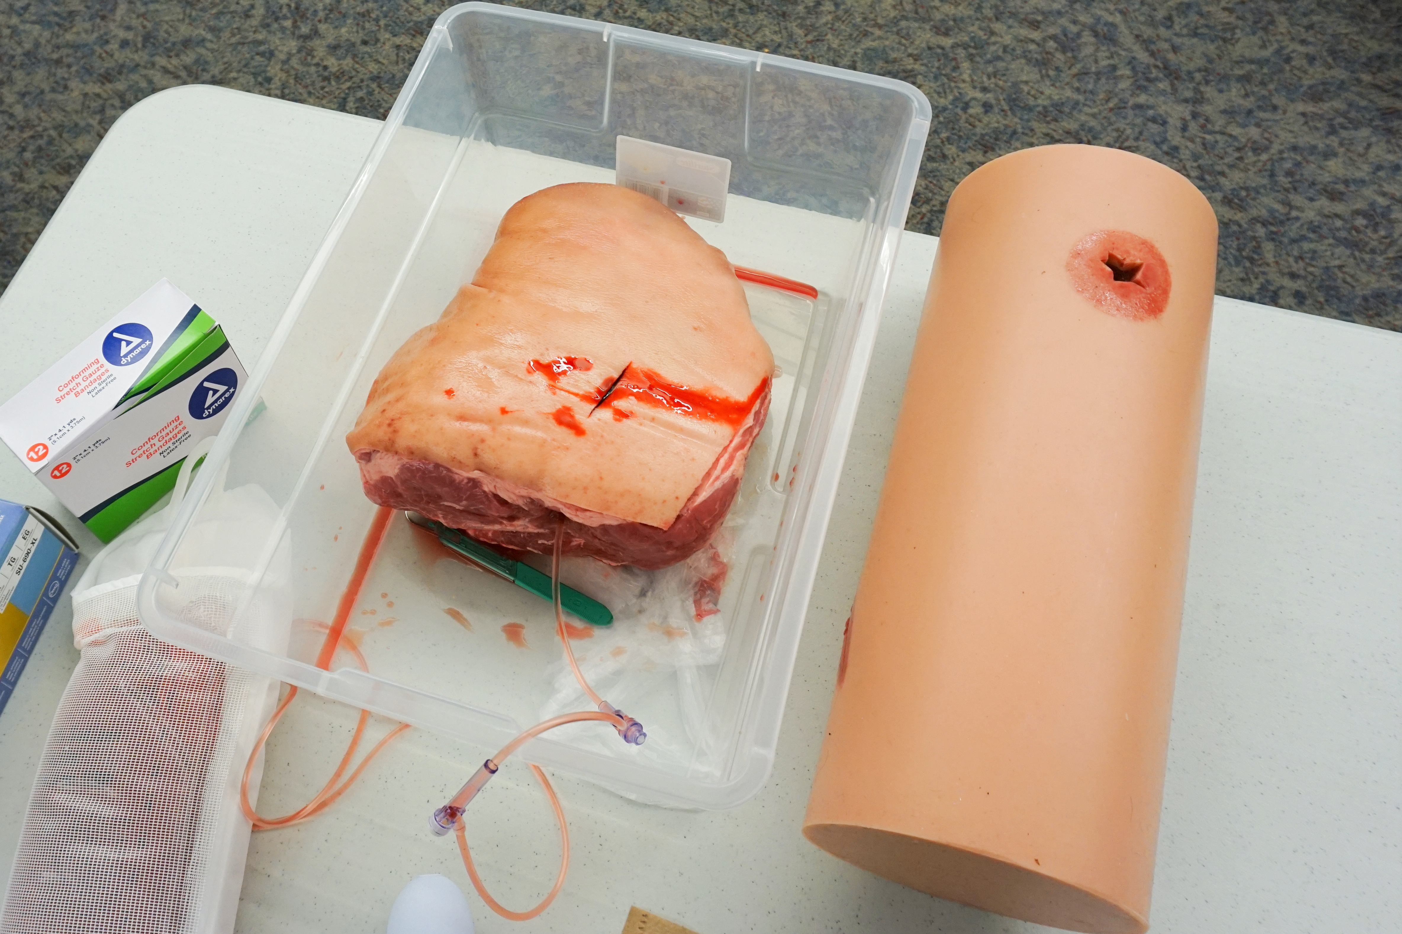
Time to practice - Hands-on Session
    Put it all together (wound pack and pressure dressing)
Photo: J. Beaulieu
Notes:
Each student should practice packing a wound under direct instructor supervision. Emphasize the proper technique for filling the wound with gauze while also maintaining pressure.
Instructors may decide to use a large piece of meat (i.e. pork shoulder) to create the realism of an actual wound. Commercial trainers are available, if desired.

Slide 30
Pressure Dressings
.
Notes:
At this point in the program, Instructors should show the slides that correspond to the devices their agencies use. Instructors should ‘hide’ the slides for the unused devices.
Currently, the devices presented include:
Israeli Bandage
H Bandage (and Thin-H version)
Oleas Modular Bandage
Cinch Tight Bandage (and Thin Cinch Tight)
North American Rescue (NAR) Emergency Trauma Dressing
As other dressings become available, they can be added to this series.
Not included: Commercial version of a Blast Bandage
Topic # of Slides Time
Indications 1 1
Contraindications 1 1
Basic principles of pressure dressings 2 1
Improvised pressure dressings 3 5
Components of commercial dressings 1 1
Select the commercial dressings your agency provides
Emergency Bandage or Israeli Bandage 3 5
H-Bandage 2 5
Oleas Modular Bandage 2 5
Cinch Tight Bandage 3 4
North American Rescue (NAR) Emergency Trauma Dressing 2 3
Practice Session - - 15
Total time depends on how many commercial devices your agency uses. Give ample time for participants to practice.
Supplies needed - Sufficient supplies for a practice session
For improvised pressure dressings
6” Kerlix gauze rolls
BP Cuff ( w/ 2 hemostats)
3” firmly rolled gauze rolls
5x9” ABD pads
4” or 6” Ace bandages w/ clips
18X24” trauma dressings
2” tape or Duct tape
SWAT-T tourniquet
To show your commercial pressure dressings
Emergency Bandage (Israeli)
H-Bandage
Oleas Modular Bandage
Cinch Tight Bandage
NAR Emergency Trauma Dressing

Slide 31
Pressure Dressings - Indications
Limb and torso wounds with significant bleeding
Head wounds with significant bleeding
As an adjunct to wound packing
Notes:
Indications for using pressure dressings
Instructors need to emphasize the value of using a pressure dressing.
Aids in controlling hemorrhage. Pressure dressings might work in junctional areas where a tourniquet cannot be applied (i.e., Figure 8 bandage around neck and axilla for a neck wound)
Head wounds with significant bleeding (caution against applying heavy direct pressure to shattered skull injuries)
A pressure dressing can be applied loosely to maintain abdominal contents following an evisceration injury in conjunction with a moist gauze or non-stick dressing to keep the injury moist during transport.

Slide 32
Pressure Dressings – Basic Principles
Apply pressure dressings securely enough to do the job the first time. A loosely applied pressure dressing may waste time and blood.
Most commercial pressure dressings have a method to concentrate pressure in a specific area. This should be placed directly over the wound.
Notes:
Basic principles for applying pressure dressings
Emphasize the victim cannot continue to lose blood. Also, the rescuer should not need to spend time re-tying a pressure dressing.

Slide 33
Pressure Dressings – Basic Principles
Do not loosen a pressure dressing to check bleeding.
If bleeding continues after applying a pressure dressing:
    If on an extremity, apply a tourniquet
    Apply additional pressure
    Apply an additional pressure dressing
Notes:
Do not purposely loosen a pressure dressing to see if the wound is bleeding. Realize the initial dressing might not have fully stopped the hemorrhage or that it may have loosened slightly as the victim is moved or evacuated.
Re-check a pressure dressing on a regular basis and reinforce the dressing with a second pressure dressing or an elastic wrap if needed. If the wound continues to bleed profusely after applying a pressure dressing, leave it in place and apply a tourniquet proximally when possible.

Slide 34
Pressure Dressings – Application Tips
Wrap the bandage to cover the entire dressing.
The bandage should not bunch or become rope-like when wrapped.
Additional directed pressure to the wound can be created by adding a half or full spin to the bandage over the wound or pressure device.
Notes:
When wrapping, try to cover the entire dressing. This helps to secure the entire dressing and avoids debris from entering the wound.

Slide 35
Improvised Pressure Dressings
Consider how any of the following readily-available items could be combined to create an improvised pressure dressing:
  Small/Med trauma pad
  Large trauma dressing
  Bulky roller bandage (example: Kerlix)
  Elastic bandage such as an Ace™ bandage – 4” or 6” wide
  1” or 2” tape
  BP Cuff (plus 2 hemostats if available)
  SWAT-T™ / elastic tourniquet
OTHERS??
Notes:
As important as knowing how to use a commercial pressure dressing is being able to improvise a bandage in event of an MCI or if you don’t have a commercial dressing readily available.
The instructor should discuss how an improvised pressure dressing could be made using different combinations of readily available items such as those listed here.
As a less than ideal alternative, rescuers can use a BP cuff to make a pressure dressing. Don’t inflate the cuff so much that the blood flow is occluded (like a Tourniquet). Also, since many cuffs have slow leaks, rescuers need to monitor the pressure in the cuff. Ideally, use a hemostat on each of the cuff’s tubes to limit leaks or to avoid someone mistakenly releasing the pressure. Further, add a piece of tape around the cuff to ensure the Velcro doesn’t release when moving the victim.

Slide 36
Pressure Dressing Example – Distal Extremity Amputation
Application:
  Cover wound with a large trauma pad or similar dressing material.
  Place a roll of Kerlix or roller gauze over the wound.
  Bind the roller gauze to the limb with an elastic bandage.
  Continue to unroll, stretch and wrap the entire elastic bandage.
  Secure the bandage with clips or tape.
Notes:
Instructors Note: It is acceptable to go directly to tourniquet use for any extremity injury with severe bleeding.

Slide 37
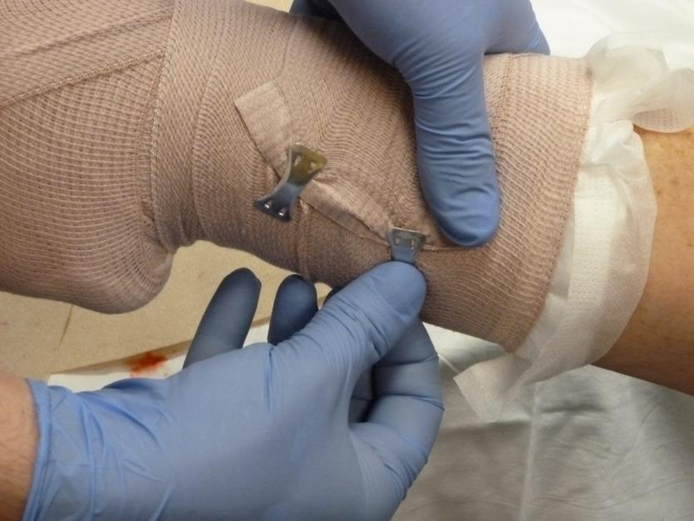
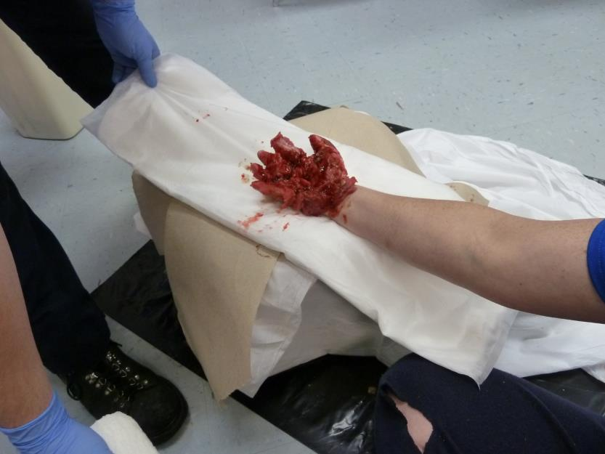
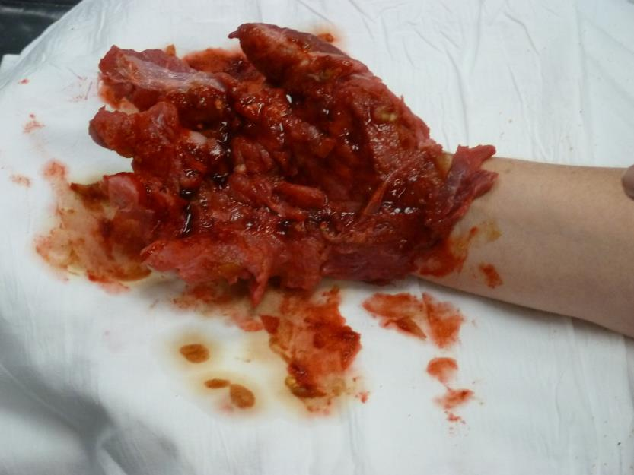
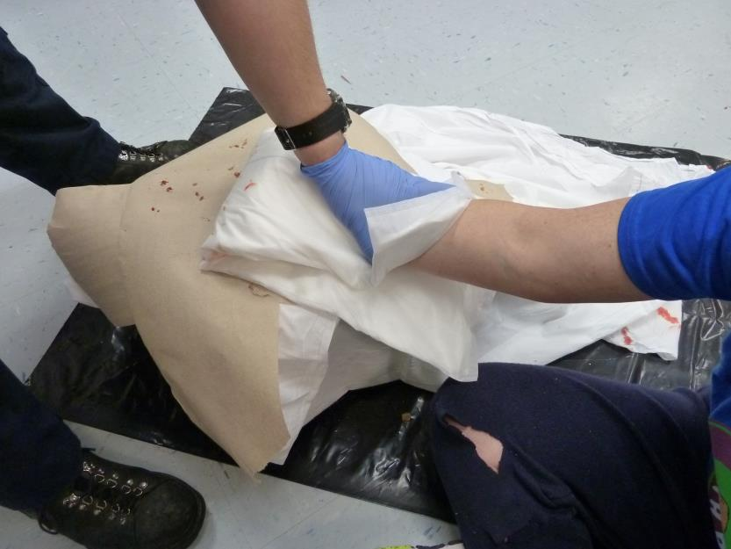
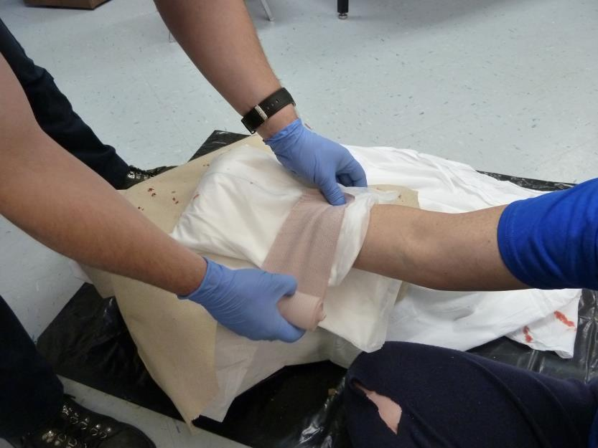
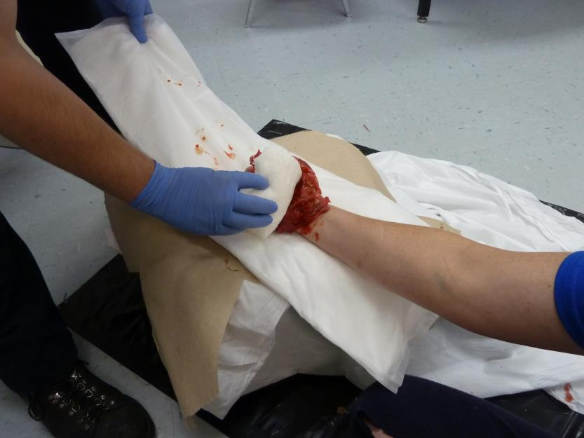
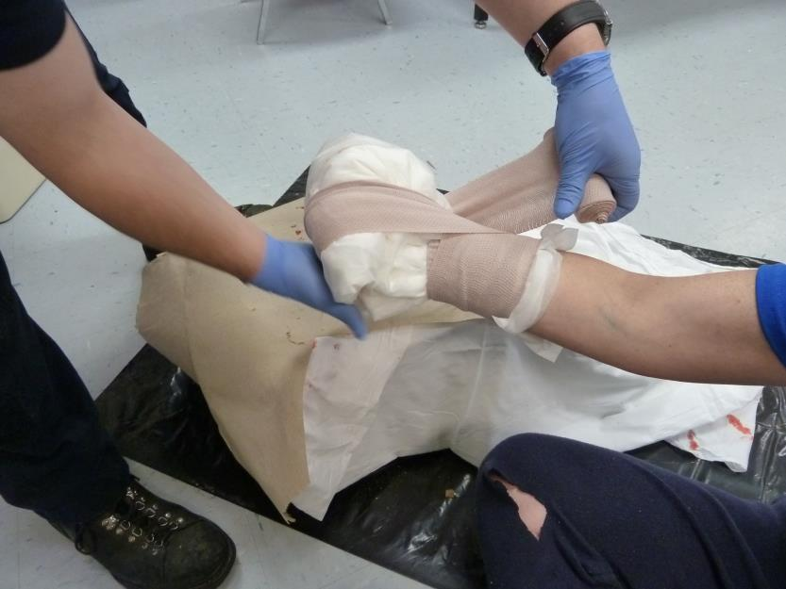
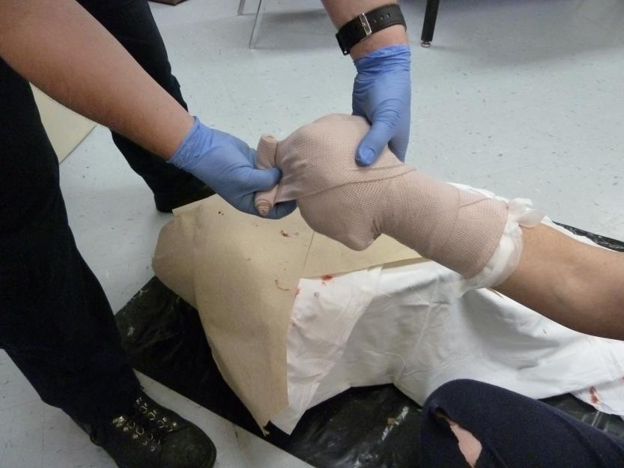
Improvised Pressure Dressing
A pressure dressing can be improvised with a trauma dressing and a strong elastic bandage.
Carefully place a trauma dressing under the injury.
If appropriate, place a sterile gauze roll in the hand to maintain a position of function.
Quickly wrap the trauma dressing around the injury.
Continue to tightly wrap the injured area. Be sure you maintain pressure: Unroll … Stretch … Wrap
Unroll … Stretch … Wrap
Anchor the elastic bandage.
Secure the bandage.
Although clips are shown here, using tape is preferred in most cases.
Photo: D.Burich
Notes:
This series of photos shows application of a pressure dressing to a mangled hand.
(Don’t get hung-up on the image…it’s moulage, not a real injury. It could have been the result of a severe crushing trauma or a machine that de-gloved or mangled the hand. It doesn’t matter…a pressure dressing is needed!)
2x2” gauze pads could have been added between the fingers, but consider the time that would take, then decide if the action is appropriate on a case-by-case basis.
The captions with each photo explain the steps to be followed.

Slide 38
Commercial Pressure Dressings
Most commercial pressure dressings have common features:
  Bulky, sterile dressing that absorbs a large quantity of blood
  Wide elastic bandage
  Device to concentrate pressure to a small area
  Securing mechanism
Notes:
There are slight variations to each of the commercial products.
Note that North American Rescue’s Emergency Trauma Dressing does not have a cleat or other device to concentrate pressure to the wound.
This slide set shows several of the current pressure bandages. Before your class, select the dressing(s) your agency uses. Do not DELETE the other slides, but highlight the slides pertaining to the dressings you don’t use and “hide” those slides.
Since you will be showing the dressing your agency uses, don’t waste a lot of time on this slide.

Slide 39
Commercial Pressure Dressing - Application
  In all cases, read the manufacturers instructions and be familiar with the dressings available to you. In general:
  Place the sterile dressing directly over the wound.
  Unroll a few inches of the bandage, pull it tight, then wrap around the limb.
  Integrate the bandage with the pressure mechanism and secure as per the manufacturers instructions.
Notes:
Israeli Bandage
Application
Place the label above the wound…as the cleat is pulled down, it applies pressure to the top of the label…and wound
Unwrap the bandage, pull it tight, then wrap around the limb
Place bandage through both slots of the cleat. Be sure the bandage material is spread across the entire inside of the cleat, not bunched up
Stretch tight, and pull the bandage backward across the dressing. You will use the cleat to reverse the direction just this one time
Continue to unwrap…stretch…wrap (around the limb)

Slide 40
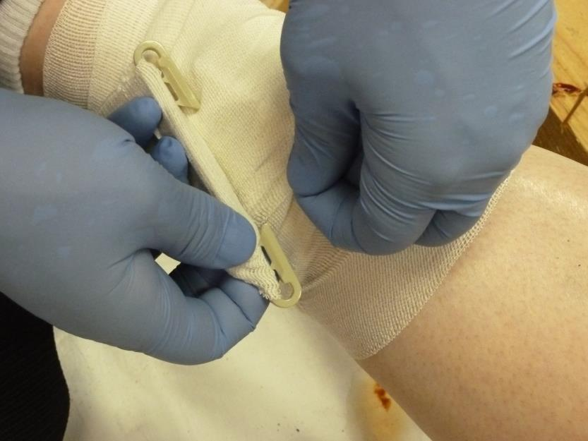
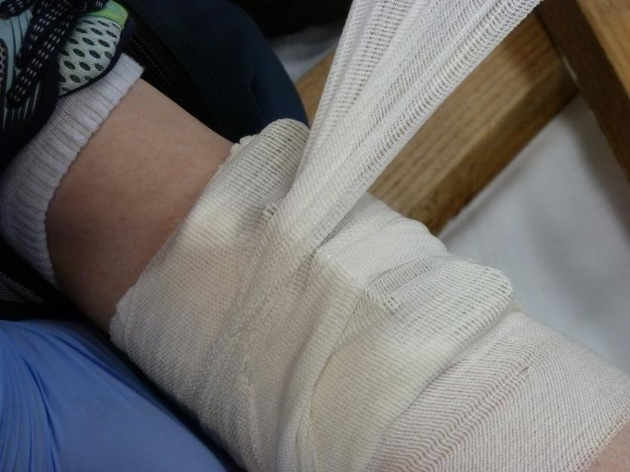
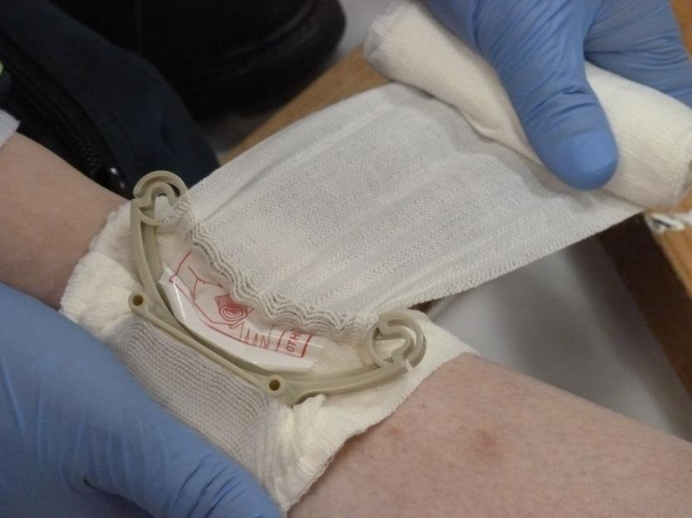
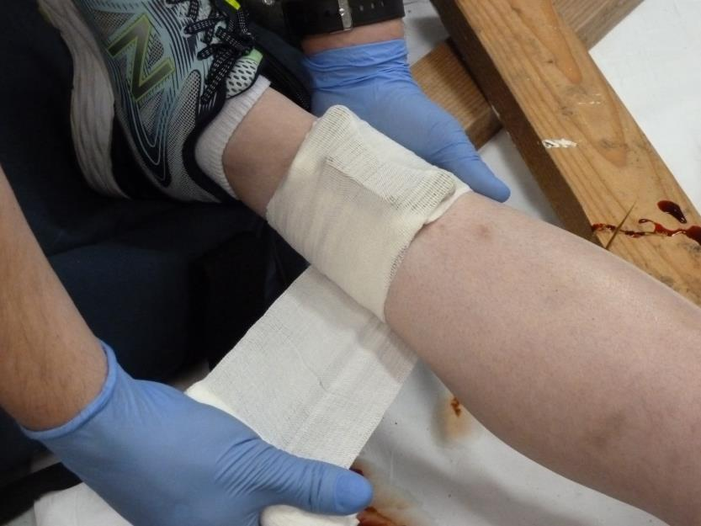
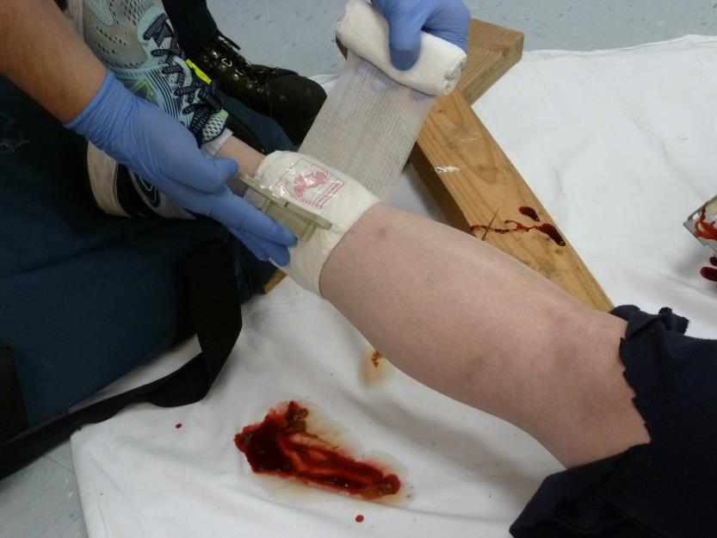
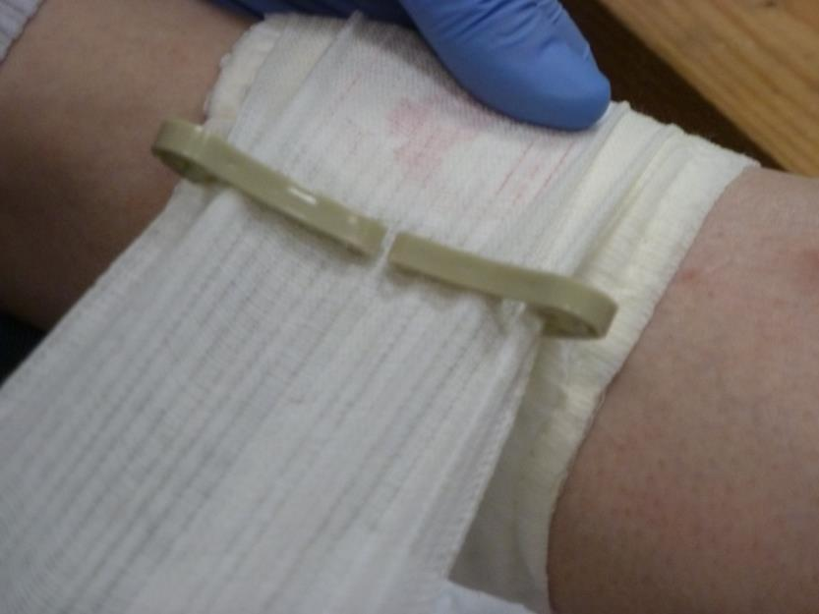
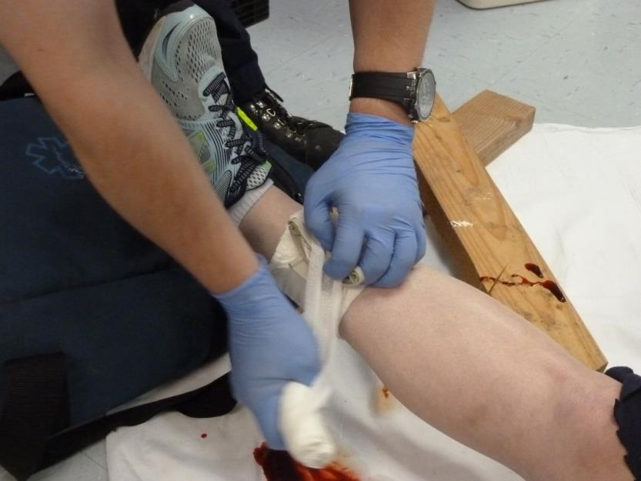
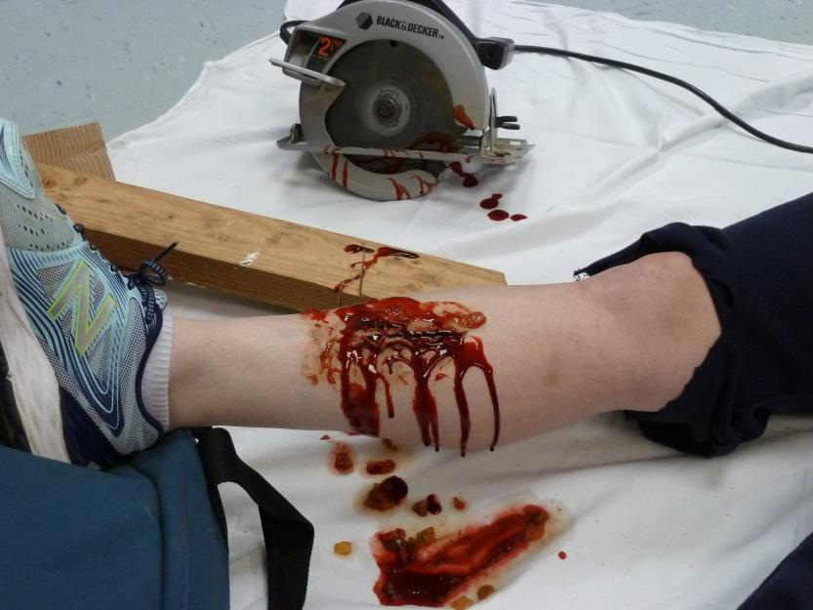
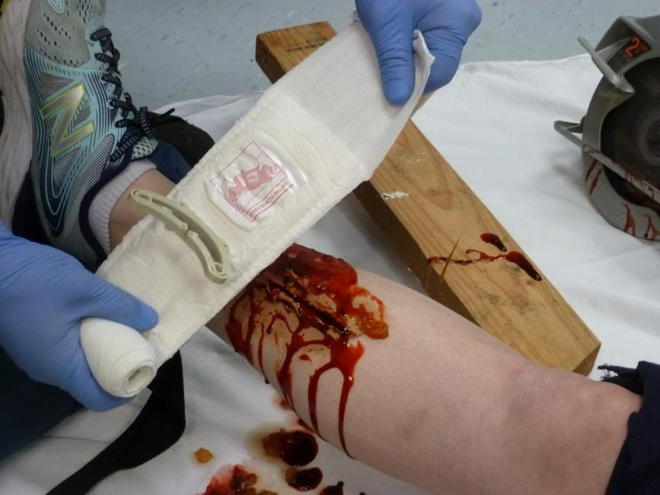
Pressure Dressing Example - Israeli Bandage
A tourniquet is not needed for this wound. Depending on the depth, the wound may, or may not need packing.
Anchor the bandage with the barrette.
As you wrap the bandage, you can add additional pressure to the wound by spinning the bandage directly over the cleat.
Continue to add pressure with the bandage. Unroll … Stretch … Wrap
Slide the bandage into the center of the cleat.
Apply this dressing with the label over the wound.
Wrap the dressing around the limb. There is no Velcro to help anchor the bandage …don’t pull hard or it may slip.
Spread the bandage inside the cleat.
Reverse the direction of the bandage. Start to Unroll … Stretch … Wrap.
Photo: D. Burich
Notes:
Israeli Bandage
The captions with each photo discuss the steps to take.

Slide 41
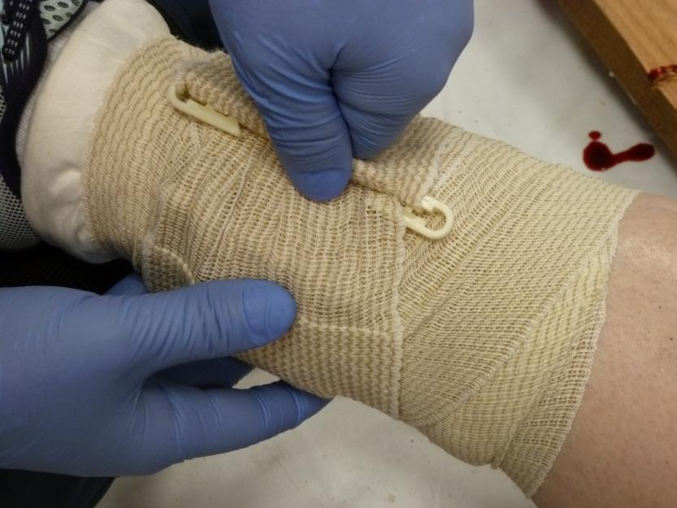
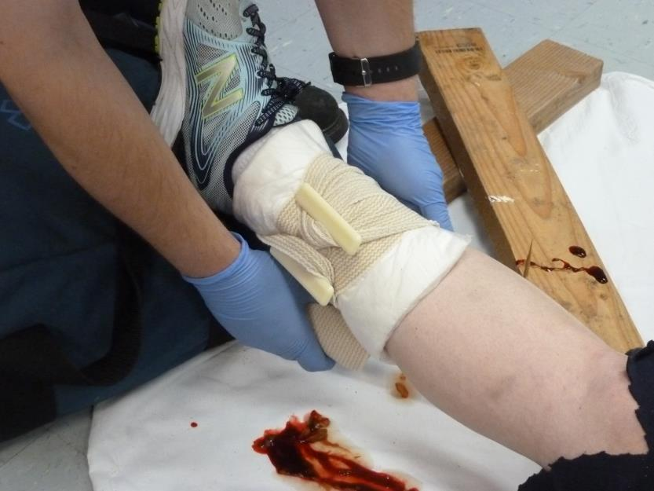
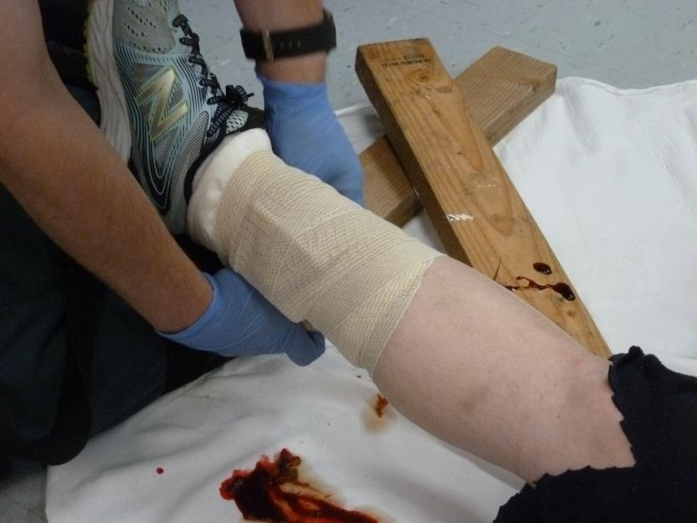
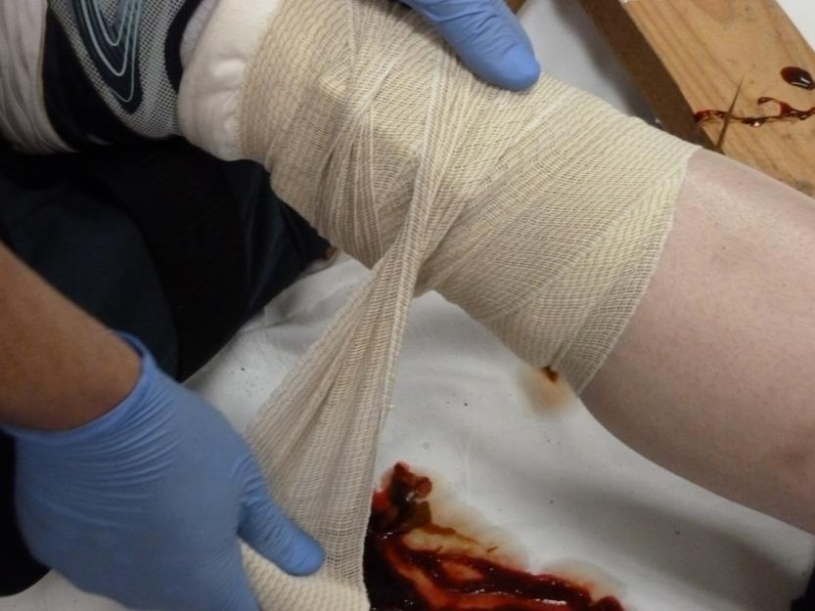
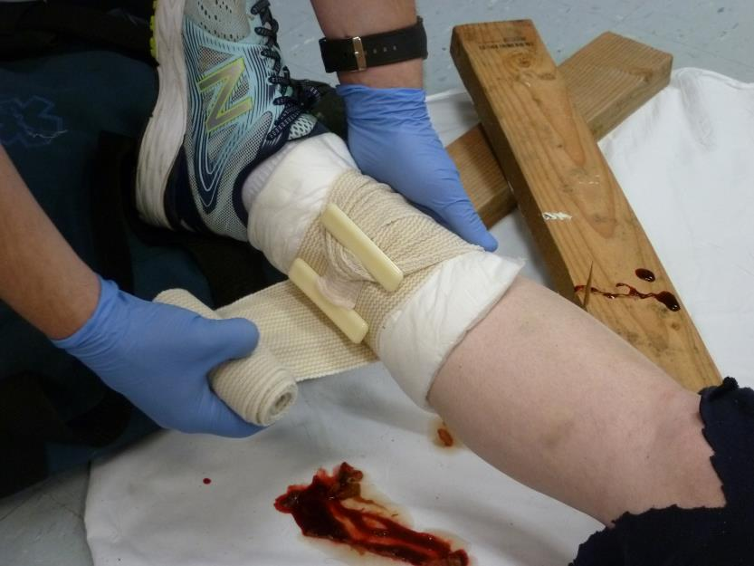
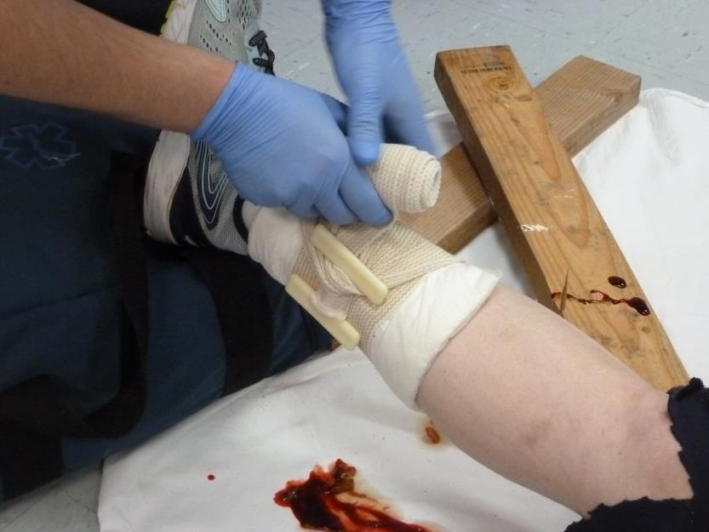
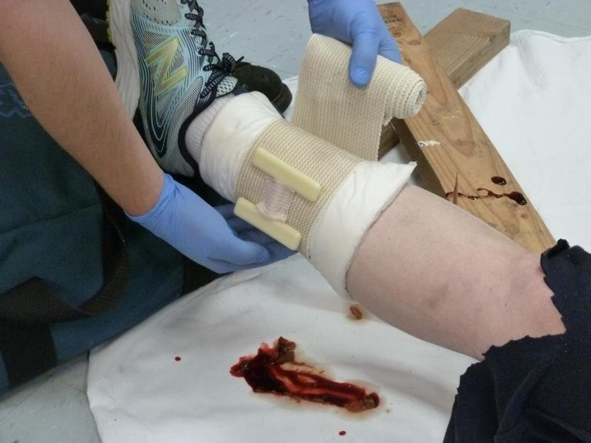
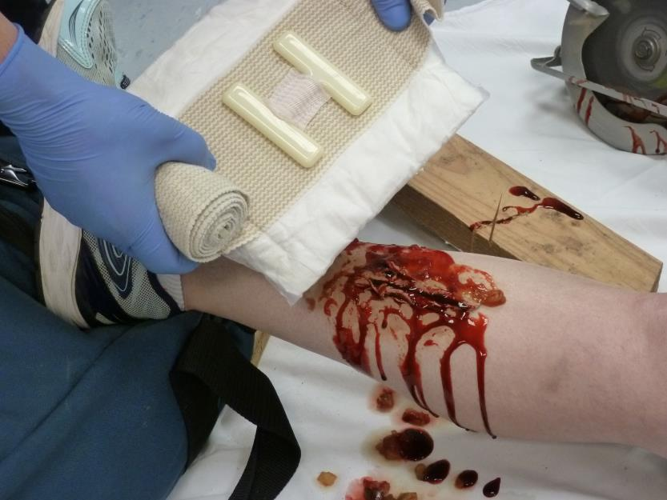
Pressure Dressing Example - H-Bandage
Apply the H-Bandage with the “H” directly over the wound.
Secure the bandage with the barrette.
Wrap the bandage around the limb. A strip of Velcro will help hold the bandage
Wrap the bandage around the 1st cleat, then pull bandage snug. Support the cleat as you pull.
Wrap it around the other cleat. Support the “H” as you pull tight.
Continue to apply pressure. Unroll … Stretch … Wrap
Wrap the bandage snug around the back of the limb.
You can add more pressure to the wound by spinning the bandage on top of the “H”.
Photo: D. Burich
Notes:
H-Bandage:
Don’t argue about the injury…just fix it!
The captions with each photo discuss the steps to take.

Slide 42




Pressure Dressing Example - Oleas Modular Bandage
Place dressing on the injury with the cup directly over the wound.
Begin wrapping the bandage around the limb. Unroll … Stretch … Wrap
Continue to wrap tightly. This dressing does not need a change in direction.
Secure with the Velcro and barrette.
Photo: D. Burich
Notes:
Oleas Modular Bandage:
Don’t argue about the injury…just fix it!
The captions with each photo discuss the steps to take.

Slide 43
Pressure Dressing – Practical Application
Please practice on your partner…
  Apply an improvised bandage to the arm or leg.
  Practice with the pressure dressing you will most likely use with your agency.

Slide 44
TOURNIQUET USE
.

Slide 45
Tourniquet Use
Tourniquets should be applied rapidly if extremity bleeding cannot be controlled with direct pressure, or if effective direct pressure is not possible.
Notes:
Instructor Notes:
- Direct Pressure should be used in conjunction with tourniquet application
When applied appropriately for less than a few hours, no damage to nerves and vessels should occur if the proper tourniquet is used (1.5” wide strap or greater); Tourniquet control of exsanguinating hemorrhaging is 80% or better; No limb loss has occurred as a result from placing a tourniquet by the U.S. military; tourniquets have been widely used by surgeons for many years to control arterial inflow in the OR with satisfactory results.
A military study showed a 96% survival rate when tourniquet application occurred prior to the patient going into decompensated shock compared to a 4% survival rate when tourniquet application was after the patient was in decompensated shock (PHTLS 8th Edition, pg. 234).

Slide 46

Tourniquet Use – Junctional Tourniquets
Junctional tourniquets are in a different category and are not addressed in this program
Control bleeding by compressing vessels in areas other than extremities.
Newer to the market
$$$$
Notes:
Junctional tourniquets are used in places such as bleeds from the carotid artery, and brachial artery bleeds in the thoracic region or femoral artery bleeds in the pelvic regions where there is not enough of the extremity left to put on an extremity tourniquet.
The instructor should differentiate these from EMS tourniquets, which are used exclusively on extremities.

Slide 47
Tourniquet Application do’s / don’ts
Commercial tourniquets should be applied per manufacture guidelines
Ideally, tourniquets should be placed 2”-3” above the site of the injury.
An acceptable alternative is to place the tourniquet as high as possible on the extremity (“Go High or Die”)
Notes:
Reference: TECC course, 2017.
Per PHTLS 8th Edition, pg. 235 – Place the tourniquet “just proximal to the hemorrhaging wound”.

Slide 48
Tourniquet Application do’s/don’ts
If bleeding won’t stop with one tourniquet, apply a second tourniquet above the first one.
If an additional tourniquet is required and there is no room above the tourniquet, put the second tourniquet below and as close to the first one as possible.

Slide 49
Tourniquet Application do’s/don’ts
Do not place a tourniquet over a joint. If the joint is the 2”-3” above the bleed, place the tourniquet above the joint.
Placing the tourniquet in direct contact with the skin is preferred.
Tourniquets can be placed over clothes but avoid placement over pockets containing any items.

Slide 50
Types of Tourniquets
There are several variations of tourniquets on the market.
Mechanical tourniquets have 3 basic components:
    A wide strap
    A mechanical tightening mechanism
    A method for securing the tightening mechanism
    Elastic tourniquets may be an acceptable alternative
Notes:
Instructor Notes:
Good data on tourniquet use on children is lacking. Not all mechanical tourniquets will fit small children.
If a child’s arm or leg is too small for a commercial tourniquet to be effective, it is likely that bleeding can be adequately controlled with sufficient direct pressure. If necessary, consider an improvised tourniquet or elastic-type tourniquet for small children.
The SWAT-T is an example of an elastic tourniquet.

Slide 51
Tourniquet Selection
Tourniquets should be chosen by the EMS service in cooperation and consultation with medical control
Notes:
Instructor Notes:

Slide 52


Tourniquet Examples
Combat Action Tourniquet
(C-A-T)
Special Operations Forces Tactical Tourniquet -
(SOF®TT)
Notes:
CAT -Instructor Notes:
Three colors – Blue is for TRAINING USE ONLY and should not be applied to actual patients; Orange is predominantly for EMS (we want people to see the tourniquet is applied); Black is “tactical” and primarily for use by tactical teams.
Current version is GEN-7 – several differences than previous generations; Routing through the buckle is through 1 slit vice 2 (previous generations required use of both slits on the buckle for lower extremity application, the windlass is thicker and easier to grasp and control, the base plate is thicker and rounder, the windlass clip now has buttressed sides to better secure the windlass.
EMT -Instructor Notes:
Similar to blood pressure cuff operation
3.5” wide band
Max circumference is 34”
Min circumference is 3”
About $450 per unit
SOFTT -Instructor’s Notes:
SOFTT has 1” wide band with an alligator-type clip with a locking nut that must be screwed down after tightening the windlass. Additionally, there are 2 locking mechanisms for the windlass.
SOFTT Wide: Currently on the 4th generation - 1.5” wide band. High strength hook and buckle interface was designed for strength, security and ease of application. Windlass is made from high strength aluminum bar stock. There is only 1 locking mechanism for the windlass.

Slide 53


Tourniquet Examples
Improvised Tourniquets
SAM XT
Photo: J. Hundley
Notes:
Instructor Notes: SAM XT by SAM Medical.
Improvised tourniquets have a high fail rate and should not be used when a commercial tourniquet is available.

Slide 54
Improvised Tourniquets – CAUTION!
Improvised tourniquets can be considered when a commercial tourniquet is not immediately available.
Improvised tourniquets are more likely to fail than commercial tourniquets
They should only be used when a commercial tourniquet is not available.

Slide 55
Improvised Tourniquets - Items Needed
An appropriate length of material, at least 1” wide.
2”-3” width is preferred.
A rigid item to serve as a windlass (should resist bending or breaking such as a metal bar, trauma shears, large stick) strong enough to tighten the tourniquet.
Additional material to secure the windlass once the tourniquet is tightened.
Notes:
**not first choice

Slide 56



Improvised Tourniquets
Wrap the constricting material around the limb and secure with an appropriate knot.
Constrict the limb by twisting the material with a rigid item such as a ring cutter, shears or a carabiner.
Prevent the improvised windlass from loosening by securing it with additional material.
Photos: J. Beaulieu

Slide 57


Improvised Tourniquets
Ring cutter as a windlass
Carabiner as a windlass
Shears as a windlass
Photos: J. Beaulieu
Notes:
While trauma shears are shown in this example, consider using something else (ring cutter, O2 key, etc..) if you only have one pair of shears – you may need these for cutting!

Slide 58

Protocols v2017.2
Notes:
Instructor Notes:
Please ensure that you are referring to the most recent protocol.

Slide 59

Protocols v2017.2
Notes:
Instructor Notes:
Please ensure that you are referring to the most recent protocol.

Slide 60
Demonstration of Tourniquet Application
CAT
SOFTT
Notes:
Training Exclusions – Instructors, please relay the following to your students:
Do not tighten a tourniquet on your leg during the training program if one or more conditions exist:
Clotting or circulation abnormalities
Blood pressure conditions
Pain syndromes
Peripheral neuropathies
Over 50 years old
Do not repeatedly tighten TQs on any extremity
Instructor Notes:
Instructor should demonstrate the application of the tourniquet that is being used by the participants agencies. If the class is a generic class, the instructor should demonstrate the application of the CAT, SOFTT-W and SWAT-T (all hyperlinked in the video to manufacture YouTube videos).
There should be a few training tourniquets of each type available for students to actually apply the tourniquets to themselves and each other. The instructor should spend about 15 minutes allowing students to practice tourniquet application.

Slide 61
Acknowledgements
This presentation is a product of the CT EMS Advisory Board’s EMS Training and Education Committee. The committee would like to recognize the following people for their time and effort toward providing content and reviewing this presentation:
Richard Kamin, MD Medical Director, CT OEMS
Kyle McClaine, MD Co-chair, CT EMS Medical Advisory Committee
Shea Gregg, MD Chair, CT Trauma Committee
Joshua Beaulieu CEMSAB Ed & Training Committee
David Burich CEMSAB Ed & Training Committee
Joey Hundley CEMSAB Ed & Training Committee

Slide 62
References

